Slide 1
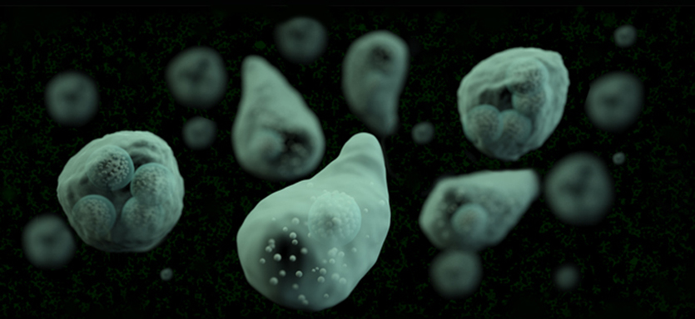
Micro Health Science Lab
Protists, Helminths, Fungi

Slide 2
Domains of Life:
    Domain Archaea
      Prokaryotes, includes extremophile bacteria
      Not dealing with in this lab
    Domain Bacteria
      Prokaryotes, includes species we have been dealing with in this lab
    Domain Eukarya
      All the eukaryotes
      Includes protists, fungi, plants, animals
      In micro health science, we are looking at some protists protozoans that cause disease, some animals that cause disease (helminths) and some fungi

Slide 3
Remember: Domain, Kingdom, Phylum, Genus, species, common name, and disease caused. In case of fungi, know sexual and asexual spores.
(Genus and species italicized, species is not capitalized)

Slide 4
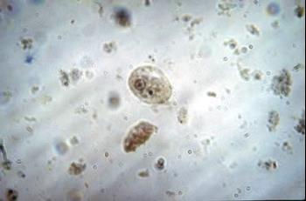
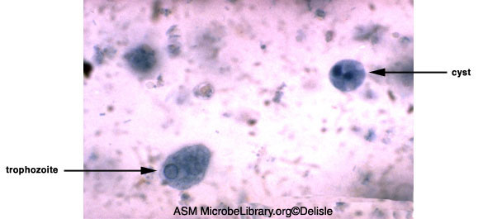
Protozoan
Phylum Sarcomastigophora
Entamoeba histolytica
  Causes amebic dysentery
  Identifying in fecal samples

Slide 5
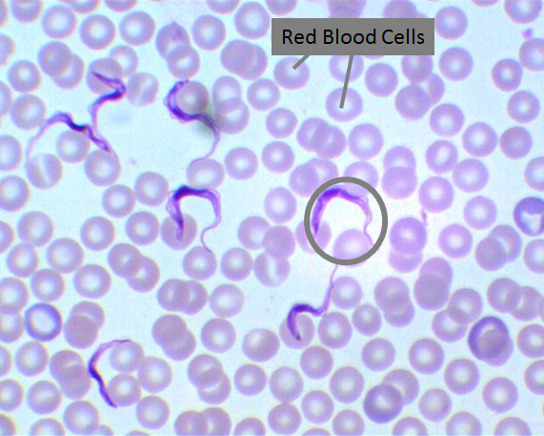
Protozoan
Phylum Sarcomastigophora
Trypanosoma
  Species in this genus cause African sleeping sickness (neurological issues), Chaga’s disease (intestinal and heart issues)
  Transmitted through insect vector
  We will be looking at it in a blood smear from infected individual

Slide 6
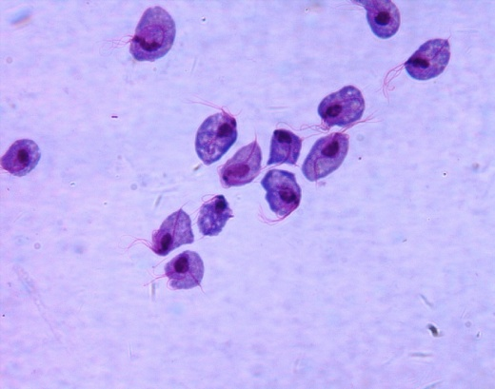
Protozoan
Phylum Sarcomastigophora
Trichimonas
    STD

Slide 7
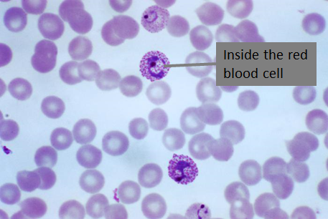
Protozoan
Phylum Apicomplexa
Plasmodium
    Causes malaria
    Transmitted by insect vector

Slide 8
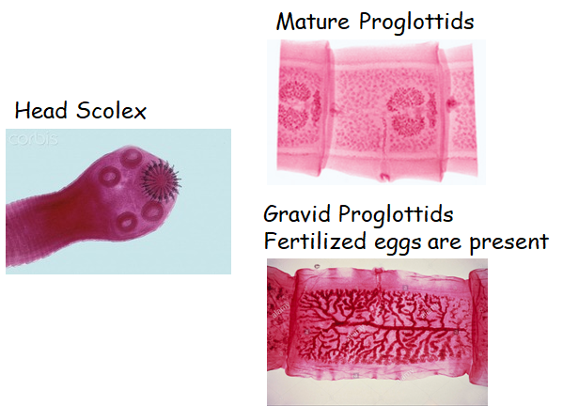
Kingdom Animalia
Phylum Platyhelminthes
Taenia pisiformes
    Tapeworm (this one most common in dogs) – intestinal worm
    Some will spend part of life cycle in other tissues in intermediate hosts

Slide 9
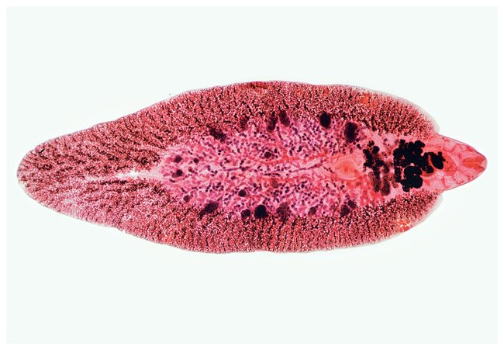
Kingdom Animalia
Phylum Platyhelminthes
Fasciola hepatica
  Common liver fluke, sheep liver fluke
  Migrates from intestine to liver

Slide 10
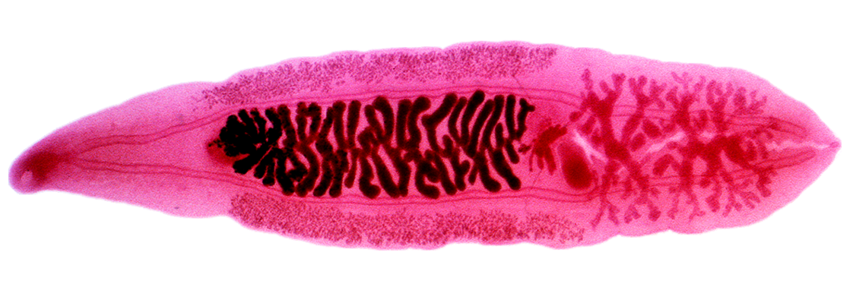
Kingdom Animalia
Phylum Platyhelminthes
Clinorchis sinensis
    Chinese liver fluke
    Can cause liver cancer
    Transmitted from freshwater snail

Slide 11
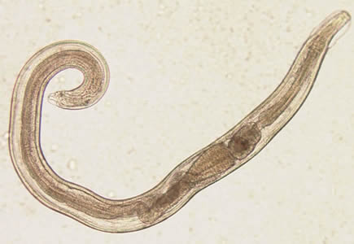
Kingdom Animalia
Phylum Nematoda (Round worms)
Enterobius vermicularis
    Pinworm
    Small, common in humans
    Infected by ingesting eggs

Slide 12
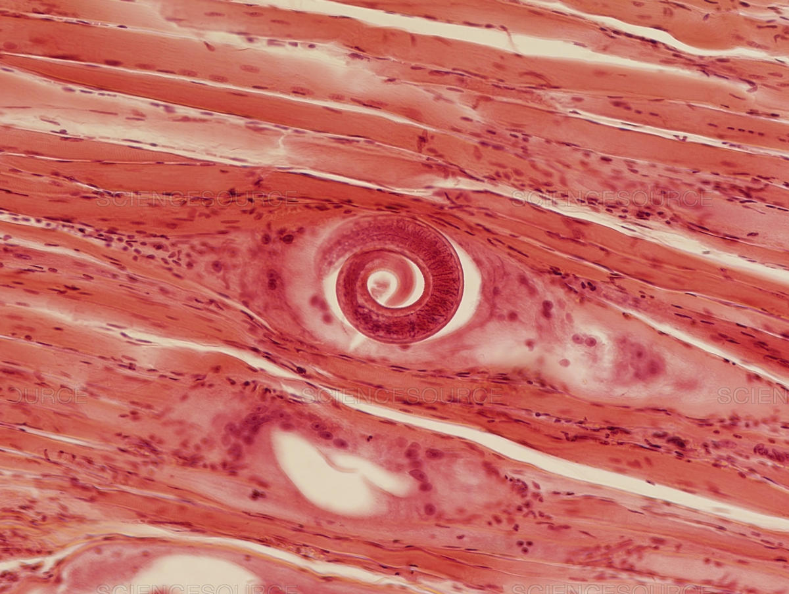
Kingdom Animalia
Phylum Nematoda
Trichinella spiralis
    Causes trichinosis (intestinal issues, fever, can be treated but can cause heart problems or other complications)
    Larvae migrate from intestines to muscle
    This is a cross section of infected muscle

Slide 13
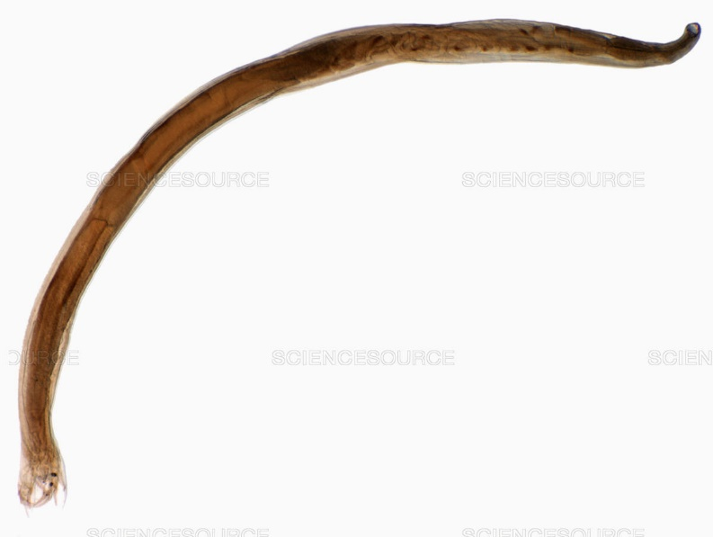
Kingdom Animalia
Phylum Nematoda
Necator americanus
  Parasite of humans
  Fertilized eggs eliminated in feces, person comes into contact with larvae and goes through skin, travels to lungs, coughed up and swallowed where it makes it’s way to the intestine
  Can cause blood loss

Slide 14
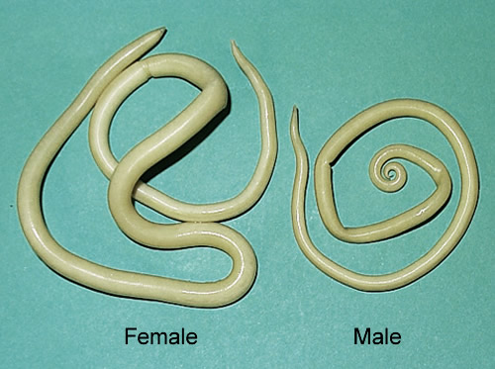
Kingdom Animalia
Phylum Nematoda
Ascaris lumbricoides
    Large number of people worldwide infected
    Can cause abdominal discomfort
    Sexual dimorphism
    You will look at this in a biomount (not under the microscope)

Slide 15
The Fungi
    For immunocompetent humans, most fungal infections are more of a nuisance
        Athlete’s foot, ringworm, yeast infections
    For immunocompromised individuals, it can be more serious
        Fungal pneumoniae
    Constant exposure to molds can cause respiratory problems
    Some individuals can have allergic reaction (but this is not a pathogenic process)

Slide 16
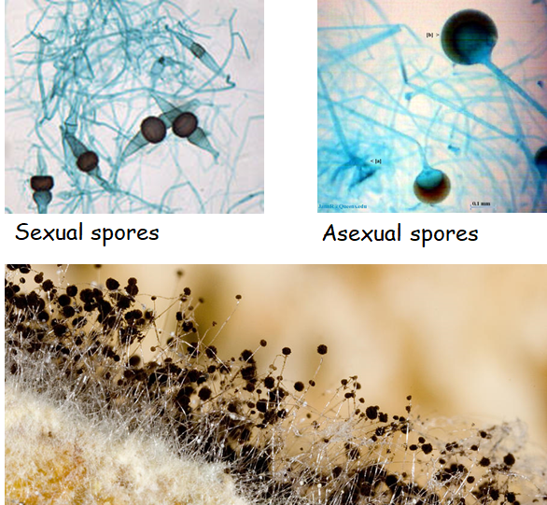
Kingdom Fungi
Phylum Zygomycota
Rhizopus

Slide 17
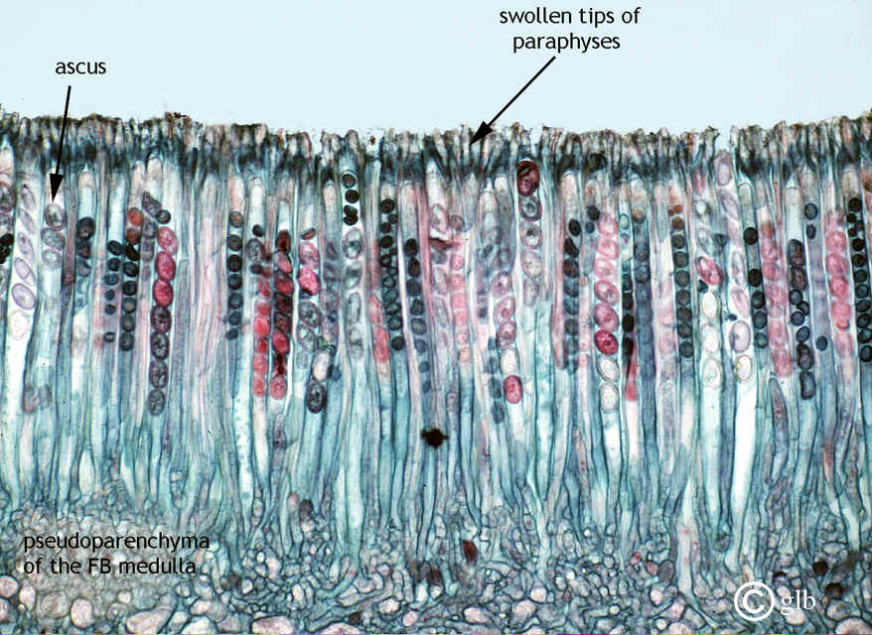
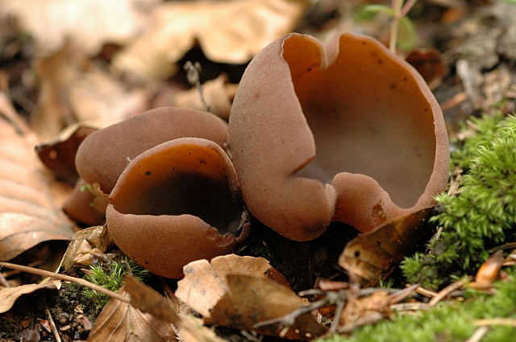
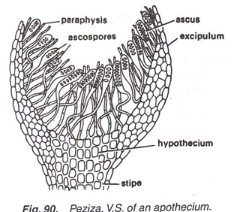
Kingdom Fungi
Phylum Ascomycota
Peziza

Slide 18
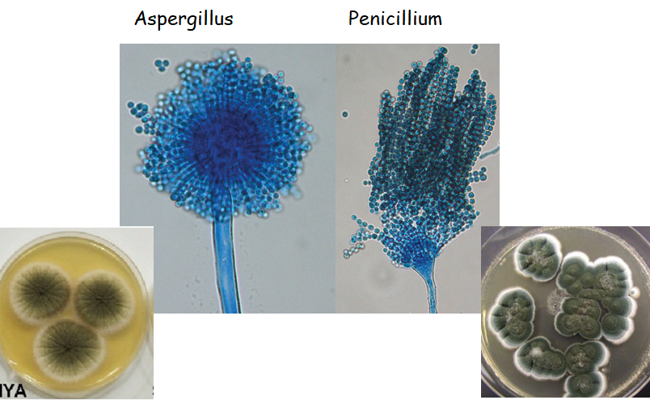
Kingdom Fungi
Phylum Ascomycota

Slide 19
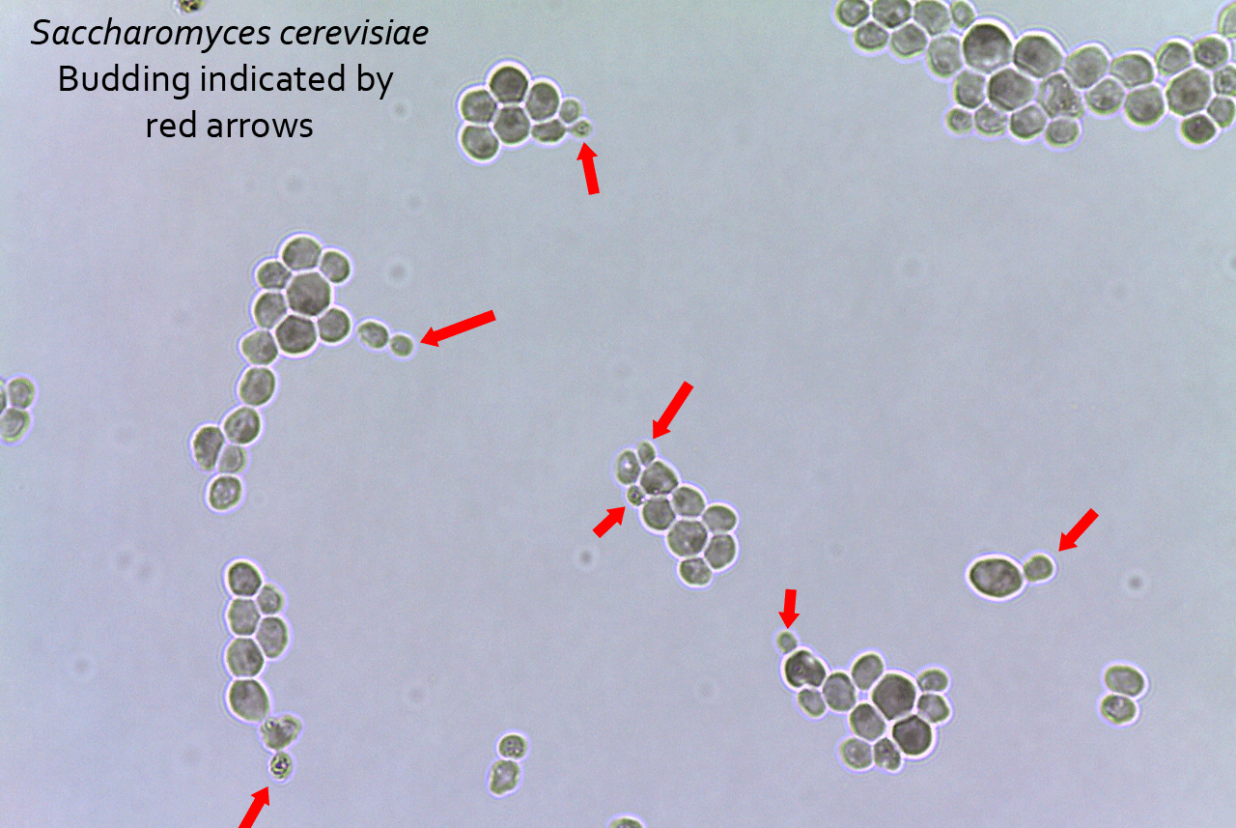
Kingdom Fungi
Phylum Ascomycota
Saccharomyces

Slide 20
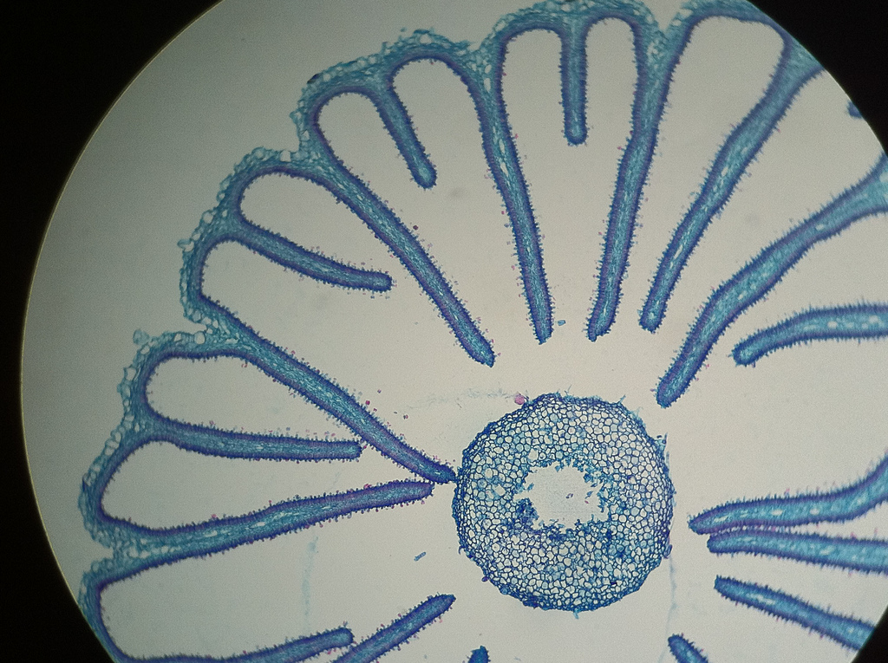
Kingdom Fungi
Phylum Basidiomycota
Coprinus

