Slide 1
Mitosis
Cell Biology and Physiology Lab

Slide 2
Mitosis is critical to the existence and perpetuation of life
Mitosis is a highly regulated process
Must be precise – loss or gain of a chromosome can be lethal or cause severe complications
There are things that need to happen:
Organization of the assembly of the machine (the spindle) to segregate the chromosomes
The duplicated chromosomes have to attach to the spindle
One copy of each chromosome moves toward each pole
Cell divides in two

Slide 3
Animal cells
Cell has microtubule organizing center (MTOC, the centrosome)
Made of 2 centrioles
Duplicates during S phase in preparation for mitosis
Replicated by CDKs – G₁/S phase CDK and Plk4
Duplicated centrosomes separate and go to opposite poles – centrosome dysjunction

Slide 4
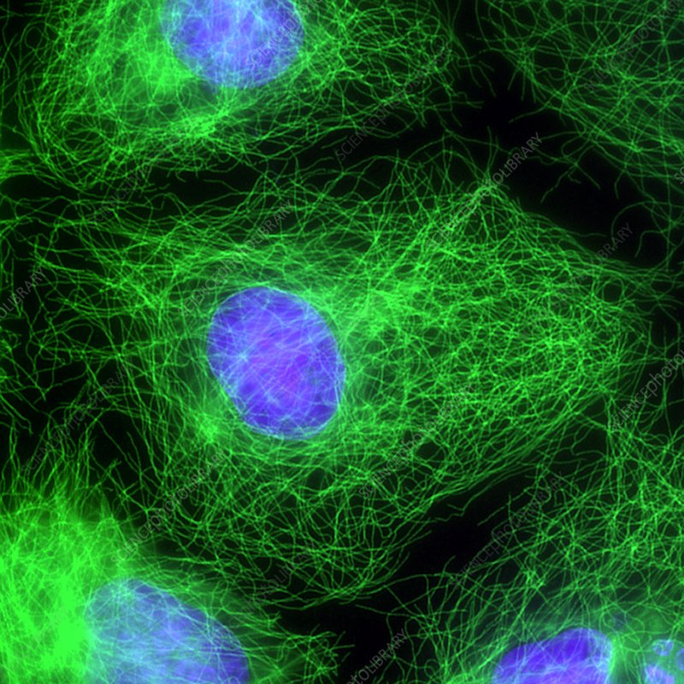
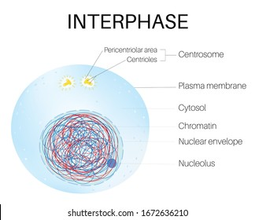
Interphase
Once a cell gets the signal to divide, the cell proceeds into G₁, S and G₂ phase (we will discuss more of these phases in lecture)
Fluorescence
Blue DNA, green tubulin (protein in microtubules)

Slide 5
Prophase
The centrosomes are at the poles, resemble stars (mitotic asters)
Sister chromosomes are held together by cohesion proteins
Kinetochores form at the centromeric region
Endomembrane (ER, Golgi) breaks down
Endocytosis and exocytosis cease
Chromosomes begin to condense

Slide 6
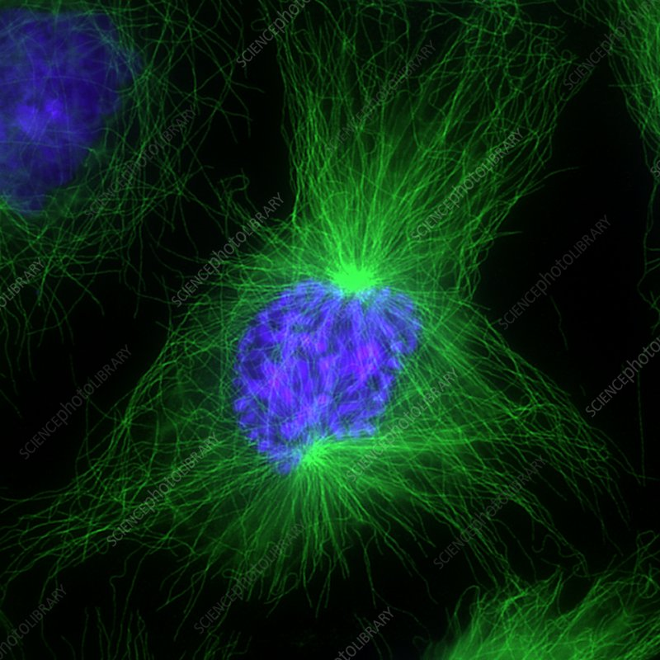
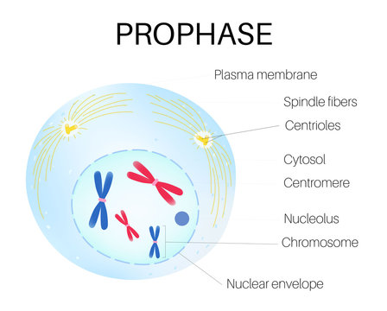

Slide 7
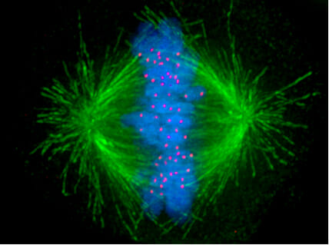
Prometaphase
Disassembly of nuclear pores and nuclear lamina (underlies and supports nuclear envelope)
Now the microtubules can find the chromosomes and associate with the kinetochore
Red dots in fluorescence microscopy are kinetochores (not aligned yet)

Slide 8
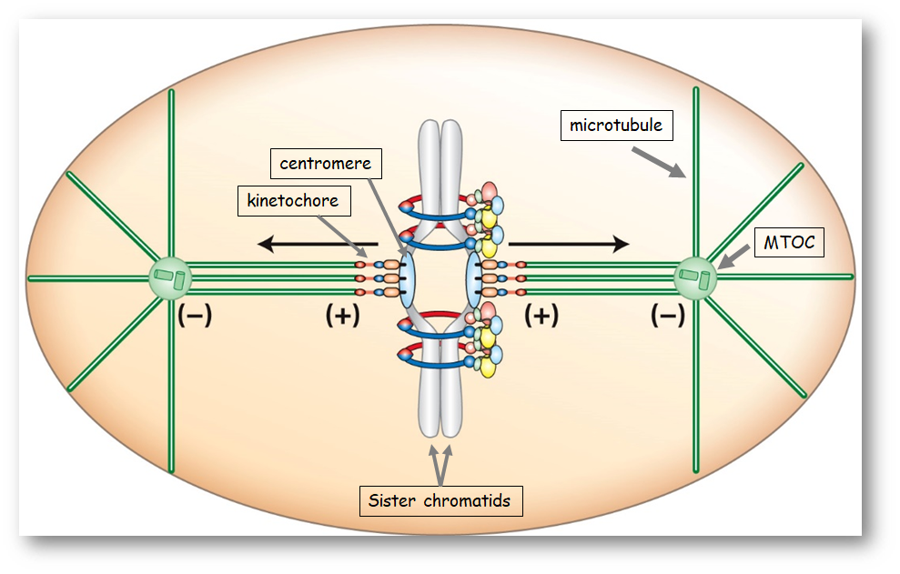

Slide 9
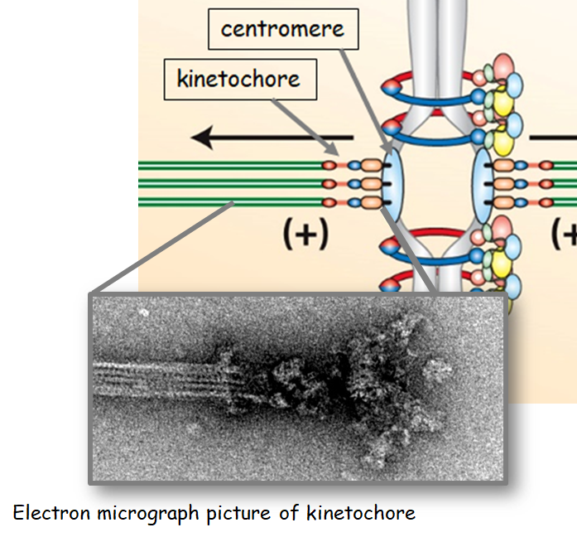

Slide 10
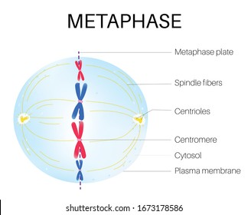
Metaphase
All chromosomes are aligned at points equidistant to the spindle

Slide 11
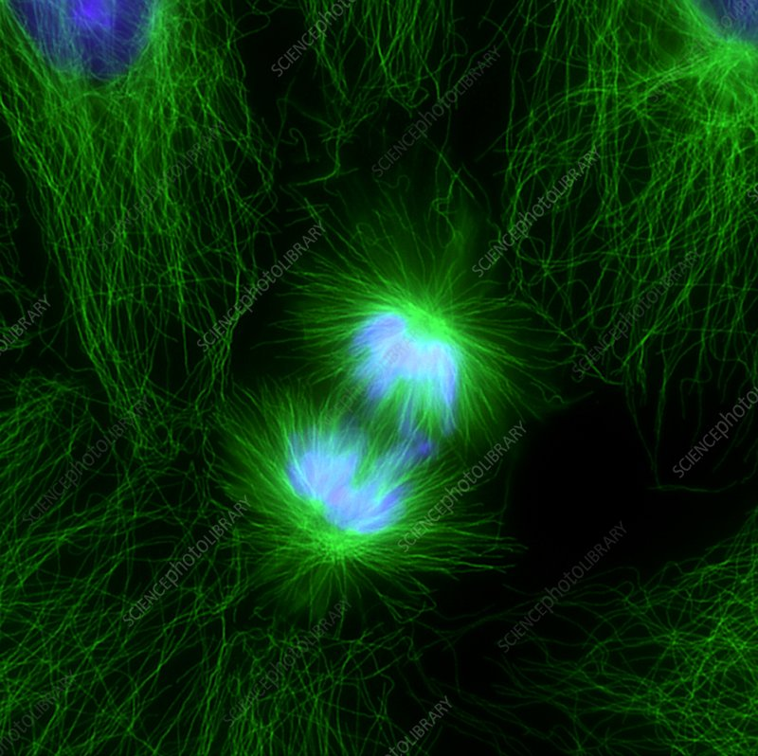
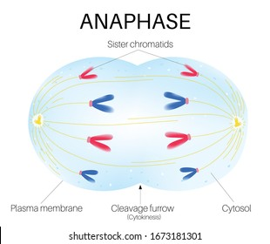
Anaphase
APC/C (anaphase promoting complex) leads to the destruction of cohesion proteins holding sister chromatids together

Slide 12
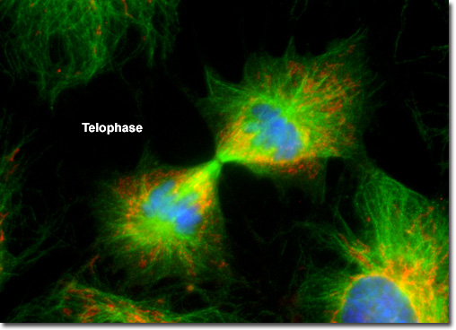
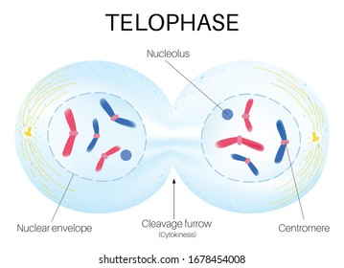
Telophase
Nuclear envelope and nuclear lamina reassemble
Chromosome decondense

