Slide 1
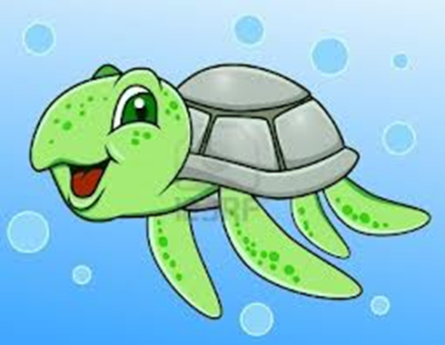
Flashcards for Marine Organisms
These might help you with studying
“Front” of flashcard is immediately followed by “back” of flashcard
You can write this information on your own flashcards or scroll through
I suggest adding pictures and/or more information that might help you study

Slide 2
What are the 3 Domains of Life?

Slide 3
Bacteria
Archaea
Eukarya

Slide 4
Domain Archaea

Slide 5
Prokaryotic cells
Includes “extremophile” bacteria

Slide 6
Domain Bacteria

Slide 7
Prokaryotic
Includes what used to be in Kingdom Monera

Slide 8
Domain Eukarya

Slide 9
Eukaryotic cells
Can be unicellular or multicellular
Includes protists, fungi, plants, animals

Slide 10
“Kingdom Protista”
What are algae?

Slide 11
Photosynthetic protists
Seaweed
Brown algae – kelp, sargassum
Green algae
Red algae
Phytoplankton
Diatoms, dinoflagellates

Slide 12
“Kingdom Protista”
What are protozoans?

Slide 13
Heterotrophic protists
Part of the zooplankton
Includes – radiolarians, foraminiferans, amoeba

Slide 14
Plants
Can many plants species survive in saltwater?

Slide 15
NO

Slide 16
Plants
Phylum Anthophyta

Slide 17
Sea grasses
Mangroves
Dune plants

Slide 18
Animals
What are the characteristics of animals?

Slide 19
Heterotrophic
Multicellular
Have motility, at least at some point during life cycle

Slide 20
Animals
Phylum Porifera

Slide 21
Sponges
Simplest of animals
Larvae have motility

Slide 22
Animals
Phylum Cnidaria

Slide 23
Corals, jellyfish
Have cnidocytes (stinging cells)

Slide 24
Animals
Phylum Mollusca
Class Bivalvia

Slide 25
Clams, oysters

Slide 26
Animals
Phylum Mollusca
Class Gastropoda

Slide 27
Snails

Slide 28
Animals
Phylum Annelida

Slide 29
Segmented worms
Polycheates

Slide 30
Animals
Phylum Mollusca
Class Cephalopoda

Slide 31
Squid, octopus, nautilus
Intelligent invertebrates
Have better developed eye than vertebrate eye

Slide 32
Animals
Phylum Arthropoda

Slide 33
Crustaceans
Shrimp, crab, lobster, krill
Largest phylum of animals

Slide 34
Animals
Phylum Echinodermata

Slide 35
Sea stars, sea cucumbers

Slide 36
Animals
What are the characteristics of Phylum Chordata?

Slide 37
Notochord (becomes vertebrate in vertebrates)
Dorsal, hollow nerve cord (spinal cord in vertebrates)
Pharyngeal gill slits
Post-anal tail

Slide 38
Animals
Phylum Chordata
What classes are in subphylum Vertebrata?

Slide 39
Chondrichthyes
Osteichthyes
Reptilia/Aves
Mammalia

Slide 40
Animals
Class Chondrichthyes

Slide 41
Cartilaginous fish
Sharks, skates, rays

Slide 42
Animals
Class Osteichthyes

Slide 43
Bony fish, ray-finned fish
Very diverse

Slide 44
Animals
Class Reptilia/Aves

Slide 45
Reptiles – sea turtles, sea snakes
Birds - pelicans, penguin, osprey
Data shows dinosaurs more closely related to modern day birds so reptiles and birds now put into same group

Slide 46
Animals
Class Mammalia
Order Carnivora

Slide 47
Sea otter, polar bear, walrus, sea lions, seals

Slide 48
Animals
Class Mammalia
Order Carnivora
Family Odobenidae

Slide 49
Walrus

Slide 50
Animals
Class Mammalia
Order Carnivora
Family Otariidae

Slide 51
Sea Lions
“eared”
Can stand on hind limbs

Slide 52
Animals
Class Mammalia
Order Carnivora
Family Phocidae

Slide 53
Seals

Slide 54
Animals
Class Mammalia
Order Sirenia

Slide 55
Manatees

Slide 56
Animals
Class Mammalia
Order Cetacea
Suborder Odontoceti

Slide 57
Toothed whales
Dolphins, orcas, sperm whales

Slide 58
Animals
Class Mammalia
Order Cetacea
Suborder Mysticeti

Slide 59
Baleen whales
Largest animals on Earth
Blue whale, grey whale, humpback

