Slide 1
Evolution
General Biology I Lab

Slide 2
Change in allele frequency in the population is evolution
Natural selection is the mechanism by which evolution takes place
If you have a trait that makes you more successful in the environment, you are more likely to successfully produce offspring and pass that trait on

Slide 3
Simulation – Predator and Prey
We will simulate effects on 2 populations – a predator and its prey
Each population has a variety of phenotypes
We will see how natural selection results in the survival and reproduction of particular phenotypes

Slide 4
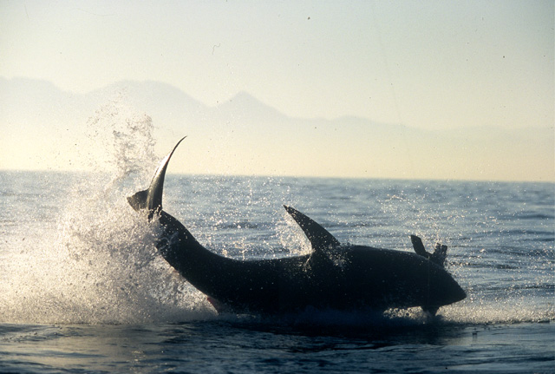
The Game
The players:
Predators – that’s you!
Mouths will be different size forceps
Tiny, small, medium, large
Prey – beans
Beans will vary in color
Black, brown, tan, white
Set up on “lawn”
100 of each color prey will be placed on lawn (400 prey)
3 predators of each phenotype will compete (12 predators)
Beans will be placed in “stomachs” of predators (small dish)
Feeding will last for 2 minutes
After feeding:
Count # of prey (beans) eaten and record
Keep around 400 for next round, each will reproduce in proportion to survival
6 most successful predators will survive and reproduce 1 offspring
The rest will “die”

Slide 5
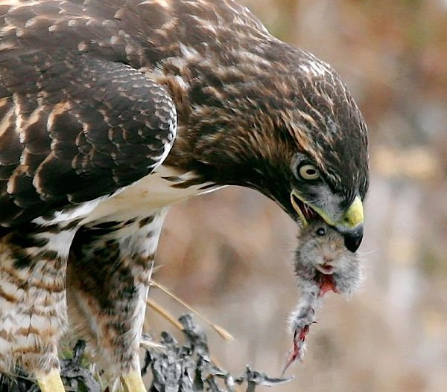
Which predator’s mouth size was more successful at obtaining the available food source?
Remember, the forceps represented the mouths of the predators.
Which prey was more vulnerable?
Did color make certain prey more visible in the grass?

