Slide 1
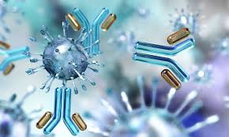
Covid-19 and the mRNA Vaccine
Dr. Jennifer Capers
Updated June 2021

Slide 2
What does our Immune System do?
Our immune system checks out anything foreign (antigens) that enter into our body
Just because it is foreign does not mean it causes disease
Only a small number of microbes are pathogenic
But our immune system has to check out everything, regardless
Most antigen is quickly removed without causing problems
If the antigen is pathogenic, it might start to cause disease before the immune system can clear it

Slide 3
Why do we have an immune system?
Again, most of what we come into contact with does not cause disease
However, there are organisms that can cause disease in us
Viruses
Bacteria
Fungi
Parasitic Protists
Parasitic worms
Without a functioning immune system, a person will quickly succumb to any number of diseases
Those of us with a functioning immune system are able to get sick and then get better, but not always

Slide 5
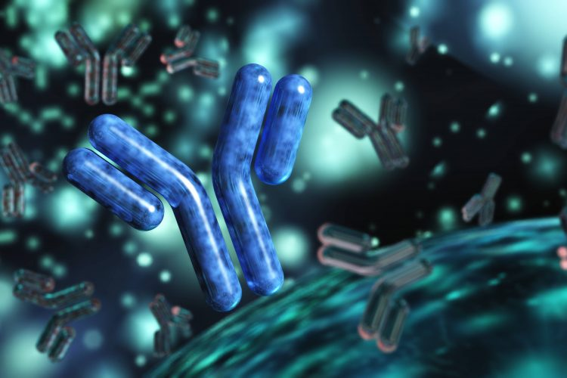
How do B and T cells protect us?
B cells make antibodies
an antibody that is produced by a particular B cell is specific and will recognize a specific pathogen
T cells have T Cell Receptors that are also specific for the pathogen
After we recover from an infection, we have memory B and T cells that are now specific for that pathogen that will remain in our system for a couple of decades, offering us more protection from the pathogen than what we had before

Slide 6
Prior infections and vaccinations can give us protection from disease for a long time
But why don’t we have long-term immunity against things like colds and flu?
Because the viruses that are responsible for these diseases mutate often
When they change too much the antibodies we have no longer recognize them so it’s like our immune system is starting over

Slide 8
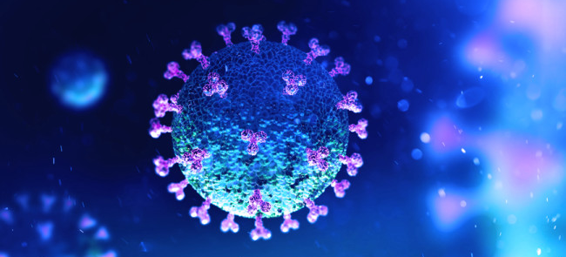
COVID-19
Covid-19 is what we call a novel virus
It mutated so that it went from infecting another animal (possibly a bat) to us as humans
Viruses are species specific and tissue specific
Even though viruses are species specific, mutation can lead to them having the ability to infect another species
Since Covid-19 is new to humans, none of us has immunity to it
Therefore, we are all starting at the Primary Immune Response
Some of us will be able to fight this off very quickly, and have little to no symptoms
For some of us, the infection will be much worse

Slide 9
Because we were all having the Primary Immune Response in 2020 and 2021, there was no “herd immunity”
Without herd immunity, the virus spreads very quickly
Many people sick overloading hospitals and using up supplies
Why did we have to social distance and shut things down?
To slow the spread. Why?
Our hospitals needed time to take care of patients, release them and make room for new patients
We needed time to find out what this disease does to the body, we still aren’t 100% sure
We needed more time to figure out what drugs are effective for treatment
We needed time to develop a vaccine which will help gain herd immunity

Slide 10
What is COVID-19?
The World Health Organization (WHO) named the novel coronavirus that causes the disease COVID-19 “severe acute respiratory syndrome coronavirus 2” (SARS-CoV-2) in January 2020.
This disease was first observed in humans in Wuhan, China in December 2019.
The WHO declared COVID-19 a Public Health Emergency of International Concern (PHEIC) on January 30, 2020.

Slide 11
Where did it come from?
Three coronaviruses have crossed the species barrier (spreading of disease from one species to another) since 2000
SARS-CoV emerged in a province of China in 2002 ultimately infecting 8,098 people and causing 774 deaths across 5 continents
Middle-East respiratory syndrome coronavirus (MERS-CoV) emerged in the Arabian peninsula in 2012 and remains a public health concern
SARS-CoV-2 was identified in December 2019
Virus Origins:
Both SARS-CoV and SARS-CoV-2 could have originated from bats, with small mammals as intermediate hosts between bat and human.
They are still investigating the origin of SARS-CoV-2, was there a lab leak?
MERS-CoV originated from a camel with direct transfer to humans.
In addition, four low-pathogenicity coronaviruses are endemic in humans.
As of July 2020, there were no approved treatments or vaccines for any coronavirus species.
Now we know how to better treat and we now have vaccines.

Slide 12
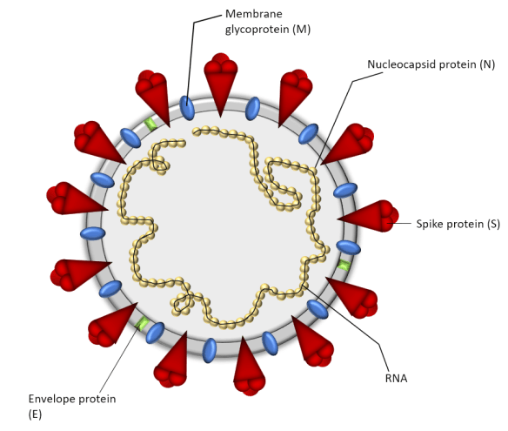
Covid-19 Characteristics
SARS-CoV-2 is an enveloped virus with a single stranded RNA molecule
Genetic materials: a small number of genes (4 main structural proteins and 16 nonstructural proteins*)
Four main structural proteins make up the capsid and envelope:
spike (S) glycoproteins (protrudes from the viral surface and aids to binding the envelope of the virus to the host cells)
envelope (E) glycoproteins (production and maturation of the virus)
membrane (M) glycoproteins (determines the shape of the virus envelope)
nucleocapsid (N) proteins (involved in viral replication)

Slide 13
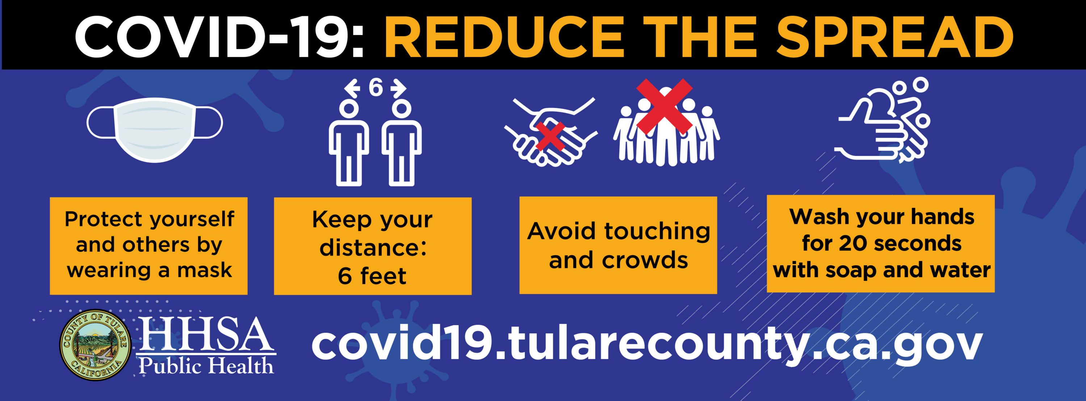

Slide 14
Once transmitted, viral S-proteins bind to an enzyme on the host cells: Angiotensin-converting enzyme 2 (ACE2)
Physiological functions: Lowering blood pressure, controlling fluid balance, and regulating the inflammatory response.
Present in tissues, including lungs, kidneys, heart, arteries, and the gastrointestinal tract
Since the virus interacts with this enzyme on the host tissues, it has an increased ability to infect many tissues.

Slide 15
Testing
Diagnostic Tests – to determine if individual is currently infected
PCR – Most accurate test
Tests for presence of the viral RNA in nasal secretion
Rapid Antigen Test – less accurate but faster
Tests for presence of viral antigen
Antibody Tests – to determine if individual has had previous infection and has current immunity
There are many of these tests, some are not as sensitive
Even if there are Abs present, we still don’t know at this point how long they will last after Covid infection

Slide 16
A contagious disease has a high R₀ value (for example, measles transmitted via aerosol R₀ = 12 − 18), compared to a disease that does not spread easily from person to person (for example, Ebola transmitted directly through body fluids R₀ = 2).
The maximum R₀ for COVID-19 was calculated (May 2020) in the 5 to 6 range, higher than earlier estimates from China of 2.2 to 2.7.
The R₀ is crucial to determine what percentage of the population must be immune in order to halt the disease spread.
With an R₀ of 5.7 for example, we know that at least 82% of the population must be immune, thereby preventing its spread through herd immunity.
The goal is to get the R_{e}, the effective reproduction rate in the current (recovered/vaccinated) state of the population, to a value of 1 or less.

Slide 17
Vaccines have been developed!
They are safe.
They have been approved by the FDA.
mRNA technology is not new, scientists just finally got it to work for a vaccine.
People have worries over how “fast” these were developed. However, they are safe.
Remember that this was a pandemic the entire world was dealing with. Many institutions around the world stopped other research and put all of their efforts into Covid-19 vaccine development.
Money was not an issue, these institutions were given as much money as they needed to expedite the process.

Slide 18
Let’s discuss how Covid-19 enters cells and how the mRNA vaccine works.

Slide 19
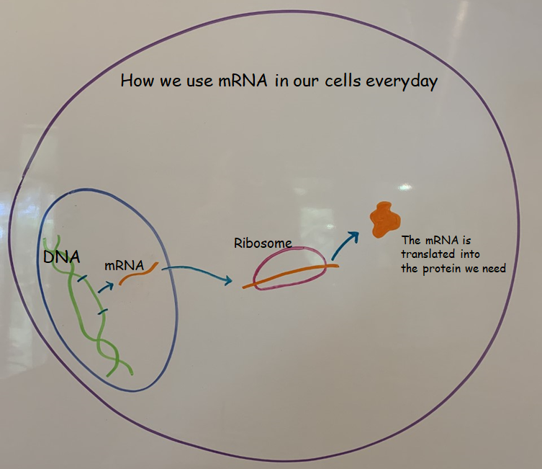

Slide 20
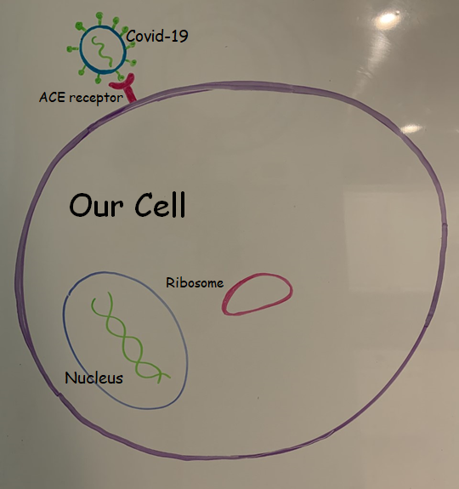

Slide 21
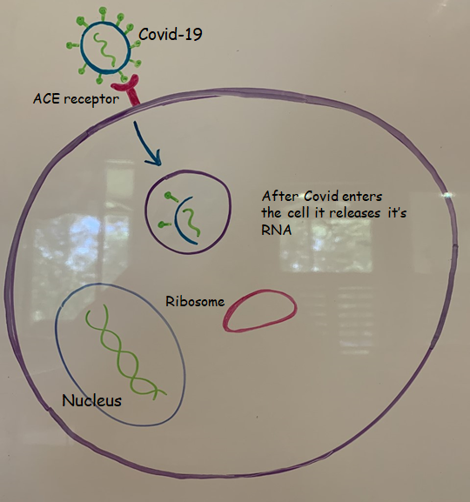

Slide 22
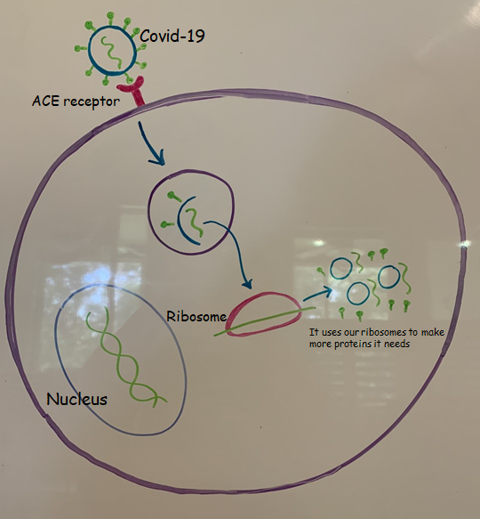

Slide 23
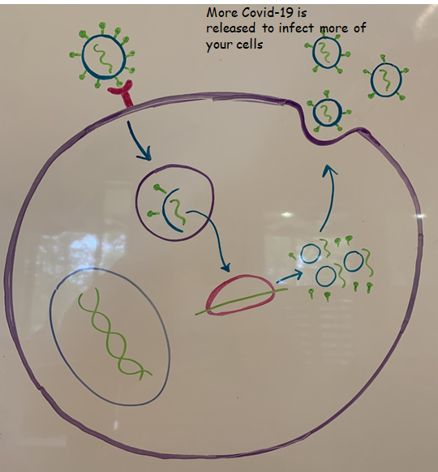

Slide 24
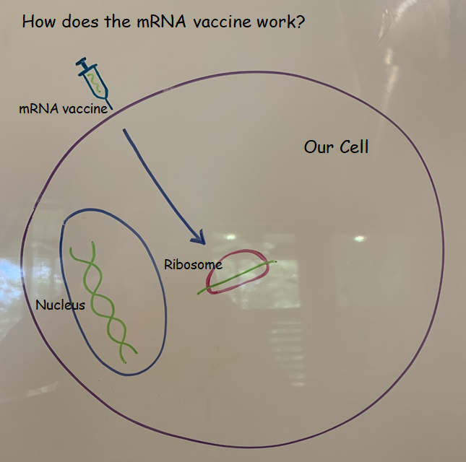

Slide 25
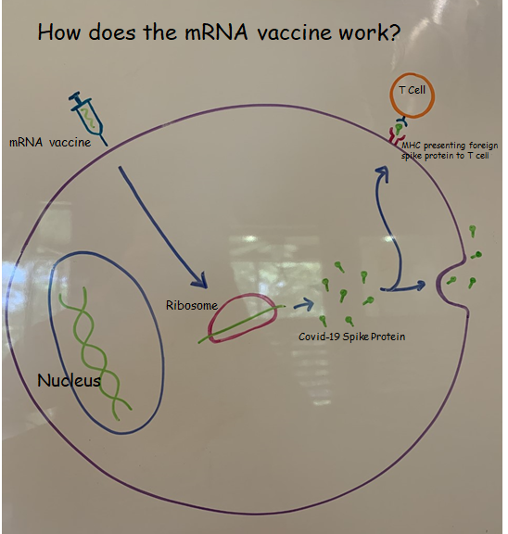

Slide 26
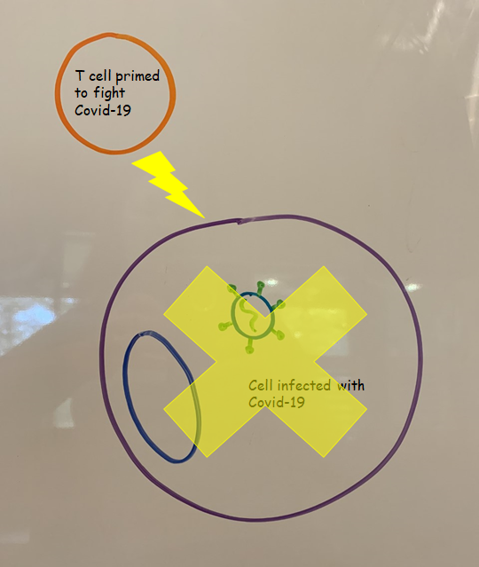

Slide 27
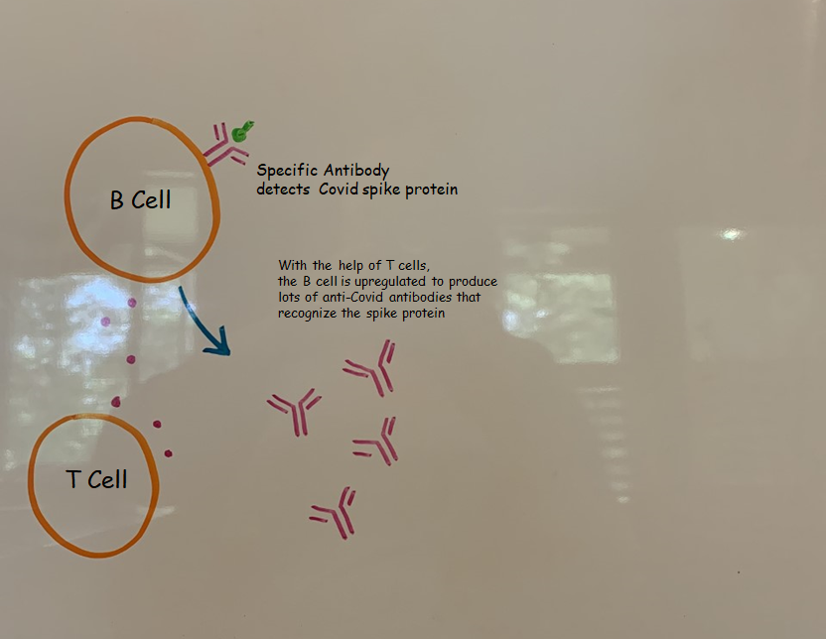

Slide 28
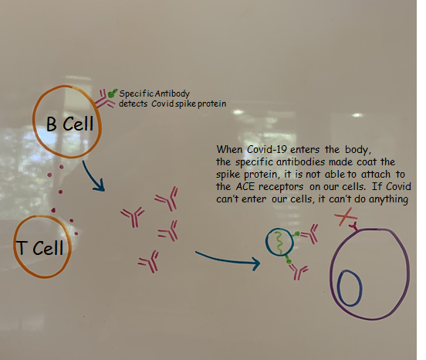

Slide 29
Scientific Literacy is so important!
Scientific literacy is not knowing everything about science
It’s the ability to understand that the conspiracy theory that you just read on Facebook might not be true (I promise, Bill Gates is not looking to microchip us with the COVID vaccine)
It’s the ability to say, I don’t know about this, but I’m going to go to a trusted source and ask questions

Slide 30
“Over the course of the COVID crisis, we have repeatedly seen leading scientists and scientific organizations change their recommendations, and we have seen multiple scientific studies retracted or at least highly debated. Many view this as proof that science doesn’t work and/or scientists don’t know what they are doing. In reality, this is exactly what we expect to see when science works. Science is a method, not just a body of facts, and the method is often messy. Peer-review does not end with publication. Rather, studies are subjected to the scrutiny of the entire scientific community, and the fact that high-profile papers sometimes get retracted is evidence of science correcting itself. Similarly, the fact that scientists change their views as new evidence about a novel virus comes to light is a good thing! It means that scientists are learning and adjusting their views rather than clinging to biases and preconceptions. That’s how science works.”

Slide 31
There are a lot, a lot of misconceptions about vaccinations. Vaccinations save lives, period – and this is so important now if we want to get us all back to school, football games, economy up, etc.
I have a document on my website called Debunking Vaccine Myths that will help explain the misinformation on vaccines.
http://jcapers-irsc.weebly.com/virus-information.html

