Slide 1
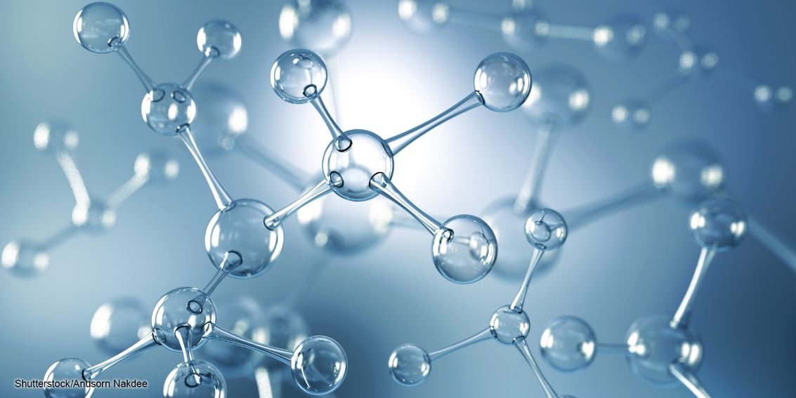
Chapter 2 - Chemistry
Microbiology for Health Sciences
Dr. Capers
Download for free at http://cnx.org/contents/185cbf87-c72e-48f5-b51e-f14f21b5eabd@10.61

Slide 2
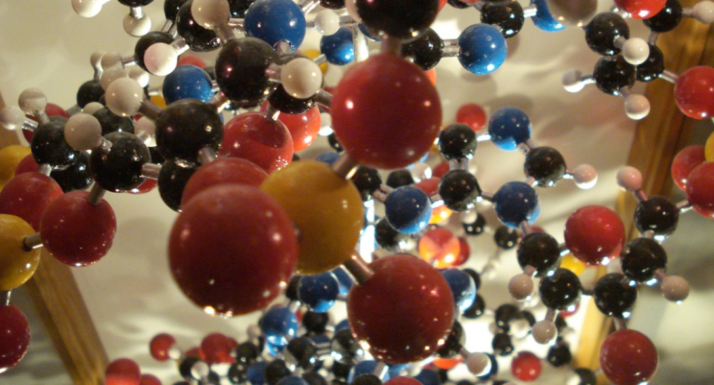
Atoms are the Building Blocks
Atoms are the building blocks of molecules found in the universe—air, soil, water, rocks . . . and the macromolecules found in living things.
All biological processes follow the laws of physics and chemistry.
Therefore, it is important to understand some basic chemistry.

Slide 4
Matter
Matter is any substance that occupies space and has mass.
Each element is a specific form of matter with specific properties.
The atoms of an element cannot be broken down into smaller parts by ordinary chemical reactions.
There are over 100 known elements.
Some are man-made.
Some are unstable.
Each element is designated by a chemical symbol.

Slide 5
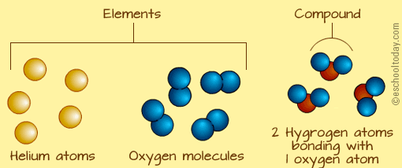

Slide 6
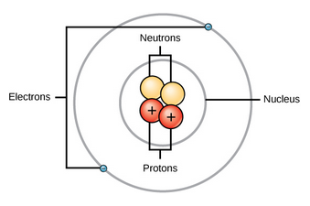
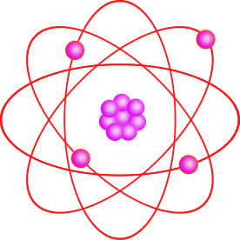
The Structure of an Atom
Download for free at http://cnx.org/contents/185cbf87-c72e-48f5-b51e-f14f21b5eabd@10.61
Caption: Atom Clipart violet (c) MarekM, Public domain
An atom is the smallest unit of an element.
Each type of atom has a specific number of subatomic particles
Protons, neutrons, electrons
The central atomic nucleus has protons and neutrons.
The outer region has the electrons.

Slide 7
Particles in an atom have electric charges and masses.
Download for free at http://cnx.org/contents/185cbf87-c72e-48f5-b51e-f14f21b5eabd@10.61
Electrons contribute very little to an atom’s mass. So little, it is customary to ignore their mass.

Slide 8
The atomic number is the number of protons in an atom.
Each element has a characteristic atomic number.
Carbon atoms have an atomic number of 6.
Hydrogen atoms have an atomic number of 1.
Atomic number cannot change without changing to a different element!
The mass number is the number of protons and neutrons in an atom.
Mass number is an approximation of the atom’s mass, since it ignores the very tiny contribution of the electrons.
Each element has isotopes where neutron number changes
Protons cannot change (you change the element if that happens)
Since there can be several isotopes of an element, atomic mass is an average of all of those
Some isotopes are unstable – radioisotopes (radioactive)

Slide 9
Carbon Dating Video:
https://www.youtube.com/watch?v=2io5opwhQMQ
Fossils that might be older (let’s say million of years old) have to be aged using different elements found in the body (potassium for instance) that have longer half lives

Slide 10
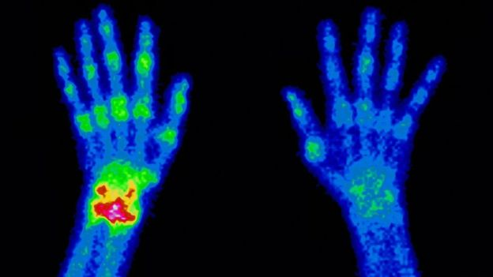
Some radioisotopes can be dangerous to living tissue
Radiation therapy can kill fast growing cancer cells (but can also damage good tissue)
Non-harmful radioisotopes can be used as tracers for diagnostic procedures

Slide 11
The Periodic Table of the Elements
Download for free at http://cnx.org/contents/185cbf87-c72e-48f5-b51e-f14f21b5eabd@10.61

Slide 12
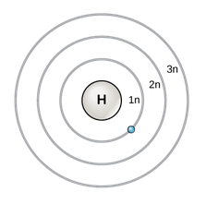
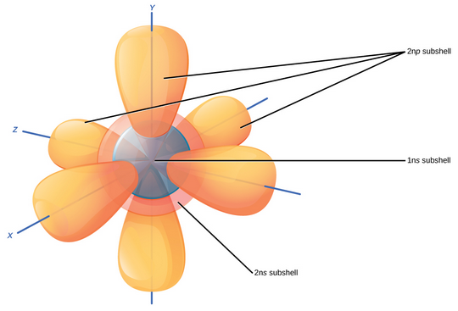
Models Explain Atom Structure
Bohr Model of Electron Shells
3-D Model of Subshells and Orbitals
Download for free at http://cnx.org/contents/185cbf87-c72e-48f5-b51e-f14f21b5eabd@10.61

Slide 14
Neutral vs. Charged Atoms
A typical atom is “neutral” (has no overall charge) because the number of protons (+) matches the number of electrons (-).
The equal numbers of plus and minus cancel each other.
Atoms can gain or lose electrons to become ions (charged particles).
An extra electron results in an overall negative charge.
Loss of an electron results in an overall positive charge.

Slide 15
A chemical reaction (formation or breaking of chemical bonds between elements) involves electrons
In a chemical reaction, you are always following the electrons

Slide 16
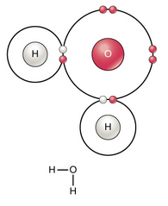
Atoms Can Bond Together to Make Molecules
The differences in chemical reactivity between the elements are based on the number and spatial distribution of an atom’s electrons.
Atoms that chemically react and bond to each other form molecules.
Molecules are simply two or more atoms chemically bonded together.
Electrons play a key roles in forming these bonds.
Download for free at http://cnx.org/contents/185cbf87-c72e-48f5-b51e-f14f21b5eabd@10.61

Slide 17
Electrons Help Atoms Bond Together in Chemical Reactions
Ionic bonds have transferred electrons.
Their strength varies depending on conditions.
Covalent bonds have shared electrons.
They hold atoms together very strongly.
Nonpolar covalent bonds – electrons equally shared
Polar covalent bonds – electrons are unequally shared
Can result in hydrogen bonds
Weak bonds
Important in biological processes

Slide 18
Ionic Bonds Have Transferred Electrons
Cation (+)
Anion (-)
sodium chloride
Opposite charges attract, holding the atoms together.
Download for free at http://cnx.org/contents/185cbf87-c72e-48f5-b51e-f14f21b5eabd@10.61

Slide 20
Polar Covalent Bonds
Electrons are not fully transferred like in ionic bonds. They are still shared, but shared unequally.
The unequal sharing results in very slight charges at each end of the bond.
The resulting molecule will have polarity – regions with very slight positive and negative charges.

Slide 23
Hydrogen Bonding Between Water Molecules Gives it Properties Essential to Life
Water:
is cohesive (bonds to itself).
This results in surface tension.
is adhesive (bonds to other charged materials).
This permits capillary action.
is less dense when frozen (solid ice floats in liquid water).
has high specific heat capacity (it takes a lot of energy to cool it down or heat it up).
1 calorie of energy will raise the temperature of 1 gram of water by 1 degree Celsius.
has high heat of vaporization (which results in evaporative cooling).
is an excellent solvent for hydrophilic materials.
The charges of water can dissociate polar materials, and ionic materials like table salt.
Hydrophobic materials like oil are nonpolar, have no charges, and do not dissolve well in water.

Slide 24
pH, Buffers, Acids and Bases
A small number of water molecules spontaneously come apart, generating hydrogen ions.
H₂O → H⁺ + OH⁻
pH is a measure of hydrogen ions in solution.
Most living things do best at near-neutral pH.

Slide 25
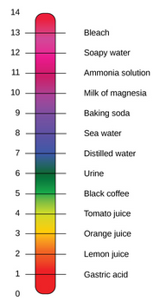
The pH Scale
pH is defined as the negative log of the hydrogen ion concentration.
Pure water has pH 7 (neutral), in the middle.
Acids are at lower pH numbers. (more hydrogen ions)
Bases are at higher pH numbers. (fewer hydrogen ions)
Download for free at http://cnx.org/contents/185cbf87-c72e-48f5-b51e-f14f21b5eabd@10.61

Slide 26
Buffers Maintain pH Homeostasis
Human blood pH is maintained by the carbonic acid/ bicarbonate/CO₂ system shown above.
Buffers can absorb excess H⁺ or excess OH⁻, helping the system resist pH changes.
Download for free at http://cnx.org/contents/185cbf87-c72e-48f5-b51e-f14f21b5eabd@10.61

Slide 27
Let’s talk about macromolecules

Slide 28
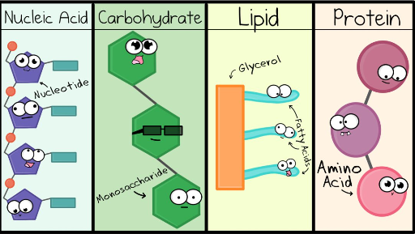
Watch this video: https://www.youtube.com/watch?v=YO244P1e9QM

Slide 29
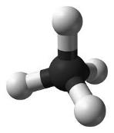
Carbon
Carbon is the perfect “tinker toy” because it can bond with four other elements
Life on Earth is carbon-based - ORGANIC
Framework of organic compounds consists primarily of C bonded to other C, or N, O, P, S, or H
Carbon forms up to 4 covalent bonds
Methane (CH₄)
Caption: Ball-and-stick model of the methane molecule (c)Ben Mills, Public domain

Slide 30
Macromolecules are a bunch of monomers linked together to form polymers
Polymer – built by linking monomers
Monomer – small, similar chemical subunits
Monomers
Polymers

Slide 31
4 Types of Macromolecules
Proteins: monomers = amino acids
Carbohydrates: monomers = monosaccharides
3. Nucleic acids: monomers = nucleotides
4. Lipids: aren’t built of monomers but form large complexes considered macromolecules

Slide 32
Building Macromolecules
Dehydration Synthesis
Formation of large molecules by the removal of water
Monomers are joined to form polymers
Monomers
Polymer
Caption: Dehydration Synthesis and Hydrolysis (c) OpenStax College, Public domain

Slide 33
Breaking Macromolecules
Hydrolysis
Breakdown of large molecules by the addition of water (hydro=water, lysis=break)
Polymers are broken down to monomers
Polymer
Monomers
Caption: Dehydration Synthesis and Hydrolysis (c) OpenStax College, Public domain

Slide 34
Carbohydrates
Three Major Groups:
Monosaccharaides - monomer
Disaccharides – 2 monosaccharides
Polysaccharides - polymer

Slide 35
Proteins
Protein functions include:
1. Enzyme catalysis
2. Defense
3. Transport
4. Support
5. Motion
6. Regulation
7. Storage

Slide 36
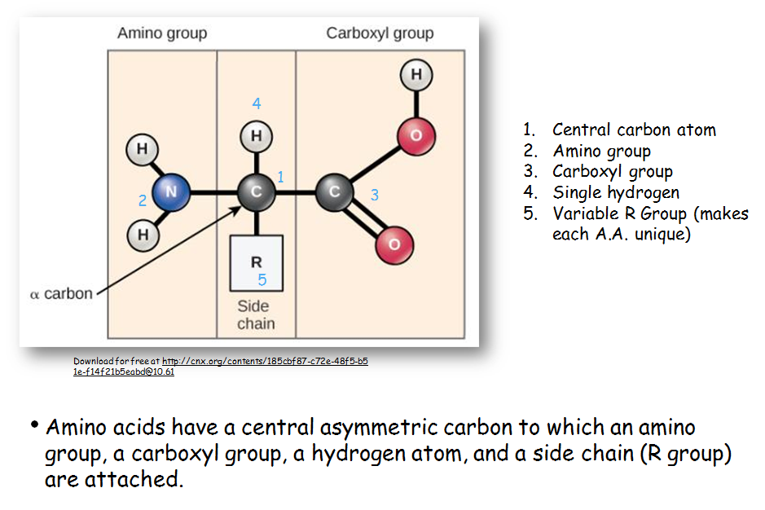

Slide 37
Nucleic Acids
Polymer: nucleic acids
Monomers: nucleotides
Nucleotide: sugar + phosphate + nitrogenous base
Sugar is deoxyribose in DNA or ribose in RNA
Caption: DNA Nucleotides (c) OpenStax College, Public domain

Slide 38
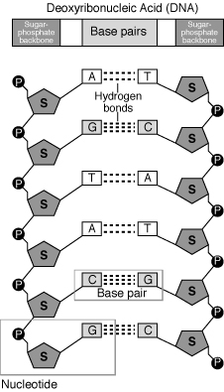
Caption: Nucleotide (c) Mirmillon, Public domain

Slide 39
Lipids
Group of nonpolar compounds
hydrophobic
insoluble in water
Not polymers
Examples: Fats, oils, waxes, cholesterol, hormones, some vitamins
Excellent for energy storage
Due to high number of C-H bonds

Slide 40
Download for free at http://cnx.org/contents/185cbf87-c72e-48f5-b51e
-f14f21b5eabd@10.61

Slide 41
Download for free at http://cnx.org/contents/185cbf87-c72e-48f5-b51e-f14f21b5eabd@10.61
The phospholipid bilayer is the major component of all cellular membranes. The hydrophilic head groups of the phospholipids face the aqueous solution. The hydrophobic tails are sequestered in the middle of the bilayer.

