Slide 1
Microbioilogy
Chapter 11
Characterizing and Classifying Prokaryotes

Slide 2
General Characteristics of Prokaryotic Organisms
Morphology of Prokaryotic Cells
Most diverse group of cellular microbes
Thrive in various habitats
Only a few capable of colonizing humans and causing disease
Exist in a variety of shapes

Slide 3
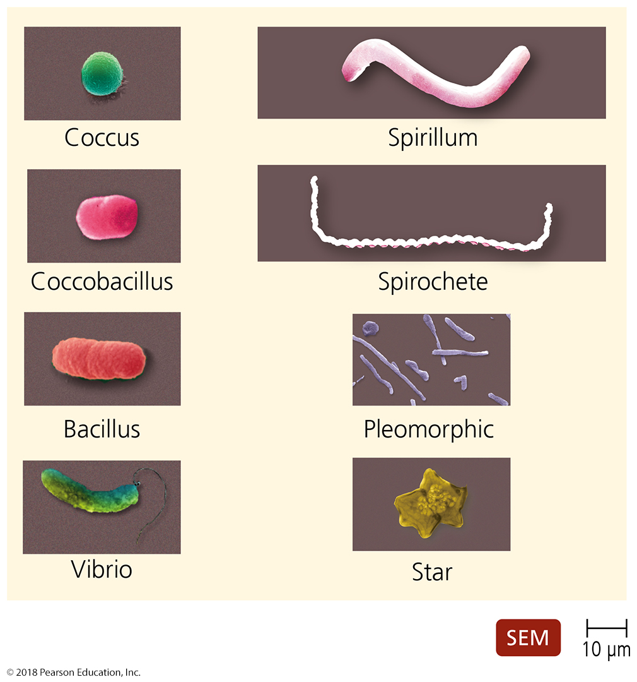
Figure 11.1 Typical prokaryotic morphologies.
Notes:
3

Slide 4
General Characteristics of Prokaryotic Organisms
Endospores
Produced by Gram-positive bacteria Bacillus and Clostridium
Each vegetative cell transforms into one endospore
Each endospore germinates to form one vegetative cell
Defensive strategy against unfavorable conditions
Concern to food processors, health care professionals, and governments

Slide 5
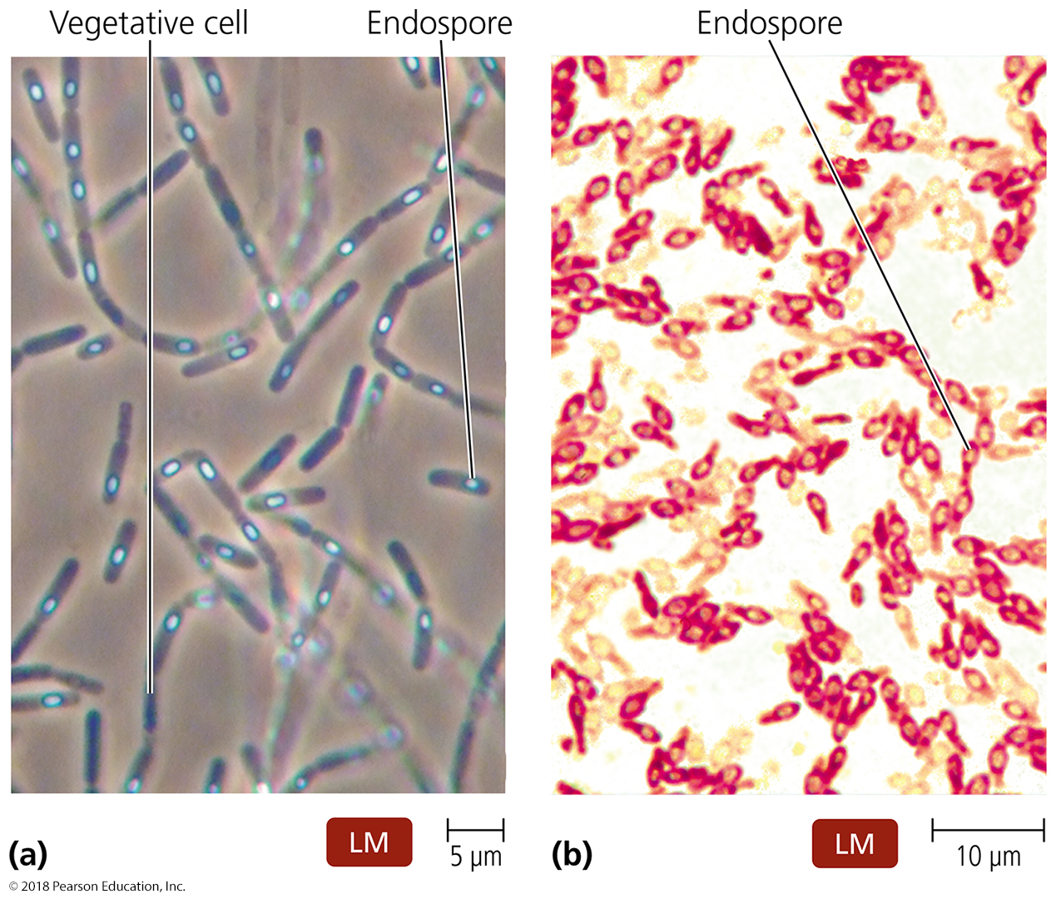
Figure 11.2 Locations of endospores.
Notes:
5

Slide 6
General Characteristics of Prokaryotic Organisms
Reproduction of Prokaryotic Cells
All reproduce asexually
Three main methods:
Binary fission (most common)
Snapping division
Budding

Slide 7
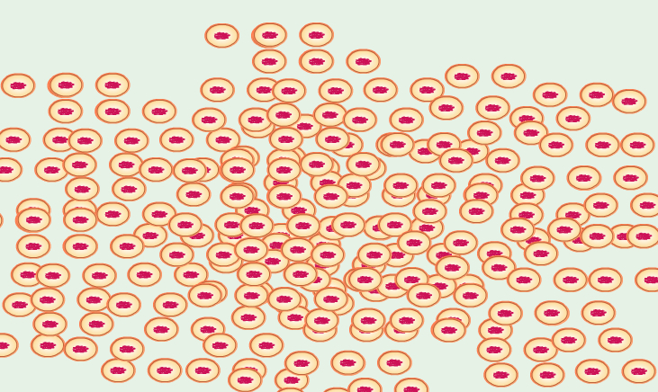
Bacterial Growth: Overview
PLAY
Bacterial Growth: Overview

Slide 8
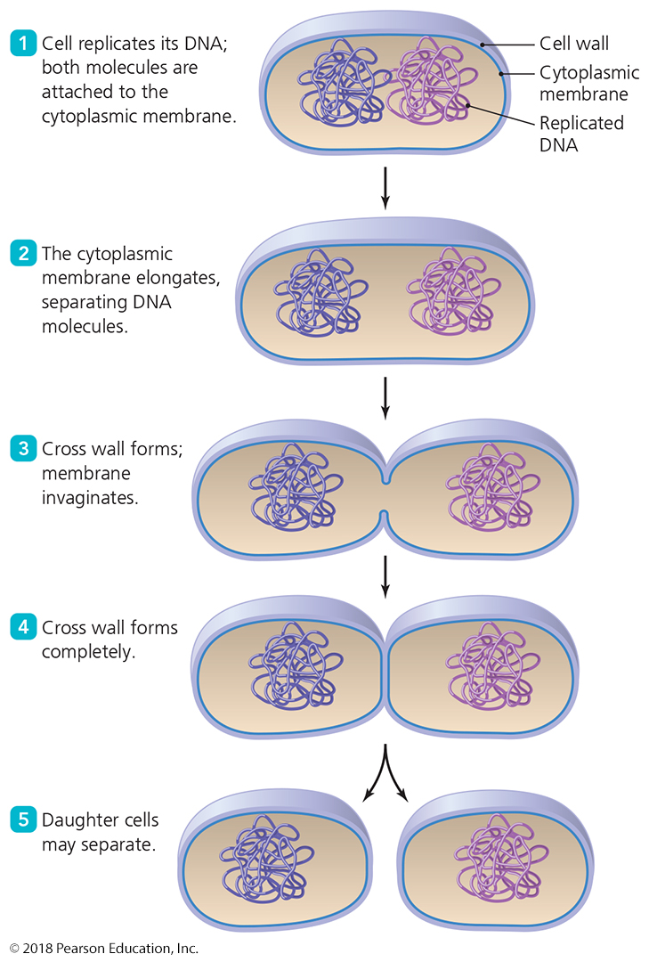
Figure 11.3 Binary fission.
Notes:
8

Slide 9
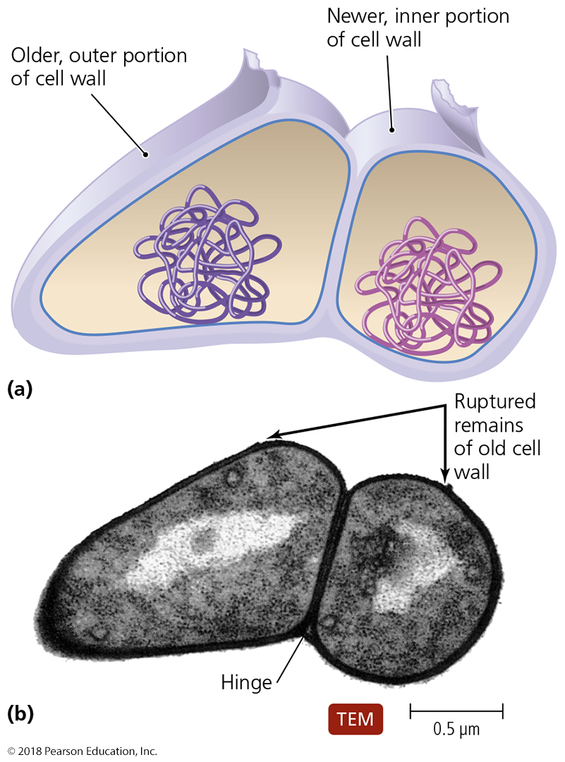
Figure 11.4 Snapping division, a variation of binary fission.
Notes:
9

Slide 10
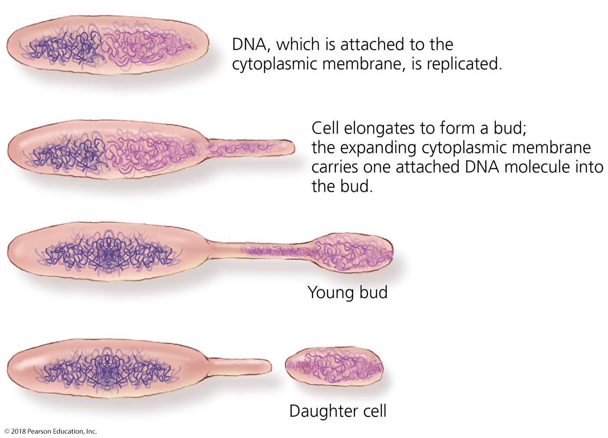
Figure 11.6 Budding.
Notes:
10

Slide 11
General Characteristics of Prokaryotic Organisms
Reproduction of Prokaryotic Cells
Epulopiscium and its relatives have unique method of reproduction
Live offspring emerge from the body of the dead mother cell (viviparity)
First noted case of viviparous behavior in prokaryotic world

Slide 12
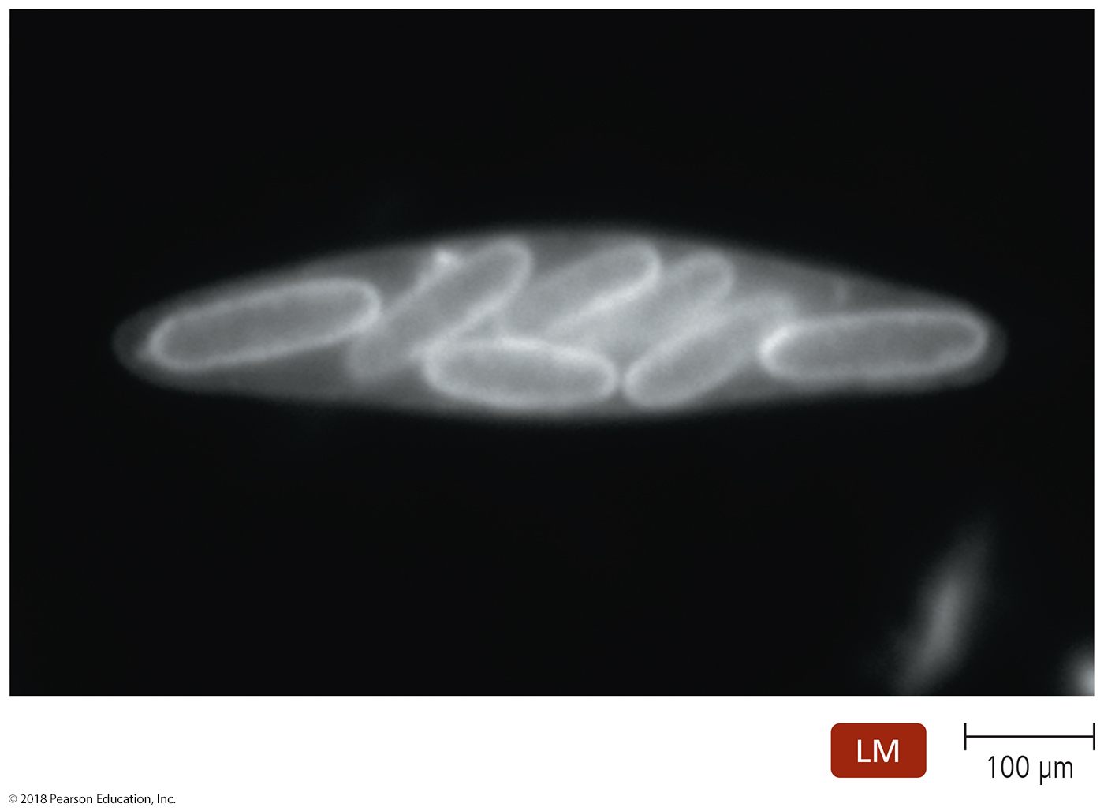
Figure 11.7 Viviparity in Epulopiscium.
Notes:
12

Slide 13
General Characteristics of Prokaryotic Organisms
Arrangements of Prokaryotic Cells
Result from two aspects of division during binary fission:
Planes in which cells divide
Separation of daughter cells

Slide 14
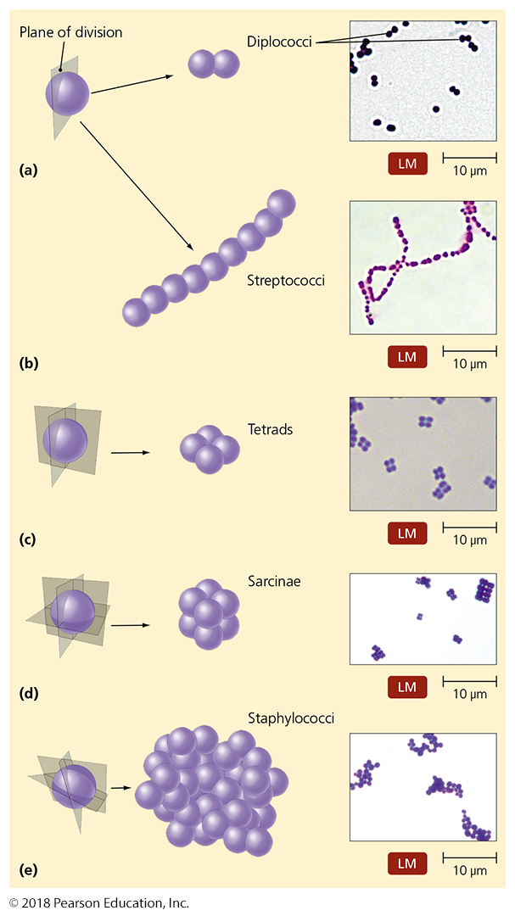
Figure 11.8 Arrangements of cocci.
Notes:
14

Slide 15
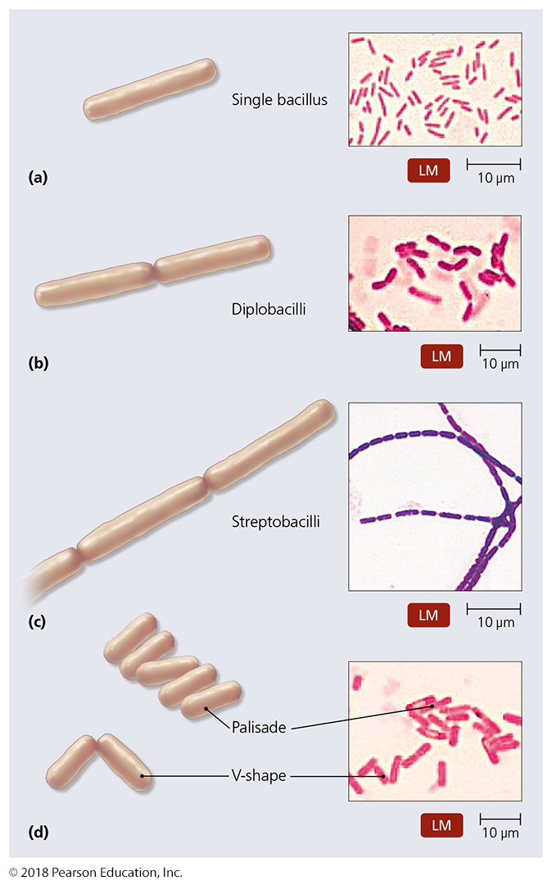
Figure 11.9 Arrangements of bacilli.
Notes:
15

Slide 16
Modern Prokaryotic Classification
Currently based on genetic relatedness of rRNA sequences
Three domains:
Archaea
Bacteria
Eukarya

Slide 17
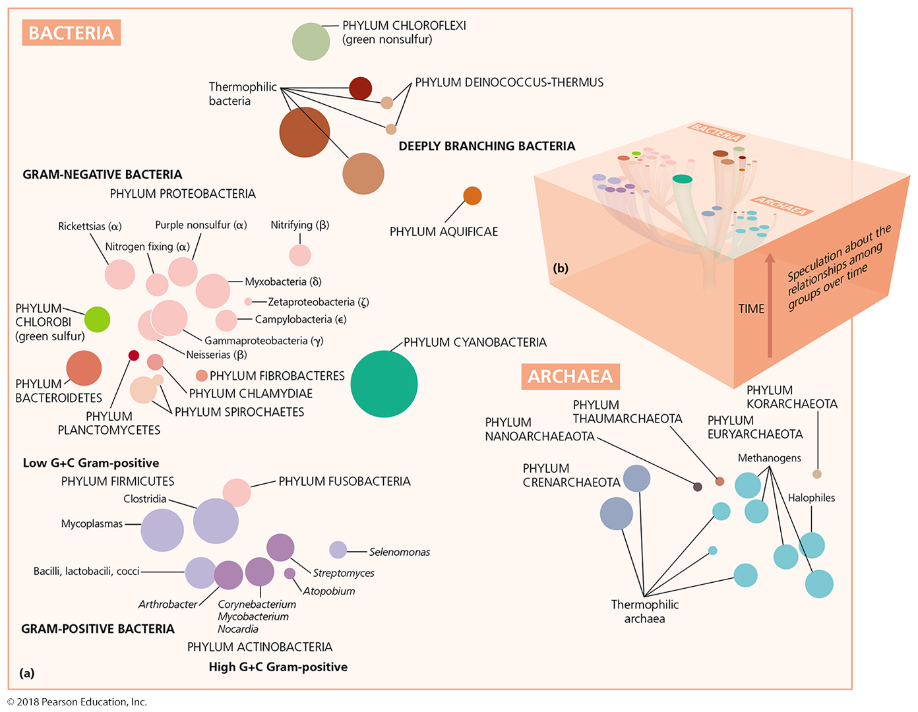
Figure 11.10 Prokaryotic taxonomy.
Notes:
17

Slide 18
Survey of Archaea
Common features:
Lack true peptidoglycan
Cell membrane lipids have branched hydrocarbon chains
AUG codon codes for methionine
Reproduce by binary fission, budding, or fragmentation
Are cocci, bacilli, spirals, or pleomorphic
Not known to cause disease

Slide 19
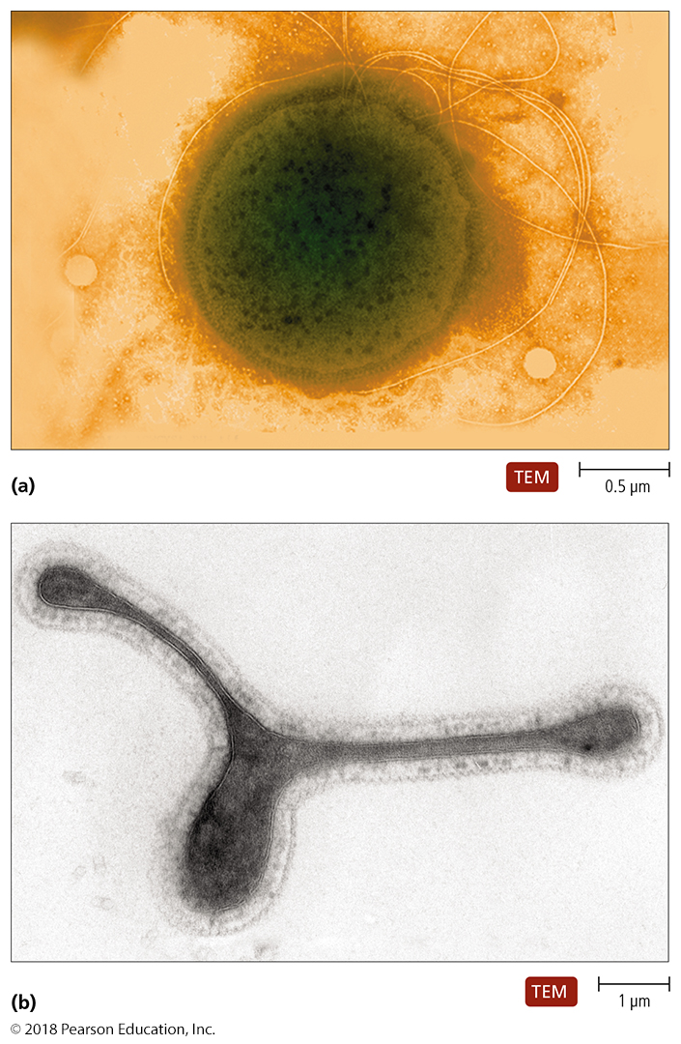
Figure 11.11 Archaea.
Notes:
19

Slide 20
Survey of Archaea
Extremophiles
Require extreme conditions to survive
Temperature, pH, and/or salinity
Prominent members are thermophiles and halophiles

Slide 21
Survey of Archaea
Extremophiles
Thermophiles
DNA, RNA, cytoplasmic membranes, and proteins do not function properly below 45°C
Hyperthermophiles require temperatures over 80°C

Slide 22
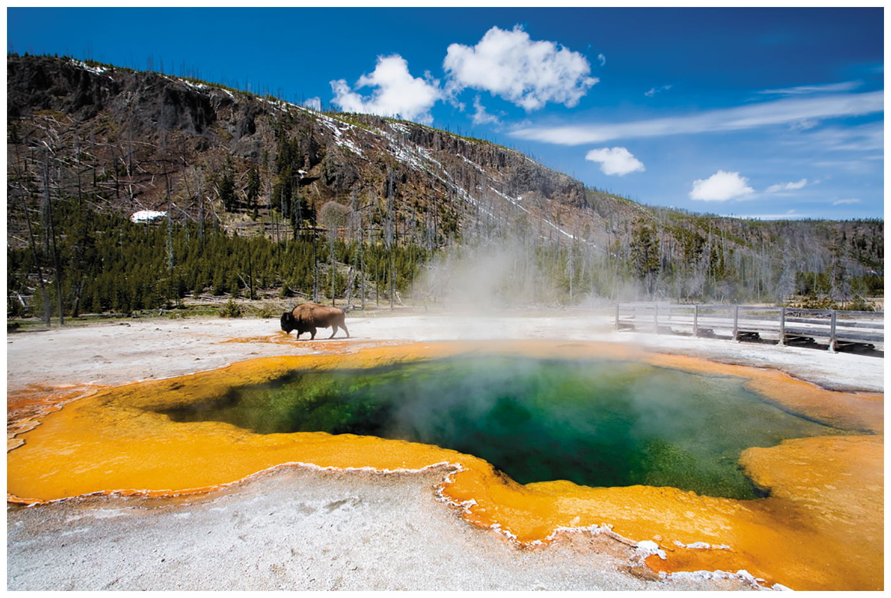
Figure 11.12 Some hyperthermophilic archaea live in hot springs.
Notes:
22

Slide 23
Survey of Archaea
Extremophiles
Halophiles
Inhabit extremely saline habitats
Depend on greater than 9% NaCl to maintain integrity of cell walls
Many contain red or orange pigments
May protect from sunlight
Most studied—Halobacterium salinarium

Slide 24
Figure 11.13 The habitat of halophiles: highly saline water.
Notes:
24

Slide 25
Survey of Archaea
Methanogens
Largest group of archaea
Convert carbon dioxide, hydrogen gas, and organic acids to methane gas
Convert organic wastes in pond, lake, and ocean sediments to methane
Some live in colons of animals
One of primary sources of environmental methane
Have produced ~10 trillion tons of methane that is buried in mud on ocean floor

Slide 26
Chapter 11:
Stop Here

Slide 27
Survey of Bacteria
Low G + C Gram-Positive Bacteria
Clostridia
Rod-shaped, obligate anaerobes
Many form endospores
Important in medicine and industry

Slide 29
Survey of Bacteria
Low G + C Gram-Positive Bacteria
Mycoplasmas
Facultative or obligate anaerobes
Lack cell walls
Smallest free-living cells
Colonize mucous membranes of the respiratory and urinary tracts

Slide 30
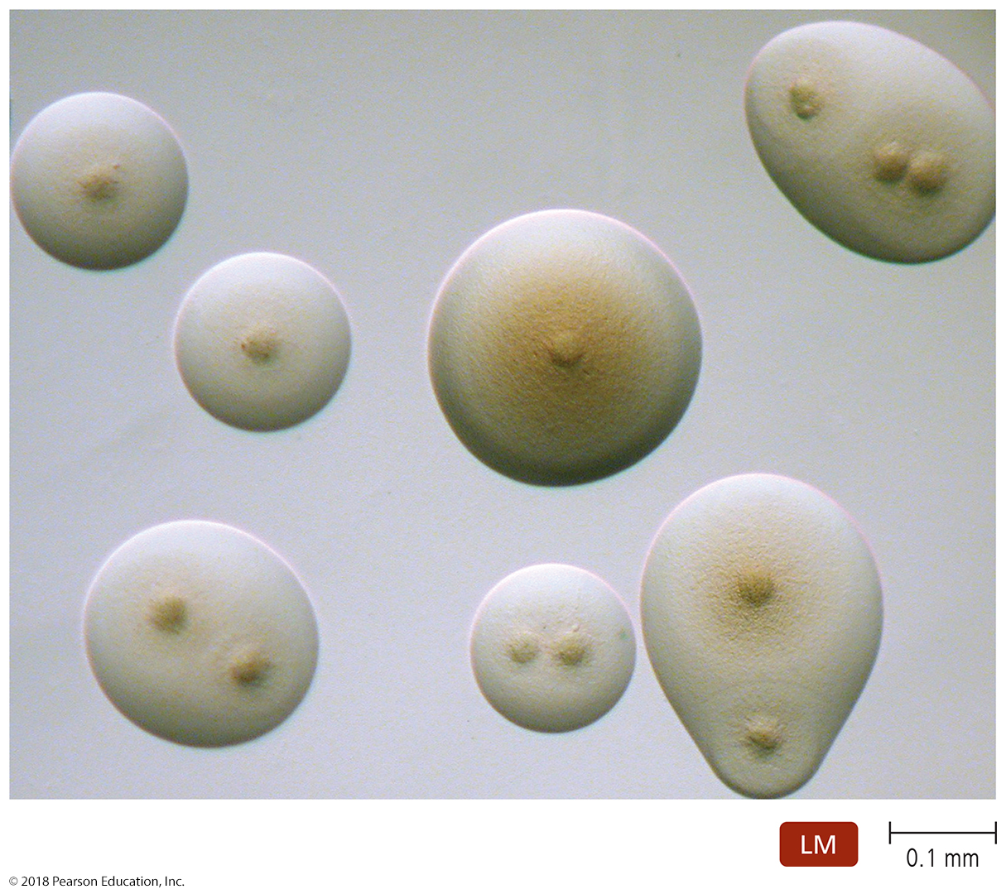
Figure 11.16 The distinctive “fried egg” appearance of Mycoplasma colonies.
Notes:
30

Slide 31
Survey of Bacteria
Low G + C Gram-Positive Bacteria
Other low G + C Gram-positive bacilli and cocci
Bacillus
Many are common in soil
Form endospores
Bacillus thuringiensis toxin used by farmers and gardeners as an insecticide
Bacillus anthracis causes anthrax

Slide 32
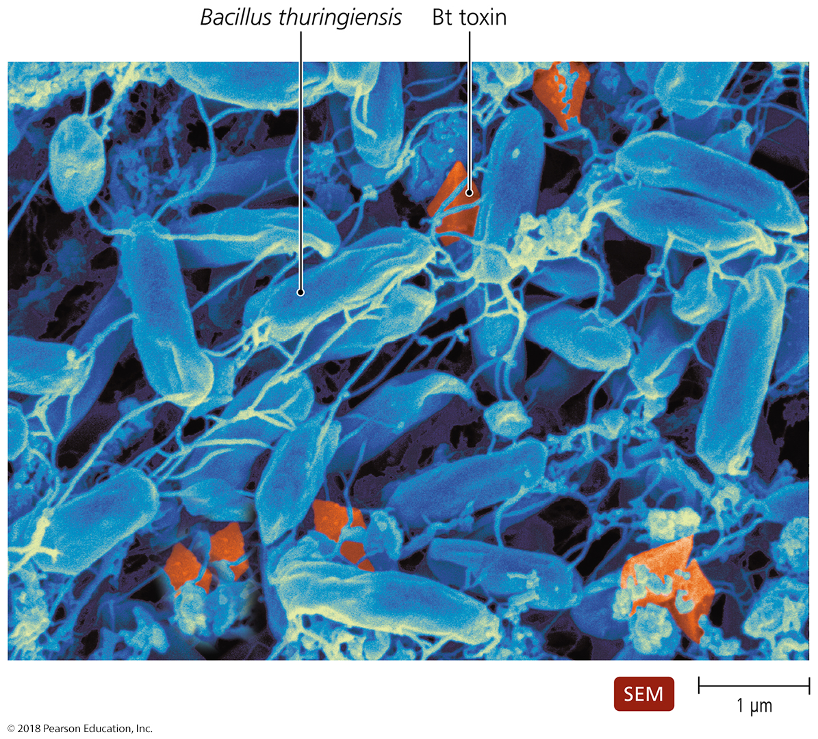
Figure 11.17 Crystals of Bt toxin, produced by the endospore-forming Bacillus thuringiensis.
Notes:
32

Slide 33
Survey of Bacteria
Low G + C Gram-Positive Bacteria
Other low G + C Gram-positive bacilli and cocci
Listeria
Contaminates milk and meat products
Capable of reproducing under refrigeration
Can cross the placenta in pregnant women
Lactobacillus
Grows in the body but rarely causes disease
Used in the production of various foods

Slide 34
Survey of Bacteria
Low G + C Gram-Positive Bacteria
Other low G + C Gram-positive bacilli and cocci
Streptococcus and Enterococcus
Cause numerous diseases
Various strains of multi-drug-resistant streptococci
Staphylococcus
One of the most common inhabitants of humans
Produces toxins and enzymes that contribute to disease

Slide 35
Survey of Bacteria
High G + C Gram-Positive Bacteria
Corynebacterium
Pleomorphic aerobes and facultative anaerobes
Produces metachromatic granules
Mycobacterium
Aerobic rods that sometimes form filaments
Slow growth partly due to mycolic acid in its cell walls
Actinomycetes
Form branching filaments resembling fungi
Important genera include Actinomyces, Nocardia, Streptomyces

Slide 36
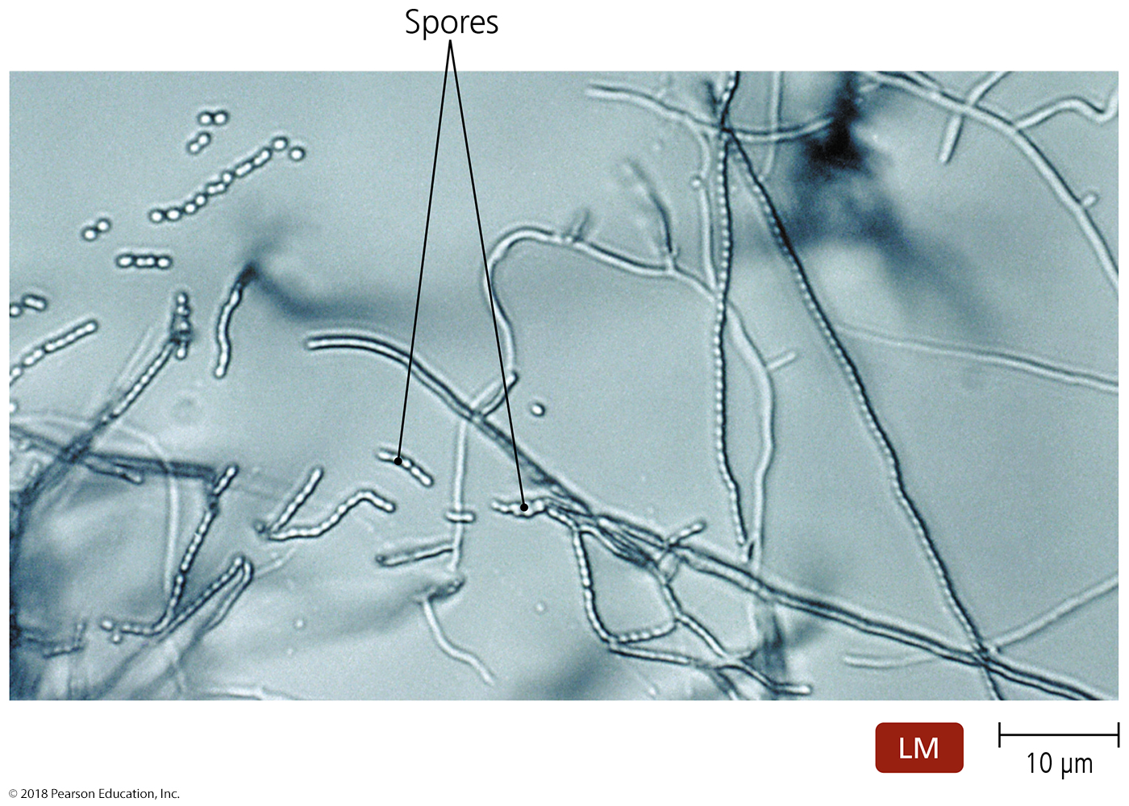
Figure 11.18 The branching filaments of actinomycetes.
Notes:
36

Slide 37
Survey of Bacteria
Gram-Negative Proteobacteria
Largest and most diverse group of bacteria
Six classes of proteobacteria:
Alphaproteobacteria
Betaproteobacteria
Gammaproteobacteria
Deltaproteobacteria
Epsilonproteobacteria
Zetaproteobacteria

Slide 38
Survey of Bacteria
Gram-Negative Proteobacteria
Class Alphaproteobacteria
Nitrogen fixers
Grow in association with the roots of plants
Two genera important to agriculture
Azospirillum
Rhizobium

Slide 39
Survey of Bacteria
Gram-Negative Proteobacteria
Class Alphaproteobacteria
Nitrifying bacteria
Oxidation of nitrogenous compounds provides electrons
Important in the environment and agriculture
Nitrobacter
Purple nonsulfur phototrophs
Grow at the bottom of lakes and ponds

Slide 40
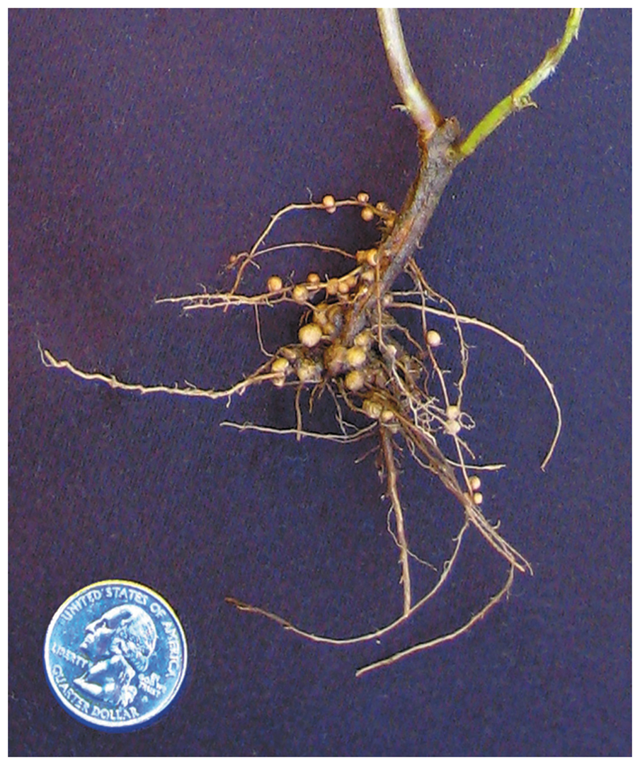
Figure 11.20 Nodules on pea plant roots.
Notes:
40

Slide 41
Survey of Bacteria
Gram-Negative Proteobacteria
Class Alphaproteobacteria
Pathogenic alphaproteobacteria
Rickettsia
Transmitted through bite of an arthropod
Causes several human diseases
Brucella
Causes brucellosis

Slide 42
Survey of Bacteria
Gram-Negative Proteobacteria
Class Betaproteobacteria
Pathogenic betaproteobacteria
Neisseria
Inhabits mucous membranes of mammals
Causes numerous diseases
Bordetella
Causes pertussis
Burkholderia
Colonizes moist environmental surfaces and respiratory passages of cystic fibrosis patients

Slide 43
Survey of Bacteria
Gram-Negative Proteobacteria
Class Gammaproteobacteria
Largest and most diverse class of proteobacteria

Slide 44
Survey of Bacteria
Gram-Negative Proteobacteria
Class Gammaproteobacteria
Intracellular pathogens
Legionella
Causes Legionnaires’ disease
Coxiella
Causes Q fever
Methane oxidizers
Use methane as a carbon and energy source
Inhabit anaerobic environments

Slide 45
Survey of Bacteria
Gram-Negative Proteobacteria
Class Gammaproteobacteria
Glycolytic facultative anaerobes
Catabolize carbohydrates by glycolysis and the pentose phosphate pathway
Divided into three families

Slide 46
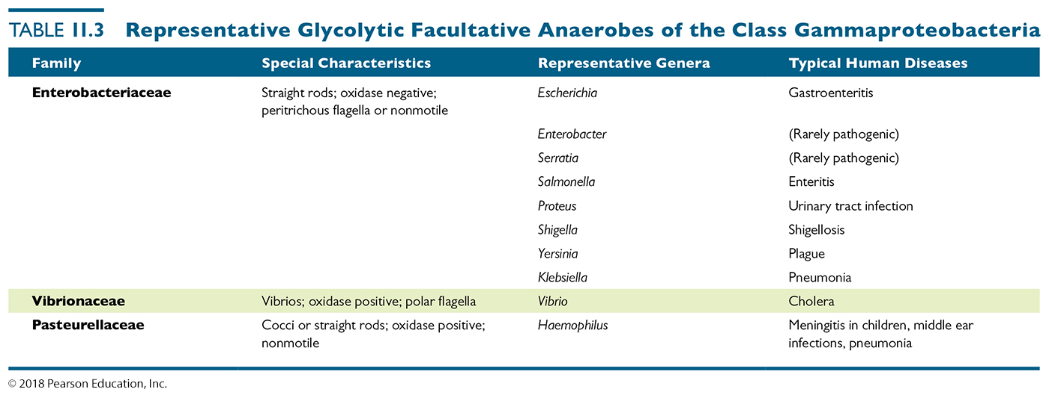
Table 11.3 Representative Glycolytic Facultative Anaerobes of the Class Gammaproteobacteria
Notes:
46

Slide 47
Survey of Bacteria
Gram-Negative Proteobacteria
Class Gammaproteobacteria
Pseudomonads
Break down numerous organic compounds
Important pathogens of humans and animals
Pseudomonas causes urinary tract, ear, and lung infections

Slide 48
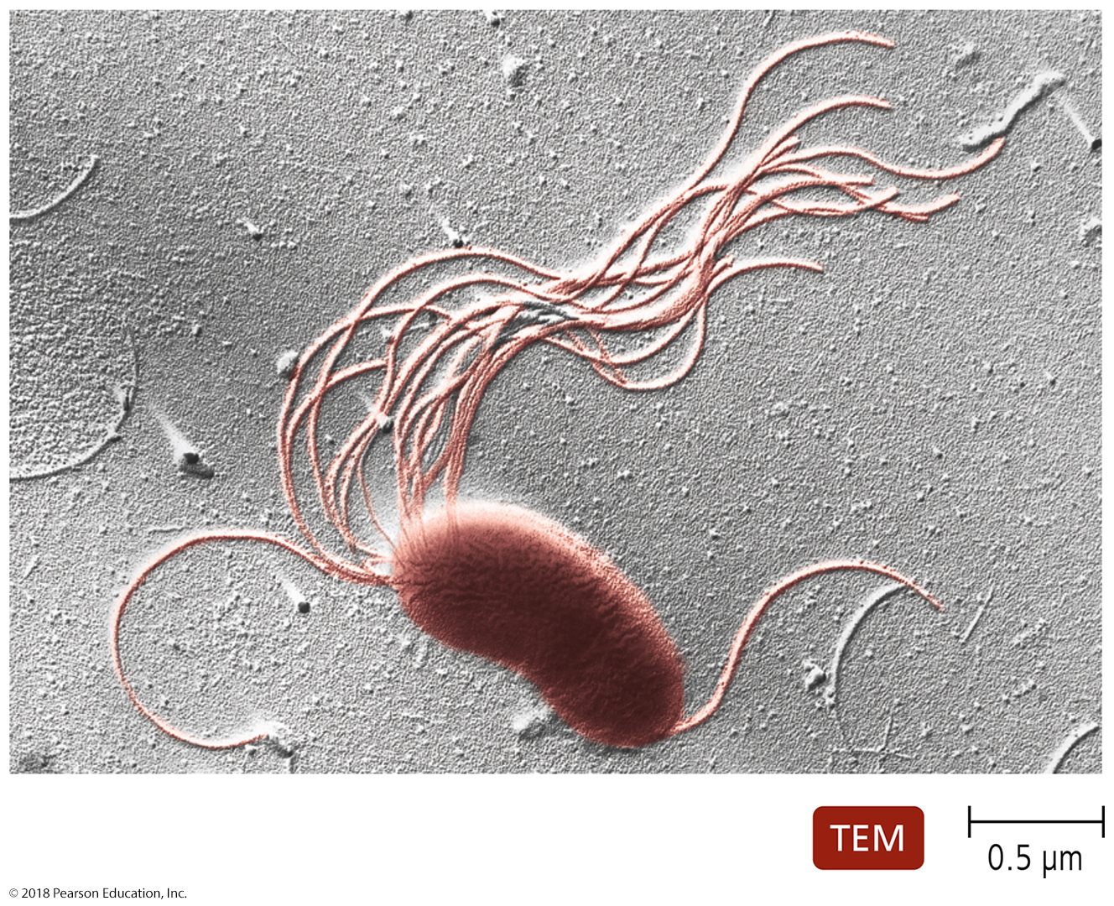
Figure 11.25 Pseudomonas has notable polar flagella.
Notes:
48

Slide 49
Survey of Bacteria
Gram-Negative Proteobacteria
Class Epsilonproteobacteria
Important genera include
Campylobacter
Helicobacter

Slide 50
Survey of Bacteria
Other Gram-Negative Bacteria
Chlamydias
Grow intracellularly in mammals, birds, and some invertebrates
Some are smaller than viruses
Most common sexually transmitted bacteria in the United States

Slide 51
Survey of Bacteria
Other Gram-Negative Bacteria
Spirochetes
Motile bacteria that move in a corkscrew motion
Have diverse metabolism and habitats
Treponema and Borrelia both cause disease in humans

Slide 52
Survey of Bacteria
Other Gram-Negative Bacteria
Bacteroids
Bacteroides
Inhabit digestive tracts of humans and animals
Some species cause infections

