Slide 1
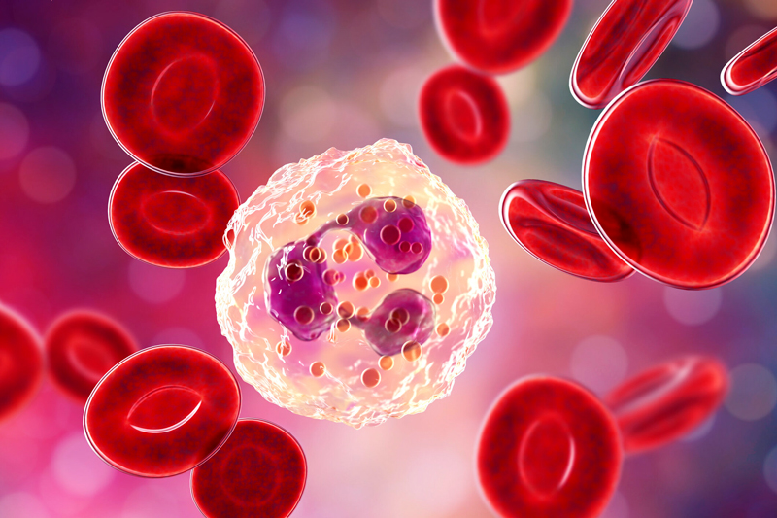
Cell Biology and Physiology Lab IRSC
Blood Cell Types

Slide 2
Wright-Giemsa stain
Methylene blue and azure B stains nucleus purple/blue
Eosin dyes the cytoplasm reddish (sometimes reddish/orange)

Slide 3
Erythrocytes
Red blood cells
Smallest
Biconcave
Lack nucleus
Reddish due to hemoglobin
120 days

Slide 4
Leukocytes
White blood cells
Granulocytes
Neutrophils
Basophils
Eosinophils
Agranulocytes
Lymphocytes (B and T cells)
Monocytes
Natural killer cells
platelets

Slide 5
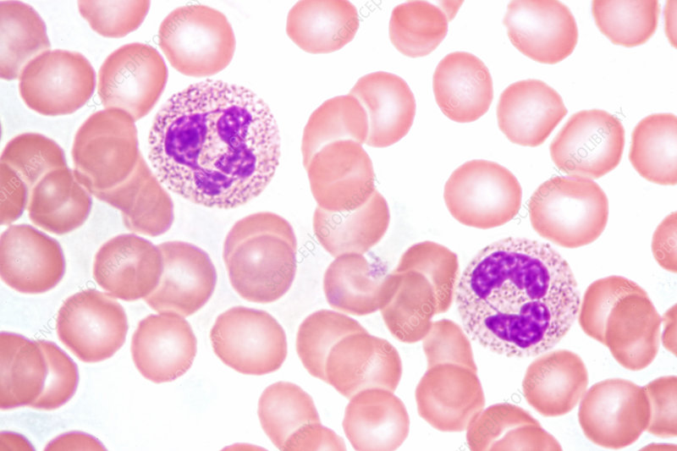
Neutrophils
First to site of infection
When there is injury, inflammatory molecules cause neutrophils to leave the capillaries and enter the injured tissue, they phagocytize bacteria and alert other cells
Nucleus has 3-5 lobes
Light granules

Slide 6
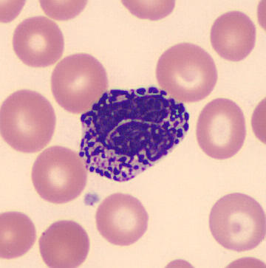
Basophils
Phagocytize foreign material, release histamine and other inflammatory molecules calling other immune cells to area; can also release histamine in allergic reactions (dysfunction)
Granules stain with basic dyes, blackish in color
Low numbers
Multi-lobed nucleus

Slide 7
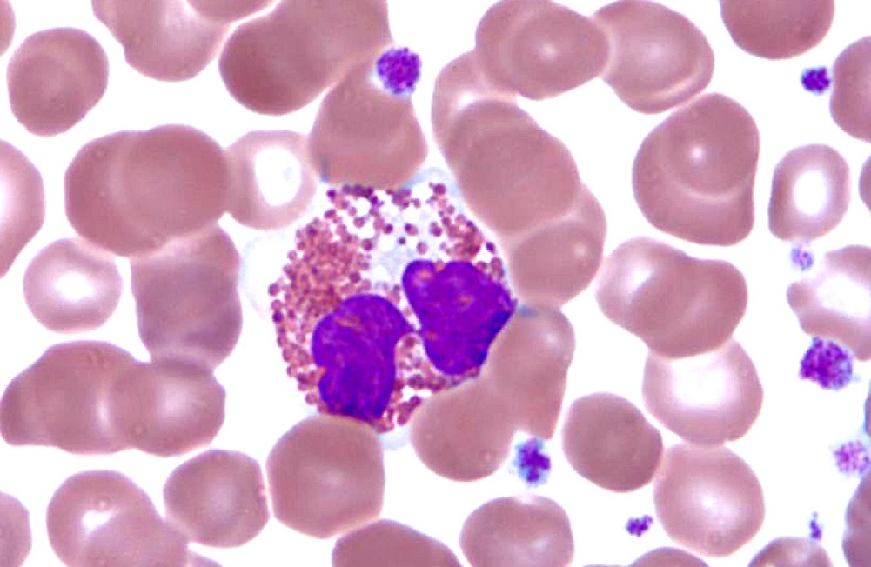
Eosinophils
Help to fight parasitic infections; they can also release histamine excessively adding to an allergic response
Granules are reddish in color
Nucleus usually is 2 lobes
Granules are lysosomes

Slide 8
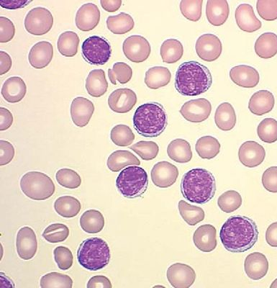
Lymphocytes
B and T cells – adaptive immune cells
B cells produce antibody
T cells (several different types)
Small, almost like RBC but purple
Nucleus is huge

Slide 9
Monocytes
Large cells, large nucleus
Sometimes you can see pseudopods once they start developing into macrophages

Slide 10
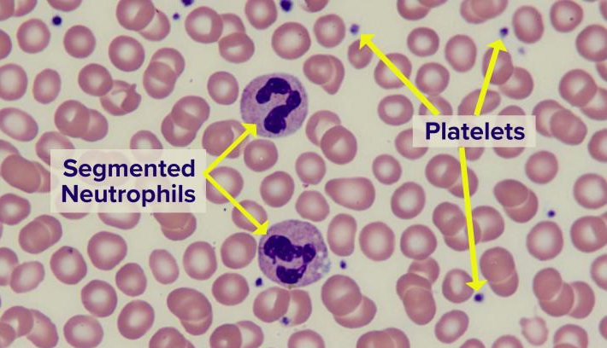
Platelets
Blood clot formation
Breakage of larger cells, megakaryocytes

