Slide 1
Cell Culture
lifetechnologies.com

Slide 2
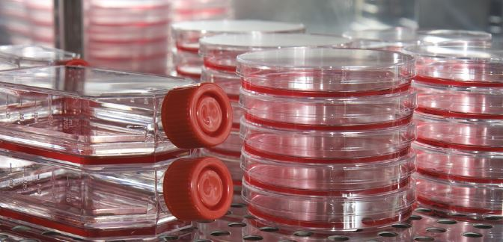
What is cell culture?
Removal of cells from an animal or plant and their subsequent growth in a favorable artificial environment
Much more difficult than growing established bacterial and fungal strains
In this lab we will be dealing with mammalian cell culture

Slide 3
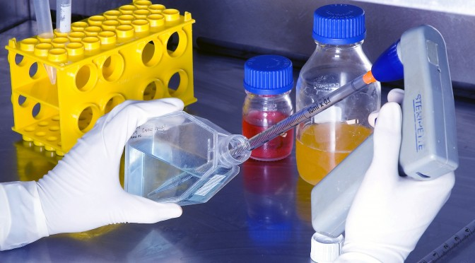
Why do cell culture?
Uses of cell culture:
Culturing specific plants
Used medically to generate artificial tissues
Investigating normal physiology and biochemistry of the cell
Study the effects of various chemicals on cell types before testing on whole animal
Growing viruses and production of anti-viral vaccines
Cancer research
Production of monoclonal antibodies

Slide 4
Biosafety Levels
Biosafety Level 1 (BSL-1)
BSL-1 is the basic level of protection common to most research and clinical laboratories, and is appropriate for agents that are not known to cause disease in normal, healthy humans.
Biosafety Level 2 (BSL-2)
BSL-2 is appropriate for moderate-risk agents known to cause human disease of varying severity by ingestion or through percutaneous or mucous membrane exposure. Most cell culture labs should be at least BSL-2, but the exact requirements depend upon the cell line used and the type of work conducted.
Our lab is a Biosafety Level 2
Biosafety Level 3 (BSL-3)
BSL-3 is appropriate for indigenous or exotic agents with a known potential for aerosol transmission, and for agents that may cause serious and potentially lethal infections.
Biosafety Level 4 (BSL-4)
BSL-4 is appropriate for exotic agents that pose a high individual risk of life-threatening disease by infectious aerosols and for which no treatment is available. These agents arerestricted to high containment laboratories.

Slide 5
Equipment Needed
Cell culture hood (i.e., laminar-flow hood or biosafety cabinet) – Need at least Class II
Incubator (humid CO2 incubator recommended)
Water bath
Centrifuge
Refrigerator and freezer (–20°C)
Cell counter (e.g., CountessR II Automated Cell Counter or hemacytometer)
Inverted microscope
Liquid nitrogen (N2) freezer or cryostorage container
Sterilizer (i.e., autoclave)
Aspiration pump (peristaltic or vacuum)
pH meter
Cell culture vessels (e.g., flasks, Petri dishes, roller bottles, multiwell plates)
Pipettes and pipettors
Syringes and needles
Small waste containers
Media, serum, and reagents
Cells

Slide 6
Culture Conditions
Can vary depending on cell type but include:
a substrate or medium that supplies the essential nutrients (amino acids, carbohydrates, vitamins, minerals)
growth factors
Fetal bovine serum is often used – high embryonic growth factors
hormones
gases - O₂, CO₂
5% CO₂ is needed to simulate mammalian blood
Majority of CO2 in blood exists in the form of bicarbonate (HCO3-) which acts as a pH buffer
As a culture sits there and more CO2 is produced by the cells, the pH of the media might change and need to be adjusted
a regulated physico-chemical environment (pH, osmotic pressure, temperature)

Slide 7
Primary Cell Culture
Cells are isolated from the tissue and start to proliferate
We will do this using chicken embryos
If you are doing a necropsy on an animal, might take some of the tissues to grow out in primary culture
Confluence – occupy all the available substrate (aka bottom of well or flask)
When confluence is reached, cells need to sub-cultured
After subculture, the primary culture becomes known as a cell line
Finite vs. Continuous Cell Line
Normal cells only divide a certain number of times
If cells go through transformation, they can become immortal or continuous
Can be induced spontaneously, by chemical, or by virus

Slide 8
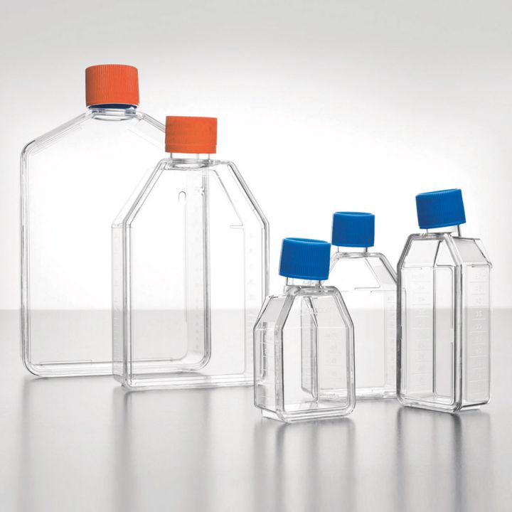
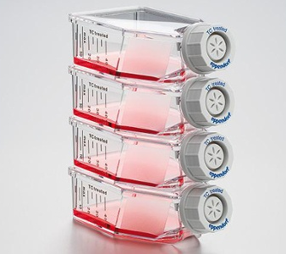
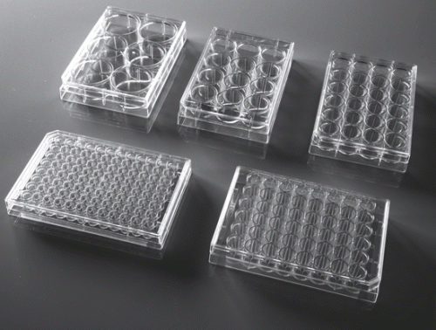

Slide 9
Media
Type depends on cell type
Contains vitamins, nutrients, antibiotics (in some cases)
Fetal bovine serum used for growth factors
Contains phenol red (pH indicator)
Remember, cells of multicellular organisms rely on other cell types within the organism - have to account for that within the media make-up
We will be using DMEM
Dulbecco’s Modified Eagle Media (developed by a guy named Eagle)
High concentration of amino acids, vitamins, glucose

Slide 10
CO2 Incubator
Most mammalian cells need ~5% CO2 in the incubator
This serves as a buffer to help maintain pH just like you would find in the blood
Don’t want anything else in our incubator except our cells – no microbiology experiments!

Slide 11
Tissue culture needs extreme aseptic technique!
Needs a hood, incubator, equipment NOT being used for things like bacterial growth
Cells need to be under a hood anytime they are exposed to open air
Everything must be sterilized and only opened under the hood!
Spray hood down with alcohol before use, turn hood on for ~30 minutes before use
Spray any bottles with alcohol before placing in hood
If you even think you touched your pipette tip, replace with new one
Just be aware and vigilant!

Slide 12
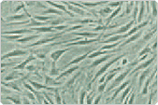
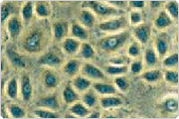
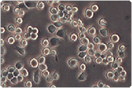
Most cells are anchorage dependent and have to be grown adhered to solid medium (i.e. bottom of flask)
Adhesion molecules hold the cells to the flask
Some can be grown suspended in medium (suspension culture)
Morphology of Mammalian Cells:
Fibroblast
Epithelial-like
Lymphoblast-like
http://www.lifetechnologies.com/us/en/home/references/gibco-cell-culture-basics/introduction-to-cell-culture.html

Slide 13
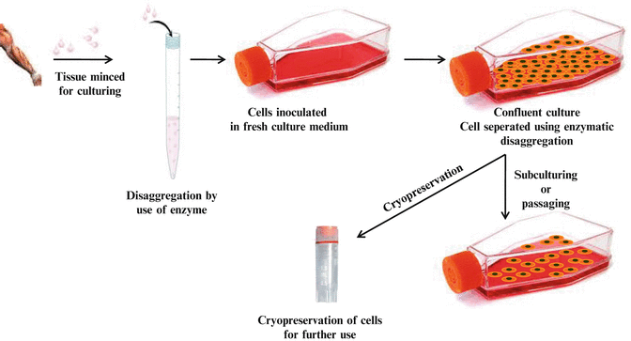
Cryopreservation
Excess cells are frozen down for future use
Must be properly treated with glycerol or DMSO
Prevention of ice crystals
10%
Slow freeze – first placed at -70°C
Then place in -130°C – liquid nitrogen

Slide 14
Before you start working with the cells:
Turn hood on and turn UV light off
Wash hands and arms up to elbows
I like to be extra cautious and spray hands with alcohol
Wipe hood with alcohol
Place all of the sterile equipment you need inside the hood
Pipettes
Waste container
Warm media and other reagents in warm water bath outside hood, wipe down with alcohol before placing them in hood
Flasks, plates
Make sure all of these have been autoclaved, sterilized, sprayed down with alcohol (especially if you have warmed bottles of media in the warm water bath)
DON’T open anything until under the hood and ideally until needed
Wash hands again, if wearing gloves be cautious of what you touch (gloves can give false sense of security), if not wearing gloves spray hands with alcohol every once in a while

Slide 15
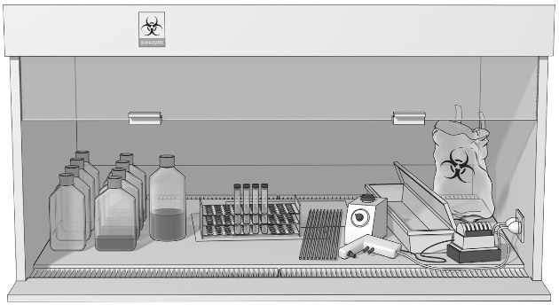

Slide 16
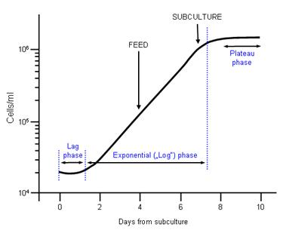
When to Subculture?
Depends on cell type, want to do it before they reach confluence – don’t want them to crash
http://lifescience.roche.com/shop/products/subculture-of-animal-cells

Slide 17
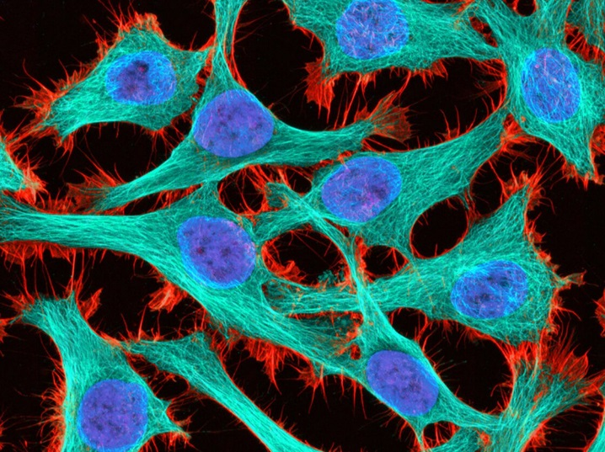
HeLa Cells
Human cervical cancer cells (adenocarcinoma)
Taken from Henrietta Lacks in the 1950s
Contain human papillomavirus
Adherent cells
Media: Eagles Minimum Essential Medium (EMEM or DMEM)
Used in lots of cancer research

Slide 18
HeLa cells – a great legacy
Been described in over 100,000 publications
Used to grow Polio in the 50s, laid the groundwork for development of vaccine
Effects of x-rays on human cells
In 60s were taken up to space to see the effects of space on human cells before manned missions
Research how Salmonella causes disease
In the 80s they were used to study HPV
In the 80s, researchers discovered HeLa cells were not that susceptible to HIV infection, leading to new directions in the research
Cancer research
Telomere research

Slide 19
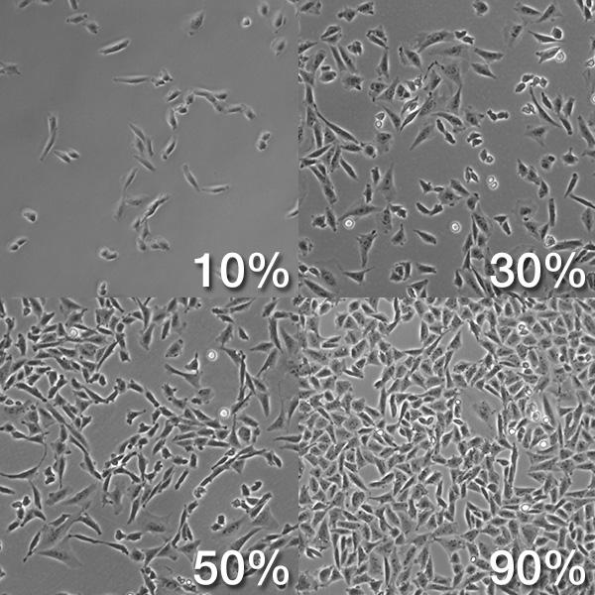
Measuring confluency

Slide 20
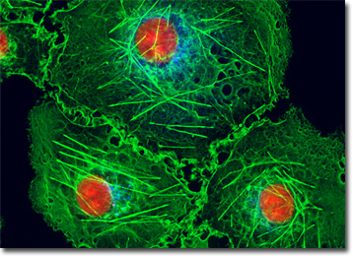
Cos-7 Cells
Monkey Cells – derived from kidney of African green monkey
These cells were originally CV-1
Transformed by simian vacuolating virus 40 (SV40)
Resemble most fibroblast in humans
Adherent
Media: Dulbecco’s Modified Eagles Medium (DMEM)
Used to study the SV40 monkey virus, used to make recombinant proteins, used in transfection experiments, used in mesothelioma research

Slide 21
293T cells
Human embryonic kidney cells
Adherent
Media: DMEM
Contains SV40 T antigen, highly transfectable, used for retroviral production and protein production

Slide 22
HT1080 cells
Prostate cancer cell line, fibrosarcoma
Adherent
Media: EMEM
Used for cancer research

Slide 23
SupT1
Human T lymphoblast
Suspension
Media: RPMI-1640
Express high levels of CD4, used in HIV research

Slide 24
Developing Vaccines
In order to develop vaccines for viruses that could be mass-produced, researchers first had to grow the viruses with which to develop those vaccines – in large quantities and with great consistency.
Can only grow viruses in a host
At first scientists were limited to doing this in live animal hosts. Vaccine farms were started in the 1800s to harvest cowpox virus.
However, mammalian cell culture now allows this process of virus growth for vaccine development in cell lines.
Better controlled, less contamination

Slide 25
During early research to develop a polio vaccine, researchers discovered that the virus also infects monkeys.
Early vaccine trial candidates took material taken from spinal cord cells taken from infected monkeys.
This resulted in some paralysis due to the myelin in the vaccine material, trials were stopped.
In 1936, Olitsky and Sabin had success growing polio in human brain tissue taken from an embryo, but feared the same side effects.
13 years later, they successfully grew polio in skin and muscle cells.
A monkey kidney cell strain is now used to develop polio vaccine.
Vaccine development for viruses using human cell strains really got started in the 1960s.

Slide 26
WI-38 and MRC-5 are human cells lines derived from fetal tissues
Many have ethical questions due to the lack of understanding the specifics:
Babies are NOT being constantly aborted to produce these cell lines to produce vaccines. These cells lines were taken from one fetus and have been continuously grown since.
There is NOT aborted fetal tissue in the vaccine solution put into your arm.
Researchers took tissue from an already aborted fetus to grow cell lines (embryos have lots of stem cells)
The vaccines that have been developed using these cells lines have resulted in saving millions (or more) lives.

