Slide 1
Cell Biology and Physiology
Stem Cells, Cell Asymmetry, and
Cell Death
Chapter 21
Dr. Capers
Molecular and Cell Biology, Lodish, 8th edition
Notes:
Pluripotent stem cells regenerate planaria tissue.
Colony of pluripotent stem cell–like neoblasts (red) and differentiating cells (blue) all derived from a single neoblast (14 days after regeneration of the tail was initiated by amputation).

Slide 2
Descriptions of cell division always imply that the parent cell always gives rise to 2 identical, symmetrical daughter cells
If this were always the case, none of the hundreds of differentiated cell types and functioning tissues present in complex multicellular organisms would ever form
Specific patterns of mitotic divisions – cell lineage
Cell lineage traces the birth order of cells as they progressively become more restricted in their developmental potential and differentiate

Slide 3
Both mouse and human embryos pass through 8-cell stage in which each cell can still form every tissue
All of these cells are totipotent
At the 16-cell stage, this is no longer possible
Some cells will become embryo, some will become placental
Those that will become embryo are pluripotent

Slide 4
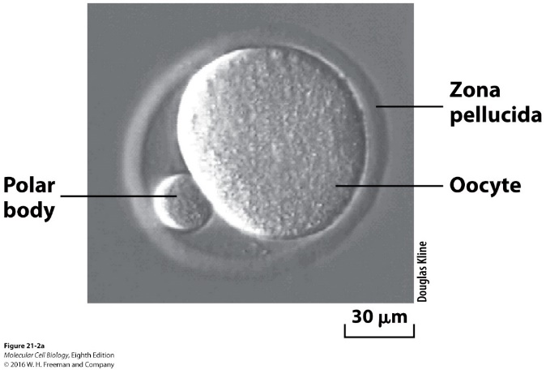
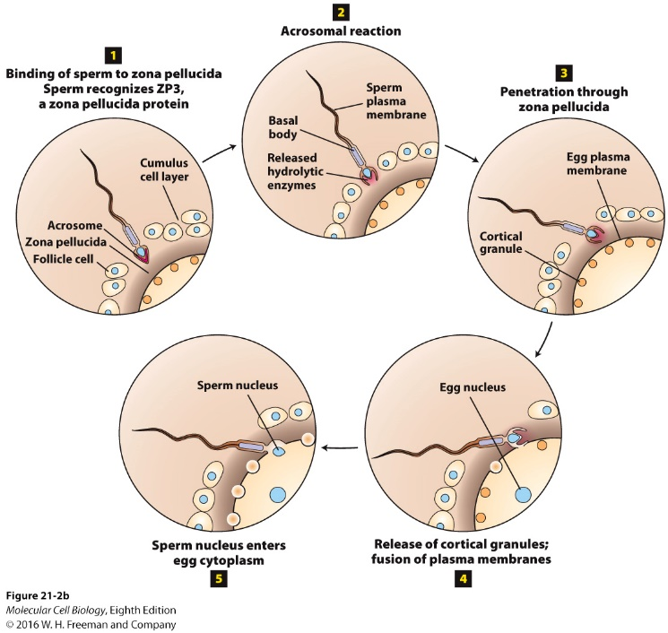
Early mammalian development
Fertilization unifies the genome
Sperm must swim an incredible distance to make it to the egg (equivalent of several miles if the sperm was a person)
Sperm flagellum contains 9000 dynein motors
Once it reaches the egg, it has to penetrate several layers

Slide 5
The zygote does not remain single celled for long
Fertilization quickly followed by cleavage
Series of divisions that take about one day each
8-cell embryo forms 16-celled morula
Morula becomes compacted
Cells are held together by cell adhesion
Some of the cell adhesions release allowing fluid into blastocoel
Additional divisions lead to the blastocyst

Slide 6
Blastocyst
Composed of 64 cells
2 cell types:
Trophectoderm – form the placenta
Inner cell mass (ICM) – forms embryo

Slide 7
Embryonic Stem cells (ES cells)
Isolated from inner cell mass
Grown indefinitely in culture
Pluripotency of ES cells is controlled by multiple factors:
State of DNA methylation
Chromatin regulators
Certain micro-RNAs
Transcription factors: Oct4, Sox2, Nanog

Slide 8
Animal cloning shows that differentiation can be reversed
For the most part, genome is the same in all types of cells in an organism
Exception would be T cells and B cells
In somatic-cell nuclear transfer, a nucleus of an adult somatic cell is introduced into an egg whose nucleus has been removed
Then implanted into a foster mother
Has been successful in developing into embryo and then growing animal
However, there are issues: low clone success, high obesity in cloned animals, etc
Induced Pluripotent Stem Cells (iPS)

Slide 9
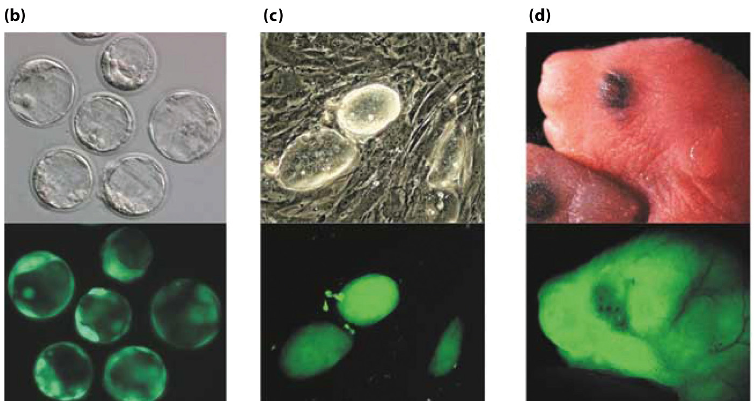
Post mitotic cells (olfactory neurons) from mouse that were
genetically labeled with GFP

Slide 10
Stem cells and niches in multicellular organisms
Cells in an animal can have a shorter lifespan than the animal itself
Therefore, cells need to be replenished
There are populations of multipotent stem cells
In contrast to pluripotent ES cells, multipotent can give rise to some but not all cell types
Stem cell populations for many tissues:
Blood, intestine, skin, ovaries, testes, muscle, even some parts of the brain

Slide 11
Multipotent somatic stem cells have 3 key properties:
Give rise to multiple types of differentiated cells. Stem cells have the ability for self renewal
Undifferentiated – they do not express proteins characteristic of the differentiated cell types formed by their descendants
The # of stem cells of a particular type generally increases during embryonic development and then remains constant over the individual’s lifetime.
These stem cell can be lost after chronic tissue injury, chemotherapy/radiation, etc.

Slide 13
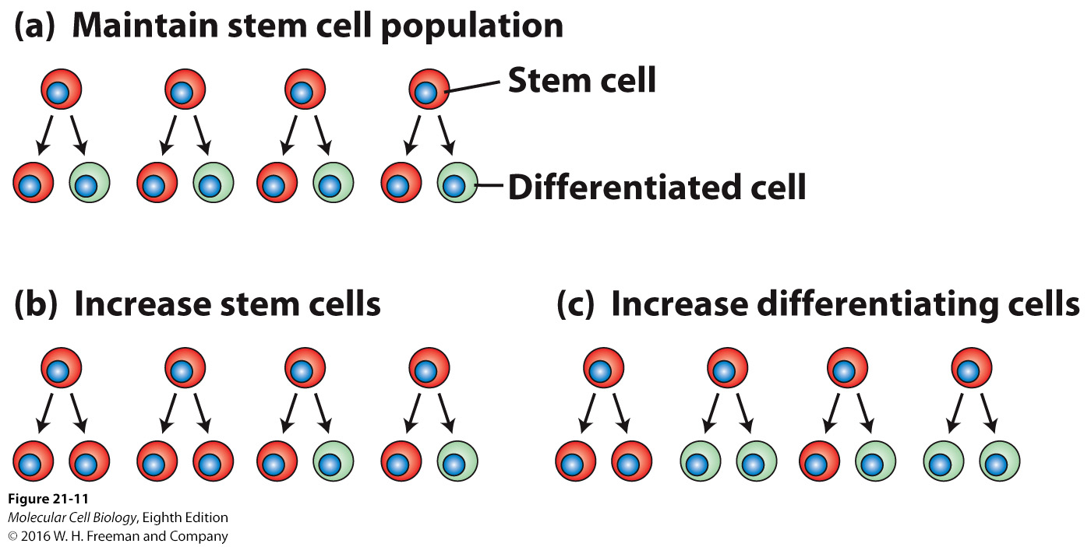
Patterns of stem cell division
Invertebrates:
Divide asymmetrically to generate one copy of the parent cell and one daughter cell that will be more restricted
Vertebrates:
Division allows the # of stem cells or differentiated cells to increase or decrease according to the needs of the animal

Slide 14
Stem cells need the right microenvironment to remain multipotent and regulate divisions
Need certain transcription factors to remain active inside them
Hormone signals
Location: stem-cell niche
In order to investigate or use stem cells, scientists must find them and isolate them

Slide 15
Germ-line Stem Cells
Germ line is the cell lineage that gives rise to oocytes and sperm
Unipotent – only give rise to one type of cell
Will undergo meiosis

Slide 16
Intestinal stem cells continuously generate all the cells of the intestinal epithelium
Enterocytes – transport nutrients from the lumen into the blood
Continuously self renewed
Stem cell population located in the crypts of the intestine
Include Paneth cells, these cells also have immune function (secrete antimicrobial proteins)

Slide 17
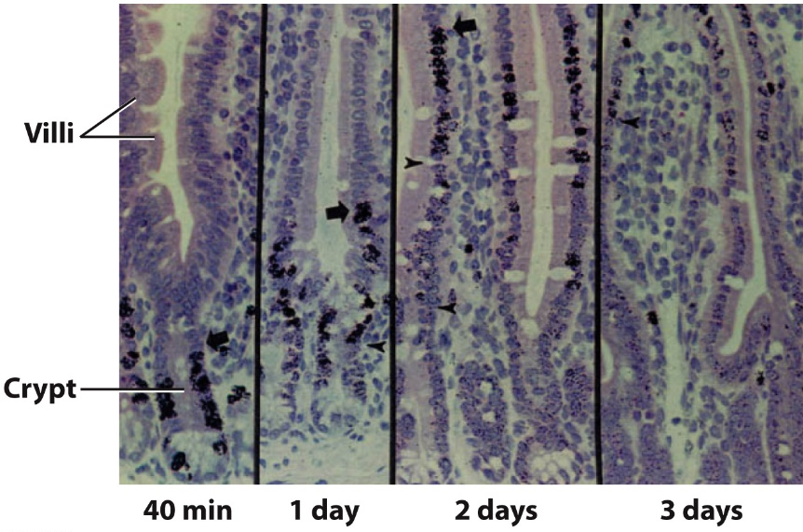

Slide 18
Hematopoietic Stem Cells
Replenish all blood cells
Located in embryonic liver and then in adult bone marrow
Give rise to other multipotent cell types:
Myeloid
Lymphoid
Numerous cytokines involved

Slide 19
Notes:
FIGURE 21-17 Formation of blood cells from hematopoietic stem cells in the bone marrow.
Hematopoietic stem cells (HSCs) form all blood cells.
Multipotent hematopoietic stem cells:
Divide symmetrically – increase stem cell number
Divide asymmetrically –
One daughter cell – remains multipotent like the parent stem cell
One daughter – generates either lymphoid progenitors or myeloid progenitors (capable of limited self-renewal but committed to one of the two major hematopoietic lineages)
Cytokine types and amounts – regulate HSC self-renewal divisions and proliferation and differentiation of the precursor cells for various blood-cell lineages
Progenitors – either multipotent or unipotent
(Cytokines that support HSC differentiation: CSF = colony-stimulating factor; IL = interleukin; SCF = stem-cell factor; Epo = erythropoietin; Tpo = thrombopoietin.)

Slide 20
Notes:
EXPERIMENTAL FIGURE 21-19 The hematopoietic stem-cell niche in the bone marrow.
Rare cell types constitute the hematopoietic stem cell bone marrow niche.
(a) Bone marrow:
Permeated by small blood vessels termed sinusoids
Contains dozens of different cell types – including osteoblasts and osteoclasts that build and degrade bone, multiple types of hematopoietic cells, fibroblasts, and other cell types.
HSC niche cells – rare mesenchymal stromal cells:
Adhere to sinusoids
Express SCF (stem cell factor) hormone – activates the HSC Kit protein tyrosine kinase receptor
Express the leptin (cytokine) receptor
Secrete CXCL12 – chemoattractant keeps HSCs in niche
Experiment – immunofluorescence detection of HSCs and niche cells in bone marrow:
Results –
(b) SCF-GFP-expressing cells
(c) HSCs stained anti-CD150 HSC marker protein antibody
(d) Cells stained with a collection of antibodies specific for proteins expressed by different types of differentiated blood cells, but not by HSCs
(e) (b-d) images merged
Conclusion: HSCs localize close to SCF-expressing cells.

Slide 21
Meristems are niches for stems cells in plants
Shoot apical meristems
Root apical meristems
Unlike somatic stem cells in animals, somatic stem cells in plants give rise to entire organs (not just tissues like in animals)

Slide 22
Notes:
FIGURE 21-20 Structures of the Arabidopsis thaliana shoot and root meristems.
(a) Shoot apical meristem apex:
Organizing center cells – signal to maintain the overlying stem cells
Stem cells generate rapidly dividing transient amplifying cells (direction of black arrows).
Transient amplifying cells – eventually differentiate and give rise to entire organs, such as a leaf
(b) Root meristem:
Stem cells surround the mitotically less active quiescent center – four cells signal stem cells to prevent differentiation
Each stem cell divides asymmetrically:
One daughter – remains adjacent to the quiescent center – remains a stem cell (self-renewal)
One daughter – becomes a transient amplifying cell that divides several times before exiting the cell cycle, elongating, and differentiating

Slide 23
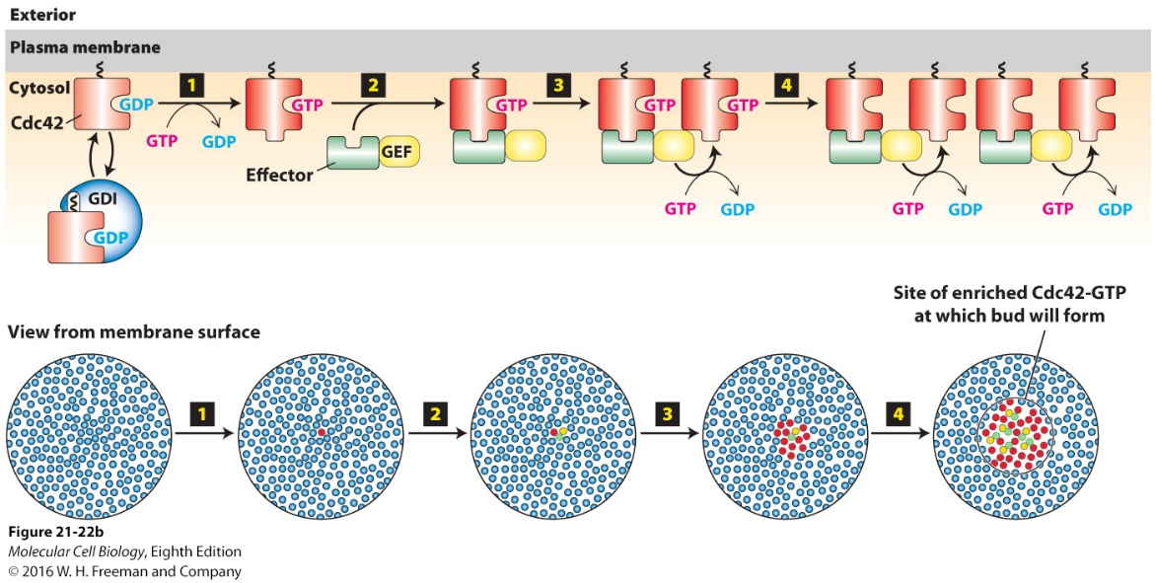
Mechanisms of cell polarity and asymmetric cell divisions
Cell polarity – ability of cells to organize their internal structure, resulting in changes in cell shape and function
Budding yeast grow by selecting a single site on its surface at which to assemble a new bud
If cell grew 2 buds simultaneously, the duplicated chromosomes would not know where to go
Single bud for growth requires concentration of Cdc42 at site of bud growth
Member of Rho family, small GTP-binding proteins, molecular switch

Slide 24
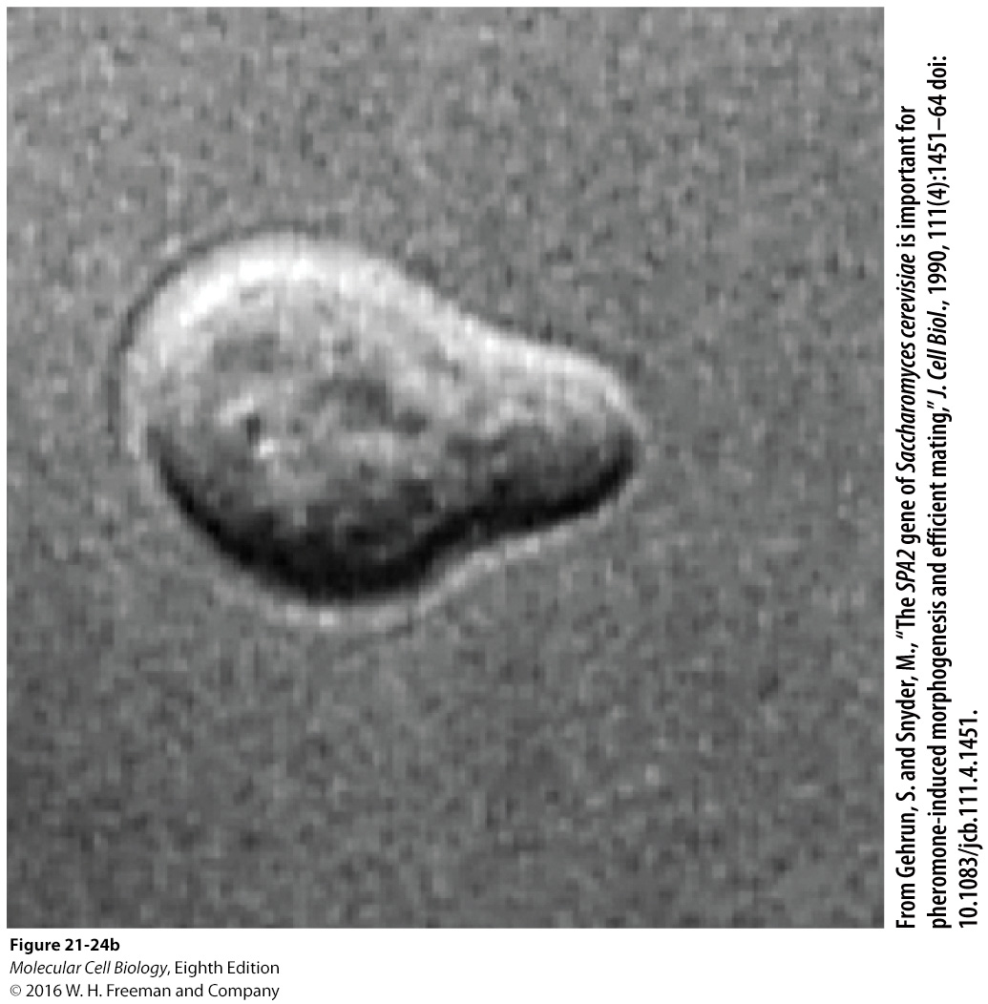
Notes:
FIGURE 21-24 Mechanism of shmoo formation in yeast.
Haploid yeast cell grows asymmetrically toward the highest concentration of opposite mating type mating factor through polarized membrane traffic.
(a) Mechanism:
Step 1:
Surface receptors respond strongest at site of highest mating factor/pheromone concentration.
Receptor signaling locally activates Cdc42·GTP.
Step 2:
Cdc42·GTP locally activates formins.
Formins nucleate and elongate actin filaments with (+) ends oriented toward Cdc42·GTP at membrane.
Step 3: Myosin V motor transports secretory vesicles toward actin filament (+) ends.
Step 4: Reinforcement – endocytic cycle constantly returns diffusing polarity factors such as membrane-associated Cdc42 back along the actin filaments to the signal site
(b) LM image of a shmooing yeast cell.

Slide 25
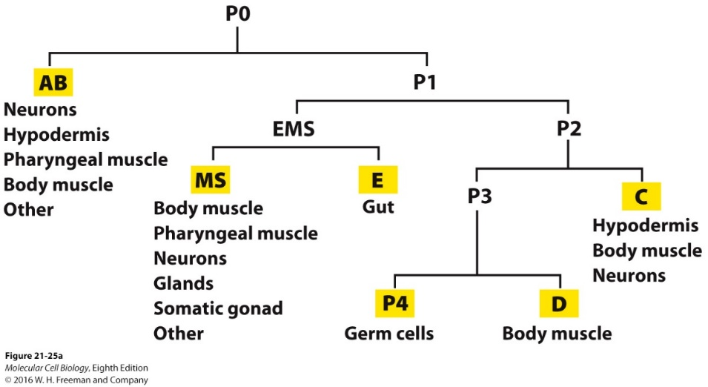
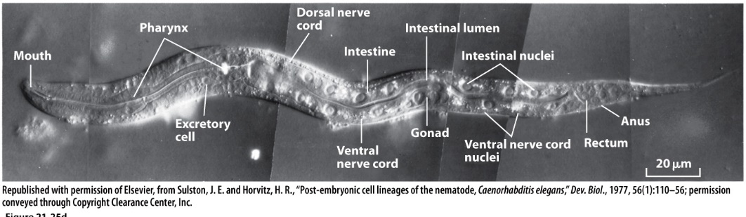
Par proteins direct cell asymmetry in the nematode embryo
C. elegans
Zygote gives rise to AB and PI cells by asymmetric division
Both give rise to different lineages

Slide 26
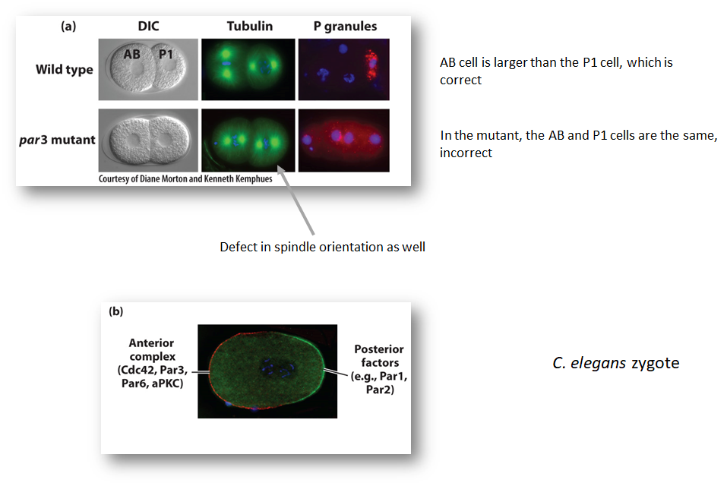
Notes:
EXPERIMENTAL FIGURE 21-26 Par proteins are asymmetrically localized in the one-cell worm embryo.
(a) Caenorhabditis elegans nematode worm wild-type and par3 mutant embryos:
Wild-type embryo –
AB cell– larger than the P1 cell
P granules – highly localized at one end of P1 cell
Spindles oriented perpendicular to each other
par3 mutant embryo –
AB and P cells – same size
P granules – mislocalized throughout both cells
Spindle orientation defect – same orientation
(b) Complementary localization of the anterior Par complex (Cdc42-Par3-Par6-aPKC) (red) and posterior factors (green) in the one-cell embryo
Protein complex localizations – mutually antagonistic

Slide 27
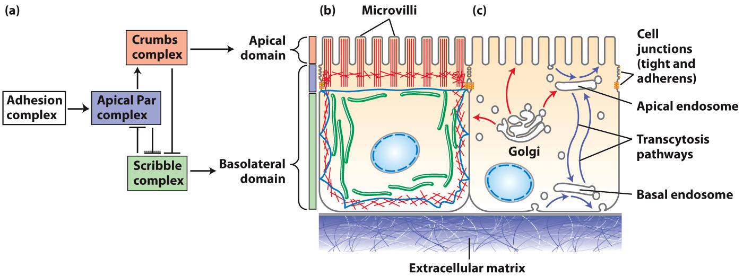
Par proteins and other polarity complexes are involved in epithelial cell polarity in vertebrates
Epithelial cells use cues from adjacent cells and extracellular matrix to orient their axis of polarization
Process in vertebrates is close to Drosophila
1st step in polarization is interaction between adjacent cells through nectin (cell adhesion molecule) and JAM-A
Signals the Par complexes and other complexes
Crumbs complex – signals apical domain
Scribble complex – signals basolateral domain

Slide 28
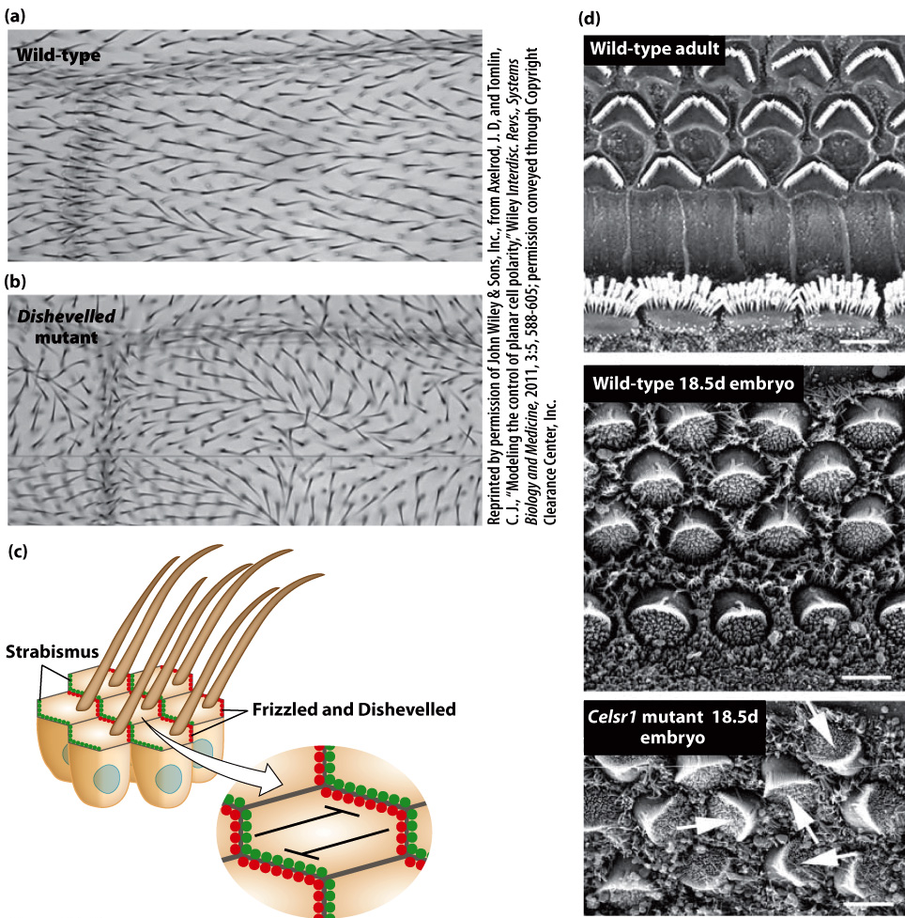
So far we have talked about symmetry in one dimension
Often cells are polarized in two dimensions
Top to bottom
Along a body axis (head-to-tail or proximal/distal manner)
Well-studied example is hairs of each cell of fruit fly point backwards on the wing

Slide 29
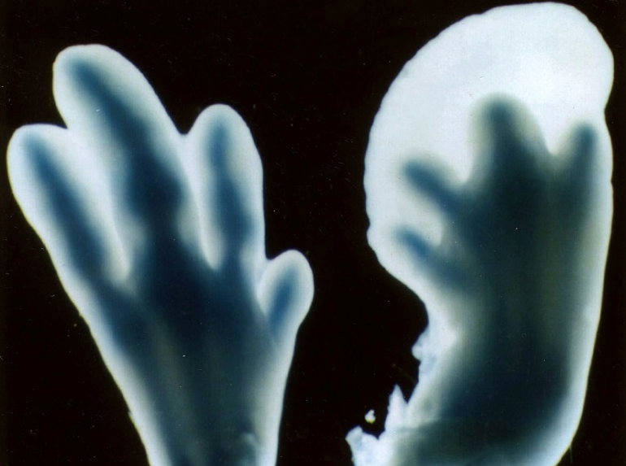
Cell death and its regulation
Regulated cell death is essential
During embryogenesis, the programmed cell death of specific cells keeps chicken feet as well as our hands from being webbed
Also prevents our embryonic tails from persisting and our brains from being filled with useless connections
Many white blood cells need to be removed

Slide 30
Cells need certain signals to survive
“trophic factors”
In the absence of these, cell will have suicide signal
In other instances, cells might receive a “murder” signal
Both will initiate apoptosis

Slide 31
Notes:
FIGURE 21-33 Ultrastructural features of cell death by apoptosis.
Most programmed cell death occurs through apoptosis.
(a) Apoptotic cell morphological changes:
Dense chromatin condensation at nuclear periphery
Cell body shrinkage (most organelles remain intact)
Nucleus and cytoplasm fragmentation –
Forms membrane-enclosed apoptotic bodies
No loss of intracellular contents into extracellular milieu
Apoptotic bodies phagocytosed by surrounding cells.
(b) Apoptotic cell with dense spheres of compacted chromatin as nucleus begins to fragment.
(Cells undergoing necrosis or necroptosis – exhibit very different morphological changes – swell and burst, releasing intracellular contents that can damage surrounding cells and cause inflammation)

Slide 32
Genes involved in controlling cell death encode proteins with 3 distinct functions:
“killer” proteins – required for a cell to begin the apoptosis process
“destruction” proteins – perform functions such as digesting proteins and DNA in a dying cell
“engulfment” proteins – required for phagocytosis of the dying cell by another cell
Evolutionarily conserved pathways

Slide 33
Evolutionarily conserved pathway
Similar proteins in nematodes
Compared to mammals (same colors)
Notes:
FIGURE 21-35 Evolutionary conservation of apoptosis pathways.
C. elegans development – four genes encode essential apoptosis proteins – CED-3, CED-4, CED-9, and EGL-1.
Similar proteins (identical colors) play corresponding roles in nematodes and in mammals.
(a) Nematodes:
CED-9 promotes cell survival by binding CED-4 to prevent activation.
EGL-1 (BH3-only protein) binds to CED-9 on the outer mitochondrial membrane.
EGL-1-CED-9 interaction releases CED-4 from the CED-4/CED-9 complex.
Free CED-4 binds-activates autoproteolytic cleavage-activation of CED-3 caspase protease.
CED-3 – proteolyzes cell proteins to drive apoptosis
(b) Mammals:
Bcl-2 protein (similar to CED-9) promotes cell survival by preventing activation of Apaf-1 (similar to CED-4).
Bid/Bim BH3-only proteins inhibit Bcl-2 – activate apoptosis
Many apoptotic stimuli lead to outer mitochondrial membrane damage, releasing pro-apoptotic proteins into the cytosol.
Cytochrome c released from mitochondria activates Apaf-1.
Apaf-1 activates Caspase-9 initiator caspase.
Caspase-9 proteolyzes-activates effector Caspases-3 and -7.
Caspases-3 and -7 – proteolyze cellular targets to cause apoptosis
Caspase cascade amplifies the initial apoptotic signal.

Slide 34
Issues with engulfment
Proteins results in build
Up of dead cells

Slide 35
Caspases
Amplify the initial apoptotic signal and destroy key cellular proteins
Named caspases because they contain a key cysteine residue in the catalytic site and cleave proteins near asparatate residues

Slide 36
In mammals, apoptosis can be triggered oligomerization of proteins in the outer mitochondrial membrane, leading to efflux of cytochrome c in the cytosol. These then promote caspase activation and cell death

Slide 37
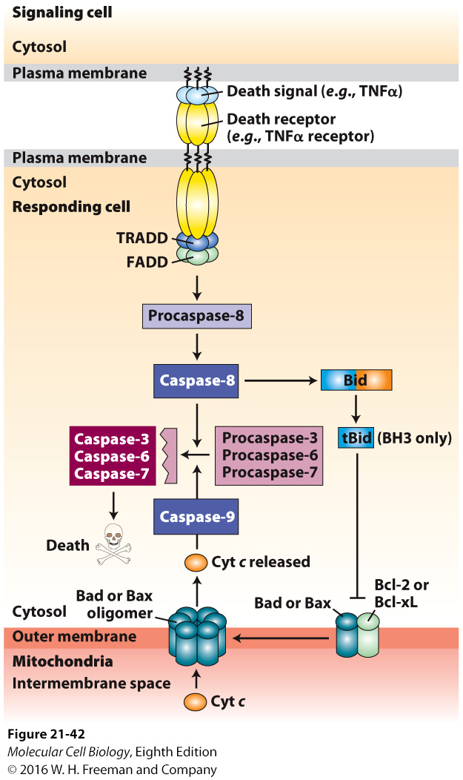
Although cell death can arise as a default in the absence of survival factors, apoptosis can also be stimulated by positively acting death signals
For example, TNK secreted by macrophages, triggers cell death of another cell
FADD – Fas-Associated Death Domain

