Slide 1
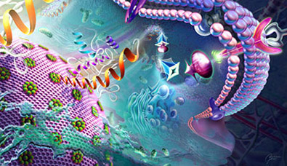
Cell Biology and Physiology
Signal Pathways that Control Gene Expression
Chapter 16
Dr. Capers
Molecular and Cell Biology, Lodish, 8th edition

Slide 2
Pathways have been evolutionarily conserved
Makes them easier to study
Many receptors are expressed in multiple types of body cells
But activation of these receptors by the same hormone triggers induction or repression of very different sets of genes in each cell type

Slide 3
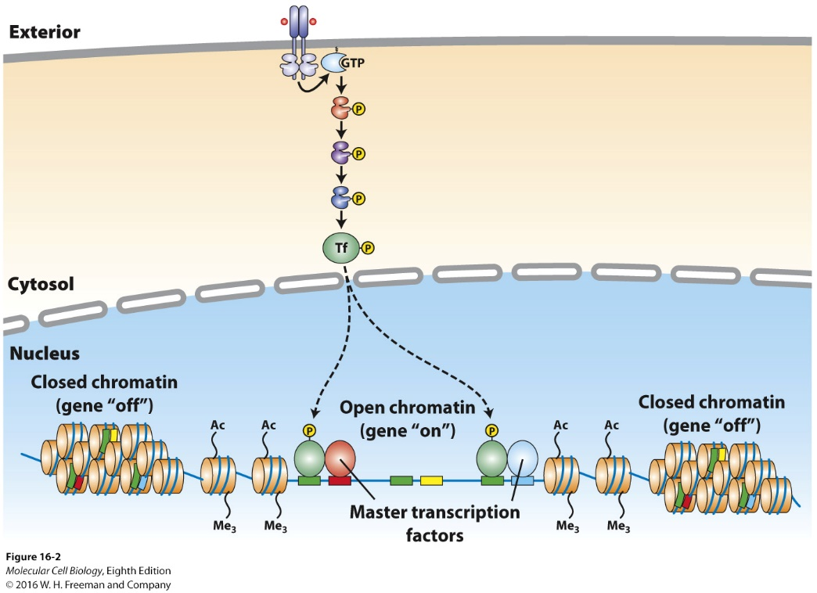
The epigenetic state of the cell is determined by its developmental history
Dictates whether a gene is in an active “open” chromatin conformation and accessible to a transcription factor
Other transcription factors produced by the cell will also determine it’s fate (certain cell types express one or more master transcription factors that determine identity of the cell)

Slide 4
Previously we talked about GPCRs
There are other receptors – 4 categories
Binding of a ligand activates GTP-binding protein that activates a cystolic kinase
Binding of a ligand to a receptor triggers activation of receptor-associated kinase
Binding of a ligand to a receptor triggers disassembly of multiprotein complex in cytosol releasing transcription factors
Binding of ligand to a receptor induces cleavage of an inhibitor of the receptor itself causing it to be a transcription factor

Slide 5
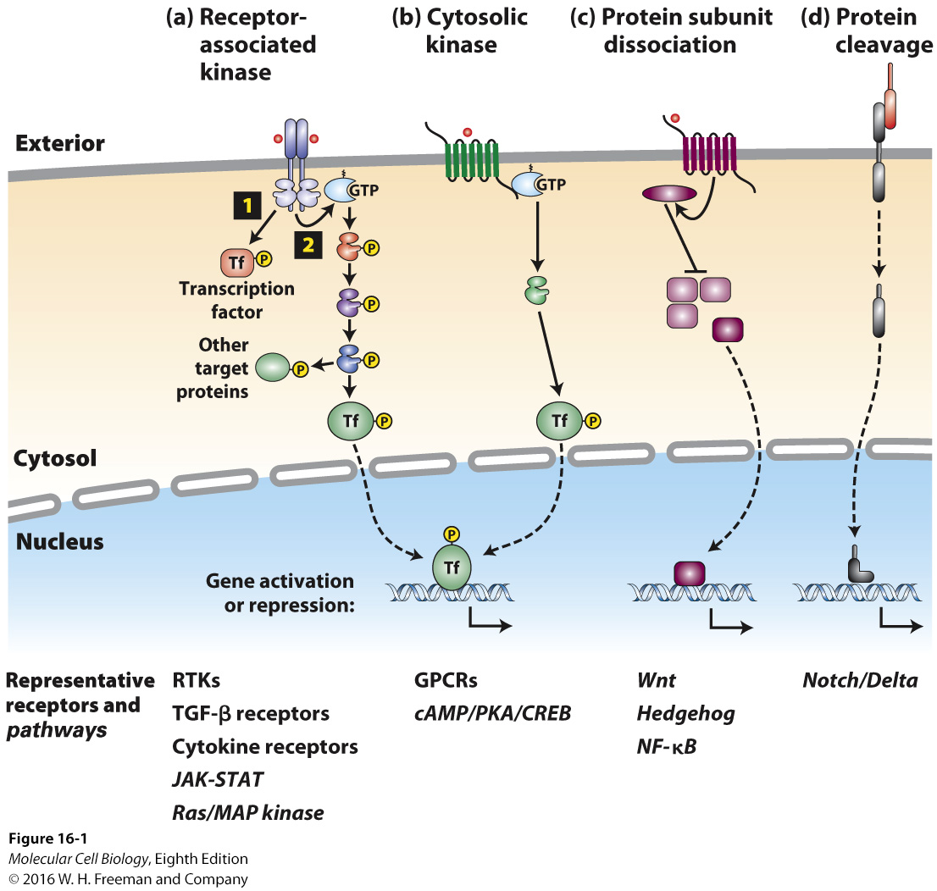

Slide 6
Watch this video on epinephrine signaling:
https://aklectures.com/lecture/epinephrine-signal-transduction-pathway
Watch this video on termination of epinephrine signaling:
https://aklectures.com/lecture/signal-transduction-pathways/termination-of-epinephrine-signaling

Slide 7
We already took at look at GCPRs, now we will look at enzyme-coupled receptors

Slide 8
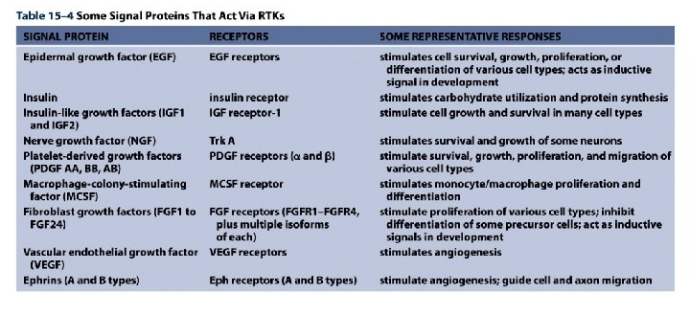
For most RTKs, ligand (signal) binding causes the receptors to dimerize, bringing the 2 cytoplasmic kinase domains together and promoting activation

Slide 10
Receptor Serine Kinases
TGF-β receptor family
Transforming Growth Factor
These receptors phosphorylate, activating the transcription factors (Smads)
Again, this will vary in different cells dependent on its developmental history
Regulate growth and differentiation pathways
Generally inhibits cell proliferation – loss of various components of this signaling pathway contribute to malignancy
In epithelial cells and fibroblasts, TGF-β induces expression of extracellular matrix proteins (also inhibits serum proteases which would degrade these proteins)

Slide 11
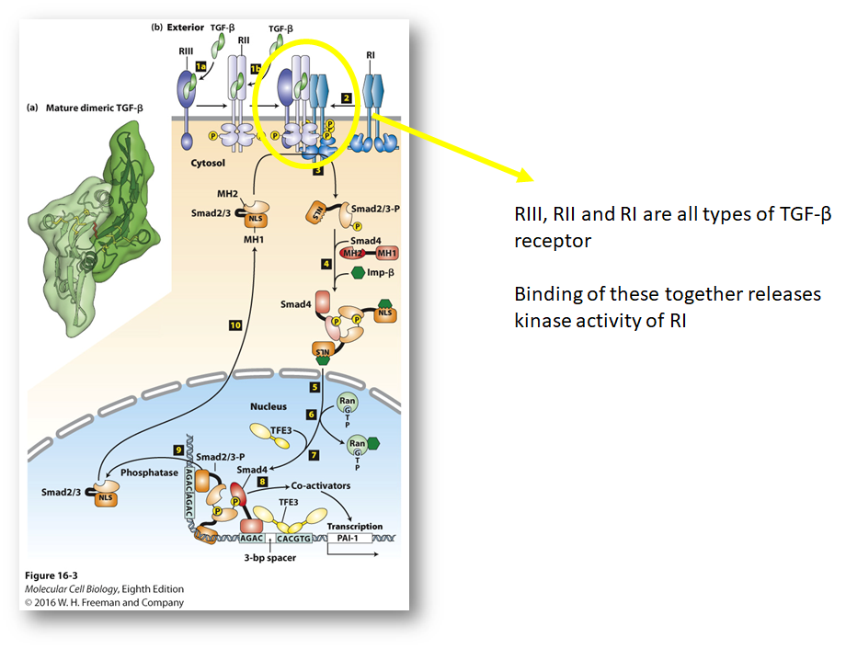

Slide 12
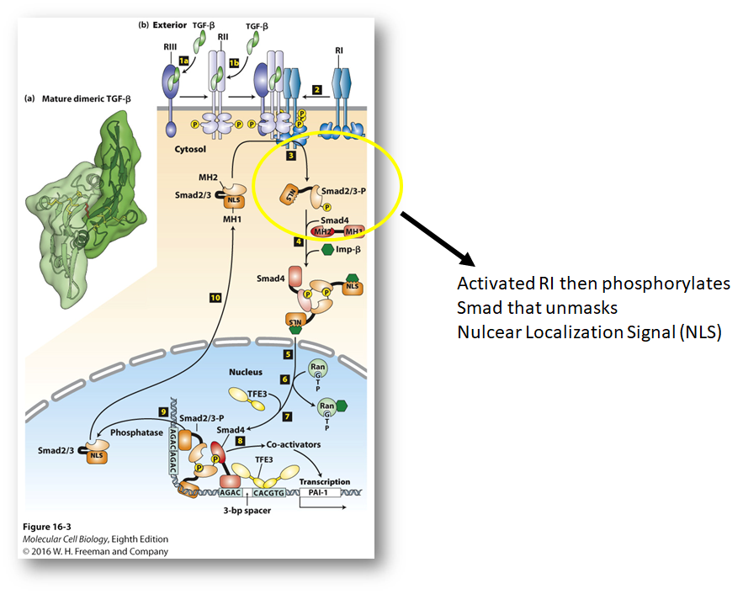

Slide 13
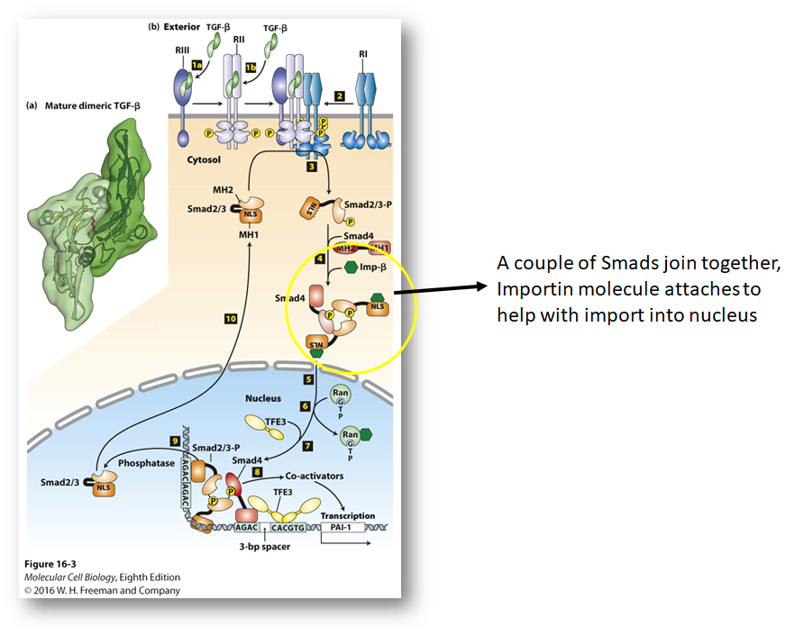

Slide 15
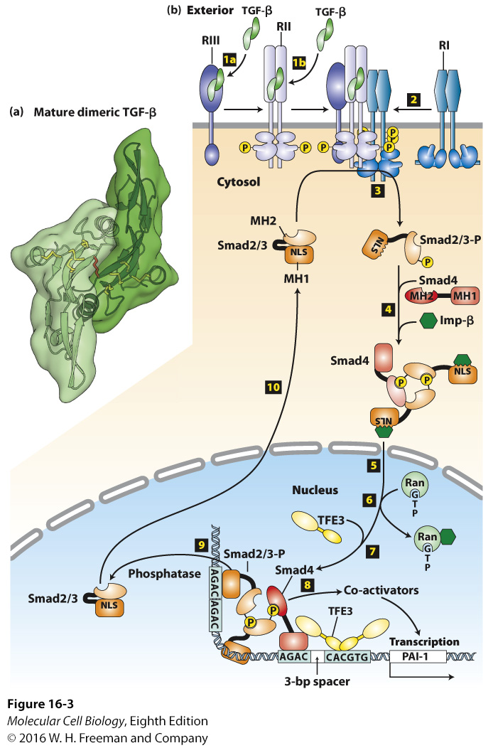

Slide 16
Next we will look at Protein Tyrosine Kinases and Cytokine Receptors

Slide 17
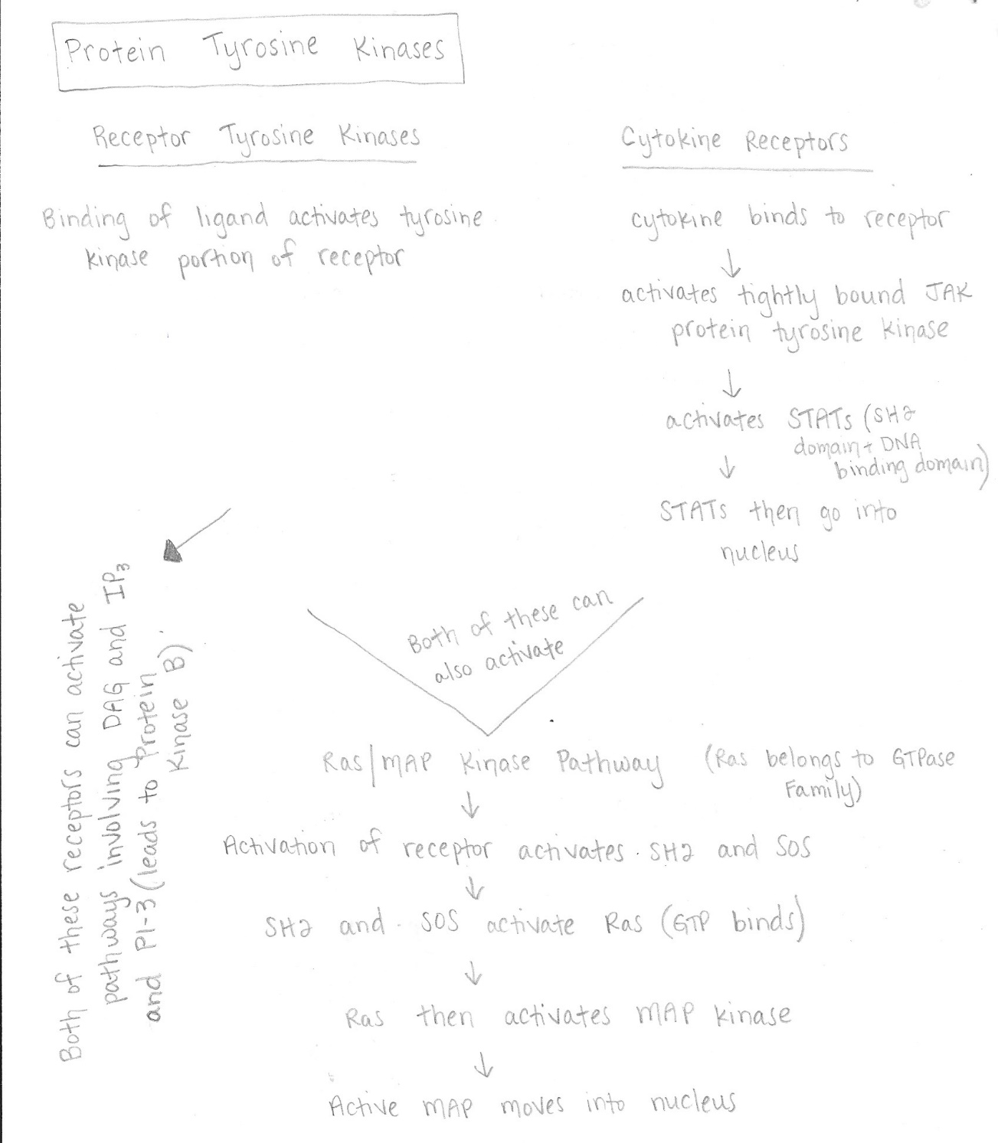

Slide 18
Protein Tyrosine Kinases
2 types:
Receptor Tyrosine Kinases – the tyrosine kinase enzyme is part of the receptor polypeptide
Cytokine Receptors – the receptor and kinase are separate (encoded by different genes) but bound tightly together
Both activate the Ras/MAP kinase pathway (we’ll talk about that later)
The next few slides will talk about Cytokine Receptors

Slide 19
Cytokines
Small, secreted signaling molecules (160-200aa)
Control growth and differentiation of specific cell types
Interleukins – work on immune cells
Interferons – produced to fight viral infections
Growth hormone
Erythropoietin
Thrombopoietin

Slide 20
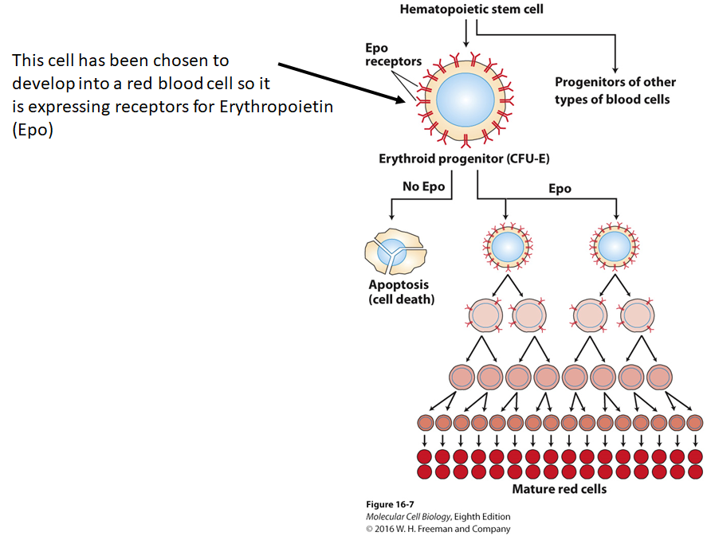

Slide 21
Binding of cytokine to its receptor activates one or more tightly bound JAK protein tyrosine kinases
Then the JAK activates the STAT (SH2 domain and DNA Binding domain)
What is an SH2 domain? – portion of Src protein, allows docking to phosphorylated tyrosine residues on other proteins.

Slide 22
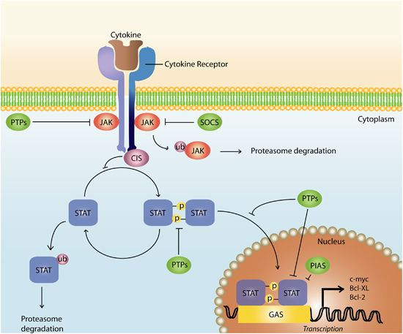

Slide 23
Watch this video on JAK/STAT pathway
https://www.youtube.com/watch?v=wai5YbAKFps
Watch this video on the phospoinoditide pathway:
https://aklectures.com/lecture/signal-transduction-pathways/phosphoinositide-signal-pathway
Watch this video on the calcium/calmodulin pathway:
https://aklectures.com/lecture/signal-transduction-pathways/calcium-and-calmodulin

Slide 24
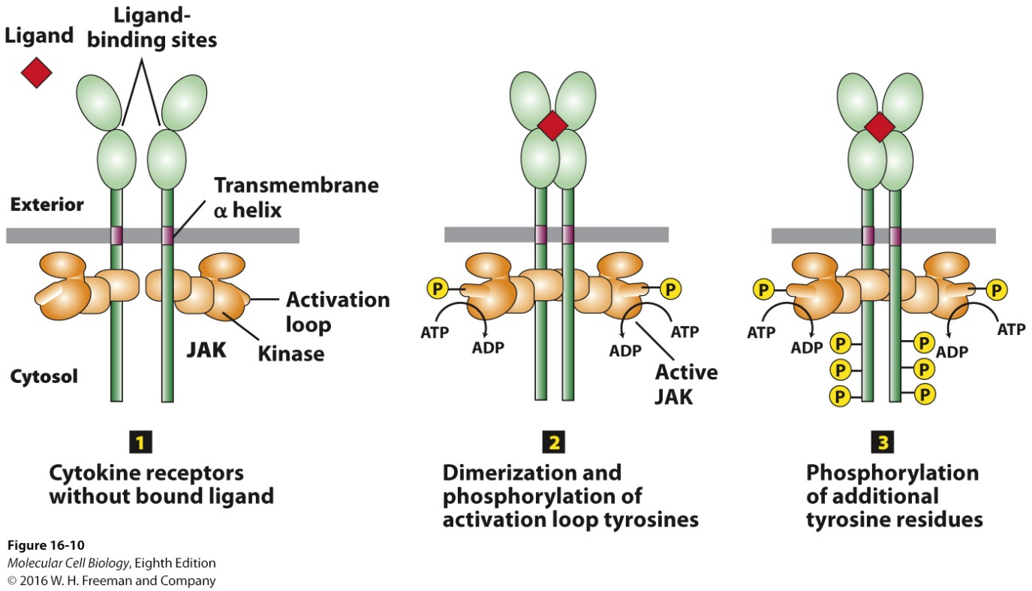
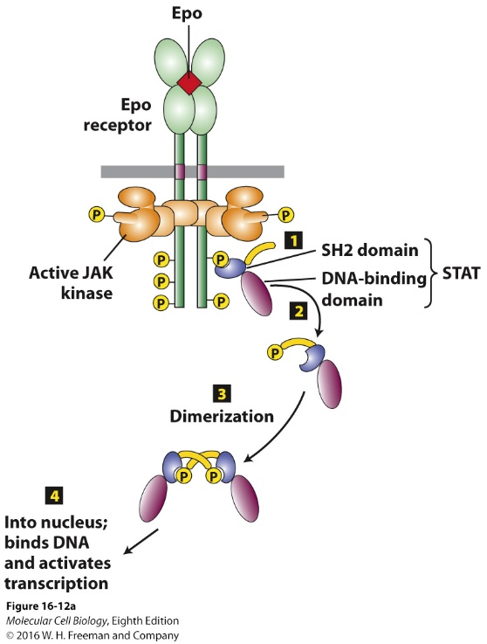
Cytokine Receptors
Notes:
FIGURE 16-10 General structure and activation of cytokine receptors.
Cytokine receptors lack an intrinsic kinase activity and activate a separate kinase.
(1) Absence of ligand:
Cytokine receptor cytosolic domain binds tightly and irreversibly to a JAK protein tyrosine kinase.
Receptors form a homodimer, but the JAK kinases are poorly active.
(2) Ligand binding:
Causes receptor conformational change that brings together the JAK kinase domains
The JAK kinase domains phosphorylate each other on a tyrosine residue in a region called the activation loop, activating the kinases.
(3) Active JAK kinases phosphorylate multiple tyrosine residues in the receptor cytosolic domain, which function as docking sites for signal-transducing proteins, including STAT proteins.

Slide 25
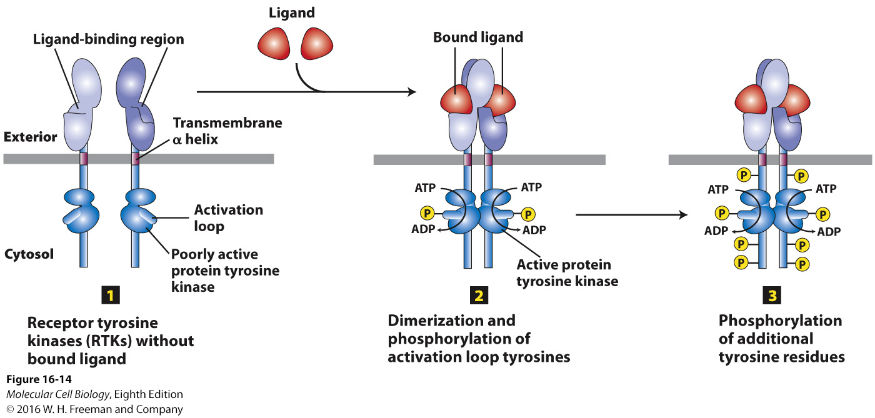
Receptor tyrosine kinases
Remember these are different from cytokine receptors in that the tyrosine kinase enzyme is part of the receptor (unlike with cytokine receptors in which it is just associated)

Slide 26
Ras/MAP Kinase Pathway
As mentioned before, receptor tyrosine kinase and cytokine receptors activate the Ras/MAP kinase pathway
Ras protein belongs to the GTPase superfamily of molecular switches
Once Ras is activated, it will activate MAP
MAP kinases will then translocate into nucleus to activate transcription factors

Slide 27
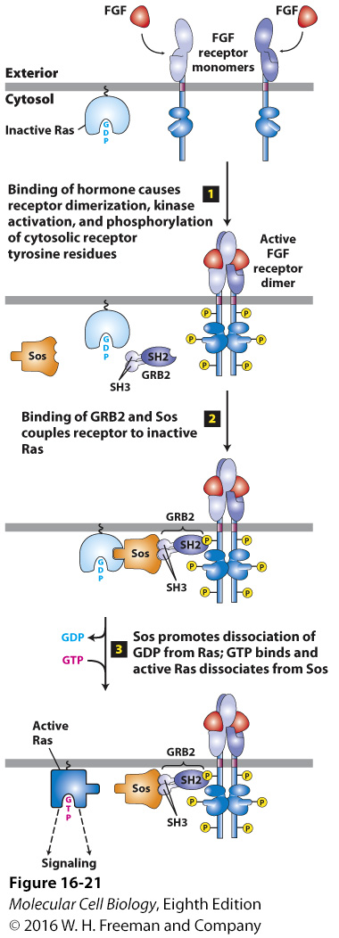
Binding of the ligand causes
dimerization of the receptor
Ras becomes activated
Notes:
FIGURE 16-21 Activation of Ras following ligand binding to receptor tyrosine kinases (RTKs) or cytokine receptors.
Receptor tyrosine kinases activate Ras via adapter proteins.
(1–2) A specific phosphotyrosine on an activated, ligand-bound receptor provides a specific site for binding the cytosolic adapter protein GRB2 SH2 domain.
GRB2 SH3 domains specifically bind proline domains on SOS, recruiting SOS to the membrane to interact with Ras∙GDP (tethered to the cytosolic surface of the plasma membrane by a hydrophobic farnesyl anchor).
(3) The SOS guanine nucleotide exchange factor (GEF) activity promotes release of GDP and formation of active Ras∙GTP.

Slide 28
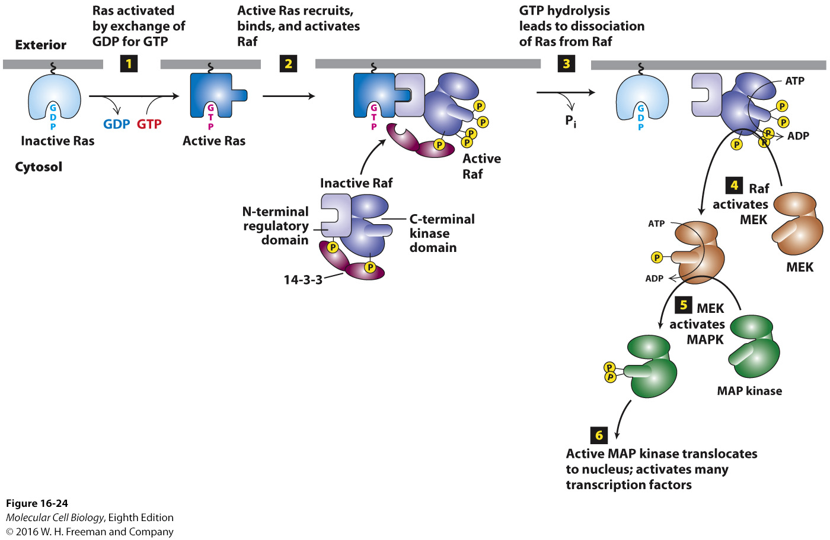
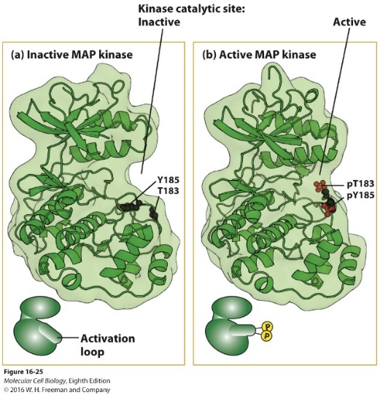
After Ras is activated, it activates the MAPK
Notes:
FIGURE 16-24 Ras/MAP kinase pathway.
Ras/MAP kinase pathway: Ras in yeast, C. elegans, Drosophila, and mammals activates a highly conserved cascade of three protein kinases (Raf → MEK → MAP kinase) culminating in MAP kinase activation, which has cell specific effects.
Unstimulated cells:
Inactive Ras·GDP is bound to the membrane.
A 14-3-3 protein dimer bound to Raf phosphoserine-259 in the Raf N-terminal domain and to phosphoserine-621 in the kinase domain stabilizes Raf in an inactive conformation.
Stimulated cell:
Step 1: Active RTK receptor activates formation of active Ras·GTP.
Step 2: Ras·GTP triggers the downstream kinase cascade by interacting with the Raf N-terminal regulatory domain, which results in dephosphorylation of one of the serines, release of 14-3-3, and activation of the Raf kinase activity.
Step 3: Ras GTP hydrolysis to Ras·GDP releases active Raf.
Step 4: Raf phosphorylates and activates MEK.
Step 5: MEK, a dual-specificity protein kinase, phosphorylates MAP kinase (and ERK kinase) on both tyrosine and serine/threonine residues.
Step 6: MAP kinase phosphorylates many different proteins in different cells, including nuclear transcription factors, that mediate cellular responses.
Activating mutations in the Raf gene occur in about 50 percent of melanomas, skin cancers that are often caused by exposure to sunlight ultraviolet radiation. Selective Raf inhibitors are used clinically for treatment of those melanomas.

Slide 29
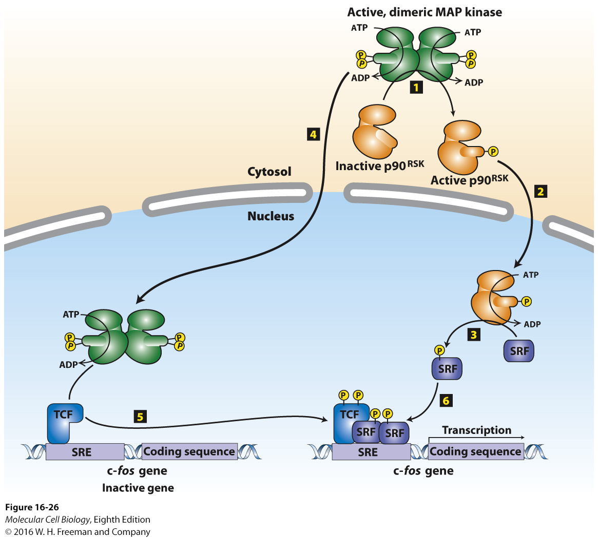
Notes:
FIGURE 16-26 Induction of gene transcription by MAP kinase.
MAP kinase regulates the activity of many transcription factors controlling the ~1100 early response genes activated by adding a growth factor to quiescent cells.
Steps 1–3: MAP kinase in the cytosol phosphorylates and activates the kinase p90^{RSK}, which then moves into the nucleus and phosphorylates the SRF (serum-response factor) transcription factor.
Steps 4 and 5: MAP kinase translocates into the nucleus and directly phosphorylates TCF transcription factor already bound to the promoter of the c-fos gene.
Step 6: Phosphorylated TCF and SRF together stimulate transcription of c-fos and other genes that contain a promoter SRE (serum response element) sequence.
MAP kinases phosphorylate over 175 target proteins in the nucleus.

Slide 30
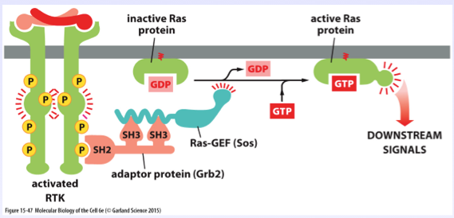
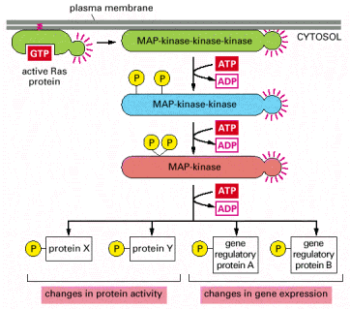
Here’s another figure to look at RTK activating Ras

Slide 31
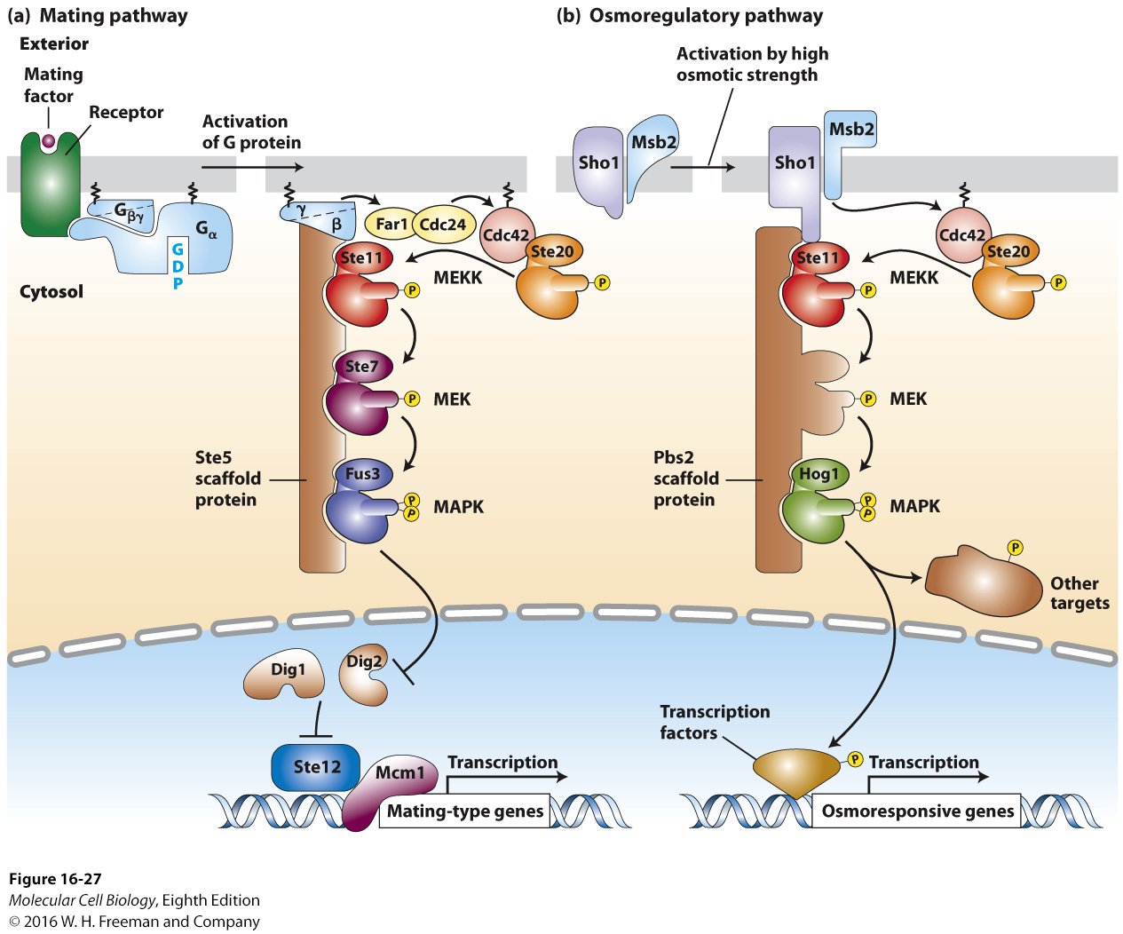
Scaffold proteins separate
multiple MAP kinase pathways
in eukaryotic cells

Slide 32
Receptor tyrosine kinases and cytokine receptors can also activate pathways involving phosphoinositides (activates phospholipase C, but different phospholipase C than involved with GCPRs)
Second messengers involved in this are
DAG
IP₃
Activation of the DAG/IP₃ pathway leads to an increase in Ca²⁺ and activation of protein kinase C and other enzymes

Slide 33
Watch this video on B cell receptor and signaling
https://www.youtube.com/watch?v=Ay28l_Ind0Q

Slide 34
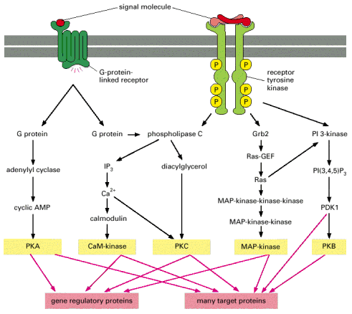
RTKs and GCPRs can activate some of the same intracellular signaling pathways

Slide 35
Now we will talk about alternative routes of gene regulation, such as Notch, Hedgehog and NF-κB
Less common that the other ways

Slide 36
Signaling pathways controlled by protein cleavage in the extracellular space: Notch

Slide 37
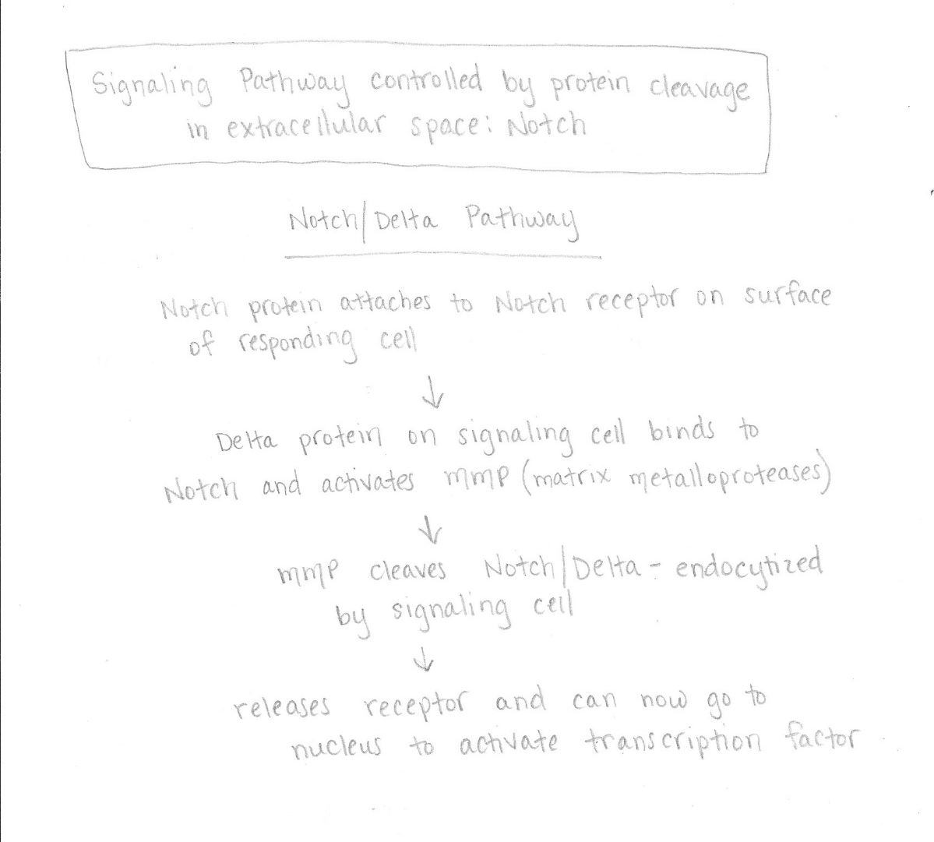

Slide 38
Notch Pathway
Used in animal development – controls cell fate choices and pattern formation during tissue development; involved in continual renewal of some tissues such as the gut
Some signal pathways begin with protein cleavage in the extracellular space
Done by matrix metalloproteases (MMPs)
Metal containing enzymes that cleave the extracellular segments of target proteins near the plasms membrane
Example is Notch/Delta Pathway

Slide 39
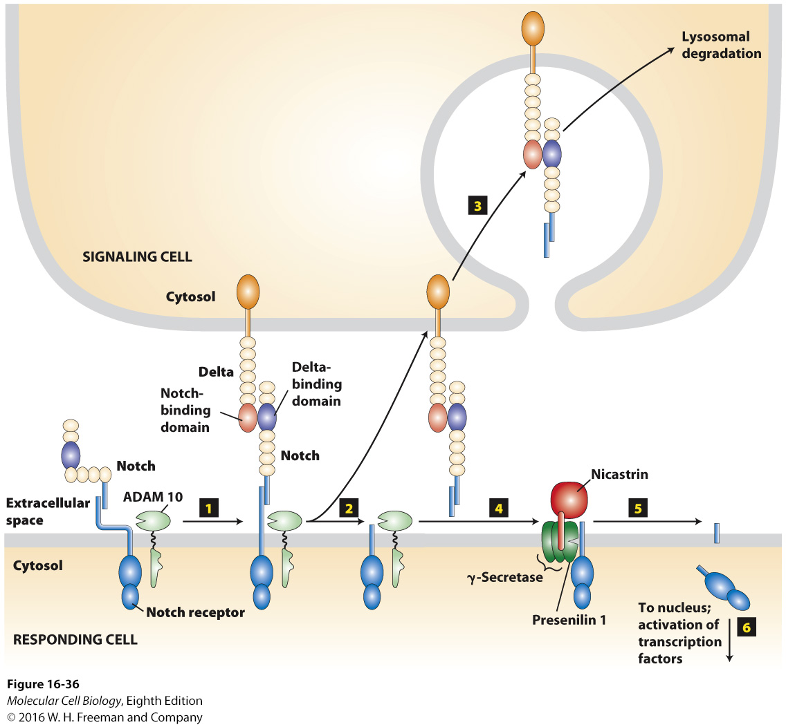
Notch binds to Delta on
signaling cell
MMP here is Adam 10;
cleaves the Notch
releasing it to the
signaling cell
Allows the protein to now
move to nucleus
Notes:
FIGURE 16-36 Notch/Delta signaling pathway.
Pathway determines the fates of many types of cells during development.
Both the Notch receptor and its ligand Delta are single-spanning transmembrane proteins found on the surface of cells.
(–) Delta: The Notch transmembrane subunit is noncovalently associated with its extracellular subunit, which is folded so that it cannot be cleaved by the ADAM 10 cell-surface protease.
(+) Delta:
Step 1: Notch binds to Delta on an adjacent cell.
Step 2: Initiation of Delta endocytosis by the signaling cell stretches the Notch extracellular domain open for ADAM 10 cleavage.
Step 3: The released Notch extracellular domain remains bound to Delta and is endocytosed by the signaling cell.
Step 4: The four-protein γ-secretase complex nicastrin subunit binds to the Notch stump generated by ADAM 10.
Step 5: The four-protein γ-secretase complex presenilin 1 protease catalyzes an intramembrane cleavage that releases the Notch cytosolic segment.
Step 6: The Notch segment translocates into the nucleus, where it interacts with several transcription factors to affect expression of genes that determine cell fate during development.

Slide 40
Hedgehog Pathway

Slide 41
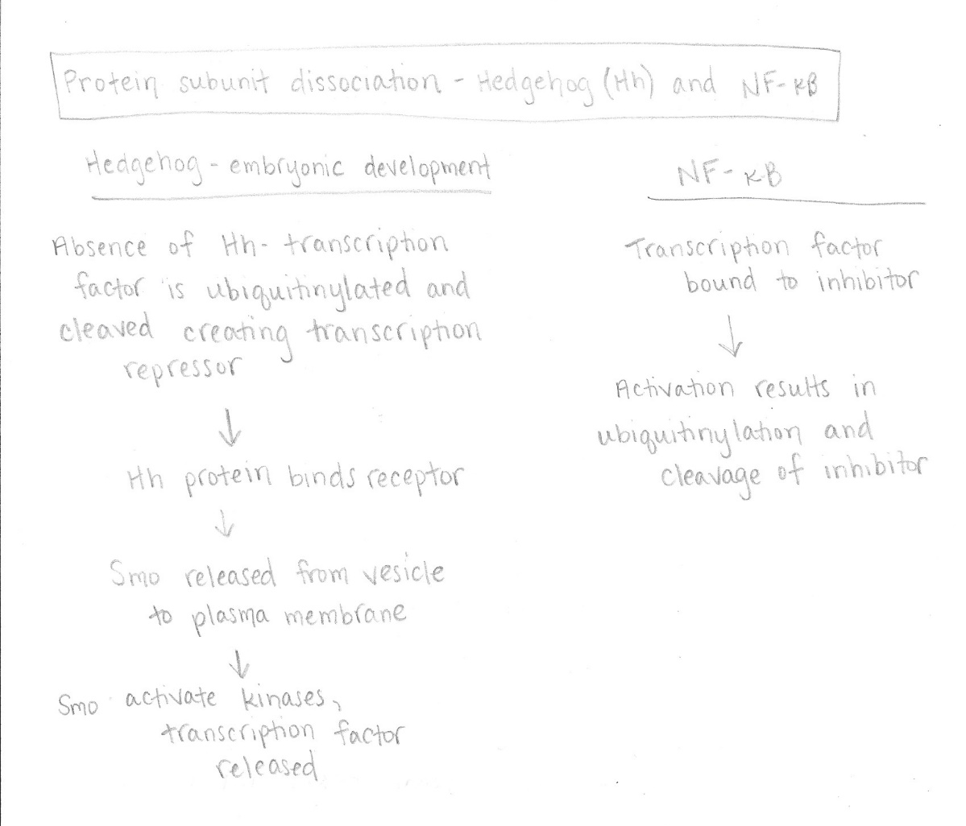

Slide 42
Hedgehog (Hh) proteins
Evolutionarily conserved
Often induce expression of genes required for a cell to acquire new identity or fate, very important in embryonic development
Key features:
In resting state, transcription factors in both pathways are ubiquitinylated and targeted for proteolytic cleavage, generating a protein fragment that is transcriptional repressor
Activation of the pathway involves disassembly of the large cystolic protein complexes, inhibition of ubiquitin and release of active transcription factor

Slide 43
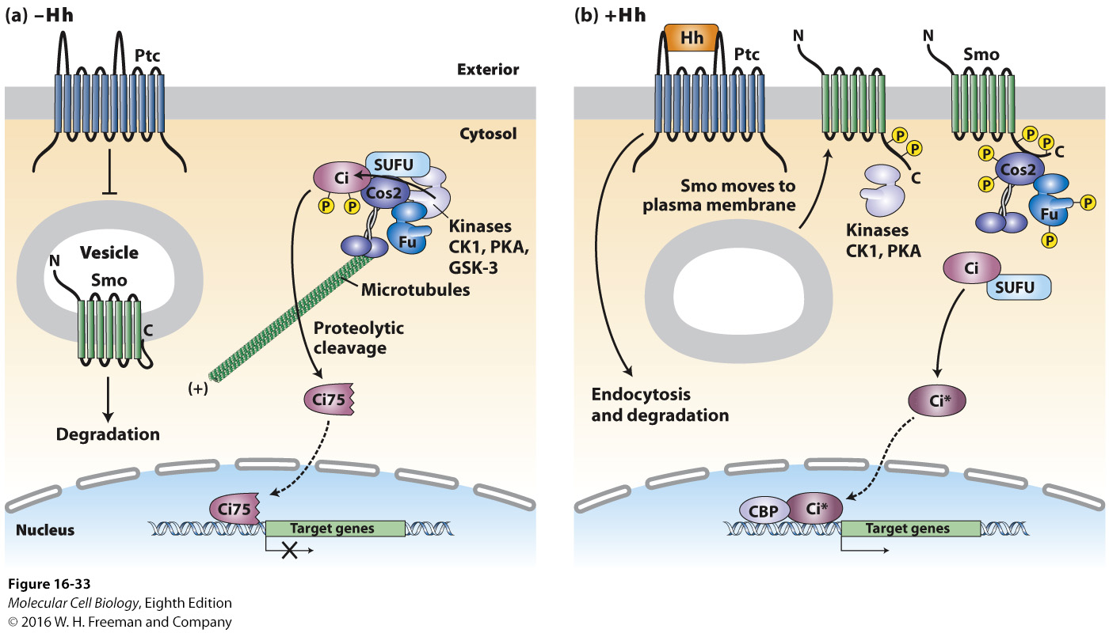
Hedgehog signaling in Drosophila

Slide 44
Feedback control of the Hh signaling pathway is important
Unrestrained signaling can lead to cancerous overgrowth or formation of the wrong cell types

Slide 45
NF-κB pathway works a little different
In resting state, NF-κB transcription factor is retained in the cytosol bound to an inhibitor
Activation by inflammatory processes leads to ubiquitinylation and degradation of the inhibitor
Excessive signaling is found in many cancers
Very important in immune function
Toll-like receptors activate this pathway
Some cytokines do as well

Slide 46
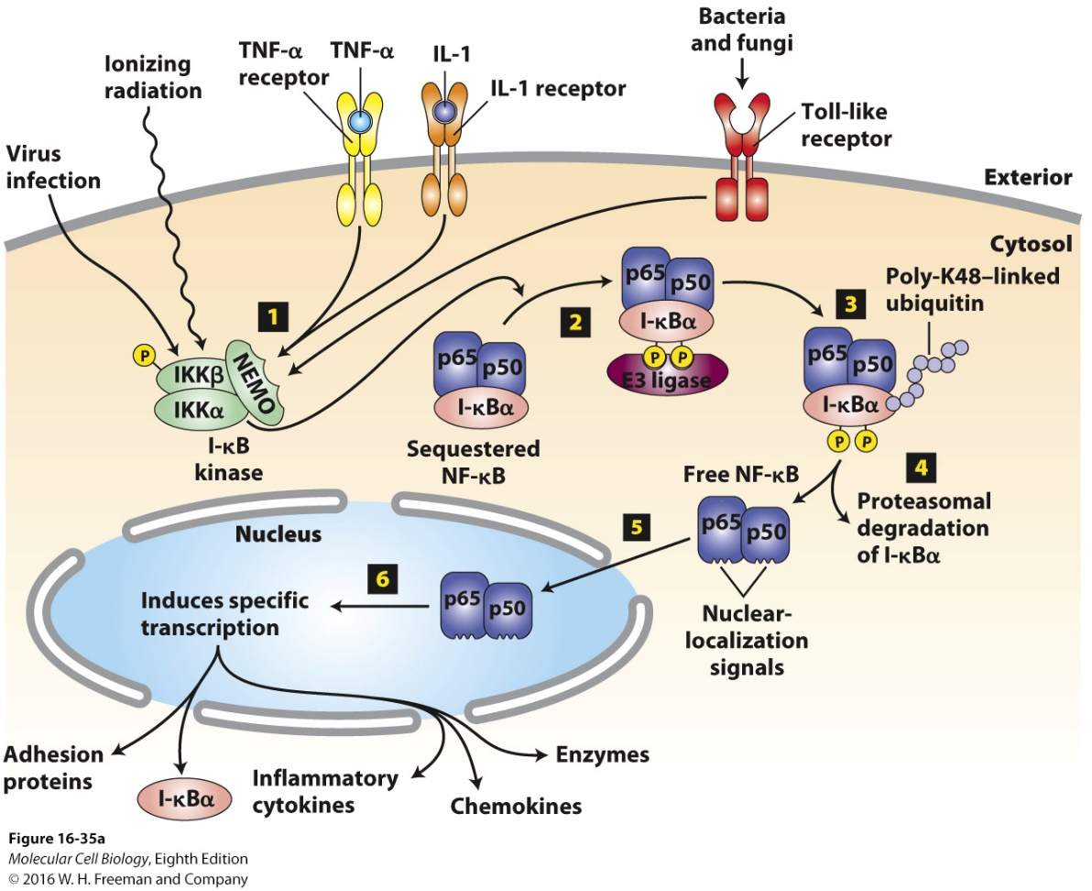
NF-κB is the master transcriptional regulator of the mammalian immune system
Many agents can activate I-κB that will then activate NF-κB
Notes:
FIGURE 16-35 Activation of the NF-𝛋B signaling pathway.
NF-κB, thought to be the master transcriptional regulator of the mammalian immune system, is a dimeric transcription factor composed of p50 and p65 subunits and is bound to its inhibitor I-κBα in resting cells.
(a) Activation:
Step 1: Many agents (including viral infection, ionizing radiation, binding of the pro-inflammatory cytokines TNFα or IL-1 to their respective receptors, or activation of any of several Toll-like receptors by components of invading bacteria or fungi) stimulate trimeric I-κB kinase activation.
Step 2: The I-κB kinase β subunit phosphorylates the inhibitor I-κBα, which then binds an E3 ubiquitin ligase.
Steps 3 and 4: E3 ubiquitin ligase polyubiquitinylation of lysine 48 targets I-κBα for degradation by proteasomes.
Step 5: Removal of I-κBα unmasks nuclear-localization signals in both subunits of NF-κB, causing them to translocate into the nucleus.
Step 6: NF-κB activates transcription of numerous target genes including the gene encoding I-κBα, which acts to terminate signaling, and genes encoding various inflammatory cytokines.
(b) Interleukin-1β (IL-1β) binding to heterodimeric IL-1 receptors:
Triggers receptor oligomerization and recruitment of several proteins to the receptor cytosolic domain, including TRAF6 and an E3 ubiquitin ligase.
E3 ubiquitin ligase catalyzes synthesis of long lysine-63-linked (K-63) polyubiquitin chains on TRAF6, NEMO, and other proteins in the complex.
The polyubiquitin chains function as a scaffold that recruits the kinase TAK1 and the NEMO subunit of the trimeric I-κB kinase complex.
TAK1 phosphorylates itself and the β subunit of I-κB kinase, activating its kinase activity and enabling it to phosphorylate I-κBα.

Slide 47
None of these pathways act alone. Multiple hormones and signal pathways interact

Slide 48
Upon ligand binding, cell-surface receptors are often subjected to receptor-mediated endocytosis.
Removal of transmembrane receptors by receptor-mediated endocytosis is one mechanism to down-regulate receptor signaling so that the signal is not too robust and does not persist long after the signaling molecule is removed.
Receptors that are endocytosed may eventually be recycled back to the cell surface, but this takes time. They may even be degraded in lysosomes, an even longer-term mechanism for down-regulation of signaling.

