Slide 1
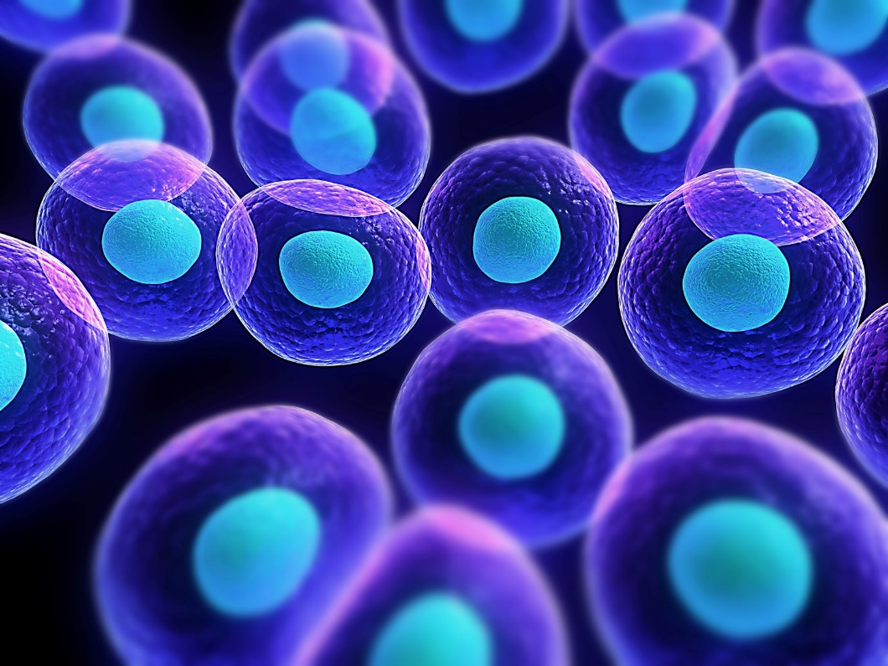
Cell Biology and Physiology
Signal Transduction and G Protein-Coupled Receptors
Chapter 15
Dr. Capers
Molecular and Cell Biology, Lodish, 8th edition

Slide 2
No cell lives in isolation
Many types of cell signaling molecules are released by one cell and induce a response in a different cell
Even single celled organisms communicate through extracellular signals
All living things need to modify their behavior in response to changes in environmental conditions

Slide 3
In cells, a signal produces a specific response only in target cells with receptor proteins that bind that signal
In this chapter and the next, we will focus on extracellular signaling molecules that are too large and hydrophilic to diffuse through the plasma membrane
Need cell surface receptors

Slide 4
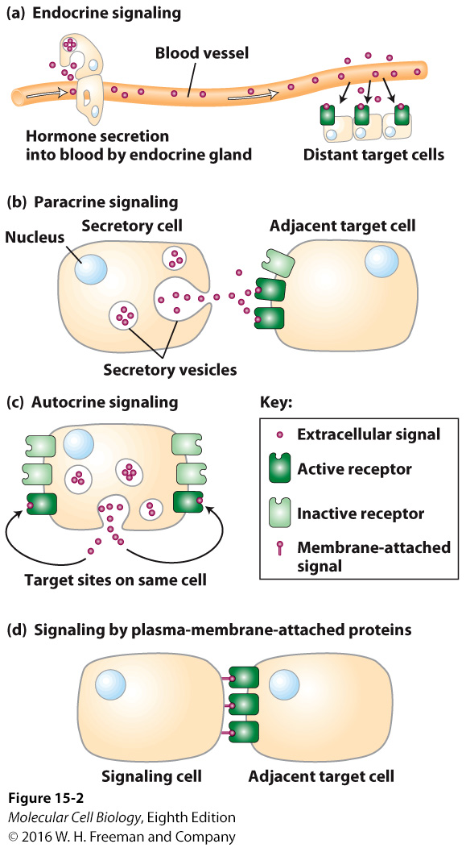
Signaling molecules can act locally or at a distance
In order for a target cell to respond, it must be expressing a receptor for the signaling molecule

Slide 5
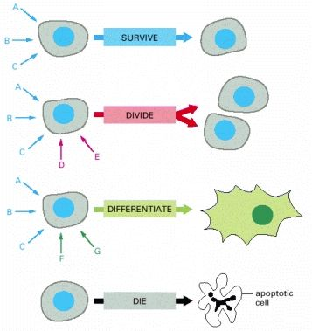
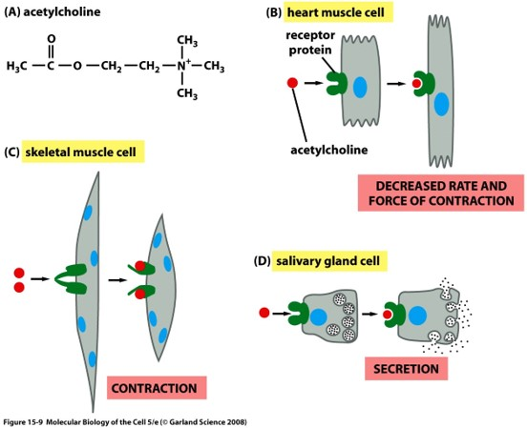
Signal molecules can work together
The same signal molecule can have a different effect on different cells depending on multiple factors

Slide 6
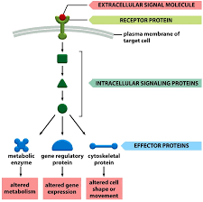

Slide 7
Signal transduction
Process of converting extracellular signals into intracellular responses
Chain of intermediates is the signal transduction pathway
Highly conserved through evolution

Slide 8
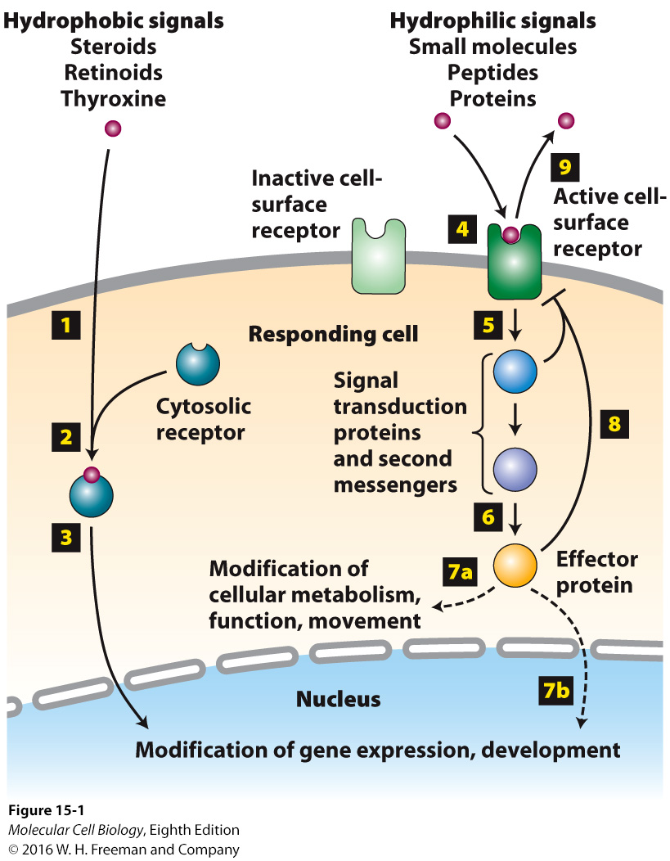

Slide 9
Cell-surface receptors
Integral membrane proteins
3 discrete domains:
Extracellular domain
Plasma-membrane spanning domain
Intracellular (cystolic) domain
Signaling molecule – “first messengers”
Acts as the ligand for the cell-surface receptor
Bind to the extracellular or plasma-membrane spanning domain
Binding of this ligand to the receptor results in conformational change that is transmitted to cystolic domain
Cell-surface receptors relay signals via intracellular signaling molecules
Some intracellular signaling molecules are small chemicals called “second messengers”
Cyclic AMP, Ca2+
Most intracellular signaling molecules are proteins
Most behave like molecular “switches”
Largest class of molecular switches are activated or inactivated by phosphorylation
Another important class are GTP-binding proteins – activated by binding GTP

Slide 10
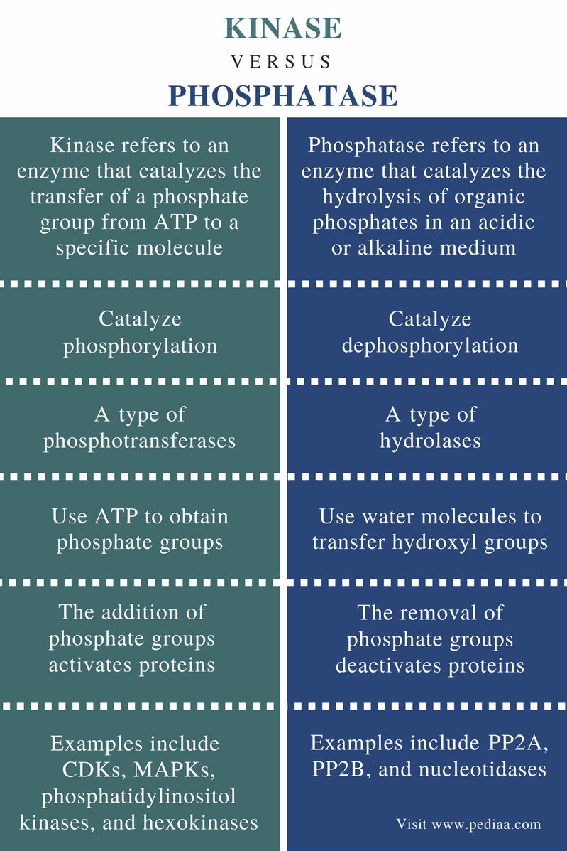
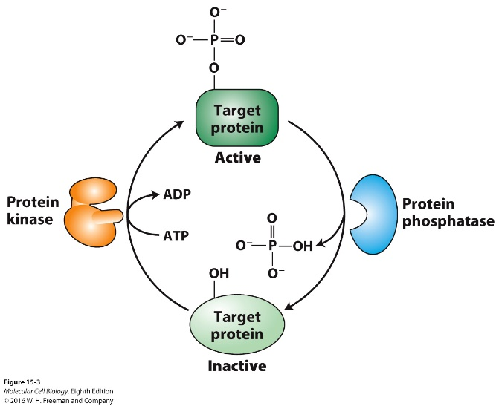

Slide 11
GTP-binding proteins are frequently used in signal transduction pathways as on/off switches
Evolutionarily ancient
2 large classes are used in signaling
Heterotrimeric G Proteins – directly bind to and are activated by cell-surface receptors
Monomeric G Proteins – play roles in cell division and motility (Ras, Ran and Sar are examples)
Regulatory proteins control GTP-binding proteins
GTPase-activating (GAPs) – inactivate
Guanine nucleotide exchange factors (GEFs) – activate
See next slide

Slide 12
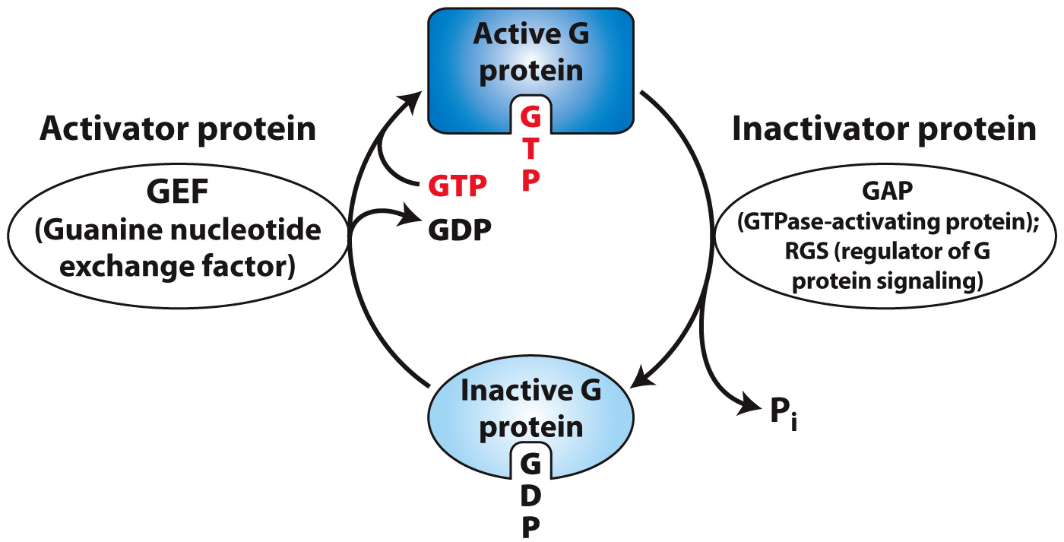
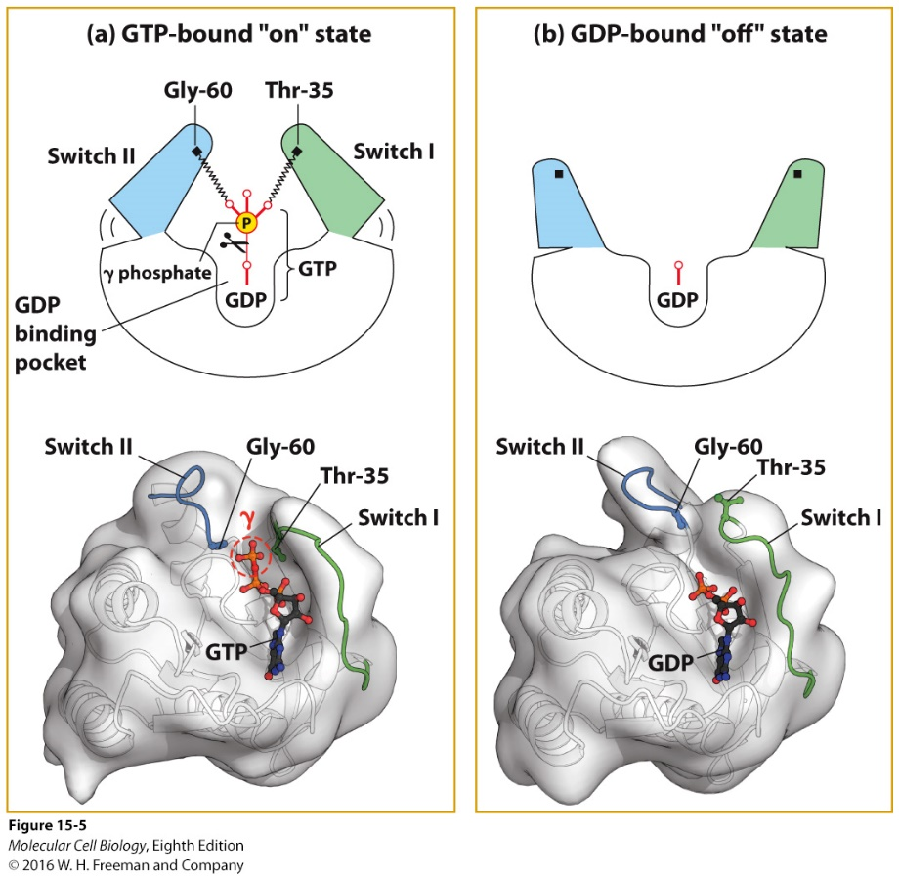

Slide 13
Second messengers
One used in all metazoan cells is Ca²⁺ ions
Ca²⁺ is usually low due to ATP-powered pumps
Can be increased by release from ER
In muscle cells this results in contraction
In neurons, this results in excitation of neurotransmitter vesicles
cAMP (cyclic adenosine monophosphate)
Can activate protein kinase A – cell metabolism
Can regulate ion channels

Slide 14
Speed of a response will vary depending on multiple factors

Slide 15
Receptors are usually detected and quantified by their ability to bind radioactively or fluorescently labeled ligands

Slide 16
Synthetic analogs of natural hormones are widely used both in research on cell-surface receptors and as drugs
Agonists – mimic the function of the actual hormone
Antagonists – bind to the receptor but induce no response (inhibits)

Slide 17
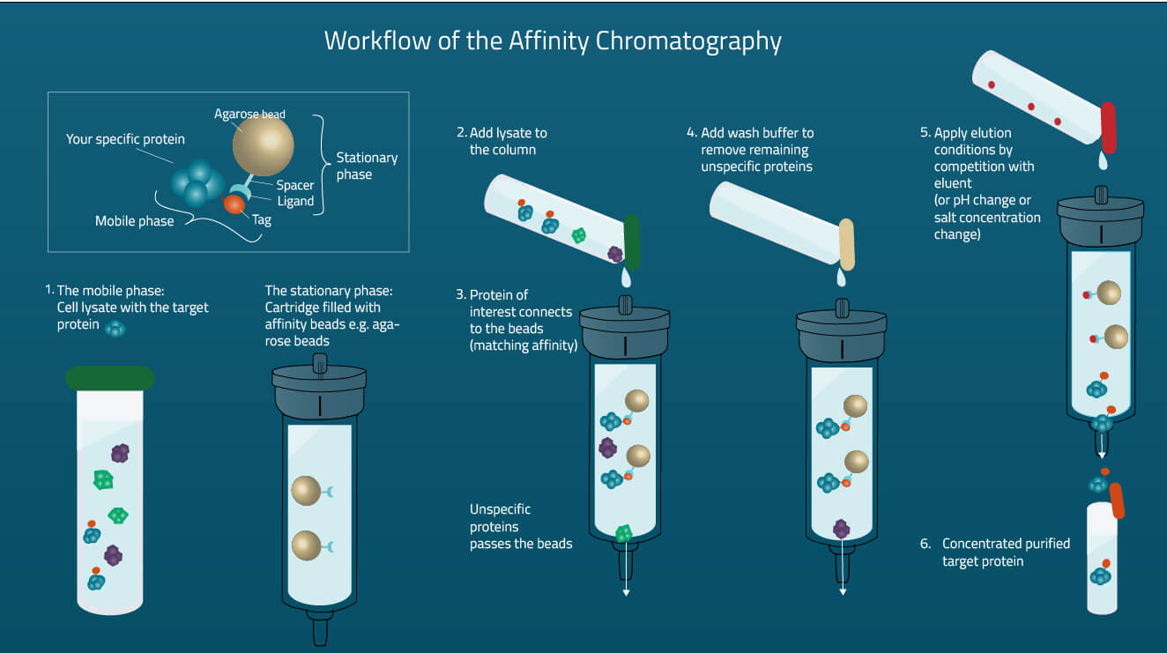
Receptors can be purified by affinity chromatography techniques using antibodies specific for the receptor that is bound to the column
Need to purify in order to characterize their structures
Even though a mammalian cell can have 1,000 – 50,000 copies of a specific receptor, this only makes up 0.1-5% of plasma membranes

Slide 18
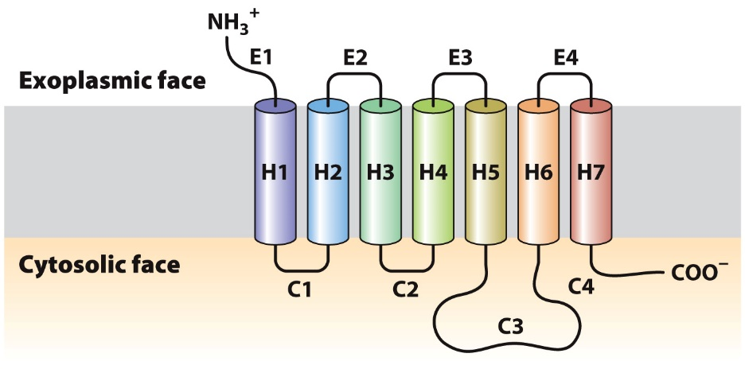
Signaling through G-Protein Coupled Receptors
G-Protein Coupled Receptors (GPCRs) are the largest family of cell-surface receptors
More than 800 in humans
Sight, smell, taste, etc.
Despite the variety signal molecules that activate them, all GPCRs have a similar structure
All G protein-coupled receptors have the same orientation in the membrane and contain 7 transmembrane α-helices, 4 extracellular segments, and 4 cytostolic fragments

Slide 19
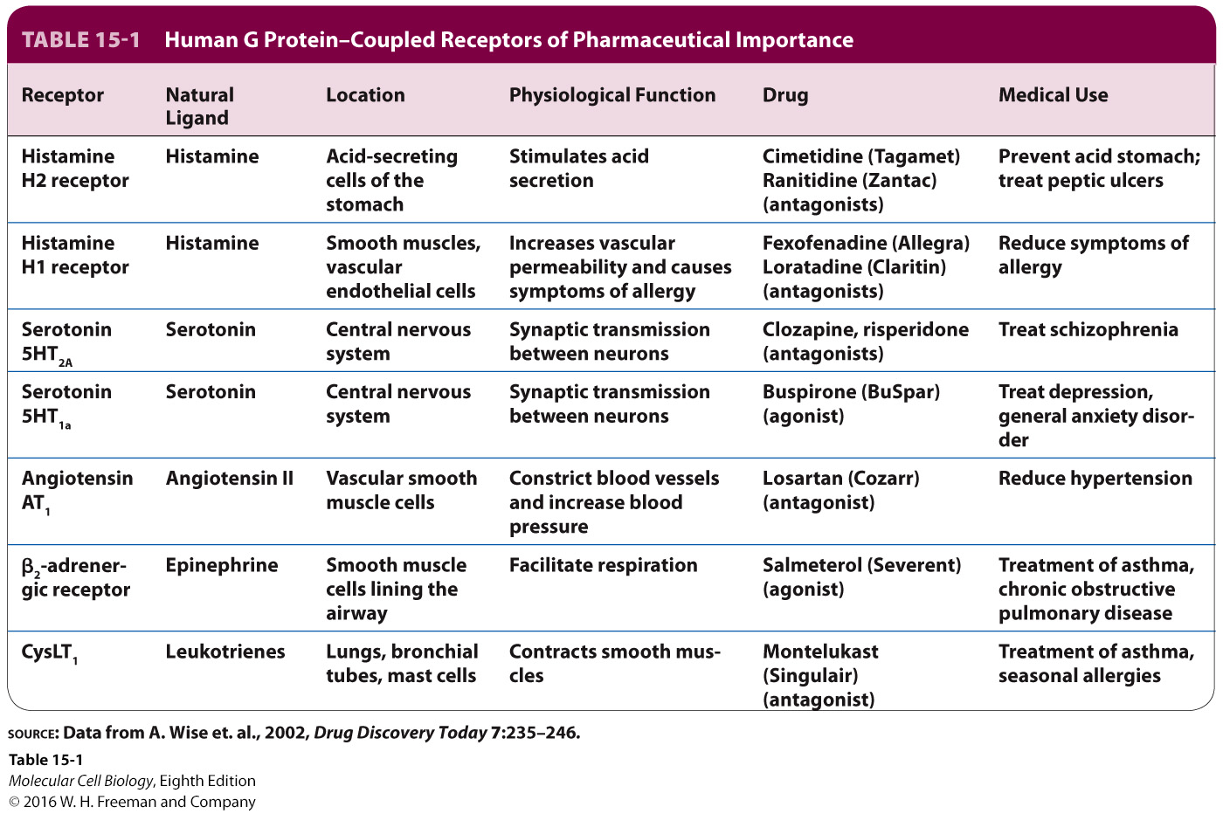
Notes:
Table 15-1 Human G Protein–Coupled Receptors of Pharmaceutical Importance
Humans GPCRs – detect and respond to a wide of signals, including neurotransmitters, hormones involved in glycogen and fat metabolism, and photons of light
~30 percent of all drugs used in humans – agonists or antagonists of specific GPCRs or groups of closely related GPCRs
GPCR signal transduction pathways share common elements:
(1) A receptor that contains seven membrane-spanning α helices
(2) A receptor-activated heterotrimeric G protein cycling between GTP-active and GDP-inactive forms
(3) A membrane-bound effector protein
(4) Proteins that desensitize the signaling pathway
Many pathways:
Involve second messengers
Have short-term effects in the cell – rapid activation/inhibition of existing proteins, including enzymes or ion channels

Slide 20
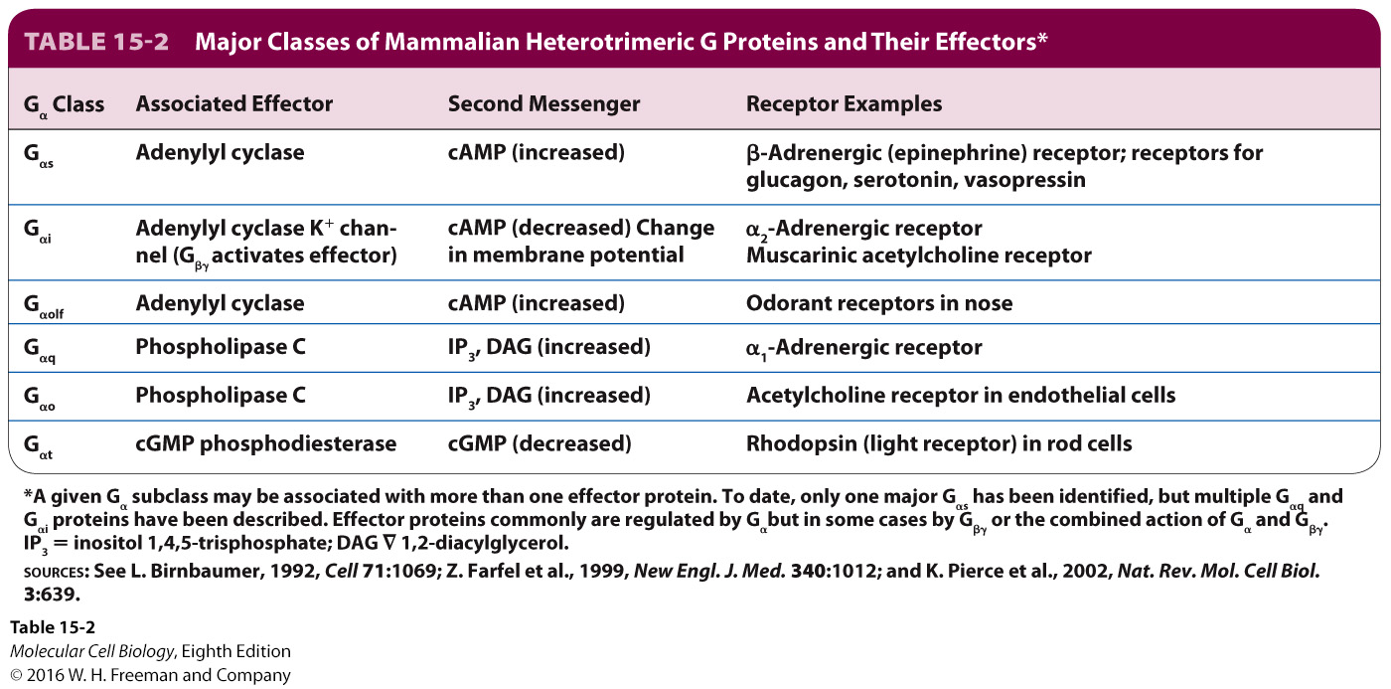

Slide 21
Trimeric G proteins
Binding of ligand to a G-coupled receptor results in
Enables the receptor to bind G subunit
GDP is released
GTP can bind
Interacts and activates effector protein
See next figure

Slide 22
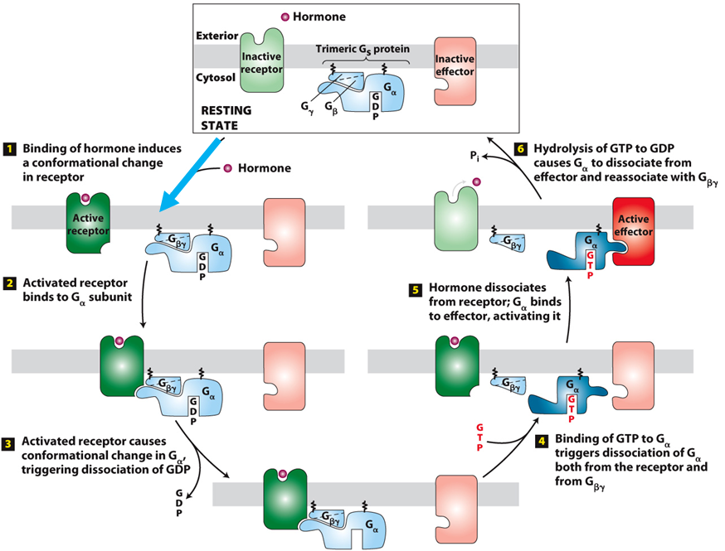

Slide 23
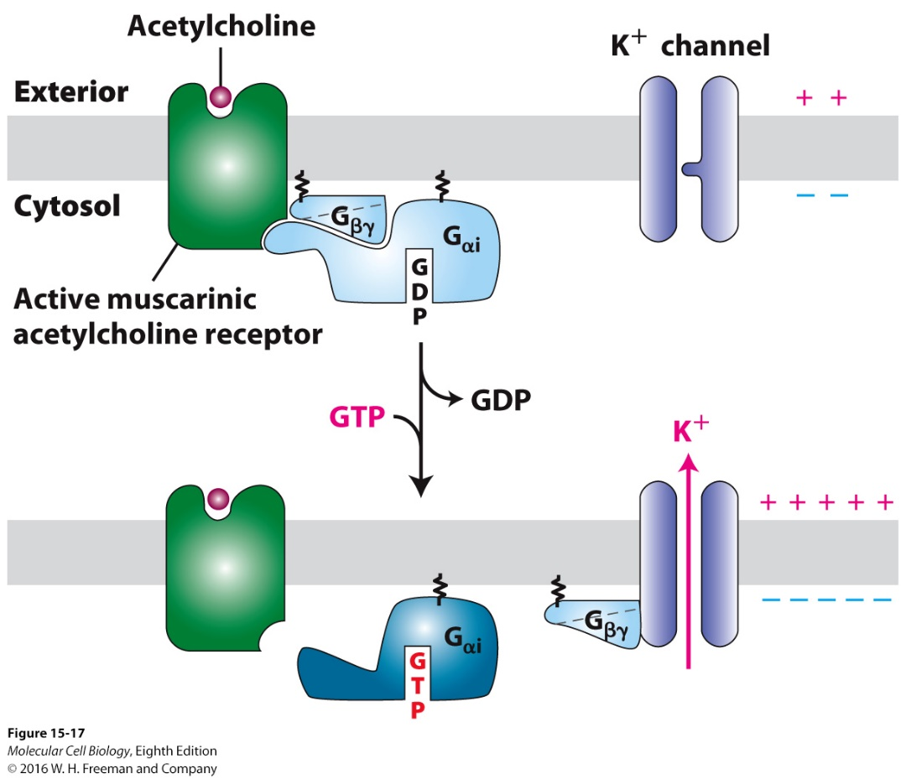
Some G Proteins directly regulate ion channels
Many neurotransmitter receptors are G protein-coupled receptors whose effector proteins are Na+ and K+ channels

Slide 24
Some G proteins regulate production of Cyclic AMP
G protein-coupled receptors that use adenylyl cyclase as an effector protein and cAMP as a second messenger are found in most mammalian cells
Rapid amplification response
Adenylyl cyclase is activated to make cAMP from ATP
Activated cAMP activates cyclic-AMP-dependent protein kinase (PKA)
Examples of cell responses mediated by cyclic AMP
Hormone glucagon attaches to receptors on liver cells, activates cAMP, results in glycogen breakdown
Thyroid stimulating hormone attaches to receptors on thyroid cells, activates cAMP, results in thyroid producing hormones and releasing them
Adrenaline attaches to receptors on heart cells, activates cAMP, results in increase heart rate

Slide 25
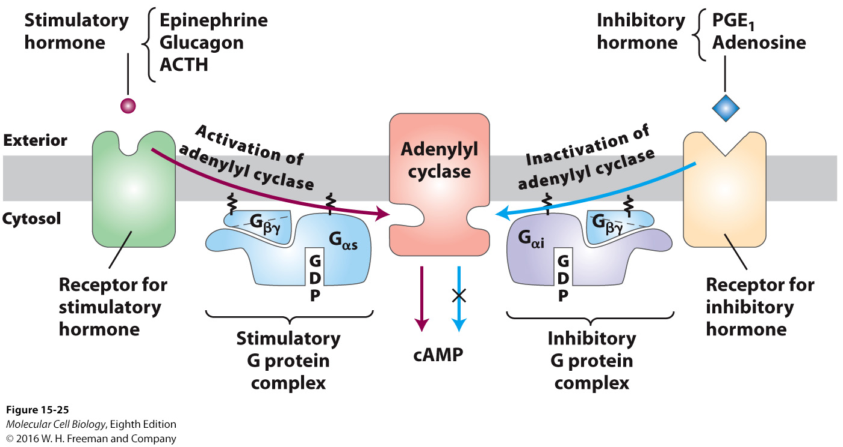

Slide 26
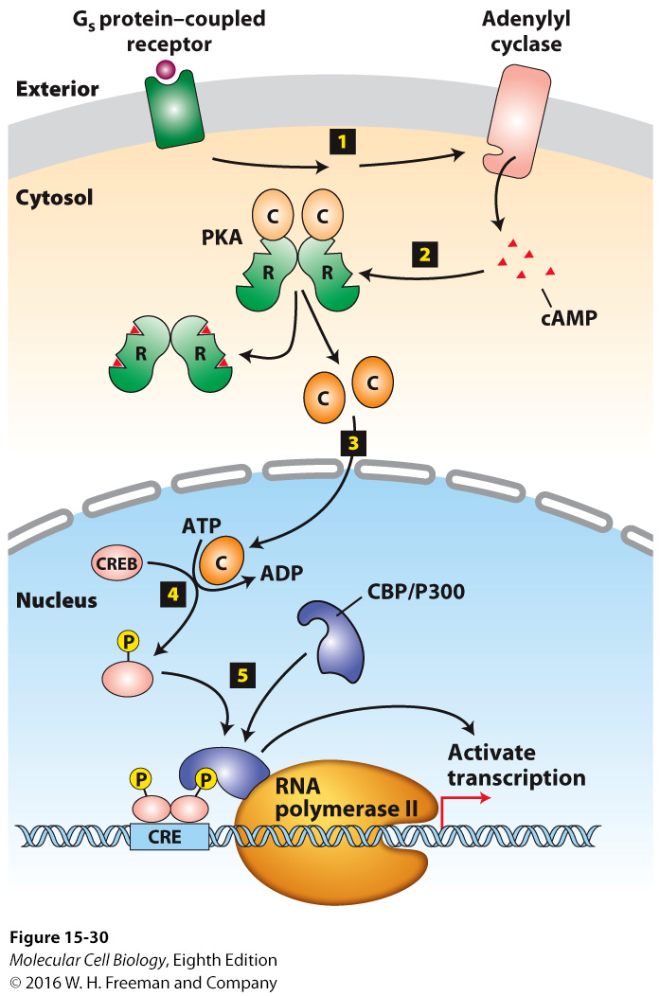
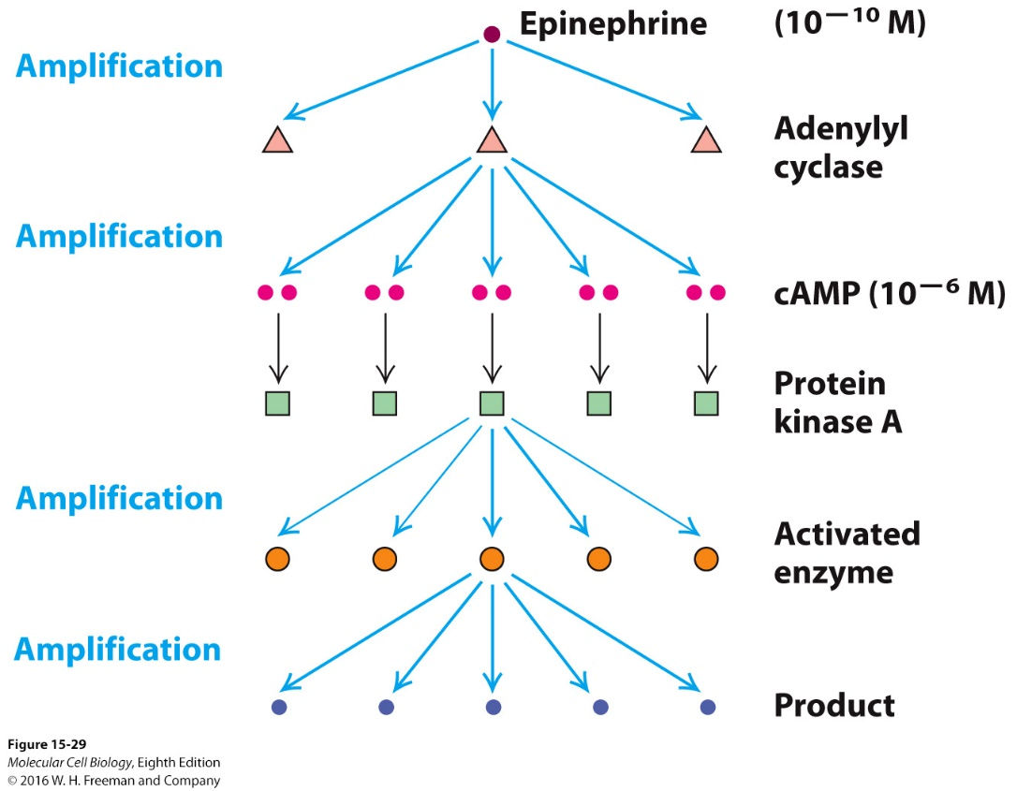

Slide 27
Some G proteins signal via phospholipids
Some GPCRs exert their effects through G proteins that activate membrane-bound enzyme Phosphlipase C-β
PIP₂ is cleaved into inositol 1,4,5-triphosphate (IP₃) and diacylglycerol
IP₃ goes to the ER and opens Ca²⁺ channels
Diacylglycerol remains in membrane and activates Protein Kinase C (PKC)

Slide 28
Increase in Ca2+ concentration
Calcium ions play an essential role in regulating cellular responses to many signals
Small rise in cystolic calcium induces a variety of cellular responses
Hormone secretion by endocrine cells
Secretion of digestive enzymes by pancreatic cells
Muscle contraction
Triggers fusion of secretory vesicles with the plasma membrane and release of contents into extracellular space

Slide 29
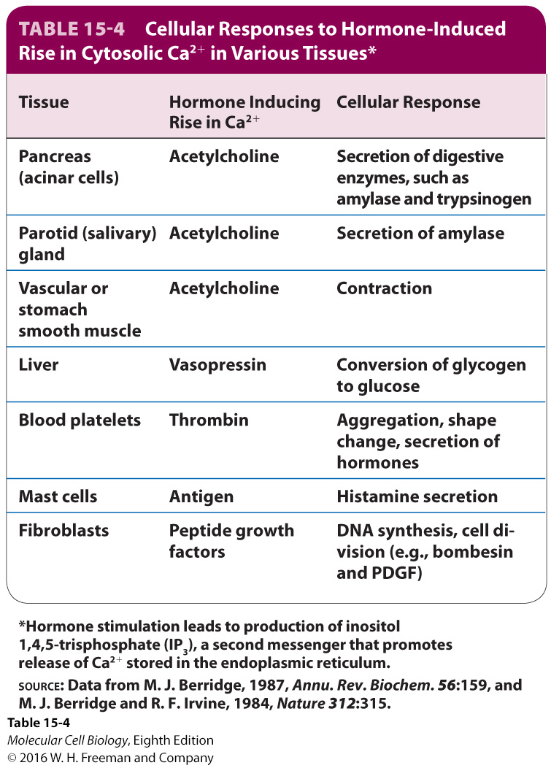

Slide 30
Step 1: GPCR activation of either the G_{αo} or G_{αq} subunit – activates phospholipase C (PLC).
Step 2: PLC cleaves PI(4,5)P₂ – yields IP₃ and DAG
Step 3: IP₃ diffuses through the cytosol – IP₃ interacts with and opens IP₃-gated Ca²⁺ channels in the
ER membrane
Step 4: Ca²⁺ ions move down concentration gradient through the channel into the cytosol.
Step 5: Ca²⁺ binding activates PKC and its recruitment to the plasma membrane.
Step 6: DAG activates membrane-associated PKC.
Step 7: Activated PKC-Ca²⁺ leaves membrane to phosphorylate various cellular enzymes and
transcription factors, activating proteins involved in cell growth and metabolism.

Slide 31
The Ca2+ - Calmodulin complex mediates many cellular responses to external signals
Cystolic Ca2+ binds to calmodulin and triggers a conformational change in the calmodulin
Allows calmodulin to bind and modulate the activity of many other enzymes and other proteins
Such as myosin and leads to contraction of smooth muscle

Slide 32
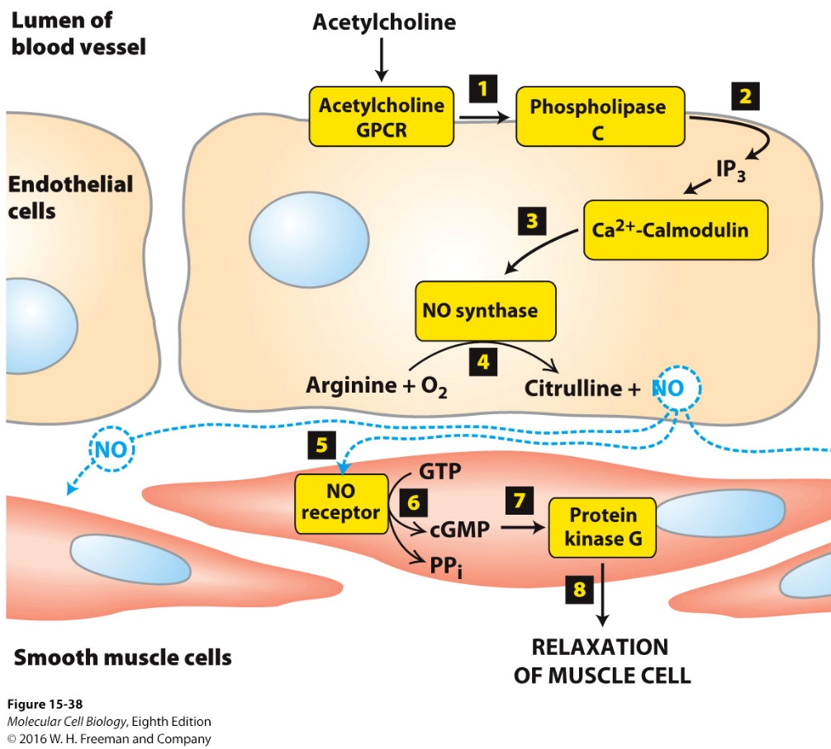
Acetylcholine attaches to the acetylcholine GPCR receptor
Activation cleaves Phospholipase C into IP₃ and diaglycerol
IP3 attaches to ER and causes Ca²⁺ channels to open
Ca²⁺ increases in cytosol and binds calmodulin
Ca²⁺ - calmodulin complex activates NO synthase
NO is produced and released into extracellular space
NO attaches to NO receptor of muscle cells
cGMP is the second messenger in the smooth muscle cell; activates protein kinase G, decreases cystolic Ca²⁺ , resulting in muscle cell relaxation
Example of drug interaction: Nitroglycerin decomposes to NO, resulting in relaxation of muscle cells of arteries feeding the heart, increasing blood flow to heart tissue

Slide 33
For cells to respond effectively in their environment, they must not only activate a signaling pathway, but they must be able to down-regulate or terminate the response
Feedback repression – end product blocks earlier step in the pathway
Enzymes also help in this process

