Slide 1
Cell Biology and Physiology
Vesicular Traffic, Secretion, and Endocytosis
Chapter 14
Dr. Capers
Molecular and Cell Biology, Lodish, 8th edition

Slide 2
In the previous chapter, we talked about protein transport into the mitochondria, chloroplast, peroxisome, nucleus and ER
Signal based trafficking
Now we will talk about vesicle based trafficking, the secretory pathway
Entry into the ER lumen is usually only the first step for proteins taking this path
We will also talk about the endocytic pathway which shares similarities to the secretory pathway

Slide 3
Secretory pathway
Named this because it was initially studied in dedicated secretory that produce and secrete large amounts of proteins
Such as insulin and digestive enzymes
Later discovered same pathway used for distribution of proteins that go from ER to other destinations in cell

Slide 4
Endocytic pathway
Used to take up substances from the cell surface and move them into the interior of the cell

Slide 5
Both pathways have single unifying principle
Transport of the membrane and soluble proteins from one membrane-bounded compartment to another is mediated by transport vesicles that collect cargo proteins in buds arising from membrane of one compartment and then deliver to next compartment by fusing with the membrane of that compartment

Slide 6
Watch this video:
https://www.youtube.com/watch?v=vIBUs81tzIE

Slide 7
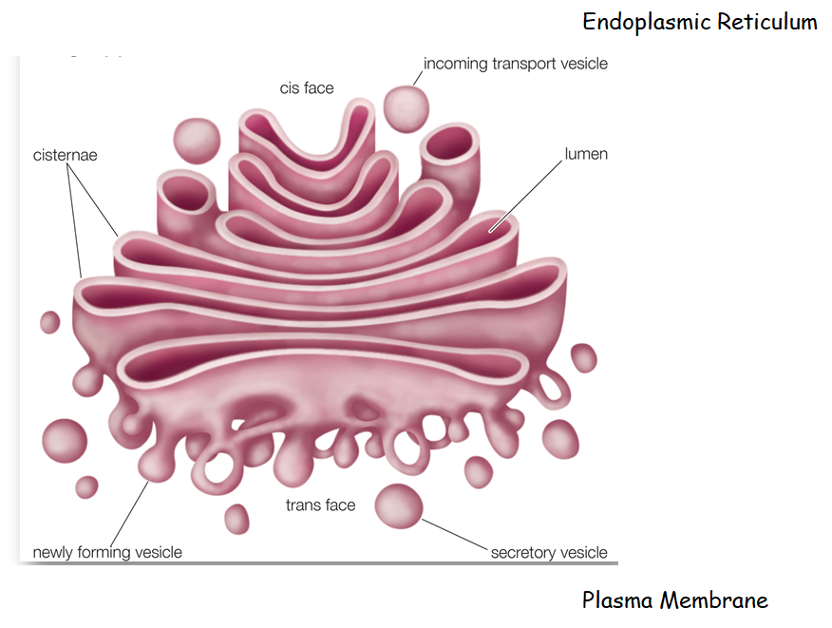

Slide 9
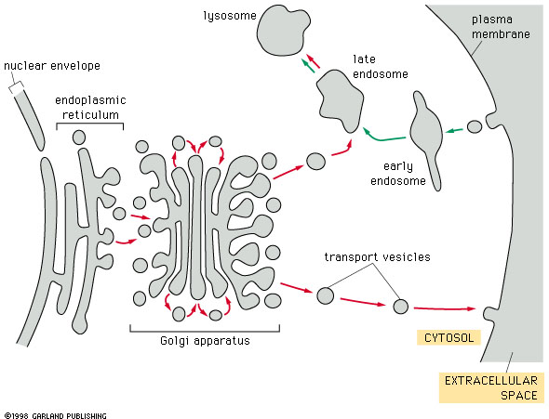
Here’s another figure:

Slide 10
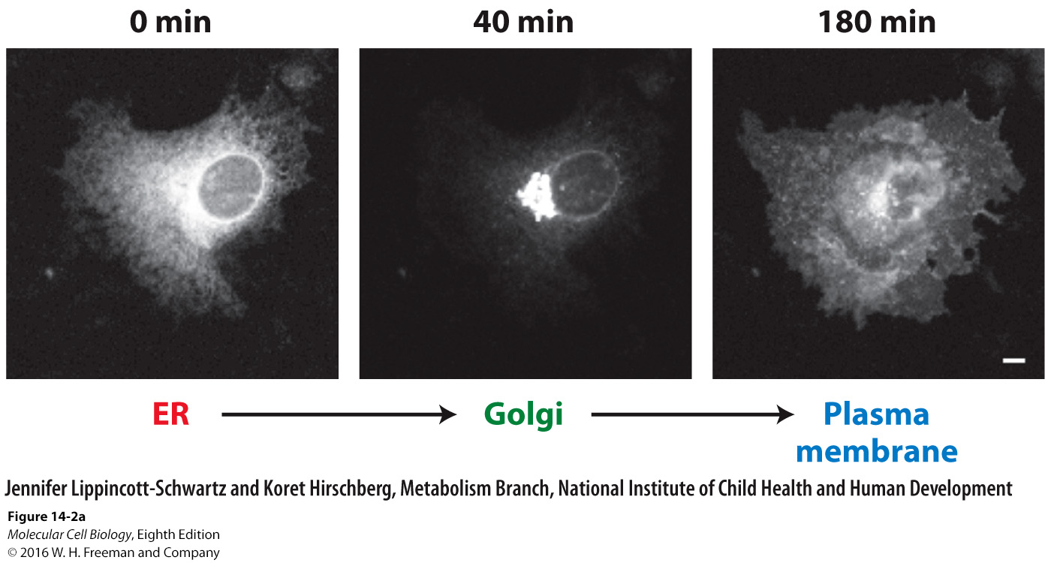

Slide 11
Molecular Mechanisms of Vesicle Budding and Fusion
Watch this video on GTPase:
https://www.youtube.com/watch?v=eohda8jt7KM
Watch this video on vesicle formation:
https://www.youtube.com/watch?v=Ecw1xYInizs
Watch this video on vesicle docking and fusion:
https://www.youtube.com/watch?v=cP7g4TLSgrI

Slide 13
G-proteins = GTPases = GTP-binding proteins
Lots of uses
Act as molecular switches inside the cell
These are the ones we’ll talk about with vesicle formation and fusion:
Sar 1 – COPII formation
ARF – COPI formation and Clathrin formation
Rab GTPases – vesicle fusion with appropriate membrane

Slide 16
Basic overview of vesicle formation

Slide 17
Basic overview for vesicle delivery

Slide 18
Types of coat proteins used for vesicle formation:
Clathrin and Adaptin I : Golgi to Lysosome
Clathrin and Adaptin 2 : Plasma membrane to Endosome
COPI : cis Golgi to ER
COPII : ER to cis Golgi

Slide 19
V-Snares
Proteins that are embedded within forming vesicle that will join with appropriate t-Snare on the target membrane
T-Snares
Proteins within the target membrane that look for v-Snares for docking and fusion
The specificity of these determines where the vesicle will travel to

Slide 20
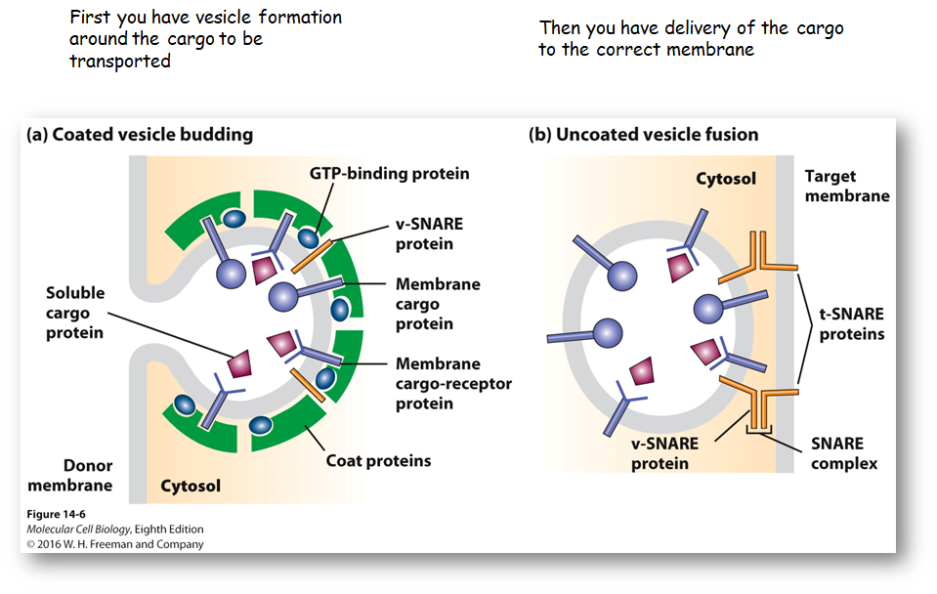

Slide 21
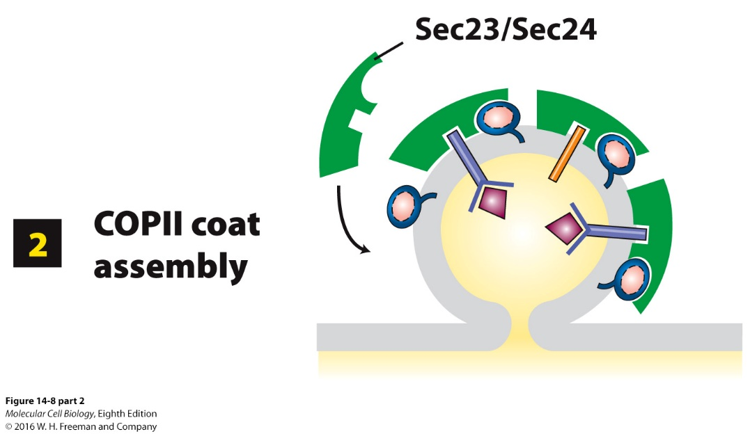
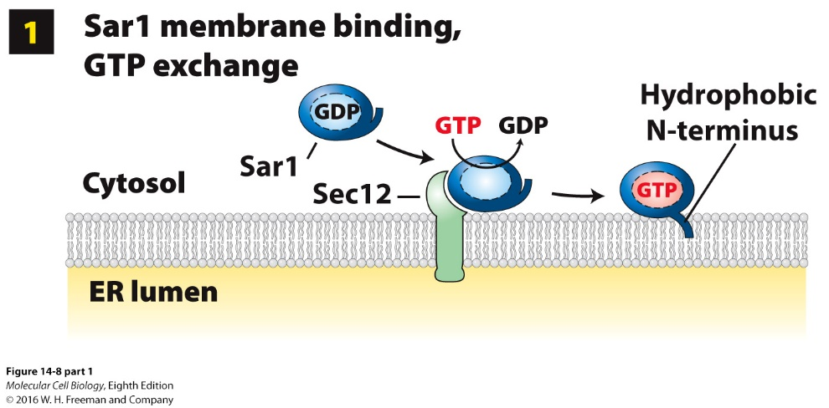
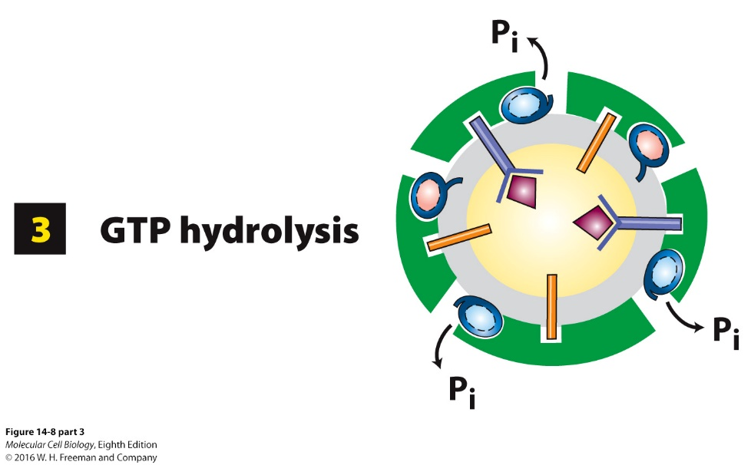
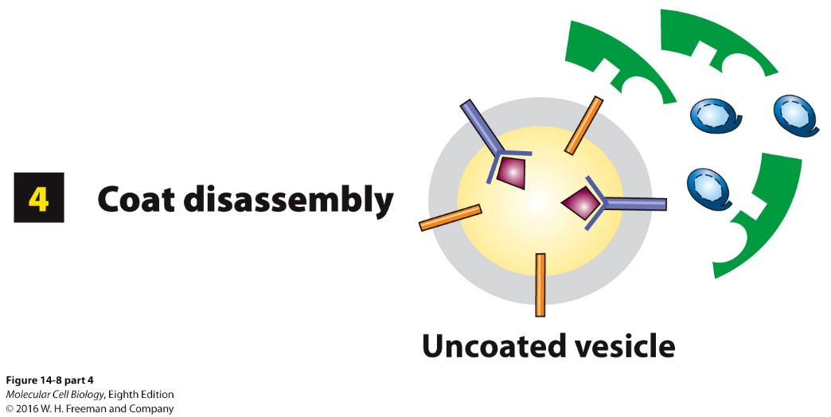
Notes:
FIGURE 14-8 Model for the role of Sar1 in the assembly and disassembly of the COPII coat.
Sar1/ARF: cycle of GEF-activated GTP binding and GAP-activated GTP-hydrolysis controls assembly and disassembly of vesicle coats.
Step 1:
Sar-GDP interacts with the ER integral membrane protein Sec12.
Sec12 GEF activity – stimulates Sar1 GTP for GDP exchange
Sar1 conformational change – integrates its N-terminal amphipathic helix into the ER membrane outer leaflet
Step 2:
Sar1-GTP recruits the Sec23/Sec24 coat protein complex.
Sec23/Sec24 – binds specific short sequences (sorting signals) in membrane cargo protein cytosolic domains
Sec13/Sec31 coat complex assembles into coat (not shown) – completes coat assembly
Coat assembly – curves and pinches off ER membrane region as a COPII-coated vesicle containing cargo proteins and v-SNARES
Step 3: Sec23 GAP activity – stimulates Sar1 GTP hydrolysis to GDP
Step 4: Release of Sar1-GDP from the vesicle membrane – causes disassembly of the coat

Slide 22
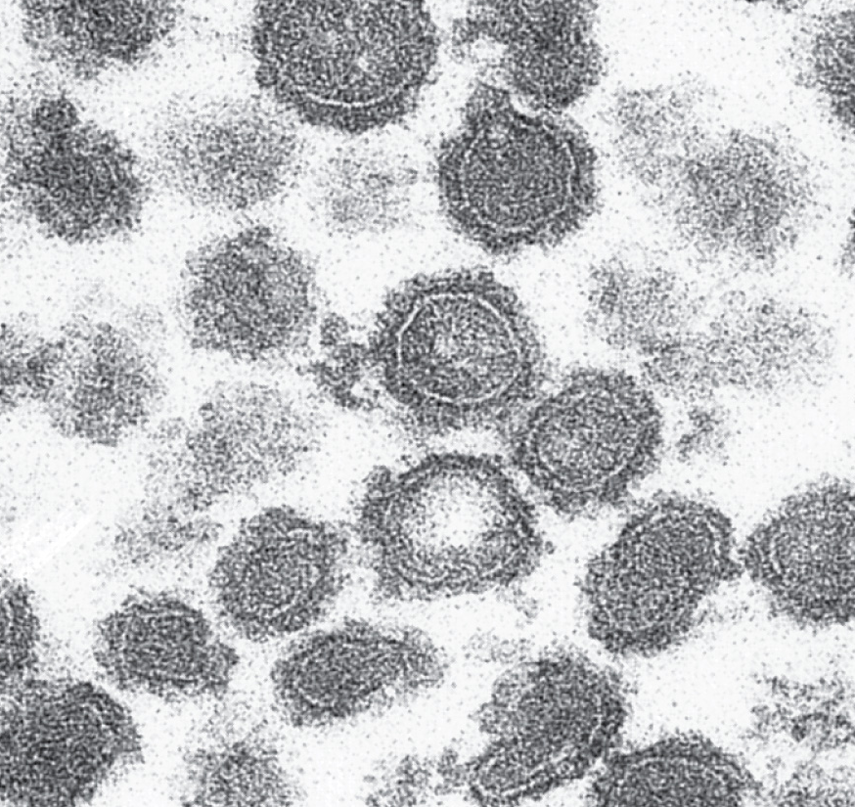
Coated vesicles accumulate
during in vitro budding reactions
in the presence of a
nonhydrolyzable analog of GTP
If the GTP cannot be
hydrolyzed, then the coat
proteins remain (not what you
want)

Slide 23
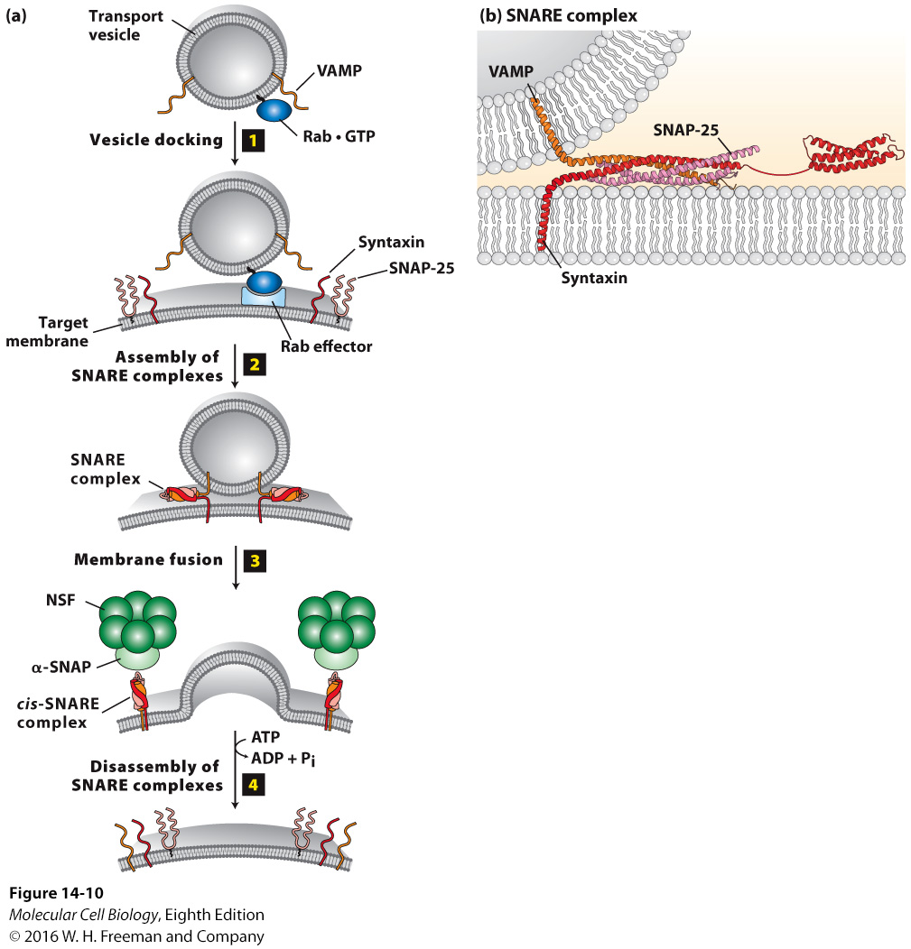

Slide 24
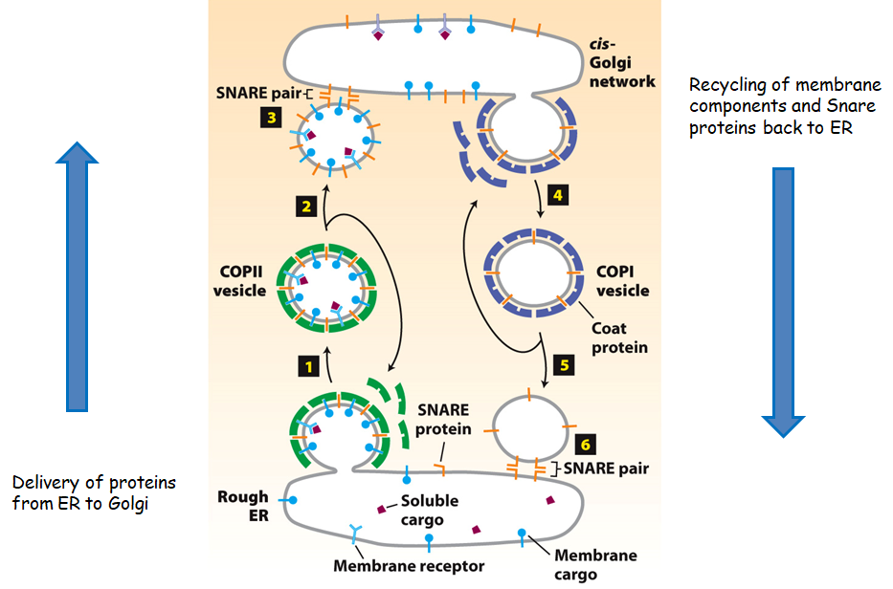

Slide 25
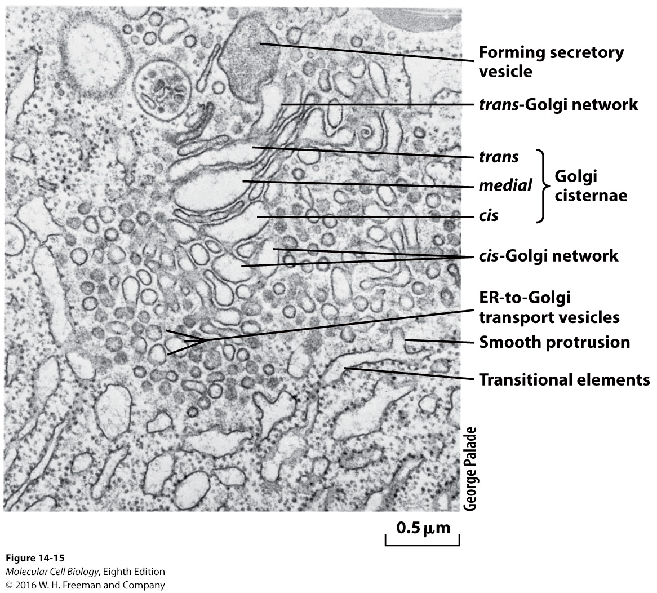

Slide 26
Golgi cisternal maturation:
Watch this video: https://www.youtube.com/watch?v=yI5x3yI3frU
Notes:
EXPERIMENTAL FIGURE 14-16 Fluorescence-tagged fusion proteins demonstrate Golgi cisternal maturation in a live yeast cell.
Experiment – yeast cisternal maturation:
Yeast cells expressing:
cis-Golgi protein Vrg4 fused to GFP (green)
trans-Golgi protein Sec7 fused to DsRed (red)
Protein localizations imaged over time (min).
Results:
(top) – Both tagged proteins change localization over time.
(bottom) – Golgi cisterna maturing –
cis to medial maturation – compartment loses Vrg4
medial to trans maturation – compartment gains Sec7
medial compartment – contains both proteins for less than one minute
Conclusion: Vesicles budding off medial compartment remove Vrg4 and vesicles budded off trans compartment fusing with medial compartment deliver Sec7, as compartment progresses through the Golgi.

Slide 27
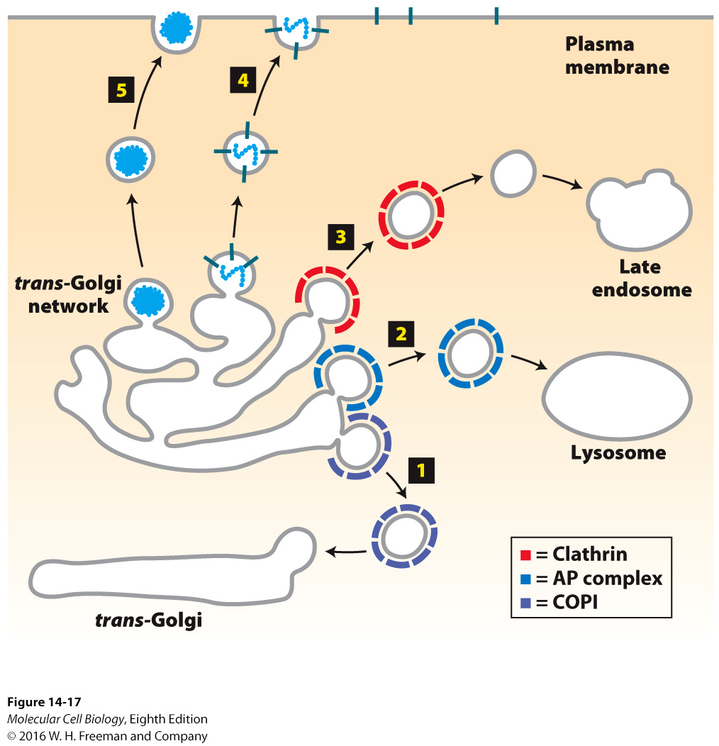
Five destinations from the trans-Golgi:
(1) COPI vesicles: retrograde transport of Golgi enzymes to the trans- Golgi (cisternal progression process)
(2) AP complex vesicles (may have clathrin coat): transport lysosomal enzymes directly to lysosomes
(3) Clathrin-coated (+AP2) vesicles: transport lysosomal enzymes to late endosomes for eventual delivery to lysosomes
(4) Constitutive secretory vesicles (unknown coat):
Transport constitutively secreted proteins and plasma membrane proteins to the plasma membrane.
Cargo proteins include ECM proteins, blood proteins, immunoglobulins.
(5) Regulated secretory vesicles (unknown coat):
Store and process secreted proteins until signaled to fuse with the plasma membrane to secrete the proteins
Cargo proteins include digestive enzymes and peptide hormones

Slide 28
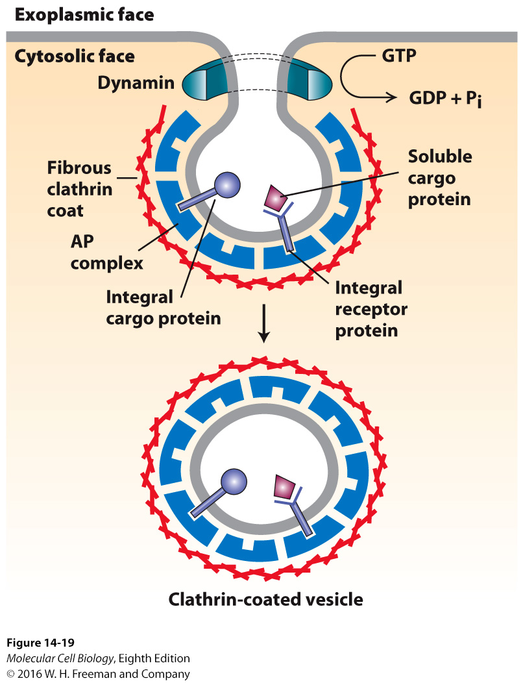
Dynamin catalyzes hydrolysis
of GTP causing pinching and
release of vesicle from
donor membrane

Slide 29
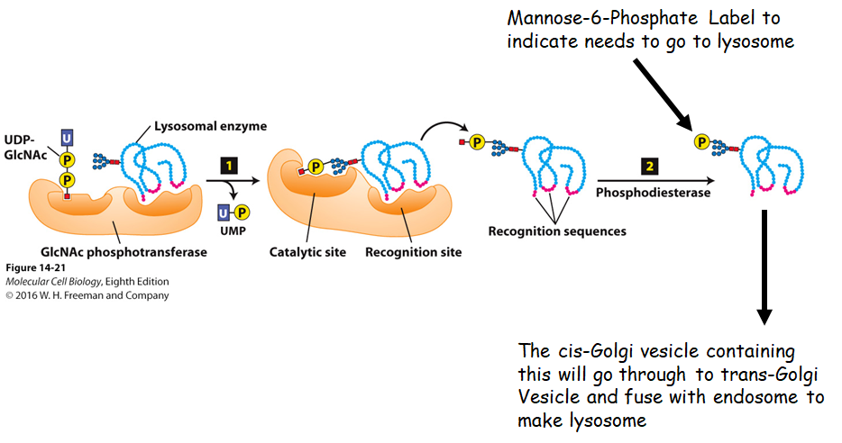
Watch this video on how proteins make it to the lysosome:
https://www.youtube.com/watch?v=OuPEXvhJ5dc

Slide 30
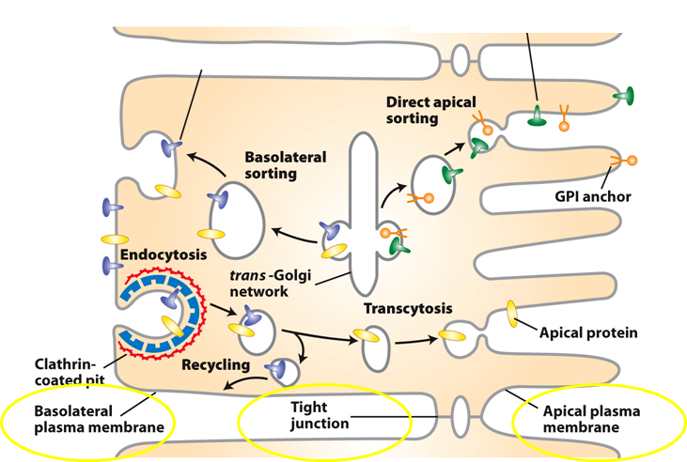
Sorting proteins to the apical or basolateral region of polarized cells
Polarized epithelial cells are divided into the apical and basolateral sides
Tight junctions prevent movement of plasma-membrane proteins between them
There are several sorting mechanisms to make sure that proteins are sorted correctly and make it to the apical or basolateral surface depending on where they need to be to be transported to

Slide 31
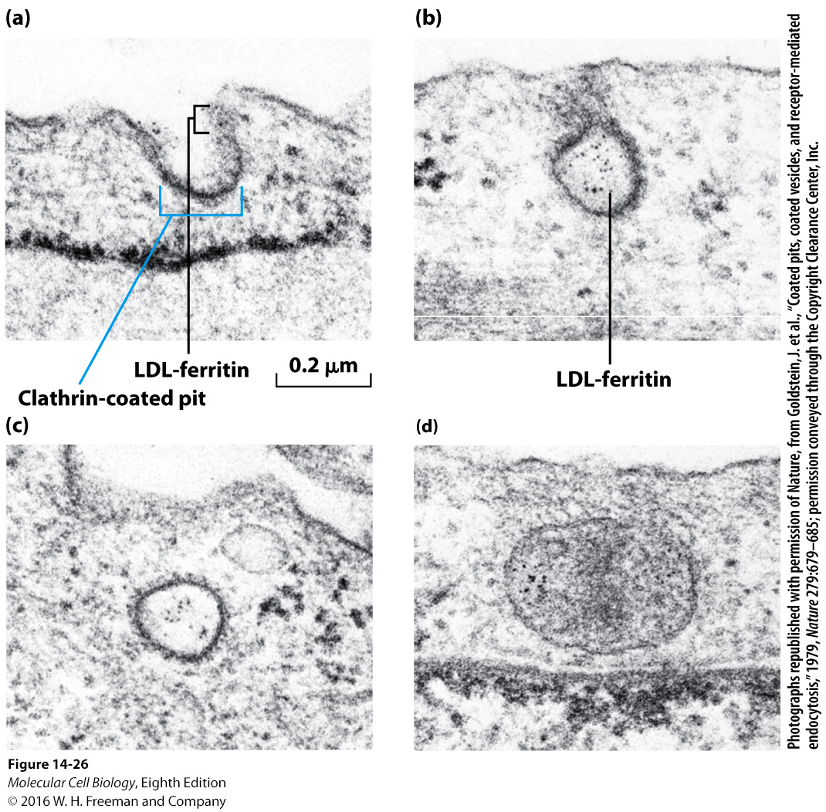
Receptor-Mediated Endocytosis
Specific receptor on cell membrane binds tightly to a macromolecule, then that part of the membrane buds inward to form pit and pinches off

Slide 32
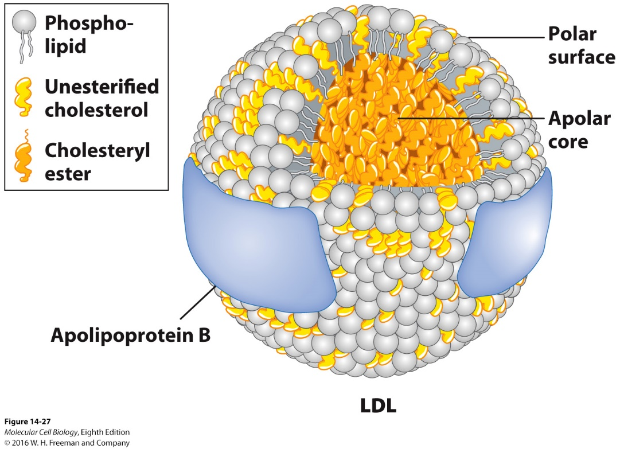
Model of low-density lipoprotein (LDL).
Cells take up lipids from the blood in the form of large, well-defined
lipoprotein complexes.
All classes of lipoproteins have the same general structure:
Shell composed of apolipoprotein and a phospholipid monolayer
(not bilayer) containing cholesterol
Hydrophobic core composed mostly of cholesteryl
esters/triglycerides (with minor amounts of other neutral lipids
[e.g., some vitamins])
LDL is bad cholesterol
HDL is “good” cholesterol

Slide 33
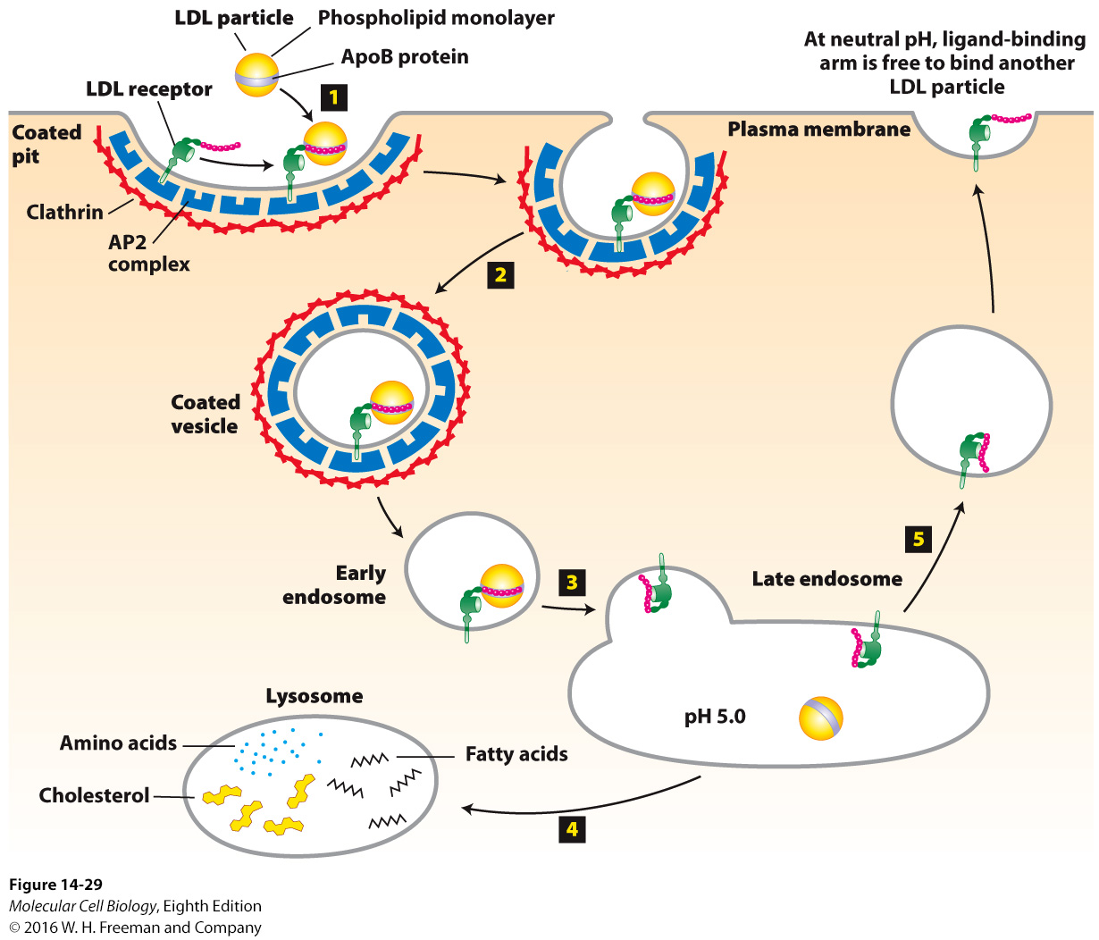
If a genetic condition causes
you to express less LDL
receptors and/or if you intake
an overabundance of cholesterol,
cholesterol can stay in your
blood vessels and cause plaques
to form

Slide 34
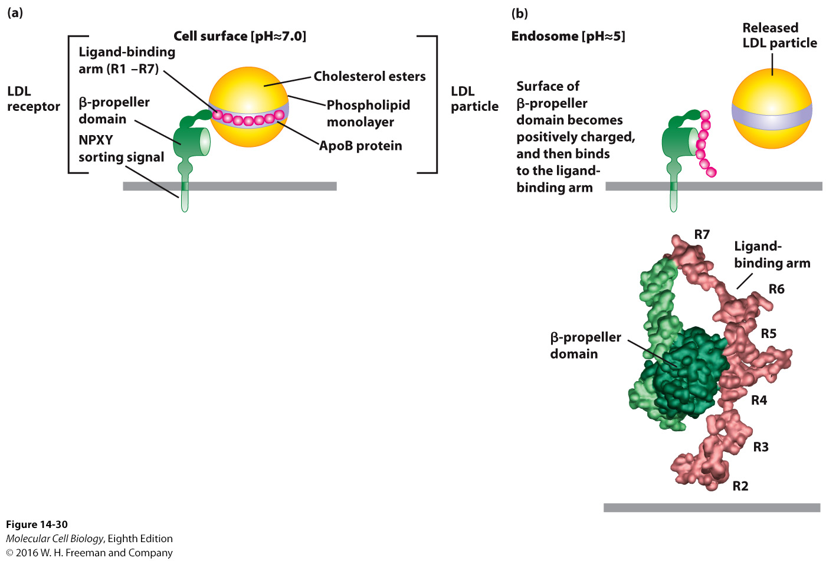
Notes:
FIGURE 14-30 Model for pH-dependent binding of LDL particles by the LDL receptor.
(a) LDL receptor at neutral pH (as at the cell surface):
Ligand binding arm seven cysteine-rich repeats (R1–R7) – tightly bind LDL apoB-100 (R4 and R5 – most critical for LDL binding)
(Note NPXY AP2-targeting sequence in receptor cytosolic domain.)
(b) LDL receptor at acidic pH (as in endosome):
β-propeller domain histidine residues – become protonated
Positively charged propeller domain binds negatively charged ligand-binding domain residues – causes release of the LDL particle
(b, bottom) LDL receptor at pH 5.3 structure – extensive hydrophobic and ionic interactions between the β propeller and R4 and R5 repeats
Human disease – Familial Hypercholesterolemia
Excessive circulating LDL causes cardiovascular disease.
LDL receptor mutations cause too little LDL uptake/clearance into cells (liver cells).
Several LDL receptor mutations including a single amino acid mutation in NPXY targeting sequence causes inefficient LDL receptor RME – FH disease.

Slide 35
How are different coat proteins recruited to different sites within the cell?
Ans: There are three known classes of coat proteins: clathrin, COPI, and COPII. Small GTPases recruit each to membranes. Sar1 recruits COPII. Sar1 itself is activated by a guanine nucleotide exchange factor, Sec12, an ER integral membrane protein. ARF recruits both clathrin and COPII. How ARF, or different isoforms of ARF, and guanine nucleotide exchange factor(s) recruit different coat protein/adapters to different sites is not yet known.
How are SNARE proteins thought to bring about specific membrane fusion?
Ans: SNARE proteins are thought to bring about specific membrane fusion by a pairing process. During vesicle budding, v-SNARE proteins are recruited into the budding vesicle membrane. The cytosolic surface of the target membrane expresses exposed t-SNARE proteins. v-SNARE and t-SNARE proteins pair to form coiled-coil complexes, drawing the vesicle and target membranes very close together. Membrane fusion then occurs by a process that is not well understood.

