Slide 1
Cell Biology and Physiology
Moving Proteins into Membranes and Organelles
Chapter 13
Dr. Capers
Molecular and Cell Biology, Lodish, 8th edition

Slide 2
Typical mammalian cell contains up to 10,000 different kinds of proteins
Yeasts have about 5,000
Most of these proteins are made by ribosomes and stay within the cytosol
However, almost half are delivered to one of the membrane bound organelles or to the cell surface

Slide 3
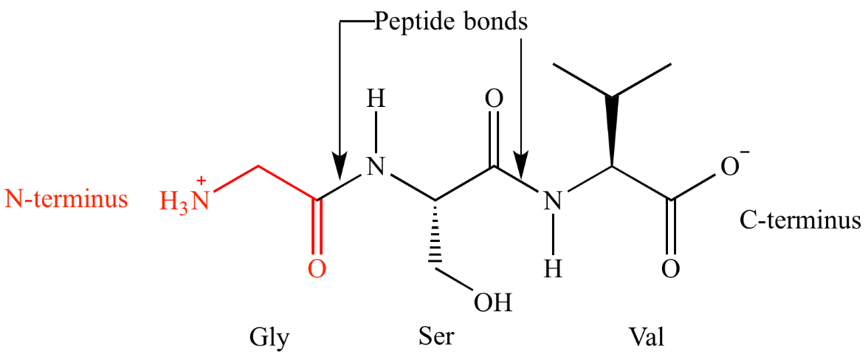
Some review on protein terminology
N-terminal, C-terminal
O-linked glycosylation
Attachment of sugar to the oxygen of a serine or threonine
N-linked glycosylation
Attachment of sugars (glycan) to the nitrogen of an asparagine

Slide 4
Delivery of newly synthesized proteins to the proper destinations – protein targeting or protein sorting
Encompasses 2 different kinds of processes:
Vesicle based trafficking – secretory pathway
Signal-based targeting
This chapter examines how proteins are targeted to 5 intracellular organelles: ER, mitochondria, chloroplasts, peroxisomes, and nucleus

Slide 5
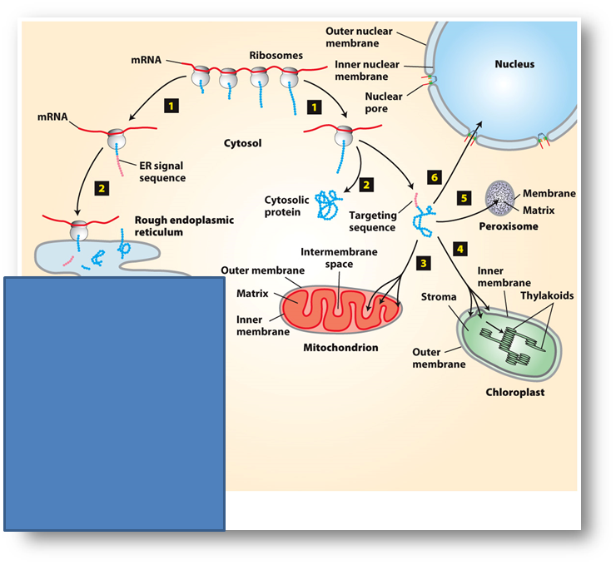
Signal-based targeting

Slide 6
Vesicle based trafficking, secretory pathway (next chapter)

Slide 7
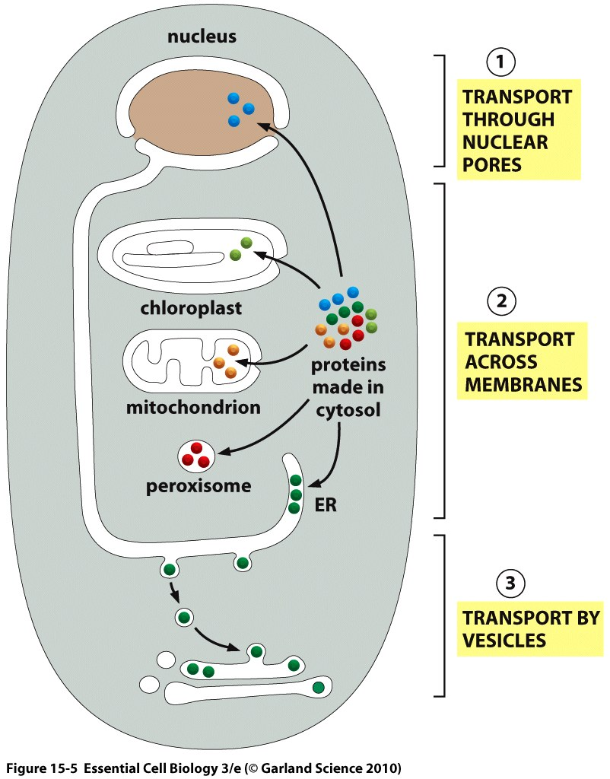

Slide 8
2 baffling questions:
How is a protein targeted to a specific membrane?
There is usually a targeting sequence or signal sequence encoded (~20 amino acids)
How relatively large hydrophilic protein molecules could be translocated across the hydrophobic membrane?
Receptors for these target sequences are found on the membranes near translocation channels

Slide 9
For each protein targeting event, there are 4 fundamental questions:
What is the nature of the target sequence?
What is the receptor for the target sequence?
What is the structure of the translocation channel?
What is the source of energy that drives the unidirectional movement of the protein across the membrane?

Slide 10
First we will look at the ER

Slide 11
ER has a large surface area
Lipids are also synthesized here
Most membrane proteins are assembled here
All proteins destined to leave the cell will go to ER
Protein trafficking that continues through ER to the plasma membrane is referred to as secretory pathway as well

Slide 12
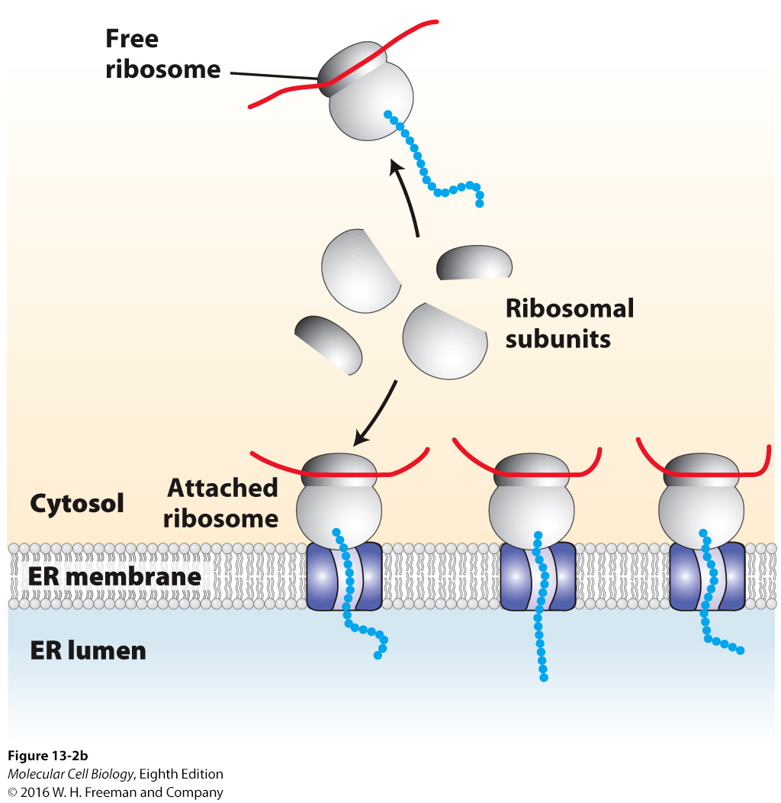
Rough ER

Slide 13
Scientists wanted to study ER but
isolating it with it’s lacelike structure
was not possible.
It was discovered that if cells were
homogenized, the rough ER breaks up
into small closed vesicles with ribosomes
on the outside.

Slide 14
Signal (target) sequence on proteins headed for the ER
16-30 amino acids
6-12 of those are hydrophobic
Attached to N-terminus of the protein
Part of this binds to an SRP (will explain next)
Transport of most of these secretory proteins into the ER lumen begins while the synthesized protein is still attached to the ribosome
Cotranslational translocation

Slide 15
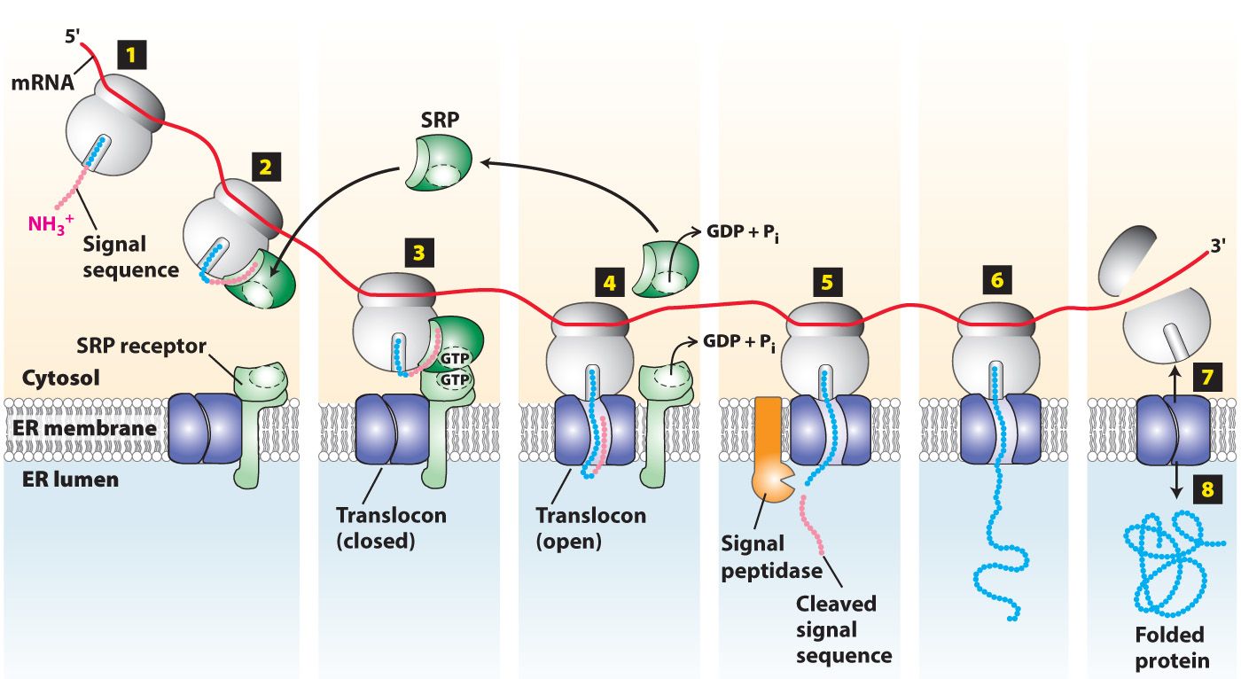
Signal Recognition Particle (SRP)
Binds to the signal sequence on the protein and the large ribosomal unit
It then brings it to the surface of the ER to an SRP receptor
Powered by GTP

Slide 17
Proteins in the ER go through modification before reaching final destination:
Covalent addition of carbs (glycosylation, N-linked and O-linked)
Formation of disulfide bonds
Proper folding
Proteolytic cleavage

Slide 18
Addition of carbs to proteins – glycosylation
form glycoproteins
O-linked oligiosaccharides – attached to O in serine and threonine
N-linked oligiosaccharides – attached to the N of asparagine (more complex sugars)
Happens exclusively to proteins that are in the ER and destined for Golgi (would not be a protein headed for nucleus, for instance)
What is the purpose of these?
Helps with folding
Stability of the protein
Help with interactions
Example: CAMs – sugars on CAMs help with interactions of other CAMs

Slide 19
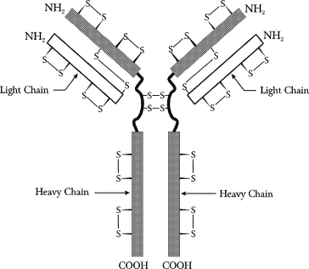
Disulfide bonds
Help stabilize the tertiary and quarternary structure of the protein

Slide 20
Chaperones and other proteins facilitate fast folding and assembly of proteins
BiP
Calnexin
Calreticulum

Slide 21
Now we will talk about how proteins synthesized on cytosolic ribosomes are transferred to mitochondria, chloroplasts, peroxisomes and nucleus
Proteins synthesized by mitochondrial and chloroplast DNA and ribosomes stay within the mitochondria and chloroplast
However, there are proteins needed by these organelles that are coded by nuclear DNA and must be transported in

Slide 22
Most studied sequences for localizing proteins to mitochondrial matrix
Matrix-targeting sequences
Located on N-terminus
20-50 amino acids

Slide 23
Mitochondrial protein import requires outer-membrane receptors and translocons in both membranes
Powered by ATP
Chaperone is located inside to fold the protein

Slide 24
What we just discussed was for moving proteins into the mitochondrial matrix
There are other pathways associated with moving proteins into the mitochondrial intermembrane spaces, inner membrane or outer membrane

Slide 25
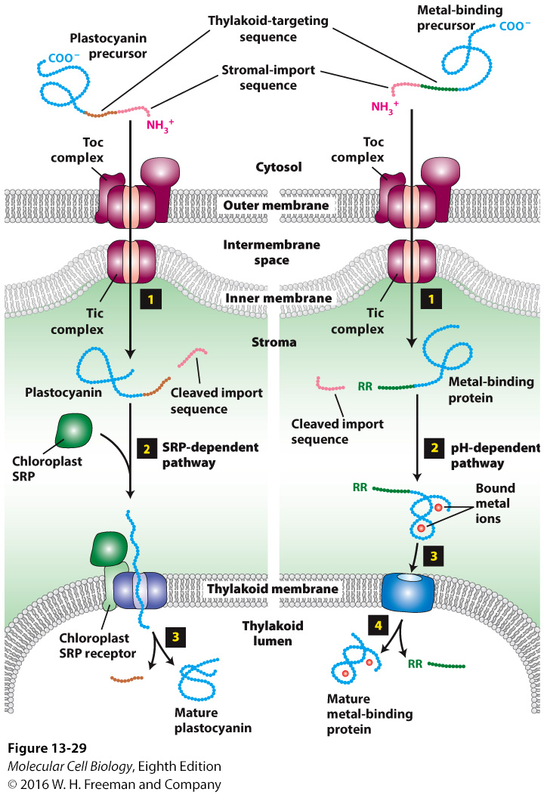
Import of chloroplast stromal proteins is similar to import of mitochondrial matrix proteins
In addition to the double membrane, chloroplasts have thylakoid membranes have secondary target sequences

Slide 26
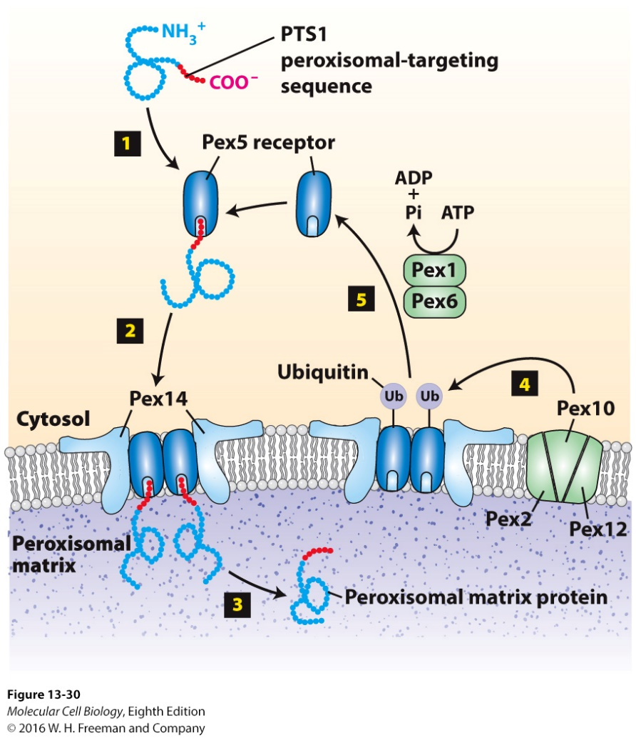
Peroxisomes are small organelles bound by one membrane
Peroxisomes contain enzymes that use molecular oxygen to oxidize various amino acids and fatty acids
H₂O₂ produced by this is toxic so they contain catalase that convert
Peroxisomes are most abundant in liver cells
Most have C-terminus target sequence
Powered by ATP

Slide 27
Transport into and out of the nucleus
Nuclear membrane is continuous with the ER
Transport in and out of nucleus:
Proteins
Macromolecules
mRNA
tRNAs
Movement happens through nuclear pore complex (NPC, receptor for this movement)
Nuclear proteins have nuclear-localization signals
Powered by GTP

Slide 28
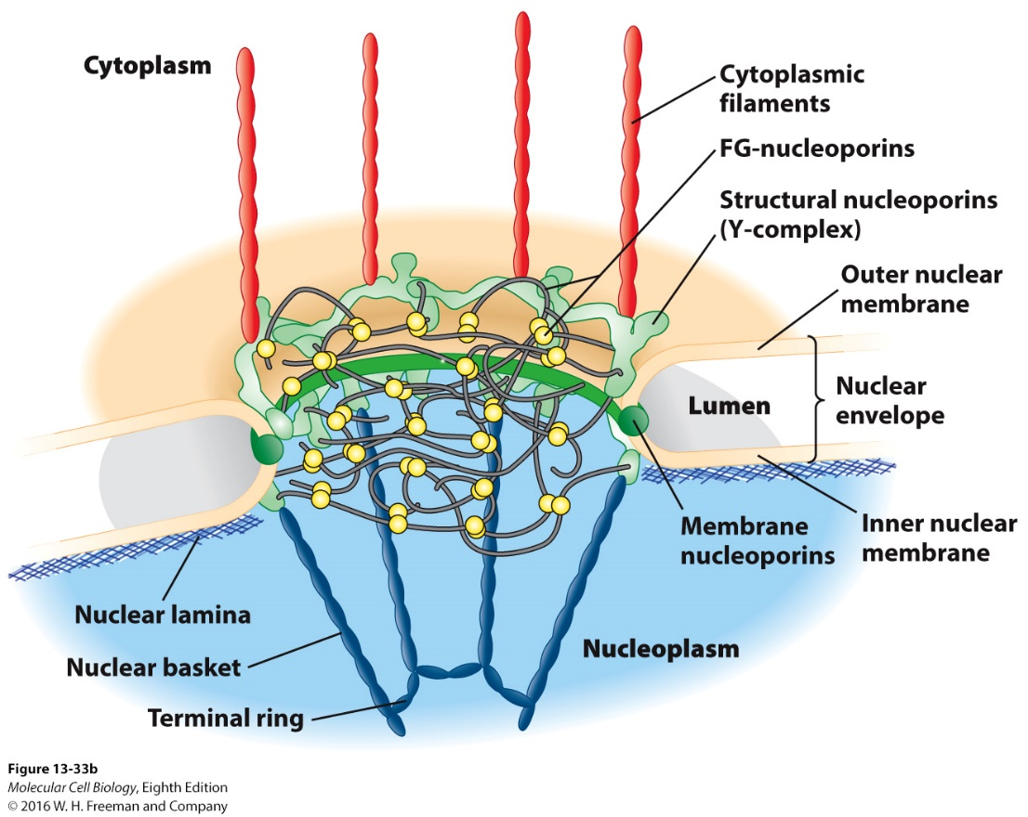
Notes:
FIGURE 13-33 Nuclear pore complex at different levels of resolution.
Nuclear envelope:
Two membrane system – separates nuclease from cytoplasm (outer membrane contiguous with ER membrane)
Nuclear pores – span both membranes for transport between cytoplasm and nucleus
(a) Xenopus oocytes nuclear envelopes (SEM):
(top):Cytoplasmic face – octagonal nuclear pore complexes
(bottom): Nucleoplasmic face – nuclear basket extends from the membrane-embedded portion.
(b) Nuclear pore complex model:
Major structural features – formed by membrane nucleoporins, structural nucleoporins, and FG-nucleoporins
(c) Nuclear pore structural scaffold –
Sixteen copies of the Y-complex (eight associated with each membrane) – form a major part of the of the complex
(d) FG-nucleoporins –
(left): Extended disordered structures composed of Phe–Gly sequence repeats interspersed with hydrophilic regions
(right): FG-repeat sequences – fill the central channel with a gel-like matrix
Gel-like matrix – bulk flow properties that allow diffusion of small molecules but block unchaperoned translocation of proteins larger than 40 kDa

Slide 29
Histones, transcription factors and DNA and RNA polymerases are all made in the cytoplasm and imported into the nucleus

Slide 30
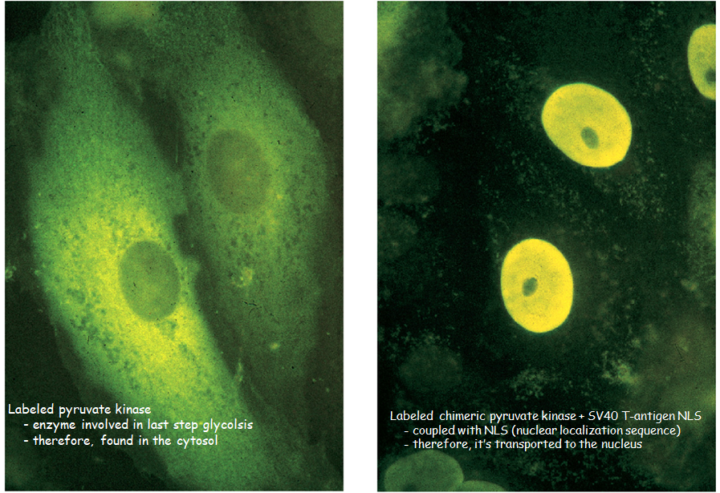
Notes:
EXPERIMENTAL FIGURE 13-34 Nuclear-localization signals (NLSs) direct proteins to the cell nucleus.
Nuclear proteins – including histones, transcription factors, and DNA and RNA polymerases –
Synthesized by cytosolic ribosomes
Imported into the nucleus through the pore complexes
Nuclear localization signal (NLS):
Targets protein for import through nuclear pores into the nucleus
SV40 T-antigen NLS – seven-residue sequence (Pro-Lys-Lys-Lys-Arg-Lys-Val) rich in basic amino acids (Lys, Arg)
Revealed by experiments with chimeric proteins
Experiment:
Pyruvate kinase –
Large cytosolic protein – normally functions in carbohydrate metabolism
Immunofluorescence localization with a specific antibody (yellow)
(a) Pyruvate kinase – localized in the cytoplasm, not in the nucleus
(b) Chimeric pyruvate kinase containing the SV40 NLS at its N-terminus – transported into the nucleus

Slide 31
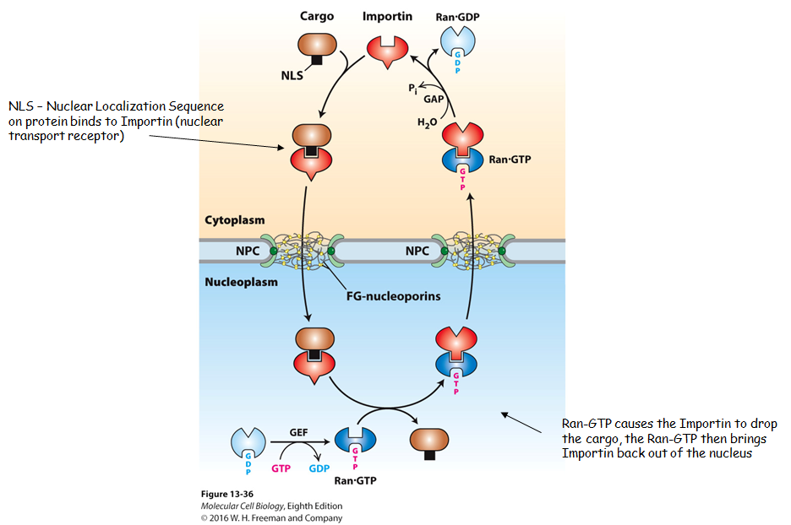
Notes:
FIGURE 13-36 Mechanism for nuclear import of proteins.
NLS-protein import mechanism:
Cytoplasm –
Importin (soluble nuclear transport receptor) – binds an NLS of a cargo protein to form an importin-cargo complex
Importin-cargo complex diffuses through the NPC by transiently interacting with FG-nucleoporins.
Ran-GDP diffuses into nucleus (not shown).
Nucleoplasm:
Ran-GDP activated by Guanine Exchange Factor (GEF) – releases GDP, binds GTP
Ran-GTP binding to the importin causes importin conformational change that releases the NLS-cargo protein.
System recycling –
Importin-Ran-GTP complex – transported back to the cytoplasm
A GTPase-activating protein (GAP) associated with the cytoplasmic filaments of the NPC – stimulates Ran hydrolysis of its bound GTP
Ran-GDP conformational change releases importin.
Localization of GEF in nucleus and GAP in cytoplasm ensures direction of nuclear import.

Slide 32
We’ll talk more about this whole pathway in the next chapter

Slide 33
Watch this video:
https://www.youtube.com/watch?v=onY_WGx4FEI
https://www.youtube.com/watch?v=TmQKHHB51P8
https://www.youtube.com/watch?v=RDUUngYhRiU
Notes:
FIGURE 13-37 Ran-dependent and Ran-independent nuclear export.
Proteins, tRNAs, and ribosomal subunits – exported from the nucleus to the cytoplasm
(a) Ran-dependent mechanism for nuclear export of NES-proteins:
Nuclear-export signal (NES) – leucine-rich region
Nucleoplasm –
Exportin 1 – binds cooperatively to form a complex with an NES-cargo protein and Ran-GTP
Complex diffuses through an NPC via transient interactions with FG-repeats in FG-nucleoporins.
Cytoplasm –
Ran-GAP associated with the NPC cytoplasmic filaments stimulates Ran-GTP hydrolysis to Ran-GDP.
Ran-GDP conformational change releases NES-containing cargo protein into the cytosol.
Recycling system –
Exportin 1 and Ran-GDP – transported back into the nucleus
Ran-GEF in the nucleoplasm – converts Ran-GDP to Ran-GTP
(b) Ran-independent mechanism for nuclear export of mRNAs:
Nucleoplasm –
Heterodimeric NXF1/NXT1 nuclear export receptor complex binds to mRNA-protein complexes (mRNPs).
Complex diffuses through NPC by transiently interacting with FG nucleoporins.
Cytoplasm – An RNA helicase (Dbp5) located on the cytoplasmic side of the NPC uses ATP energy to remove NXF1 and NXT1 from the mRNA.
Recycling system – The Ran-dependent import process recycles free NXF1 and NXT1 proteins back into the nucleus.

