Slide 1
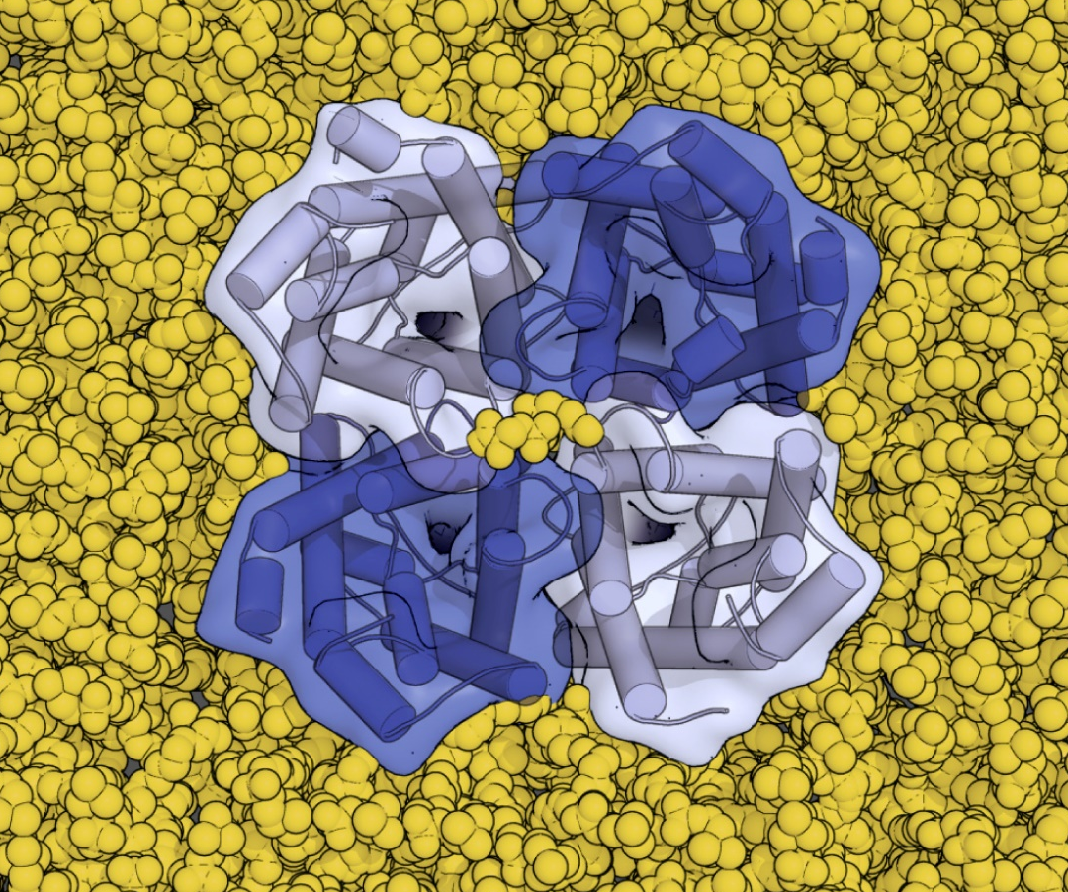
Cell Biology and Physiology
Transmembrane Transport of Ions and Small Molecules
Chapter 11
Dr. Capers
Molecular and Cell Biology, Lodish, 8th edition

Slide 2
Plasma membrane separates cytoplasm from exterior environment
Organelle membranes separate the cytosol with the internal organelle environment
Proteins are associated with the membranes serving as conduits – allowing certain molecules and ions in at certain times

Slide 3
Movement of almost all molecules and ions is mediated by membrane transport proteins
Sometimes, it’s a matter of opening protein channels and allowing molecules or ions in
In some cases, molecules or ions are pumped from area of lower to higher concentrations, thermodynamically unfavorable

Slide 4
Only gases and small uncharged molecules can readily cross membrane – simple diffusion
Due to hydrophobic interior, polar molecules cannot cross the membrane
Molecules and ions moving from high to low concentration but need protein channel – facilitated diffusion (passive)
Molecules and ions moving from low to high concentration – active diffusion, needs energy
Helps to create membrane potential, for instance

Slide 6
Therefore, molecules and ions need pathways to cross the membrane
Channels (small pores)
Passive transport (can be gated)
Carrier proteins (transporters)
active

Slide 7
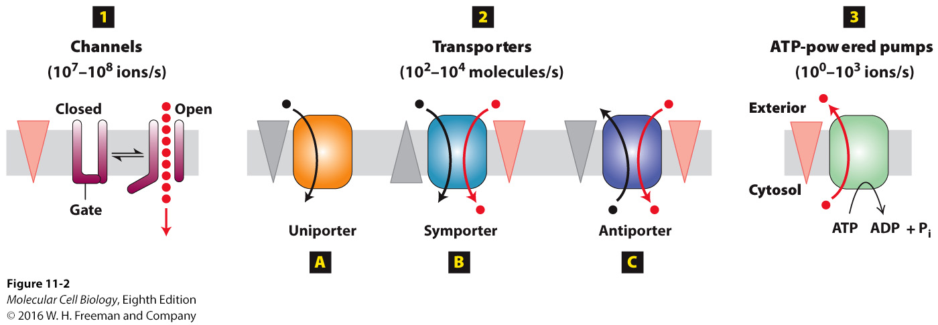
3 types of membrane proteins discussed:
Channels
Transporters – carrier proteins
ATP-powered pumps (use ATP) – active transport

Slide 8
Channels, transporters and ATP pumps often function together in the membranes of metazoan cells

Slide 9
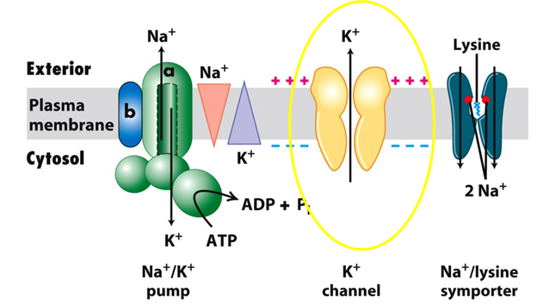
Channels
Transport water, specific ions, hydrophilic small molecules
Transporting them DOWN their concentration gradient (from high to low)
Selective for what they transport
No energy
Passive transport/facilitated transport
Nongated or gated
Gated – open in response to chemical or electrical signal

Slide 10
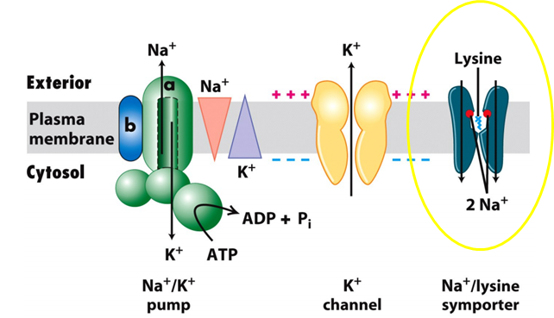
Transporters (Carriers)
Slower than channels
Move ions and molecules
3 types
Uniporters – move one molecule/ion down it’s concentration gradient
facilitated transport (glucose and amino acids move across plasma membrane like this)
Antiporters – move 2 things in 2 different directions
One is moving down its concentration gradient while the other is moving up
Symporters – move 2 things in the same direction
One is moving down its concentration gradient while the other is moving up

Slide 11
Transporters Facilitated Transport of Glucose and Water
Most animal cells use glucose as substrate for ATP production
Cells employ glucose uniporter to take up glucose from blood
Uniport transfer is much faster than simple diffusion
Many cells use aquaporins for water

Slide 12
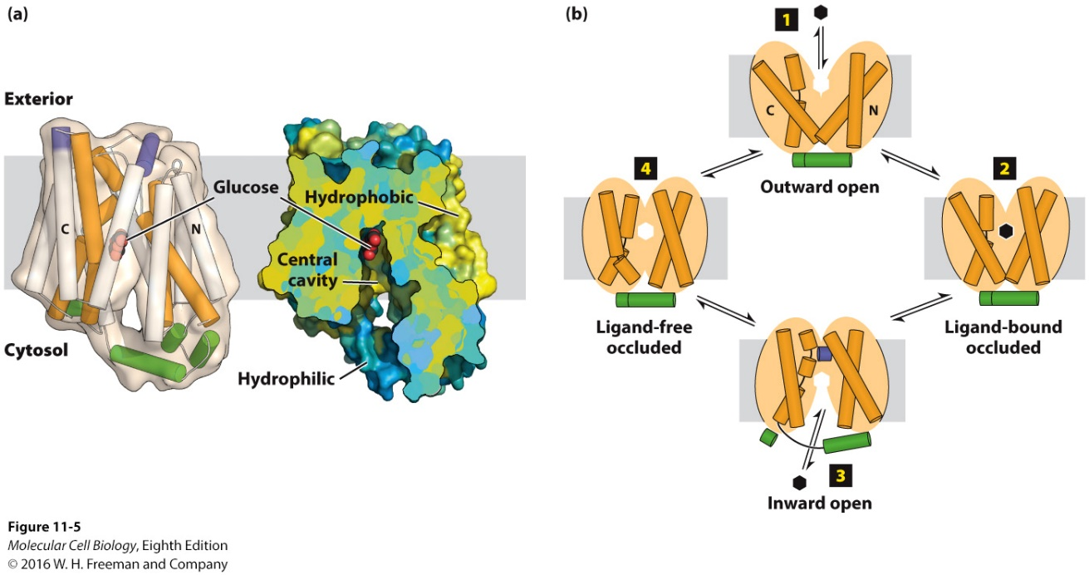
One of the best understood uniporters is the glucose transporter, GLUT1
Found in plasma membrane of most mammalian cells
Isomeric sugars, D-mannose and D-galactose can be transported
After glucose crosses into the erythrocyte, it is phosphorylated, forming glucose-6-phosphate which cannot leave the cell (first step in glycolysis)

Slide 13
Human genome encodes at least 14 highly homologous GLUT proteins
All contain 12 membrane spanning α-helices
All transport sugars but there is differential expression in various cell types
GLUT1 in erythrocytes
GLUT3 in neurons
GLUT2 in liver cells and β-islet cells in pancreas

Slide 14
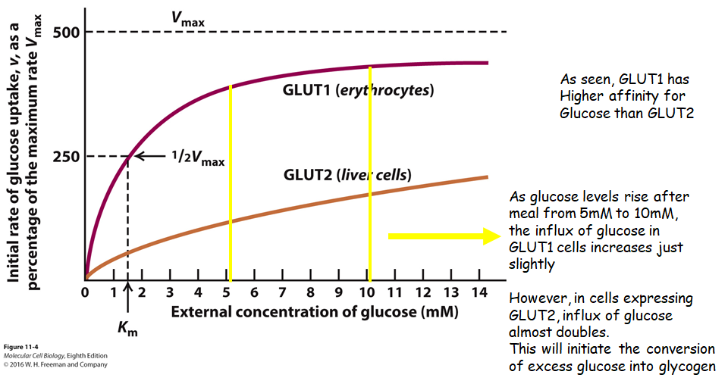

Slide 15
Osmotic pressure causes water to
move across membranes.
Water does not move as freely as
one thinks across the plasma membrane.
Membrane needs aquaporins
Notes:
FIGURE 11-6 Osmotic pressure.
Osmosis: spontaneous diffusion of water movement across a semipermeable membrane from a solution of lower solute concentration (relatively high water concentration) to one of higher solute concentration (relatively low water concentration)
Osmotic pressure: the hydrostatic pressure required to stop the net flow of water across a membrane separating solutions of different water concentrations – balances the entropy-driven thermodynamic force of the water concentration gradient
Experiment: – separated by a membrane that is permeable to water but impermeable to solutes
C_{B} (the total concentration of solutes in solution B) > C_{A} – water will flow across the membrane from solution A to solution B
Osmotic pressure π – the hydrostatic pressure that would have to be applied to solution B to prevent this water flow: π = RT(C_{B} − C_{A}). (van’t Hoff equation; R = gas constant; and T = absolute temperature)
Animal cells:
Swell in a hypotonic medium as water moves in
Shrink in a hypertonic medium as water moves out
(Isotonic medium – solute concentration, and thus osmotic strength, similar to that of the cell cytosol)

Slide 16
How do aquaporins work?
Water-selective channel is only 0.28nm in diameter, only slightly larger than water molecule
Several conserved amino acids have side-chain and carbonyl groups that extend into the middle of the channel
These form hydrogen bonds with water molecules

Slide 17
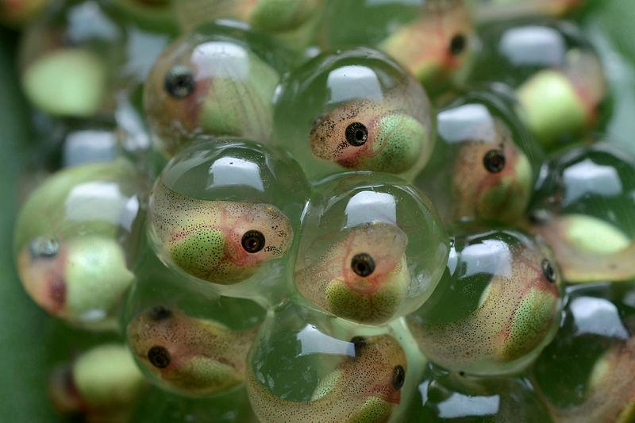
How do frog oocytes and frog eggs not swell with water until they burst?
Membrane doesn’t contain aquaporins, very important
Mammals express 11 aquaporins
Aquaporin 2 is found in kidney cells
Kidneys responsible for water retention
Regulated by antidiuretic hormone
Issues with this aquaporin causes diabetes insipidus

Slide 18
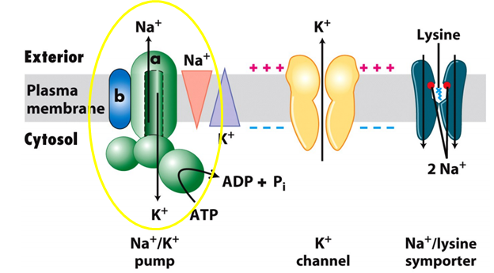
ATP- powered pumps (pumps)
Use energy of ATP hydrolysis to move ions or small molecules against its gradient
ACTIVE transport
4 classes of ATP powered pumps

Slide 19
4 Classes of ATP Pumps

Slide 21
ATP Pumps responsible for maintaining
different ion concentrations inside when
compared to outside the cell

Slide 22
Muscle relaxation depends on Ca²⁺ ATPases
Ca²⁺ is stored in the sarcoplasmic reticulum (specialized ER)
The release of Ca²⁺ causes muscle contraction
ATPase located in the SR membrane pumps Ca²⁺ from cytosol back into the SR to induce muscle relaxation

Slide 23
H+ ATPases maintain the acidity of lysosomes and vacuoles
All V-class ATPases transport only H+
Proton pumps
Watch this video: https://www.youtube.com/watch?v=1Ibc9TE2I-A

Slide 24
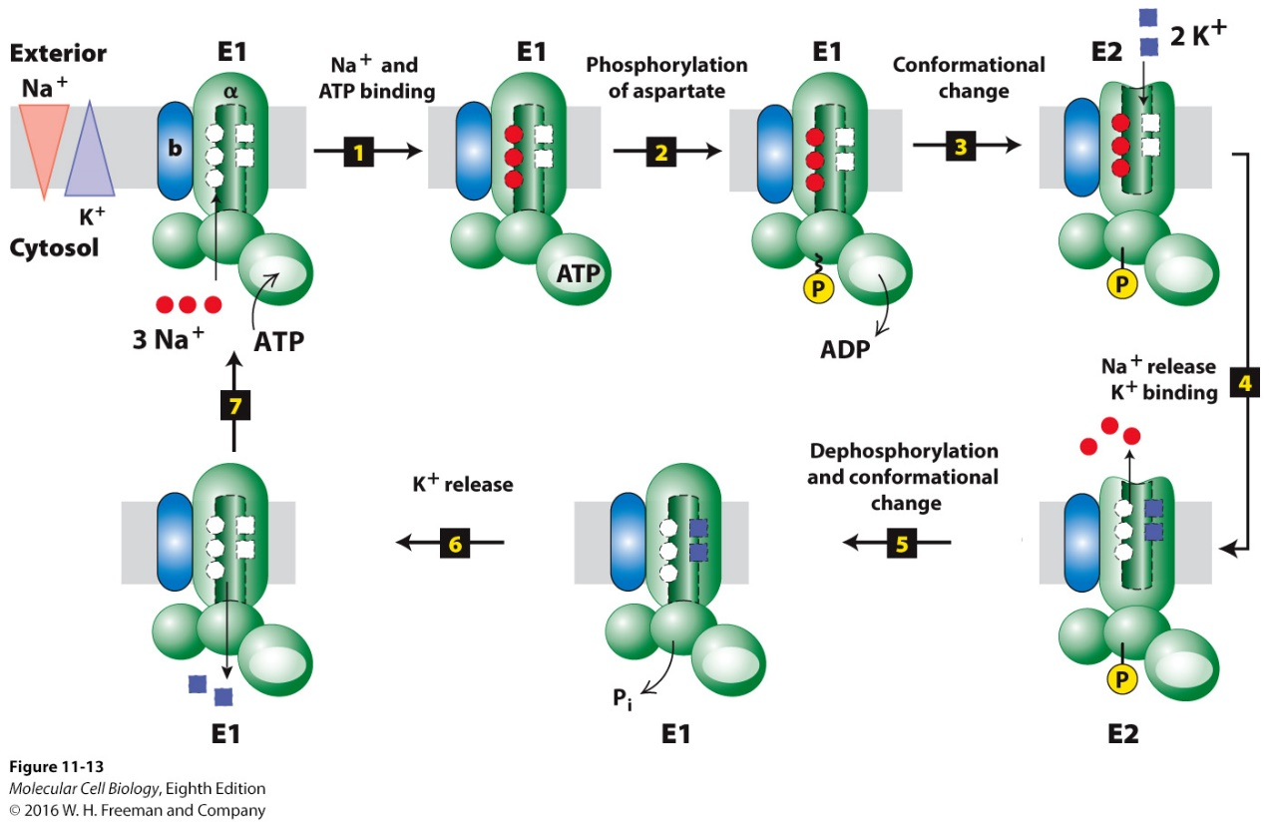
The Na⁺/K⁺ ATPase maintains the intracellular Na⁺ and K⁺ concentrations in animal cells
Moves 3 Na⁺ out and 2 K⁺ in
Ions moving against their concentration gradient
Drives the action potential
Watch this video: https://www.youtube.com/watch?v=hk09AkV5_Kc

Slide 25
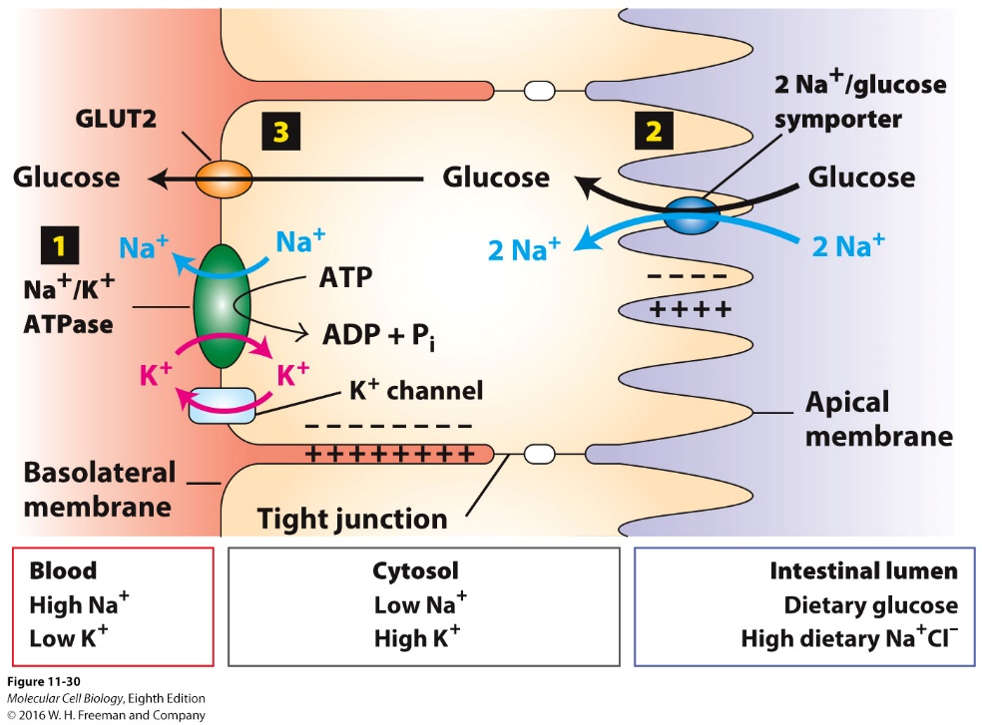
Transcellular Transport
Up until now, we have been talking about movement of ions and molecules into the cell
Polarized cells are cells that have distinct regions of the membrane based on location
Example:
Epithelia cells lining most external and internal surfaces
Apical surface – top
Basolateral surface – inside
Tight junctions separate the apical and basolateral membranes and prevent water-soluble substances from crossing
Watch this video:
https://www.youtube.com/watch?v=AXbvfBfqdtY
Notes:
e

