Slide 1
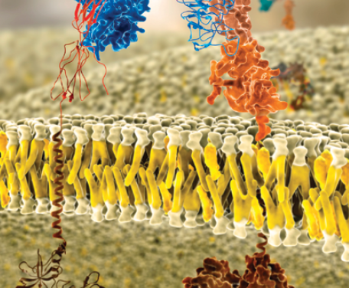
Cell Biology and Physiology
Biomembrane Structure
Chapter 7
Dr. Capers
Molecular and Cell Biology, Lodish, 8th edition

Slide 2
Plasma Membrane
Plasma membrane defines the cell and separates the inside from the outside
Membranes also define organelles
Basic structure: phospholipid bilayer with embedded proteins
Impermeable to water-soluble molecules and ions

Slide 3
Prokaryotes
    Single plasma membrane
    Contains hundreds of proteins that are integral to function of the cell
      ATP synthesis
      DNA synthesis
      Membrane transport proteins
      Receptor proteins
Eukaryotes
    Plasma membrane with proteins
      Membrane transport
      Cell signaling
      Connecting cell to tissues
      Bind to cytoskeleton
    Internal membranes formed into organelles
      ATP generation
      DNA synthesis

Slide 4
Fluid Mosaic Model

Slide 5
The Lipid Bilayer
Made up of phospholipids
    Many different kinds of phospholipids – most common are phosphoglycerides
    Amphipathic – consist of both hydrophobic and hydrophilic segments

Slide 6
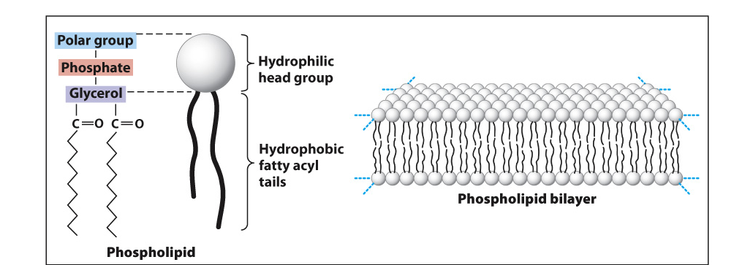

Slide 7
Besides phospholipids, the membrane contains other amphipathic lipids
    Glycolipids
    Cholesterol
    Talk more about these later

Slide 8
Phospholipid bilayers form a sealed compartment surrounding an internal aqueous space
    Impermeable to water soluble solutes
      Salts, sugars, water, etc
    Remember that water soluble solutes are polar (hydrophilic)
    Molecules or regions of the molecule that are nonpolar are hydrophobic

Slide 9
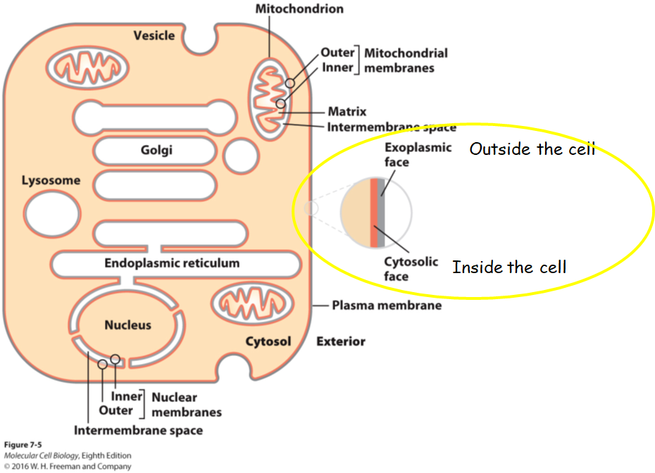

Slide 11
3 principle classes of amphipathic lipids
  Phosphoglycerides
  Sphingolipids
  sterols

Slide 12
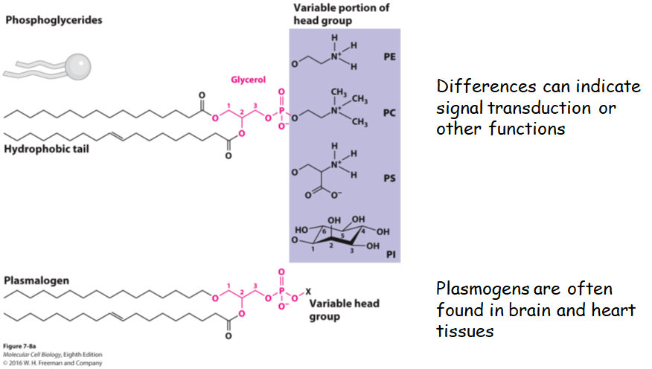
Phosphoglycerides
    2 fatty acid chains
    Glycerol phosphate group
    Polar head
        Classified based on differences in polar head

Slide 13
Sphingolipids
    Derived from sphinogosine – amino alcohol with long hydrocarbon chain
    Long fatty acid chain
Include glycolipids
    Most abundant in nervous tissue

Slide 14
Sterols
  Cholesterol
      Four-ring isoprenoid-based hydrocarbon
      Abundant in mammalian cells, absent in prokaryotes and plants
      Precursor for several important bioactive molecules (bile acids in the liver, steroid hormones produced by endocrine cells, etc)
      Cholesterol also attaches to Hedgehog protein (key signaling molecule in embryonic development)

Slide 15
Membrane Proteins
The number and amount of proteins associated with biomembranes vary depending on cell type and location
    Mitochondrial membrane – 76% protein
    Myelin membrane around axons – 18% protein
Function in
    Cell adhesion
    Cell signaling
    Transport of molecules across membrane

Slide 16
Membrane Proteins
3 categories:
  Integral membrane proteins (transmembrane)
  Lipid-anchored proteins
  Peripheral membrane proteins

Slide 17
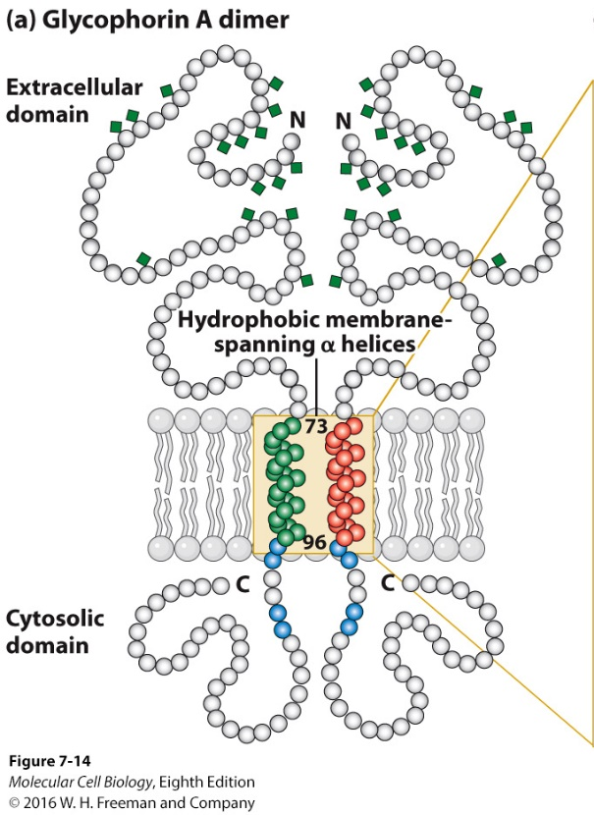
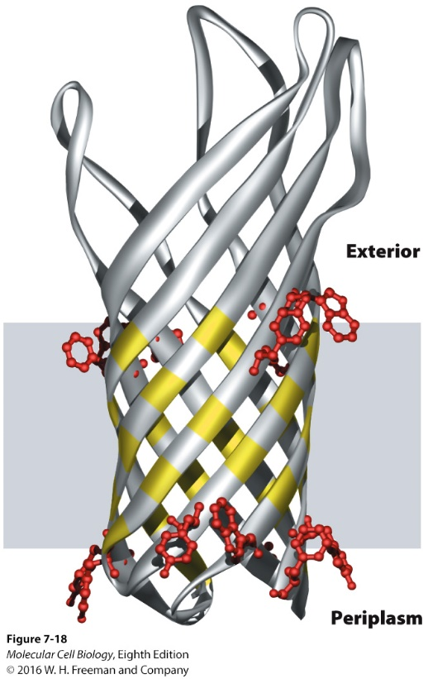
Integral membrane proteins (transmembrane)
    Span phospholipid bilayer
    Cytosolic and exoplasmic domains are hydrophilic since they interact with aqueous environment
    Membrane spanning domains consist of one or more α-helices or multiple β-strands

Slide 18
Lipid-anchored membrane proteins
    Bound to one or more of the lipid molecules
    Either attached on cytosolic or exoplasmic side
    The protein does not enter into the membrane

Slide 19
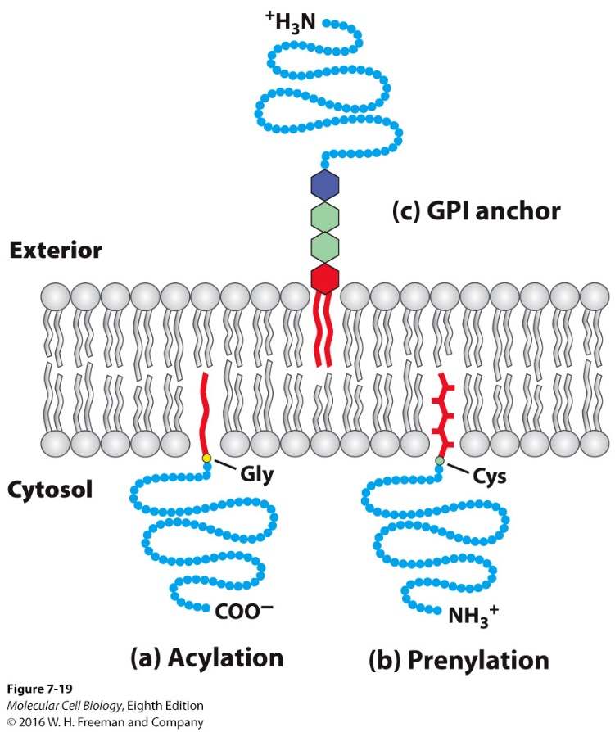
Peripheral membrane proteins
    Bound to integral or lipid-bound proteins
    Do not enter the hydrophobic region of membrane (anchored in there but polypeptide chain doesn’t enter)
    “sit” on the membrane

Slide 20
Carbohydrates can be associated with the membrane
    Carb attached to lipid – glycolipid
    Carb attached to protein on membrane - glycoprotein

Slide 21
Proteins can be removed from membranes using detergents or high-salt solutions
Watch this Video: https://www.youtube.com/watch?v=rom85WMAm08
Watch this video: https://www.youtube.com/watch?v=0emD1AmfdjY

Slide 22
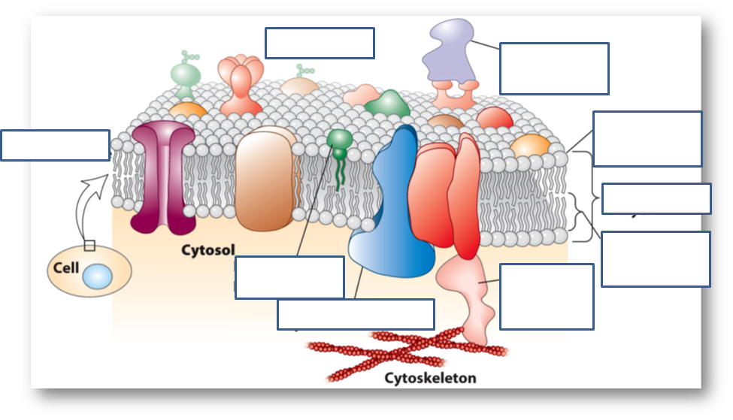

Slide 23
Explain the following statement: The structure of all biomembranes depends on the chemical properties of phospholipids, whereas the function of each specific biomembrane depends on the specific proteins associated with that membrane.
  The phospholipid bilayer provides a barrier with selective permeability that restricts the movement of hydrophilic molecules and macromolecules across the bilayer. The different types of proteins present on the two faces of the bilayer contribute to the distinctive functions of each membrane, and control the movement of selected hydrophilic molecules and macromolecules across it.

Slide 24
What are the 3 type of lipid molecules found in biomembranes?

Slide 25
Why are water soluble substances unable to freely cross the lipid bilayer of the plasma membrane? How does the cell overcome this permeability barrier?
  Water-soluble substances are hydrophilic; they are therefore repelled by the hydrophobic core of the bilayer, which is composed of non-polar hydrocarbon tails of the phospholipids. Proteins that span the cell membrane (transmembrane proteins) provide a channel or passageway through which these substances can cross the membrane. The proteins fold such that their non-polar residues are in contact with the phospholipid bilayer and their polar residues line the channel through which the hydrophilic substances travel from one side of the cell membrane to the other.

Slide 26
Name the 3 groups into which membrane-associated proteins may be classified. Explain the mechanism by which each group associates with a biomembrane.
  Membrane-associated proteins may be classifi ed as integral membrane proteins, lipid-anchored membrane proteins, or peripheral membrane proteins.
  Integral membrane proteins pass through the lipid bilayer and are therefore composed, of three domains: a cytosolic domain exposed on the cytosolic face of the bilayer; an exoplasmic domain exposed on the exoplasmic face of the bilayer; and a membrane-spanning domain, which passes through the bilayer and connects the cytosolic and exoplasmic domains.
  Lipid-anchored membrane proteins have one or more covalently attached lipid molecule, which embeds in one leaflet of the membrane and thereby anchors the protein to one face of the bilayer.
  Peripheral proteins associate with the lipid bilayer through interactions with either integral membrane proteins or with phospholipid heads on one face of the bilayer.

