Slide 1
General Biology II Lab IRSC
Lophotrochozoan Protostomes, Exercise 8

Slide 4
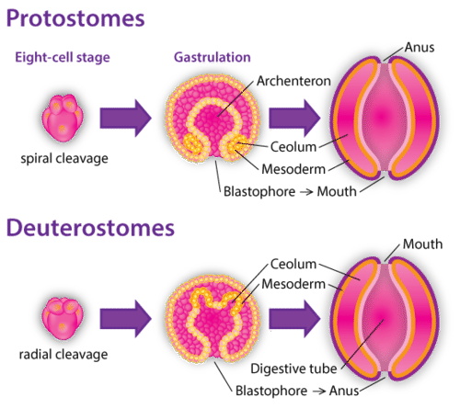
Bilaterally symmetrical animals
Platyhelminthes (talked about in previous exercise)
Protostomes – 1st blastopore is the mouth
Lophotrochozoans – will talk about in this exercise
Ecdysozoans
Deuterostomes – 1st blastopore is the anus

Slide 5
Lophotrochozoans
Phylum Mollusca
Phylum Annelida

Slide 6
Phylum Mollusca – Class Gastropoda, Polyplacophora and Bivalvia
3 part body plan – mantle, visceral mass, muscular foot
Bilateral symmetry
Body Cavity – coelomate
Digestion – complete
Circulation – open circulatory system
Respiration – gills
Excretion – rudimentary kidney (nephridium)
Locomotion – muscular foot
Support – shell (in most)
Segmentation – no
Appendages – no
Nervous – ganglion brain
Reproduction – some are hermaphrodites
Habitat – marine, freshwater and terrestrial

Slide 7
Phylum Mollusca – Class Cephalopoda
Bilateral symmetry
Body Cavity – coelomate
Digestion – complete
Circulation – CLOSED circulatory system
Respiration – gills
Excretion – rudimentary kidney
Locomotion – muscular foot is divided into tentacles
Support – most have secondarily lost shell
Segmentation – no
Appendages – muscular foot divided into tentacles
Nervous – ganglion brain
Well developed eye
Have shown some “intelligence”
Reproduction – some are hermaphrodites
Habitat – marine, freshwater and terrestrial

Slide 8
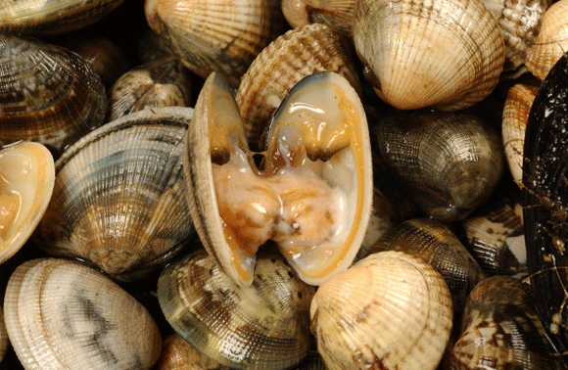
Phylum Mollusca, Class Bivalvia
2 shells, no distinct head or radula like you would find in the Gastropods

Slide 9
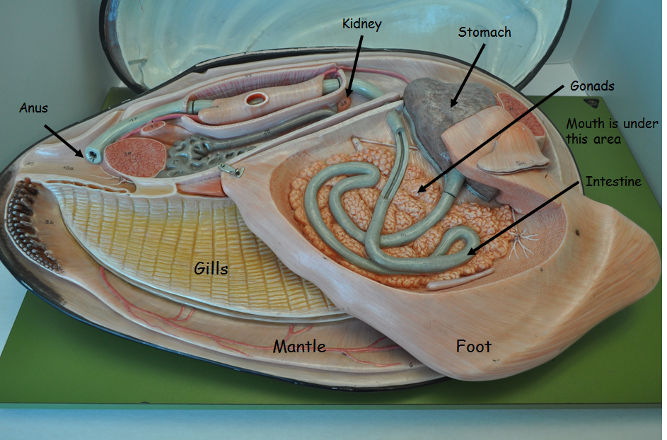

Slide 10
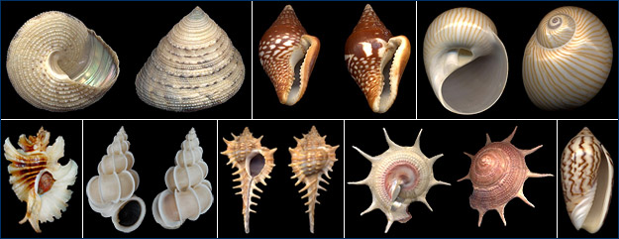
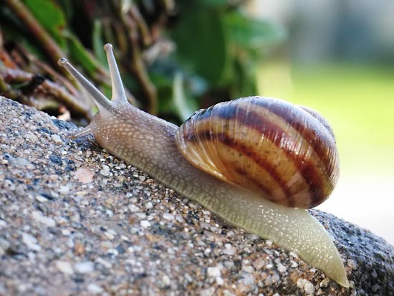
Phylum Mollusca, Class Gastropoda
Snails, slugs, conchs
distinct head, radula (used for feeding)

Slide 11
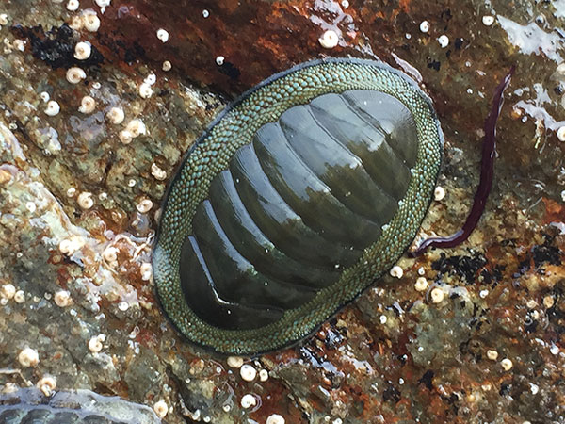
Phylum Mollusca, Class Polyplacophora
“many plates”
chitins

Slide 12
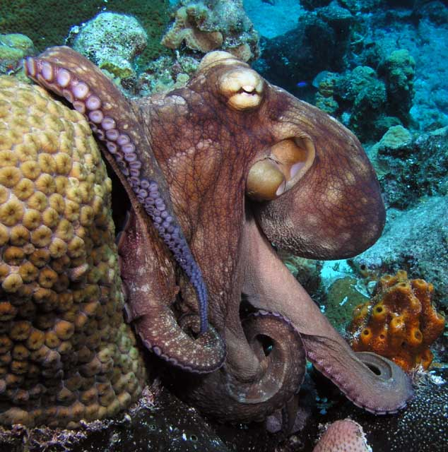
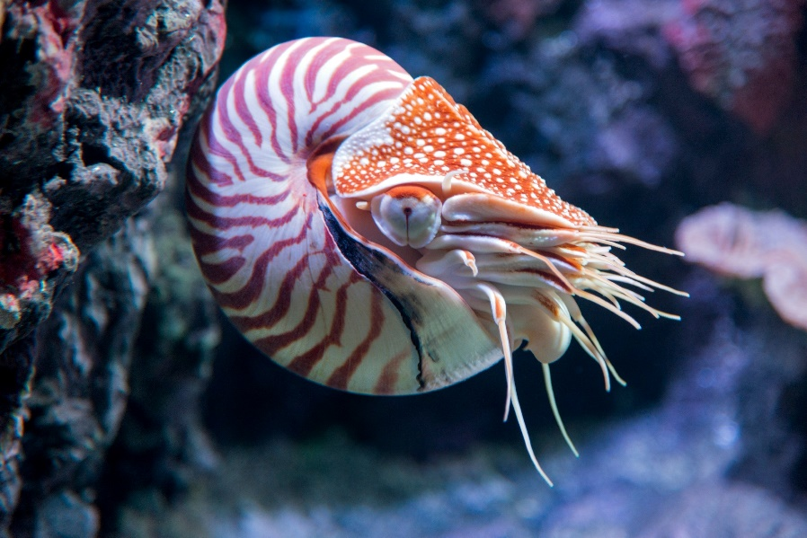
Phylum Mollusca, Class Cephalopda
Squid, octopus, nautilus
Unique group of molluscs (closed circulatory system, tentacles, intelligence)

Slide 14
Phylum Annelida
Bilateral symmetry
Body Cavity – coelomate
Digestion – complete
Circulation – closed circulatory system
Respiration – gills or diffusion through skin (depends)
Excretion – nephridia (much like the molluscs)
Locomotion – muscles (circular and longitudinal)
Support – hydrostatic skeleton
Segmentation – yes
Appendages – no
Nervous – ganglion brain
Reproduction – some are hermaphrodites
Habitat – marine, freshwater and terrestrial

Slide 15
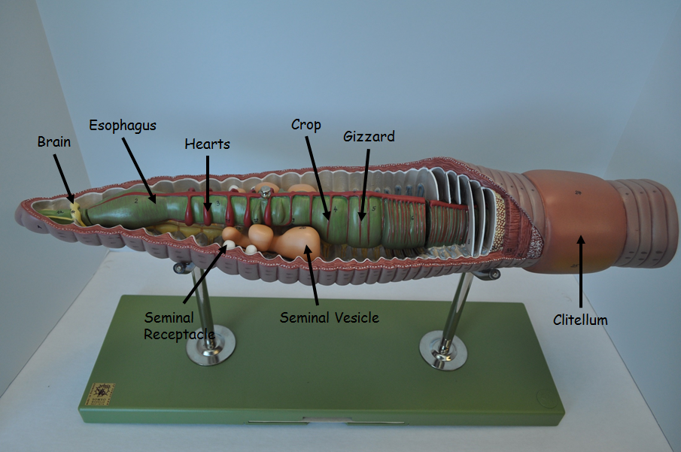
Phylum Annelida, Class Oligiochaetea
earthworm

Slide 17
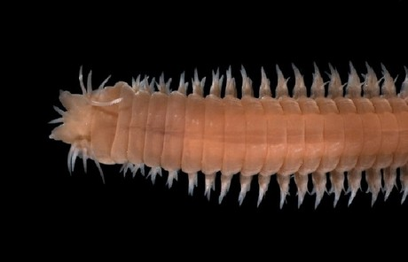
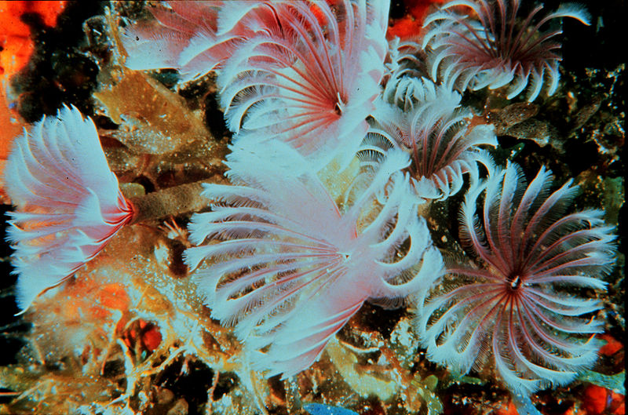
Phylum Annelida, Class Polychaetea
Sand worms, feather dusters

Slide 18
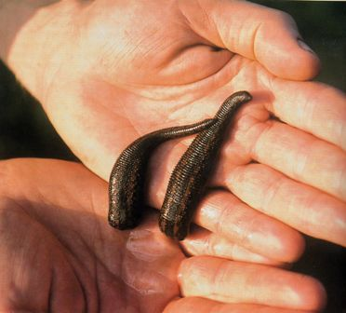
Phylum Annelida, Class Hirudinea
Leeches
Produce anti-coagulant

