Slide 1
General Biology II Lab IRSC
Acoelomate Invertebrates, Exercise 7

Slide 4
While developing, most animals have the following 3 embryonic tissues:
Endoderm
Mesoderm
Ectoderm
Sponges have no true tissues – Parazoans
All other animals have true tissues – Eumetazoans
Cnidarians and Ctenophores – Diploblastic (endoderm and ectoderm)
All other Eumetazoans – Triploblastic (all 3 embryonic tissues)

Slide 6
Animals are multicellular, heterotrophic and mobile (at least at one point during their life cycle)
Invertebrates are animals without a backbone
Acoelomate invertebrates – lack true body cavity
The rest of the invertebrates and vertebrates have true body cavity (coelomates)

Slide 7
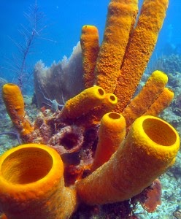
Phylum Porifera
The Sponges
Sponges are parazoans – no true tissues, simplest of animals
Asymmetrical
Body Cavity – acoelomate
Digestion – gastrovascular cavity
Circulation – gastrovascular cavity
Respiration – gastrovascular cavity
Excretion – gastrovascular cavity
Locomotion – larvae are mobile, adults are sessile
Support – spicules
Segmentation – no
Appendages – no
Nervous – no
Reproduction – asexually and sexually
Habitat – mainly marine

Slide 8
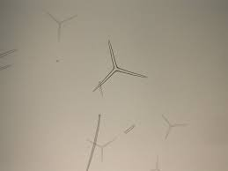

Slide 9
All the other animals are Eumetazoans
Have true tissues
Radially symmetrical animals have 2 embryonic tissues - Diploblastic (endoderm and ectoderm)
Ctenophores and Cnidarians

Slide 10
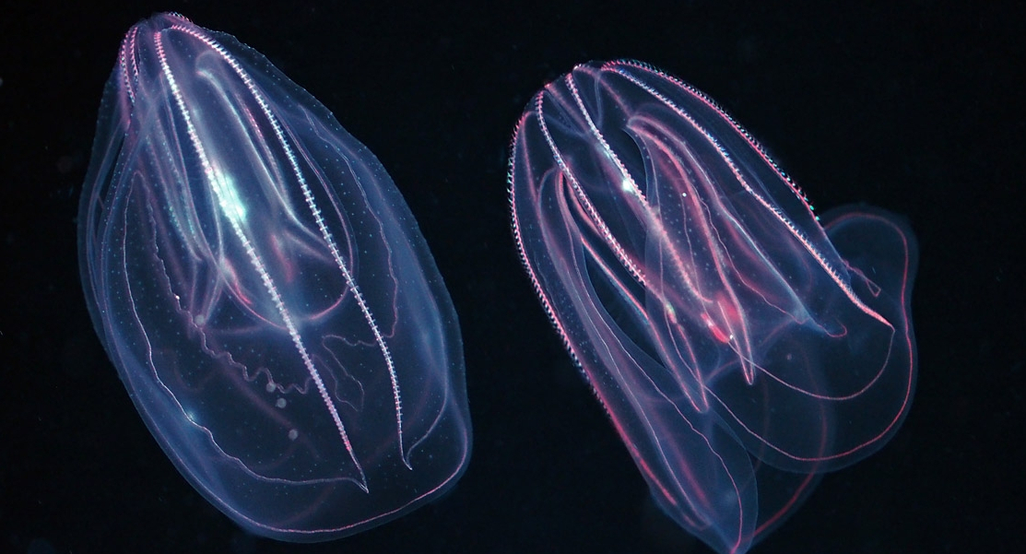
Phylum Ctenophora – Comb jellies
Don’t have stinging cells like the cnidarians
More complex than the cnidarians

Slide 11
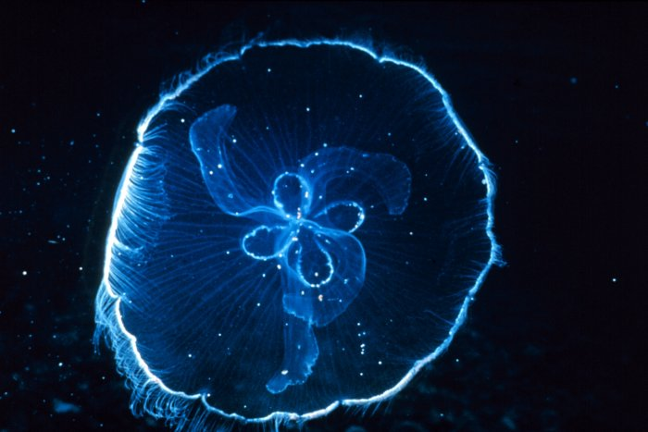
Phylum Cnidaria
The Jellyfish and Corals
Cnidocytes – stinging cells
Radial symmetry
Body Cavity – acoelomate
Digestion – gastrovascular cavity
Circulation – gastrovascular cavity
Respiration – gastrovascular cavity
Excretion – gastrovascular cavity
Locomotion – 2 forms (medusa and polyp)
Support – hydrostatic skeleton
Segmentation – no
Appendages – tentacles
Nervous – nerve net, very primitive
Reproduction – sexual and asexual
Habitat – mainly marine

Slide 12
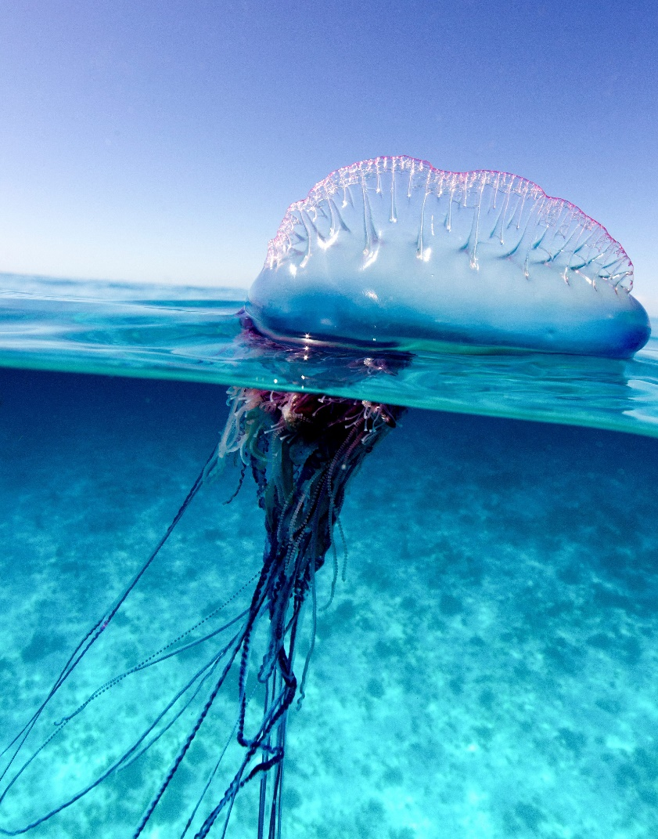
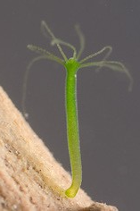
Phylum Cnidaria, Class Hydrozoa
Hydra, Portuguese-Man-of-War

Slide 13
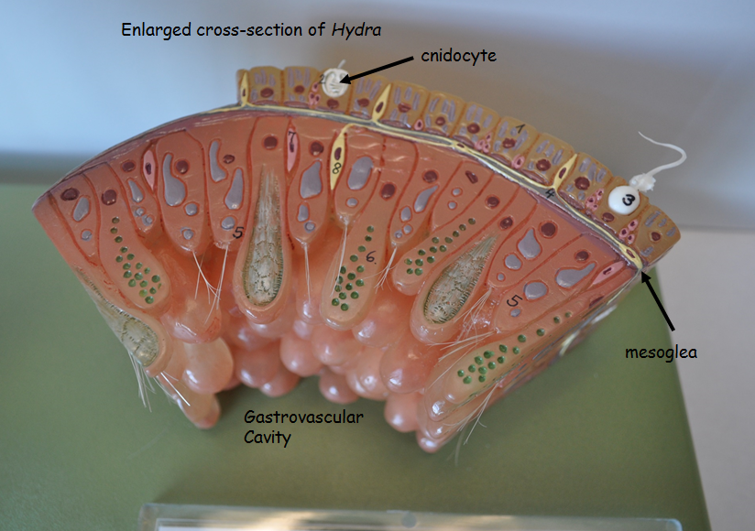
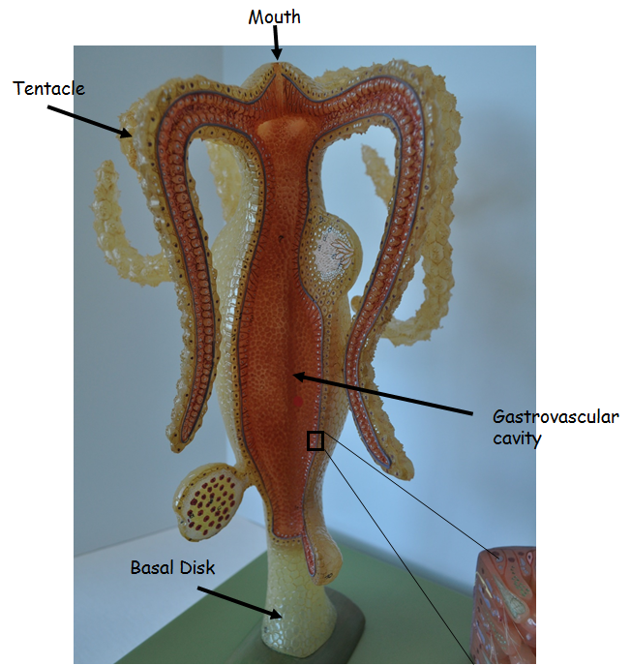
Hydra Model

Slide 15
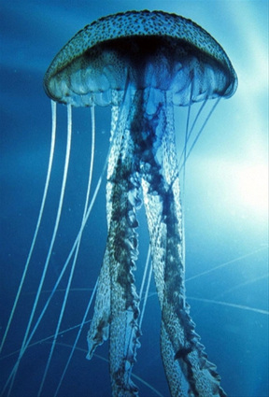
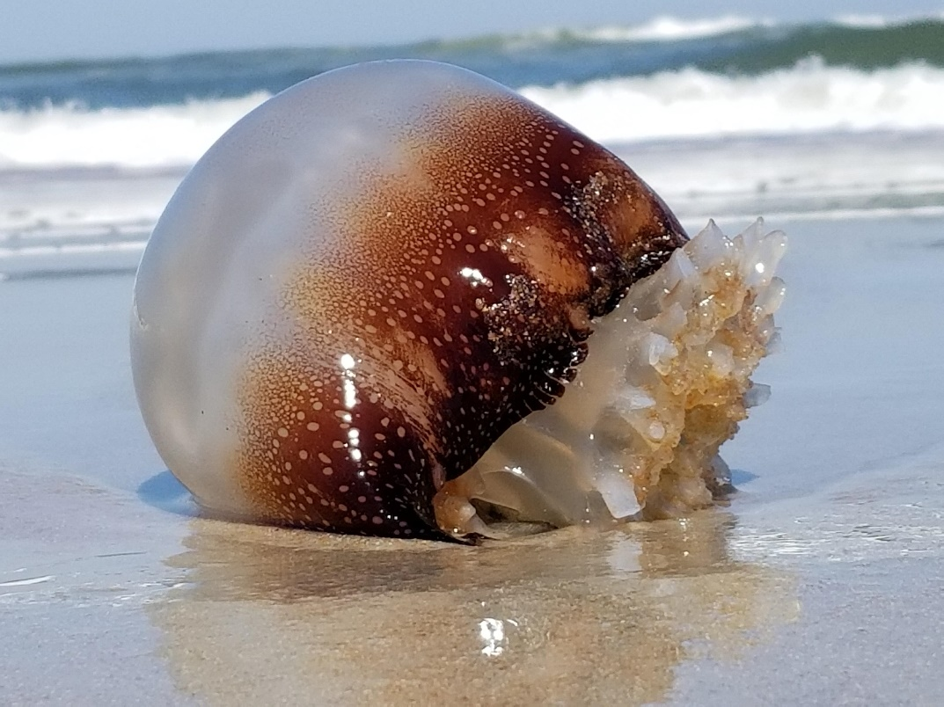
Phylum Cnidaria, Class Scyphozoa
“jellies”

Slide 16
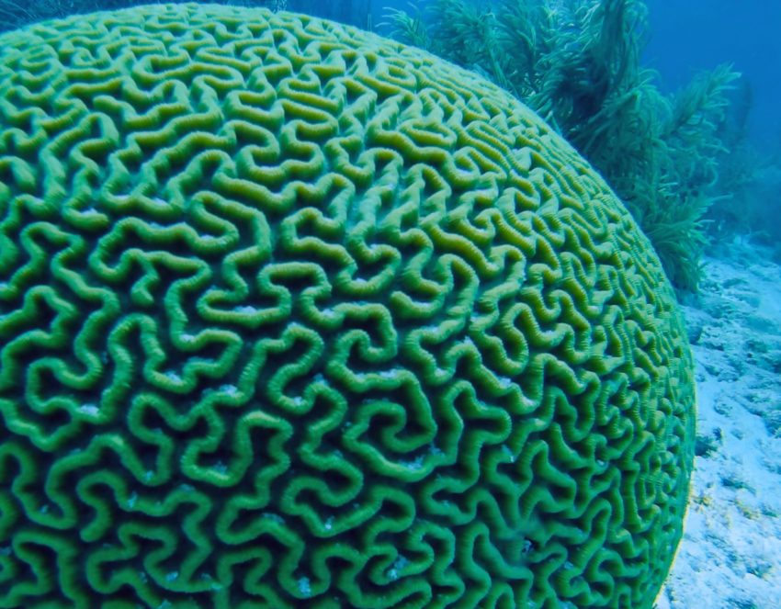
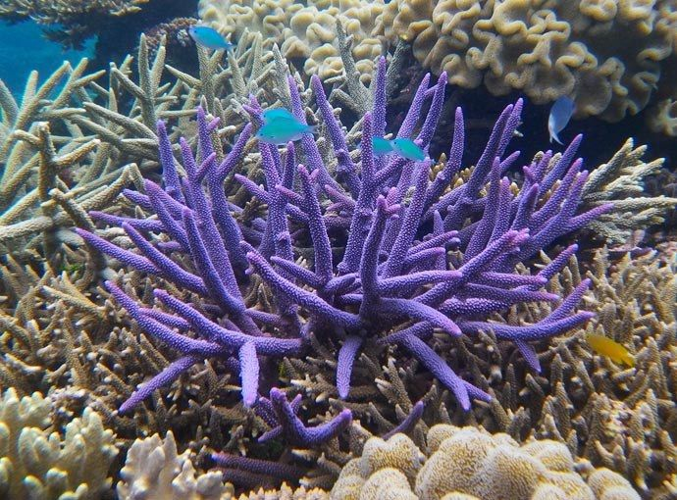
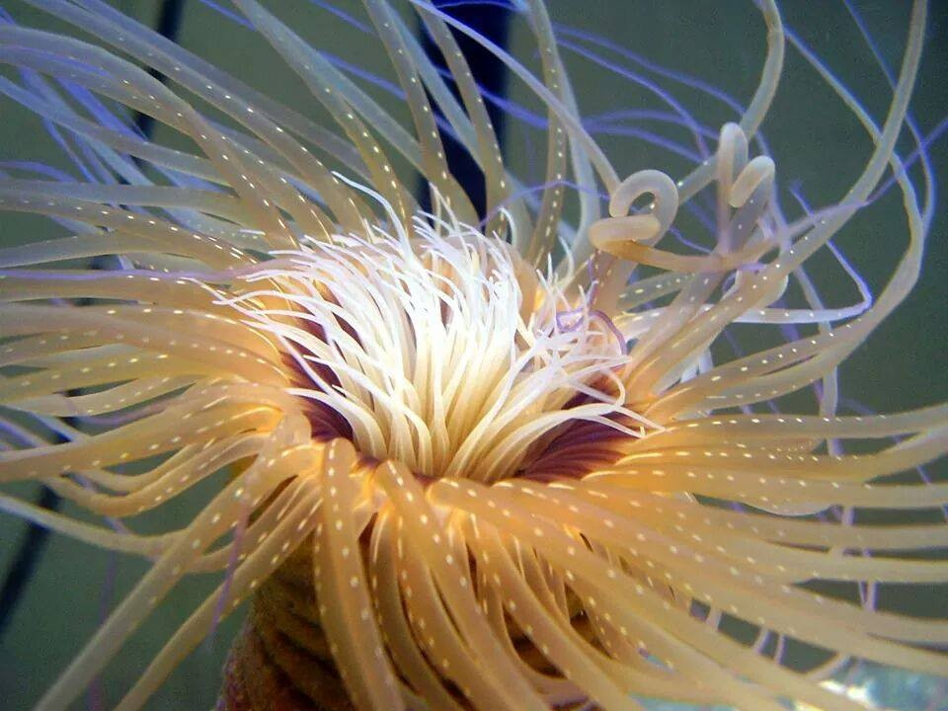
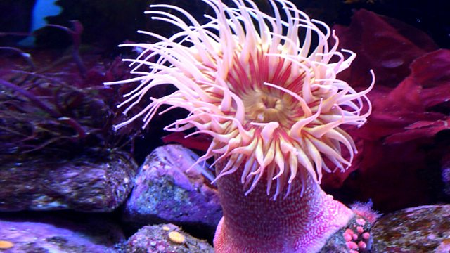
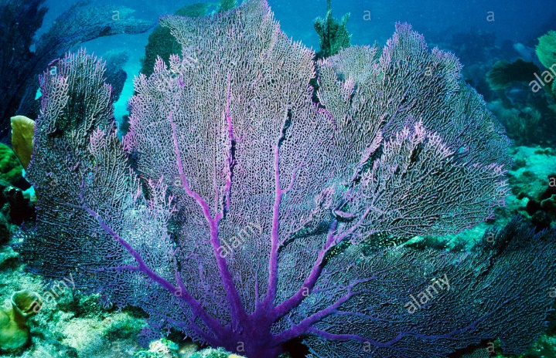
Phylum Cnidaria, Class Anthozoa
The Corals and sea anemones

Slide 17
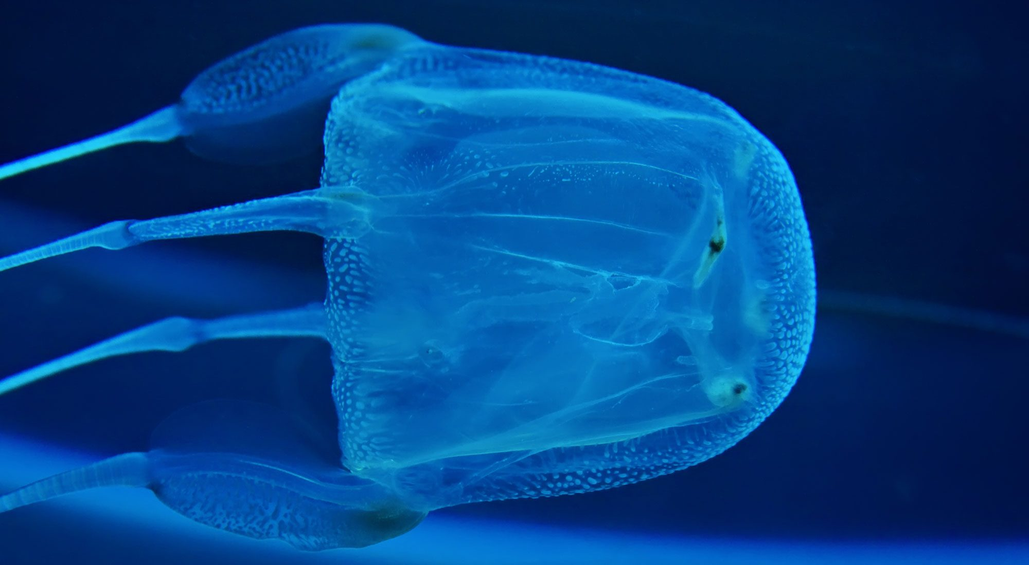
Phylum Cnidaria, Class Cubozoa
Box jellies

Slide 18
All other animals are Triploblastic (3 embryonic tissues – endoderm, mesoderm, ectoderm) and have Bilateral symmetry
Playhelminthes
Protostomes – Lophotrochozoans and Ecdysozoans)
Deuterostomes

Slide 19
Phylum Platyhelminthes
The Flatworms
Bilateral symmetry
Body Cavity – acoelomate
Digestion – gastrovascular cavity
Circulation – gastrovascular cavity
Respiration – gastrovascular cavity
Excretion – flame cells
Locomotion – muscles
Support – hydrostatic skeleton
Segmentation – no
Appendages – no
Nervous – ganglia “brain”
Reproduction – hermaphroditic
Habitat – marine, freshwater and terrestrial

Slide 20
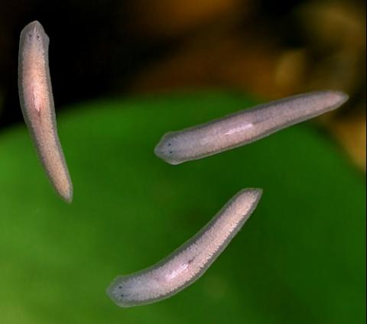
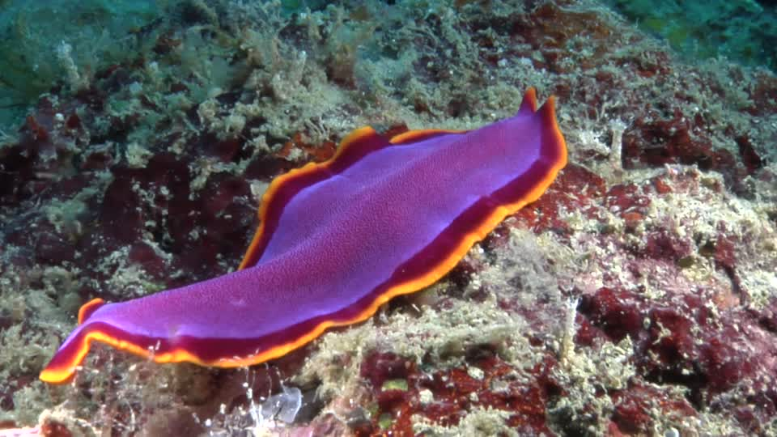
Phylum Platyhelminthes, Class Turbellaria

Slide 21
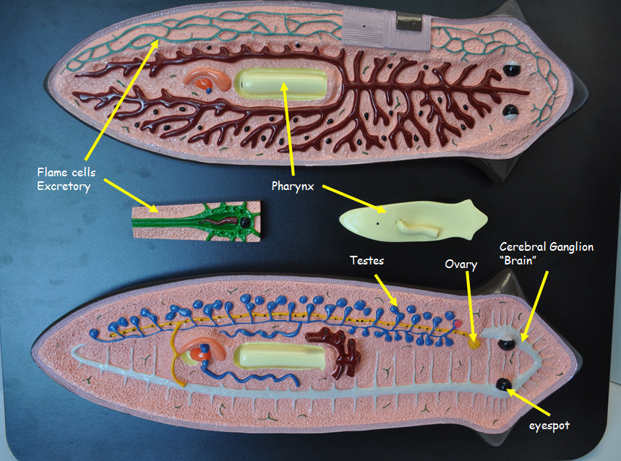

Slide 22
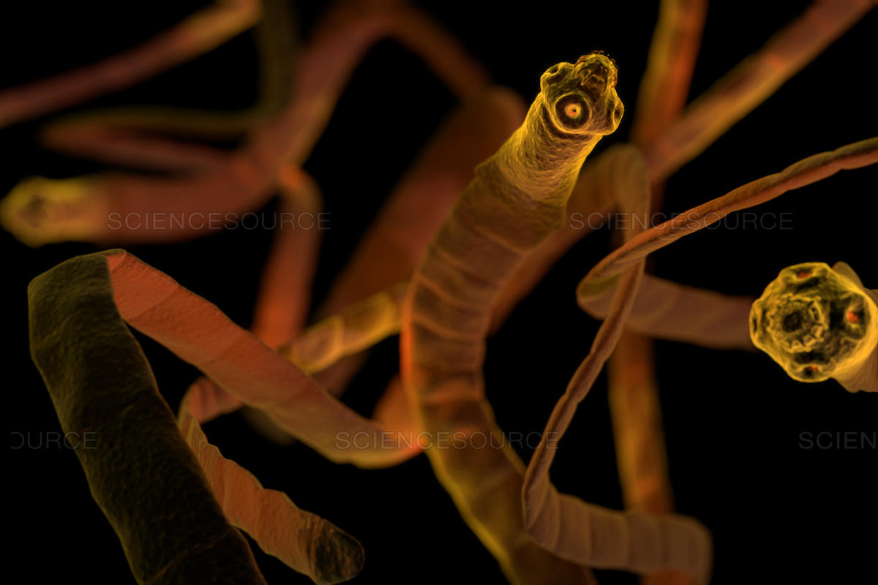
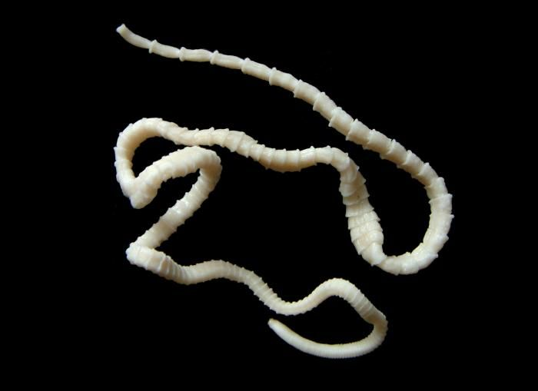
Phylum Platyhelminthes, Class Cestoda
“tapeworms”

Slide 23
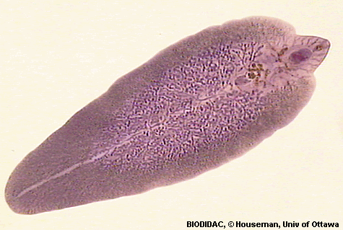
Phylum Platyhelminthes, Class Trematoda
“flukes”

