Slide 1
General Biology II Lab
IRSC
Seed Plants, Exercise 5

Slide 2


Slide 3
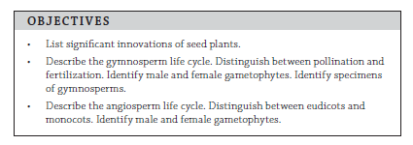

Slide 4
Seed plants
    Include Gymnosperms (“naked seed”) and Angiosperms (flowering plants)
    Collectively called Embryophytes
        Embryo is protected in the seed
        Alternation of Generations
            Sporophyte is dominant
            Gametophyte
                Megagametophyte –produces egg (enclosed in ovule, microscopic)
                Microgametopyte – enclosed in pollen grain

Slide 5

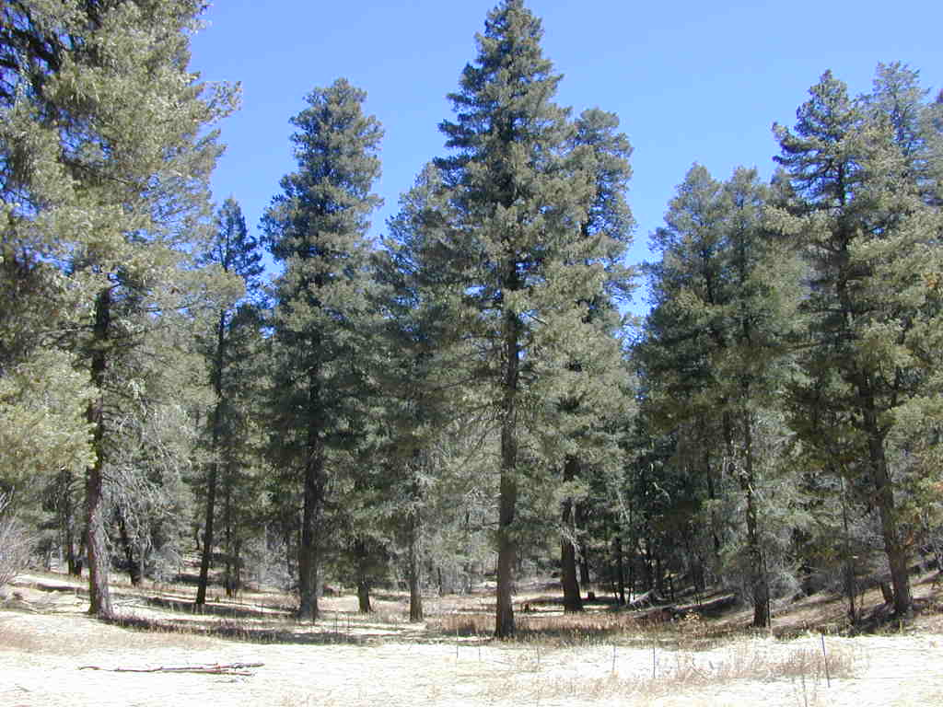
First we will look at Gymnosperms
Gymnosperms – naked seed

Slide 6
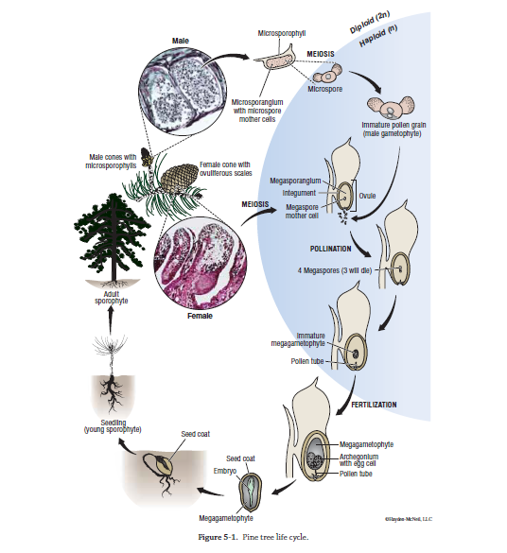

Slide 7
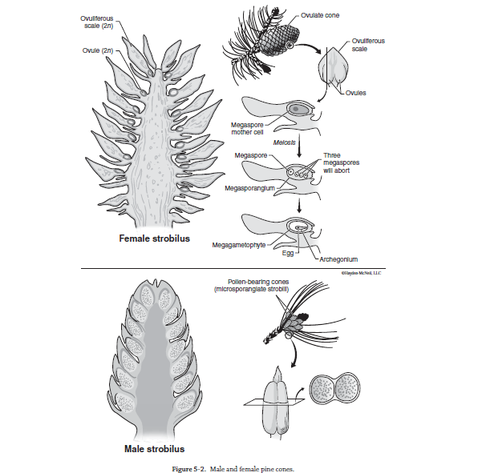
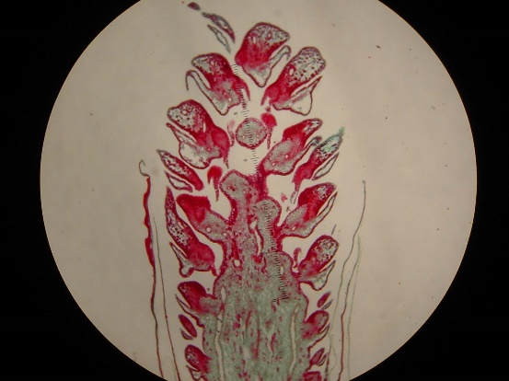
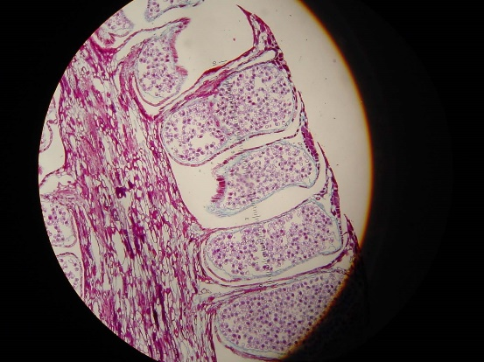

Slide 8
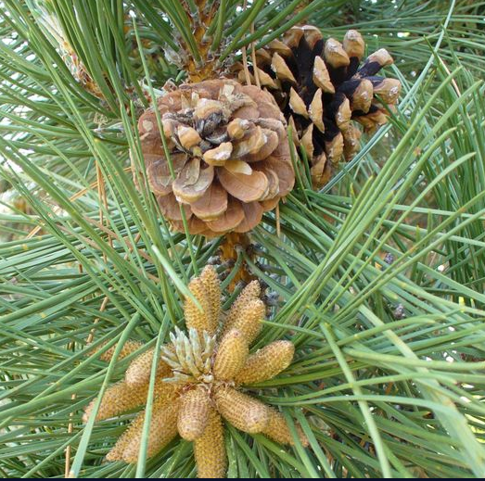
Female pine cones are larger than male pine cones

Slide 9
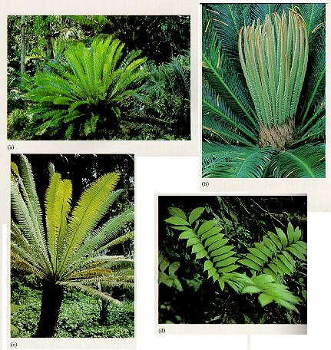
Gymnosperms
Cycads
Cone-bearing, palmlike plants found mainly in tropical and subtropical regions

Slide 10

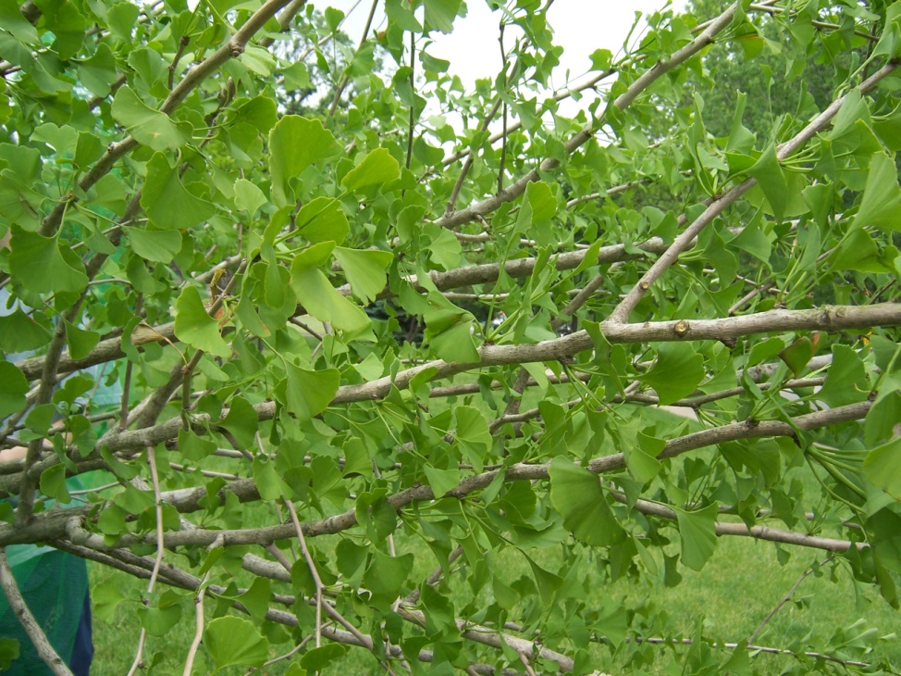
Gymnosperms
Ginkgos
Only 1 species survives today
Usually only male trees are used since female trees produce smelly seeds

Slide 11
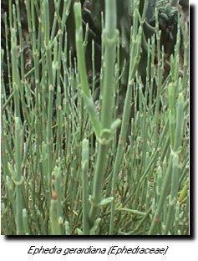
Gymnosperms
Gnetophytes
Can grow as shrubs, trees, or vines

Slide 12
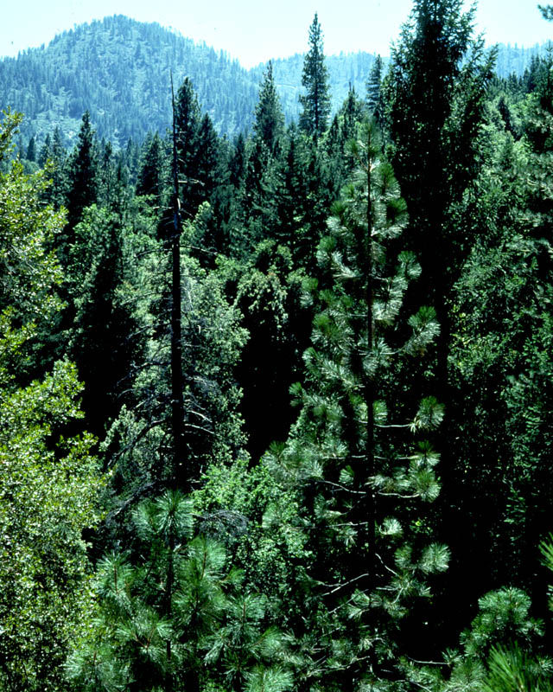
Gymnosperms
Conifers
Largest group of gymnosperms
Evergreens – pines, hemlocks, spruces
Nonevergreens – cypress tree

Slide 13
Now we will talk about the Angiosperms
Angiosperms are the flowering plants
Most recently evolved plants
Most successful plants

Slide 14
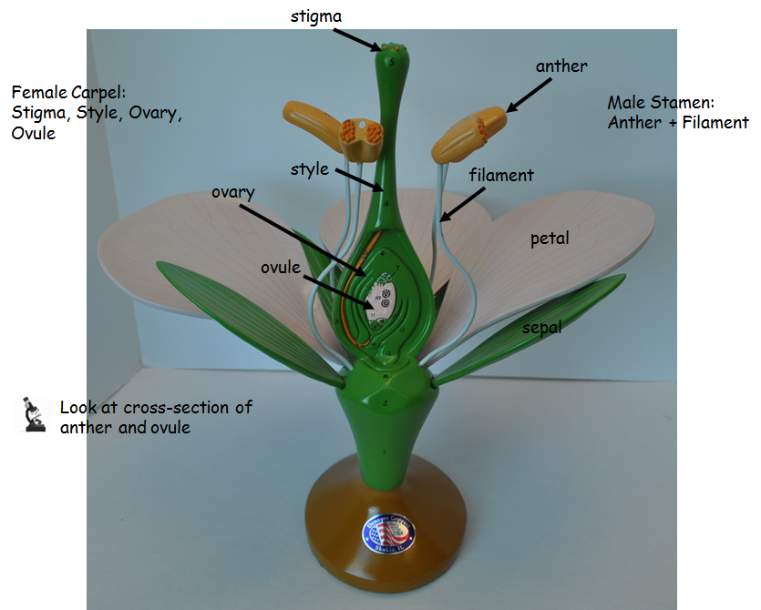

Slide 15
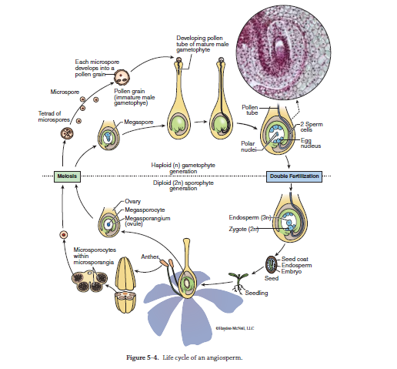

Slide 16

Cotyledons are embryonic leaves

