Slide 1
General Biology II Lab IRSC
Nonvascular Plants and Seedless Vascular Plants, Exercise 4

Slide 4
Plants
Multicellular photosynthetic eukaryotes that have adapted to terrestrial life
More organized than algae
3 major groups:
Nonvascular plants
Seedless vascular plants
Seed plants (most advanced)

Slide 6
Alternation of Generations

Slide 7
Nonvascular Plants
Nonvascular Plants
Include liverworts, hornworts, mosses
Collectively called Bryophytes
These plants have no vascular tissue
Therefore, they have to grow close to ground close to water source
Alternation of Generations
Gametophyte generation dominant in this group

Slide 8
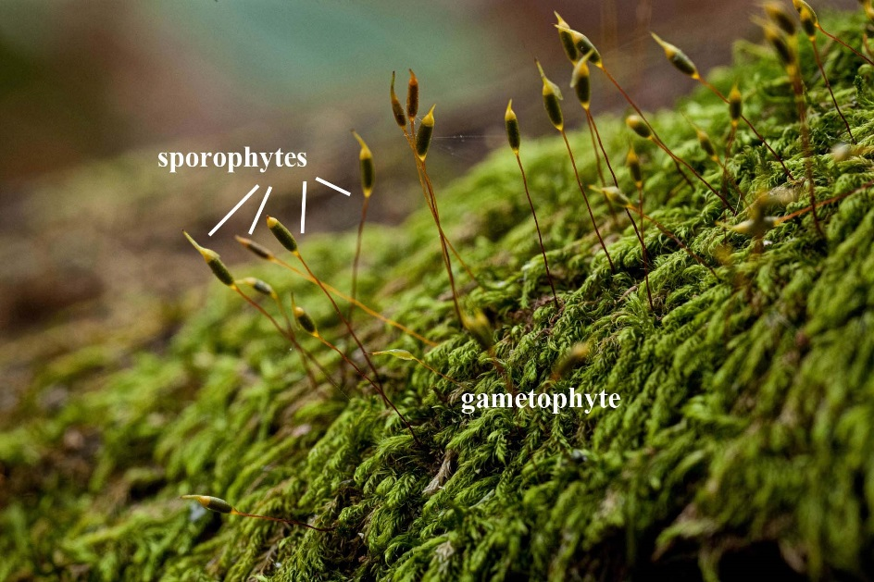
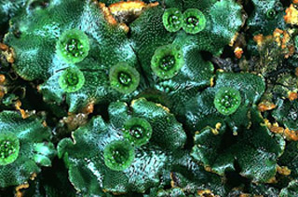
Moss
liverworts

Slide 10
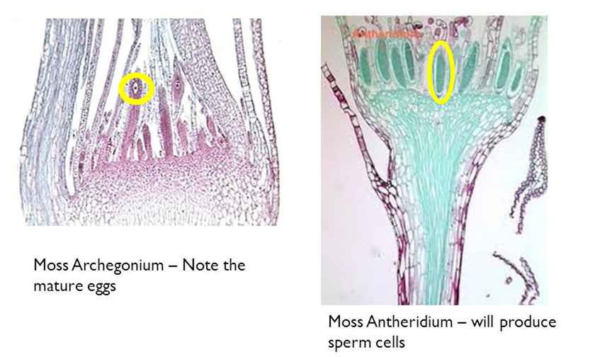

Slide 11
Seedless Vascular Plants
Seedless Vascular Plants
All vascular plants are called Tracheophytes
Have vascular tissue (xylem and phloem) – can grow taller and away from their water source
Seedless vascular plants
Include club mosses, horsetails, ferns
Still rely on water for reproduction (water has to be present for the flagellated sperm to travel to the egg)
Alternation of Generations
Sporophyte generation is dominant in seedless vascular plants
Have archegonia and antheridia like the nonvascular plant

Slide 12
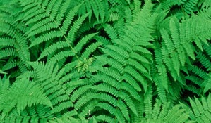
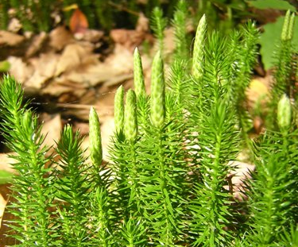
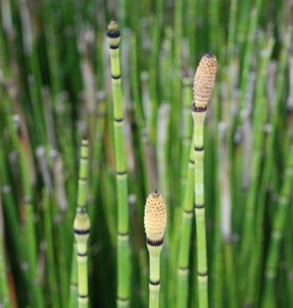
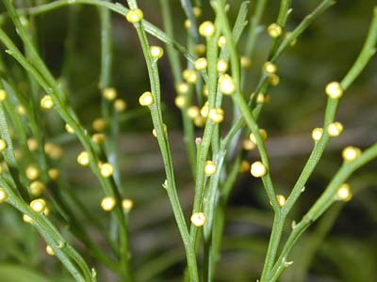
Ferns
Horsetails
Whisk ferns

Slide 14
