Slide 1
General Biology II Lab IRSC
Bacteria, Exercise 1

Slide 2
The Prokaryotes

Slide 4
Review: what is the difference between prokaryotic and eukaryotic cells?
3 Domains of Life
Domain Bacteria – prokaryotic
Domain Archaea – prokaryotic (includes extremophile bacteria)
Domain Eukarya – protists, fungi, plants, animals

Slide 5
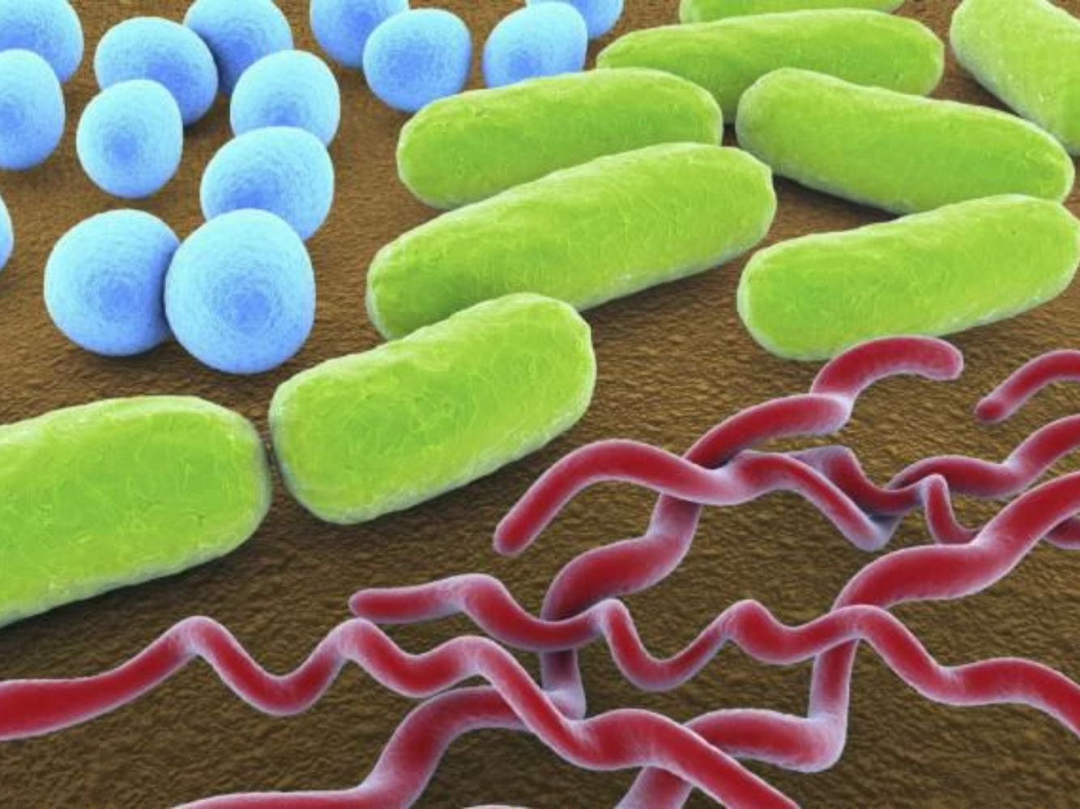
Bacteria are the most numerous organisms on the planet
Where there is life you can find bacteria
Some can live in extreme conditions
3 basic shapes of bacteria:
Coccus (round)
Bacillus (rod)
Spiral
Cell wall made up of peptidoglycan
Thick layer – Gram positive
Thin layer – Gram negative

Slide 6
Many bacteria can be grown in the lab on nutrient rich agar in a petri dish
What you are seeing on this plate is billions of bacterial cells that are now visible as colonies

Slide 7
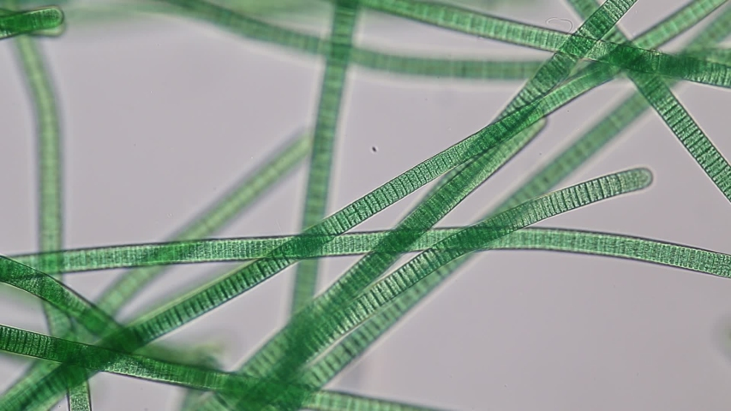
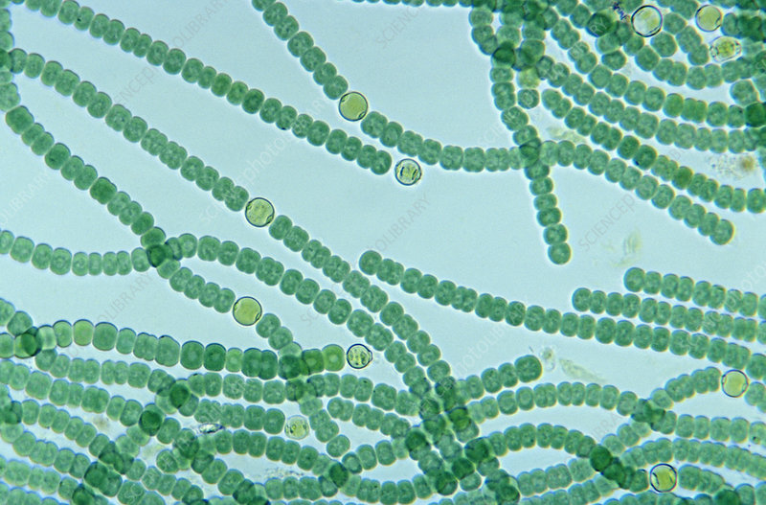
Cyanobacteria are a group of bacteria photosynthesize
Very important part of the phytoplankton in marine and freshwater environments, here are 2 examples:
Oscillatoria
Anabaena

Slide 8
Prokaryotes are found in what 2 Domains?
What are the 3 main shapes of bacteria?
What does it mean to say a bacteria is Gram positive?
What are cyanobacteria?

