Slide 1
General Biology II Lab IRSC
Tissues and Organs,
Exercise 11

Slide 4
4 main adult tissue types:
Epithelial
Connective
Muscle
Nervous

Slide 5
Epithelial Tissue
Function: protection, diffusion, secretion
The name of epithelial tissue includes 2 descriptive terms:
The shape of cells
Squamous (flat), cuboidal, columnar
The number of layers
Simple (one), stratified (many layers)

Slide 6
Simple squamous epithelial

Slide 7
Stratified squamous epithelial

Slide 8
Simple cuboidal epithelial

Slide 9
Simple columnar epithelial

Slide 10
Pseudostratified ciliated columnar epithelial

Slide 11
Connective Tissue
Function: maintains structure and joins body parts together
Cells surrounded by extracellular matrix

Slide 12
Adipose tissue

Slide 13
Bone

Slide 14
Hyaline Cartilage

Slide 15
Blood

Slide 16
Muscle Tissue
Function: Movement

Slide 17
Skeletal muscle - voluntary

Slide 18
Cardiac muscle - involuntary

Slide 19
Smooth muscle - involuntary

Slide 20
Nervous Tissue
Function: conducting impulses
2 types of cells: neurons and neuroglia

Slide 21
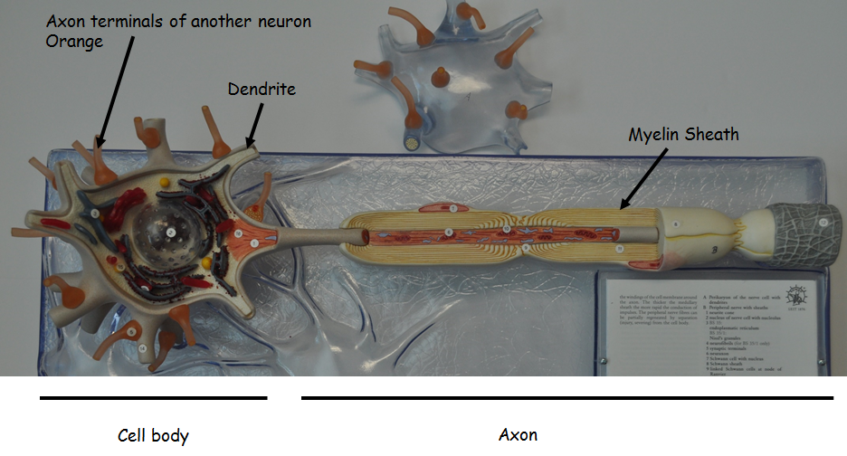

Slide 23
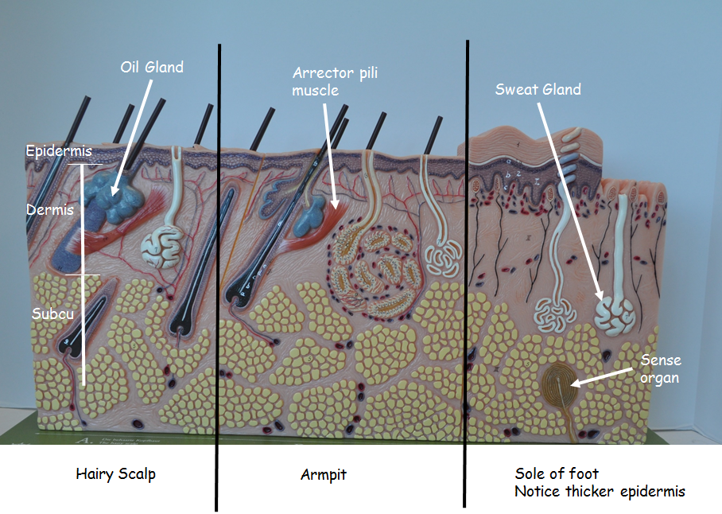
Skin

Slide 24
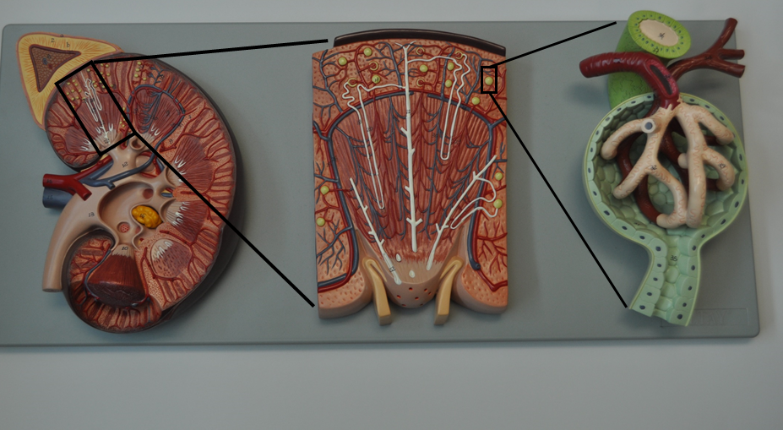
Kidney

Slide 25
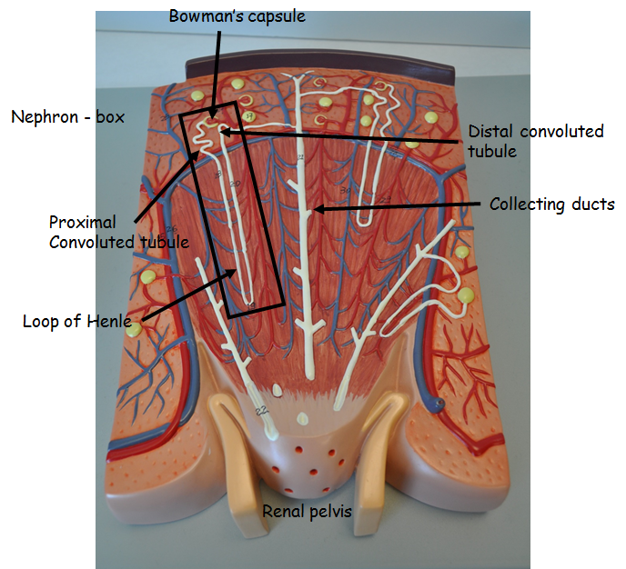
Magnified look at Renal Pyramid

Slide 26
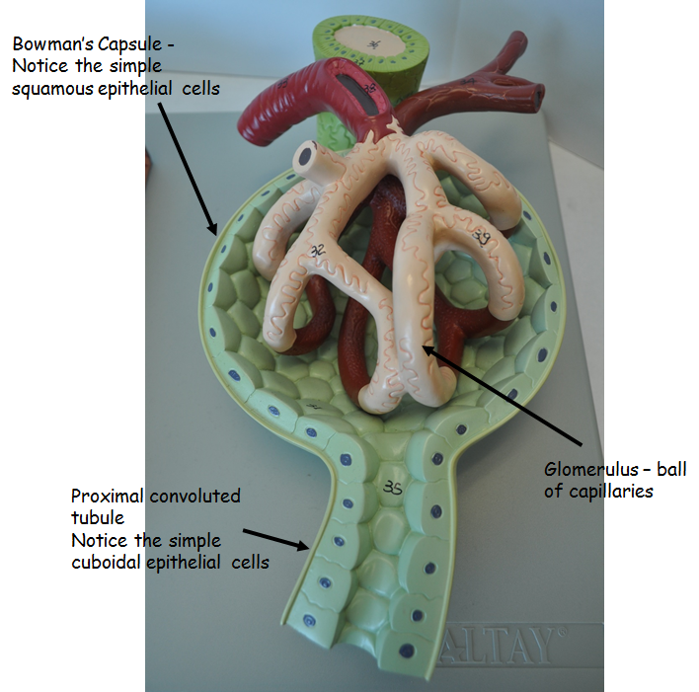
Magnified look at Bowman’s Capsule

Slide 27
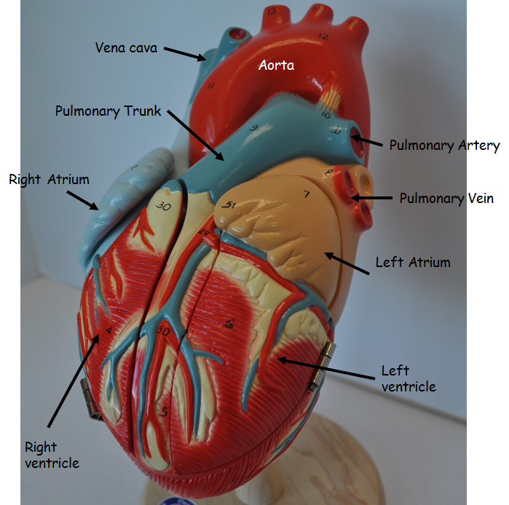
Heart - External

Slide 28
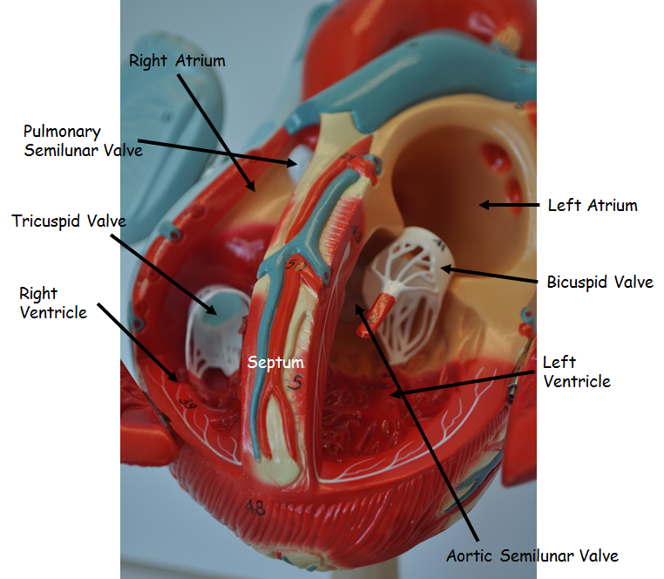
Heart - Internal

