Slide 1
Annelids,Molluscs
BSC 2011L

Slide 2
Animal Taxonomy
Domain Eukarya
  Kingdom Animalia
    Protostomes
          Phylum Annelida – annelids
            Class Polychaeta
            Class Hirudinea
            Class Oligiochaeta*
          Phylum Mollusca - molluscs
            Class Polyplacophora
            Class Gastropoda
            Class Bivalvia
            Class Cephalopoda*

Slide 3
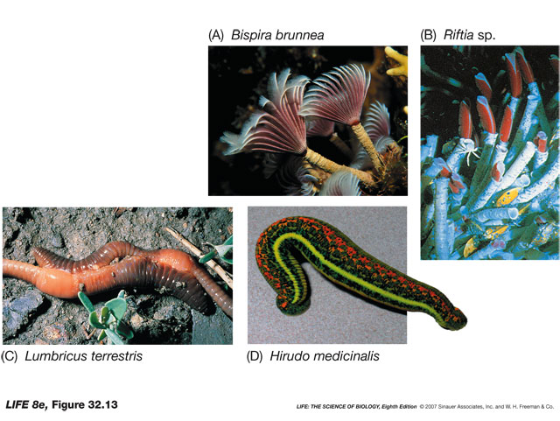
Phylum Annelida
Segmented worms – divided by “septa”
Movement - circular and longitudinal muscles work against fluid filled coelom to produce changes in width and length
  “chaetae/setae” chitin bristles
Digestion – complete
Circulation – closed (5 lateral hearts)

Slide 4
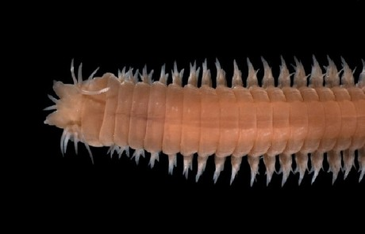
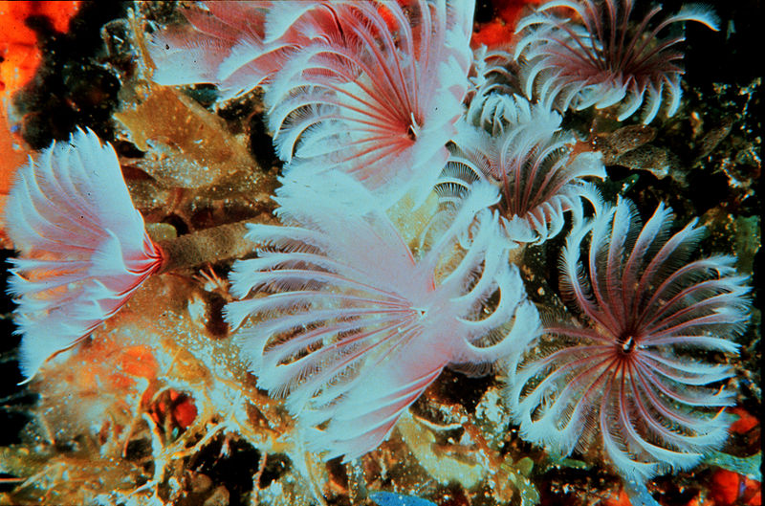
Phylum Annelida
Class Polychaeta (many chaetae)
  Parapodia – paddle like w/chaetae (swimming, crawling, burrowing, hooks to anchor)
  Almost all marine
  Live in substrate
sand worms, feather dusters

Slide 5
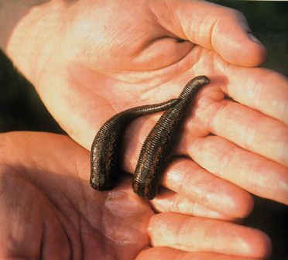
Phylum Annelida
Class Hirudinea (no chaetae)*
  “Blood suckers”
    Anticoagulant
    Vasodilators
    Anesthetics
  Detect prey via CO₂
leeches

Slide 6
Phylum Annelida
Class Oligiochaeta (few chaetae)
  Clitellum (clay-tell-um)
    “Saddle”
    Hermaphrodidic w/cross-fert.
  Found/Eat through soil
    Strong pharynx
    Gizzard grinds soil
      = aeration, enrichment of soil
Earthworms

Slide 7
Phylum Annelida
Class Oligiochaeta
Animal: Earthworm
Symmetry: Bilateral
Body cavity: coelomate – protostome
Digestion: complete – mouth, esophagus, crop, gizzard, etc
Circulation: closed, 5 hearts
Segmentation: yes
Appendages: none
Nervous: dorsal brain, ventral nerve cord
Habitat: moist soils
Respiration: diffusion through body surface
Excretion: 2 lateral tubes
Locomotion: circular and longitudinal muscles, setae
Support: hydrostatic skeleton

Slide 8
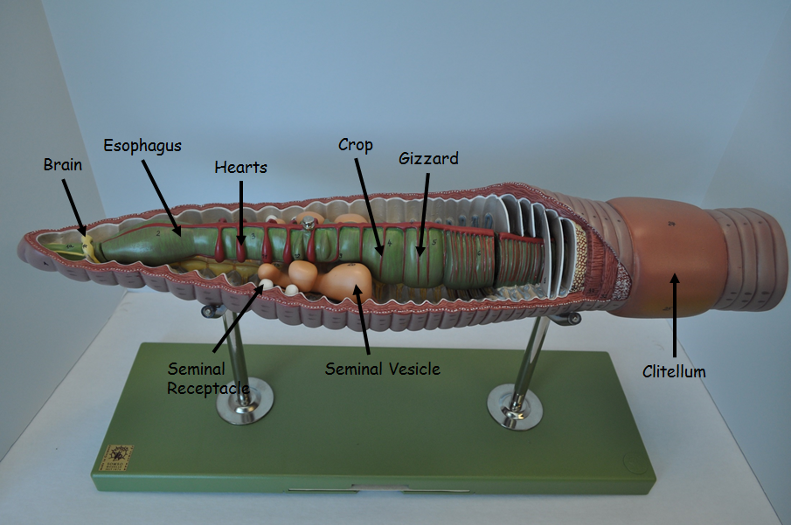
Earthworm model

Slide 9
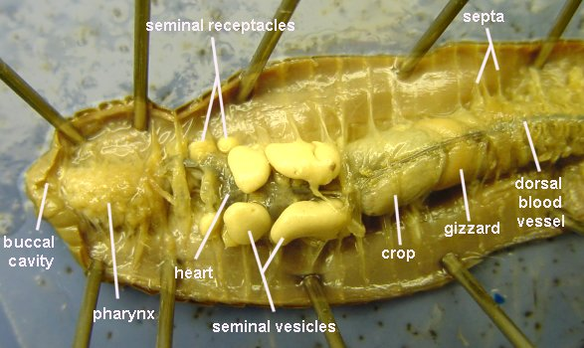
Earthworm Dissection

Slide 10
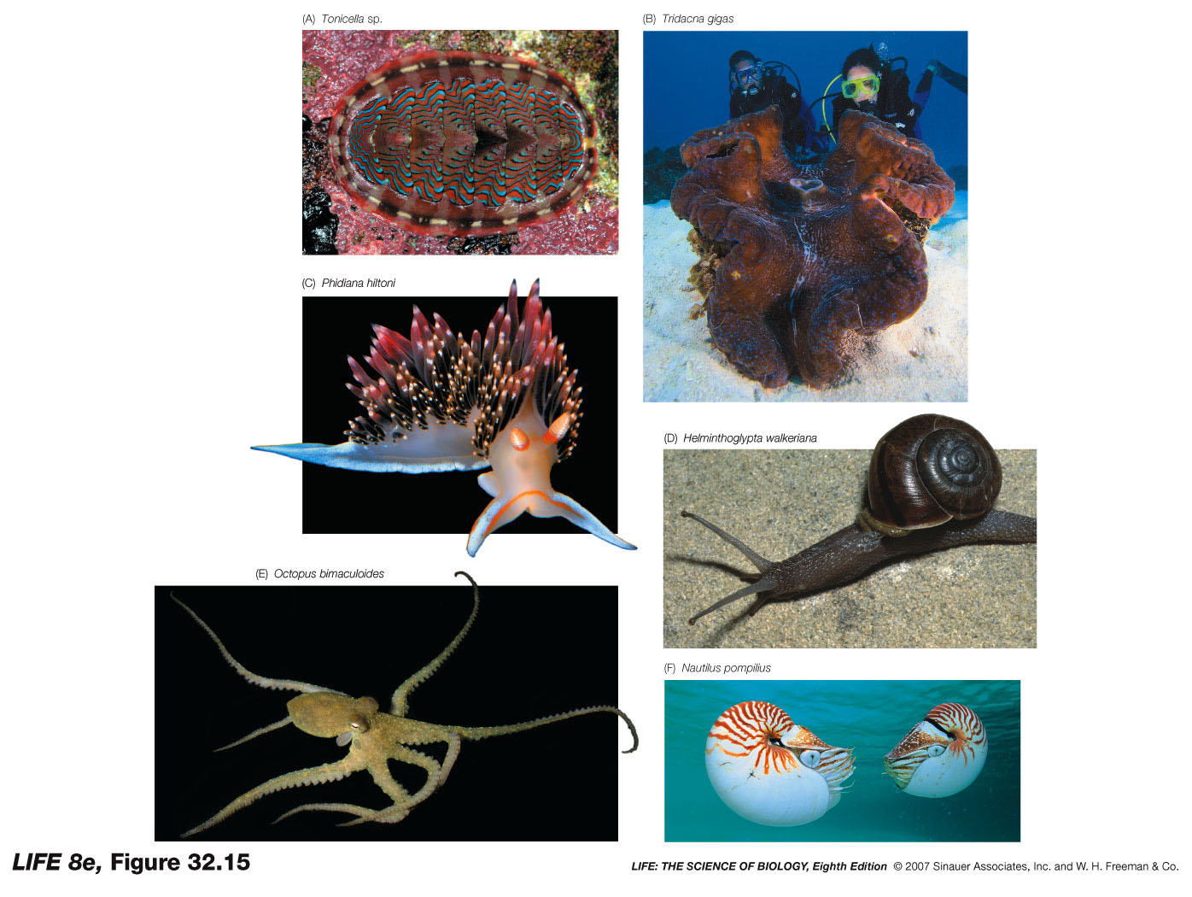
Phylum Mollusca
Mostly marine but some are freshwater and terrestrial
3 part body:
  Muscular foot – locomotion
  Visceral mass – internal organs
  Mantle – encloses visceral mass and may secrete “shell”
Digestion – complete
Respiratory – gills*
Circulation – open* (excluding cephalopods)
Feeding – radula* (excluding bivalves)
Excretion – nephridium (like a kidney)

Slide 11
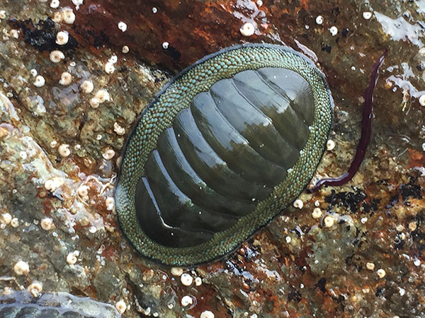
Phylum Mollusca
Class Polyplacophora “many plated”
  marine
  8 overlapping calcareous plates
  strong foot
chitins

Slide 12
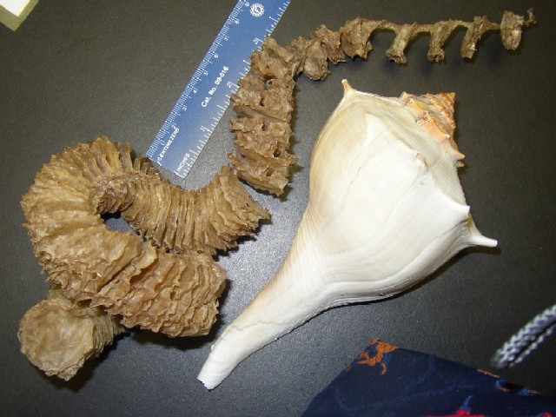
Phylum Mollusca
Class Gastropoda “stomach foot”
  Head tentacles – chemo/mechano receptors & eyes
  Torsion during devo (adults lack bilateral symmetry)
snails, slugs, conch,
abalone, welks

Slide 13
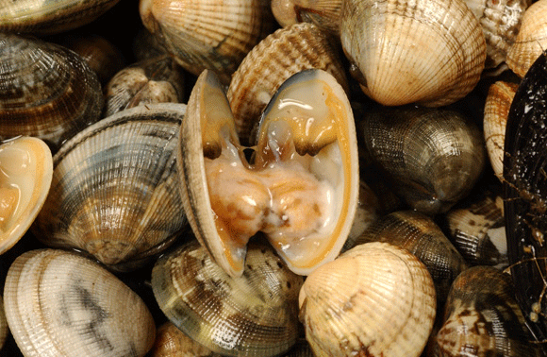
Phylum Mollusca
Class Bivalvia “two shells” hinged together
  No radula or distinct head
clams, oysters,
mussles, scallops

Slide 14
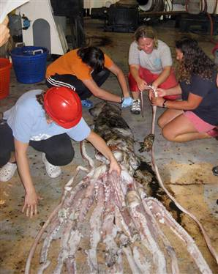
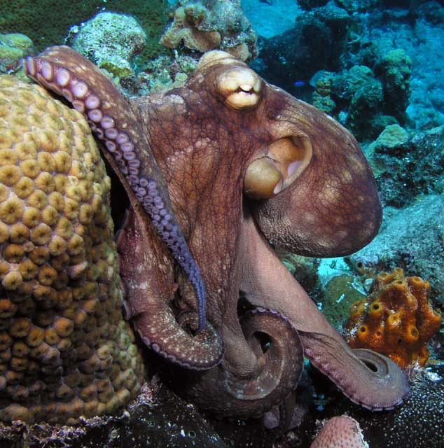
Phylum Mollusca
Class Cephalopoda “Head-foot”
  Closed circulatory system
  Lack/internalization of shell*
  Foot evolved to “arms”
  Fast swimmers – siphon
  Lack larval stage (baby octo’s)
squid, octopus, nautilus, cuttlefish

Slide 15
Phylum Mollusca
Class Bivalvia
Animal: Clam
Symmetry: bilateral
Body cavity: coelomate – protostome
Digestion: complete, filter feeders
Circulation: open, blue blood, heart, blood vessels
Segmentation: none
Appendages: none
Nervous: 3 ganglia connected by nerves
Habitat: aquatic
Respiration: gills
Excretion: nephridia in kidney
Locomotion: muscular foot
Support: shell

Slide 16
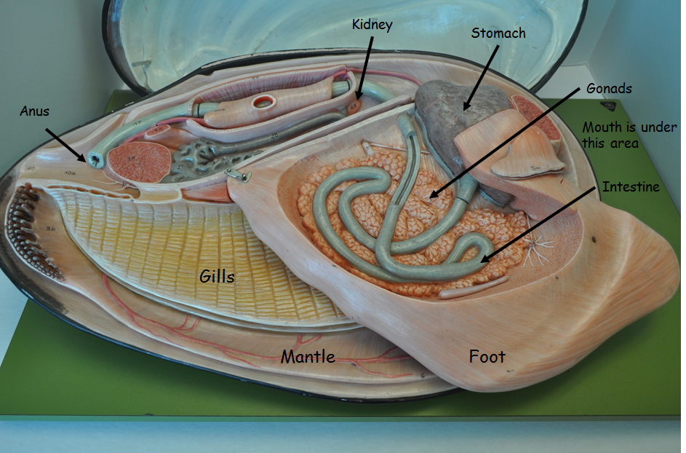
Clam model

Slide 17
Phylum Mollusca
Class Cephalopoda
Animal: squid
Symmetry: bilateral
Body cavity: coelomate – protostome
Digestion: complete, beak jaws
Circulation: closed*, 3 hearts
Segmentation: none
Appendages: 8 arms*, 2 tentacles
Nervous: brain of 3 fused ganglia, eye
Habitat: aquatic
Respiration: gills
Excretion: nephridia in kidney
Locomotion: muscular mantle, jet propulsion*
Support: shell reduced to pen

Slide 18
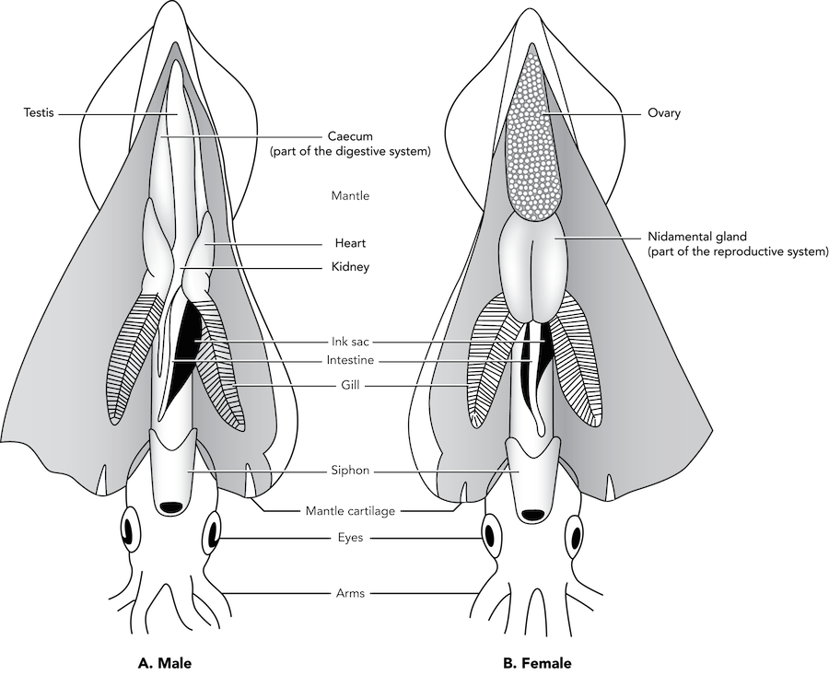
Squid Dissection

Slide 19
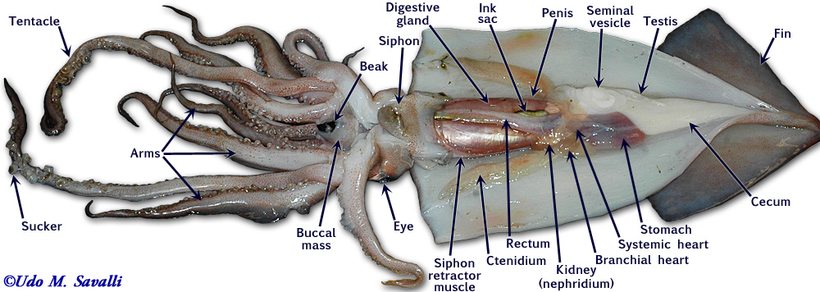
Squid Dissection

Slide 20
Today’s Lab:
To Do pg. 60 –
Earthworm Dissection
To Do pg. 58 –
Squid Dissection
Identify structures on Earthworm and Clam Models!!!
Complete “Before You leave the Lab” questions pg. 62
NEXT WEEK is last lab before Practical 3!!!!
READ UP ON Ecdysozans pgs. 63-68
Crayfish Dissection*
READ UP ON Deuterostomes pgs. 69-72

