Slide 1
The Acoelomate Invertebrates
BSC 2011L

Slide 2
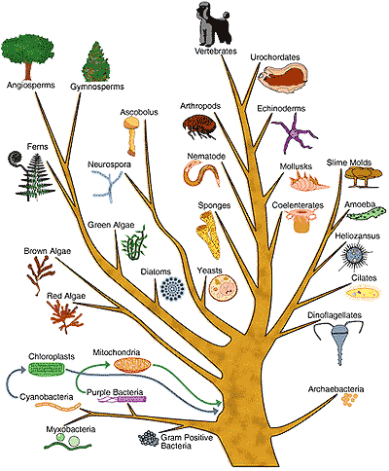
Kingdom Animalia
All animals are multicellular and heterotrophic
Locomotion at some point in life cycle
Always diploid – two sets of chromosomes

Slide 3
Animal Characteristics
Symmetry
  Radiata – radial symmetry, diploblastic (2 tissues)
  Bilateria – bilateral symmetry, triploblastic
Body Cavity
  Acoelomates – no cavity
  Psuedocoelomates – false coelom, not completely lined by mesoderm derived tissue
  Coelomates – true coelom, room for organs in body cavity lined with mesoderm tissue
      Protostomes – 1st embryonic opening becomes mouth
      Deuterostomes – 1st embryonic opening becomes anus

Slide 4
Body Symmetry
  Radiata – radial symmetry, diploblastic (2 tissues)
  Bilateria – bilateral symmetry, triploblastic

Slide 5
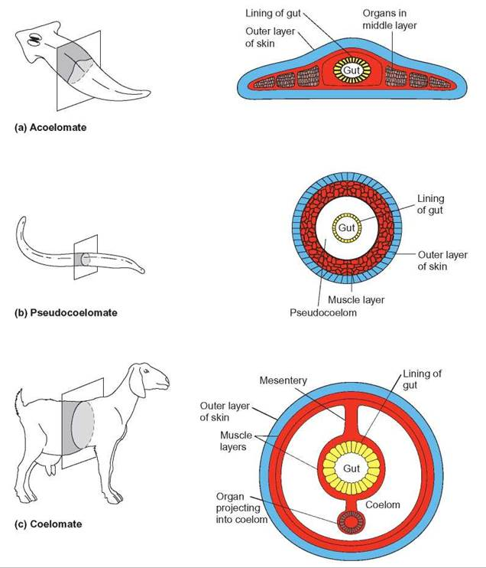
Body Cavity
  Acoelomates – no cavity
  Psuedocoelomates – false coelom, not completely lined by mesoderm derived tissue
  Coelomates – true coelom, room for organs in body cavity lined with mesoderm tissue
      Protostomes – 1st embryonic opening becomes mouth
      Deuterostomes – 1st embryonic opening becomes anus
http://schoolbag.info/biology/concepts/concepts.files/image634.jpg

Slide 6
Animal Taxonomy
Domain Eukarya
  Kingdom Animalia
      Parazoa – no true tissue layers
        Phylum Porifera – sponges
      Eumetazoa – true tissues, symmetry
        Radiata – radial symmetry
          Phylum Ctenophora – comb jellies
          Phylum Cnidaria
            Class Hydrozoa – Portuguese man of war, Hydra, Obelia
            Class Scyphozoa – jelly fish
            Class Anthozoa – coral and sea anemones
            Class Cubozoa – box jellies
        Bilateria – bilateral symmetry
            Phylum Platyhelminthes - Acoela flatworms* lack complex structures, primitive
            Protostomes – Phylum Mollusca, Phylum Annelida, Phylum Arthropoda, Phylum Nematoda
            Deuterostomes – Phylum Echinodermata, Phylum Chordata

Slide 7
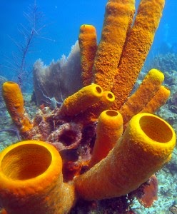
Phylum Porifera
Live in water, mostly marine
No true tissues
Adults are sessile but larvae are mobile - planktonic
asymmetrical
Can produce asexually and sexually
Digestion – intracellular choanocytes*
(like a choanoflagellate protist)
Circulation – water transport

Slide 8
Phylum Porifera
Animal: sponges
Symmetry: asymmetrical
Body cavity: spongeocoel
Digestion: intracellular choanocytes
Circulation: water transport, amoebocytes
Segmentation: none
Appendages: none
Nervous: none
Habitat: Aquatic, marine
Respiration: diffusion
Excretion: diffusion
Locomotion: none (sessile, however larvae are flagellated)
Support: spicules

Slide 9
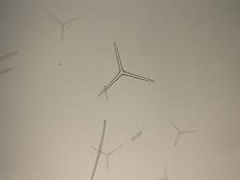
Phylum Porifera
Spicules
http://www.deanza.edu/faculty/mccauley/6a-labs-sponges-01.htm

Slide 10
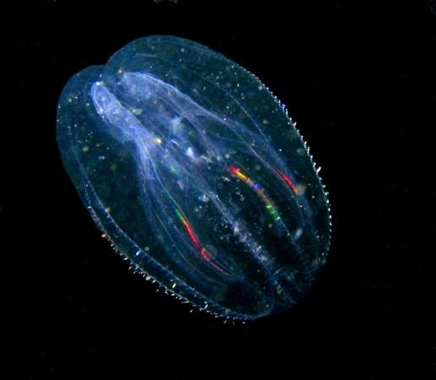
Phylum Ctenophora
Radially symmetrical
True tissues (diploblastic)
One body form – medusa
Asexual reproduction
“colloblasts”
Move by “comb” cilia
Many are bioluminescent

Slide 11
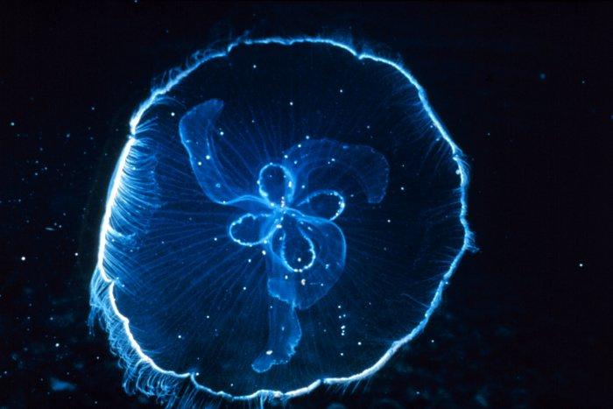
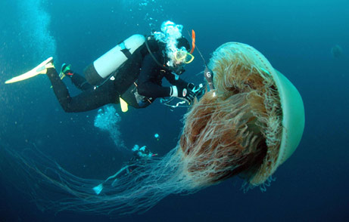
Phylum Cnidaria
Radially symmetrical
True tissues (diploblastic)
Two body forms: polyp and medusa
Reproduce sexually and asexually
Carnivores – “nematocysts”
Move by contractions “swimming”

Slide 12
Phylum Cnidaria
Class Hydrozoa - Hydra
Animal: Hydra
Symmetry: Radial
Body cavity: coelenteron (sac)
Digestion: gastrovascular cavity
Circulation: cells in direct contact with water
Segmentation: none
Appendages: tentacles around mouth
Nervous: nerve nets
Habitat: Aquatic
Respiration: diffusion
Excretion: none
Locomotion: limited
Support: none

Slide 13
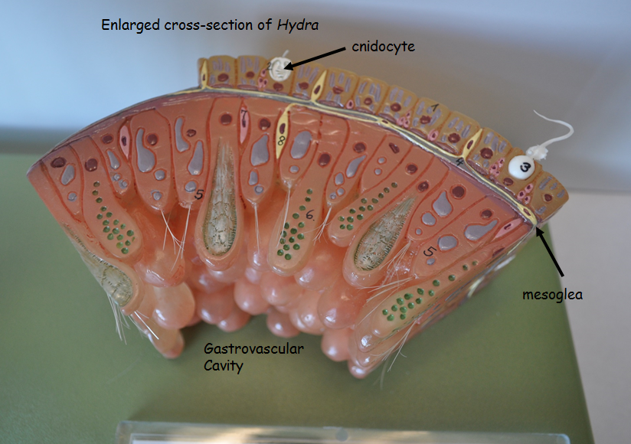
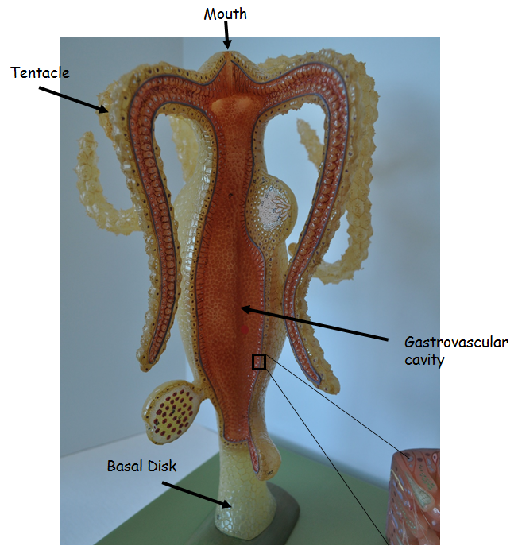
Hydra Model

Slide 14
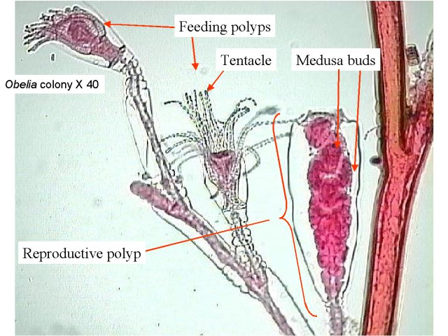
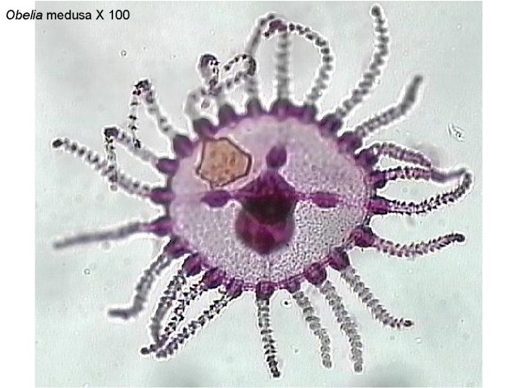
Phylum Cnidaria
Obelia
http://faculty.clintoncc.suny.edu/faculty/michael.gregory/files/bio%20102/Bio%20102%20Laboratory/Animal%20Diversity/Porifera,%20Radiata/Sponges_through_Roundworms.htm

Slide 15
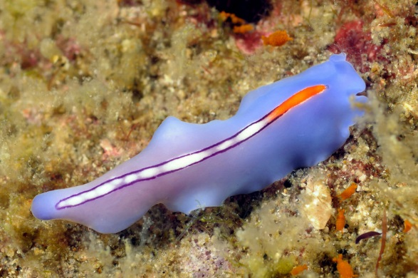
Phylum Platyhelminthes
Flatworms
  Can be free living
  or parasitic
  Hermaphroditic
  Acoelomates
    One opening
  Digestion – gastrovascular cavity
  Circulation – gastrovascular cavity
https://photos.smugmug.com/Asia/Anilao-Philippines-April-2010/i-PrhM7KW/0/L/Flatworm_100406v-L.jpg

Slide 16
Phylum Platyhelminthes
Class Turbullaria
Animal: Planaria
Symmetry: Bilateral
Body cavity: acoelomate
Digestion: gastrovascular cavity
Circulation: gastrovascular cavity
Segmentation: none
Appendages: none
Nervous: brain, 2 ventral nerve cords, ladder-like
Habitat: aquatic
Respiration: diffusion
Excretion: flame cells
Locomotion: muscles
Support: none

Slide 17
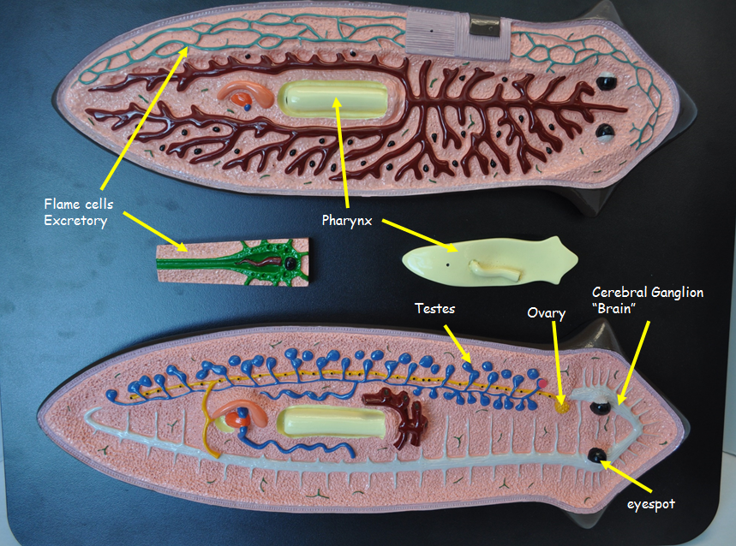
Phylum Platyhelminthes

