Slide 1
Organ Systems & Pig Dissection
BSC 2011L

Slide 2
Tissue Organization & Anatomy
Tissues
Epithelia Tissue
Connective Tissue
Muscle Tissue
Nervous Tissue
Organs – made of 2+ tissues types
Skin
Kidney (& Renal Pyramid)
Heart
Blood vessels (arteries & veins)
Organ Systems – groups of Organs that preform crucial functions for survival (11 total)
Urinary System
Cardiovascular System
Respiratory System
Digestive System
Reproductive System

Slide 3
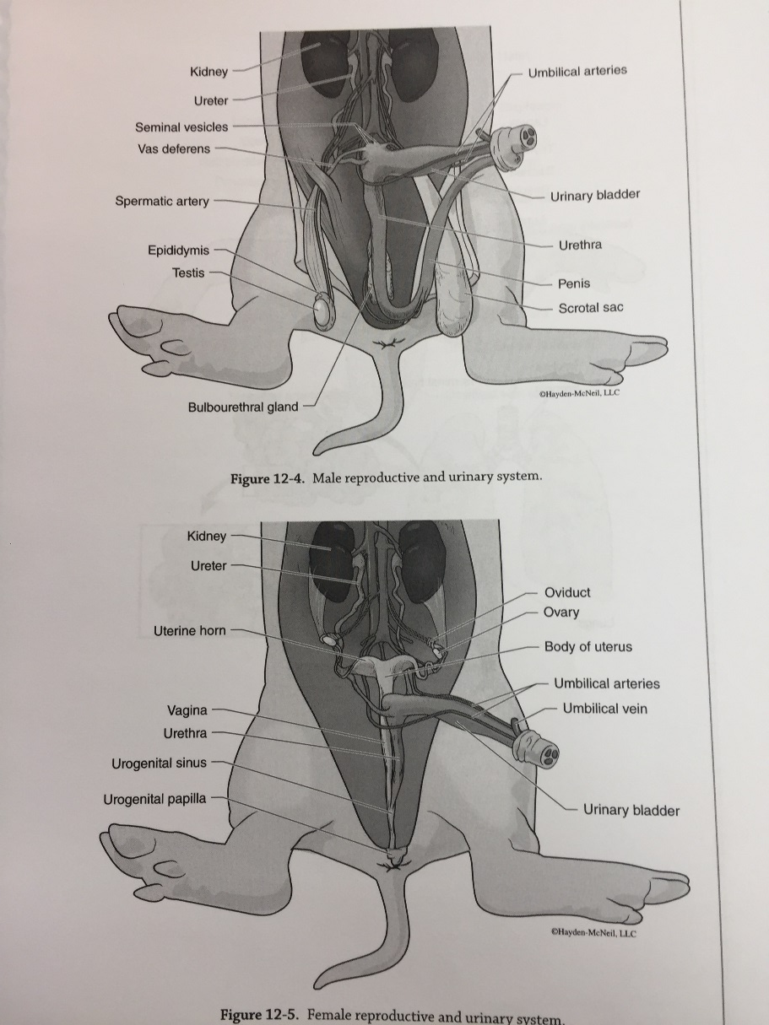
Organ System - Urinary
Bladder
Ureter
Kidney
Ureter
Renal Artery
Renal Vein

Slide 4
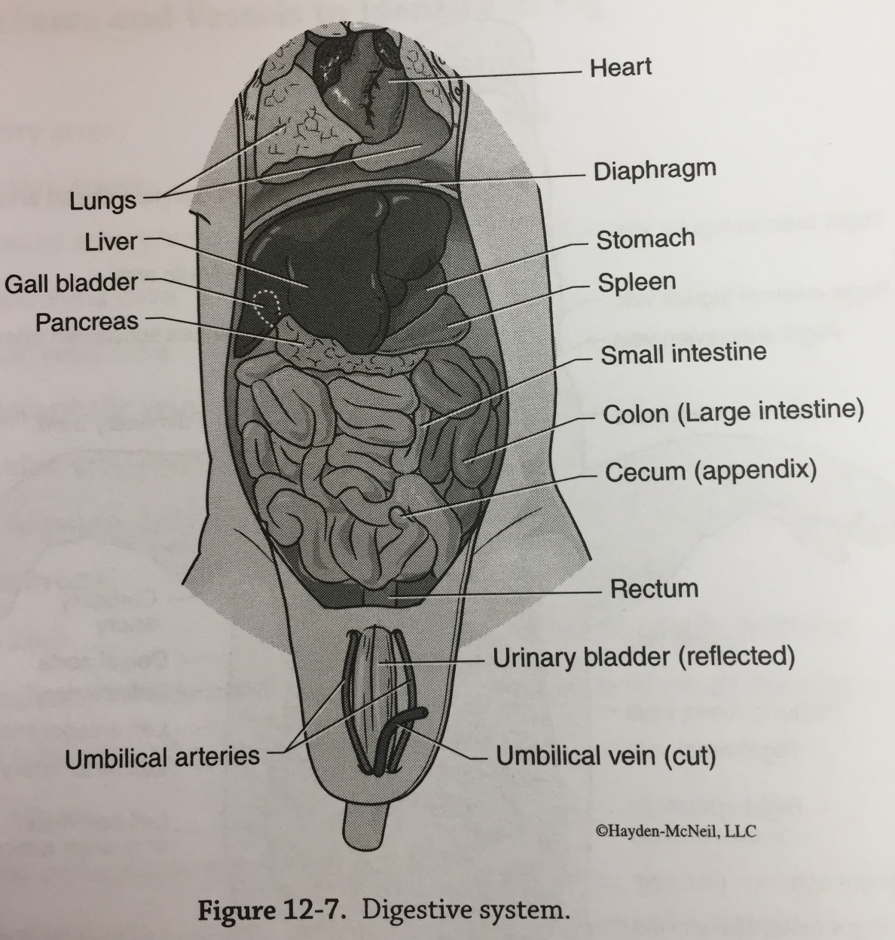
Organ System – Digestive
Liver
Gallbladder
Small Intestine
Duodenum
Jejuno-ileum
Large Intestine/colon
Cecum
Mesentary
Stomach
Spleen
Pancreas
Rectum

Slide 5
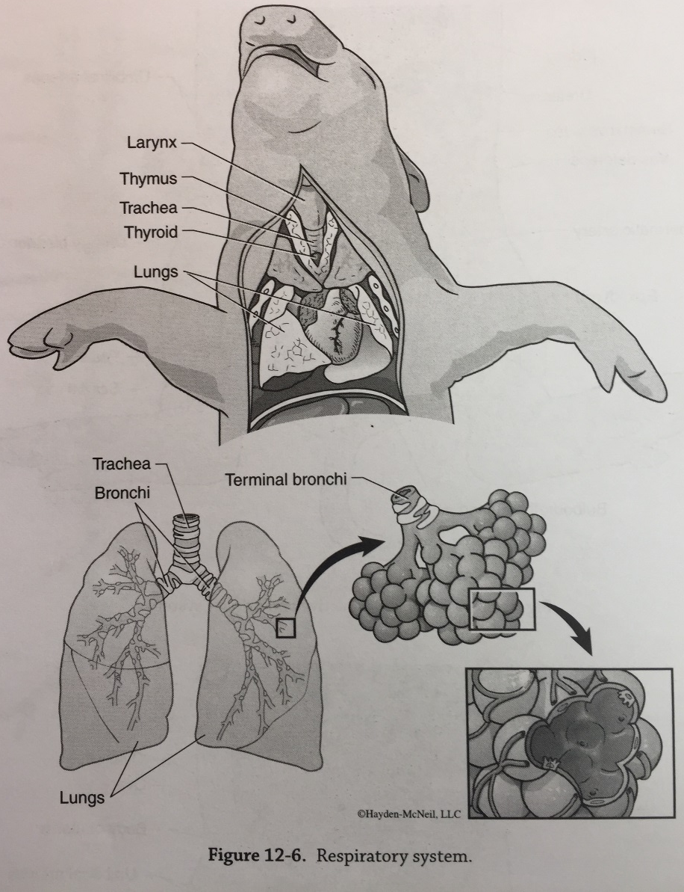
Organ System – Respiratory
Diaphram
Lungs
Left/right bronchi
Larynx
Trachea
Esophagus
Mouth
Nasal passage
Pharynx
Glottis

Slide 6
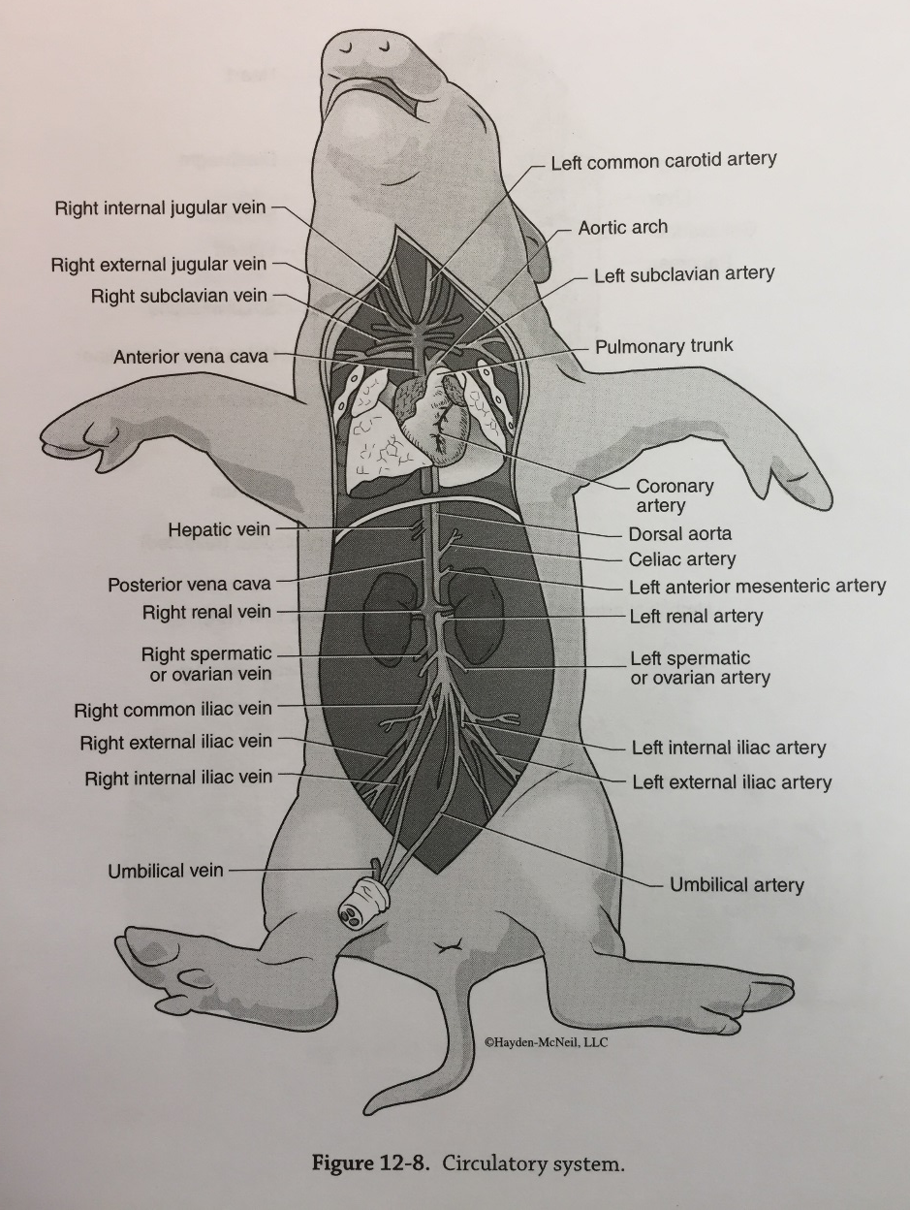
Organ System - Cardiovascular
Pericardial Sac
Right/left atrium
Right/left ventricle
Coronary Artery
Pulmonary artery/vein
Pulmonary trunk
Carotid artery
Posterior vena cava
Anterior vena cava
Brachiocephalic vein/artery
Subclavian artery/vein
Internal/external jugular
Aortic arch
Descending thoracic aorta
Dorsal (abdominal) aorta
Celiac artery- may not be able to find
Renal artery/vein
Hepatic vein – may not be able to find
Hepatic porta – may not be able to find
Umbilical artery/vein

Slide 7
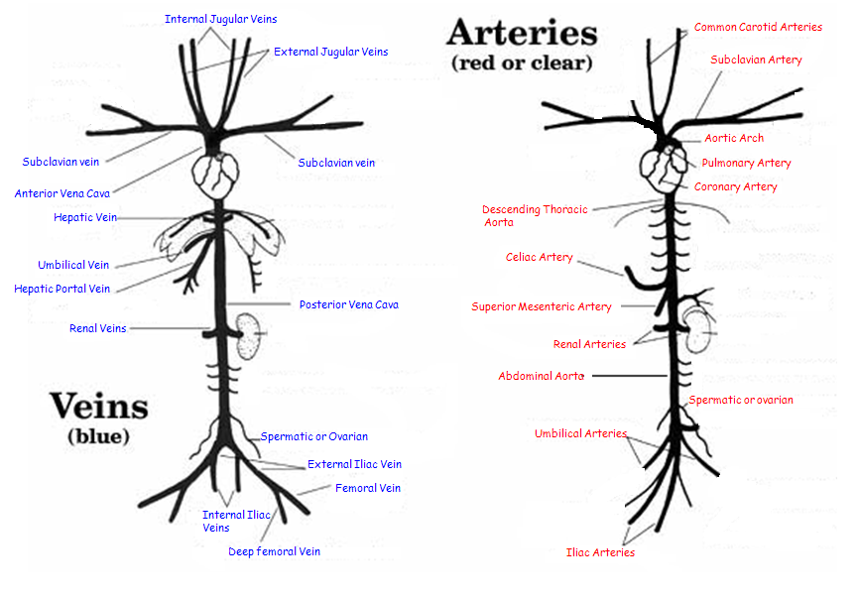
Circulatory System – Veins & Arteries

Slide 8
Organ System – Reproductive
Umbilical Artery/vein
Male:
Testes
Epididymis
Vas Deferens
Urethra
Seminal Vesicles
Female:
Ovaries
Oviducts
Uterus
Uterine Horns
Vagina

Slide 9
Fetal Pig Dissection
Work in Groups 3-4
Cutter
Assistant Cutter
Reader w/lab manual
Save storage Bags
You can dump preservative fluid down sink w/ large amt. of cold water
Pig parts should go in BioHazard Container (front of room)
Don’t throw any parts out until the end!
Terms:
Doral – back
Ventral – stomach
Anterior – towards head
Posterior – away from head

Slide 10
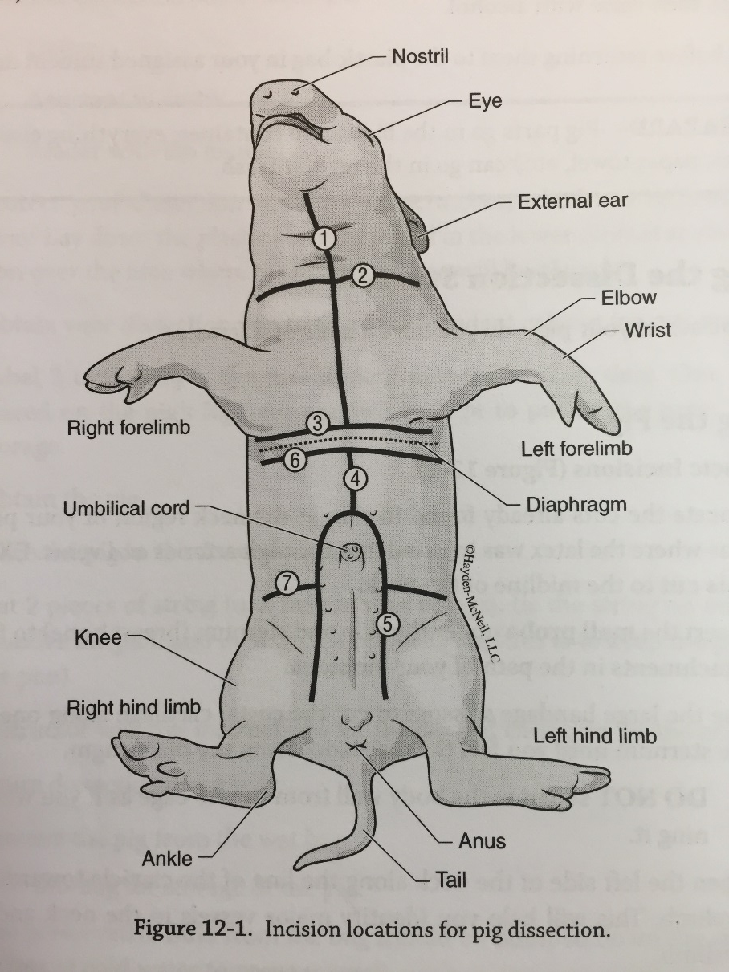
Fetal Pig Dissection
Part 1:
https://www.youtube.com/watch?v=ZWYpnLtXQrg&oref=https%3A%2F%2Fwww.youtube.com%2Fwatch%3Fv%3DZWYpnLtXQrg&has_verified=1
Prepare Pig - tie
Identify Sex
Part 2:
https://www.youtube.com/watch?v=eCNxnBbfkVs
Cut as instructed on pg. 96 (we will follow along this video all together)
Urinary Organs
Digestive Organs
Part 3:
https://www.youtube.com/watch?v=Hdijzf6frgQ
Identify Systems

Slide 11
Next 2 Weeks – cont. Organ Systems
Pig Dissection
Working through dissection for last labs
Bring your own gloves! * if you want them
Go over all Tissues, Organs, and Systems via Dissection
Final – Practical 4
April 17 – 2:30 PM do NOT be late!
KNOW all Tissues, Organs, and Systems via Dissection

