Slide 1
Nematodes, Arthropods
BSC 2011L

Slide 2
Eumetazoa Bilateria, Protstome, Ecdysozoan Phylum Nematoda
Nema is greek for “thread”
Pseudocoelomates
Un-segmented
Aquatic habitats, damp soil
Cuticle/specialized epidermis
sheds or “molts” periodically
Respiration
Partial structure support with/ hydroskeleton
Parasitize both plants and animals
Pinworms and hookworms cause intestinal problems in humans and other animals
Trichonella causes trichonosis (attaches to intestinal wall and robs host of nutrients)
One species causes what we call elephantiasis
Digestion – mouth and anus
No circulatory system
Respiration – across cuticle

Slide 3
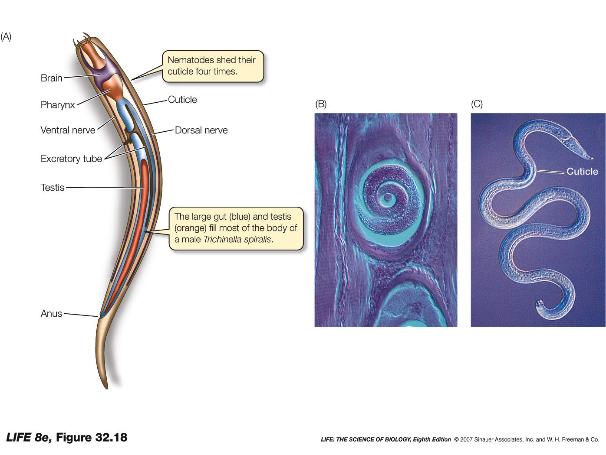
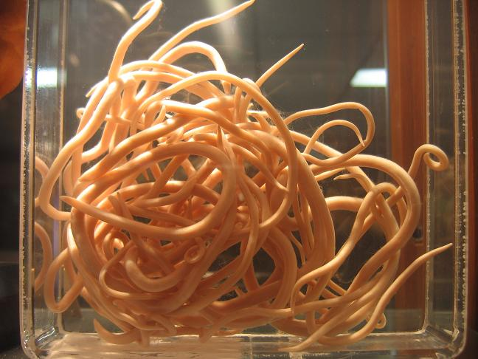
Phylum Nematoda
Cuticle is shed 4 times during lifetime
Sexual Dimorphism males vs. females
Ladies are larger
Observe Ascaris sp.

Slide 4
Are Nematodes protostomes or deuterostomes?
Are Nematodes coelomates or pseudocoelomates?
Do they have a cuticle?

Slide 5
Eumetazoa Bilateria, Protostome, Ecdysozoan Phylum Arthropoda
Most diverse and numerous animals on earth
Paired, jointed appendages
Exoskeleton made of chitin
Digestion – complete
Circulation – open
Excretory – Malphigian tubules
Respiration – gills in crustaceans, trachea and spiricules in insects
Typical Larvae is naupilus (free-swimming planktonic, no segmentation)

Slide 6
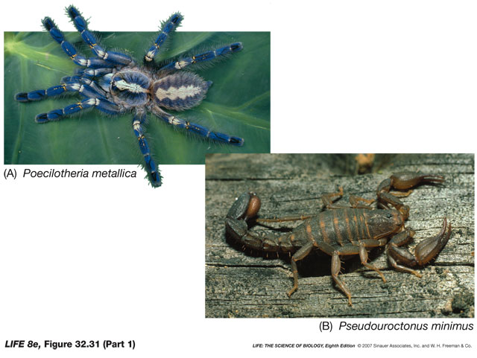
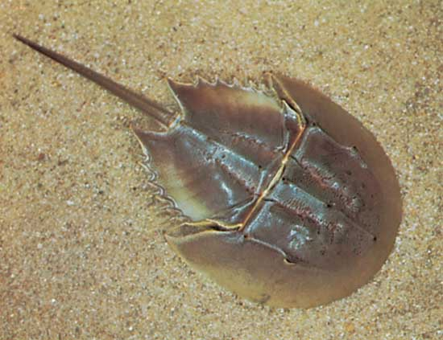
Phylum Arthropoda
Subphylum Chelierata
4 pairs of legs
No antennae
Cephalothorax and abdomen
Class Arachnida – spiders, scorpions
Class Merostomata – horseshoe crabs

Slide 7
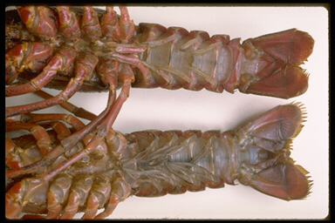
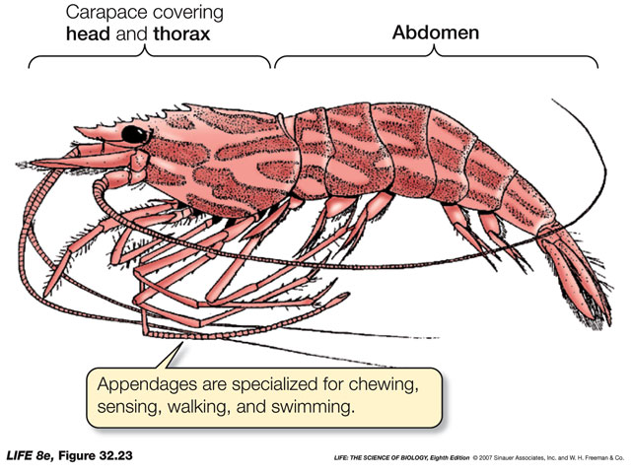
Phylum Arthropoda
Subphylum Crustacea
Crabs, shrimp, lobster, crayfish
3-5 pairs of legs
1 pair antenna
Head, thorax, abdomen
Males have swimmerets
Dissection*

Slide 8
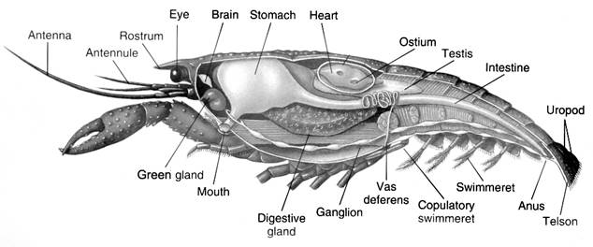
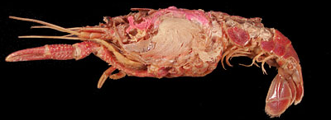
Crayfish Dissection – pgs. 65 & 67

Slide 9
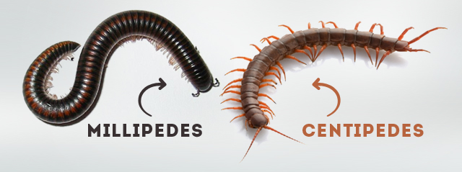
Phylum Arthropoda
Subphylum Myriapoda
Class Chilopoda – centipedes
1 pair of legs/segment
Class Diplopoda – millipedes
2 pairs of legs/segment
http://www.liveanimalslist.com/interesting-animals/images/millipedes-vs-centipedes-picture.jpg

Slide 10
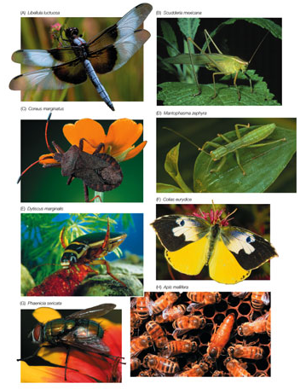
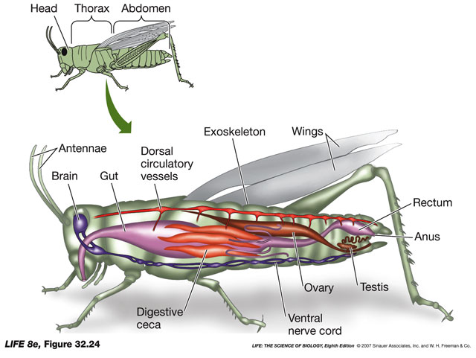
Phylum Arthropoda
Subphylum Hexapoda
Class Insecta
3 pairs of legs/segment
1 pair antenna
Head, thorax, abdomen
Grasshopper –
(identify regions on model)

Slide 11
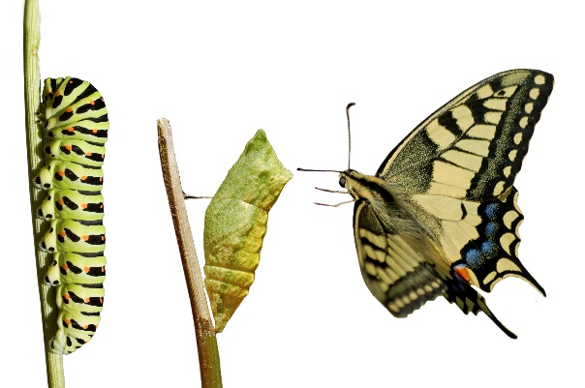
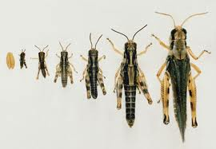
Insect Metamorphosis
Complete
Drastic change
3 stages – larval, pupa, adult
Larvae does not resemble adult form
Ex. butterfly
Incomplete
Gradual change
2 stages – nymphs, adult
Larvae (nymphs) resemble adult form
Ex. grasshopper
https://s-media-cache-ak0.pinimg.com/originals/11/2e/67/112e673f6c562b5713a4f003f4fd6f59.jpg
http://vignette3.wikia.nocookie.net/grasshoppers/images/4/45/Imagesrn.jpg/revision/latest?cb=20120917002813

Slide 12
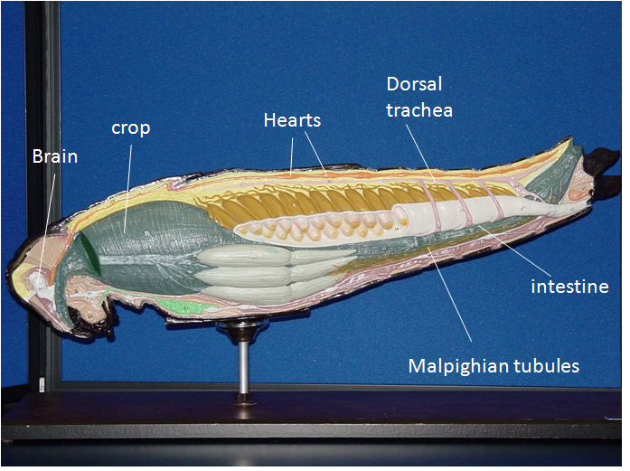
Grasshopper – pg. 66

