Slide 1
Chapter 21 - Viruses
General Biology II
BSC 2011
Dr. Capers
credit a: USDA ARS
Download for free at http://cnx.org/content/col11448/latest/
OpenStax Biology - https://openstax.org/details/books/biology,
PowerPoint made by Dr. Capers - www.jcapers-irsc.weebly.com

Slide 2
Viruses are Different from Living Cells, Yet
They Make a Large Impact on Cells
They are “acellular” (not cells).
They have no metabolism and cannot grow.
They depend on host cells to make copies of themselves.
They are the ultimate parasite; cannot replicate unless they are in host cell using that cell’s machinery
Their origin is uncertain.
They seem to have collected pieces of nucleic acid from various sources.
They can infect nearly all lifeforms.
They are not only species specific but tissue specific (as far as what they will infect)

Slide 3
Viruses were known to exist before they were seen
Download for free at http://cnx.org/contents/185cbf87-c72e-48f5-b51e-f14f21b5eabd@10.61
In 1892, tobacco mosaic disease was transmitted via plant extracts. Filtration removed the bacteria… but they knew something even smaller was transmitting the disease.

Slide 4
In the 1930s, a new technology made viruses visible by microscopy
Download for free at http://cnx.org/contents/185cbf87-c72e-48f5-b51e-f14f21b5eabd@10.61

Slide 5
Almost all viruses are too small to be seen with light microscopes.
A single virus particle (a “virion”) may be only 20 nm across.
Electron microscopes can magnify 500,000x.
The image clarity is due to good resolution (0.05 nm).
The invention of electron microscopes led to the discovery of many types of viruses in many types of organisms.

Slide 6
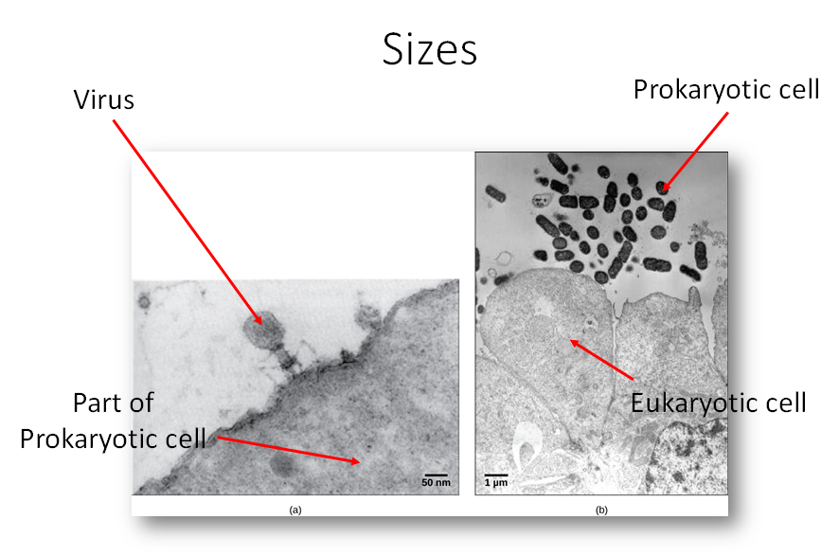

Slide 7
Virus Evolution
Did they “devolve” from free-living cells?
Did nucleic acid molecules “escape” from cells?
Did they begin as self-replicating molecules?
No one is sure.
Download for free at http://cnx.org/contents/185cbf87-c72e-48f5-b51e-f14f21b5eabd@10.61

Slide 8
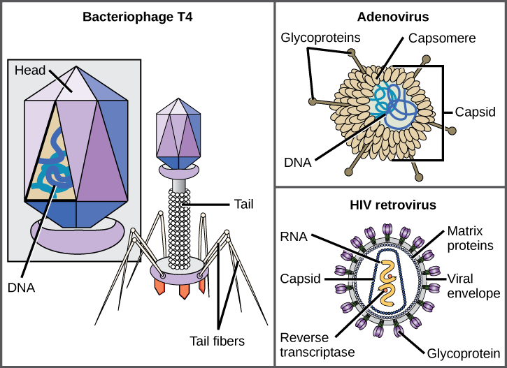
Virus Morphology
Each virion has:
Nucleic acid: might be DNA or RNA, double stranded or single stranded
Protein capsid
Some virions also have an “envelope” that is similar to a cell membrane.
Download for free at http://cnx.org/contents/185cbf87-c72e-48f5-b51e-f14f21b5eabd@10.61

Slide 10
Bacteriophage T4
Bacteriophages infect bacteria
Infects the bacterium, Escherichia coli
Has a DNA genome
Has been studied extensively
Download for free at http://cnx.org/contents/185cbf87-c72e-48f5-b51e-f14f21b5eabd@10.61

Slide 11
Adenovirus
Infects the human respiratory tract
Is non-enveloped
Other non-enveloped viruses include poliovirus, human papillomavirus, and hepatitis A virus.
Download for free at http://cnx.org/contents/185cbf87-c72e-48f5-b51e-f14f21b5eabd@10.61

Slide 12
HIV Retrovirus
Causes AIDS (acquired immunodeficiency syndrome)
Is enveloped
Is a retrovirus (can reverse transcribe its RNA genome into DNA form.
Download for free at http://cnx.org/contents/185cbf87-c72e-48f5-b51e-f14f21b5eabd@10.61

Slide 13
Viruses Have Genomes
The virus core contains nucleic acid.
either DNA or RNA (but not both)
may be single-stranded or double-stranded
may be circular or linear
may be in one piece or in multiple segments
The genome is much smaller than a cell’s genome.
DNA directs the host cell to make new virus copies.
RNA may be directly transcribed, or replicated first.
RNA viruses use enzymes that make more errors
RNA viruses mutate more frequently

Slide 14
Several Ways to Classify Viruses
According to nucleic acid type and function
According to capsid structure
Enveloped/non-enveloped
Genome structure

Slide 15
Virus Classification by Genome Structure and Core
Core Classifications | Examples
DNA RNA | Rabies virus, retroviruses Herpesviruses, smallpox virus
Single-stranded Double-stranded | Rabies virus, retroviruses Herpesviruses, smallpox virus
Linear Circular | Rabies virus, retroviruses Herpesviruses, smallpox virus Papillomaviruses, many bacteriophages
Non-segmented Segmented | Parainfluenza viruses Influenza viruses

Slide 16
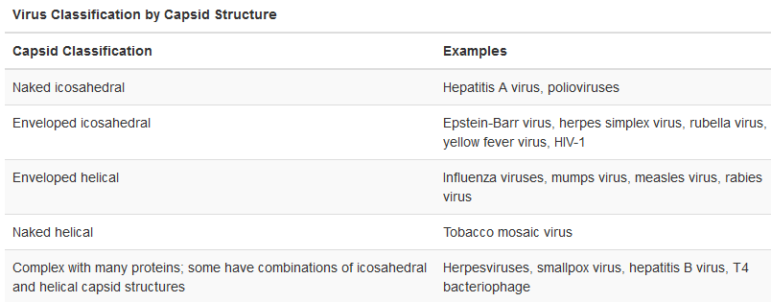
Download for free at http://cnx.org/contents/185cbf87-c72e-48f5-b51e-f14f21b5eabd@10.61

Slide 17
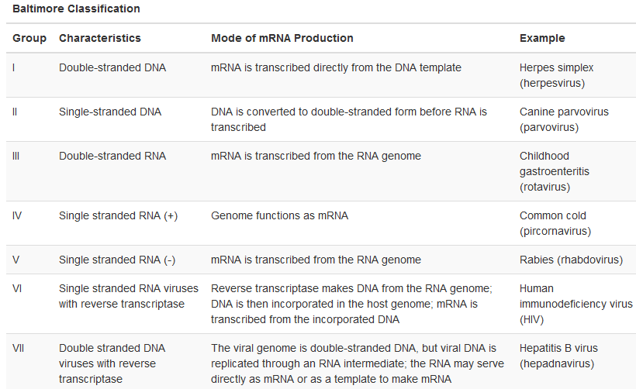
Download for free at http://cnx.org/contents/185cbf87-c72e-48f5-b51e-f14f21b5eabd@10.61

Slide 18
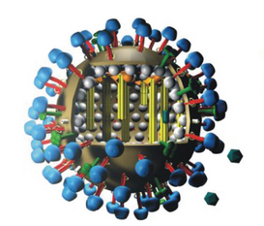
Flu Attack! How a Virus Invades Your Body
Video Link
Download for free at http://cnx.org/contents/185cbf87-c72e-48f5-b51e-f14f21b5eabd@10.61

Slide 19
Cytopathic Effects
These cell damaging changes can occur when a virus replicates in a host cell:
lysis (the cell ruptures or bursts open)*
apoptosis (programmed self-destruction)
widespread symptoms due to the body’s immune response
*In some cases, replicated viruses can leave the cell by “budding”, which does not immediately kill the cell.

Slide 20
Steps of Virus Infections
Attachment
Entry
Replication and Assembly
Egress (Release)

Slide 21
Attachment
Receptors on the surface of the host cell bind to virus capsid proteins or virus envelope glycoproteins.
Viruses can attach only to cells that have the right receptor molecules.
Therefore, viruses can be very specific about what species or cell type they can infect.

Slide 23
Replication and Assembly
Virus Genome | Steps
DNA | transcribe mRNA → make viral proteins duplicate DNA to make new viral genomes
RNA | make complementary RNA if necessary transcribe mRNA → make viral proteins copy RNA to make new viral genomes
RNA retrovirus | reverse transcribe RNA to make DNA, using reverse transcriptase DNA incorporates into host genome DNA directs synthesis and assembly of new viruses
The viral genes then direct the assembly of the new proteins and genomes to make new viruses.

Slide 24
Egress (Release)
May involve lysis and death of the host cell.
May involve budding, which does not directly kill the host cell.

Slide 25
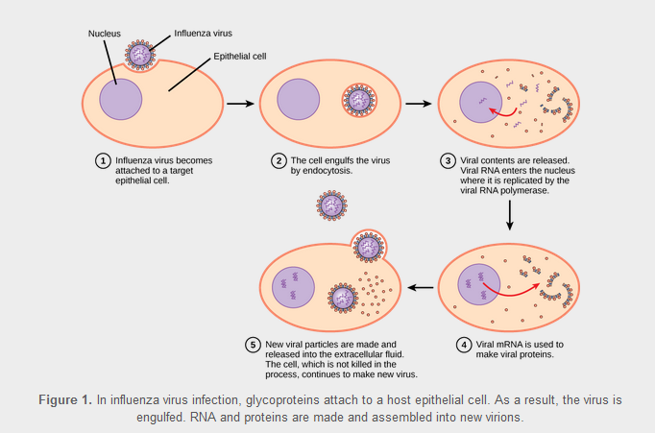
Download for free at http://cnx.org/contents/185cbf87-c72e-48f5-b51e-f14f21b5eabd@10.61

Slide 26
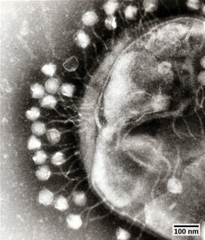
Bacteriophages
Viruses that infect bacteria
Download for free at http://cnx.org/contents/185cbf87-c72e-48f5-b51e-f14f21b5eabd@10.61

Slide 27
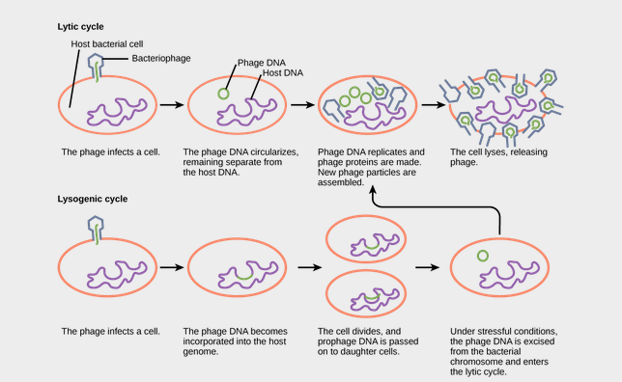
prophage
Download for free at http://cnx.org/contents/185cbf87-c72e-48f5-b51e-f14f21b5eabd@10.61

Slide 28
Animal Viruses
May cause:
Acute disease (colds, influenza)
Chronic infection (hepatitis C)
Latency and intermittent symptoms (herpes simplex)
remains in nerve tissue for life
reactivation causes active replication and cell lysis
Asymptomatic infection (other human herpesviruses)
Oncogenesis (hepatitis B and C, human papillomavirus [HPV])

Slide 29
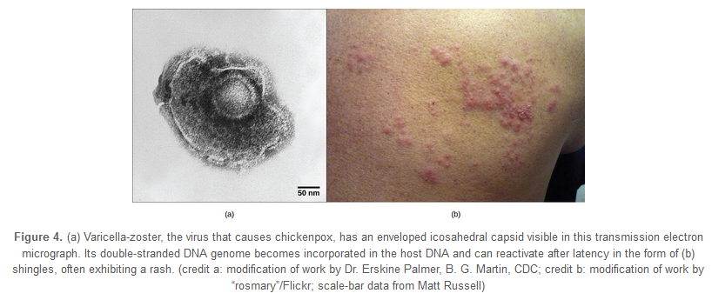
Varicella-zoster (chickenpox virus)
Childhood chickenpox → viral latency → possible reactivation in later life results in shingles
Download for free at http://cnx.org/contents/185cbf87-c72e-48f5-b51e-f14f21b5eabd@10.61

Slide 30
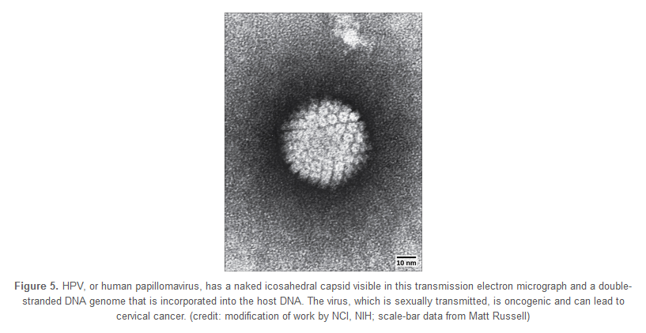
HPV
Download for free at http://cnx.org/contents/185cbf87-c72e-48f5-b51e-f14f21b5eabd@10.61

Slide 31
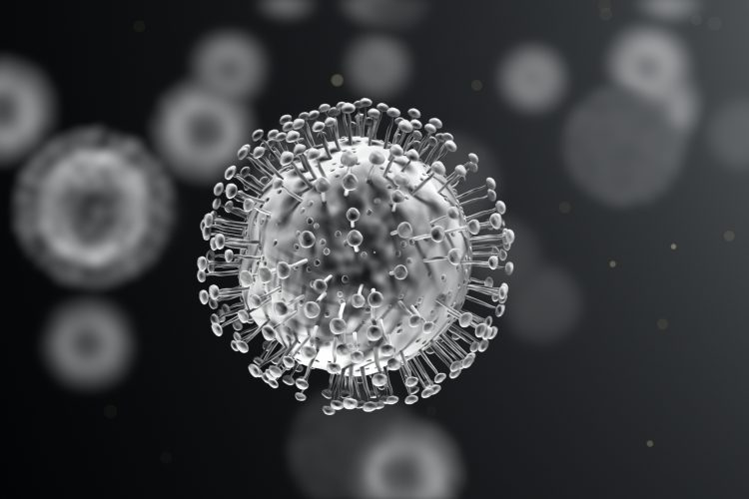
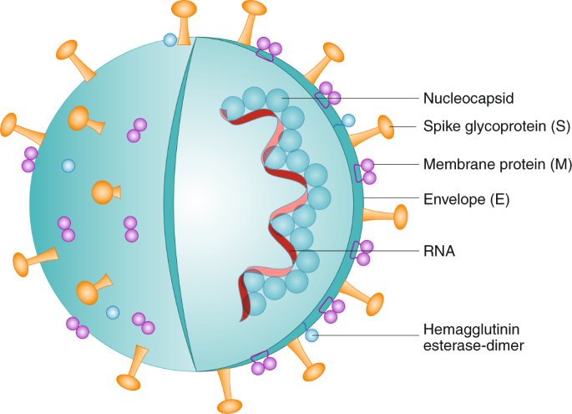
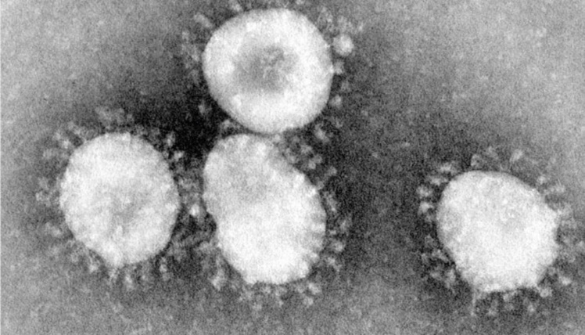
Covid-19
Coronaviruses are a family of enveloped viruses that are single stranded RNA
Get their name from their electron microscope image which shows spikes as seen on a crown
There are several known coronaviruses that infect humans (some just cause the common cold)
Recently, there have been some major outbreaks due to coronaviruses
Covid-19
SARS-CoV-2 (called Covid-19 due to it first being recognized in 2019)
Shares homology with virus that infects bats

Slide 32
Plant Viruses
Horizontal transmission
virus typically enters by way of damaged plant tissue
may come from pollen, another plant, or vectors such as insect bites
Vertical transmission
virus is transmitted from the parent plant
May cause hypoplasia (decreased growth and vigor)
May cause necrosis of the plant or plant tissue

Slide 33
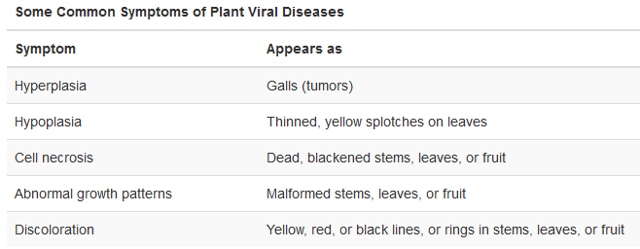
Download for free at http://cnx.org/content/col11448/latest/

Slide 34
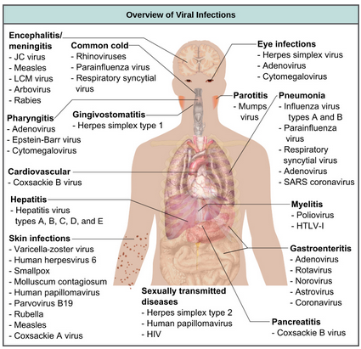

Slide 35
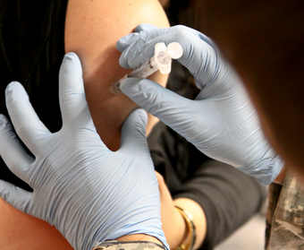
Vaccines to Prevent Viral infections
Trigger immune protection
Prepared using:
Attenuated “live” virus*
“killed” virus
molecular subunits
*very small risk of infection
credit: USACE Europe District
Download for free at http://cnx.org/content/col11448/latest/

Slide 36
Smallpox was eradicated from the human population by a global vaccination program

Slide 37
Antibiotics designed to kill bacteria will not eliminate viruses. However, there are some antiviral drugs that are for controlling, but not curing, diseases.

Slide 38
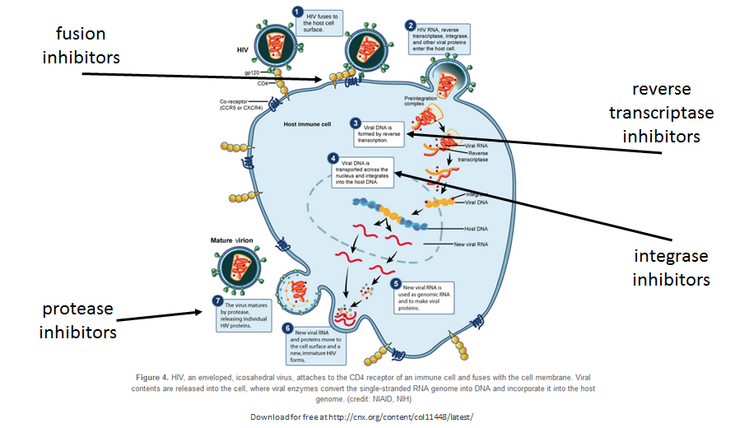

Slide 39
Temperate viruses can remain dormant for a very long time
Similar to the lysogenic cycle in bacteriophages

Slide 40
Prions: Proteinaceous Infectious Particles
Very small
Contain no nucleic acid
Cause fatal neurodegenerative diseases
Mad cow disease (BSE, bovine spongiform encephalopathy)
(v)Creutzfeldt-Jakob disease (in humans)
Kuru (in humans, spread by cannibalism)
Scrapie (in sheep)
Chronic wasting disease (in deer, moose, elk)
Prions are not destroyed by cooking.

Slide 41
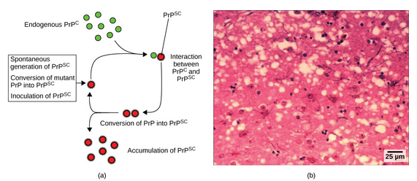
Abnormal Prp converts normal Prp into abnormal Prp.
Download for free at http://cnx.org/content/col11448/latest/

Slide 42
Viroids: Small Circles of RNA
Only known to infect plants
Can replicate within cells
Do not manufacture any proteins
Can cause crop failures

Slide 43
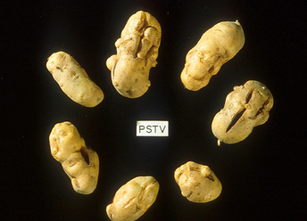
These potatoes have been infected by the potato spindle tuber viroid (PSTV), which is typically spread when infected knives are used to cut healthy potatoes, which are then planted. (credit: Pamela Roberts, University of Florida Institute of Food and Agricultural Sciences, USDA ARS)
Download for free at http://cnx.org/content/col11448/latest/

