Slide 1
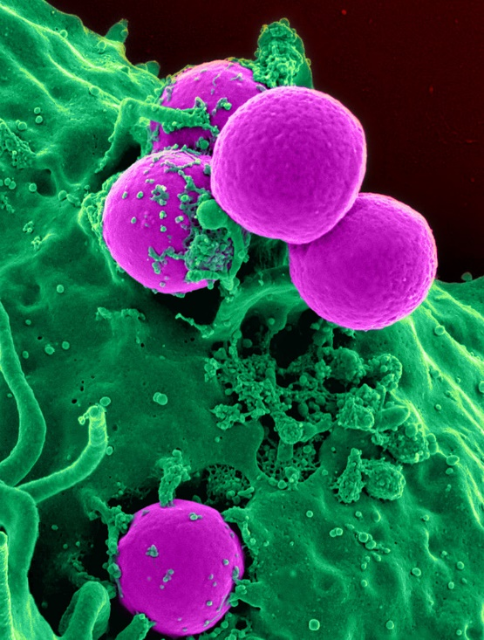
Chapter 42
General Biology I
BSC 2010
Dr. Capers
Human neutrophil ingesting MRSA , (c) NIH, Public Domain
OpenStax Biology - https://openstax.org/details/books/biology,
PowerPoint made by Dr. Capers - www.jcapers-irsc.weebly.com

Slide 2
As long lived multicellular organisms, we need protection against pathogenic organisms.
Only a small percentage of microbes are pathogenic.
However, those that are pathogenic are very good at invading our tissues when getting past certain barriers.
Our immune system has the ability to fight:
Viruses
Bacteria
Protozoans (i.e. malaria, amoebas)
Fungi
Parasitic animals (i.e. tapeworms, flukes)

Slide 3
2 Systems:
Innate Immune System
Innate immune components found throughout all of the animal kingdom and even in the plant kingdom
Nonspecific
No memory
Adaptive Immune System
Found only in vertebrate animals
Highly specific
Has memory (gives us the ability to recover from an infection and then have protection when exposed to same pathogen)

Slide 4
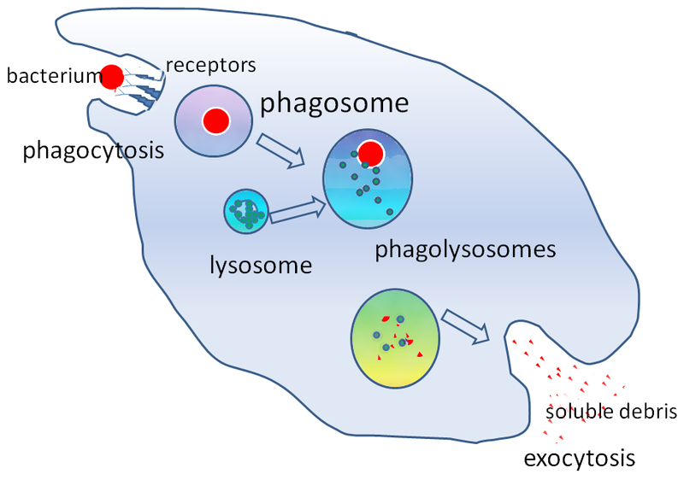
Innate Immune System
Physical and Chemical Barriers
Skin
Normal flora found on skin
Mucous and cilia in respiratory tract
Low pH of stomach
Antimicrobial peptides
Pathogen Recognition
Microbes have different cell surface markers than our cells
Anything that is foreign is called an antigen
Cells will recognize these pathogen associated molecular patterns (PAMPs) and phagocytize
These markers are not specific – they are found on wide range of microbes
We will see later that cells of the adaptive immune response can recognize one bacterial species from another
Simplified illustration of the stages of phagocytosis (c) Graham Colm, Public Domain

Slide 5
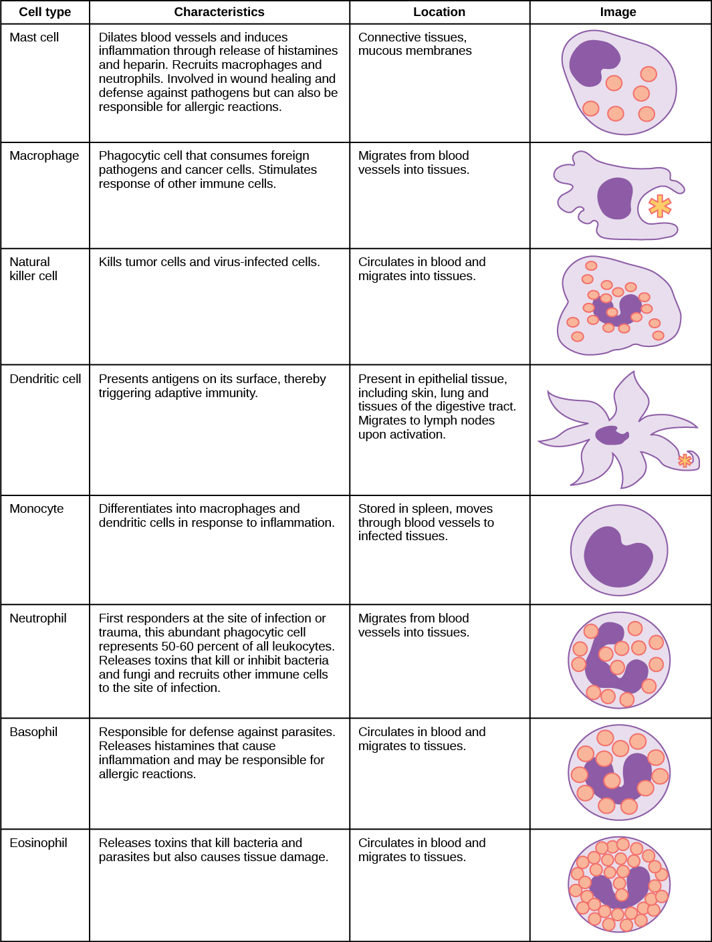
Cells involved
in the Innate
Immune System –
Cells of the
immune system
are white blood
cells (WBCs),
leukocytes
Download for free at https://cnx.org/contents/GFy_h8cu@10.96:XaEKhjEp@6/Innate-Immune-Response

Slide 6
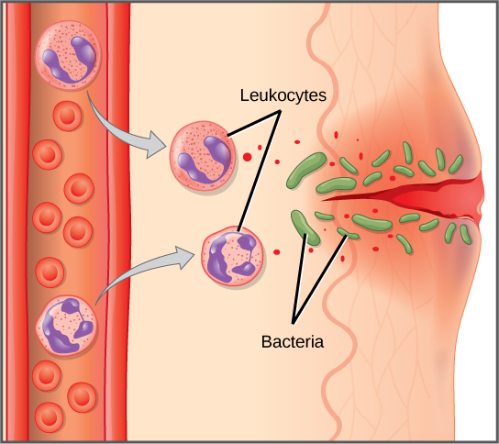
Innate Immune System
Inflammatory Response
Pain
Heat – body raises temp in attempt to slow growth of pathogenic bacteria
Redness
Swelling (edema)
Redness and swelling are due to increased vascular permeability to allow WBCs to leave capillaries and enter tissues
Download for free at https://cnx.org/contents/GFy_h8cu@10.96:XaEKhjEp@6/Innate-Immune-Response

Slide 7
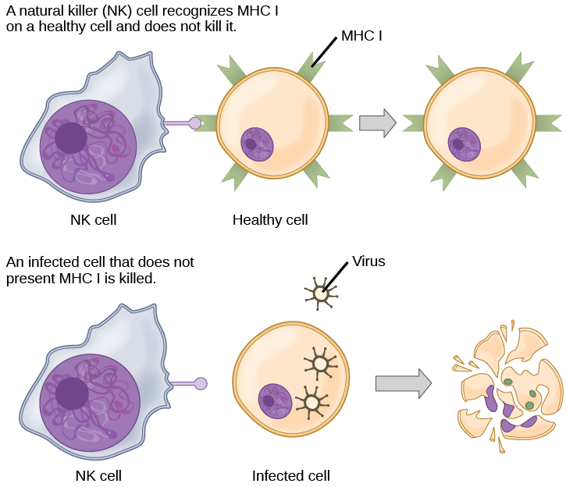
Innate Immune System
Natural Killer Cells
Kill virus infected or altered self cells (tumor cells)
Download for free at https://cnx.org/contents/GFy_h8cu@10.96:etZobsU-@6/Adaptive-Immune-Response

Slide 8
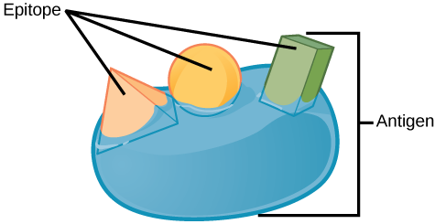
Adaptive Immune Response
Characteristics:
Cells: B cells and T cells (lymphocytes)
Can take days or even weeks to become upregulated
We’ll talk about primary and secondary response later
Remember the innate immune system is immediate
Highly specific Antibodies (Abs) made by B cells and T-cell Receptors (TCRs) made by T cells
Innate immune system recognizes PAMPs found on wide variety of microbes, B cells and T cells can distinguish between different motifs (epitopes) found on an individual microbe
Has memory
Download for free at https://cnx.org/contents/GFy_h8cu@10.96:etZobsU-@6/Adaptive-Immune-Response

Slide 9
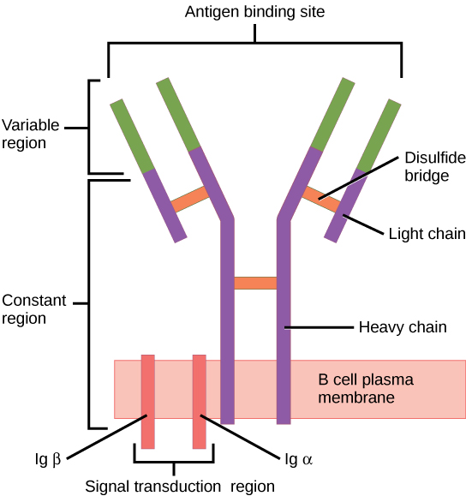
Adaptive Immune System – Humoral Response
B Cells
Mature in the bone marrow
Make antibodies (Abs)
Antibodies are proteins – encoded for in our DNA
Each B cell produces antibodies with a specific variable region that recognizes a specific epitope
Can be secreted or membrane-bound on the B cell
Download for free at https://cnx.org/contents/GFy_h8cu@10.96:etZobsU-@6/Adaptive-Immune-Response

Slide 10
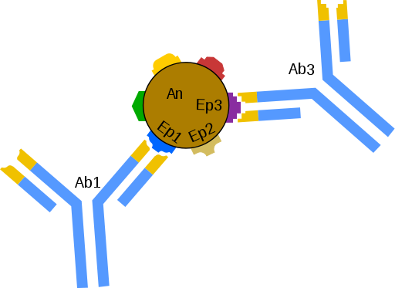
Each B cell secretes antibodies with a specific variable region that recognizes a specific epitope
Title:Schemat łączenia się przeciwciał (Ab) z epitopami (Ep) znajdującymi się na powierzchni antygenu., (c) Schorschski, Public Domain

Slide 11
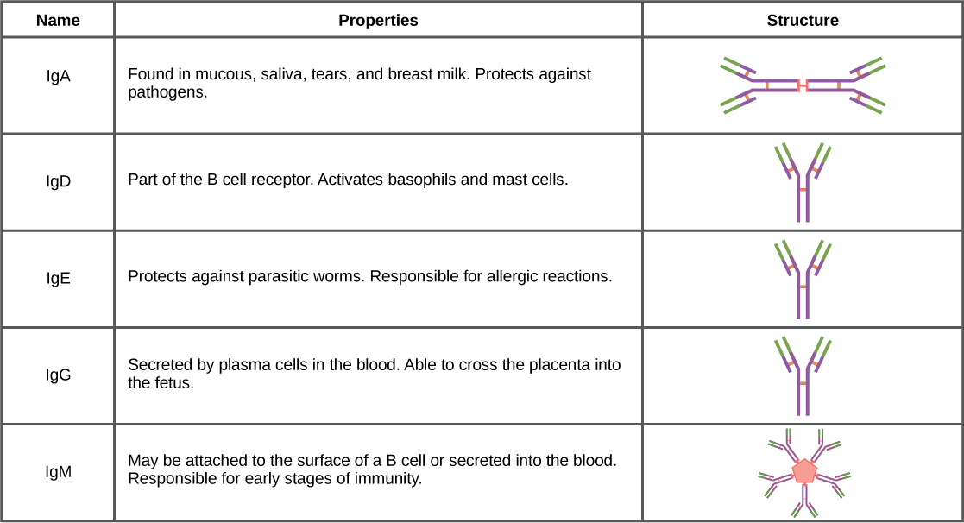
Download for free at https://cnx.org/contents/GFy_h8cu@10.96:Ab5hWIaf@6/Antibodies

Slide 12
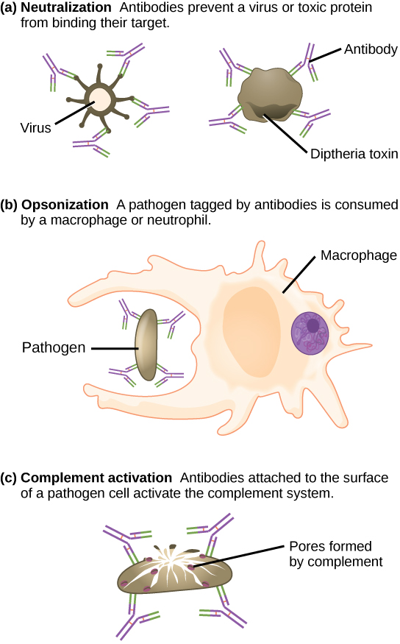
Adaptive Immune System – Humoral Response
Antibody Function
Download for free at https://cnx.org/contents/GFy_h8cu@10.96:Ab5hWIaf@6/Antibodies

Slide 13
Complement process can
make a hole in the pathogen’s
membrane
Don’t need to know the
details of this
Download for free at https://cnx.org/contents/FPtK1zmh@6.27:zMTtFGyH@4/Introduction

Slide 14
Adaptive Immune System
Major Histocompatibility Complex (MHC)
Antigen presenting molecules
MHC Class I
Found on all of our nucleated cells
MHC Class II
Found on Antigen Presenting Cells (APCs)
B cells
Dendritic cells
macrophages

Slide 15
Adaptive Immune System – Cell-Mediated Response
T cells
Mature in the thymus
Produce the T cell receptor (TCR) that is membrane bound
Also encoded in our DNA
Recognized specific antigens presented in MHC molecules
3 populations of T cells
T_{H} - helper T cells – CD4 markers
T_{c} – cytotoxic T cell – CD8 markers
T regulatory cells

Slide 16
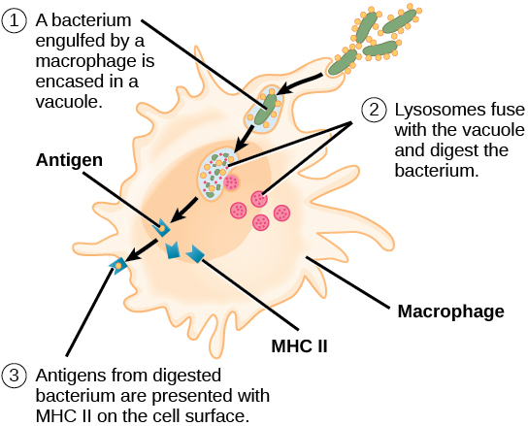
Adaptive Immune System – Cell-mediated Response
How an antigen presenting cell (APC) processes antigen to be presented on the MHC to a T cell
Download for free at https://cnx.org/contents/GFy_h8cu@10.96:etZobsU-@6/Adaptive-Immune-Response

Slide 17
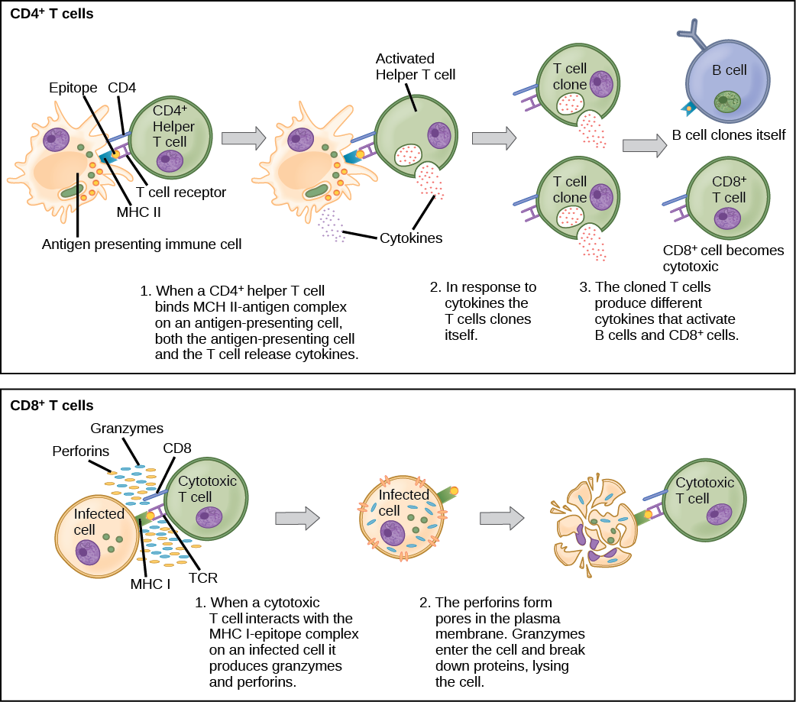
Helper T cells will then release cytokines to
upregulate B cells, other immune cells, will go
through mitosis to make clones of itself
Download for free at https://cnx.org/contents/GFy_h8cu@10.96:etZobsU-@6/Adaptive-Immune-Response

Slide 18
Cytotoxic T cells will kill infected self cells or altered (tumor) self cells
For instance, if a cell is infected with a virus, it will present some of that virus on it’s MHC Class I, the Tc cell will then force that self cell to go through apoptosis
Download for free at https://cnx.org/contents/GFy_h8cu@10.96:etZobsU-@6/Adaptive-Immune-Response

Slide 19
Adaptive Immune Response
How does the variable region of an antibody secreted by one B cell differ from another B cell?
How does the variable region of the T cell receptor (TCR) of one T cell differ from another T cell?
Process called gene rearrangement
During B and T cell development, the region of the DNA that codes for the variable region “rearranges” – this results in each B and T cell having unique variable region
Results in high diversity
Process is complicated and will be explained further in a class such as Immunology

Slide 20
Lymphatic System
Most of the cells in the blood vessels are erythrocytes.
The leukocytes have the ability of migrating into the tissues along with other fluid, nutrients, etc.
Lymph is that watery fluid that then travels through our lymph vessels to be dumped back into circulation.
Along the way, the lymph will travel through lymph nodes.
There are a congregation of B, T and other white blood cells there.
If there is something foreign that made it past the skin or mucosal membranes into the tissues, hopefully it will be detected in the lymph nodes, clones of T and B cells specific for the antigen will be released into circulation to find more of that same antigen

Slide 21
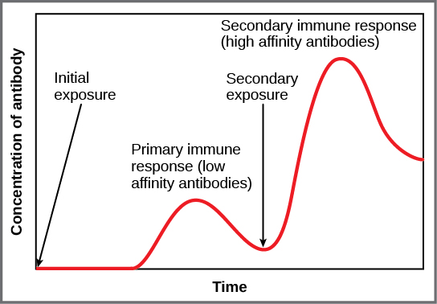
Adaptive Immune Response
Primary Response
Initial exposure to antigen/pathogen
Takes days to weeks for B and T cells to upregulate and mount a full response
After recovery, memory B and T cells that are specific to that antigen/pathogen will remain and circulate (up to decades)
Secondary Response
Second exposure to same antigen/pathogen
Memory cells will respond faster
Results in an individual either not getting sick or being able to recover faster
Download for free at https://cnx.org/contents/GFy_h8cu@10.96:etZobsU-@6/Adaptive-Immune-Response

Slide 22
Adaptive Immune Response
Vaccination initiates that Primary Immune Response
The body is given time to mount a primary response against a pathogen and make memory B and T cells against that pathogen
When person is exposed to pathogen later, a secondary response will hopefully prevent sickness

Slide 23
Things that can go wrong:
Chronic Inflammation
Can cause damage to tissues
Allergies
Immune system’s over-reaction to antigen
Autoimmunity
The immune system can sometimes recognize self antigen as being foreign – results in tissue/organ damage
Lupus
Multiple sclerosis
Grave’s disease
Rheumatoid arthritis
Immunodeficiency
Primary – genetic/developmental defect results in individual lacking in some component of the immune system
SCID
Inability to make certain antibody class
Lack of thymus
Acquired – later in life (i.e. AIDS as a result of HIV infection)

