Slide 1
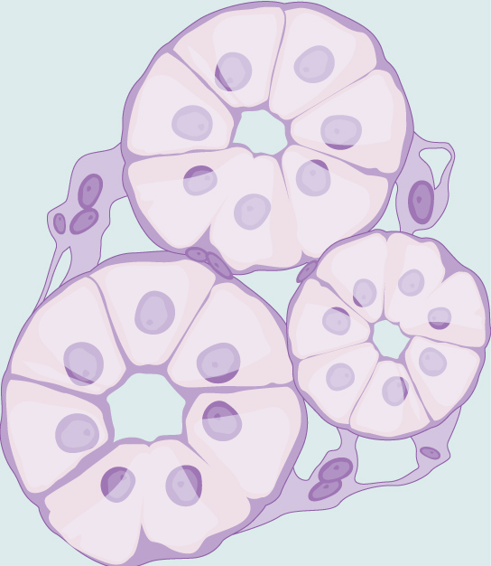
Chapter 33 The Animal Body Plan: Basic Form and Function
General Biology II
BSC 2011
Dr. Capers
Download for free at http://cnx.org/contents/185cbf87-c72e-48f5-b51e-f14f21b5eabd@10.61
OpenStax Biology - https://openstax.org/details/books/biology,
PowerPoint made by Dr. Capers - www.jcapers-irsc.weebly.com

Slide 2
Animal Body Plans
3 key aspects of animal body plans discussed in this chapter
Symmetry and body plans
Bioenergetics and Thermoregulation
Tissues

Slide 3
Animal Body Plans
1. Evolution of symmetry
Sponges do lack any definite symmetry
However, all other animals have symmetry (Eumetozoa)
Eumetazoa have a symmetry defined along an imaginary axis drawn through the animal’s body
There are two main types of symmetry:
Radial
Bilateral

Slide 4
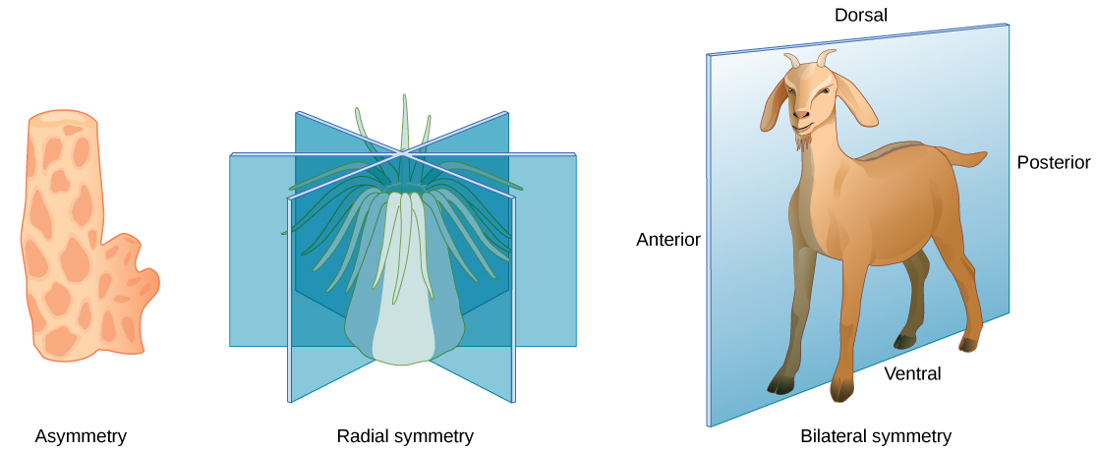
Symmetry
Radial symmetry
Body parts arranged around central axis
Can be bisected into two equal halves in any 2-D plane
Bilateral symmetry
Body has right and left halves that are mirror images
Only the sagittal plane bisects the animal into two equal halves
Download for free at http://cnx.org/contents/185cbf87-c72e-48f5-b51e-f14f21b5eabd@10.61

Slide 5
Animal Body Plans
Body Shapes/Sizes and Metabolism
Small, unicellular organisms get nutrients through diffusion
Cell size is constrained by surface area-to-volume ratio
As the cell gets larger, this ratio decreases (not good)
Therefore, larger organisms don’t have larger cells, they have more cells (multicellular)
Must provide nutrients and oxygen to all cells with specialized cells, organs, and organ systems.

Slide 6
Bioenergetics
Energy from nutrients is used in the animal body to fuel anabolic reactions
Basal Metabolic Rate – Average amount of energy used by an organism in a non-active state
Excess energy is given off as heat

Slide 7
Bioenergetics
Smaller endothermic organisms have a higher BMR than larger ones (compensates heat lost from large surface area)
Active animals have a higher BMR than inactive ones
Download for free at http://cnx.org/contents/185cbf87-c72e-48f5-b51e-f14f21b5eabd@10.61

Slide 8
Homeostasis/Thermoregulation
Homeostasis aims to keep internal conditions around a set point
If conditions stray too far from the set point homeostatic mechanisms kick in
Set point can potentially change over time (alteration), but homeostasis will still work towards new set point
Acclimatization – changes in one organ system to maintain a set point in another organ system (altitude example)

Slide 9
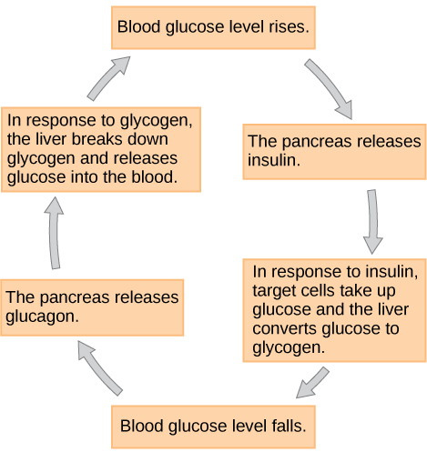
Homeostasis/Thermoregulation
Negative Feedback Loop – Counteracts any internal changes (reverses the direction of the change)
Most biological systems are on negative feedback
Examples
Temperature
Glucose
pH
Blood Calcium
Download for free at http://cnx.org/contents/185cbf87-c72e-48f5-b51e-f14f21b5eabd@10.61

Slide 10
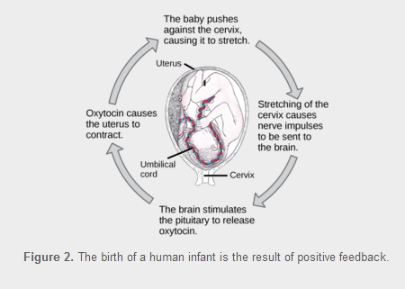
Homeostasis/Thermoregulation
Positive Feedback Loop – Maintains and potentially strengthens the response to a stimulus
Not many biological systems are on positive feedback
Example:Oxytocin
Download for free at http://cnx.org/contents/185cbf87-c72e-48f5-b51e-f14f21b5eabd@10.61

Slide 11
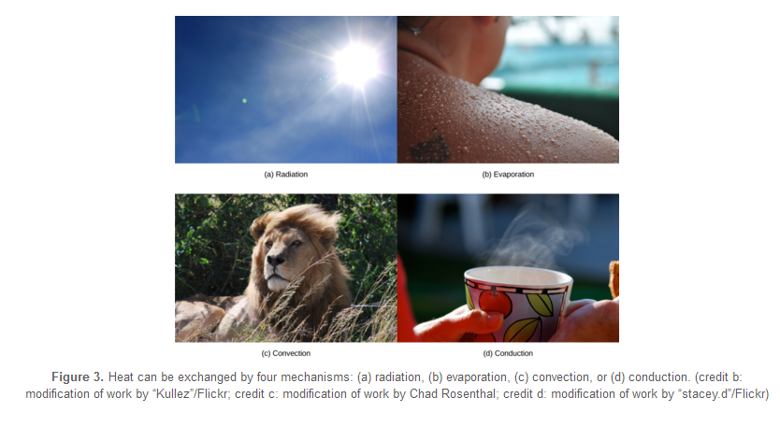
Homeostasis/Thermoregulation
Must maintain a relatively constant internal temperature to keep enzymes efficient and avoid denaturation
Thermoregulatory control by hypothalamus
Endotherm vs. Ectotherm
Temperature maintained in several different ways
Radiation
Convection
Conduction
Evaporation
Download for free at http://cnx.org/contents/185cbf87-c72e-48f5-b51e-f14f21b5eabd@10.61

Slide 12
Animal Body Plans
Evolution of tissues
Parazoa (Sponges – the simplest animals) lack defined tissues and organs
Have the ability to disaggregate and aggregate their cells
Eumetazoa (all other animals) have distinct and well-defined tissues
Have irreversible differentiation for most cell types

Slide 13
Types of Multicellular Animal Tissues
There are 4 main types of animal tissues
Epithelia – Line cavities, open spaces, and surfaces
Connective Tissues – Connect tissues together, provide support
Muscles – Generate movement
Neurons – Generate and send electrical signals

Slide 14
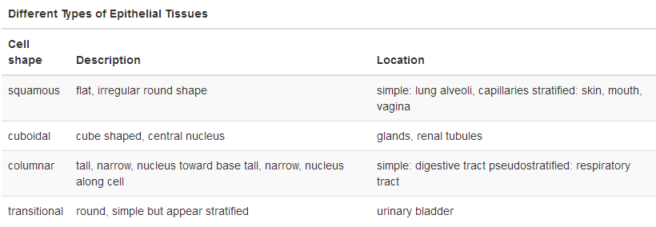
Epithelial Tissue
Epithelial tissues are classified by number of layer and shape of the cell
Single layer = simple Multiple layers = Stratified
Download for free at http://cnx.org/contents/185cbf87-c72e-48f5-b51e-f14f21b5eabd@10.61

Slide 15
Caption: Illu Epithelium (c) M Kubica, Public domain

Slide 16
Squamous Epithelial
Simple Squamous
Stratified Squamous
Download for free at http://cnx.org/contents/185cbf87-c72e-48f5-b51e-f14f21b5eabd@10.61

Slide 17
Cuboidal Epithelial
Simple Cuboidal
Download for free at http://cnx.org/contents/185cbf87-c72e-48f5-b51e-f14f21b5eabd@10.61

Slide 18
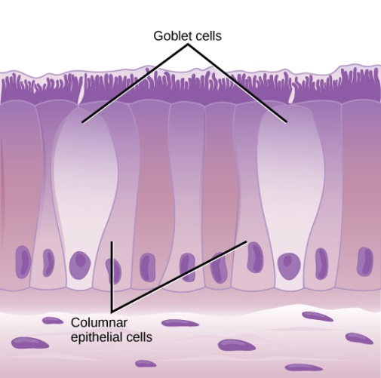
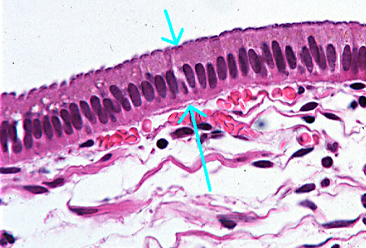
Simple Columnar
Download for free at http://cnx.org/contents/185cbf87-c72e-48f5-b51e-f14f21b5eabd@10.61

Slide 19
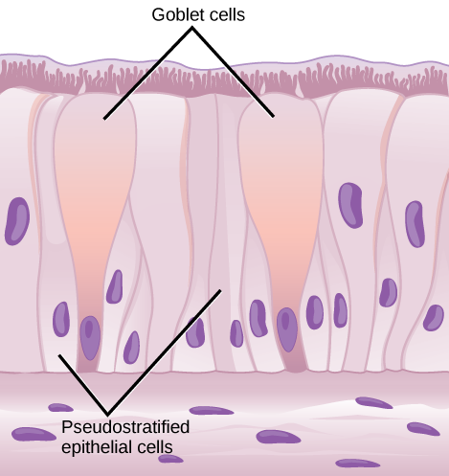
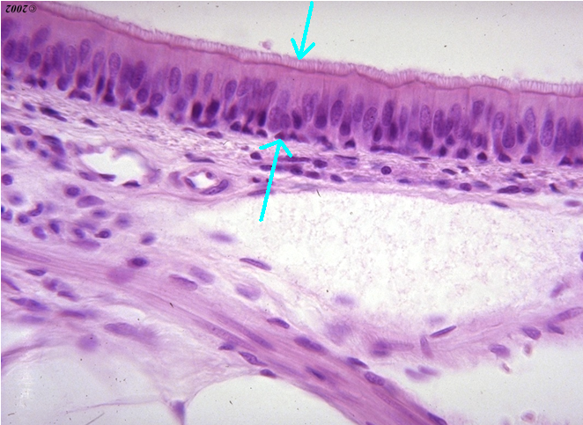
Pseudostratified Ciliated Columnar Epithelial
Download for free at http://cnx.org/contents/185cbf87-c72e-48f5-b51e-f14f21b5eabd@10.61

Slide 20
Connective Tissue
Consist of cells (fibroblasts) embedded in a non-cellular matrix
Matrix usually composed of a ground substance
Ground substance usually contains some combination of collagen, elastic, or reticular fibers
Connective tissues are used to connect different tissues or give the body structure (blood has unique functions)

Slide 21
Connective Tissue

Slide 22
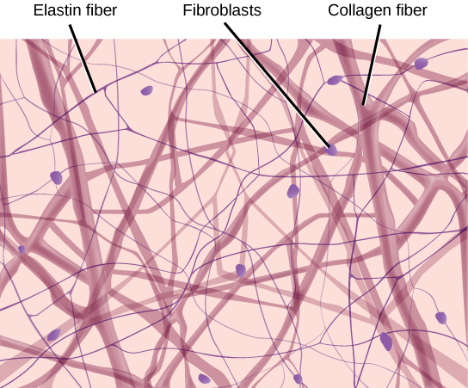
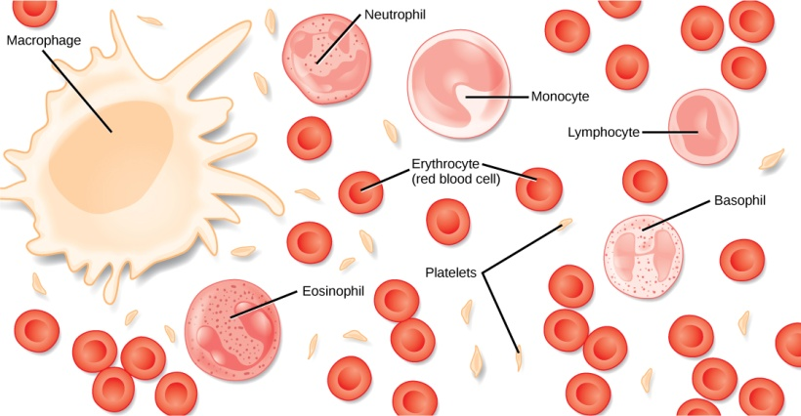
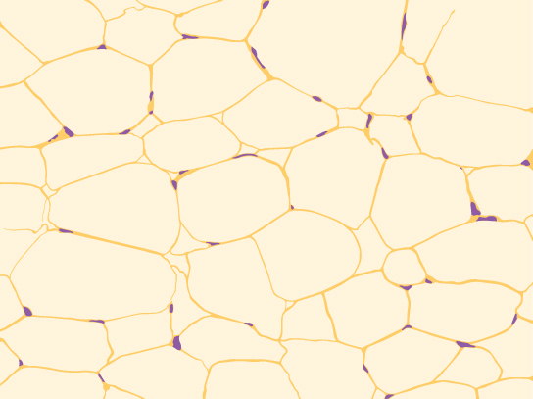
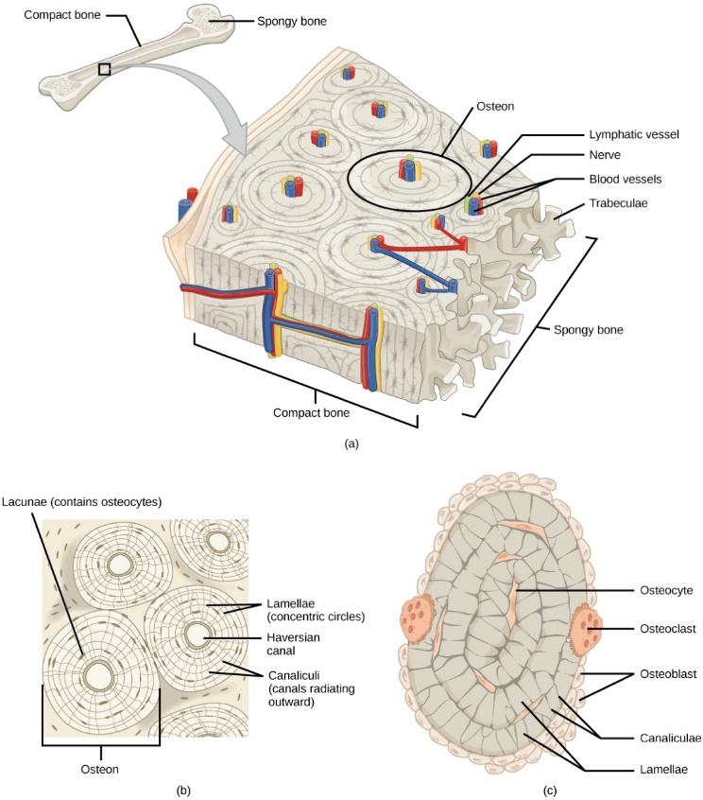
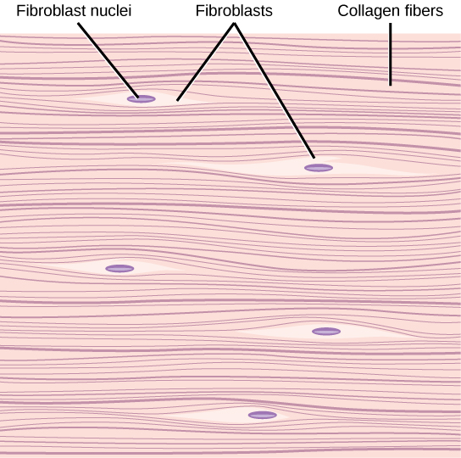
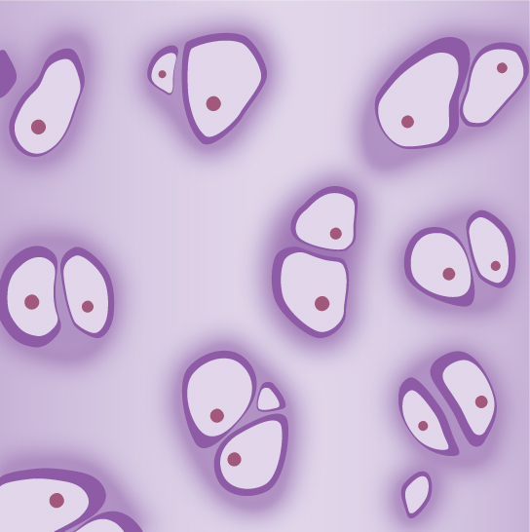
Connective Tissues
Download for free at http://cnx.org/contents/185cbf87-c72e-48f5-b51e-f14f21b5eabd@10.61

Slide 23
Muscle Tissues
Three kinds: Skeletal, Smooth, and Cardiac
Skeletal – voluntary, striated
Smooth – involuntary, no striations
Cardiac – involuntary, striated, intercalated discs
Download for free at http://cnx.org/contents/185cbf87-c72e-48f5-b51e-f14f21b5eabd@10.61

Slide 24
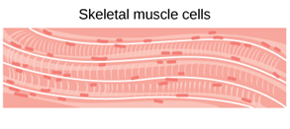
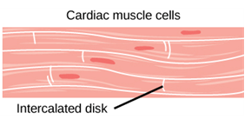
Muscle Tissue
Download for free at http://cnx.org/contents/185cbf87-c72e-48f5-b51e-f14f21b5eabd@10.61

Slide 25
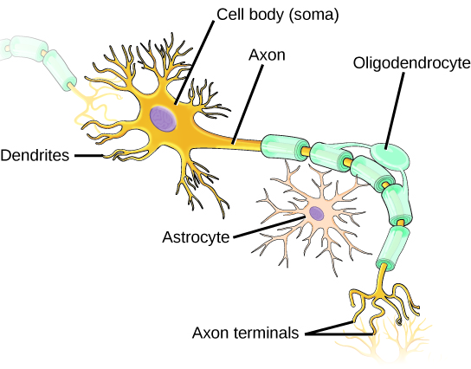
Nervous Tissue
Consists of Neurons and Neuroglia
Generate and transmit electrical impulses
Download for free at http://cnx.org/contents/185cbf87-c72e-48f5-b51e-f14f21b5eabd@10.61

