Slide 1
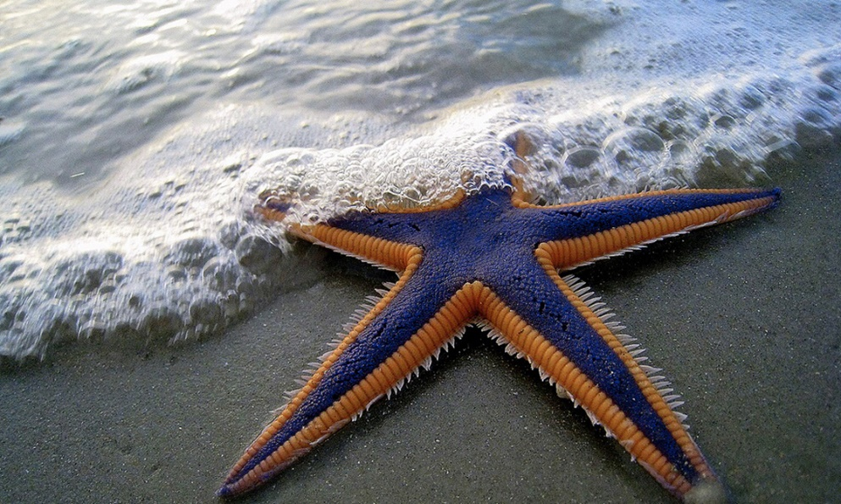
Chapter 28 Invertebrates
General Biology II
BSC 2011
Dr. Capers
Insert photo here representing
chapter
Download for free at http://cnx.org/contents/185cbf87-c72e-48f5-b51e-f14f21b5eabd@10.61
Caption: Mycelium (c) Rob Hille, Public domain
OpenStax Biology - https://openstax.org/details/books/biology,
PowerPoint made by Dr. Capers - www.jcapers-irsc.weebly.com

Slide 2
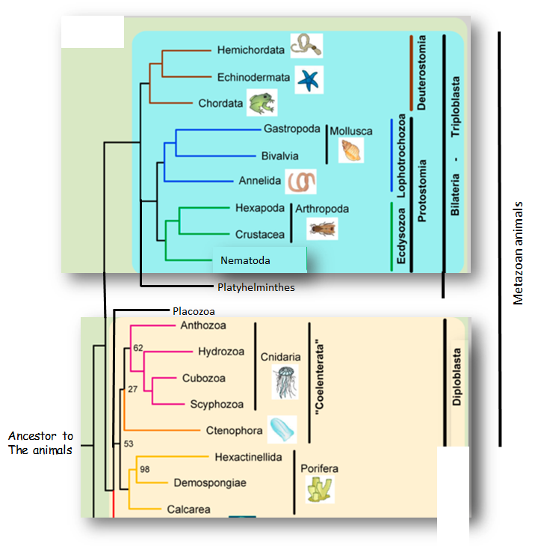
Caption: Metazoan Phylogenetic Tree (c) Schierwater, Public domain

Slide 3
Invertebrates
All of the animals without vertebrate
About 97% of all the animals on Earth
Many are aquatic

Slide 4
Let’s talk about a few terms:
Parazoa (“beside the animals”) – no true embryonic tissues
Sponges
Symmetry – asymmetrical (no symmetry)
Eumetazoa (Metazoa) – true embryonic tissues
All other animals (except sponges)
Symmetry:
Radial Symmetry
Diploblastic – 2 embryonic tissues (endoderm and ectoderm)
Cnidarians and Ctenophores
Bilateral Symmetry
Triploblastic – 3 embryonic tissues (endoderm, mesoderm, ectoderm)
3 main groups:
Platyhelminthes
Protostomes – mouth first
Deuterostomes – anus first

Slide 5
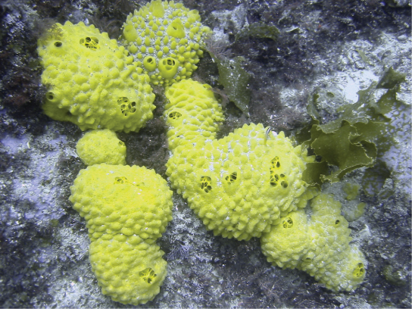
Sponges – Phylum Porifera
Latin “bearing pores”
Sponges are the simplest of all the animals
All are aquatic
Parazoans – no true tissues
Asymmetrical
Adults are sessile but larvae have motility (will settle on substrate and grow)

Slide 6
Download for free at http://cnx.org/contents/185cbf87-c72e-48f5-b51e-f14f21b5eabd@10.61

Slide 7
Sponges have NO digestive, respiratory, circulatory, reproductive or nervous system
They are filter feeders and trap particles in the water with the choanocytes as it flows through the osculum
Watch this video: https://www.youtube.com/watch?v=T7E1rq7zHLc
Reproduction
Asexual – through budding
Sexual – sponges are hermaphroditic; release egg and sperm into the water

Slide 8
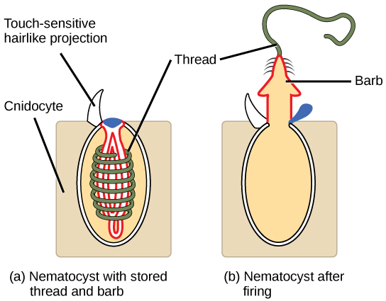
Phylum Cnidaria
Cnidarians are metazoans
Diploblastic – endoderm and ectoderm
Radial symmetry
Cnidarians contain specialized cells called cnidocytes that contain nematocysts
Download for free at http://cnx.org/contents/185cbf87-c72e-48f5-b51e-f14f21b5eabd@10.61

Slide 9
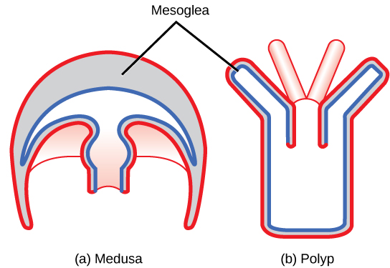
Cnidarians display 2 distinct body plans:
Polyp - sessile
Medusa
Some cnidarians display both body plans during life cycle
Download for free at http://cnx.org/contents/185cbf87-c72e-48f5-b51e-f14f21b5eabd@10.61

Slide 10
Reproduction
Asexual – budding (as we see in corals)
Sexual – release of gametes into the water
Primitive nervous system – nerve net
Gastrovascular cavity
One opening, serves as both mouth and anus
Digestion takes place here, exchange of gases, etc
carnivorous

Slide 11
Phylum Cnidaria
Class Anthozoa
Class Scyphozoa
Class Cubozoa
Class Hydrozoa

Slide 12
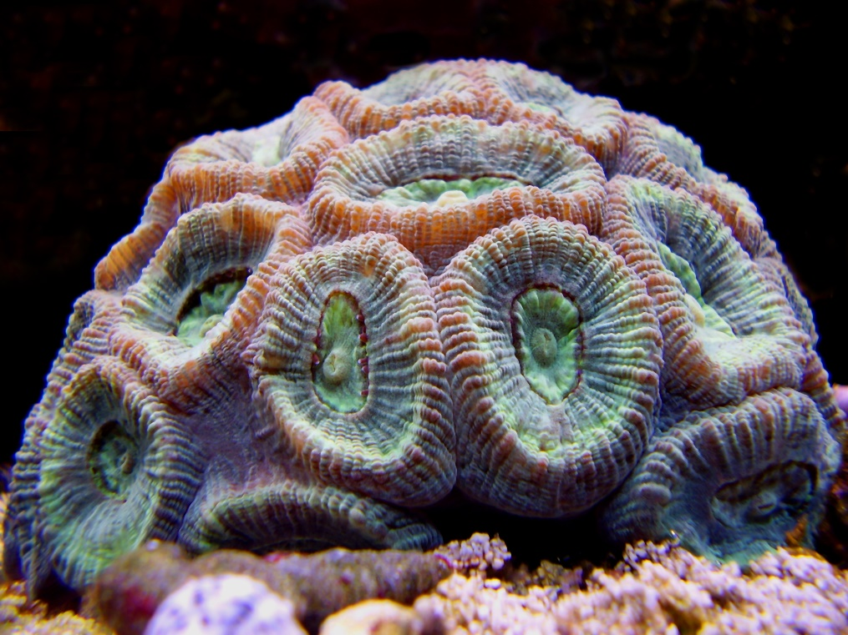
Class Anthozoa
“Anthos” = flower; “zoa” = animals
Corals, sea anemones
Polyp body plan
Watch this video: https://www.youtube.com/watch?v=ysOmq71fcMk
Caption: Closed Brain Coral (c) RevolverOcelet, Public domain

Slide 13
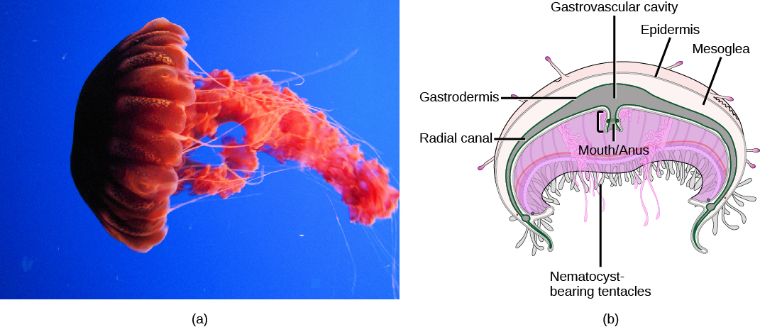
Class Scyphozoa
“scyphos” = cup; “zoa” = animal
Medusa is prominent
“jellies”
Download for free at http://cnx.org/contents/185cbf87-c72e-48f5-b51e-f14f21b5eabd@10.61

Slide 14
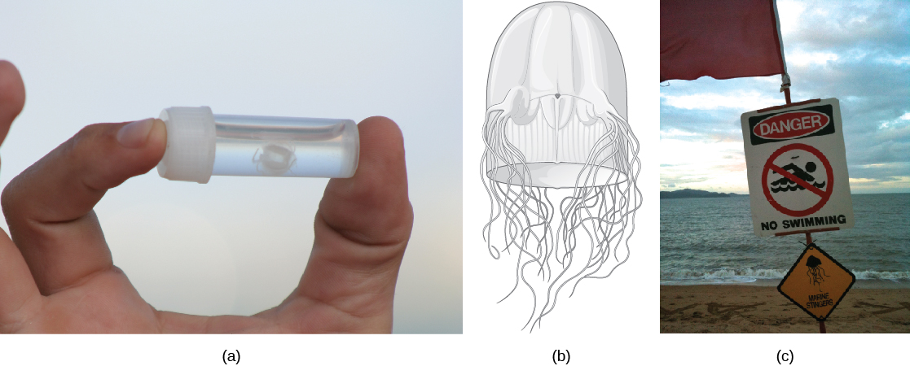
Class Cubozoa
Box shaped medusa – “box jellies”
Most dangerous of all the cnidarians
Download for free at http://cnx.org/contents/185cbf87-c72e-48f5-b51e-f14f21b5eabd@10.61

Slide 15
Class Hydrozoa
Both polyp and medusa forms
Includes Hydra and Portuguese-man-of-war
Download for free at http://cnx.org/contents/185cbf87-c72e-48f5-b51e-f14f21b5eabd@10.61

Slide 16
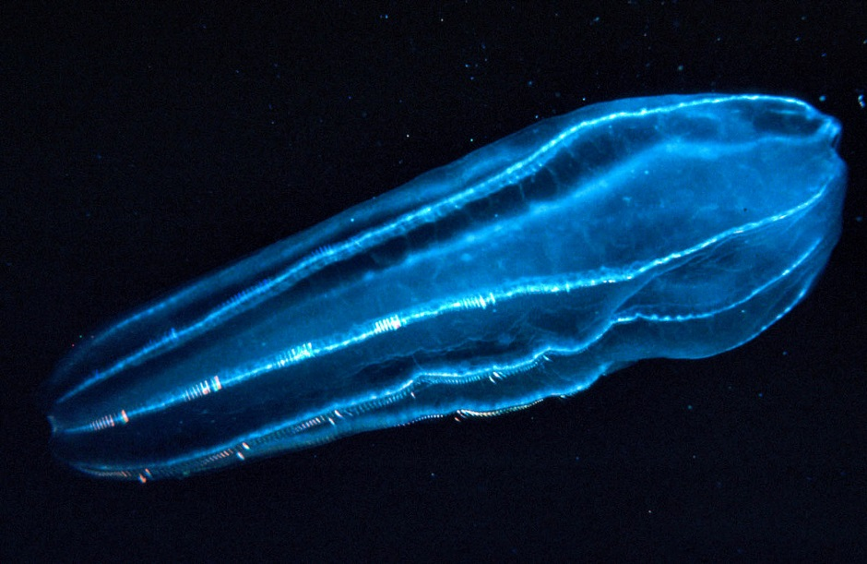
Phylum Ctenophora
“comb-bearers”
Ctenophores (comb jellies) are also diploblastic and have radial symmetry
They do not have cnidocytes like the cnidarians
They also have a complete gut
Caption: Zooplankton2300 (c) Shane Anderson, Public domain

Slide 17
Now we move onto the Bilateral animals
Have bilateral symmetry
Triploblastic – ectoderm, mesoderm, endoderm
3 groups –
Platyhelminthes – acoelomates
Protostomes - coelomates
Lophotrochozoans (sometimes Platyhelminthes lumped into this group)
Ecdysozoans
Deuterostomes - coelomates
Echinoderms
Chordates

Slide 18
Phylum Platyhelminthes
The Platyhelminthes are the flatworms
Have a gastrovascular cavity – do not have complete gut
Hermaphroditic
Flame cells – primitive excretory system
Some are free-living, some are parasitic
Start to see development of cephalization in the animals
Head region where sensory organs are congregated

Slide 19
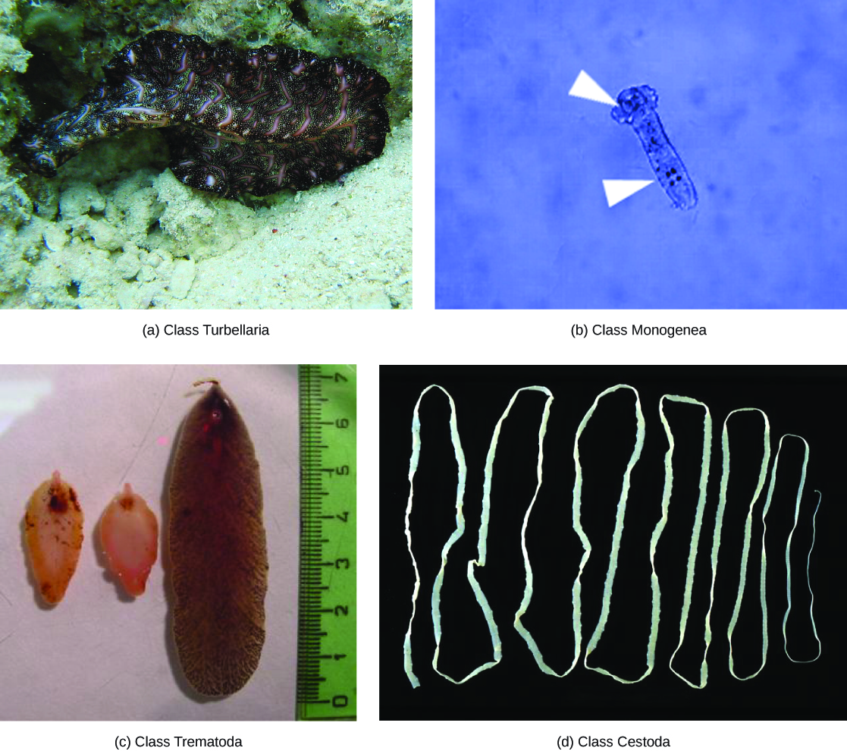
Phylum Platyhelminthes
Class Turbellaria – planaria
Class Trematoda – flukes
Class Cestoda – tapeworms
Download for free at http://cnx.org/contents/185cbf87-c72e-48f5-b51e-f14f21b5eabd@10.61

Slide 20
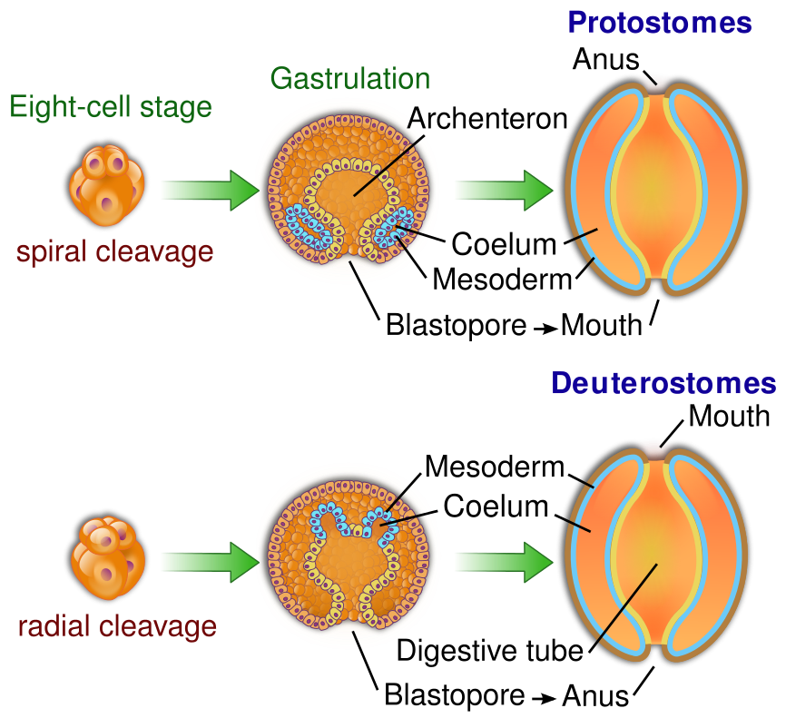
Protostomes
During embryological development, a blastopore will start to develop in the blastula
Caption: protovsdeuterostomes (c) YassinMrabet, Public domain

Slide 21
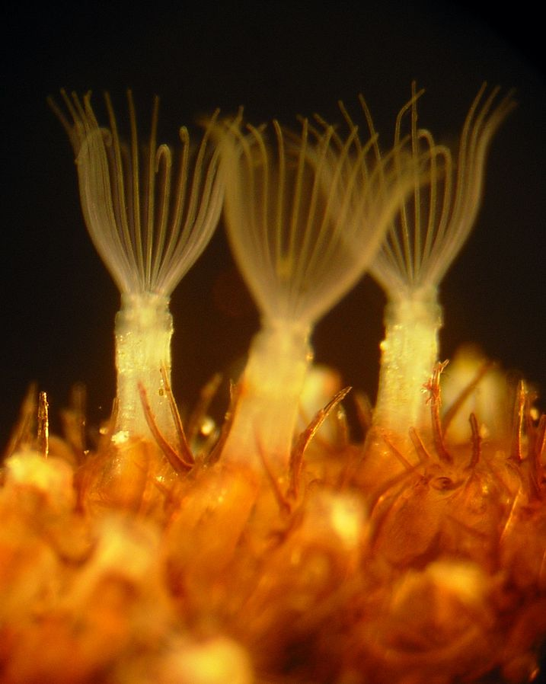
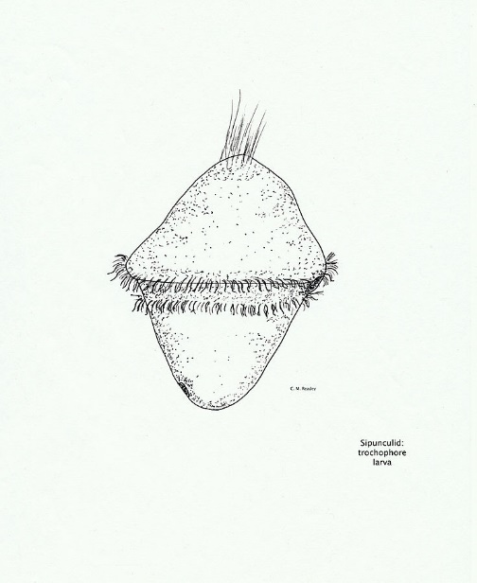
Protostomes Superphylum Lophotrochozoa
A lot of the lophotrochozoans have a lophophore
Used to filter feed and used in gas exchange
A lot have a larval form called a trochophore larvae
Caption: Flustrellidra hispida 2090a (c) Arruz, Public domain
Caption: Spinuculid Trochophore Larvae (c) M Ready, Public domain

Slide 22
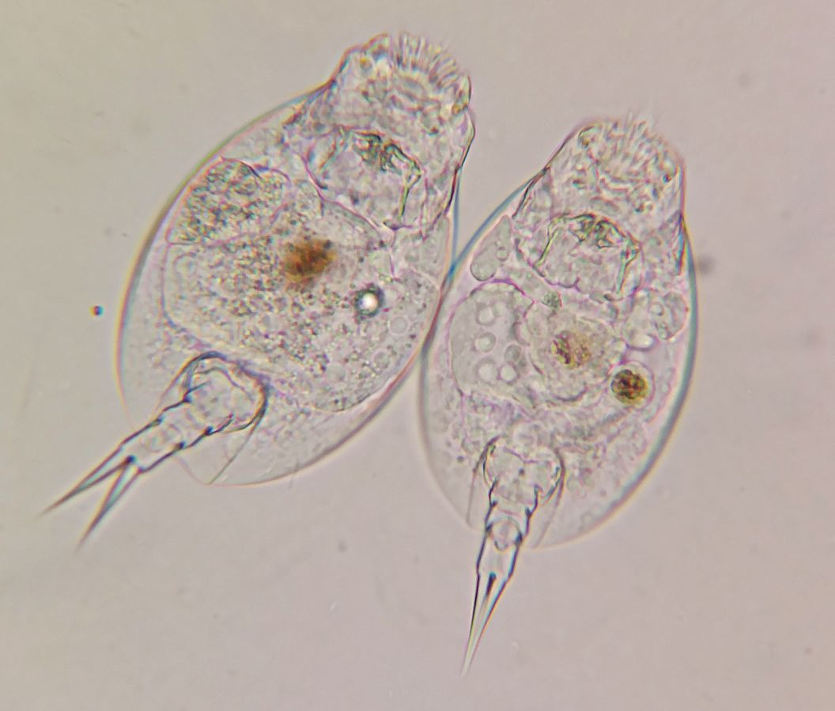
Protostomes Superphylum Lophotrochozoa
Phylum Rotifera
Microscopic animals – part of the zooplankton
Caption: Pair of Rotifers, likely Euchlanis, from Northeast US Pond sample (c) Matthew A Robinson, Public domain

Slide 23
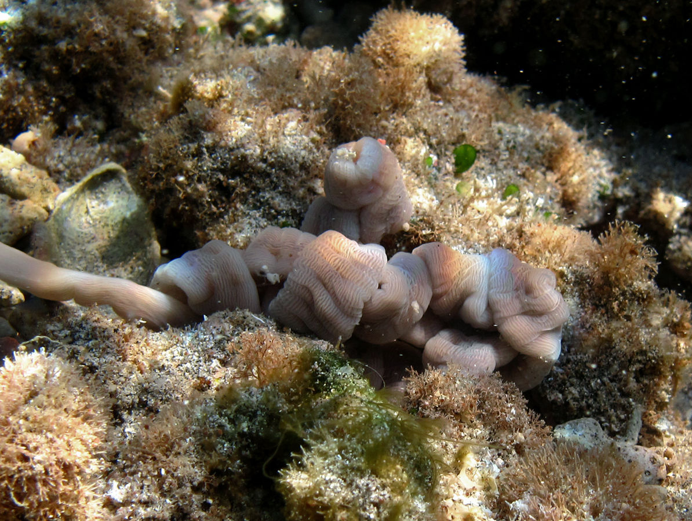
Protostomes Superphylum Lophotrochozoan
Phylum Nemertea- ribbon worms
Named after Greek sea-nymph Nemertes
Watch this video: https://www.youtube.com/watch?v=55wChToy5fM
Caption: Nemertea Reunion (c) Philippe Bourjon, Public domain

Slide 24
Protostomes Superphylum Lophotrochozoa
Phylum Mollusca
Latin “mollis” = soft bodied
Predominantly marine
Body plan: mantle (secretes shell), muscular foot, visceral mass (where the organs are)
Complete digestive system
Have gills for respiration
Open circulatory system (except for the cephalopods that have a closed circulatory system)

Slide 25
Phylum Mollusca
Class Polyplacophora
Class Gastropoda
Class Bivalvia
Class Cephalopoda

Slide 26
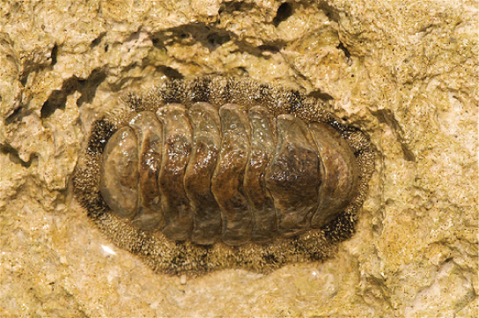
Class Polyplacophora
Many plates
Have a radula to scrap algae off rocks
Download for free at http://cnx.org/contents/185cbf87-c72e-48f5-b51e-f14f21b5eabd@10.61

Slide 27
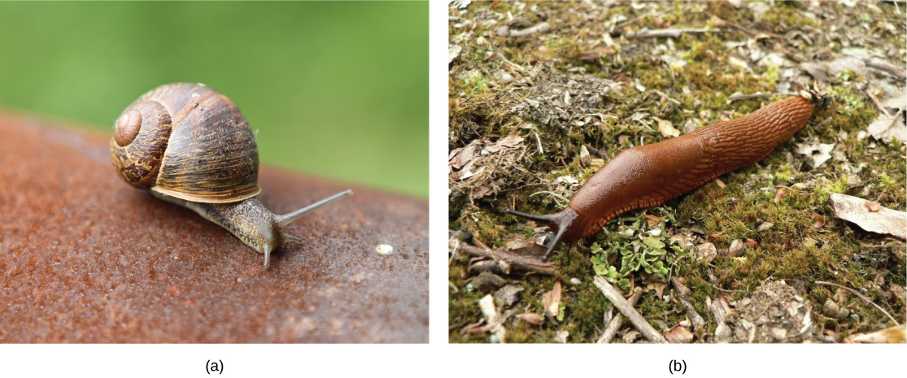
Class Gastropoda
Greek “gastros” = stomach; “podas” = foot
Snails, slugs (slugs don’t have a shell), conchs, nudibranchs
Download for free at http://cnx.org/contents/185cbf87-c72e-48f5-b51e-f14f21b5eabd@10.61

Slide 28
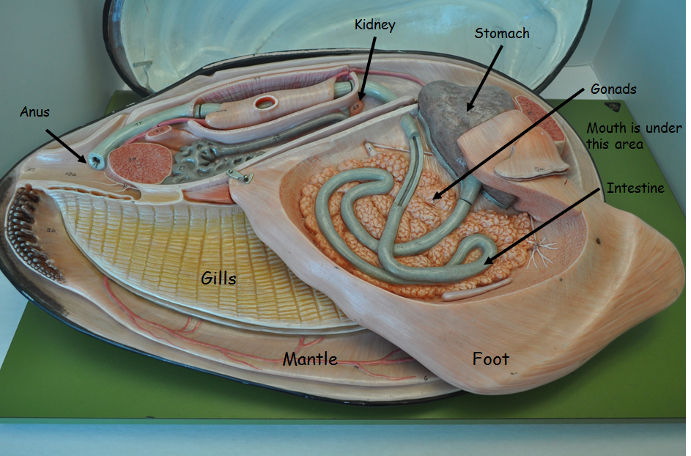
Class Bivalvia
Clams, oysters, scallops

Slide 29
Class Cephalopoda – “head-foot”
Octopus, squid, nautilus
Most unique group of molluscs
Closed circulatory system
“intelligent” group of invertebrates
Watch this video: https://www.youtube.com/watch?v=S0Bal56bF2E
Download for free at http://cnx.org/contents/185cbf87-c72e-48f5-b51e-f14f21b5eabd@10.61

Slide 30
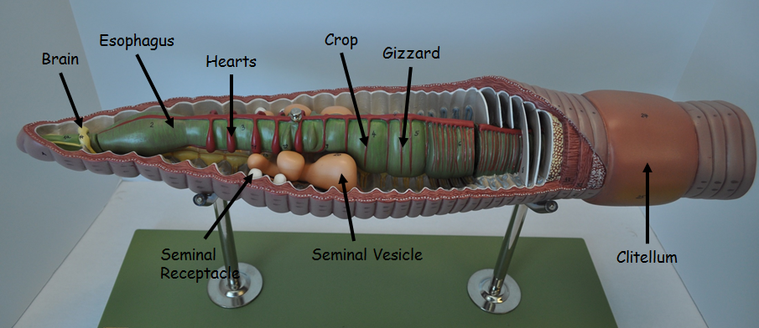
Protostomes Superphylum Lophotrochozoa
Phylum Annelida
Latin “annulus” = little ring
Segmented worms – repeated body segments
Most advanced worms
Complete digestive system
Closed circulatory system

Slide 31
Phylum Annelida
Class Oligiochaeta – earthworm
Latin “oligos” = few, “chaeta” = bristles
Class Hirudinea – leeches
Latin “hirudo” = leech
Class Polychaeta – marine worms
Download for free at http://cnx.org/contents/185cbf87-c72e-48f5-b51e-f14f21b5eabd@10.61

Slide 32
Protostome Superphylum Ecdysozoa
Superphylum Ecdysozoa
Huge group of animals
Includes the Arthropods and Nematodes
External covering called cuticle that molts - ecdysis

Slide 33
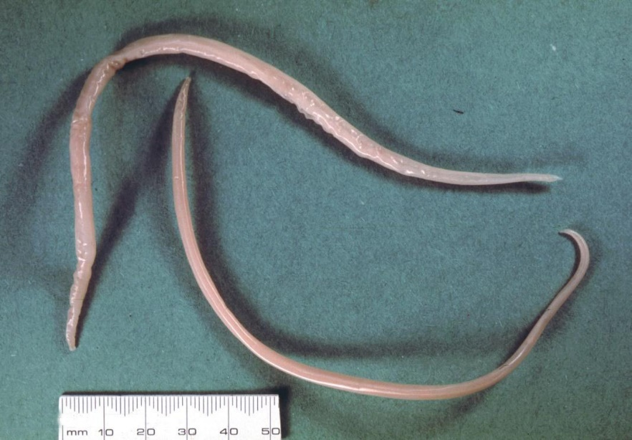
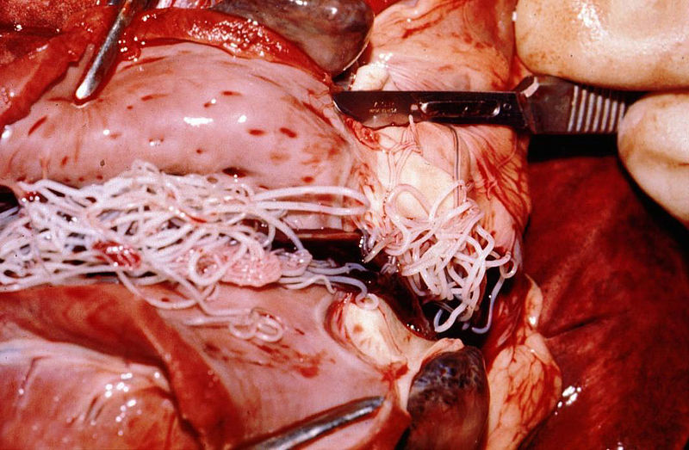
Protostome Superphylum Ecdysozoa
Phylum Nematoda
Greek “nematos” = thread
“pseudocoelomates”
Many are parasitic (complex life cycles)
Why are C elegans used for research? – watch this video: https://www.youtube.com/watch?v=ADiGY5jyNmk
Caption: Asaris-suum (c) Alan Walker, Public domain
Caption:Dirofilaria-immitis-dog-heart (c) Alan Walker, Public domain

Slide 34
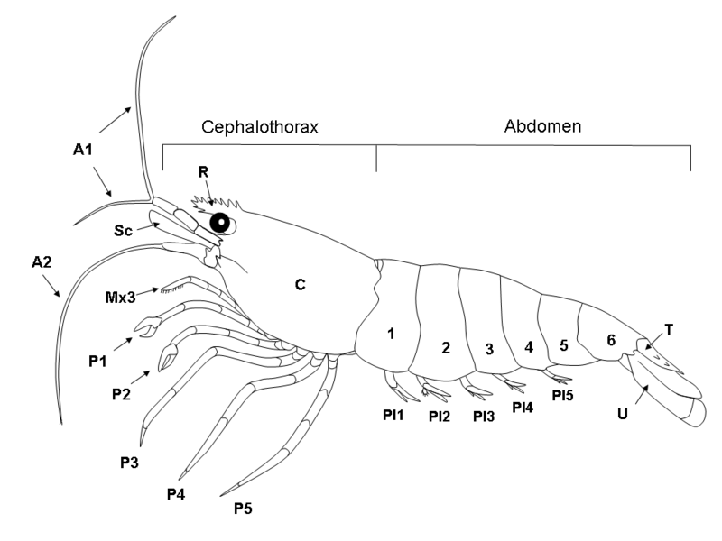
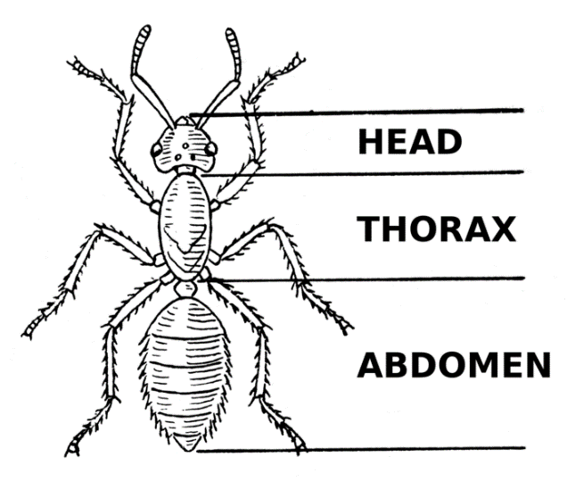
Protostome Superphylum Ecdysozoa
Phylum Arthropoda
Greek “artho” = jointed; “poda” = legs
This group dominates the animal kingdom
Exoskeleton made of chitin
Have muscles that are attached to exoskeleton
Open circulatory system
Hemocoel – cavity containing organs
Respiration:
Gills found in crustaceans
Tracheae (tubes) in insects
Caption: Abdomen (c) Foresman, Public domain
Caption: Anatomy of a Shrimp 2 (c) JCD, Public domain

Slide 35
Phylum Arthropoda
Subphylum Hexapoda
Subphylum Myriapoda
Subphylum Crustacea
Subphylum Chelicerata

Slide 36
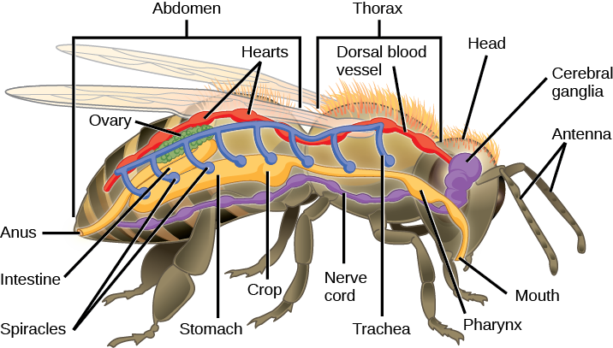
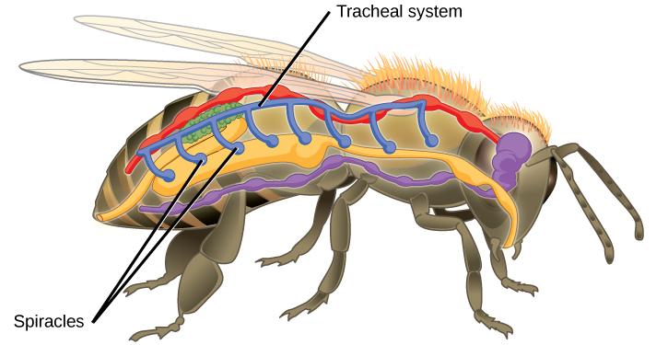
Protostome Superphylum Ecdysozoa
Phylum Arthropoda
Subphylum Hexapoda – 6 legs, includes the insects
Respiration – openings (spiracles) in exoskeleton lead to tubes (tracheae) that branch through body
Download for free at http://cnx.org/contents/185cbf87-c72e-48f5-b51e-f14f21b5eabd@10.61

Slide 37
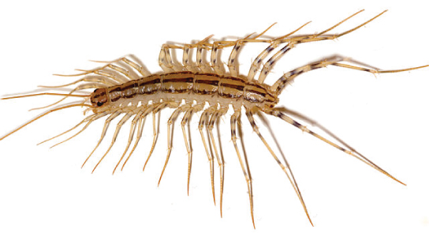
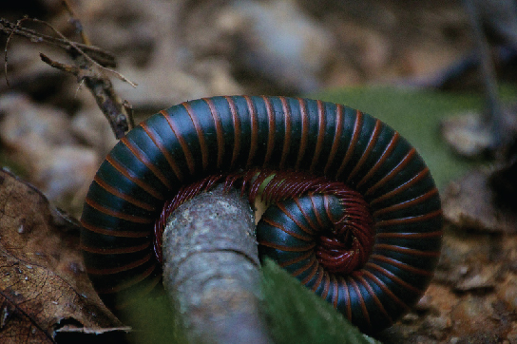
Protostome Superphylum Ecdysozoa
Phylum Arthropoda
Subphylum Myriapoda (Greek “murias” = thousand)
Chilopods – centipedes (1 set of legs per segment)
carnivores
Diplopoda – millipedes (2 sets of legs per segment)
herbivores
Download for free at http://cnx.org/contents/185cbf87-c72e-48f5-b51e-f14f21b5eabd@10.61

Slide 38
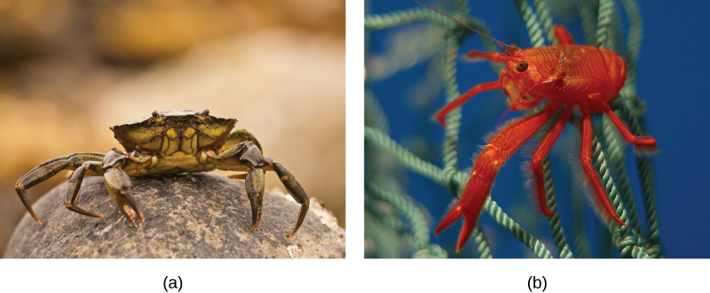
Protostome Superphylum Ecdysozoa
Phylum Arthropoda
Subphylum Crustacea
Mostly aquatic
Respiration – gills
Covering is referred to as a carapace
Download for free at http://cnx.org/contents/185cbf87-c72e-48f5-b51e-f14f21b5eabd@10.61

Slide 39
Subphylum Crustacea
Giant isopod – watch this video: https://www.youtube.com/watch?v=L5lrbcLX_rw
Largest land crab: https://www.youtube.com/watch?v=Z_mq_63fEdI
Larval form in this group is mainly the naupilus larvae
Download for free at http://cnx.org/contents/185cbf87-c72e-48f5-b51e-f14f21b5eabd@10.61

Slide 40
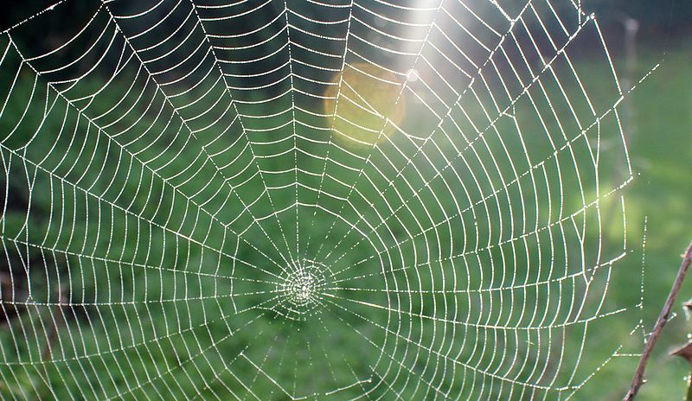
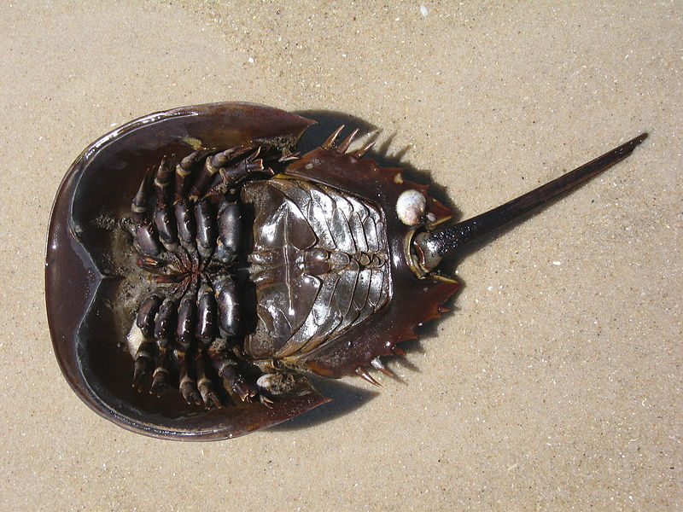
Protostome Superphylum Ecdysozoa
Phylum Arthropoda
Subphylum Chelicerata – spiders, horseshoe crabs
Chelicerae – claw-like or fang-like mouth parts
Caption: Spider Web (c) vastateparkstaff, Public domain
Caption: The horseshoe crab looks like Darth Vader (c) Adam Sofen, Public domain

Slide 41
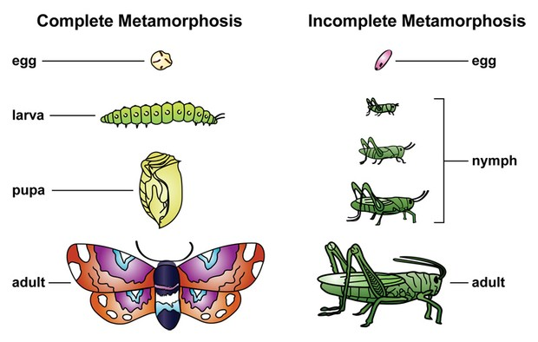

Slide 42
Up until this point, we’ve talked about the protostome animals
We will now talk about the deuterostome animals
Deuterostomes
Echinoderms
Chordates
This chapter only deals with the invertebrate chordates
The next chapter will deal with the Vertebrates

Slide 43
Deuterostome Phylum Echinodermata
Phylum Echinodermata
Echino – “spiny”, derma – “skin”
Adult echinoderms exhibit pentaradial symmetry
Larval forms have bilateral symmetry
Capable of regeneration
Water vascular system
Up until this point, we’ve seen further development of cephalization in the animals, but the Echinoderms lack a head region
Do have a nerve ring

Slide 44
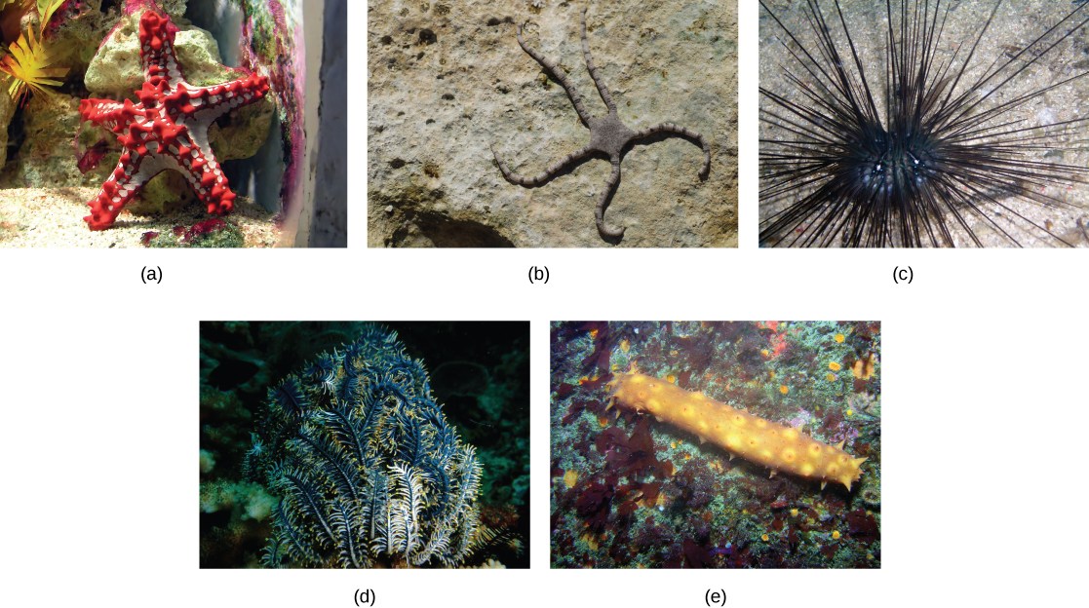
Phylum Echinodermata
Class Asteroidea – Sea Star
Class Ophiuroidea – brittle stars
Greek “ophis” = snake
Class Echinoidea – sea urchins, sand dollars
Class Crinoidea – sea lilies
Greek “krinon” = lillies
Class Holothuroidea – sea cucumbers
Download for free at http://cnx.org/contents/185cbf87-c72e-48f5-b51e-f14f21b5eabd@10.61

Slide 45
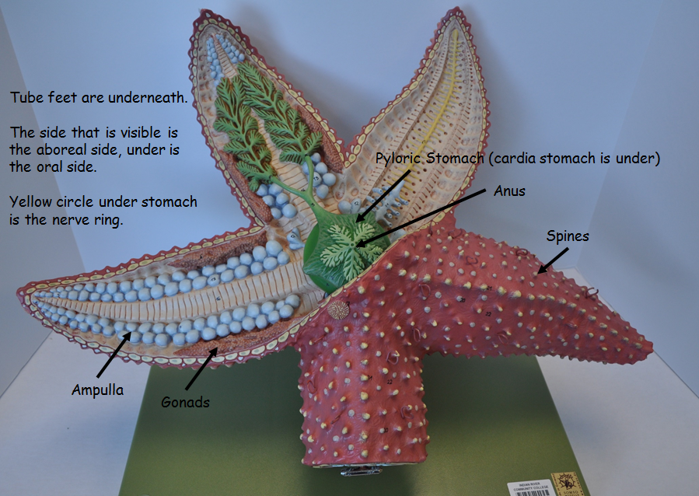

Slide 46
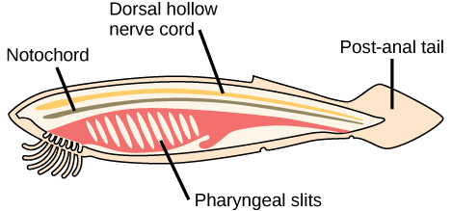
Deuterostomes Phylum Chordata
Phylum Chordata
All chordates possess the following characteristics at some point during their life cycle. Some of these traits might only be present during embryological development:
Dorsal hollow nerve cord
Notochord
Post anal tail
Pharyngeal gill slits
Download for free at http://cnx.org/contents/185cbf87-c72e-48f5-b51e-f14f21b5eabd@10.61

Slide 47
Phylum Chordata
Subphylum Urochordata – invertebrates
Subphylum Cephalochordata - invertebrates
Subphylum Vertebrata

Slide 48
Deuterostome Phylum Chordata
Subphylum Urochordata – tunicates
Larvae resembles tadpole
Download for free at http://cnx.org/contents/185cbf87-c72e-48f5-b51e-f14f21b5eabd@10.61

Slide 49
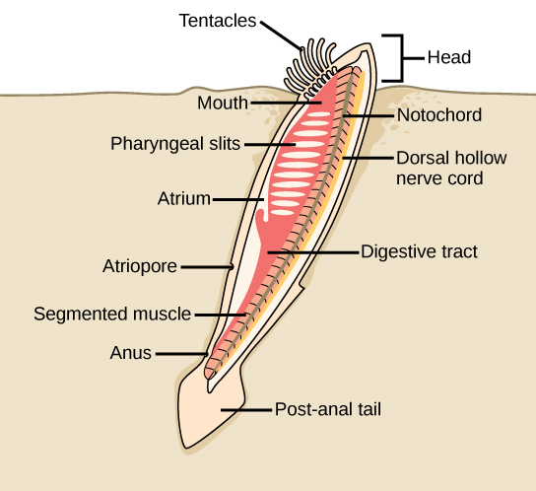
Deuterostome Phylum Chordata
Subphylum Cephalochordata – lancelets
Small filter feeders, bury in substrate

Slide 50
The next chapter will deal with the Vertebrate animals
For a summary of how evolution took animals from invertebrate to vertebrate life, watch this: https://www.youtube.com/watch?v=pmPZNtCZmWI

Slide 52
