Slide 1
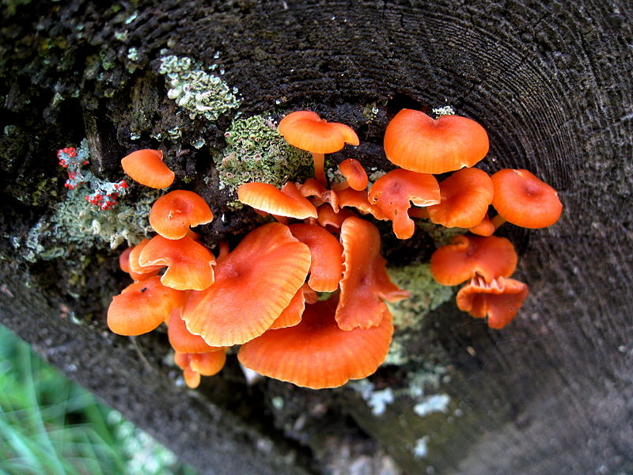
Chapter 24 Fungi
General Biology II
BSC 2011
Dr. Capers
Insert photo here representing
chapter
Caption: Group of orange fungi photographed at the King's Landing Historical Settlement in Prince William, New Brunswick, Canada. (c) M Kubica, Public domain
OpenStax Biology - https://openstax.org/details/books/biology,
PowerPoint made by Dr. Capers - www.jcapers-irsc.weebly.com

Slide 2
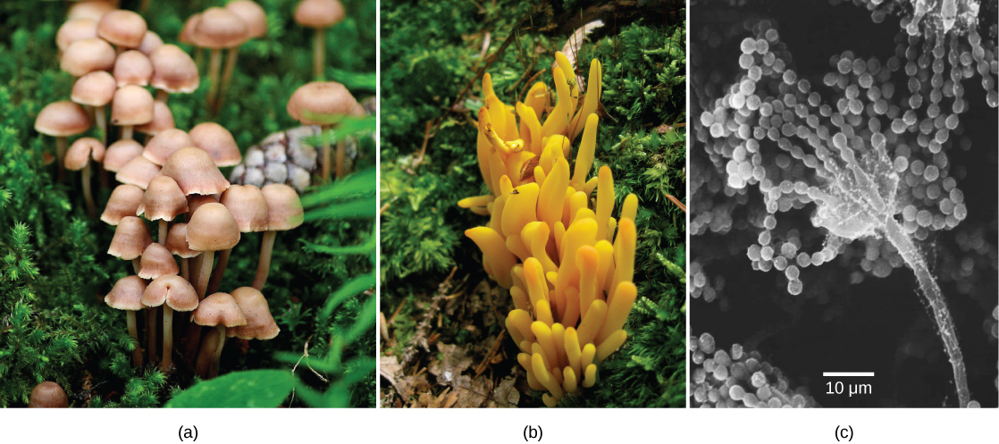
Fungi
More closely related to animals than plants
Heterotrophic
Cell wall is made of chitin
Most cells are nonmotile
Most fungi are multicellular
Yeasts are unicellular
Download for free at http://cnx.org/contents/185cbf87-c72e-48f5-b51e-f14f21b5eabd@10.61

Slide 3
Fungal Nutrition
Fungi are heterotrophs
Release enzymes into the environment and absorb nutrients
Saprobes – obtain their nutrients from dead or decaying material
Some fungi are parasitic

Slide 4
Download for free at http://cnx.org/contents/185cbf87-c72e-48f5-b51e-f14f21b5eabd@10.61
Caption: Mycelium (c) Rob Hille, Public domain

Slide 5
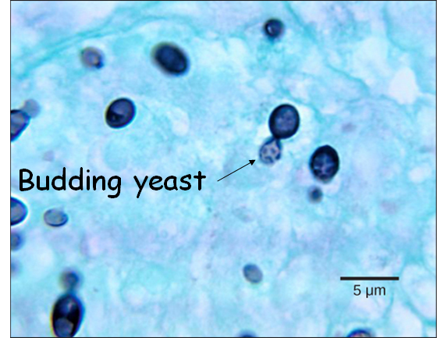
Fungal Reproduction
Fungi reproduce sexually and/or asexually. “Perfect” fungi reproduce both sexually and asexually
Asexual Reproduction
Fragmentation (hyphae and fragment off and grow elsewhere), budding, or producing asexual spores

Slide 6
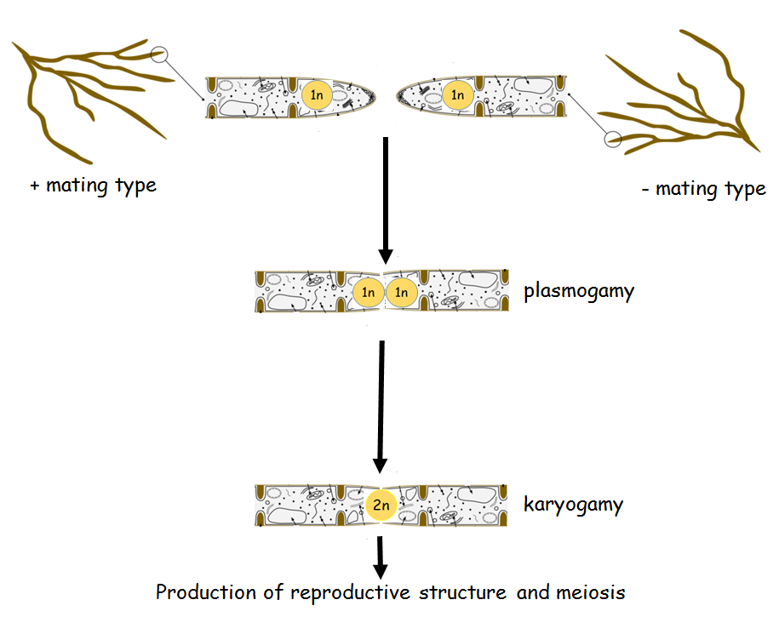
Sexual Reproduction

Slide 7
Classification of Fungi
Chytridiomycota – Chytrids
Simplest and most primitive fungi
Have cellulose as well as chitin in the cell wall
Some live in aquatic environments
One species causes skin infection on amphibians

Slide 8
Classification of Fungi
Zygomycota
Includes bread molds, includes Rhizopus
Spores:
Asexual – sporangiospores
Sexual - zygospores

Slide 9
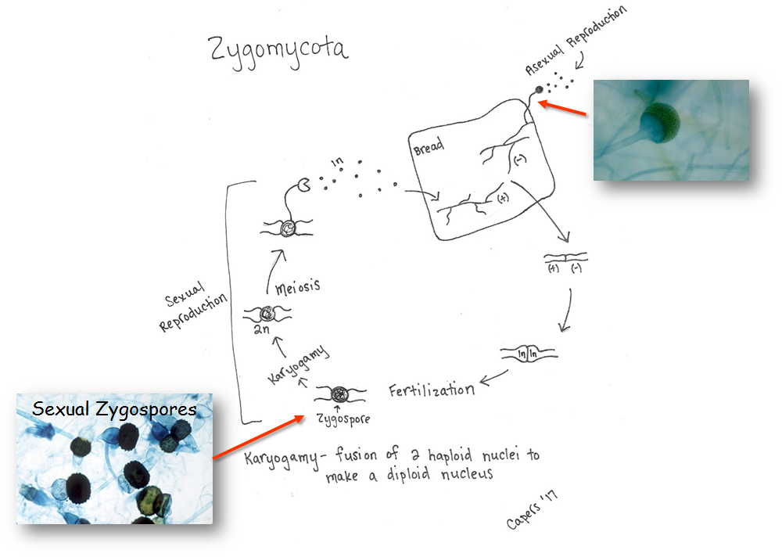
Caption: Light micrograph of a whole-mount slide of zygospores of Rhizopus (c) Curtis Clark, Public domain
Caption: Zygomycota sporangia (c) Kristi Yim, Public domain

Slide 10
Classification of Fungi
Basidiomycota – club fungi
Mushrooms, puffballs, shelf fungus, Coprinus
Spores:
Asexual – some have asexual reproduction (used to be in Deuteromycota)
Sexual - basidiospores

Slide 11
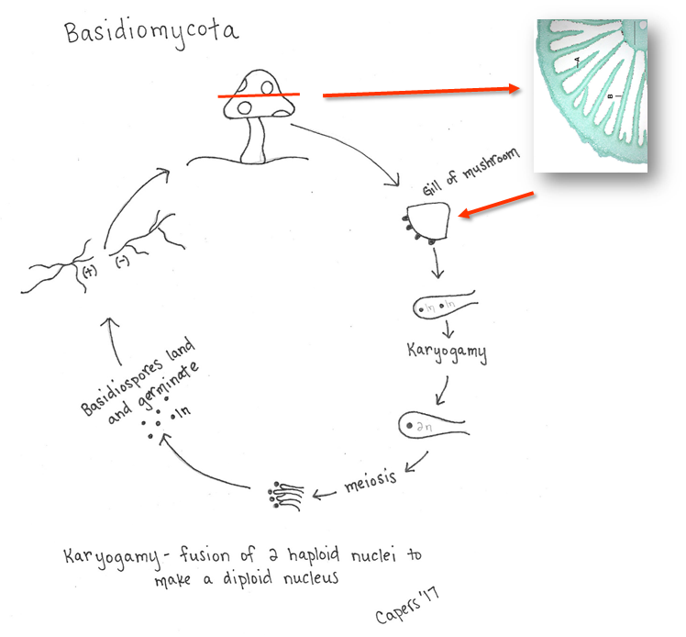
Caption: Light microscopy of Coprinus showing a sectional view of the mushroom Coprinus where the gills can be seen with basidiospores lining the gills. A=Gill, B=Basiospore. Scale bar = 0.3mm.
(c) Jon Houseman, Public domain

Slide 12
Classification of Fungi
Ascomycota – sac fungi
Largest group of fungi
Includes yeasts, truffles, morels
Some parasitize plants
Spores:
Asexual – conidiospores
Sexual - ascospores
Ascus – sac-like structure that produces haploid spores

Slide 13
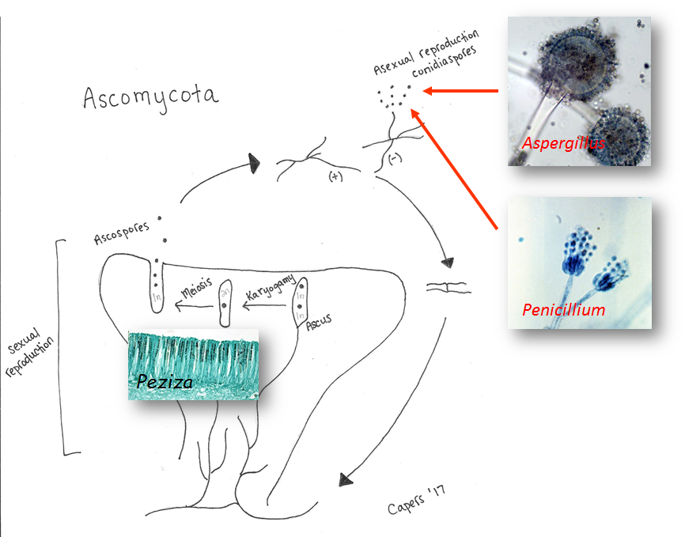
Caption: Light microscopy of Peziza showing the hymenial layer with the ascus on the ascocarp mycelium and the ascospores can be seen within the ascus. (c) Jan Houseman, Public domain
Caption: fungi in microscope (c) Jan Houseman, Public domain
Caption: Magnified at 1200x, this 1971 photomicrograph depicted two conidiophores of a Penicillium glabrum fungus. The fungal conidiophore is a stalk (c) Lucille Georg, Public domain

Slide 14
Classification of Fungi
Asexual fungi – Imperfect Fungi
Used to be phylum Deuteromycota
Molecular evidence shows these might be Ascomycota and Basidiomycota
Hyphae give “fuzzy” appearance, commonly known as mold
Includes Aspergillus and Penicillium
Look at Ascomycota life cycle figure

Slide 15
Classification of Fungi
Glomeromycota
New phylum
Close association with roots of plants
Arbuscular Mycorrhizae (endomycorrhizae) and Ectomycorrhizae
Carbon supplied to fungus by plant, fungus helps the plant to uptake minerals from the soil
80-90% of all plants have this symbiotic relationship
Caption: Biologische Schemata, gezeichnet und freigegeben von M. Piepenbring (c) M. Piepenbring, Public domain

Slide 16
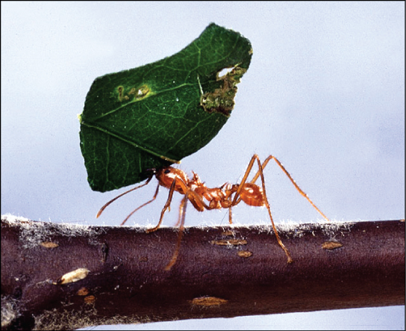
Ecology of Fungi
Important decomposers
Mutualistic relationships
Fungus/Plant mutualism - Mycorrhizae
Fungus/Animal mutualism
Some fungi mycelium can protect insect colonies
Leaf cutting ants – cut leaves and pile them, cultivate fungi that breakdown the cellulose to a point where the ants can consume the sugars
Parasitic relationships
Diseases in plants
Diseases in animals
Lichens
Symbiotic relationship between fungus and cyanobacteria (bacteria that photosynthesizes)
Download for free at http://cnx.org/contents/185cbf87-c72e-48f5-b51e-f14f21b5eabd@10.61

Slide 17
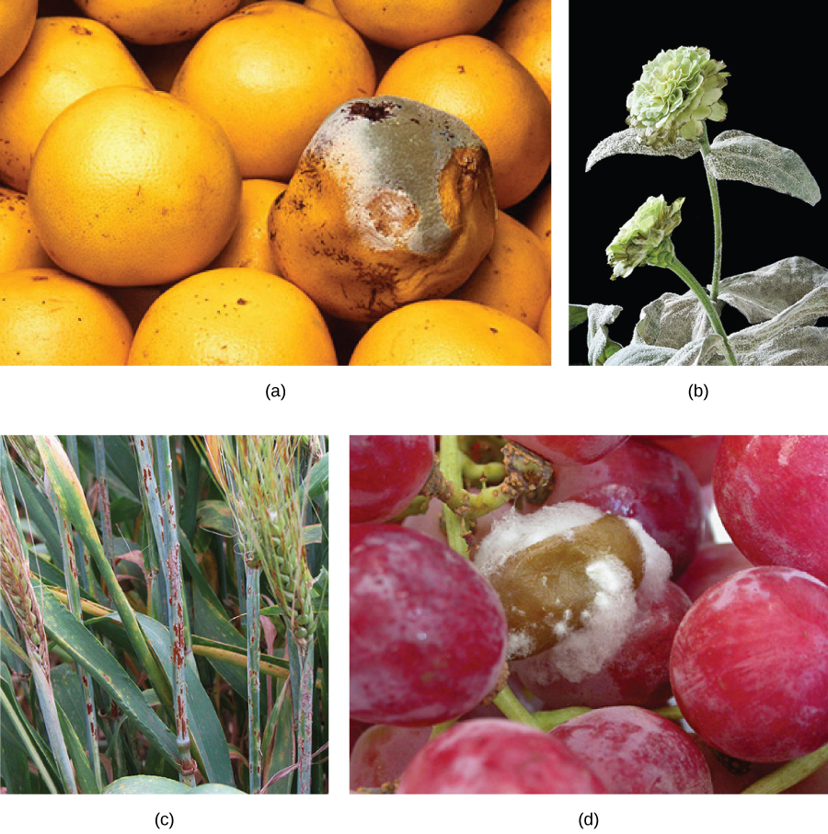
Fungal Parasites and Pathogens
Plant pathogens
Crops can be decimated by fungal infections
Animal Pathogens
Most fungal infections in humans are more of a nuisance
Ringworm, athlete’s foot, yeast infections
More serious disease in immunocompromised individuals
Toxins from mushrooms can be fatal
Download for free at http://cnx.org/contents/185cbf87-c72e-48f5-b51e-f14f21b5eabd@10.61

Slide 18
Importance of Fungi in Human Life
Fungi that infect insects help control insect populations
Production of antibiotics
Edible mushrooms
Some fungi involved in production of food: cheese, bread, beer (fermentation)
As simple eukaryotic organisms, fungi are important research models

