Slide 1
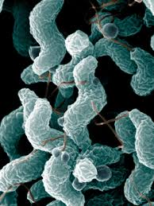
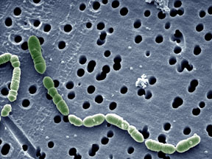
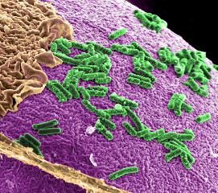
Chapter 22
Prokaryotes: Bacteria and Archaea
General Biology II (BSC 2011)
Dr. Capers
Caption: Oenococcus oeni (c)Got-commonswiki, Public domain
Caption: Campylobacter bacteria
as seen from an electron
microscope (c)De Wood, Public domain
Caption: Improving Human Intestinal Health (c)Pacific Northwest National Laboratory, Public domain
OpenStax Biology - https://openstax.org/details/books/biology,
PowerPoint made by Dr. Capers - www.jcapers-irsc.weebly.com

Slide 2
History of Microbiology
The size of prokaryotic cells led to their being undiscovered for most of human history.
In 1546, Italian physician Girolamo Fracastoro suggested that disease was caused by unseen organisms.
Two technology strands that allows study of microbes:
Microscopy for visualization
Infectious disease investigations

Slide 3
Antony van Leeuwenhoek was first to observe and accurately describe microbial life
Modern electron microscopes allowed the study of cell substructure
Louis Pasteur refuted idea of spontaneous generation

Slide 4
Robert Koch studied anthrax (causative agent is Bacillus anthracis) and proposed four postulates to prove a causal relationship between a microorganism and an individual:
The microorganism must be present in every case of
the disease and absent from healthy individuals.
2. The putative causative agent must be isolated and grown in pure culture.
3. The same disease must result when the cultured microorganism is used to infect a healthy host.
4. The same microorganism must be isolated again from the diseased host.

Slide 5
Prokaryotic Diversity
Oldest, structurally simplest, and most abundant forms of life.
Abundant for over a billion years before eukaryotes.
90 to 99% unknown and undescribed
Less than 1% cause disease
Fall into 2 domains
Bacteria (also called Eubacteria)
Archaea (formerly called Archaebacteria)
Many Archaeans are extremophiles (live in extreme environments)

Slide 6
Download for free at http://cnx.org/contents/185cbf87-c72e-48f5-b51e-f14f21b5eabd@10.61
Credit: modification of work by Jon Sullivan
The Morning Glory pool, a hot spring in Yellowstone National Park. The spring’s vivid blue color is from the prokaryotes that thrive in it’s very hot waters.
Certain prokaryotes can live in this extreme environment.

Slide 7
Download for free at http://cnx.org/contents/185cbf87-c72e-48f5-b51e-f14f21b5eabd@10.61
Credit a: Julien Menichini; credit b: NASA; scale-bar data from Matt Russell
The Dead Sea is hypersaline. Nevertheless, salt-tolerant bacteria thrive in this sea.
These halobacteria (salt-loving bacteria) cells can form salt-tolerant bacterial mats.

Slide 8
Prokaryotes differ from Eukaryotes
Unicellularity
Prokaryotes are single-celled
Only eukaryotic cells can be multicellular
Prokaryotes may stick together to form associations and biofilms
Cell size
Size varies tremendously but are generally much smaller than eukaryotes
Most prokaryotes are less than 1 mm in diameter
Nucleoid
Prokaryotic chromosome is single, circular, double-stranded DNA
Found in the nucleoid region of the cell
Often have plasmids
Cell division and genetic recombination
Most divide by binary fission, don’t go through mitosis process that eukaryotes do
Exchange genetic material extensively

Slide 9
Prokaryotes differ from Eukaryotes
Genetic recombination
Occurs through horizontal gene transfer, no sexual reproduction
NOT a form of reproduction
Internal compartmentalization
Prokaryotes have no membrane-bounded organelles
No internal compartment
Ribosomes differ from eukaryotic form
Flagella
Simple in structure
Different from eukaryotic flagella
Metabolic diversity
Oxygenic and anoxygenic photosynthesis
Chemolithotrophic
They can use energy stored in bonds of inorganic molecules

Slide 10
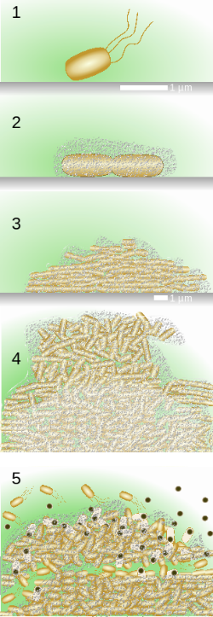
Stage 1, initial attachment, bacteria adhere to a solid surface via weak van der Waals interactions.
Stage 2, irreversible attachment, hairlike appendages called pili permanently anchor the bacteria to the surface.
Stage 3, maturation I, the biofilm grows through cell division and recruitment of other bacteria. An extracellular matrix composed primarily of polysaccharides holds the biofilm together.
Stage 4, maturation II, the biofilm continues to grow and takes on a more complex shape.
Stage 5, dispersal, the biofilm matrix is partly broken down, allowing some bacteria to escape and colonize another surface.
Caption: Biofilm Growth (c)Asw-hamburg, Public domain

Slide 11
Bacteria and Archaea Differ Fundamentally
They differ in four key areas:
Plasma membranes
Cell walls
DNA replication
Gene expression

Slide 12
Bacteria vs. Archaea
Plasma membrane
Bacterial lipids are unbranched
Use ester bonds
Archaean membranes are formed on glycerol skeleton with ether linkages (not ester)
Hydrocarbons may be branched or have rings
Tetraether polymer allows extremophiles to withstand high temperatures
Download for free at http://cnx.org/contents/185cbf87-c72e-48f5-b51e-f14f21b5eabd@10.61

Slide 13
Bacteria vs. Archaea
Cell wall
Bacteria have peptidoglycan
Archaea lack peptidoglycan
DNA replication
Both have single replication origin
Archaeal DNA replication is more similar to that of eukaryotes
Gene Expression
Archaeal transcription and translation are more similar to those of eukaryotes
Enzymes are similar

Slide 14
Bacteria and Archaea are both prokaryotes but differ enough to be placed in separate domains.
An ancestor of modern Archaea is believed to have given rise to Eukarya, the third domain of life.
Archaeal and bacterial phyla are shown; the evolutionary relationship between these phyla is still open to debate.
Download for free at http://cnx.org/contents/185cbf87-c72e-48f5-b51e-f14f21b5eabd@10.61

Slide 15
Early Classification Characteristics
Relied on staining characteristics and observable phenotypes
Photosynthetic or nonphotosynthetic
Motile or nonmotile
Unicellular, colony-forming, or filamentous
Formation of spores or division by transverse binary fission
Importance as human pathogens or not

Slide 16
Molecular Classification - Newer
Amino acid sequences of key proteins
Percent guanine–cytosine content
Nucleic acid hybridization
Closely related species will have more base pairing
Gene and RNA sequencing
Especially rRNA
Whole-genome sequencing

Slide 17
The features of a typical prokaryotic cell are shown.
Download for free at http://cnx.org/contents/185cbf87-c72e-48f5-b51e-f14f21b5eabd@10.61

Slide 18
Basic bacterial shapes
Prokaryotes fall into three basic categories based on their shape, visualized here using scanning electron microscopy: (a) cocci, or spherical (a pair is shown); (b) bacilli, or rod-shaped; and (c) spirilli, or spiral-shaped.
Download for free at http://cnx.org/contents/185cbf87-c72e-48f5-b51e-f14f21b5eabd@10.61

Slide 19
Based on these molecular data, several prokaryotic groupings have been proposed
Bergey’s Manual of Systematic Bacteriology, 2nd edition
3 of 5 volumes completed
Large scale sequencing of random samples indicates vast majority of bacteria have never been cultured or studied in detail

Slide 20
Major groups of Prokaryotes:
Archaeans – includes groups like Euryarchaeota
Bacteria
Chlamydias
Gram positive bacteria
Low G/C – examples are bacilli, Clostridium
High G/C - example is Streptomyces
Spirochetes
Photosynthetic – example is cyanobacteria
Proteobacteria – examples are E. coli, Pseudomonas, Salmonella

Slide 21
Phylum Proteobacteria is one of five bacterial phyla.
Proteobacteria is further subdivided into five classes, Alpha through Epsilon.
Download for free at http://cnx.org/contents/185cbf87-c72e-48f5-b51e-f14f21b5eabd@10.61

Slide 22
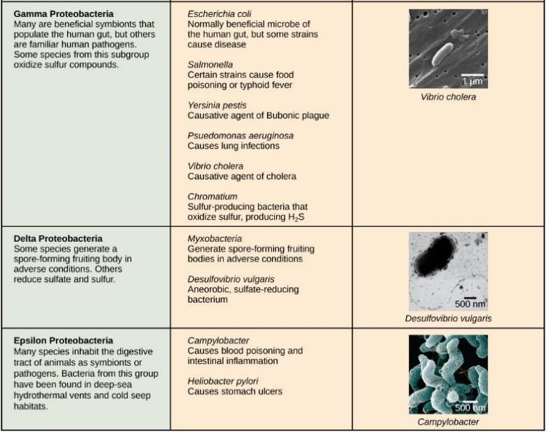
Download for free at http://cnx.org/contents/185cbf87-c72e-48f5-b51e-f14f21b5eabd@10.61

Slide 23
Chlamydia, Spirochetes, Cyanobacteria, and Gram-positive bacteria are described in this table.
Note that bacterial shape is not phylum-dependent; bacteria within a phylum may be cocci, rod, or spiral-shaped.
Download for free at http://cnx.org/contents/185cbf87-c72e-48f5-b51e-f14f21b5eabd@10.61

Slide 24
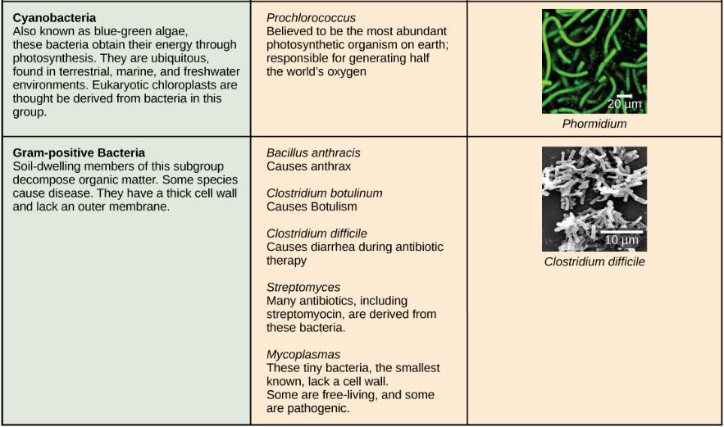
Download for free at http://cnx.org/contents/185cbf87-c72e-48f5-b51e-f14f21b5eabd@10.61

Slide 25
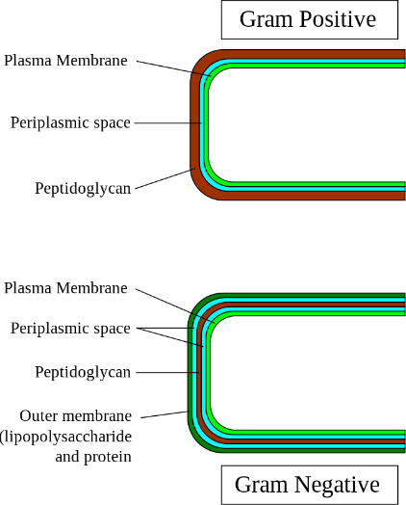
Generally, most species of bacteria are divided into two major groups: Gram positive and Gram negative.
Both groups have a cell wall composed of peptidoglycan: in Gram-positive bacteria, the wall is thick, whereas in Gram-negative bacteria, the wall is thin.
Caption: Gram-cell-wall (c) Graevemoore , Public domain

Slide 26
Cell wall
Peptidoglycan forms a rigid network
Maintains shape
Withstands hypotonic environments
Archaea have a similar molecule
Gram stain
Gram-positive bacteria have a thicker peptidoglycan wall and stain a purple color
Gram-negative bacteria contain less peptidoglycan and do not retain the purple-colored dye – retain counterstain and look pink

Slide 27
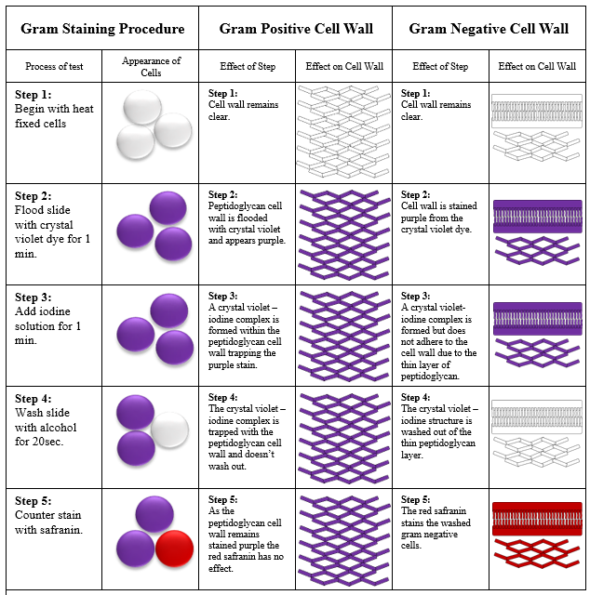
The Gram
Stain Procedure
Caption: Gram Stain Procedure (c)Michigan State University, Public domain

Slide 28
S-layer
Rigid paracrystalline layer found in some bacteria and Archaea
Outside of peptidoglycan or outer membrane layers in gram-negative and gram-positive bacteria
Diverse functions – often involves adhesion
Capsule
Gelatinous layer found in some bacteria
Aids in attachment
Protects from the immune system

Slide 29
Flagella
Slender, rigid, helical structures
Composed of the protein flagellin
Involved in locomotion – spins like propeller
Pili
Short, hairlike structures
Found in gram-negative bacteria
Aid in attachment and conjugation

Slide 30
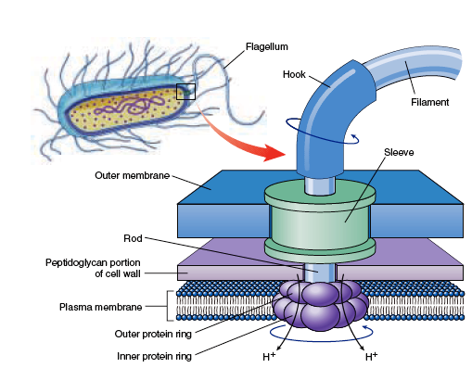
Rotary motion propels the cell
Caption: Flagellum-Beating (c)L. Kohidai, Public domain
Basal body
Caption: Bacterial Flagella (c)biologyexams4u.blogspot.in, Public domain

Slide 31
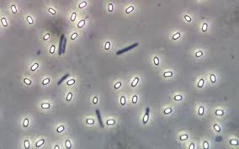
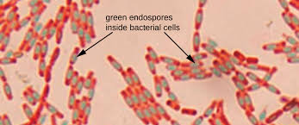
Endospores
Develop a thick wall around their genome and a small portion of the cytoplasm
When exposed to environmental stress
Highly resistant to environmental stress
Especially heat
When conditions improve can germinate and return to normal cell division
Bacteria causing tetanus, botulism, and anthrax
Caption: OSC Microbio 02 04 Endospores (c)CNX OpenStax, Public domain
Caption: Endospore Bazillus (c)Geoman3, Public domain

Slide 32
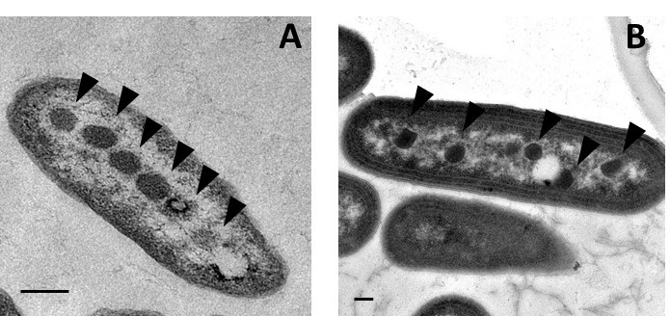
Caption: Electron micrograph of (A) alpha-carboxysomes in Halothiobacillus neapolitanus and (B) beta-carboxysomes in Synechococcus elongatus PCC 7942 (c)Raul Gonzalez and Cheryl Kerfeld, Public domain
Prokaryotic cells often have complex internal membranes
Invaginated regions of plasma membrane
Function in respiration or photosynthesis

Slide 33
Nucleoid region
Contains the single, circular chromosome
May also contain plasmids
Ribosomes
Smaller than those of eukaryotes
Differ in protein and RNA content
Targeted by some antibiotics

Slide 34
Prokaryotic Metabolism
Acquisition of Carbon
Autotrophs – from inorganic CO₂
Photoautotrophs – energy from Sun
Chemolithoautotrophs – energy from oxidizing inorganic substances
Heterotrophs – from organic molecules
Photoheterotrophs – light as energy source but obtain organic carbon made by other organisms
Chemoheterotroph – both carbon atoms and energy from organic molecules
Humans are also an example

Slide 35
Prokaryotic Genetics
Prokaryotes divide by binary fission
Prokaryotes do not reproduce sexually
However, genetic variation is still important
3 types of horizontal gene transfer
Conjugation – cell-to-cell contact
Transduction – by bacteriophages
Transformation – from the environment
All 3 processes also observed in Archaea.

Slide 36
Download for free at http://cnx.org/contents/185cbf87-c72e-48f5-b51e-f14f21b5eabd@10.61
In (a) transformation, the cell takes up prokaryotic DNA directly from the environment. The DNA may remain separate as plasmid DNA or be incorporated into the host genome.
In (b) transduction, a bacteriophage injects DNA into the cell that contains a small fragment of DNA from a different prokaryote.
In (c) conjugation, DNA is transferred from one cell to another via a pilus that connects the two cells.

Slide 37
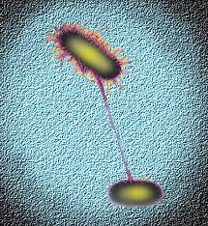
Conjugation
Plasmids may encode advantageous info
Are not required for normal function
In E. coli, conjugation is based on the presence of the F plasmid (fertility factor)
F⁺ cells contain the plasmid
F⁻ cells do not
Caption: Bacterial Conjugation (c)AJC1, Public domain

Slide 38
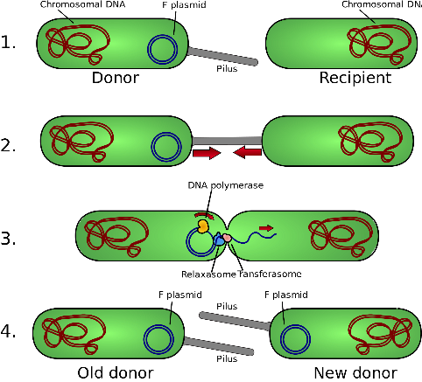
F⁺ cell produces F pilus that connects it to F⁻ cell
Transfer of F plasmid occurs through conjugation bridge
F plasmid copied through rolling circle replication
The end result is two F⁺ cells
The F plasmid can integrate into bacterial chromosome
Caption: Conjugation (c)Adenosine, Public domain

Slide 39
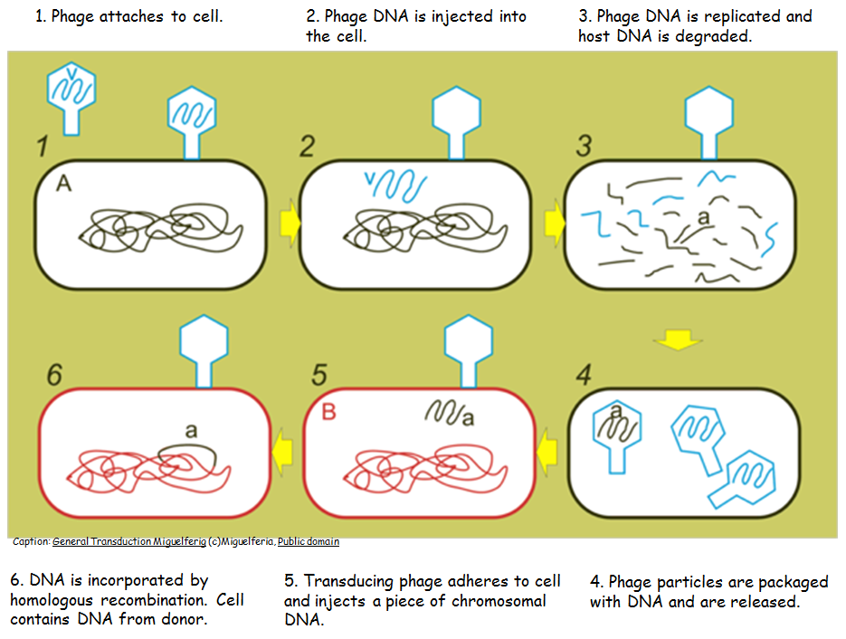
Transduction – by bacteriophages

Slide 40
Transformation
Natural transformation
Occurs in many bacterial species
DNA that is released from a dead cell is picked up by another live cell
Proteins involved in transformation are encoded by bacterial chromosome
Not an accident like plasmid or phage biology

Slide 41
Caption: Artificial Bacterial Transformation (c)Amunroe13, Public domain
Artificial transformation
Some species do not naturally undergo transformation
Accomplished in the lab
Used to transform E. coli for molecular cloning

Slide 42
R (resistance) plasmids
Encode antibiotic resistance genes
Acquire genes through transposable elements
Important factor in appearance of antibiotic resistant strains of Staphylococcus aureus
Virulence plasmids or transduction
Encode genes for pathogenic traits
Enterobacteriaceae
E. coli O157:H7 strain

Slide 43
Mutations can arise spontaneously in bacteria as with any organism
Radiation and chemicals increase likelihood
Auxotrophs are nutritional mutants
Studied using replica plating
Mutations (and plasmids) can spread rapidly in a population
Methicilin-Resistant Staphylococcus aureus (MRSA)
Vancomycin-Resistant Staphylococcus aureus (VRSA)

Slide 44
Download for free at http://cnx.org/contents/185cbf87-c72e-48f5-b51e-f14
f21b5eabd@10.61
Credit: modification of work by Janice Haney Carr; scale-bar data from Matt
Russell
This scanning electron micrograph shows methicillin-resistant Staphylococcus aureus bacteria, commonly known as MRSA.
S. aureus is not always pathogenic, but can cause diseases such as food poisoning, and skin and respiratory infections.

Slide 45
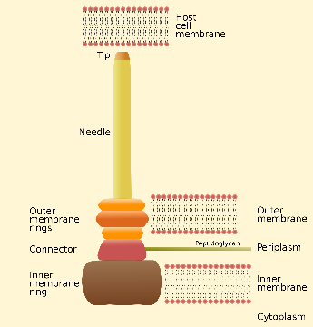
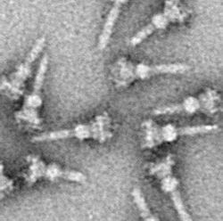
Type III secretion system
Specialized proteins found in many gram-negative bacteria
Molecular syringe to inject virulence proteins into host cell cytoplasm
Yersinia pestis (bubonic plague), Salmonella, Shigella
Caption: T3SS needle complex (c)Pixie, Public domain
Caption: TEM of isolated T3SS needle complexes (c)O. Schraidt et al., Public domain

Slide 46
Salmonella enterica serovar Typhi, the
causative agent of Typhoid fever, is a
Gram-negative, rod-shaped gamma
protobacterium.
Typhoid fever, which is spread through
feces, causes intestinal hemorrhage,
high fever, delirium and dehydration.
Today, between 16 and 33 million cases of this re-emerging disease occur annually, resulting in over 200,000 deaths.
Carriers of the disease can be asymptomatic. In a famous case in the early 1900s, a cook named Mary Mallon unknowingly spread the disease to over fifty people, three of whom died.
Other Salmonella serotypes cause food poisoning.

Slide 47
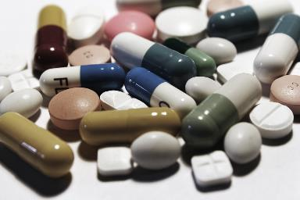
Human Bacterial Disease
In the early 20th century, infectious diseases killed 20% of children before the age of five
Sanitation and antibiotics considerably improved the situation
In recent years, however, many bacterial diseases have appeared and reappeared
Bacterial resistant to antibiotics
Caption: Pills 1 (c)e-Magine Art, Public domain
Caption: Antibiotic Resistance Test
(c)Graham Beards, Public domain

Slide 48
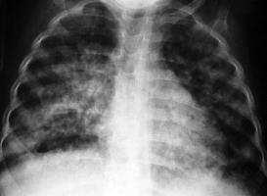
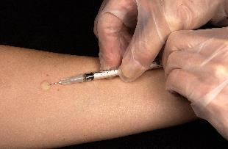
Tuberculosis (TB)
Mycobacterium tuberculosis
Problem for thousands of years
Afflicts the respiratory system
Escapes immune system
Easily transferred from person to person through the air
Multidrug-resistant (MDR) strains are very alarming
Caption: Pulmonary Tuberculosis (c)AJC1,
Public domain
Caption: Mantoux Tuberculin Skin Test (c) Greg Knobloch, Public domain

Slide 49
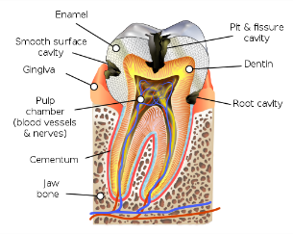
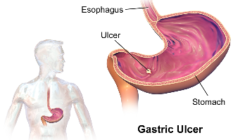
Dental caries (tooth decay)
Plaque consists of bacterial biofilms
Streptococcus sobrinus ferments sugar
to lactic acid
Tooth enamel degenerates
Peptic ulcers
Helicobacter pylori is the main cause
Treated with antibiotics
Caption: Blausen 0864 ToothDecay (c)KDS4444, Public domain
Caption: Gastric Ulcer (c)BruceBlaus, Public domain

Slide 50
Download for free at http://cnx.org/contents/185cbf87-c72e-48f5-b51e-f14f21b5eabd@10.61
The (a) Great Plague of London killed an estimated 200,000 people, or about twenty percent of the city’s population.
The causative agent, the (b) bacterium Yersinia pestis, is a Gram-negative, rod-shaped bacterium from the class Gamma Proteobacteria.
The disease is transmitted through the bite of an infected flea, which is infected by a rodent. Symptoms include swollen lymph nodes, fever, seizure, vomiting of blood, and (c) gangrene.

Slide 51
Download for free at http://cnx.org/contents/185cbf87-c72e-48f5-b51e-f14f21b5eabd@10.61
Lyme disease often, but not always, results in (a) a characteristic bullseye rash.
The disease is caused by a (b) Gram-negative spirochete bacterium of the genus Borellia.
The bacteria (c) infect ticks, which in turns infect mice.
Deer are the preferred secondary host, but the ticks also may feed on humans.
Untreated, the disease causes chronic disorders in the nervous system, eyes, joints, and heart.
The disease is named after Lyme, Connecticut, where an outbreak occurred in 1995 and has subsequently spread.
The disease is not new, however. Genetic evidence suggests that Ötzi the Iceman, a 5,300-year-old mummy found in the Alps, was infected with Borellia.

Slide 52
Download for free at http://cnx.org/contents/185cbf87-c72e-48f5-b51e-f14f21b5eabd@10.61
Credit c: NIDDK, NIH
(a) Vegetable sprouts grown at an organic farm were the cause of an (b) E. coli outbreak that killed 32 people and sickened 3,800 in Germany in 2011.
The strain responsible, E. coli O104:H4, produces Shiga toxin, a substance that inhibits protein synthesis in the host cell.
The toxin (c) destroys red blood, cells resulting in bloody diarrhea.
Deformed red blood cells clog the capillaries of the kidney, which can lead to kidney failure, as happened to 845 patients in the 2011 outbreak.
Kidney failure is usually reversible, but some patients experience kidney problems years later.

Slide 53
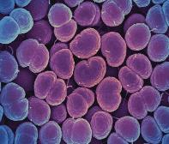
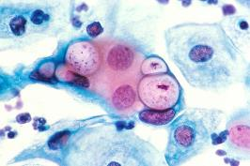
Sexually transmitted diseases (STDs)
Gonorrhea
Neisseria gonorrhoeae
One of the most prevalent communicable diseases in North America.
Transmitted through exchange of body fluids
Can pass from mom to baby via birth canal
Chlamydia
Chlamydia trachomatis
“Silent STD” – incidence has skyrocketed
Obligate intracellular parasite
Can cause pelvic inflammatory disease and
heart disease
diplococci
Chlamydia in the vacuoles
Caption: Pathology: Histology: Pap Smear (c)Unknown photographer/artist, Public domain
Caption: Neisseria gonorrhoeae
(c)NIAID, Public domain

Slide 54
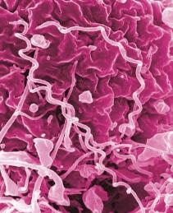
Syphilis
Treponema pallidum
Transmitted through sex or contact with open chancre
Can pass from mom to baby via birth canal
Four distinct stages
Primary – Chancre – highly infectious
Secondary – Rash – infectious
Tertiary – Latency – no longer infectious but attacking internal organs
Quaternary – Damage now evident
Heart disease, nerve damage
Caption: Syphilis Bacteria
(c)NIAID, Public domain

Slide 55
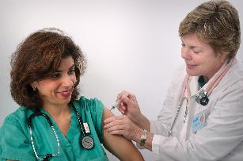
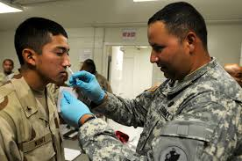
Caption: A woman receiving a vaccination shot from her doctor (c) CDC/ Judy Schmidt acquired from Public Health Image Library, Public domain
Download for free at http://cnx.org/contents/185cbf87-c72e-48f5-b51e-f14f
21b5eabd@10.61
Caption: GI gets a nasal flu vaccination at Guantanamo (c)Elisha Dawkins, Public domain
Vaccinations can slow the spread of communicable diseases.

Slide 56
Beneficial Prokaryotes
Only a small percentage is pathogenic
Bacteria are vital to the environment
Decomposers release a dead organism’s atoms to the environment
Fixation
Photosynthesizers fix carbon into sugars
Ancient cyanobacteria added oxygen to air
Nitrogen fixers reduce N₂ to NH₃ (ammonia)
Anabaena in aquatic environments
Rhizobium in soil

Slide 57
Download for free at http://cnx.org/contents/185cbf87-c72e-48f5-b51e-f
14f21b5eabd@10.61
Prokaryotes play a significant role in continuously moving carbon through the biosphere.

Slide 58
Download for free at http://cnx.org/contents/185cbf87-c72e-48f5-b51e-f1
4f21b5eabd@10.61
Prokaryotes play a key role in the nitrogen cycle.

Slide 59
Some of the products derived from the use of prokaryotes in early biotechnology include (a) cheese, (b) wine, (c) beer and bread, and (d) yogurt.
Download for free at http://cnx.org/contents/185cbf87-c72e-48f5-b51e-f14f21b5eabd@10.61

Slide 60
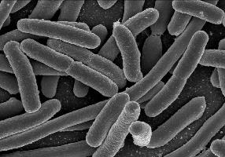
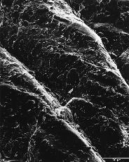
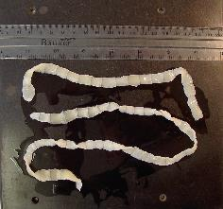
Symbiosis refers to the ecological relationship between different species that live in direct contact with each other
Mutualism – both parties benefit
Nitrogen-fixing bacteria on plant roots
Cellulase-producing bacteria in animals
Commensalism – one organism benefits and the other is unaffected
Parasitism – one organism benefits and the other is harmed
mutualism
commensalism
parasitism
Caption: Escherichia coli, one of the many species of bacteria present in the human gut (c)NIAID, Public domain
Caption: Skin surface (human) (c)Bruce Wetzel, Public domain
Caption: Tapeworm Proglottids (c)Nathan Reading, Public domain

Slide 61
Bacteria are used in genetic engineering
“Biofactories” that produce various chemicals, including insulin and antibiotics
Bacteria are used for bioremediation
Remove pollutants from water, air, and soil
Biostimulation/Bioenhancement – adds nutrients to encourage growth of naturally occurring microbes
Exxon Valdez oil spill

Slide 62
Download for free at http://cnx.org/contents/185cbf87-c72e-48f5-b51e-f14f21b5eabd@10.61
Cleaning up oil after the Valdez spill in Alaska, workers hosed oil from beaches and then used a floating boom to corral the oil, which was finally skimmed from the water surface. Some species of bacteria are able to solubilize and degrade the oil.
One of the most catastrophic consequences of oil spills is the damage to fauna.

