Slide 1
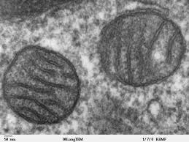
Chapter 5
Structure and Function of Plasma Membranes
Gen Bio I
Dr. Capers
Caption: Mitochondria, Mammalian Lung - TEM (c)Louisa
Howard, Public domain
OpenStax Biology - https://openstax.org/details/books/biology,
PowerPoint made by Dr. Capers - www.jcapers-irsc.weebly.com

Slide 2
Download for free at http://cnx.org/contents/185cbf87-c72e-48f5-b51e-f14f21b5eabd@10.61
The fluid mosaic model of the plasma membrane describes the plasma membrane as a fluid combination of phospholipids, cholesterol, and proteins.
Carbohydrates attached to lipids (glycolipids) and to proteins (glycoproteins) extend from the outward-facing surface of the membrane.

Slide 3
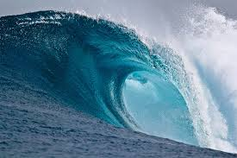
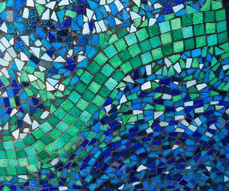
Membrane Structure
Phospholipids arranged in a bilayer.
Globular proteins inserted in the lipid bilayer.
Fluid mosaic model
Fluid Mosaic
Caption: Large Breaking Wave (c)NOAA, Public domain
Caption: Mosaic Patterns (c)Ali Harrison,
Public domain

Slide 4
Membrane Structure
Cellular membranes have 4 components
Phospholipid bilayer
Flexible matrix, barrier to permeability
Transmembrane proteins
Integral membrane proteins
Interior protein network
Peripheral or Intracellular membrane proteins
Cell surface markers
Glycoproteins and glycolipids

Slide 5
Download for free at http://cnx.org/contents/185cbf87-c72e-48f5-b51e-f14f21b5eabd@10.61
The exterior surface of the plasma membrane is not identical to the interior surface of the same membrane.

Slide 6
Phospholipids
Structure consists of
Glycerol – a 3-carbon alcohol
2 fatty acids attached to the glycerol
Nonpolar and hydrophobic (“water-fearing”)
Phosphate group attached to the glycerol
Polar and hydrophilic (“water-loving”)
Spontaneously forms a bilayer
Fatty acids are on the inside
Phosphate groups are on both surfaces

Slide 7
This phospholipid molecule is composed of a hydrophilic head and two hydrophobic tails.
The hydrophilic head group consists of a phosphate-containing group attached to a glycerol molecule.
The hydrophobic tails, each containing either a saturated or an unsaturated fatty acid, are long hydrocarbon chains.
Download for free at http://cnx.org/contents/185cbf87-c7
2e-48f5-b51e-f14f21b5eabd@10.61

Slide 9
In an aqueous solution, phospholipids tend to arrange themselves with their polar heads facing outward and their hydrophobic tails facing inward.
Download for free at http://cnx.org/contents/185cbf87-c7
2e-48f5-b51e-f14f21b5eabd@10.61
Credit: modification of work by Mariana Ruiz Villareal

Slide 10
Membrane Proteins
Various functions:
Transporters
Enzymes
Cell-surface receptors
Cell-surface identity markers
Cell-to-cell adhesion proteins
Attachments to the cytoskeleton

Slide 11
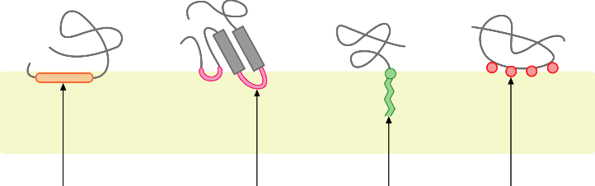
Membrane Proteins
Diverse functions arise from the diverse structures of membrane proteins
Peripheral proteins
Anchoring molecules attach membrane protein to surface
Different peripheral proteins
Caption: Monotopic Membrane Protein (c)Foobar, Public domain

Slide 12
HIV binds to the CD4 receptor, a glycoprotein on the surfaces of T cells.
Download for free at http://cnx.org/contents/185cbf87-c7
2e-48f5-b51e-f14f21b5eabd@10.61
Credit: modification of work by NIH, NIAID

Slide 13
Membrane Proteins
Integral membrane proteins
Span the lipid bilayer (transmembrane proteins)
Nonpolar regions of protein within interior of bilayer
Polar regions of the protein protrude from both sides of the bilayer
Transmembrane domain
Spans the lipid bilayer
Hydrophobic amino acids arranged in α helices

Slide 14
Download for free at http://cnx.org/contents/185cbf87-c72e-48f5-b51e-f14f21b
5eabd@10.61
Credit: “Foobar”/Wikimedia Commons
Integral membrane proteins may have one or more alpha-helices that span the membrane (examples 1 and 2), or they may have beta-sheets that span the membrane (example 3).

Slide 15
Proteins need only a single transmembrane domain to be anchored in the membrane, but they often have more than one such domain.
Pores
Extensive nonpolar regions within a transmembrane protein can create a pore through the membrane
Cylinder of β sheets in the protein secondary structure (b-barrel)
Interior is polar and allows water and small polar molecules to pass through the membrane

Slide 16
Passive Transport

Slide 17
Passive Transport
Passive Transportation: DOES NOT require energy, goes with the concentration gradient
Diffusion
Facilitated Diffusion
Channel Proteins
Ion Channels
Gated Channel
Carrier proteins
Osmosis

Slide 18
Download for free at http://cnx.org/contents/185cbf87-c72e-48f5-b51e-f14f21b5eabd@10.61
Credit: modification of work by Mariana Ruiz Villareal
Diffusion through a permeable membrane moves a substance from an area of high concentration (extracellular fluid, in this case) down its concentration gradient (into the cytoplasm where the concentration is low).
This will continue until the concentration is the same in all regions (equilibrium).

Slide 19
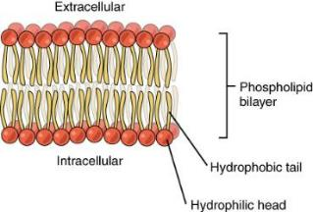
Membrane is Selectively Permeable
Major barrier to crossing a biological membrane is the hydrophobic interior that repels polar molecules but not nonpolar molecules
Nonpolar molecules will move until the concentration is equal on both sides
Limited permeability to small polar molecules
Very limited permeability to larger polar molecules and ions
Caption: 0302 Phospholipid Bilayer (c)OpenStax,
Public domain

Slide 20
Membrane is Selectively Permeable
Facilitated Diffusion:
Molecules that cannot cross membrane easily may move through proteins
Move from higher to lower concentration (passive, no energy!)
Channel proteins
Hydrophilic channel when open
Example: Ion Channels
Carrier proteins
Bind specifically to molecules they assist

Slide 21
Channel Proteins
Ion Channels
Allow the passage of ions
Gated channels: open or close in response to stimulus (chemical or electrical)
3 conditions determine direction
Relative concentration on either side of membrane
Voltage differences across membrane
Gated channels: channel open or closed

Slide 22
Download for free at http://cnx.org/contents/185cbf
87-c72e-48f5-b51e-f14f21b5eabd@10.61
Credit: modification of work by Mariana Ruiz Villareal
Facilitated transport moves substances down their concentration gradients. They may cross the plasma membrane with the aid of channel proteins.

Slide 23
Carrier Proteins
Help transport ions and some sugars and amino acids
Requires a concentration difference across the membrane
Must bind to the molecule they transport
Saturation: rate of transport limited by number of transporters
Think people exiting a classroom through only 2 doors versus one door.

Slide 24
Download for free at http://cnx.org/contents/185cbf87-c72e-48f5-b51e-f14f21b5eabd@10.61
Credit: modification of work by Mariana Ruiz Villareal
Some substances are able to move down their concentration gradient across the plasma membrane with the aid of carrier proteins.
Carrier proteins change shape as they move molecules across the membrane.

Slide 25
Osmosis
Cytoplasm of the cell is an aqueous solution
Water is solvent
Dissolved substances are solutes
Osmosis – net diffusion of water across a membrane toward a higher solute concentration
Some water passes through the membrane in specialized channels called aquaporins.

Slide 26
Download for free at http://cnx.org/contents/185cbf87-c72e-48f5-b51e-f14f21b5eabd@10.61
In osmosis, water always moves from an area of higher water concentration (more pure) to one of lower concentration (less pure).
In the diagram shown, the solute cannot pass through the selectively permeable membrane, but the water can.

Slide 27
Osmotic Concentration
When 2 solutions have different osmotic concentrations…
The Hypertonic Solution has a higher solute concentration
The Hypotonic Solution has a lower solute concentration
When two solutions have the same osmotic concentration, the solutions are isotonic
Aquaporins facilitate osmosis

Slide 28
Download for free at http://cnx.org/contents/185cbf87-c72e-48f5-b51e-f14f21b5eabd@10.61
Credit: Mariana Ruiz Villareal
Osmotic pressure changes the shape of red blood cells in hypertonic, isotonic, and hypotonic solutions.

Slide 29
Download for free at http://cnx.org/contents/185cbf87-c72e-48f5-b51e-f14f21b5eabd@10.61
Credit: modification of work by Mariana Ruiz Villareal
The turgor pressure within a plant cell depends on the tonicity of the solution that it is bathed in.

Slide 30
Osmotic Pressure
Osmotic Pressure: Force needed to stop osmotic flow
Cell in a hypotonic solution gains water causing cell to swell – creates pressure
If membrane is strong enough, cell reaches counterbalance of osmotic pressure driving water in with hydrostatic pressure driving water out
Cell wall of prokaryotes, fungi, plants, protists
If membrane is not strong, may burst
Animal cells must be in isotonic environments

Slide 31
Maintaining Osmotic Balance
Some cells use extrusion in which water is ejected through contractile vacuoles
Isosmotic regulation involves keeping cells isotonic with their environment
Marine organisms adjust internal concentration to match sea water
Terrestrial animals circulate isotonic fluid
Plant cells use turgor pressure to push the cell membrane against the cell wall and keep the cell rigid

Slide 32
Download for free at http://cnx.org/contents/185cbf87-c72e-48f5-b51e-f14f21b5eabd@10.61
Credit: modification of work by NIH; scale-bar data from Matt Russell
A paramecium’s contractile vacuole, here visualized using bright field light microscopy at 480x magnification, continuously pumps water out of the organism’s body to keep it from bursting in a hypotonic medium.

Slide 33
Active Transport

Slide 34
Active Transport
Active Transportation: requires energy, against concentration gradient
Uniport, symport, antiport
Na⁺–K⁺ Pump
Coupled Transport

Slide 35
Active Transport
Requires Energy: ATP is used directly or indirectly to fuel active transport
Moves substances from low to high concentration
Requires the use of highly selective carrier proteins

Slide 36
Download for free at http://cnx.org/contents/185cbf87-c72e-48f5-b51e-f1
4f21b5eabd@10.61
Credit: “Synaptitude”/Wikimedia Commons
Electrochemical gradients arise from the combined effects of concentration gradients and electrical gradients.

Slide 37
Active Transport
Carrier proteins used in active transport include
Uniporters: move one molecule at a time
Symporters: move two molecules in the same direction
Antiporters: move two molecules in opposite directions
Terms can also be used to describe facilitated diffusion carriers (when no energy required)

Slide 38
Download for free at http://cnx.org/contents/185cbf87-c72e-48f5-b51e-f14f21b5eabd@10.61
Credit: modification of work by “Lupask”/Wikimedia Commons
A uniporter carries one molecule or ion.
A symporter carries two different molecules or ions, both in the same direction.
An antiporter also carries two different molecules or ions, but in different directions.

Slide 39
Active Transport
Sodium–Potassium (Na⁺–K⁺) Pump:
Direct use of ATP for active transport
Antiporter moves…
3 Na⁺ out of the cell
2 K⁺ into the cell
Against their concentration gradient
ATP energy changes conformation of carrier protein

Slide 40
Caption: Blausen 0818 Sodium-PotassiumPump (c) BruceBlaus, Public domain
Takes ATP
3 sodium ions out, 2 potassium ions in
For more info look at this video: https://www.youtube.com/watch?v=vh166DKxYiM

Slide 41
Active Transport
Coupled Transport:
Uses ATP indirectly; uses Symporter
Molecules moved against their concentration gradient using energy stored in a gradient of a different molecule
Sodium-Glucose Symporter:
Captures the energy from Na⁺ diffusion to move glucose against a concentration gradient

Slide 42
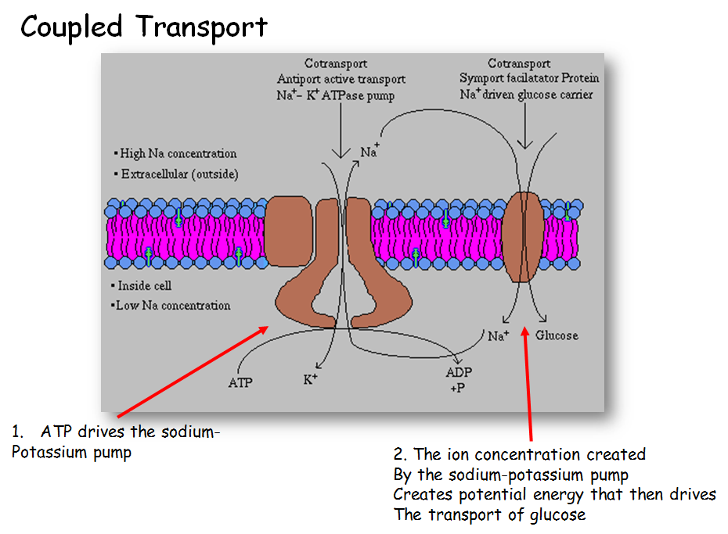

Slide 43
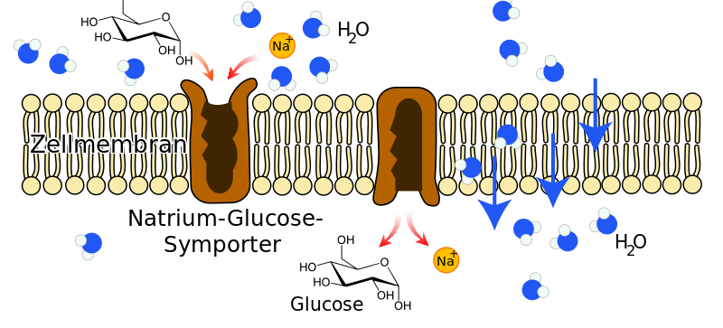
Na⁺ - Glucose Symporter
Caption: Na-Glucose-Symporter (c)Furfur, Public domain

Slide 44
Bulk Transport
Endocytosis
Movement of substances into the cell
Phagocytosis – cell takes in particulate matter
Pinocytosis – cell takes in only fluid
Receptor-mediated endocytosis – specific molecules are taken in after they bind to a receptor, formation of clathrin-coated pits and vesicles
Exocytosis
Movement of substances out of cell
Requires energy

Slide 45
In phagocytosis, the cell membrane surrounds the particle and engulfs it.
Download for free at http://cnx.org/contents/185cbf87-c72e-48
f5-b51e-f14f21b5eabd@10.61
Credit: Mariana Ruiz Villareal

Slide 46
In pinocytosis, the cell membrane invaginates, surrounds a small volume of fluid, and pinches off.
Download for free at http://cnx.org/contents/185cbf87-c72e-4
8f5-b51e-f14f21b5eabd@10.61
Credit: Mariana Ruiz Villareal

Slide 47
In receptor-mediated endocytosis, uptake of substances by the cell is targeted to a single type of substance that binds to the receptor on the external surface of the cell membrane.
Download for free at http://cnx.org/contents/185cbf87-c
72e-48f5-b51e-f14f21b5eabd@10.61
Credit: modification of work by Mariana Ruiz Villareal

Slide 48
In exocytosis, vesicles containing substances fuse with the plasma membrane. The contents are then released to the exterior of the cell.
Download for free at http://cnx.org/contents/185cbf87-c72e-48f5-b51e-f14f21b5eabd@10.61
credit: modification of work by Mariana Ruiz Villareal

