Slide 1
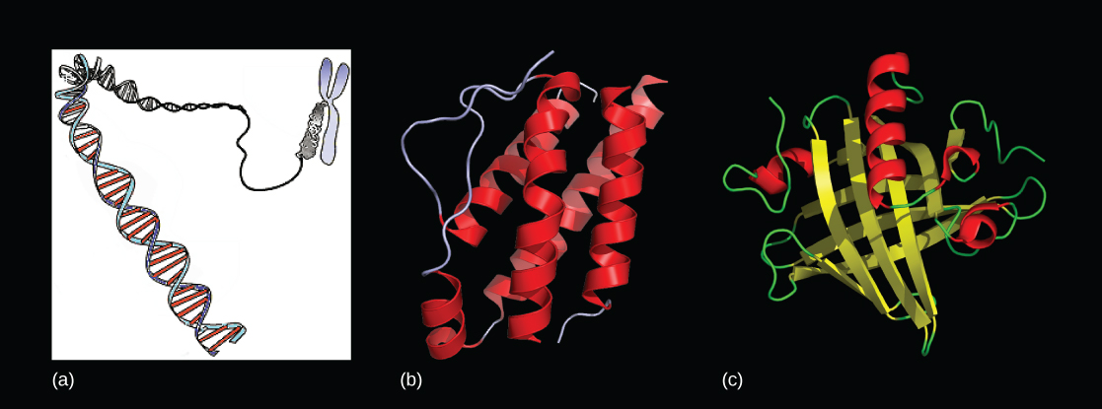
Chapter 15 Genes and Proteins
General Biology I
BSC 2010
Dr. Capers
Download for free at http://cnx.org/contents/185cbf87-c72e-48f5-b51e-f14f21b5eabd@10.61
OpenStax Biology - https://openstax.org/details/books/biology,
PowerPoint made by Dr. Capers - www.jcapers-irsc.weebly.com

Slide 2
Genes specify the sequence of amino acids, the building blocks of proteins
Proteins are responsible for orchestrating almost every function of the cell (think about enzymes)

Slide 3
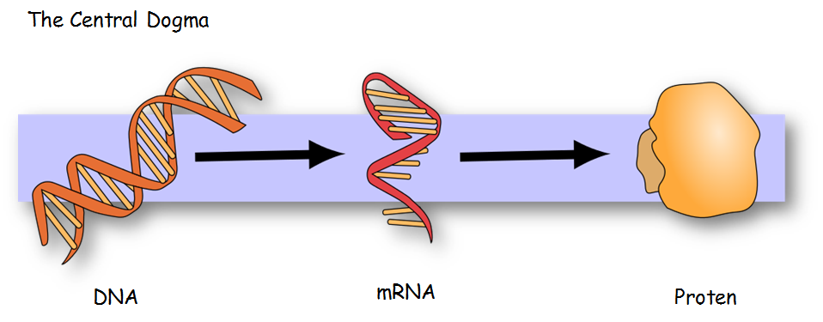
Caption: MolbioHeader (c) Squidonius, Public domain

Slide 4
The DNA sequence will determine the amino acid sequence and therefore, will determine the function of the protein
Every 3 nucleotides on the mRNA codes for an amino acid
Codon
The genetic code is universal
This means that from bacteria to us – 4 nucleotides (A, T, C, G) code for 20 amino acids
The sequence of those is what make a bacteria DIFFERENT from us

Slide 5
Download for free at http://cnx.org/contents/185cbf87-c72e-48f5-b51e-f14f21b5eabd@10.61

Slide 6
Caption: Genetic Code (c) Madprime, Public domain

Slide 7
Prokaryotes
Remember in prokaryotes, there is no membrane bound nucleus
They have 1 circular chromosome

Slide 8
Prokaryotes
Steps of Transcription:
Initiation
Promotor is a piece of DNA upstream that indicates where the RNA polymerase should bind and start
Elongation
RNA polymerase adds complimentary nucleotides (A, U, C, G) to make the mRNA
Termination
Since there is no nuclear membrane in prokaryotes, there is no separation of the transcription and translation process.
A ribosome will go ahead and grab onto the growing mRNA to start translation

Slide 9
Eukaryotes
Transcription and Translation separated by nuclear membrane in eukaryotes
Steps of Transcription
Initiation
Promotors are much more complex than prokaryotic promotors
Eukaryotes have 3 RNA polymerases (RNA Polymerase I, II, III)
Transcription factors are needed
Elongation
Termination
mRNA is released
It has to be modified before leaving the nucleus for translation

Slide 10
mRNA processing in Eukaryotes
5’ Cap – cap is added to help the mRNA from being immediately degraded
3’ Poly A Tail - adenines added to end, helps mRNA pass through nuclear pore
Splicing of introns
Gene has exons and introns (exons are expressed, introns are cut out)
Caption: Exon-Intron 2 (c) Kazulanth, Public domain

Slide 11
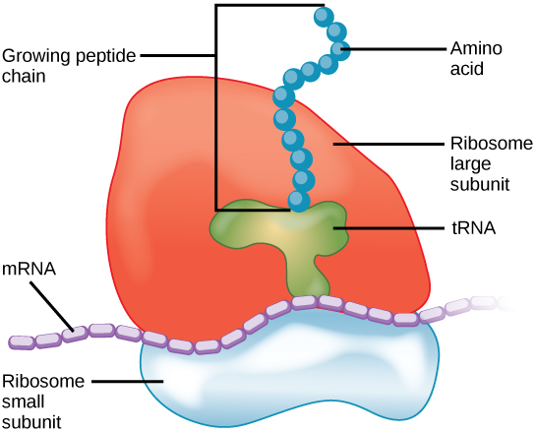
For translation to occur, ribosomes are needed
Ribosomes of prokaryotes are slightly different from eukaryotes
Caption: Ribosome Translation (c) Openstax, Public domain

Slide 12
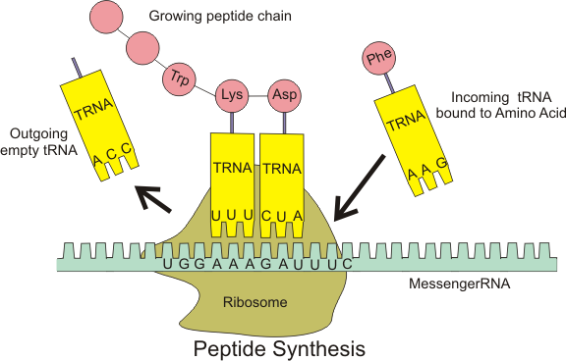
For translation to occur, tRNAs are needed. These grab onto amino acids in the cytosol and carry it to the growing amino acid chain on the ribosome
tRNAs have an anticodon that is complimentary to the codon on the mRNA
Caption: Protein Syn (c) Baumphreyfr, Public domain

Slide 13
3 Steps of Translation:
Initiation
mRNA attaches to the smaller subunit of the ribosome
AUG is the start codon – a tRNA with the appropriate anticodon attaches
The larger subunit of the ribosome then comes in
Elongation
tRNAs move in with the appropriate amino acid, the amino acid chain grows using peptidyl transferase
Termination
Stop codon is reached
The amino acid chain then is processed
In eukaryotes, the amino acid chain moves into the endoplasmic reticulum to be further processed

Slide 14
Download for free at http://cnx.org/contents/185cbf87-c72e-48f5-b51e-f14f21b5eabd@10.61

Slide 15
Watch this video on Eukaryotic Transcription and Translation:
https://www.youtube.com/watch?v=gG7uCskUOrA
Watch this video on Prokaryotic Transcription and Translation:
https://www.youtube.com/watch?v=1b-bRVgqof0
Watch this video on the Lac Operon that shows gene regulation: https://www.youtube.com/watch?v=oBwtxdI1zvk

Slide 16
Overview for Eukaryotic Cells

