Slide 1
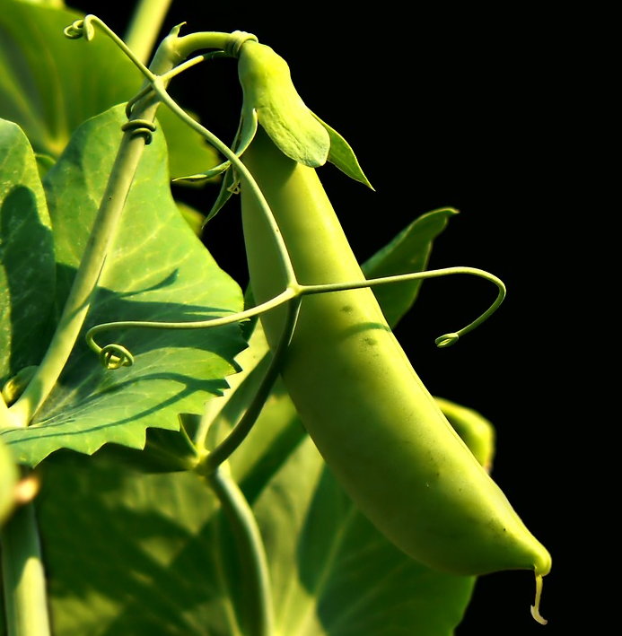
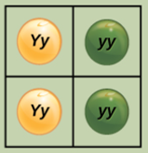
Chapter 12: Mendel’s Experiments and Heredity
General Biology I
BSC 2010
Dr. Capers
Caption: Pea Plant (c)Wikipedia, Public domain
Download for free at https://cnx.org/contents/GFy_h8cu@10.114:O2lXSTlf@2/Introduction
OpenStax Biology - https://openstax.org/details/books/biology,
PowerPoint made by Dr. Capers - www.jcapers-irsc.weebly.com

Slide 2
Johann Gregor Mendel is considered the father of genetics.
Mendel selected a simple biological system and conducted methodical, quantitative analyses using large sample sizes.
Because of Mendel’s work, the fundamental principles of heredity were revealed.
We now know that genes, carried on chromosomes, are the basic functional units of heredity with the capability to be replicated, expressed, or mutated.
Mendels ideas form the basis of classical, or Mendelian, genetics.
Download for free at http://cnx.org/contents/185cbf87-c72e-48f5-b51e-f14f21b5eabd@10.61

Slide 3
It was once thought that parental traits were blended in offspring
Mendel’s choice of these traits allowed him to see experimentally that traits were not blended in offspring, they kept their distinctness
Download for free at http://cnx.org/contents/185cbf87-c72e-48f5-b51e-f14f21b5eabd@10.61

Slide 4
Gregor Mendel
Studied heredity in pea plants because:
Pea hybrids could be produced
Many pea varieties were available
Peas are small plants and easy to grow
Peas can self-fertilize or be cross- fertilized
Caption: Pea Plant (C)Wikipedia, Public domain
Download for free at http://cnx.org/contents/185cbf87-c72e-48f5-b51e-f14f21b5eabd@10.61

Slide 5
Mendel’s experimental method
Some Terminology:
Cross-fertilize: male and female gametes from different flowers/plant used to make zygote (pea)
Self-fertilize: male and female gametes from one flower/plant used to make zygote (pea)
True-breeding: offspring produced by self fertilization look like parent (purple flower plants make more purple colored plants).

Slide 6
Remember that homologous chromosomes are chromosomes that have the same genes (one chromosome came from mom, one came from dad)
There be different alleles (versions) of those genes
Eye color for humans, there is Brown (B) and blue (b)
An individual that has the same 2 alleles are (BB or bb) is homozygous
An individual that has 2 different alleles (Bb) is heterozygous
One allele can be dominant over the other
The dominant is a capital letter (B), the recessive is a lower case letter (b)

Slide 7
Mendel’s experimental method
Some Terminology:
Phenotype: The observable traits expressed by an organism (white or purple flowers)
Genotype: underlying genetic makeup, consisting of both physically visible and non-expressed alleles
Homozygous: at a given gene, or locus, have two identical alleles for that gene on their homologous chromosomes.
Heterozygous: at a given gene, or locus, have two different alleles for that gene on their homologous chromosomes.

Slide 8
Notes:
Figure 14.4 Alleles, alternative versions of a gene

Slide 10
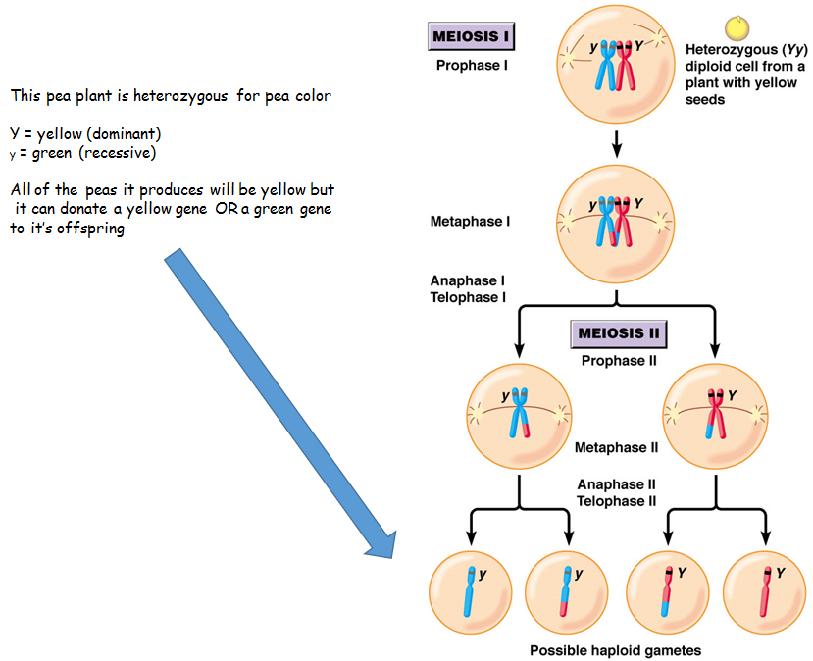

Slide 11
Law of Independent Assortment
During meiosis, homologous chromosomes line up randomly during metaphase
This means that not all of the maternal chromosomes will line up on one side and not all of the paternal chromosomes will line up on the other
This results in various combinations of maternal/paternal chromosomes that will end up in the resulting egg or sperm cell

Slide 12
Gets more complicated and there are more possible
gametes when looking at genes on 2 different chromosomes

Slide 13
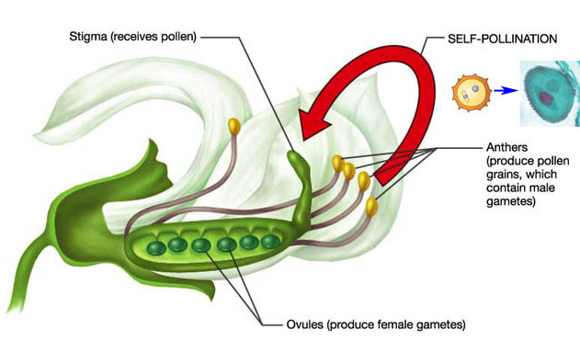
Mendel’s experimental method
Self-fertilize
Pollen taken from anther used to fertilize eggs in female carpel.
Zygote forms.
True-breeding = peas produced will develop into plants with white flowers
Caption: Pea Plant Anatomy (c) Wikipedia, Public domain

Slide 14
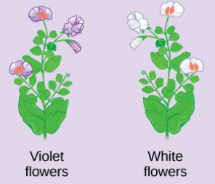
Mendel’s experimental method
X
Cross-fertilize: male and female gametes from different flowers/plant used to make zygote (pea)
Remove anthers from purple flower (prevent self fertilization).
Transfer pollen from purple to white flower.
Collect peas, plant them, observe flower color of the offspring generation.
Download for free at http://cnx.org/contents/185cbf87-c72e-48f5-b51e-f14f21b5eabd@10.61

Slide 15
Mendel’s experimental method
Usually 3 stages:
Produce true-breeding strains for each trait he was studying
Cross-fertilize true-breeding strains having alternate forms of a trait
Allow the hybrid offspring to self-fertilize for several generations and count the number of offspring showing each form of the trait

Slide 16
Monohybrid crosses
Monohybrid Cross:
Mono = one trait (ex: flower color)
Hybrid = 2 variations (ex: white or purple)
Monohybrid Cross: to study 2 variations of a single trait
Mendel produced true-breeding pea strains for 7 different traits
Each trait had 2 variants

Slide 17
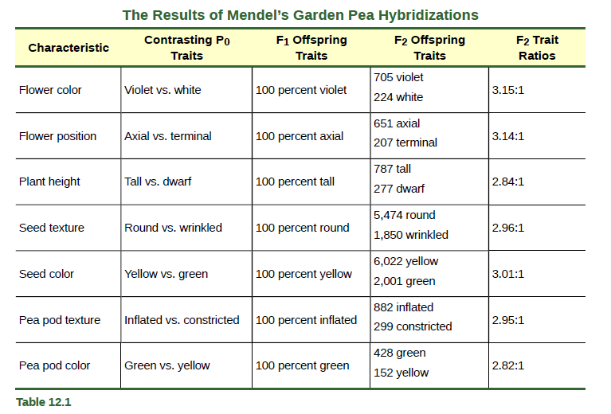
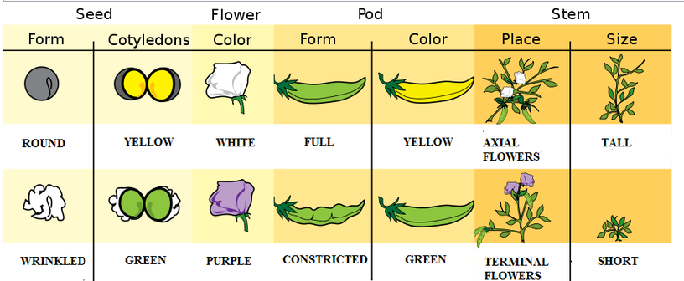
Download for free at http://cnx.org/contents/185cbf87-c72e-48f5-b51e-f14f21b5eabd@10.61
Caption: Pea Traits (c) Wikipedia, Public domain

Slide 19
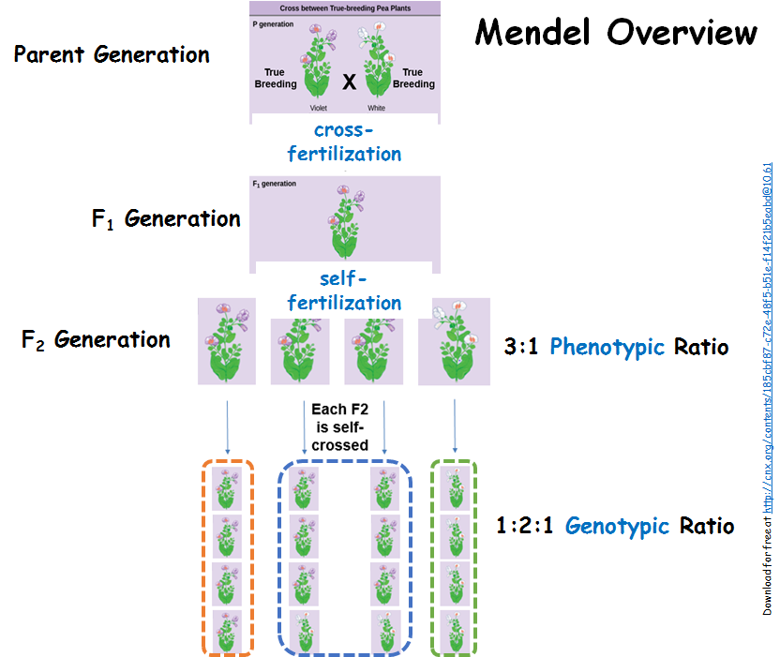

Slide 20
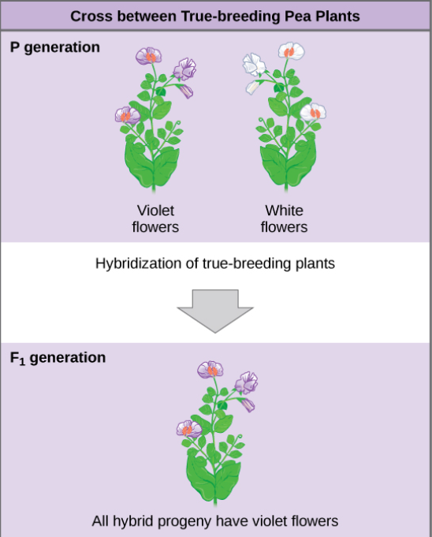
F₁ Generation
F₁ Generation: First filial generation
Offspring of 2 true-breeding parents (P generation)
All F₁ plants looked like only 1 of parents
Visible trait in F₁ is dominant
Other trait was recessive (hidden)
No blending: No intermediate colors observed (purple-ish white)
True
Breeding
X
True
Breeding
cross-fertilization
Download for free at http://cnx.org/contents/185cbf87-c72e-48f5-b51e-f14f21b5eabd@10.61

Slide 21
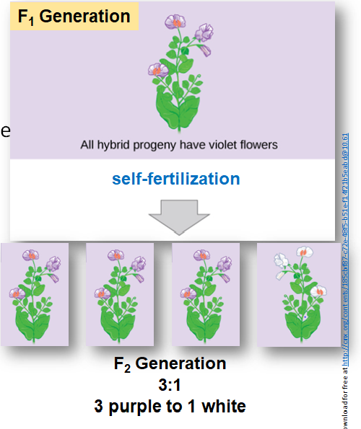
F₂ Generation
F₂: Offspring resulting from the self-fertilization of F₁ plants
The recessive trait is seen in some F₂ plants
F₂ Generation:
3:1 = 3 purple to 1 white
Always found about 3:1 ratio
3 dominant to 1 recessive

Slide 22
F2 Ratios: Phenotype and Genotype
F₂ plants ratio based on phenotype (observable characteristics)
¾ plants showed dominant trait
¼ plants showed the recessive trait
Ratio of 3:1 = 3 dominant to 1 recessive
F₂ plants ratio based on genotypes (alleles responsible for phenotype)
1 homozygous purple dominant = PP
2 heterozygous purple dominant = Pp
1 homozygous white recessive plant = pp
Genotype ratio = 1:2:1

Slide 23
Punnett Square
Cross purple-flowered plant with white-flowered plant
P is dominant allele – purple flowers
p is recessive allele – white flowers
True-breeding white-flowered plant is pp
Homozygous recessive
True-breeding purple-flowered plant is PP
Homozygous dominant
Pp is heterozygote purple-flowered plant

Slide 24
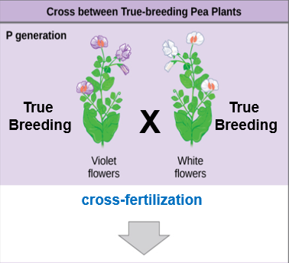
Punnett Square
Let’s make a Punnett Square for cross-fertilizing a true-breeding (homozygous) purple flower with a true breeding (homozygous) white flower to create F₁ generation
What is the genotype of the purple flower? (PP, Pp or pp?)
What is the genotype of the white flower?
F₁ Generation?
Download for free at http://cnx.org/contents/185cbf87-c72e-48f5-b51e-f14f21b5eabd@10.61

Slide 26
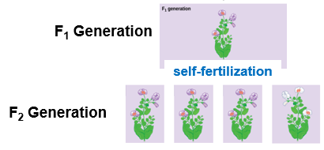
Punnett Square
Let’s make a Punnett Square fertizlizing an F₁ with another F₁
Pp x Pp
What is the genotype of the F₂ purple flowers?
Download for free at http://cnx.org/contents/185cbf87-c72e-48f5-b51e-f14f21b5eabd@10.61

Slide 28
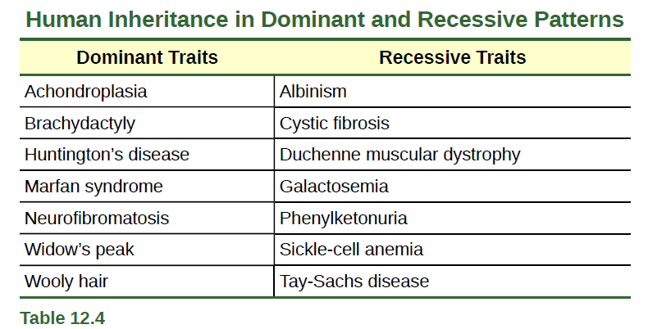
Pedigree Analysis
Pedigree Analysis: track pattern of inheritance in a family
A genetic family tree
Track dominant or recessive traits or genetic diseases
Download for free at http://cnx.org/contents/185cbf87-c72e-48f5-b51e-f14f21b5eabd@10.61

Slide 29
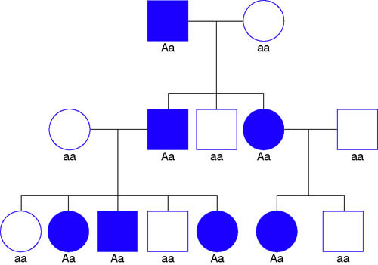
How to read a pedigree:
Squares are male
Circles are female
Shapes filled in with color are affected/have trait

Slide 30
Pedigrees
General Steps:
Determine mode of inheritance: autosomal dominant, autosomal recessive, sex-linked, etc
Write out the genotypes of affected and unaffected individuals
Start filling in the pedigree with the obvious genotypes (ex: for a dominant trait, you know all filled in shapes have one capital letter [dominant allele])

Slide 31
Autosomal Dominant Inheritance Rules:
Every affected person has an affected parent
About half of the offspring of just one affected parent are also affected
The phenotype occurs equally in both sexes (so not on X or Y chromosome)
Affected individuals have at least one dominant allele

Slide 32
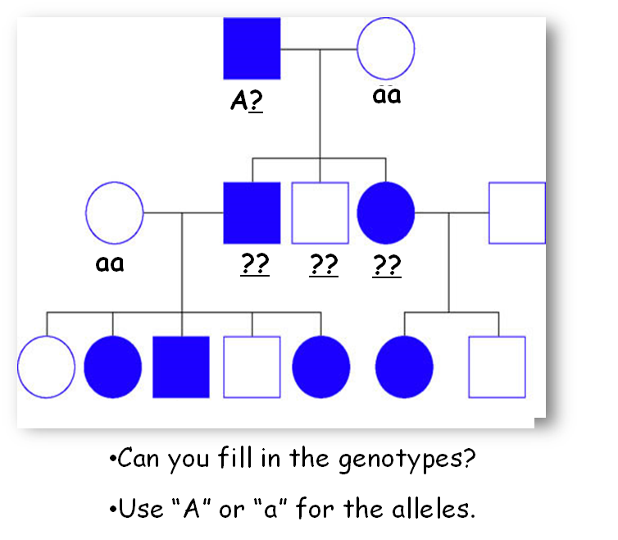

Slide 33
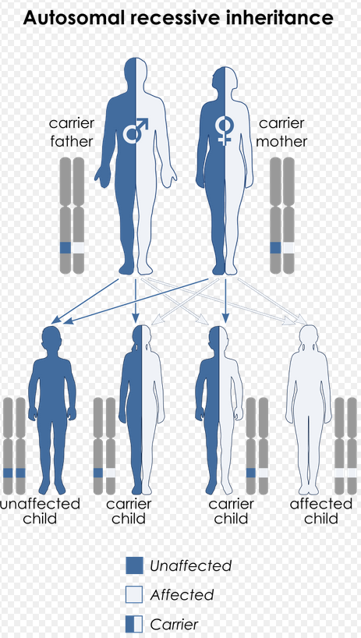
Autosomal Recessive Inheritance Rules:
Most affected individuals do not have affected parents
Skips generations
Males and females equally likely to be affected
Carriers: healthy individuals that are heterozygous, they have one good allele and one bad allele (Aa)
Sometimes on a pedigree carrier boxes/circles will be half colored in
Caption: Recessive (c) Wikipedia, Public domain

Slide 34
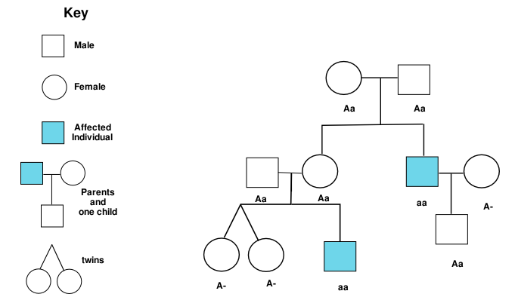
Autosomal Recessive Inheritance Rules:
Most affected individuals do not have affected parents
Skips generations
Males and females equally likely to be affected
Carriers: healthy individuals that are heterozygous, they have one good allele and one bad allele (Aa)
Caption: Recessive Pedigree (c) Wikipedia, Public domain

Slide 36
What type on Inheritance is this? What are the genotypes?
Caption: Pedigree (c) Wikipedia, Public domain

Slide 37
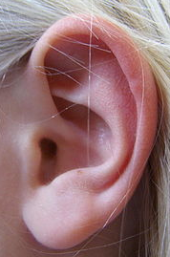
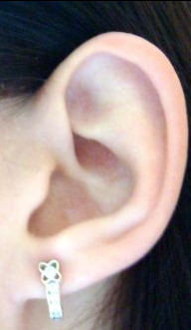
Use F’s = FF, Ff or ff
Is an attached earlobe a dominant or recessive trait?
Free earlobe
Attached earlobe
Caption: Free Ear (c) Wikipedia, Public domain
Caption: Attached Ear (c) Wikipedia, Public domain
Notes:
Figure 14.15b Pedigree analysis

Slide 38
Question
R = round seed
r = wrinkled seed
A homozygous round seeded plant is crossed with a homozygous wrinkled seeded plant. What are the genotypes of the parents? __________ x __________
What percentage of the offspring will also be homozygous? ______________

Slide 39
Question
P = purple
p = white
Two plants, both heterozygous for the gene that controls flower color are crossed. What percentage of their offspring will have purple flowers? ______________ What percentage will have white flowers? ___________

Slide 40
Dihybrid Crosses
Dihybrid Cross: a cross between two true-breeding parents that express different traits for two characteristics
Consider the characteristics of seed color and seed texture for two pea plants, one has green, wrinkled seeds (yyrr) and another has yellow, round seeds (YYRR).
The law of segregation indicates that the gametes for the green/wrinkled plant all are yr, and the gametes for the yellow/round plant are all YR.
F1 generation of offspring all are YyRr

Slide 42
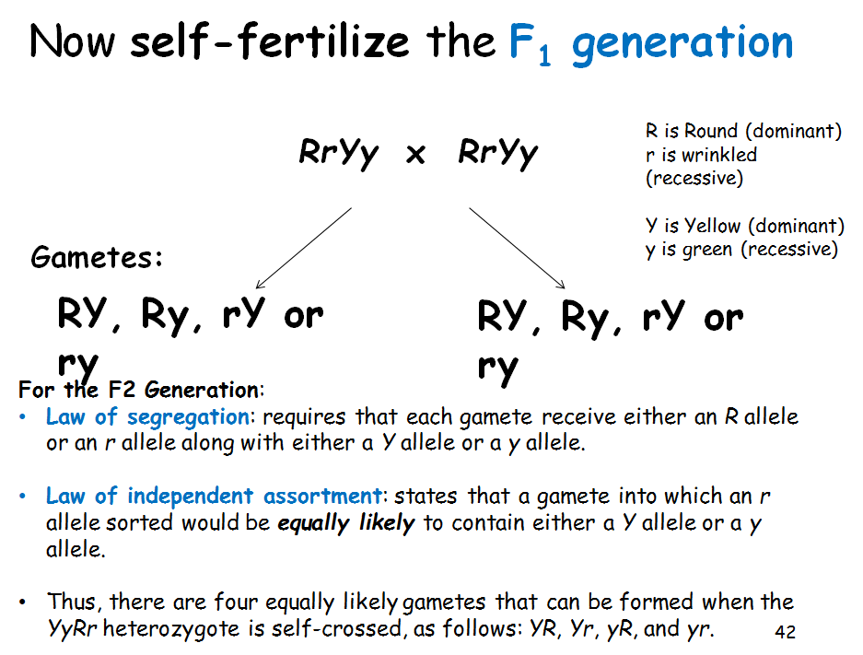

Slide 43
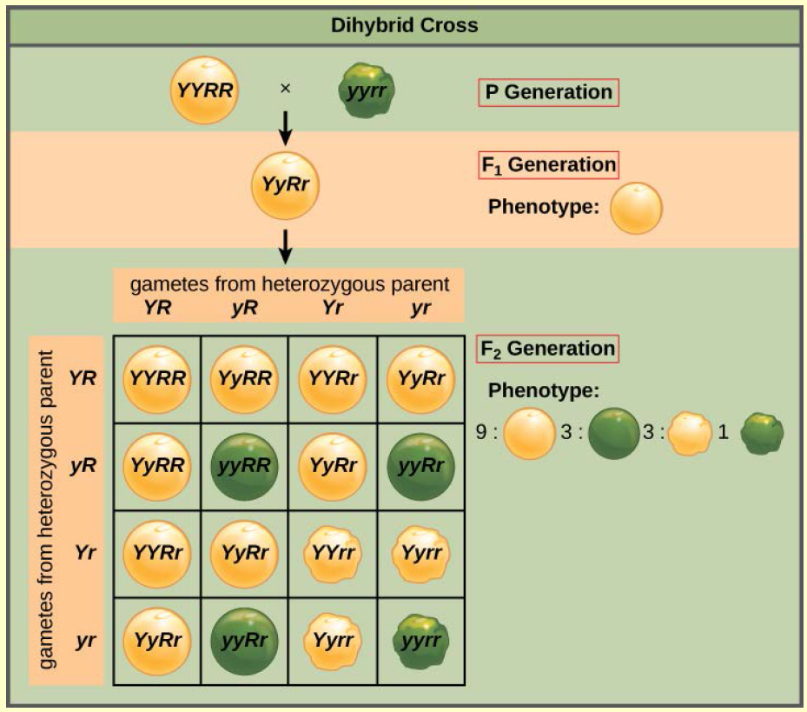
Dihybrid Cross
F₁ x F₁ =
RrYy x RrYy
The F₂ generation shows all four phenotypes
F2 Ratio:
9:3:3:1
9 Round Yellow
3 Round green
3 wrinkled Yellow
1 wrinkled green
Download for free at http://cnx.org/contents/185cbf87-c72e-48f5-b51e-f14f21b5eabd@10.61

Slide 44
Independent Assortment
Law of independent assortment: states that a gamete into which an r allele sorted would be equally likely to contain either a Y allele or a y allele.
Thus, there are four equally likely gametes that can be formed when the YyRr heterozygote is self-crossed, as follows: YR, Yr, yR, and yr.
Peas can be…
Yellow and round, or green and round
Yellow and wrinkled, or green and wrinkled
Remember how homologous chromosomes align independently in meiosis (metaphase I)

Slide 45
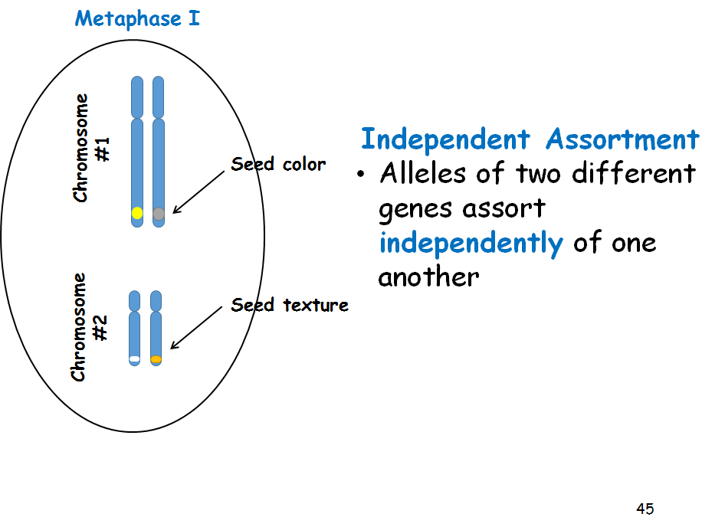

Slide 46
Dihybrid Cross
A male rabbit with the genotype GGbb is crossed with a female rabbit with the genotype ggBb The square is set up below. Fill it out and determine the phenotypes and proportions in the offspring.
How many out of 16 have grey fur and black eyes? ____
How many out of 16 have grey fur and red eyes? _____
How many out of 16 have white fur and black eyes? ____
How many out of 16 have white fur and red eyes? _____
G = grey fur
g = white fur
B = black eyes
b = red eyes

Slide 47
Dihybrid Cross
A male rabbit with the genotype GgBb is crossed with a female rabbit with the genotype GgBb The square is set up below. Fill it out and determine the phenotypes and proportions in the offspring.
How many out of 16 have grey fur and black eyes? ____
How many out of 16 have grey fur and red eyes? _____
How many out of 16 have white fur and black eyes? ____
How many out of 16 have white fur and red eyes? _____
G = grey fur
g = white fur
B = black eyes
b = red eyes

Slide 48
Alternatives to Dominance and Recessiveness
Mendel’s experiments with pea plants suggested that:
Two “units” or alleles exist for every gene
Alleles maintain their integrity in each generation (no blending)
In the presence of the dominant allele, the recessive allele is hidden and makes no contribution to the phenotype
Further genetic studies in other plants and animals have shown that much more complexity exists, but that the fundamental principles of Mendelian genetics still hold true

Slide 49
Figure 12.7
Incomplete Dominance
Incomplete dominance, denoting
the expression of two contrasting alleles such that the individual displays an intermediate phenotype
A cross between a homozygous
parent with white flowers (C^{W}C^{W}) and a homozygous parent with red flowers (C^{R}C^{R}) will produce offspring with pink
flowers (C^{R}C^{W})
These pink flowers of a heterozygote snapdragon result from incomplete dominance. (credit: “storebukkebruse”/Flickr)
Download for free at http://cnx.org/contents/185cbf87-c72e-48f5-b51e-f14f21b5eabd@10.61

Slide 51
Examples
A man with type A blood is married to a woman with type O blood. What are ALL of the possible blood types of their children.
A man with type AB blood is married to a woman with type AB blood. What are all the possible blood types of their children?

Slide 52
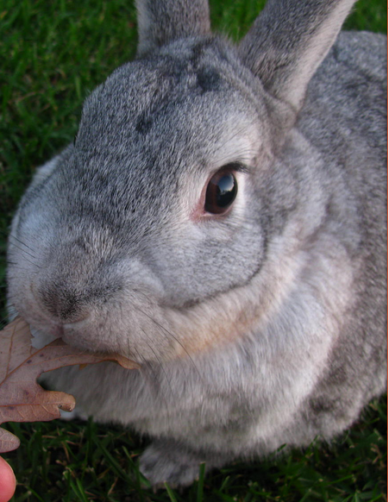
Multiple Alleles
Mendel: only two alleles, one dominant and one recessive exist for a given gene
Multiple alleles may exist at the population level such that many combinations of two alleles are observed
The most common phenotype or genotype among wild animals as the wild type (often abbreviated “+”)
All other phenotypes or genotypes are considered variants
Caption: Rabbit (c) Wikipedia, Public domain

Slide 53
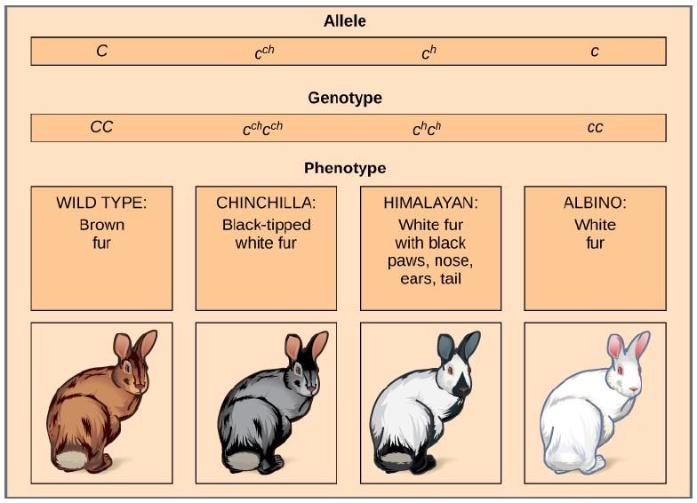
Multiple Alleles
Four different alleles exist for the rabbit coat color (C) gene.
>
>
>
In this case, the wildtype allele is dominant over all the others, chinchilla is incompletely dominant over Himalayan and albino, and Himalayan is dominant over albino.
Download for free at http://cnx.org/contents/185cbf87-c72e-48f5-b51e-f14f21b5eabd@10.61

Slide 55
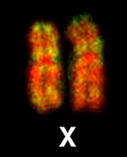
Sex Chromosomes
The sex of a human is determined by the Y chromosome
Chromosomes XX = female
Chromosomes XY = male
Humans have 46 total chromosomes
22 pairs are autosomes
1 pair of sex chromosomes
XX = female
XY = male
Caption: XX (c) Wikipedia, Public domain
Caption: XY (c) Wikipedia, Public domain

Slide 56
Sex Linkage and Human Traits and Disease
X-linked human diseases: color blindness, hemophilia, and muscular dystrophy
Because human males need to inherit only one recessive mutant X allele to be affected, X-linked disorders are disproportionately observed in males.
Females must inherit recessive X-linked alleles from both of their parents in order to express the trait
Therefore, recessive X-linked traits appear more frequently in males than females

Slide 59
Sex Linkage and Human Traits and Disease
The son of a woman who is a carrier of a recessive X-linked disorder will have a 50% chance of being affected.
A daughter will not be affected, but she will have a 50% chance of being a carrier like her mother.
Caption: Inheritance (c) Wikipedia, Public domain

Slide 60
Lethality
Occasionally, a nonfunctional allele for an essential gene can arise by mutation and be transmitted in a population as long as individuals with this allele also have a wild-type, functional copy
Depending on what life stage requires this essential gene, individuals with the nonfunctional allele might:
Fail to develop past fertilization
Die in utero
die later in life, but younger than average lifespan
Recessive Lethal: inheritance pattern in which an allele is only lethal in the homozygous form and in which the heterozygote may be normal or have some altered non-lethal phenotype

Slide 61
Lethality
A single copy of the wild-type allele is not always sufficient for normal functioning or even survival
Dominant Lethal: an allele is lethal both in the homozygote and the heterozygote
this allele can only be transmitted if the lethality phenotype occurs after reproductive age.
Dominant lethal alleles are very rare because, the allele only lasts one generation and is not transmitted

Slide 62
Lethality
A dominant lethal example in humans is Huntington’s disease, in which the nervous system gradually wastes away
People heterozygous for the dominant Huntington allele (Hh) will inevitably develop the fatal disease.
Onset of Huntington’s disease may not occur until age 40, well past reproductive maturity
Figure 12.14: The neuron in the center of this micrograph (yellow) has nuclear inclusions characteristic of Huntington’s disease (orange area in the center of the neuron).
Download for free at http://cnx.org/contents/185cbf87-c72e-48f5-b51e-f14f21b5eabd@10.61
(credit: Dr. Steven Finkbeiner, Gladstone Institute of Neurological Disease, The Taube-Koret Center for Huntington's Disease Research, and the University of California San Francisco/Wikimedia)

