Slide 1
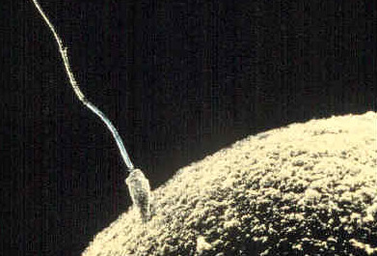
Chapter 11 meiosis
General Biology I
BSC 2010
Dr. Capers
Caption: Sperm-egg (c) unknown, Public domain
OpenStax Biology - https://openstax.org/details/books/biology,
PowerPoint made by Dr. Capers - www.jcapers-irsc.weebly.com

Slide 2
introduction
Mitosis create many genetically identical cells
Asexual reproduction of unicellular organisms.
Growth, development, repair and regeneration in multicellular organisms.
Meiosis produces gametes for sexual reproduction resulting in offspring that are genetically different from parents and each other.

Slide 3
introduction
Sexual reproduction contributes to genetic variation
Gametes from each parent contain one set of chromosomes
Gametes fuse to produce a single cell, the zygote, with two sets of chromosomes
Offspring are genetically different from parents and each other, even before mutations

Slide 4
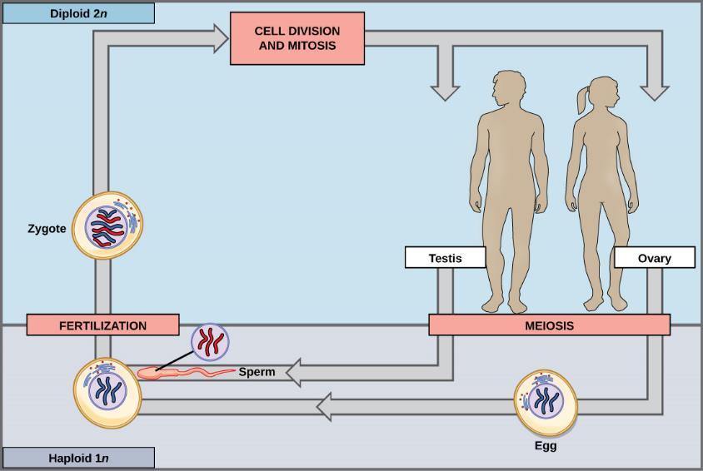
Download for free at http://cnx.org/contents/185cbf87-c72e-48f5-b51e-f14f21b5eabd@10.61

Slide 5
Sperm + Ovum = Zygote
haploid (1n) sperm
diploid (2n) zygote
haploid (1n) ovum

Slide 6
In diploid (2n) multicellular organisms, somatic cells (non-gametes) each contain two sets of chromosomes
For each pair of chromosomes, each parent contributes one homolog
Have corresponding genes but might have different versions of those genes (alleles)

Slide 7
Functions of meiosis:
produce gametes
reduce chromosome number from in half (2n to 1n)
ensure each gamete gets a complete set of chromosomes (one of each pair)
promote genetic diversity of products

Slide 9
Remember that every time the cell divides, the DNA will replicate before
In mitosis, there is only one division
But in order to get down to a haploid # of chromosomes in meiosis, there must be 2 divisions
In Meiosis I, the homologous chromosomes are separated. The number of chromosomes are reduced in half.
In Meiosis II, the sister chromatids are separated. The final products are four haploid gametes (n).

Slide 10
Early in prophase I, homologous chromosomes come together to form a synapse. The chromosomes are bound tightly together and in perfect alignment by a protein lattice called a synaptonemal complex and by cohesin proteins at the centromere.
During this time, crossing over can occur.
Download for free at http://cnx.org/contents/185cbf87-c72e-48f5-b51e-f14f21b5eabd@10.61

Slide 11
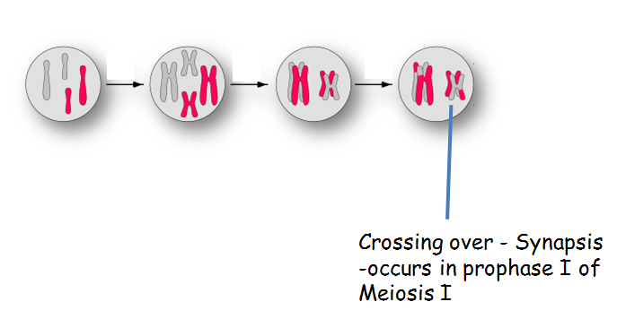
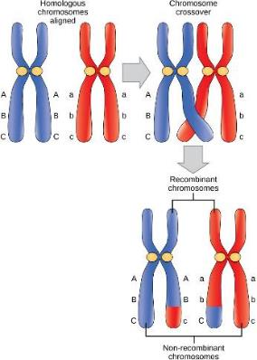
Download for free at http://cnx.org/contents/185cbf87-c72e-48f5-b51e-f14f21b5eabd@10.61

Slide 12
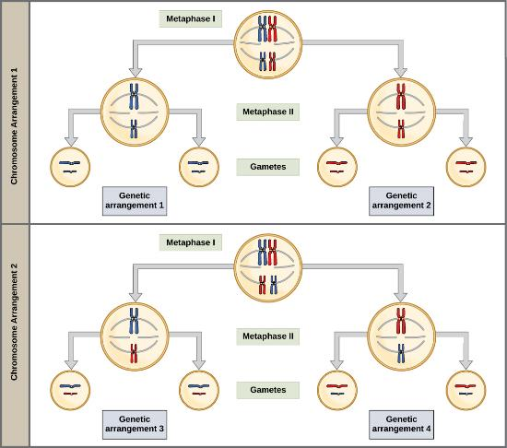
Independent Assortment
Metaphase I of
Meiosis I
Random, independent assortment during metaphase I can be demonstrated by considering a cell with a set of two chromosomes (n = 2). In this case, there are two possible arrangements at the equatorial plane in metaphase I. The total possible number of different gametes is 2n, where n equals the number of chromosomes in a set. In this example, there are four possible genetic combinations for the gametes. With n = 23 in human cells, there are over 8 million possible combinations of paternal and maternal chromosomes
Download for free at http://cnx.org/contents/185cbf87-c72e-48f5-b51e-f14f21b5eabd@10.61

Slide 13
Meiosis
DNA replicates (chromosome # doubled)
Meiosis I
Stages:
Prophase I – synapsis occurs
Metaphase I – homologous chromosome pairs line up (4 chromosomes)
Anaphase I – homologous chromosomes seperate
Telophase I
Results in 2 cells, but still diploid number
Meiosis II
Stages
Prophase II
Metaphase II
Anaphase II – sister chromosomes seperate
Telophase II
Results in 4 cells, haploid number, one of each homologous pair in every cell

Slide 14
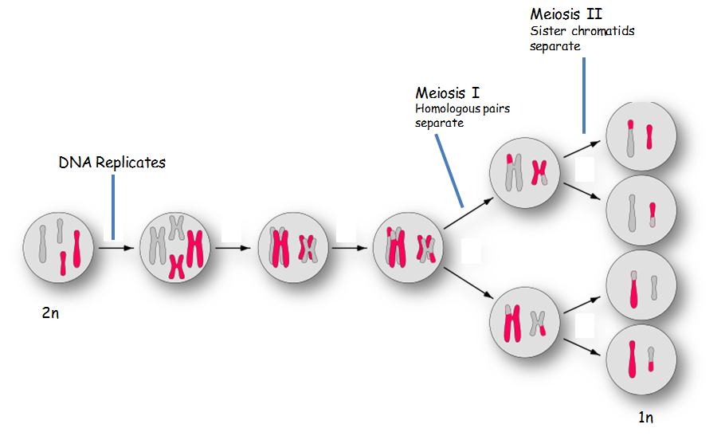

Slide 15
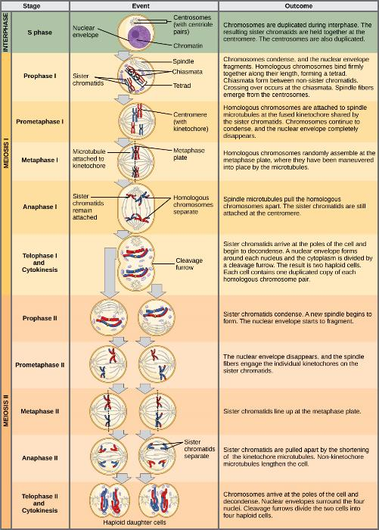
Download for free at http://cnx.org/contents/185cbf87-c72e-48f5-b51e-f14f21b5eabd@10.61

Slide 16
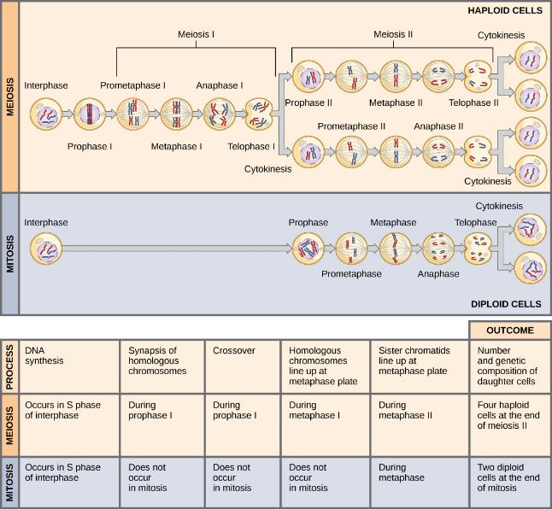
Meiosis vs mitosis
Download for free at http://cnx.org/contents/185cbf87-c72e-48f5-b51e-f14f21b5eabd@10.61

Slide 19
Oogenesis and Spermatogenesis
Oogenesis – meiosis that leads to egg production
Results – 1 usable egg
Spermatogenesis – meiosis that leads to sperm production
Results – 4 usable sperm

Slide 20
Oogenesis
4 cells, but only 1 egg
that can be fertilized
Caption: Gray5 (c) Henry Carter, Public domain

Slide 21
Spermatogenesis
4 sperm cells that can fertilize eggs
Download for free at http://cnx.org/contents/185cbf87-c72e-48f5-b51e-f14f21b5eabd@10.61

Slide 22
nondisjunction
Caption: Mitotic Disjunction (c) Wpeissner, Public domain

Slide 23
nondisjunction
Caption: Nondisjunction Diagrams (c) Tweety207, Public domain

