Slide 1
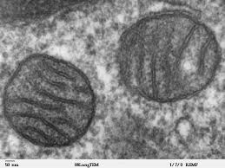
Chapter 5
Structure and Function of Plasma Membranes
Biology for Health Sciences
Dr. Capers
Caption: Mitochondria, Mammalian Lung - TEM (c)Louisa
Howard, Public domain
OpenStax Biology - https://openstax.org/details/books/biology,
PowerPoint made by Dr. Capers - www.jcapers-irsc.weebly.com

Slide 2
Download for free at http://cnx.org/contents/185cbf87-c72e-48f5-b51e-f14f21b5eabd@10.61
The fluid mosaic model of the plasma membrane describes the plasma membrane as a fluid combination of phospholipids, cholesterol, and proteins.
Carbohydrates attached to lipids (glycolipids) and to proteins (glycoproteins) extend from the outward-facing surface of the membrane.

Slide 3
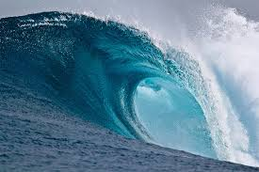
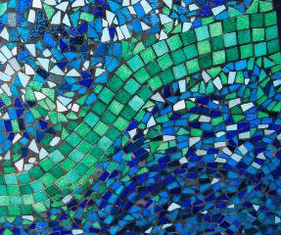
Membrane Structure
Phospholipids arranged in a bilayer.
proteins inserted in the lipid bilayer.
Fluid mosaic model
Fluid Mosaic
Caption: Large Breaking Wave (c)NOAA, Public domain
Caption: Mosaic Patterns (c)Ali Harrison,
Public domain

Slide 4
Membrane Structure
Cellular membranes have 4 components
Phospholipid bilayer
Flexible matrix, barrier to permeability
Transmembrane proteins
Integral membrane proteins
Interior protein network
Peripheral or Intracellular membrane proteins
Cell surface markers
Glycoproteins –sugar that binds to protein
Glycolipids – sugar that binds to lipid

Slide 5
Download for free at http://cnx.org/contents/185cbf87-c72e-48f5-b51e-f14f21b5eabd@10.61
The exterior surface of the plasma membrane is not identical to the interior surface of the same membrane.

Slide 6
Phospholipids
Structure consists of
Glycerol – a 3-carbon alcohol
2 fatty acids attached to the glycerol
Nonpolar and hydrophobic (“water-fearing”)
Phosphate group attached to the glycerol
Polar and hydrophilic (“water-loving”)
Spontaneously forms a bilayer
Fatty acids are on the inside
Phosphate groups are on both surfaces

Slide 7
This phospholipid molecule is composed of a hydrophilic head and two hydrophobic tails.
The hydrophilic head group consists of a phosphate-containing group attached to a glycerol molecule.
The hydrophobic tails, each containing either a saturated or an unsaturated fatty acid, are long hydrocarbon chains.
Download for free at http://cnx.org/contents/185cbf87-c7
2e-48f5-b51e-f14f21b5eabd@10.61

Slide 8
Membrane Proteins
Various functions:
Transporters
Enzymes
Cell-surface receptors
Cell-surface identity markers
Cell-to-cell adhesion proteins
Attachments to the cytoskeleton

Slide 9
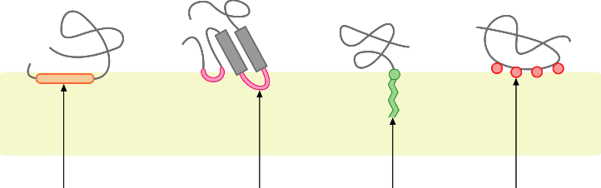
Membrane Proteins
Diverse functions arise from the diverse structures of membrane proteins
Peripheral proteins
Anchoring molecules attach membrane protein to surface
Different peripheral proteins
Caption: Monotopic Membrane Protein (c)Foobar, Public domain

Slide 10
Membrane Proteins
Integral membrane proteins
Span the lipid bilayer (transmembrane proteins)
Download for free at http://cnx.org/contents/185cbf87-c72e-48f5-b51e-f14f21b
5eabd@10.61
Credit: “Foobar”/Wikimedia Commons

Slide 11
Pores
Extensive nonpolar regions within a transmembrane protein can create a pore through the membrane
Cylinder of β sheets in the protein secondary structure (b-barrel)
Interior is polar and allows water and small polar molecules to pass through the membrane

Slide 12
Passive Transport

Slide 13
Passive Transport
Passive Transportation: DOES NOT require energy, goes with the concentration gradient
Simple Diffusion
Facilitated Diffusion
Channel Proteins
Ion Channels
Gated Channel
Carrier proteins
Osmosis

Slide 14
Download for free at http://cnx.org/contents/185cbf87-c72e-48f5-b51e-f14f21b5eabd@10.61
Credit: modification of work by Mariana Ruiz Villareal
Diffusion through a permeable membrane moves a substance from an area of high concentration (extracellular fluid, in this case) down its concentration gradient (into the cytoplasm where the concentration is low).
This will continue until the concentration is the same in all regions (equilibrium).

Slide 15
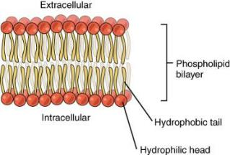
Membrane is Selectively Permeable
Major barrier to crossing a biological membrane is the hydrophobic interior that repels polar molecules but not nonpolar molecules
Nonpolar molecules will move until the concentration is equal on both sides
Limited permeability to small polar molecules
Very limited permeability to larger polar molecules and ions
Caption: 0302 Phospholipid Bilayer (c)OpenStax,
Public domain

Slide 16
Membrane is Selectively Permeable
Facilitated Diffusion:
Molecules that cannot cross membrane easily may move through proteins
Move from higher to lower concentration (passive, no energy!)
Channel proteins
Example: Ion Channels
Carrier proteins
Bind specifically to molecules they assist and “carry” across membrane

Slide 17
Channel Proteins
Ion Channels
Allow the passage of ions
Gated channels: open or close in response to stimulus (chemical or electrical)

Slide 18
Carrier Proteins
Help transport ions and some sugars and amino acids
Requires a concentration difference across the membrane
Must bind to the molecule they transport

Slide 19
Osmosis
Cytoplasm of the cell is an aqueous solution
Water is solvent
Dissolved substances are solutes
Osmosis – net diffusion of water across a membrane toward a higher solute concentration
Some water passes through the membrane in specialized channels called aquaporins.

Slide 20
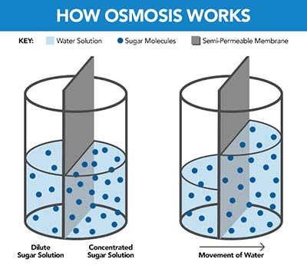
Download for free at http://cnx.org/contents/185cbf87-c72e-48f5-b51e-f14f21b5eabd@10.61
In osmosis, water always moves from an area of higher water concentration (more pure) to one of lower concentration (less pure).
In the diagram shown, the solute cannot pass through the selectively permeable membrane, but the water can.

Slide 21
Osmotic Concentration
When 2 solutions have different osmotic concentrations…
The Hypertonic Solution has a higher solute concentration
The Hypotonic Solution has a lower solute concentration
When two solutions have the same osmotic concentration, the solutions are isotonic
Aquaporins facilitate osmosis

Slide 22
Download for free at http://cnx.org/contents/185cbf87-c72e-48f5-b51e-f14f21b5eabd@10.61
Credit: Mariana Ruiz Villareal
Osmotic pressure changes the shape of red blood cells in hypertonic, isotonic, and hypotonic solutions.

Slide 23
Download for free at http://cnx.org/contents/185cbf87-c72e-48f5-b51e-f14f21b5eabd@10.61
Credit: modification of work by Mariana Ruiz Villareal
The turgor pressure within a plant cell depends on the tonicity of the solution that it is bathed in.

Slide 24
Osmotic Pressure
Osmotic Pressure: Force needed to stop osmotic flow
All organisms must maintain osmotic balance.
By diffusion of water or solutes, osmotic balance ensures that optimal concentrations of electrolytes and non-electrolytes are maintained in cells, body tissues, and in interstitial fluid.
Watch this video: https://www.youtube.com/watch?v=L-osEc07vMs

Slide 25
Active Transport

Slide 26
Active Transport
Active Transportation: requires energy, against concentration gradient

Slide 27
Active Transport
Requires Energy: ATP is used directly or indirectly to fuel active transport
Moves substances from low to high concentration
Requires the use of highly selective carrier proteins

Slide 28
Download for free at http://cnx.org/contents/185cbf87-c72e-48f5-b51e-f1
4f21b5eabd@10.61
Credit: “Synaptitude”/Wikimedia Commons
Electrochemical gradients arise from the combined effects of concentration gradients and electrical gradients.

Slide 29
Active Transport
Carrier proteins used in active transport include
Uniporters: move one molecule at a time
Symporters: move two molecules in the same direction
Antiporters: move two molecules in opposite directions
Terms can also be used to describe facilitated diffusion carriers (when no energy required)

Slide 30
Download for free at http://cnx.org/contents/185cbf87-c72e-48f5-b51e-f14f21b5eabd@10.61
Credit: modification of work by “Lupask”/Wikimedia Commons
A uniporter carries one molecule or ion.
A symporter carries two different molecules or ions, both in the same direction.
An antiporter also carries two different molecules or ions, but in different directions.

Slide 31
Active Transport
Sodium–Potassium (Na⁺–K⁺) Pump:
Direct use of ATP for active transport
Antiporter moves…
3 Na⁺ out of the cell
2 K⁺ into the cell
Against their concentration gradient
ATP energy changes conformation of carrier protein

Slide 32
Caption: Blausen 0818 Sodium-PotassiumPump (c) BruceBlaus, Public domain
Takes ATP
3 sodium ions out, 2 potassium ions in
For more info look at this video: https://www.youtube.com/watch?v=vh166DKxYiM

Slide 33
Active Transport
Coupled Transport:
Uses ATP indirectly; uses Symporter
Molecules moved against their concentration gradient using energy stored in a gradient of a different molecule
Sodium-Glucose Symporter:
Captures the energy from Na⁺ diffusion to move glucose against a concentration gradient

Slide 34
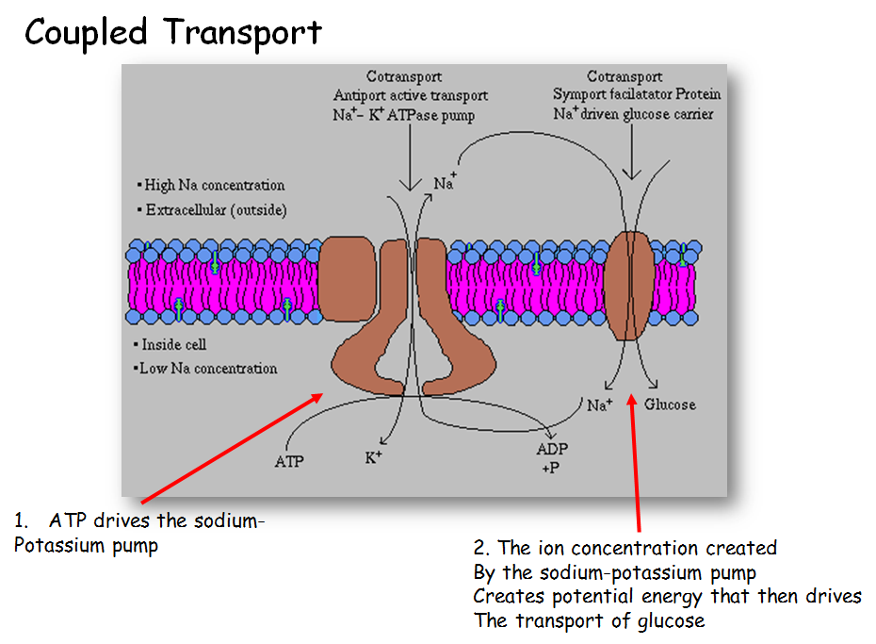

Slide 35
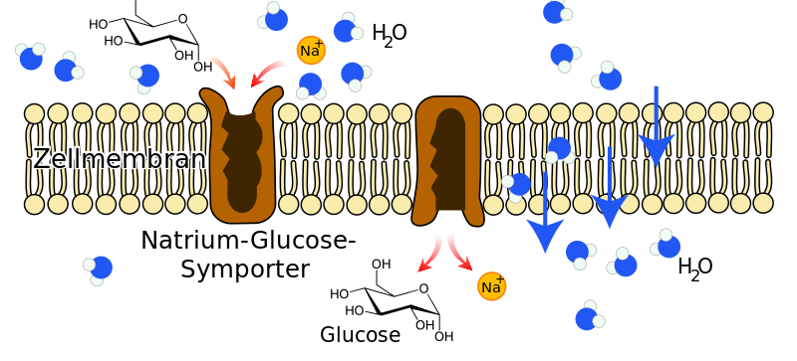
Na⁺ - Glucose Symporter
Caption: Na-Glucose-Symporter (c)Furfur, Public domain

Slide 36
Bulk Transport
Endocytosis
Movement of substances into the cell
Phagocytosis – cell takes in particulate matter
Pinocytosis – cell takes in only fluid
Receptor-mediated endocytosis – specific molecules are taken in after they bind to a receptor, formation of clathrin-coated pits and vesicles
Exocytosis
Movement of substances out of cell
Requires energy

Slide 37
In phagocytosis, the cell membrane surrounds the particle and engulfs it.
Download for free at http://cnx.org/contents/185cbf87-c72e-48
f5-b51e-f14f21b5eabd@10.61
Credit: Mariana Ruiz Villareal

Slide 38
In pinocytosis, the cell membrane invaginates, surrounds a small volume of fluid, and pinches off.
Download for free at http://cnx.org/contents/185cbf87-c72e-4
8f5-b51e-f14f21b5eabd@10.61
Credit: Mariana Ruiz Villareal

Slide 39
In receptor-mediated endocytosis, uptake of substances by the cell is targeted to a single type of substance that binds to the receptor on the external surface of the cell membrane.
Download for free at http://cnx.org/contents/185cbf87-c
72e-48f5-b51e-f14f21b5eabd@10.61
Credit: modification of work by Mariana Ruiz Villareal

Slide 40
In exocytosis, vesicles containing substances fuse with the plasma membrane. The contents are then released to the exterior of the cell.
Download for free at http://cnx.org/contents/185cbf87-c72e-48f5-b51e-f14f21b5eabd@10.61
credit: modification of work by Mariana Ruiz Villareal

