Slide 1
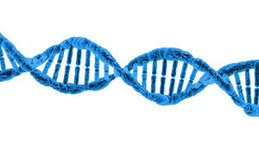
Chapter 3 Macromolecules
Biology for Health Sciences
BSC 1020
Dr. Capers
Caption: DNA Structure (c)Pixabay, Public domain
OpenStax Biology - https://openstax.org/details/books/biology,
PowerPoint made by Dr. Capers - www.jcapers-irsc.weebly.com

Slide 2
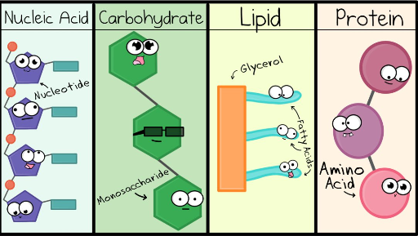
Watch this video: https://www.youtube.com/watch?v=YO244P1e9QM

Slide 3
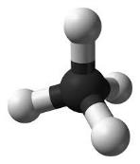
Carbon
Carbon is the perfect “tinker toy” because it can bond with four other elements
Life on Earth is carbon-based - ORGANIC
Framework of organic compounds consists primarily of C bonded to other C, or N, O, P, S, or H
Carbon forms up to 4 covalent bonds
Methane (CH₄)
Caption: Ball-and-stick model of the methane molecule (c)Ben Mills, Public domain

Slide 4
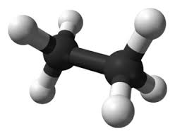
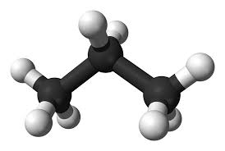
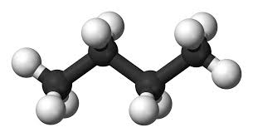
Carbon
Hydrocarbons: molecule consisting only of carbon and hydrogen
Nonpolar - most hydrocarbons (think oil/gas)
Functional groups add chemical properties
Biological molecules are made from hydrocarbon frames, and have functional groups that can make the molecules polar
Ethane Propane Butane
Caption: Ball-and-stick model of the ethane molecule (c)Ben Mills, Public domain
Caption: Ball-and-stick model of the propane molecule (c)Ben Mills, Public domain
Caption: Ball-and-stick model of the butane molecule (c)Ben Mills and Jynto, Public domain

Slide 5
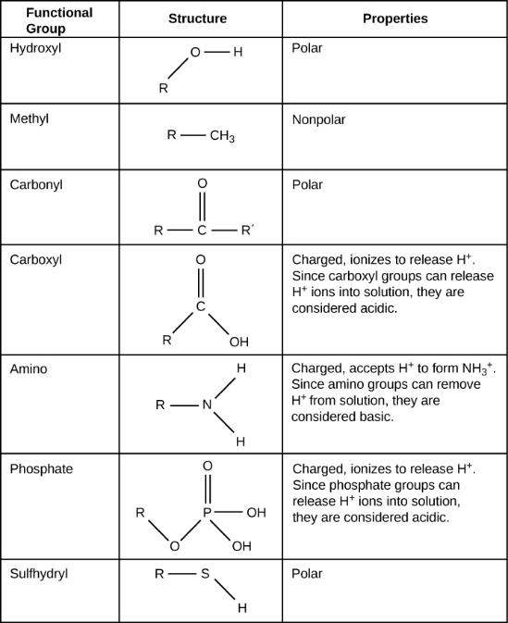
These functional groups can be found in carbohydrates, proteins, lipids, and nucleic acids.
Know all of these functional groups – make flashcards!
Download for free at http://cnx.org/contents/185cbf87-c72e-48f5-b51e-f14f21b5eabd@10.61

Slide 6
Macromolecules are a bunch of monomers linked together to form polymers
Polymer – built by linking monomers
Monomer – small, similar chemical subunits
Monomers
Polymers

Slide 7
4 Types of Macromolecules
Proteins: monomers = amino acids
Carbohydrates: monomers = monosaccharides
3. Nucleic acids: monomers = nucleotides
4. Lipids: aren’t built of monomers but form large complexes considered macromolecules

Slide 8
Building Macromolecules
Dehydration Synthesis
Formation of large molecules by the removal of water
Monomers are joined to form polymers
Monomers
Polymer
Caption: Dehydration Synthesis and Hydrolysis (c) OpenStax College, Public domain

Slide 9
Breaking Macromolecules
Hydrolysis
Breakdown of large molecules by the addition of water (hydro=water, lysis=break)
Polymers are broken down to monomers
Polymer
Monomers
Caption: Dehydration Synthesis and Hydrolysis (c) OpenStax College, Public domain

Slide 10
Let’s talk about the different groups of macromolecules found in organisms

Slide 11
Carbohydrates
Molecules with a 1:2:1 ratio of carbon, hydrogen, oxygen
Empirical formula (CH₂O)_{n}
C-H covalent bonds hold a lot of energy
Carbohydrates are good energy storage molecules
Examples: Sugars, Starch, Glucose
Example: Starch is an energy storage molecule that is formed of glucose molecules linked by covalent bonds through dehydration synthesis.

Slide 12
Carbohydrates
Three Major Groups:
Monosaccharaides - monomer
Disaccharides – 2 monosaccharides
Polysaccharides - polymer

Slide 13
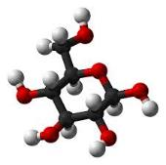
Monosaccharides
Simplest carbohydrates
Monomers for polysaccharides
6 carbon sugars play important roles in biological systems
Hexose sugars (6 carbons)
Glucose C₆H₁₂O₆
_{5 carbon sugars are pentoses}
Glucose (C₆H₁₂O₆)
Caption: Alpha–D-glucose (c)Ben Mills, Public domain

Slide 14
Monosaccharides
Examples of Monosaccharides:
Glucose
Fructose is a structural isomer of glucose
Galactose is a stereoisomer of glucose
Enzymes that act on different sugars can distinguish structural and stereoisomers of this basic six-carbon skeleton

Slide 15
Pentose and hexose sugars can be in linear form or ring form.
We will be looking at glucose in ring form when we review cellular respiration.
Download for free at http://cnx.org/contents/185cbf87-c72e-48f5-b51e-f14
f21b5eabd@10.61

Slide 16
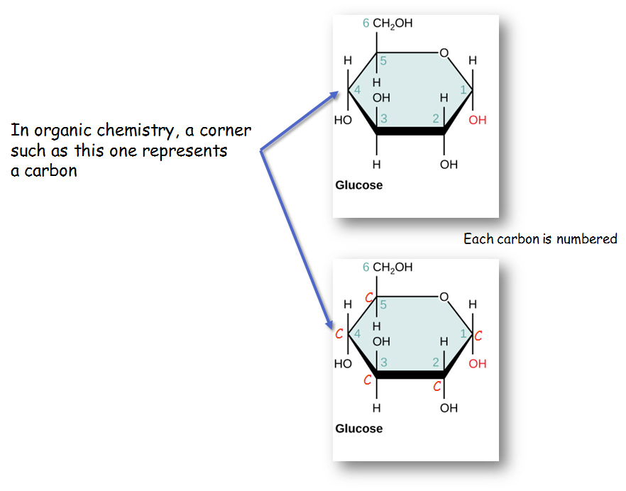

Slide 17
Disaccharides
2 monosaccharides linked together by dehydration synthesis
Used for sugar transport or energy storage
Examples: sucrose, lactose, maltose

Slide 18
Sucrose is formed when a monomer of glucose and a monomer of fructose are joined in a dehydration reaction to form a glycosidic bond. In the process, a water molecule is lost.
Download for free at http://cnx.org/contents/185cbf87-c72e-48f5-b51e-f
14f21b5eabd@10.61

Slide 19
Polysaccharides
Long chains of monosaccharides
Linked through dehydration synthesis
Four major classes:
Starch: energy storage in plants (rice, pasta, potatoes)
Glycogen: short term energy storage in animals
Cellulose: structural molecule of plants (dietary fiber: this is why fiber is listed under the carbohydrate section of food label).
Chitin: structural support in insects, arthropods (exoskeleton), fungal cell walls

Slide 20
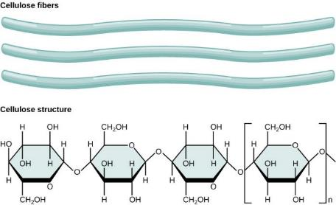
Download for free at http://cnx.org/contents/185cbf87-c7
2e-48f5-b51e-f14f21b5eabd@10.61

Slide 21
Download for free at http://cnx.org/contents/185cbf87-c72e-48f5-b
51e-f14f21b5eabd@10.61
Credit: Louise Docker
Insects have a hard outer exoskeleton made of chitin, a type of polysaccharide.

Slide 22
Carbohydrates:
Monomer – monosaccharides
Covalent bond name – glycosidic linkage

Slide 23
Proteins
Protein functions include:
1. Enzyme catalysis
2. Defense
3. Transport
4. Support
5. Motion
6. Regulation
7. Storage

Slide 24
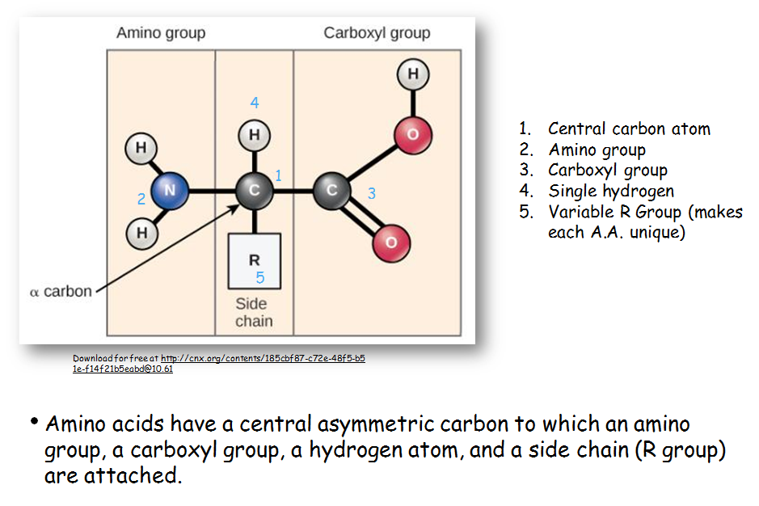

Slide 25
There are 20 common amino acids commonly found in proteins, each with a different R group (blue box) that determines its chemical nature.
You do not have to memorize all 20 individual amino acids
Download for free at http://cnx.org/contents/185cbf87-c72e-48f5-b51e-f14f21b5eab
d@10.61

Slide 26
Download for free at http://cnx.org/contents/185cbf87-c72e-48f5-b51e-f14f2
1b5eabd@10.61
Peptide bond formation is a dehydration synthesis reaction. The carboxyl group of one amino acid is linked to the amino group of the incoming amino acid. In the process, a molecule of water is released.

Slide 27
Proteins
Proteins are polymers made of Amino Acid monomers
There are 20 amino acids
Combinations of these 20 AA make up long chains from 2 to over 5,000 or more AA in length
Each chain is a polypeptide
AA link together by a peptide bond to form the long chain polymers of proteins

Slide 28
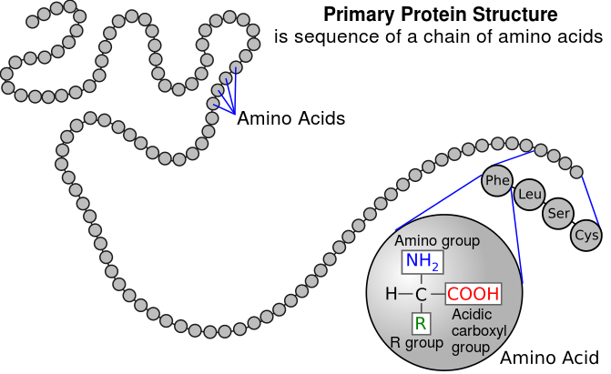
4 Levels of Protein Structure
Primary structure: sequence of amino acids
Amino acids linked by peptide bonds
Millions of different proteins made from the 20 A.A.
A.A. sequence: amino acids given 3 or 1 letter abbreviation
Caption: Primary Protein Structure (c) National Human Genome Research Institute, Public domain

Slide 29
Secondary Protein Structure
Download for free at http://cnx.org/contents/185cbf87-c72e-48f5-b51e-f14f2
1b5eabd@10.61
The α-helix and β-pleated sheet are secondary structures of proteins that form because of hydrogen bonding

Slide 30
Download for free at http://cnx.org/contents/185cbf87-c72e-48f5-b51e-f14f21b5eabd@10.61
The tertiary structure of proteins is determined by a variety of chemical interactions. The alpha helixes and beta pleated sheets fold on each other.

Slide 31
Quaternary structure: arrangement of individual chains (subunits) in a protein with 2 or more polypeptide chains.
Caption: Main Protein Structure Levels
(c)LadyofHats, Public domain

Slide 32
The four levels of protein structure can be observed in these illustrations. (credit: modification of work by National Human Genome Research Institute)
Download for free at http://cnx.org/contents/185cbf87-c72e-48f5-b5
1e-f14f21b5eabd@10.61

Slide 33
Additional Structural Characteristics
Domains
Functional units within a larger structure
Most proteins made of multiple domains that perform different parts of the protein’s function
Example: enzyme’s active site

Slide 34
Chaperones
Chaperone proteins: help proteins fold correctly
Deficiencies in chaperone proteins implicated in certain diseases
Cystic fibrosis is a hereditary disorder
In some individuals, protein appears to have correct amino acid sequence but fails to fold

Slide 35
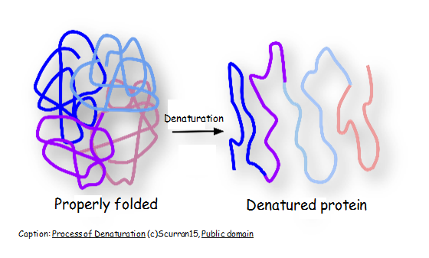
Denaturation
Denature: Protein loses structure and function
Due to environmental conditions
pH
Temperature
Ionic concentration of solution
Sometimes reversible

Slide 36
Proteins
Monomer – amino acids
Covalent bond – peptide bond

Slide 37
Nucleic Acids
Polymer: nucleic acids
Monomers: nucleotides
Nucleotide: sugar + phosphate + nitrogenous base
Sugar is deoxyribose in DNA or ribose in RNA
Caption: DNA Nucleotides (c) OpenStax College, Public domain

Slide 38
Nitrogeneous bases in Nucleotides
Download for free at http://cnx.org/contents/185cbf87-c72e-48f5-b51e-f1
4f21b5eabd@10.61

Slide 39
Sugars in Nucleotides
Two types of pentose are found in nucleotides, deoxyribose (found in DNA) and ribose (found in RNA). Deoxyribose is similar in structure to ribose, but it has an H instead of an OH at the 2′ position.

Slide 40
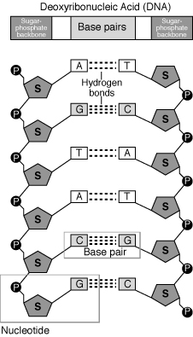
Caption: Nucleotide (c) Mirmillon, Public domain

Slide 41
Deoxyribonucleic Acid (DNA)
Genes: Encodes information for amino acid sequence of proteins
Sequence of bases (A, T, C, G)
Double helix
Base-pairing rules
A with T (or U in RNA)
C with G
DNA Strand 1: T T A C G G A T C
DNA Strand 2: _ _ _ _ _ _ _ _ _

Slide 42
Ribonucleic Acid (RNA)
RNA similar to DNA except
Contains ribose instead of deoxyribose
Contains uracil instead of thymine
Single stranded
RNA plays many roles in the cell
Messenger RNA (mRNA): DNA encodes the information to make proteins, mRNA relays this info to the structures that make proteins
Ribosomal RNA (rRNA)
Transfer RNA (tRNA)
Notes:
)

Slide 43
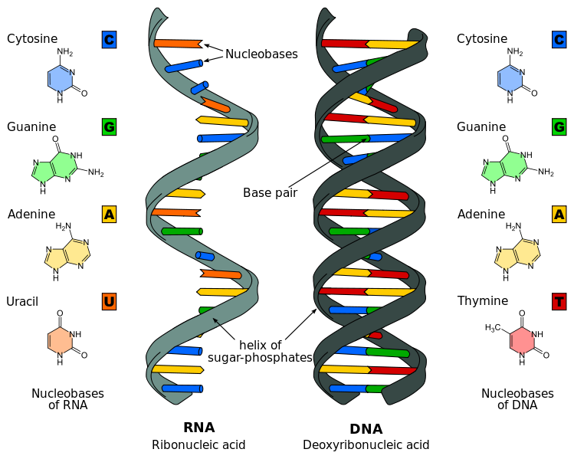
Caption: Difference in DNA and RNA (c)Sponk, Public domain

Slide 44
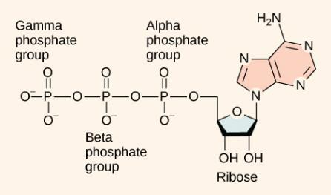
Other nucleotides
ATP Adenosine TriPhosphate
Primary energy currency of the cell
Caption: Figure 06 04 01 – Adenosine Triphosphate (c)CNX Openstax, Public domain

Slide 45
Nucleic Acids
Monomer – nucleotides (made up of phosphate group, sugar and nitrogeneous base)
Covalent bond linking one nucleotide to another – phosphodiester bond
Remember that hydrogen bonds hold the 2 strands of DNA together

Slide 46
Lipids
Group of nonpolar compounds
hydrophobic
insoluble in water
Not polymers
Examples: Fats, oils, waxes, cholesterol, hormones, some vitamins
Excellent for energy storage
Due to high number of C-H bonds

Slide 47
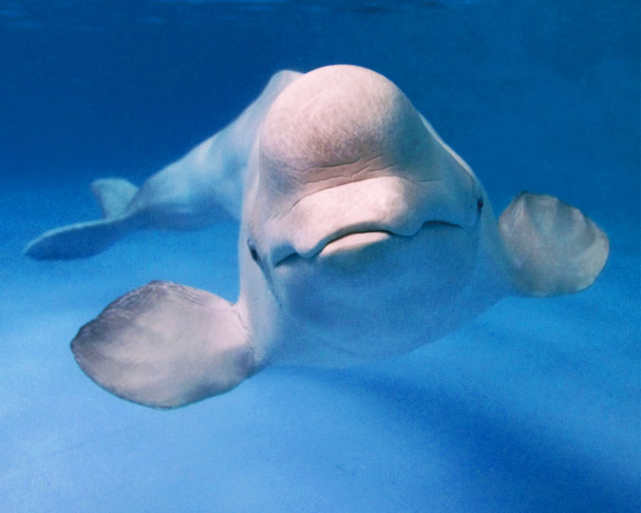
Caption: Premier Beluga (c) Premier, Public domain
Hydrophobic lipids in the blubber of aquatic mammals, such as this river otter, protect them from the elements.

Slide 48
Lipids: Fats
Fatty acids
Saturated: no double bonds between carbon atoms
Higher melting point, animal origin
Solid at room temperature
Unsaturated: 1 or more double bonds
Low melting point, plant origin
Liquid at room temperature
Trans fats: produced industrially

Slide 49
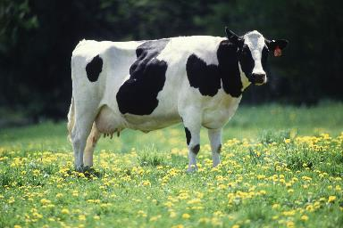
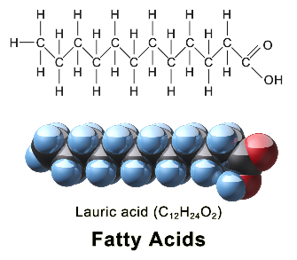
Saturated:
No double bonds
Solid at room temperature
Animal origin
Caption: Cow Female Black White
(c) Keith Weller, Public domain
Caption: Saturated Fatty Acid (c)BruceBlaus,
Public domain

Slide 50
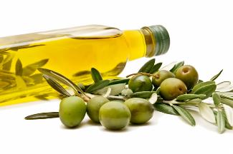
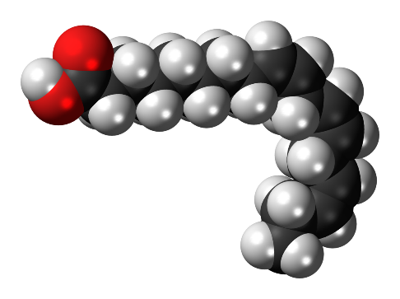
Unsaturated:
1 or more double bonds
Liquid at room temperature due to “kinks”
Plant origin
Caption: Extra Virgin Olive Oil (c)USDA, Public
domain
Caption:Alpha-Linolenic-acid-3D-spacefill (c) Jynto, Public
domain

Slide 51
Download for free at http://cnx.org/contents/185cbf87-c72e-48f5-b51ef14f21b5
eabd@10.61
Credit: Roger Griffith
Waxy coverings on some leaves are made of lipids.

Slide 52
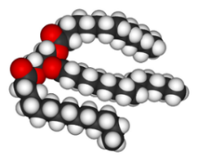
Lipids: Fats
Triglycerides
Composed of 1 glycerol and 3 fatty acids
Caption: Triglycerides (c)OpenStax College, Public domain
Caption: Trimyristin 3D (c)Wikimedia Commons, Public domain

Slide 53
Download for free at http://cnx.org/contents/185cbf87-c72e-48f5-b51e
-f14f21b5eabd@10.61

Slide 54
Download for free at http://cnx.org/contents/185cbf87-c72e-48f5-b51e-f14f21b5eabd@10.61
The phospholipid bilayer is the major component of all cellular membranes. The hydrophilic head groups of the phospholipids face the aqueous solution. The hydrophobic tails are sequestered in the middle of the bilayer.

Slide 55
Steroids such as cholesterol and cortisol are composed of four fused hydrocarbon rings.
Download for free at http://cnx.org/contents/185cbf87-c72e-48
f5-b51e-f14f21b5eabd@10.61

