Slide 1
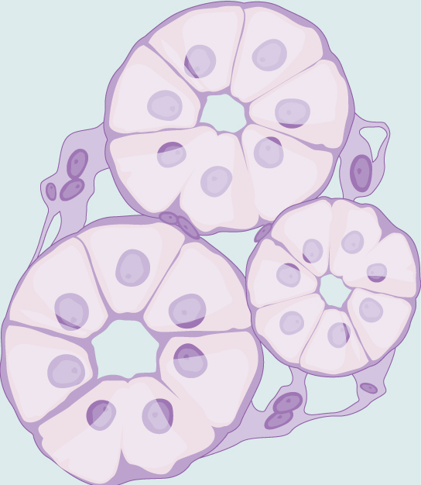
Chapter 33 The Animal Body Plan: Basic Form and Function
Biology For Health Sciences
BSC 1020
Dr. Capers
Download for free at http://cnx.org/contents/185cbf87-c72e-48f5-b51e-f14f21b5eabd@10.61
OpenStax Biology - https://openstax.org/details/books/biology,
PowerPoint made by Dr. Capers - www.jcapers-irsc.weebly.com

Slide 2
Animal Body Plans
Evolution of symmetry in animals
Sponges do lack any definite symmetry
However, all other animals have symmetry - symmetry defined along an imaginary axis drawn through the animal’s body
There are two main types of symmetry:
Radial
Bilateral

Slide 3
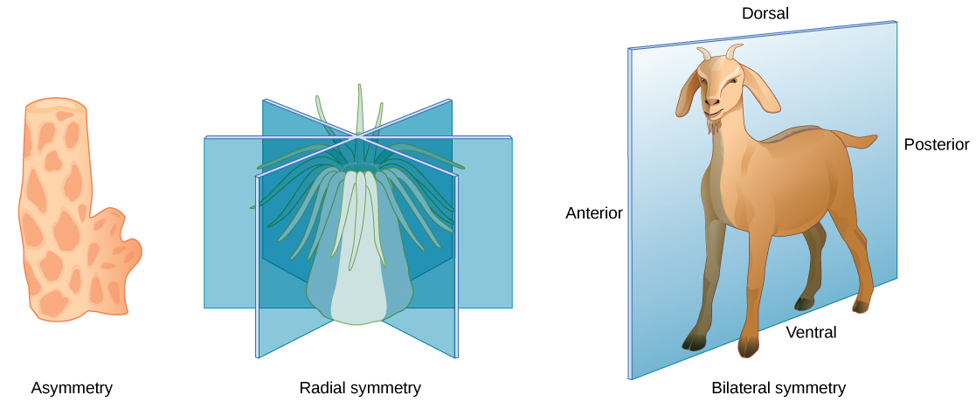
Symmetry
Radial symmetry
Body parts arranged around central axis
Can be bisected into two equal halves in any 2-D plane
Bilateral symmetry
Body has right and left halves that are mirror images
Only the sagittal plane bisects the animal into two equal halves
Download for free at http://cnx.org/contents/185cbf87-c72e-48f5-b51e-f14f21b5eabd@10.61

Slide 4
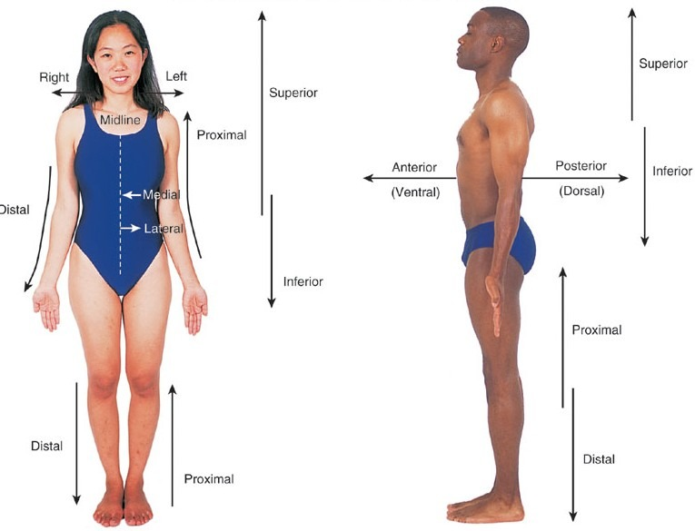
Anatomical Directional Terms

Slide 5
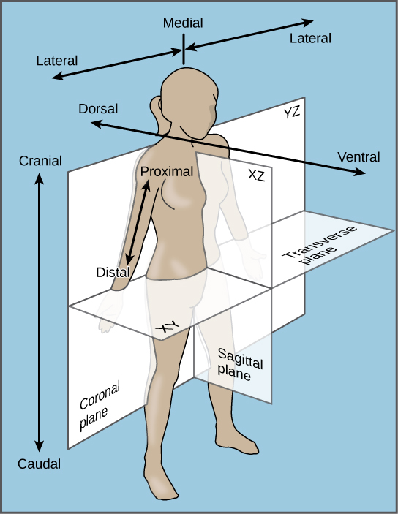
Body Planes

Slide 6
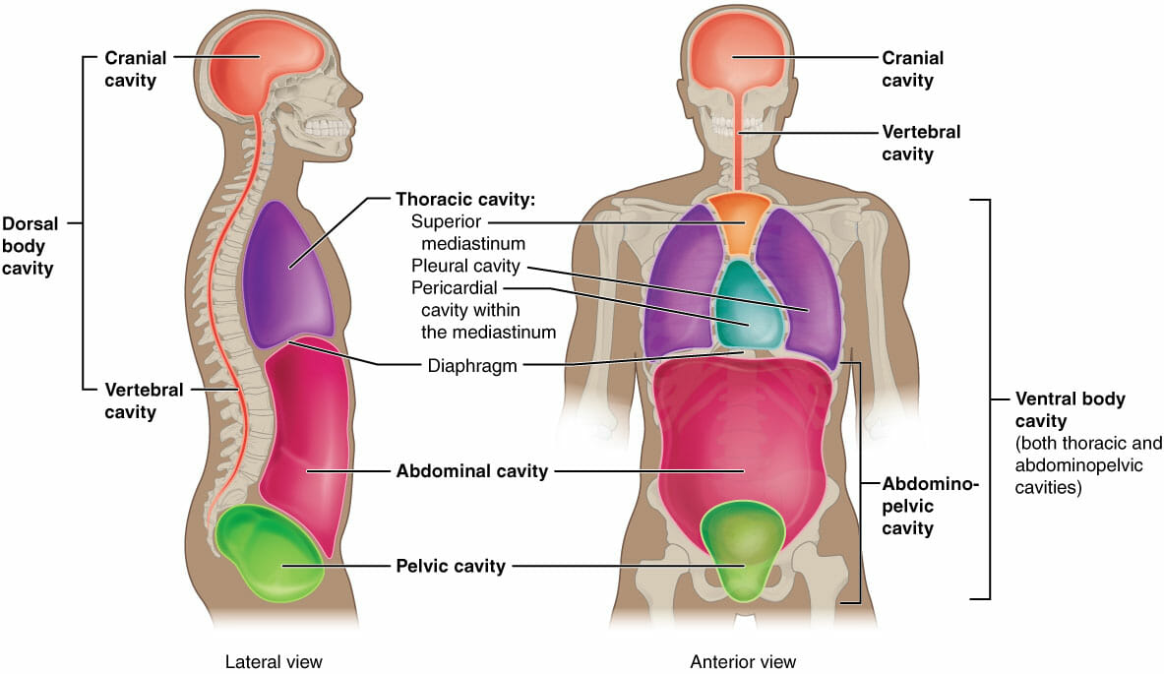
Body Cavities

Slide 7
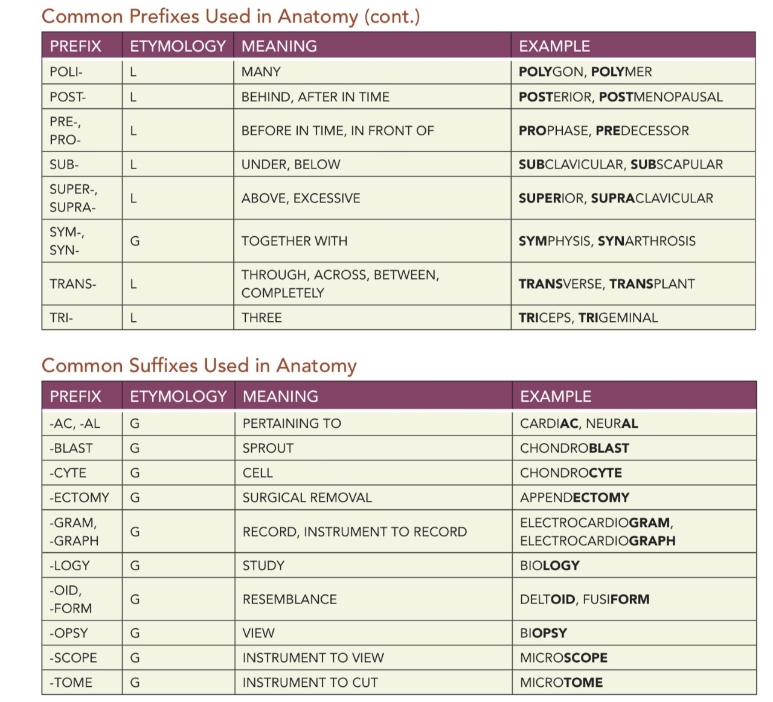
Anatomy Prefixes and Suffixes

Slide 8
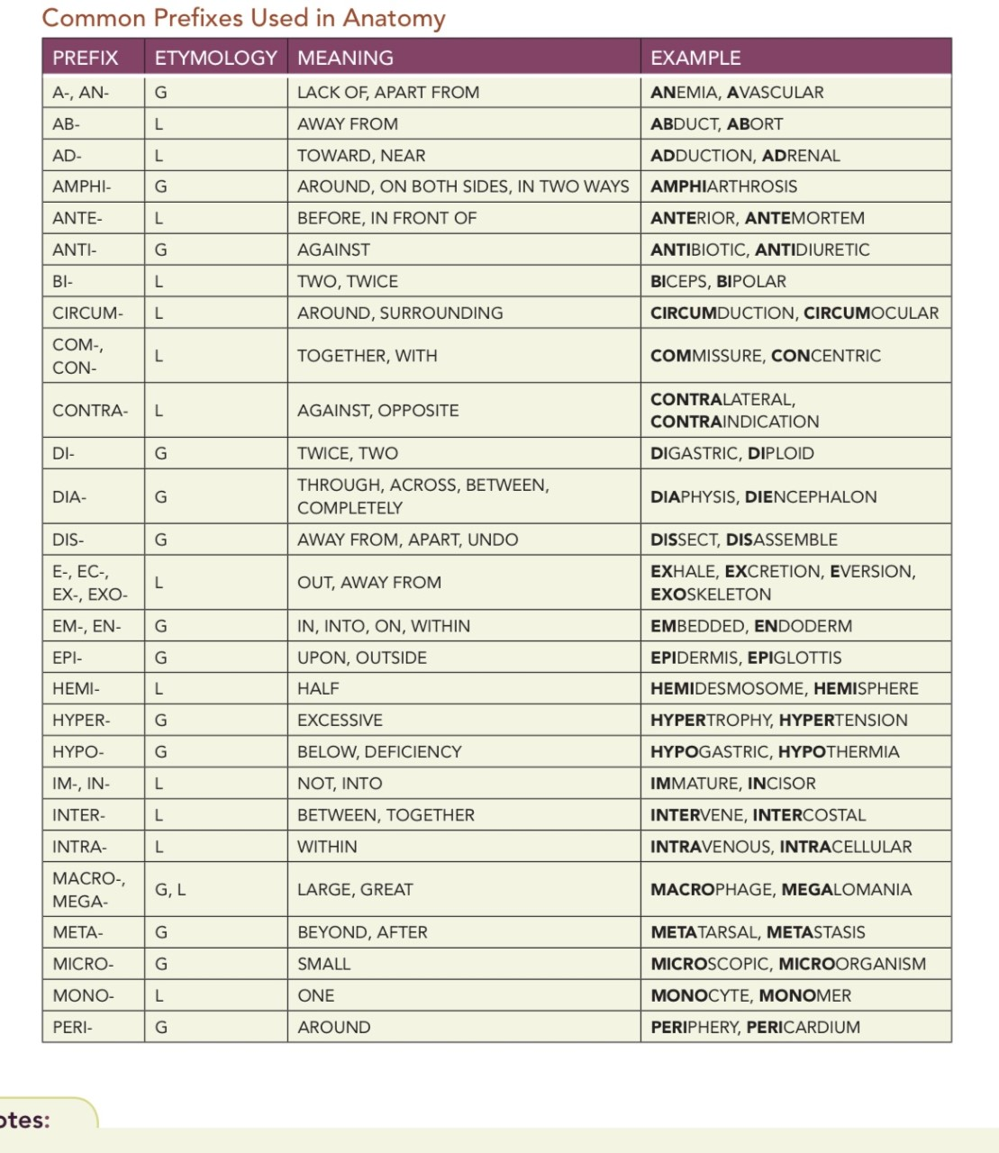

Slide 10
Stem Cells
Embryonic Stem Cells are Pluripotent
Can develop into any cell type in the body
Adult stem cells (and by “adult” I mean fully formed fetus)
Multipotent – have already picked a lineage but can still develop into several different cell types
We need these to replace cells we have to replace a lot through our lifetime
Example – Hematopoietic Stem Cells
Cells found in bone marrow
Can become any blood cell type (red blood cell, B cell, T cell, macrophage, neutrophil, etc)
But can’t become a liver cell, for instance, it is limited on what it can become

Slide 11
Tissues
Evolution of tissues
Sponges – the simplest animals, ack defined tissues and organs
Have the ability to disaggregate and aggregate their cells
all other animals have distinct and well-defined tissues
Have irreversible differentiation for most cell types

Slide 12
Types of Multi-cellular Animal Tissues
There are 4 main types of animal tissues
Epithelia – Line cavities, open spaces, and surfaces
Connective Tissues – Connect tissues together, provide support
Muscles – Generate movement
Neurons – Generate and send electrical signals

Slide 13
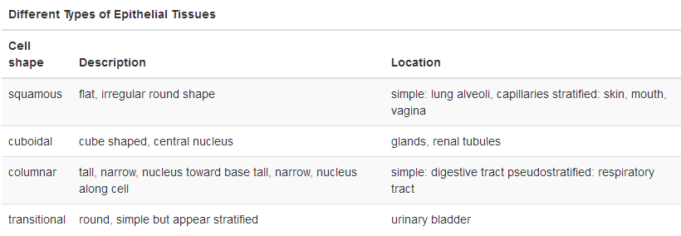
Epithelial Tissue
Epithelial tissues are classified by number of layer and shape of the cell
Single layer = simple Multiple layers = Stratified
Download for free at http://cnx.org/contents/185cbf87-c72e-48f5-b51e-f14f21b5eabd@10.61

Slide 14
Caption: Illu Epithelium (c) M Kubica, Public domain

Slide 15
Squamous Epithelial
Simple Squamous
Stratified Squamous
Lining capillaries
and aveoli in lungs
Skin, lots of wear
and tear
Download for free at http://cnx.org/contents/185cbf87-c72e-48f5-b51e-f14f21b5eabd@10.61

Slide 16
Cuboidal Epithelial
Simple Cuboidal
Tubules in kidneys
Download for free at http://cnx.org/contents/185cbf87-c72e-48f5-b51e-f14f21b5eabd@10.61

Slide 17
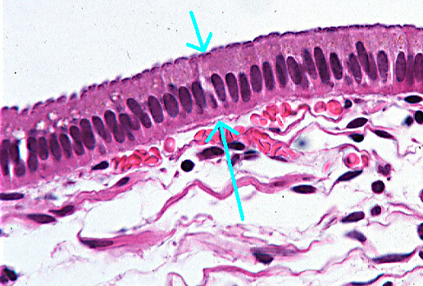
Simple Columnar Epithelial
Small intestine
Download for free at http://cnx.org/contents/185cbf87-c72e-48f5-b51e-f14f21b5eabd@10.61

Slide 18
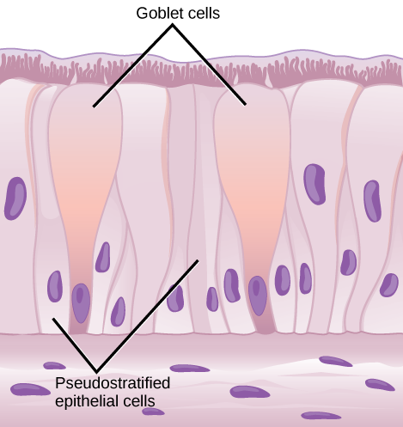
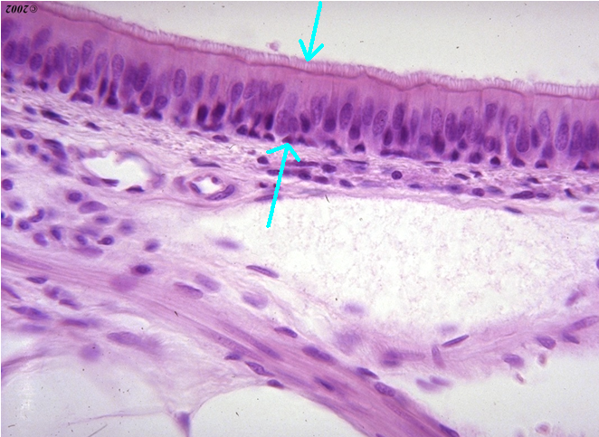
Pseudostratified Ciliated Columnar Epithelial
In the trachea
Download for free at http://cnx.org/contents/185cbf87-c72e-48f5-b51e-f14f21b5eabd@10.61

Slide 19
Connective Tissue
Consist of cells (fibroblasts) embedded in a non-cellular matrix
Matrix usually composed of a ground substance
Ground substance usually contains some combination of collagen, elastic, or reticular fibers
Connective tissues are used to connect different tissues or give the body structure (blood has unique functions)

Slide 20
Connective Tissue

Slide 22
Muscle Tissues
Three kinds: Skeletal, Smooth, and Cardiac
Skeletal – voluntary, striated
Smooth – involuntary, no striations
Cardiac – involuntary, striated, intercalated discs
Download for free at http://cnx.org/contents/185cbf87-c72e-48f5-b51e-f14f21b5eabd@10.61

Slide 23
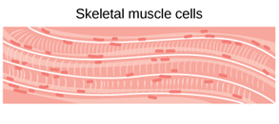
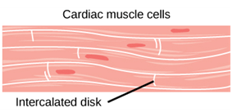
Muscle Tissue
Download for free at http://cnx.org/contents/185cbf87-c72e-48f5-b51e-f14f21b5eabd@10.61

Slide 24
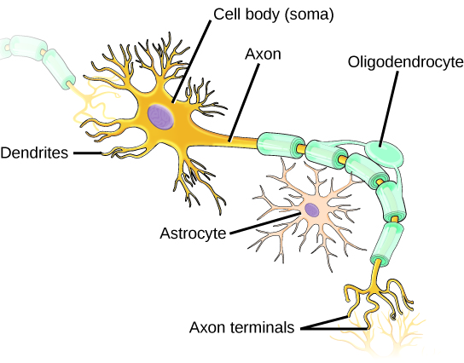
Nervous Tissue
Consists of Neurons and Neuroglia
Generate and transmit electrical impulses
Download for free at http://cnx.org/contents/185cbf87-c72e-48f5-b51e-f14f21b5eabd@10.61

