Slide 1
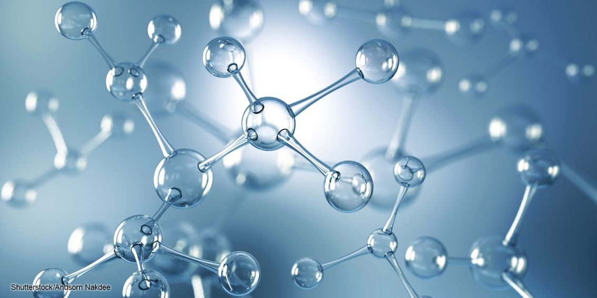
Chapter 2 - Chemistry
Biology for Health Sciences
BSC 1020
Dr. Capers
Download for free at http://cnx.org/contents/185cbf87-c72e-48f5-b51e-f14f21b5eabd@10.61
OpenStax Biology - https://openstax.org/details/books/biology,
PowerPoint made by Dr. Capers - www.jcapers-irsc.weebly.com

Slide 2
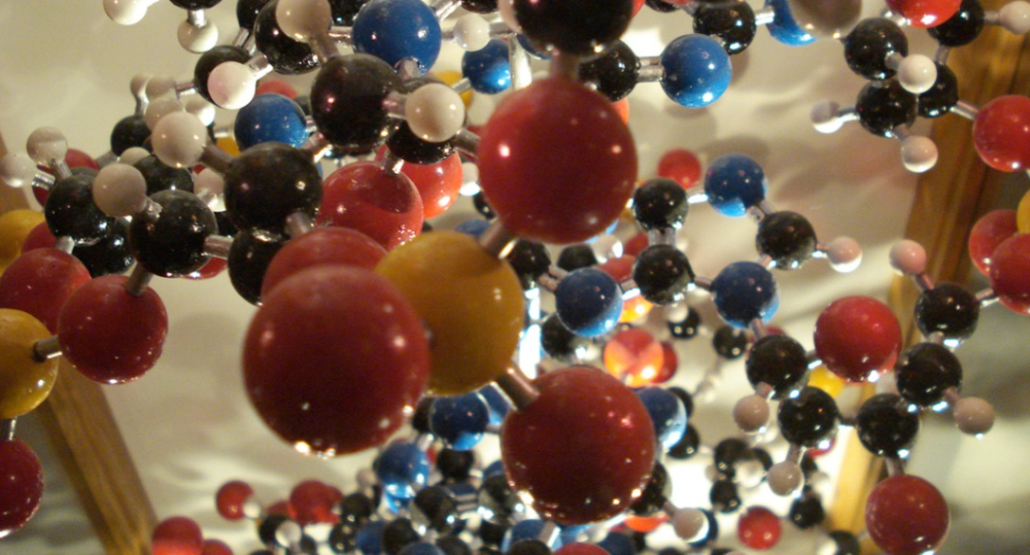
Atoms are the Building Blocks
Atoms are the building blocks of molecules found in the universe—air, soil, water, rocks . . . and the macromolecules found in living things.
All biological processes follow the laws of physics and chemistry.
Therefore, it is important to understand some basic chemistry.

Slide 4
Matter
Matter is any substance that occupies space and has mass.
Each element is a specific form of matter with specific properties.
The atoms of an element cannot be broken down into smaller parts by ordinary chemical reactions.
There are over 100 known elements.
Some are man-made.
Some are unstable.
Each element is designated by a chemical symbol.

Slide 5
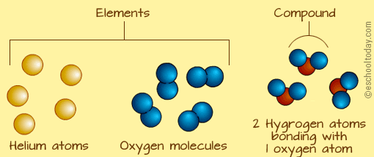

Slide 6
Download for free at http://cnx.org/contents/185cbf87-c72e-48f5-b51e-f14f21b5eabd@10.61

Slide 7
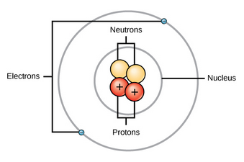
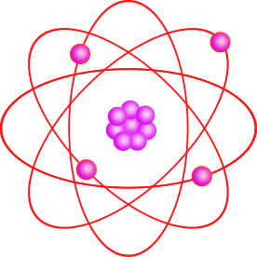
The Structure of an Atom
Download for free at http://cnx.org/contents/185cbf87-c72e-48f5-b51e-f14f21b5eabd@10.61
Caption: Atom Clipart violet (c) MarekM, Public domain
An atom is the smallest unit of an element.
Each type of atom has a specific number of subatomic particles
Protons, neutrons, electrons
The central atomic nucleus has protons and neutrons.
The outer region has the electrons.

Slide 8
Particles in an atom have electric charges and masses.
Download for free at http://cnx.org/contents/185cbf87-c72e-48f5-b51e-f14f21b5eabd@10.61
Electrons contribute very little to an atom’s mass. So little, it is customary to ignore their mass.
Note: An “amu” (atomic mass unit) is sometimes referred to as a “dalton” to honor John Dalton’s work on atomic theory (1800s).

Slide 10
Atomic Number - # of protons
The atomic number is the number of protons in an atom.
Each element has a characteristic atomic number.
Carbon atoms have an atomic number of 6.
Hydrogen atoms have an atomic number of 1.
Atomic number cannot change without changing to a different element!

Slide 11
Mass Number - # of protons + neutrons
The mass number is the number of protons and neutrons in an atom.
Mass number is an approximation of the atom’s mass, since it ignores the very tiny contribution of the electrons.
Each element has isotopes where neutron number changes
Protons cannot change (you change the element if that happens)
Since there can be several isotopes of an element, atomic mass is an average of all of those
Some isotopes are unstable – radioisotopes (radioactive)

Slide 12
Isotopes of Hydrogen
Caption: Hydrogen Isotopes (c) BruceBlaus, Public domain

Slide 13
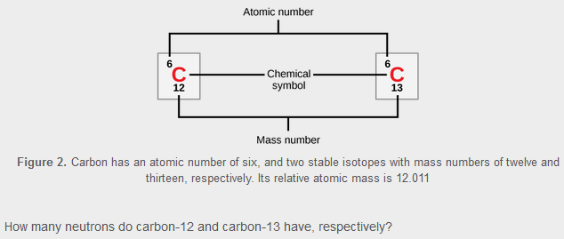
Two Isotopes of Carbon
Download for free at http://cnx.org/contents/185cbf87-c72e-48f5-b51e-f14f21b5eabd@10.61

Slide 14
Radioisotopes
Let’s look at this video:
https://www.youtube.com/watch?v=cKJMk2Oiod0
https://www.youtube.com/watch?v=s0TtHjuEE5Y
Every radioisotope has a half life – that half life can be measured

Slide 15
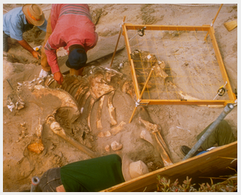
Using Radioactive Decay to Date Fossils and Rocks
¹²C has a radioisotope- ¹⁴C
¹⁴C is made when ¹⁴N is hit with cosmic rays in the atmosphere and gains a neutron and loses proton
Organisms take in ¹²C and ¹⁴C throughout their lifetime
When an organism dies, it stops taking in Carbon
The ¹⁴C that is in the body will begin to decay, then the level can be measures
Download for free at http://cnx.org/contents/185cbf87-c72e-48f5-b51e-f14f21b5eabd@10.61

Slide 16
Carbon Dating Video:
https://www.youtube.com/watch?v=2io5opwhQMQ
Fossils that might be older (let’s say million of years old) have to be aged using different elements found in the body (potassium for instance) that have longer half lives

Slide 17
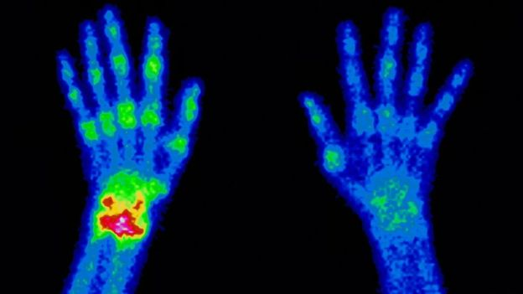
Some radioisotopes can be dangerous to living tissue
Radiation therapy can kill fast growing cancer cells (but can also damage good tissue)
Non-harmful radioisotopes can be used as tracers for diagnostic procedures

Slide 18
The Periodic Table of the Elements
Download for free at http://cnx.org/contents/185cbf87-c72e-48f5-b51e-f14f21b5eabd@10.61

Slide 19
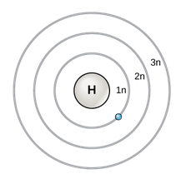
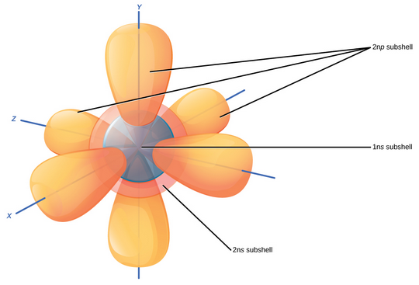
Models Explain Atom Structure
Bohr Model of Electron Shells
3-D Model of Subshells and Orbitals
Download for free at http://cnx.org/contents/185cbf87-c72e-48f5-b51e-f14f21b5eabd@10.61

Slide 21
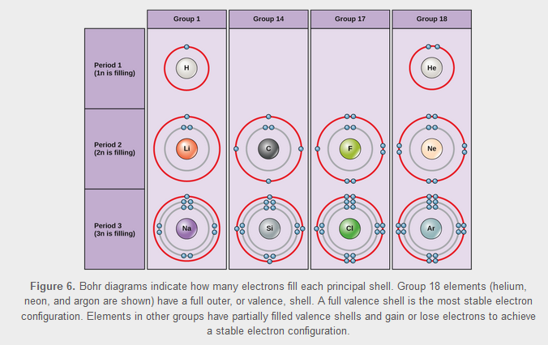
Electrons Fill the Innermost Shell First
The outermost shell is the valence shell.
Download for free at http://cnx.org/contents/185cbf87-c72e-48f5-b51e-f14f21b5eabd@10.61

Slide 22
Neutral vs. Charged Atoms
A typical atom is “neutral” (has no overall charge) because the number of protons (+) matches the number of electrons (-).
The equal numbers of plus and minus cancel each other.
Atoms can gain or lose electrons to become ions (charged particles).
An extra electron results in an overall negative charge.
Loss of an electron results in an overall positive charge.

Slide 23
A chemical reaction (formation or breaking of chemical bonds between elements) involves electrons
In a chemical reaction, you are always following the electrons

Slide 24
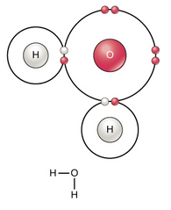
Atoms Can Bond Together to Make Molecules
The differences in chemical reactivity between the elements are based on the number and spatial distribution of an atom’s electrons.
Atoms that chemically react and bond to each other form molecules.
Molecules are simply two or more atoms chemically bonded together.
Electrons play a key roles in forming these bonds.
Download for free at http://cnx.org/contents/185cbf87-c72e-48f5-b51e-f14f21b5eabd@10.61

Slide 26
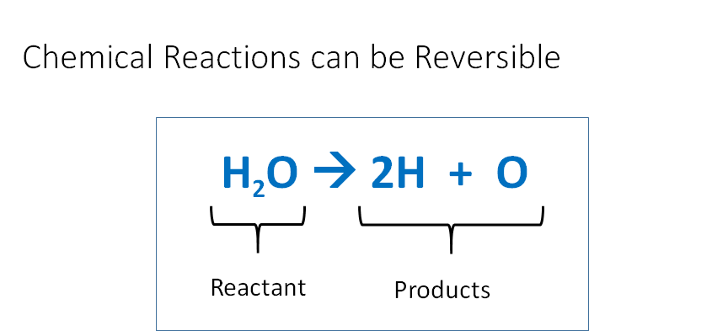

Slide 27
Equilibrium
Reversible reactions proceed in one direction or the other toward equilibrium (based on “the law of mass action”).
In human blood, excess hydrogen ions bind with bicarbonate to form carbonic acid. Adding carbonic acid to the system would drive the reaction toward the left. Loss of carbonic acid would drive it to the right.
Video: https://www.youtube.com/watch?v=X3VdcLD6h9w

Slide 28
Electrons Help Atoms Bond Together in Chemical Reactions
Ionic bonds have transferred electrons.
Their strength varies depending on conditions.
Covalent bonds have shared electrons.
They hold atoms together very strongly.
Nonpolar covalent bonds – electrons equally shared
Polar covalent bonds – electrons are unequally shared
Can result in hydrogen bonds
Weak bonds
Important in biological processes

Slide 29
Ionic Bonds Have Transferred Electrons
Cation (+)
Anion (-)
sodium chloride
Opposite charges attract, holding the atoms together.
Download for free at http://cnx.org/contents/185cbf87-c72e-48f5-b51e-f14f21b5eabd@10.61

Slide 32
Nonpolar vs. Polar Covalent Bonds

Slide 33
Electronegativity with covalent bonds
Very “electronegative” atoms pull strongly on electrons.
Electronegative atoms do not share well with less electronegative atoms.
In a covalent bond between atoms with mismatched electronegativity, the most electronegative atom will keep the shared electrons more than the other atom.
The electron charges are not evenly shared.
One end of the bond has a slight negative charge, the other end a slight positive charge.
This separation of slight charges is what we call a polar covalent bond.

Slide 34
Polar Covalent Bonds
Electrons are not fully transferred like in ionic bonds. They are still shared, but shared unequally.
The unequal sharing results in very slight charges at each end of the bond.
The resulting molecule will have polarity – regions with very slight positive and negative charges.

Slide 36
Now, we can talk about “hydrogen bonds”.
So-called hydrogen bonds happen at areas of polar molecules that have slight charges.
They are so named because of the common role of hydrogen in these bonds- but it’s not just about hydrogen.
Two atoms cannot form a hydrogen bond together.
A hydrogen bond forms when a weakly charged region of a polar molecule attracts the opposite charge.
Example: The positive part of one water molecule can hydrogen-bond to the negative part of another water molecule.

Slide 38
Hydrogen Bonding Between Water Molecules Gives it Properties Essential to Life
Water:
is cohesive (bonds to itself).
This results in surface tension.
is adhesive (bonds to other charged materials).
This permits capillary action.
is less dense when frozen (solid ice floats in liquid water).
has high specific heat capacity (it takes a lot of energy to cool it down or heat it up).
1 calorie of energy will raise the temperature of 1 gram of water by 1 degree Celsius.
has high heat of vaporization (which results in evaporative cooling).
is an excellent solvent for hydrophilic materials.
The charges of water can dissociate polar materials, and ionic materials like table salt.
Hydrophobic materials like oil are nonpolar, have no charges, and do not dissolve well in water.

Slide 39
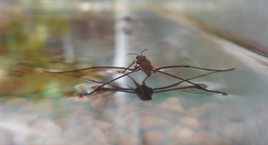
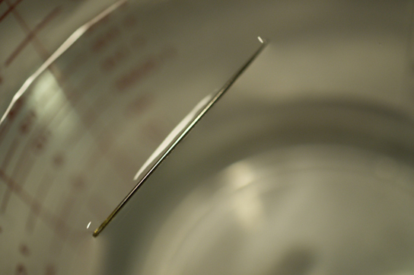
Hydrogen bonding results in surface tension
Download for free at http://cnx.org/contents/185cbf87-c72e-48f5-b51e-f14f21b5eabd@10.61

Slide 40
Hydrogen bonding makes ice less dense than liquid water
Download for free at http://cnx.org/contents/185cbf87-c72e-48f5-b51e-f14f21b5eabd@10.61

Slide 41
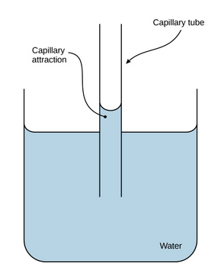
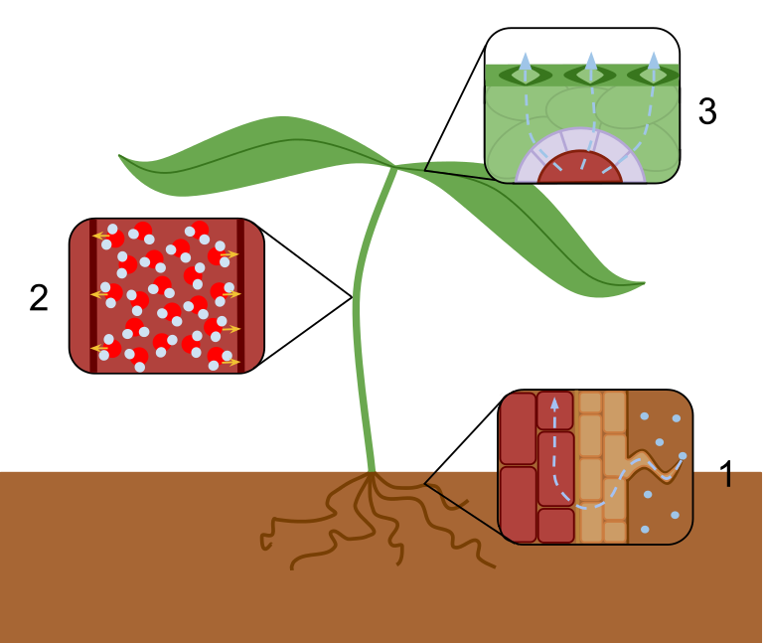
Hydrogen bonding results in capillary action
Download for free at http://cnx.org/contents/185cbf87-c72e-48f5-b51e-f14f21b5eabd@10.61
Caption: Transpiration Overview (c) Laurel Jules, Public domain

Slide 42
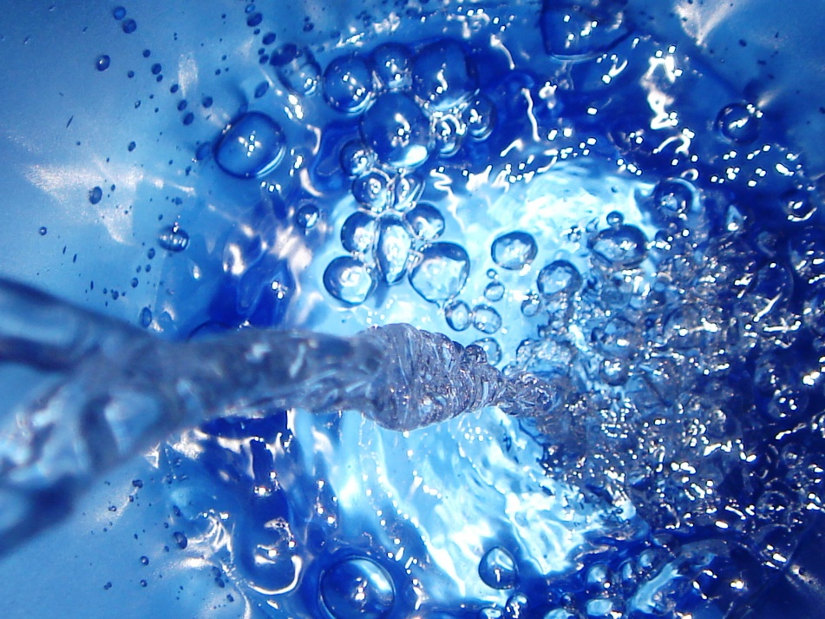
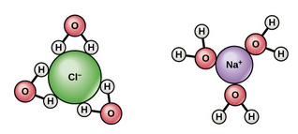
Hydrogen bonding makes water act as a solvent
Download for free at http://cnx.org/contents/185cbf87-c72e-48f5-b51e-f14f21b5eabd@10.61

Slide 43
pH, Buffers, Acids and Bases
A small number of water molecules spontaneously come apart, generating hydrogen ions.
H₂O → H⁺ + OH⁻
pH is a measure of hydrogen ions in solution.
Most living things do best at near-neutral pH.

Slide 44
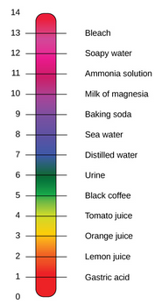
The pH Scale
pH is defined as the negative log of the hydrogen ion concentration.
Pure water has pH 7 (neutral), in the middle.
Acids are at lower pH numbers. (more hydrogen ions)
Bases are at higher pH numbers. (fewer hydrogen ions)
Download for free at http://cnx.org/contents/185cbf87-c72e-48f5-b51e-f14f21b5eabd@10.61

Slide 45
Buffers Maintain pH Homeostasis
Human blood pH is maintained by the carbonic acid/ bicarbonate/CO₂ system shown above.
Buffers can absorb excess H⁺ or excess OH⁻, helping the system resist pH changes.
Download for free at http://cnx.org/contents/185cbf87-c72e-48f5-b51e-f14f21b5eabd@10.61

Slide 46
Carbon
Molecules that contain carbon are known as “organic” molecules.*
Organic Chemistry deals with the chemistry of molecules with carbon in them.
We are carbon based beings.
The valence shell of carbon atoms have 4 missing electrons. This allows them to form 4 covalent bonds with other atoms. Such versatility makes them important building blocks of life.
*Carbon Dioxide is an exception. It is often referred to as “inorganic”. It does not have the carbon-hydrogen bonds characteristic of other organic molecules.

Slide 47
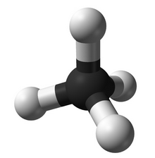
Hydrocarbons
a ball-and-stick model of methane
Hydrocarbons consist of hydrogen and carbon.
They have many covalent bonds that store energy.
Many fuels, such as propane, are hydrocarbons.

Slide 48
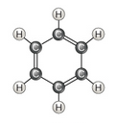
Hydrocarbons Can form Rings and Chains
aromatic aliphatic
Download for free at http://cnx.org/contents/185cbf87-c72e-48f5-b51e-f14f21b5eabd@10.61

Slide 49
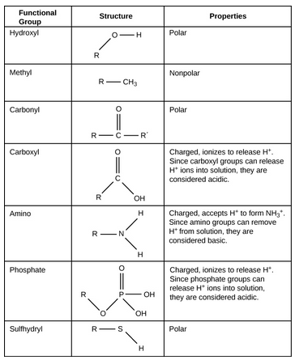
Functional Groups Can be Added to Hydrocarbon Frameworks
Download for free at http://cnx.org/contents/185cbf87-c72e-48f5-b51e-f14f21b5eabd@10.61

