Slide 1
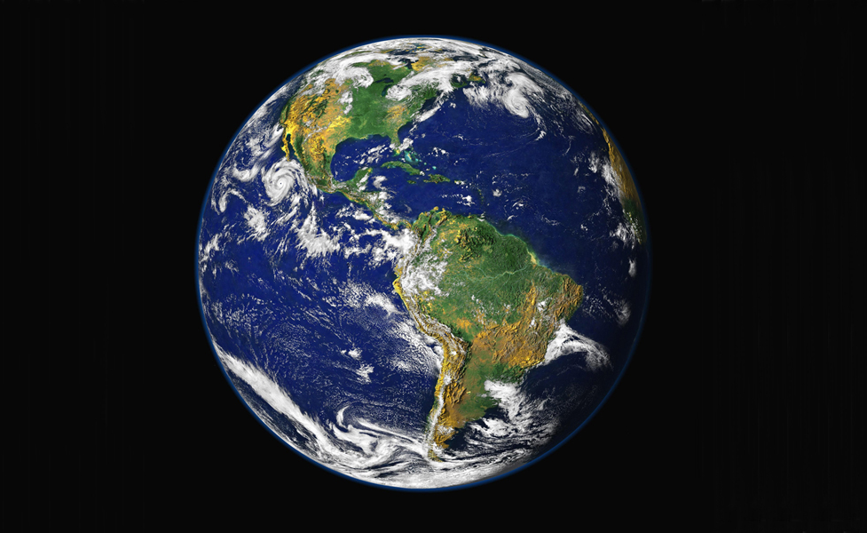
Chapter 1
Biology for Health Sciences
BSC 1020
Dr. Capers
credit: NASA/GSFC/NOAA/USGS

Slide 2
Timeline of Life on Earth
(Approximate)
credit: NASA/GSFC/NOAA/USGS
~4.5 billion years ago – Earth forms after Big Bang
Billions of years ago: microorganisms in the ocean
~3.5 billion – bacteria; ~2.5 – unicellular eukaryotes
180-200 million years ago: - animals and plants familiar to us
2.5 million years ago - genus Homo
200,000 years ago: modern-looking humans (“Homo sapiens”)

Slide 3
The Scope of Biology is Vast
Biology is the study of living organisms and their interactions with one another and their environments.
Biology is interdisciplinary - it intersects with other natural sciences, such as geology, physics, and chemistry, and with computer science, logic, and math.

Slide 4
Inductive and Deductive Reasoning
With inductive reasoning, related specific observations are used to arrive at a general conclusion.
With deductive reasoning, a general principle or law is used to forecast specific results.

Slide 5
Science uses both deductive and inductive reasoning
Inductive reasoning uses specific observations to develop general conclusions
If poodles have hair and terriers have hair, then you might generalize that all dogs have hair
Common in descriptive science
Deductive reasoning uses general principles to make specific predictions
If all mammals have hair and you find an animal that doesn’t, you might say that the animal you are looking at is not a mammal
Used to test the validity of general ideas in all branches of knowledge

Slide 6
Science can be Descriptive and/or Hypothesis-Based
I’ve discovered a new species!
Descriptive science is usually inductive. It involves observation, exploration, and describing.
Hypothesis-based science is usually deductive. It begins with a well-defined idea that can be tested experimentally.
I determined the cause of a disease!
Scientists often combine both of these approaches.

Slide 7
Science can only test what is testable!
Have to be able to gather tangible data that can be subjected to statistical analysis

Slide 8
Scientific Method:
Observations/Questions
Hypothesis/Hypotheses
Experiment
Often takes experiment after experiment after experiment. This could take years in some cases
Results – analyzing the data; data must be statistically significant!!! And data has to be checked to be verified!!
Conclusion
Is the hypothesis supported or rejected?
We never “prove” a hypothesis. Why?
In science, a rejected hypothesis is just as important (still gives us answers and points us in another direction)

Slide 9
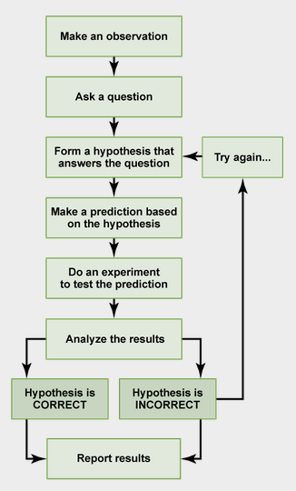
The Scientific Method
A hypothesis:
is a statement (not a question).
must be “falsifiable” (open to being disproved).
is more than an educated guess.
Download for free at http://cnx.org/content/col11448/latest/

Slide 10
What is a Scientific “Theory”?
A scientific theory is not a wild guess.
A theory is a tested and confirmed explanation for observations or phenomena.
A hypothesis may eventually become
a verified theory after it has been tested over and over and accepted by the scientific community.

Slide 11
Scientific theory
Is a body of interconnected concepts
Is supported by much experimental evidence and scientific reasoning
Expresses ideas of which we are most certain
When you say “theory” in biology, it is as close to LAW that you will get to with the information and technology we have available to us at the time
Compare to general meaning of theory
Different in everyday language, implies a lack of knowledge or a guess
Misunderstanding of scientific theory leads to misunderstanding of things like the Theory of Evolution, etc.

Slide 12
Why can’t we have laws in Biology like they do in Physics?
Remember that biology organisms/systems are changing and adapting (evolving)
What is verified today may be different a hundred, thousand years from now
Therefore, we have to modify theories as more information is found out
But for the data we have today, it is “law”

Slide 13
An Experiment Tests a Hypothesis
An experiment is designed to try to refute a hypothesis by testing a variable.
An experimental set is compared to a control set.
The control set is the same as the experimental set in every way- except for the variable being tested.
When there is only one variable being tested, any difference between the sets must be due to that variable.
The exception is when there are additional “uncontrolled variables”. In this case, the results cannot be attributed to the hypothesized variable.

Slide 14
Basic and Applied Science
Basic science seeks to expand knowledge regardless of the short-term application of that knowledge.
The immediate goal of basic science is knowledge for knowledge’s sake.
It may ultimately result in a practical “applied” application.
Applied science aims to use science to solve real-world problems.
In applied science, the problem is usually defined for the researcher.

Slide 15
Peer-Reviewed Literature
Research Results
Papers detailing scientific methods and results are submitted to scientific journals for peer review.
Research reports usually follow the IMRaD* format. (*introduction, materials and methods, results, and discussion)
Qualified colleagues judge whether or not the work is original, significant, logical, thorough and worthy of publication.
Using the work or ideas of others without proper permission and citation is considered plagiarism.
So-called “review” articles do not follow the IMRaD format because they do not present original scientific findings or primary literature; instead, they summarize and comment on findings that were published as primary literature and typically include extensive reference sections.
These are PRIMARY RESOURCES – where you want to get the information

Slide 16
Examples of scientific journals that are primary resources:
Nature
Journal of Molecular Biology
Journal of Immunology
Journal of Ecology
Journal of Virology
Journal of Experimental Medicine

Slide 17
SECONDARY RESOURCES
Magazine articles, internet, books, news reports, newspapers
Many of these do have the correct information
However, anyone can publish anything in these formats
Therefore, caution must be taken when reading the information
The author may not mean to be misleading – they themselves might have misread or misinterpreted the information in Primary Sources
New flash – news reporters and celebrities are not scientists!

Slide 18
Scientific Literacy
It is important for our society to become more scientifically literate
“Science is a constantly self-revising process by which small hypotheses are tested, retested, disproved, modified and retested, slowly and incrementally adding to an increasing understanding of a greater picture.”
~ David McNamee
Because of this, science information can be misinterpreted if you don’t know what you are looking at.
For example, someone who is anti-vaccine might refer to a study done decades ago that looked at the link between vaccines and side effects. However, they don’t refer to the more recent studies in which further study and better information say vaccines are safe.

Slide 19
Misunderstanding of the scientific process and scientific literacy can lead to incorrect views on topics such as vaccinations, climate change, etc.
Watch this video: https://www.youtube.com/watch?v=Rzxr9FeZf1g

Slide 20
Importance of Scientific Literacy:
https://www.youtube.com/watch?v=gFLYe_YAQYQ
https://www.youtube.com/watch?v=8MqTOEospfo&t=133s

Slide 21
Does everyone have to have a higher degree in science in order to be scientifically literate?
No! It is important for everyone, though, to know sources to trust and to be able to ask questions
It is important to emphasize science education from a young age
What else is important? – math, reading ability, history!
Understand that people will manipulate numbers or graphics in order to “scare” to mislead the public on scientific matters –it is up to us to say “hmmm, that may not be correct”
We need more politicians who are scientifically literate!

Slide 22
What are some misconceptions that are associated with a society lacking scientific literacy?
“The Earth is only 6,000 years old.”
“Dinosaurs and humans once co-existed.”
“Evolution isn’t a thing, it’s only a ‘theory’ scientists have so it should not be taught in our schools.”
“There is a cure for cancer but they are keeping it from the public.”
“Climate change is not real.”
“We had so much snow this winter, the Earth is not getting warmer.”
“Vaccines cause autism.”
“Getting the disease is much safer and offers better immunity than getting the vaccine.”
“You can take antibiotics to fight a viral infection.”
“Seasons are caused by Earth’s distance from the Sun.”
“Windmills cause cancer.”
The list is long. Some misconceptions are relatively benign whereas others pose serious dangers to our society.

Slide 23
Properties of Life
Order – cellular organization
Have to be made up of one or more cells
Those cells are organized internally
Sensitivity/Response to Stimuli
Have to respond to environmental stimuli and stimuli from other organisms
Reproduction
Have to be able to make more of yourself (asexual and/or sexual reproduction)
Growth and Development
Organisms have specific patterns for growth and development
Coded for in genes
Regulation
Regulating internal functions
Homeostasis
Maintaining internal conditions despite external conditions (i.e. pH, temperature, ion balance)
Energy Processing
Source of energy for planet is the Sun; however, that energy has to be processed for living organisms to use; an organism then has to intake some of that processed energy to use
Definition of Life: have to be made up of one or more cells that do these things listed

Slide 24
Hierarchy of Life
Caption: The simplest unit of life is the atom, like oxygen.
Two or more atoms is a molecule, like dioxide. Many molecules
is a macromolecule, such as a phospholipid. Multiple macromolecules
form a cell, like a Clara cell. A group of cells functioning together is a
tissue, for example, Epithelial tissue. Different tissues make up an
organ, like a lung. Organs work together to form an organ system,
such as the Respiratory System. All of the organ systems make a living
organism, like a lion. A group of the same organism living together in
an area is a population, such as a pride of lions. Two or more
populations interacting with each other form a community, for example,
lion and zebra populations interacting with each other. Communities
interacting not only with each other but also with the physical environment
encompass an ecosystem, such as the Savanna ecosystem. All of the
ecosystems make up the biosphere, the area of life on Earth.
(c)Mikala14, Public domain

Slide 27
Biosphere = all the livable space on the planet
Where is majority of the biosphere?
Hint:

Slide 28
Cells are prokaryotic or eukaryotic
Prokaryotes – bacteria
Simplistic cells
No membrane bound nucleus or organelles
Eukaryotes – protists, plants, animals, fungi
Complex, larger cells
Membrane bound organelles

Slide 29
Prokaryotes versus Eukaryotes
Caption: Celltypes (c)Snek01, Public domain
Caption: This is a phase contrast image of a cheek cell (c)Spencer Diamond, Public domain
Caption: Bacillus anthracis (c)Bruce Blaus, Public domain

Slide 30
What are the 3 Domains of Life?
Domain Archaea
Includes the extremophile bacteria
Domain Bacteria
Bacteria formerly in Kingdom Monera (includes E. coli, Staph, Strep, etc.)
Domain Eukarya
Includes the protists, Kingdom Fungi, Kingdom Plantae, Kingdom Animalia
Which Domain(s) include the most organisms? Why

Slide 31
Domain Bacteria and Archaea outnumber Domain Eukarya
Think about it – there are literally millions/billions of bacteria just on you and on your stuff
Bacteria far outnumber the number of eukaryotes on the planet

Slide 32
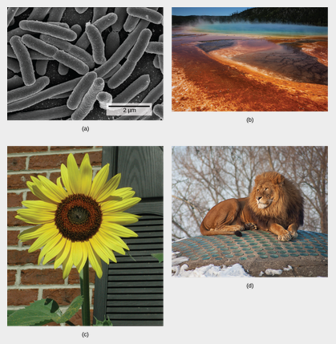
Domain:
Bacteria
Domain:
Archaea (extremophile bacteria in hot spring have that pigmentation
Domain:
Eukarya
(Kingdom: Plants)
Domain:
Eukarya
(Kingdom: Animals)
Download for free at http://cnx.org/contents/185cbf87-c72e-48f5-b51e-f14f21b5eabd@10.61

Slide 33
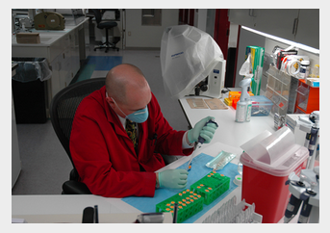
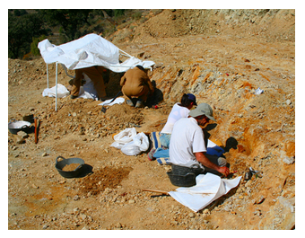
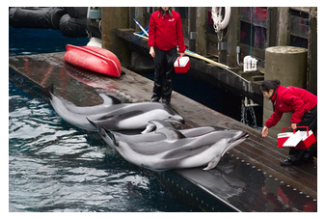
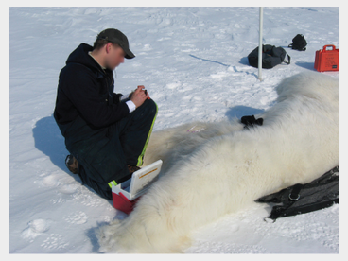
Branches of Biological Study
Molecular Biology
Biochemistry
Microbiology
Zoology
Botany
Biophysics
Neurobiology
Paleontology
… and many more
Download for free at http://cnx.org/contents/185cbf87-c72e-48f5-b51e-f14f21b5eabd@10.61

