Slide 1
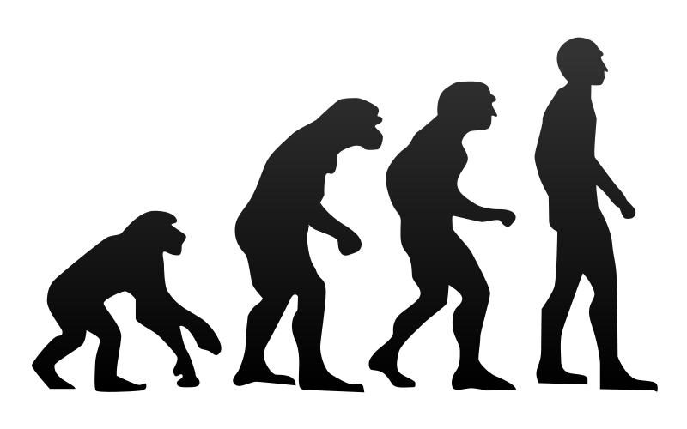
Chapter 18 and 20 Evolution
Biology for Health Sciences
BSC 1020
Dr. Capers
Caption: Human Evolution (c) Tkgd2007, Public domain
OpenStax Biology - https://openstax.org/details/books/biology,
PowerPoint made by Dr. Capers - www.jcapers-irsc.weebly.com

Slide 2
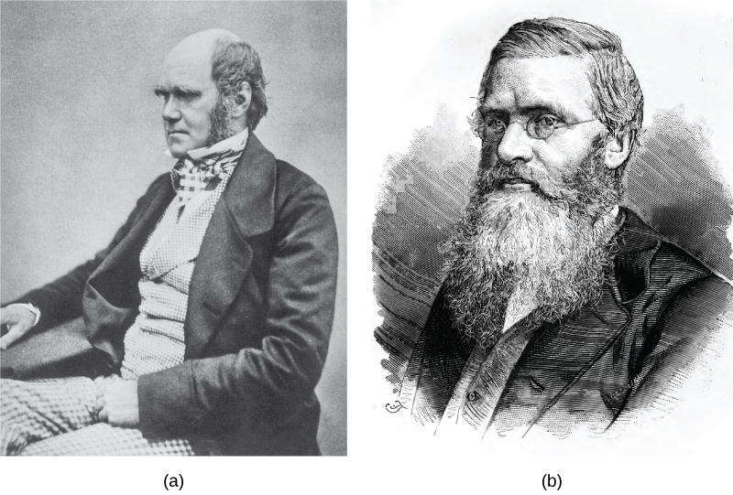
Evolution – how species change over time
Species evolve, individuals do not
Evolution does not explain the origin of life
Charles Darwin and Alfred Wallace
Download for free at http://cnx.org/contents/185cbf87-c72e-48f5-b51e-f14f21b5eabd@10.61

Slide 3
What is natural selection?
3 principles that support natural selection:
Parents pass traits to their offspring
More offspring are produced than are able to survive
Offspring vary from each other

Slide 4
Natural selection can only take place if there is variation in a population
Genetic Diversity
Arises by mutation and sexual reproduction

Slide 5
Genetic diversity caused by mutation can have 3 outcomes
Mutation could lead to an adaptation causing that individual to be more fit, more successful at reproduction and passing that trait
Mutation could lead to adaptation causing that individual to be less fit, less successful at survival and reproduction
Or, mutation could lead to a neutral adaptation – doesn’t make the individual more or less fit
Fitness = reproductive success, continuation of the species
Whether or not a new trait is favorable depends on the environment at that time
The environment is constantly changing, what is a favorable trait now may not be in the future

Slide 6
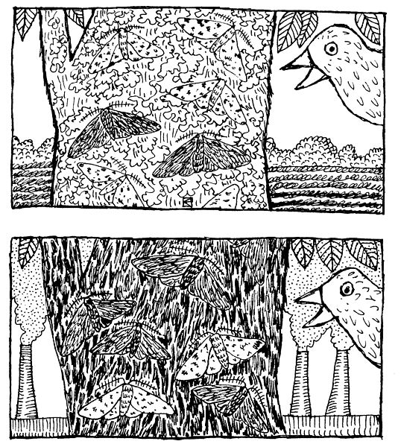
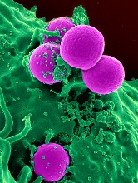
Evolution occurs over a very long period of time
Sometimes we cannot see this in our lifetime
Sometimes we can
Examples: peppered moths, MRSA
Caption: Peppered Moths (c) Khaydock, Public domain

Slide 7
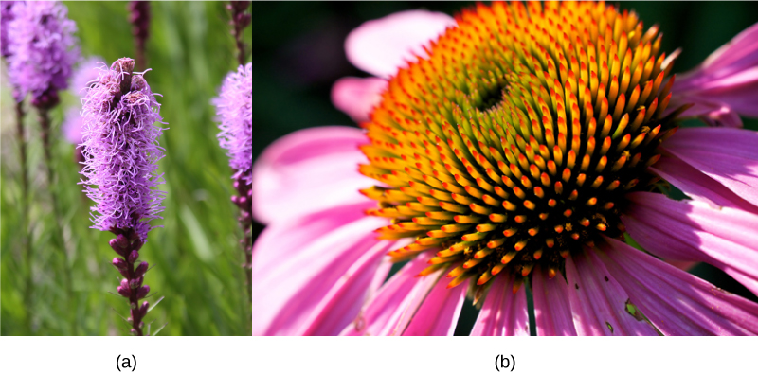
The evolution of species has lead to enormous variation in form and function
Divergent Evolution
Download for free at http://cnx.org/contents/185cbf87-c72e-48f5-b51e-f14f21b5eabd@10.61

Slide 8
Is there evidence for evolution? YES!!!!

Slide 9
Independently, similar phenotypes will evolve in distantly related species due to the same evolutionary pressures
Convergent evolution
Wings of bird and wings of dragonfly
Eye of octopus and eye of vertebrate
Analogous structures

Slide 10
Evidence for Evolution:
Fossil record
Biogeography
Anatomy and embryology
Molecular (sequence of DNA of certain genes)

Slide 11
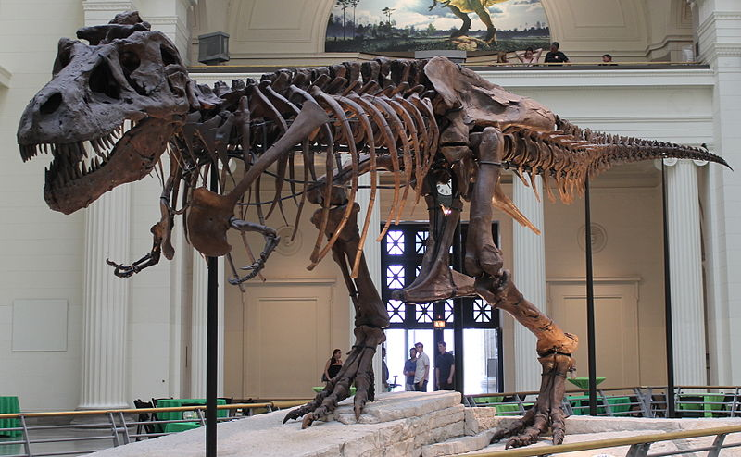
Evidence for evolution
Fossil record – shows how species have changed over time
How are fossils aged? – measuring a variety of radioactive isotypes with known half lives
Caption: Sues Skeleton (c) Connie Ma, Public domain

Slide 12
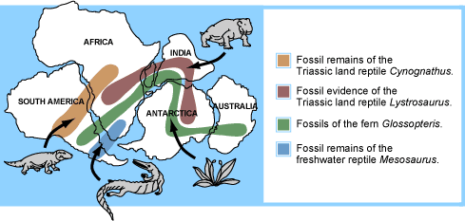
Evidence for Evolution
Biogeography

Slide 13
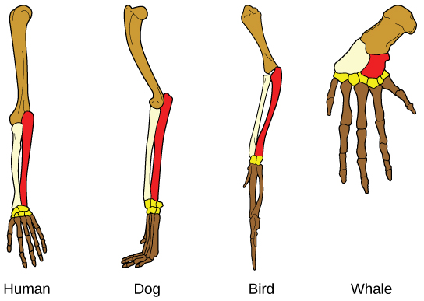
Evidence for Evolution
Anatomy and Embryology
Homologous structures – structures that have changed in size and function but are from common ancestor
Vestigial structures – unused structures left over from common anscestor
Download for free at http://cnx.org/contents/185cbf87-c72e-48f5-b51e-f14f21b5eabd@10.61

Slide 14
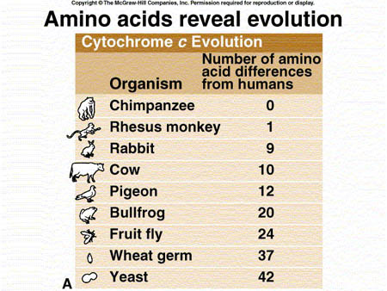
Evidence of Evolution
Molecular Biology
Looking at the sequences of DNA and the amino acid sequences of conserved proteins

Slide 15
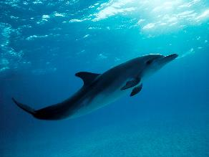
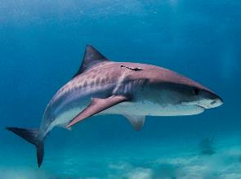
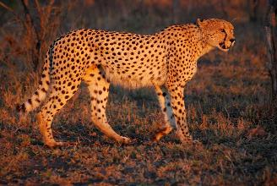
Some confusion can occur
Evolutionary reversal
Similar, analogous characters may cause taxa to appear related, when in fact they are not or only distantly related
These can obscure true evolutionary relationships → lead to inaccurate cladograms
Which 2 of these animals are more closely related?
Which animal had an evolutionary reversal?
Caption: Juvenile atlantic spotted dolphin (c) Dolphind, Public domain
Caption: Tiger Shark Bahamas (c) Albert Kok, Public domain
Caption: South African Cheetah (c) Wegmann, Public domain

Slide 16
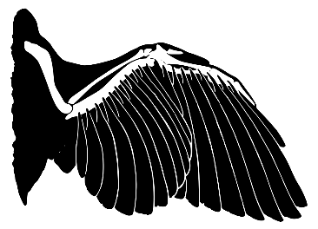
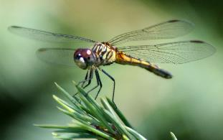
Some confusion can occur
Analogous characters
Similar due to functional or ecological constraints/pressures
Characters can be very similar in appearance due to evolutionary convergence
Convergence occurs in unrelated (or distantly-related) taxa when characters are shaped by similar ecological or evolutionary constraints (selection pressures)
Caption: Bird Wing Feather and Bones (c) L Shyamal, Public domain
Caption: Anisoptera (c) RA Nonenmacher, Public domain

Slide 17
Misconceptions of Evolution:
These are wrong!:
Evolution is just a “theory”, they don’t really know - wrong
Individuals evolve - wrong
Evolution explains the origin of life -wrong
Organisms evolve with a purpose -wrong

Slide 18
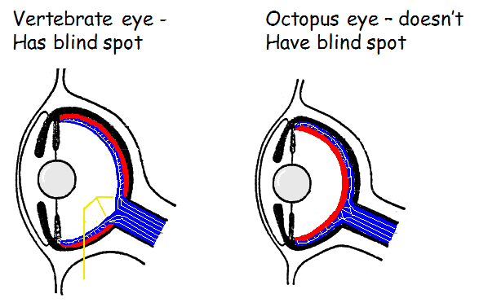
Evolution does not lead to perfection, it leads to what works in that environment at that time
Example – the octopus eye and the vertebrate eye

Slide 19
Speciation can occur overtime due to continued mutations
When groups become isolated geographically for long period of time
Changes (mutations) in each group over time lead to the groups no longer being reproductively compatible
Sometimes you can get gene flow into an area – all of a sudden something that is isolating 2 groups is removed

Slide 21
Artificial vs Natural Selection
We’ve been talking about natural selection
Artificial selection
Humans have been doing this for years
Crops
Domesticated animals
We have chosen the phenotypes we want and continually breed those individuals that have those phenotypes

Slide 22
All organisms share many characteristics:
Composed of one or more cells
Carry out metabolism
Transfer energy with ATP
Encode hereditary information in DNA
Estimates for diversity of life
1.5 - 2.3 million species cataloged
Total # of species: 5 (±3) million ??
Total # of individuals - 100 billion – 1 trillion (including all prokaryotes) ??

Slide 23
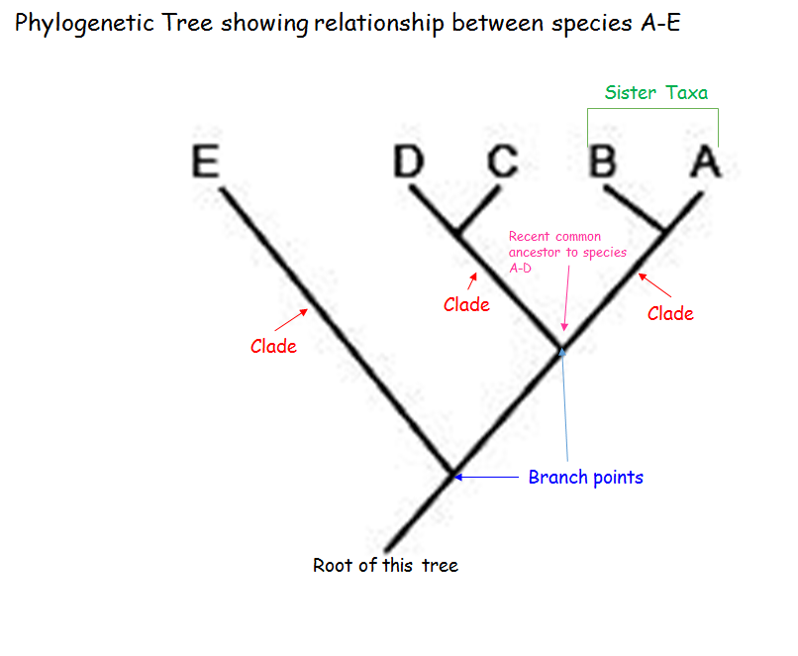

Slide 24
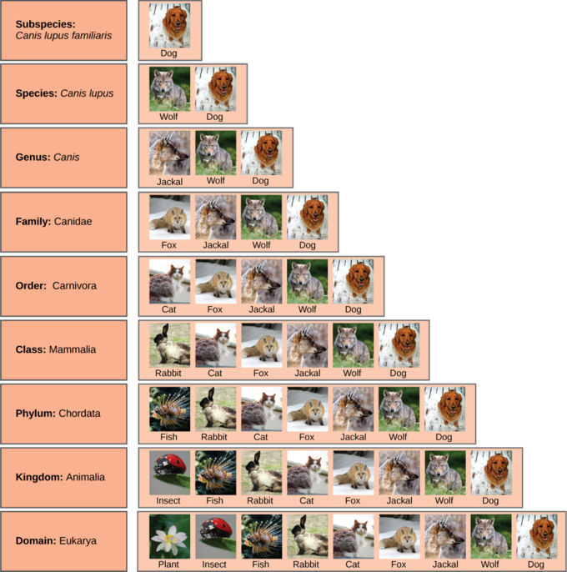
Levels of Classification

Slide 25
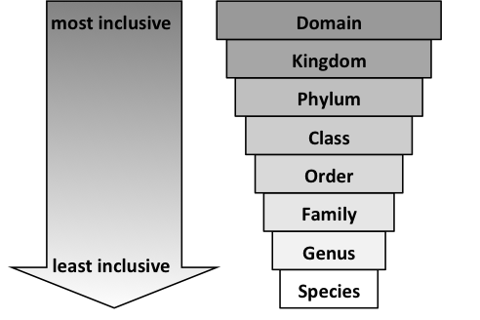

Slide 26
Levels of Classification
Binomial nomenclature of species
Species name = genus + species
Genus is capitalized, entire species name is italicized (also subspecies names)
Human: Homo sapiens or Homo sapiens
Dog: Canis lupus
Higher taxonomic names are capitalized, but not italicized – example: Hominidae, Primates, Mammalia

