Slide 1
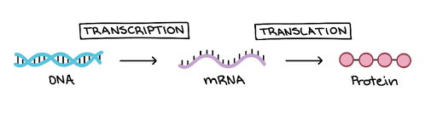
Chapter 15 Genes and Proteins
Biology for Health Sciences
BSC 1020
Dr. Capers
OpenStax Biology - https://openstax.org/details/books/biology,
PowerPoint made by Dr. Capers - www.jcapers-irsc.weebly.com

Slide 2
Genes specify the sequence of amino acids, the building blocks of proteins
Proteins are responsible for orchestrating almost every function of the cell (think about enzymes)

Slide 3
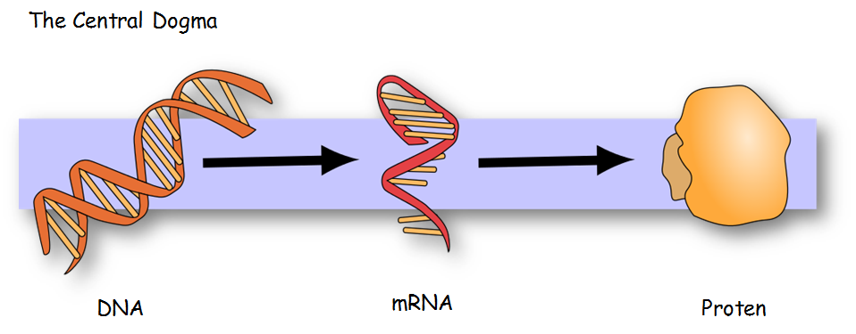
Caption: MolbioHeader (c) Squidonius, Public domain

Slide 4
The DNA sequence will determine the amino acid sequence and therefore, will determine the function of the protein
Every 3 nucleotides on the mRNA codes for an amino acid
Codon
The genetic code is universal
This means that from bacteria to us – 4 nucleotides (A, T, C, G) code for 20 amino acids
The sequence of those is what make a bacteria DIFFERENT from us

Slide 5
Download for free at http://cnx.org/contents/185cbf87-c72e-48f5-b51e-f14f21b5eabd@10.61

Slide 6
Caption: Genetic Code (c) Madprime, Public domain

Slide 7
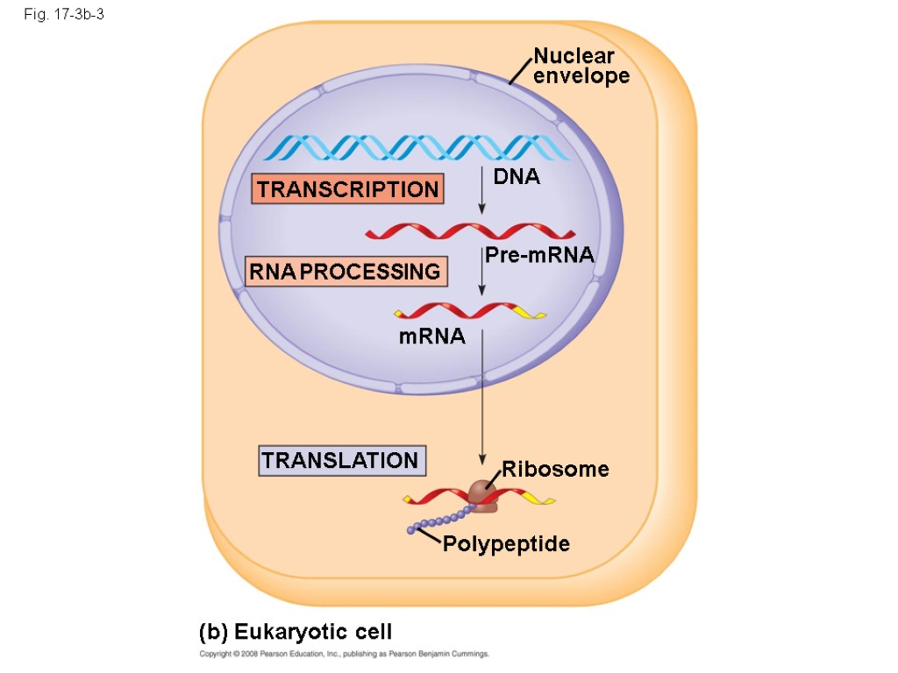
Eukaryotes
Transcription and Translation separated by nuclear membrane in eukaryotes

Slide 8
Steps of Transcription
Initiation
Promotors are much more complex than prokaryotic promotors
Eukaryotes have 3 RNA polymerases (RNA Polymerase I, II, III)
Transcription factors are needed
Elongation
Termination
mRNA is released
It has to be modified before leaving the nucleus for translation

Slide 9
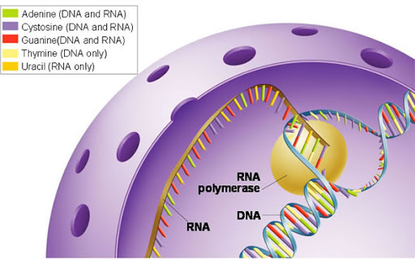
Transcription happens in the nucleus

Slide 10
Now the messenger RNA (mRNA), goes out of the nucleus and attaches to a ribosome for translation
3 Steps of Translation:
Initiation
mRNA attaches to the smaller subunit of the ribosome
AUG is the start codon – a tRNA with the appropriate anticodon attaches
The larger subunit of the ribosome then comes in
Elongation
tRNAs move in with the appropriate amino acid, the amino acid chain grows using peptidyl transferase
Termination
Stop codon is reached
The amino acid chain then is processed
In eukaryotes, the amino acid chain moves into the endoplasmic reticulum to be further processed

Slide 11
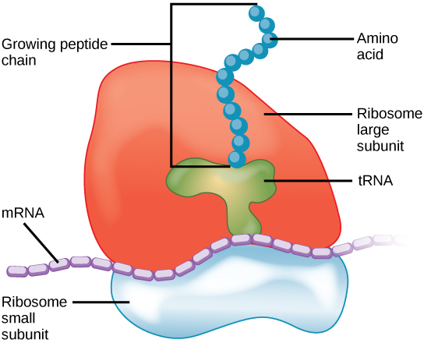
For translation to occur, ribosomes are needed
Ribosomes of prokaryotes are slightly different from eukaryotes
Caption: Ribosome Translation (c) Openstax, Public domain

Slide 12
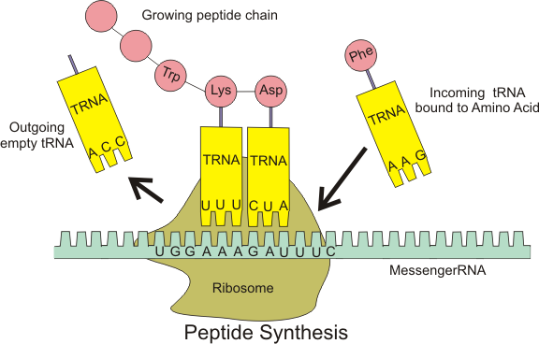
For translation to occur, tRNAs are needed. These grab onto amino acids in the cytosol and carry it to the growing amino acid chain on the ribosome
tRNAs have an anticodon that is complimentary to the codon on the mRNA
Caption: Protein Syn (c) Baumphreyfr, Public domain

Slide 13
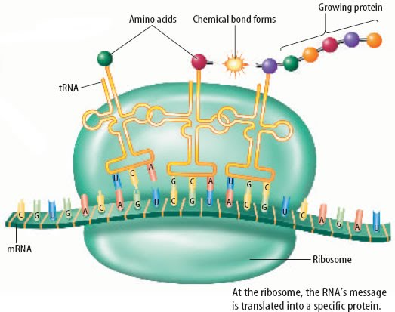
Download for free at http://cnx.org/contents/185cbf87-c72e-48f5-b51e-f14f21b5eabd@10.61

Slide 14
Watch this video on Eukaryotic Transcription and Translation:
https://www.youtube.com/watch?v=gG7uCskUOrA

Slide 15
Overview for Eukaryotic Cells

Slide 17
Since the message for the protein is in the DNA, the DNA sequence must be correct in order to get the correct protein
If a mutation occurs in the DNA, then there can be an error in the amino acid sequence in the protein
Mutation can lead to a new trait (hair color, eye color, etc) or it can lead to a disease state (cystic fibrosis, sickle cell anemia, etc)
Mutations are random – can be lethal mutations or harmless mutations
Mutations can be caused by:
Random insert during DNA synthesis
Exposure to radiation
Exposure to chemicals
Viruses
Mutation is the underlying cause for evolution
Mutations can lead to traits that are more successful in certain environments

Slide 18
The DNA needs to be proofread after replication, mistakes can be made.
Mismatch repair – wrong nucleotide is replaced
Excision repair - excise a fragment of DNA to be repaired
If the DNA is too damaged, the process might be aborted and the cell might undergo apoptosis. If not, the mistake leads to a mutation.
Mutations don’t only occur during replication. Sometimes spontaneous mutations can arise.
Watch these videos on mutations: https://www.youtube.com/watch?v=vl6Vlf2thvI
https://www.youtube.com/watch?v=LOX_59RSF68

