Slide 1
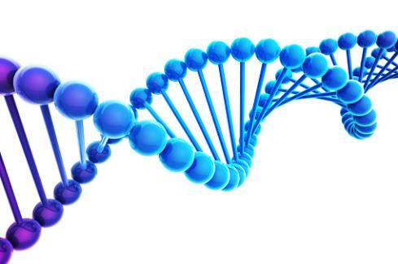
Chapter 14 DNA
Biology For Health Sciences
BSC 1020
Dr. Capers
OpenStax Biology - https://openstax.org/details/books/biology,
PowerPoint made by Dr. Capers - www.jcapers-irsc.weebly.com

Slide 2
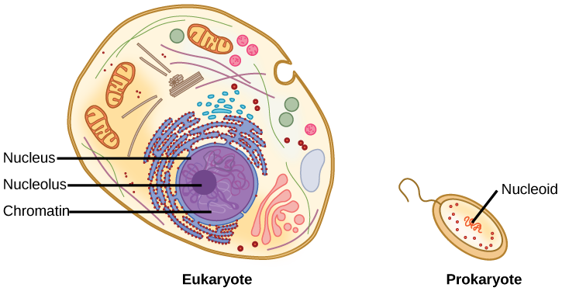
Where do organisms keep their DNA?
A eukaryote contains a well-defined nucleus and big linear chromosomes.
BUT in prokaryotes, the chromosome is relatively small, circular and lies in the cytoplasm in an area called the nucleoid.
Download for free at http://cnx.org/contents/185cbf87-c72e-48f5-b51e-f14f21b5eabd@10.61

Slide 3
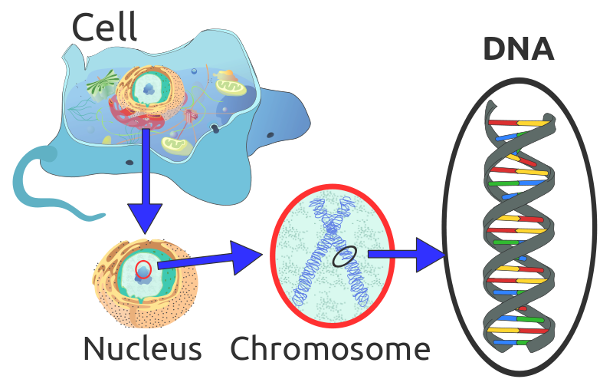
Caption: Eukaryotic DNA (c) Radio89, Public domain

Slide 4
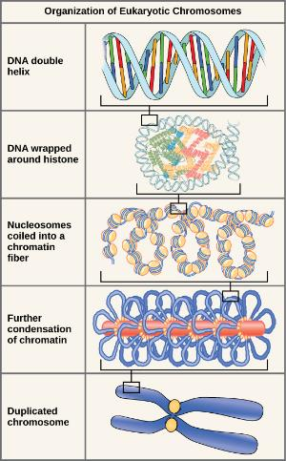
How Big are Eukaryotic Chromsomes?
Tens of Millions of nucleotides long
Too big to be a little circle of DNA.
Eukaryotic chromosomes must be compacted using special HISTONE proteins to be tightly wound.
Nucleosomes (around every 200bp) are formed from several Histones and allow DNA to form coils.
Scaffold proteins allow loops of coiled DNA to be stacked in a cylindrical form.
Multiple copies of a chromosome can be held together at their center (centromere) by proteins called cohesins
Download for free at http://cnx.org/contents/185cbf87-c72e-48f5-b51e-f14f21b5eabd@10.61

Slide 5
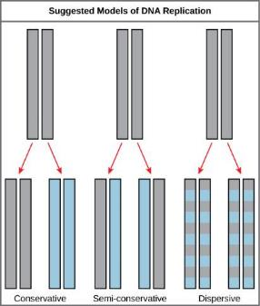
So How does DNA copy itself?
For example when a cell divides to make copies of itself (like when a cut heals), the DNA must copy itself.
The three models of how DNA replication could work were initially proposed:
In this figure, GREY indicates the exact original DNA strands from the original “parent” cell, while BLUE indicates newly made DNA.
We now know it is the semiconservative way.
Download for free at http://cnx.org/contents/185cbf87-c72e-48f5-b51e-f14f21b5eabd@10.61

Slide 6
Nucleotides make up DNA and RNA
Nucleotides:
5 carbon sugar, nitrogenous base, phosphate group
Nitrogenous bases:
Adenine (A), Thymine (T), Cytosine (C), Guanine (G) and Uracil (U)
Sugar
In DNA, the sugar is deoxyribose
In RNA, the sugar is ribose
Caption: 5 important monosaccharides (c) Openstax, Public domain

Slide 8
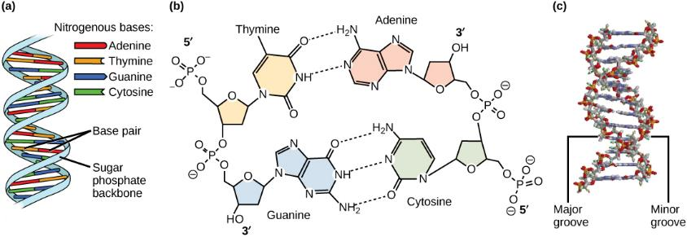
Notice: the strands have opposite (antiparallel) direction. 5’ to 3’ vs 3’ to 5’
Download for free at http://cnx.org/contents/185cbf87-c72e-48f5-b51e-f14f21b5eabd@10.61

Slide 9
DNA vs RNA
Both are Nucleic Acids
Both are made from strands of nucleotides
DNA is double stranded (two strands bound to each other); RNA is generally single stranded
DNA is made of nucleotides containing Deoxyribose as their 5 C Sugar; RNA is made of nucleotides containing Ribose as their 5 C Sugar
DNA has Thymine to bind to Adenine, but in RNA Uracil binds to Adenine.
DNA is stronger and longer lasting; RNA can only last minutes in some cases and degrades easily
DNA generally forms a simple double helix (though it can be wound up)
RNA can form very complex looping structures similar to proteins in function

Slide 11
DNA replication happens in the 5’ to 3’ direction
Many enzymes involved
DNA Replication Overview Video: https://www.youtube.com/watch?v=qdxVOQverE4
https://www.youtube.com/watch?v=Qqe4thU-os8

Slide 12
Prokaryotic DNA Replication: Enzymes and Their Function
Enzyme/protein | Specific Function
DNA pol I | Exonuclease activity removes RNA primer and replaces with newly synthesized DNA
DNA pol II | Repair function
DNA pol III | Main enzyme that adds nucleotides in the 5'-3' direction
Helicase | Opens the DNA helix by breaking hydrogen bonds between the nitrogenous bases
Ligase | Seals the gaps between the Okazaki fragments to create one continuous DNA strand
Primase | Synthesizes RNA primers needed to start replication
Sliding Clamp | Helps to hold the DNA polymerase in place when nucleotides are being added
Topoisomerase | Helps relieve the stress on DNA when unwinding by causing breaks and then resealing the DNA
Single-strand binding proteins (SSB) | Binds to single-stranded DNA to avoid DNA rewinding back.

Slide 13
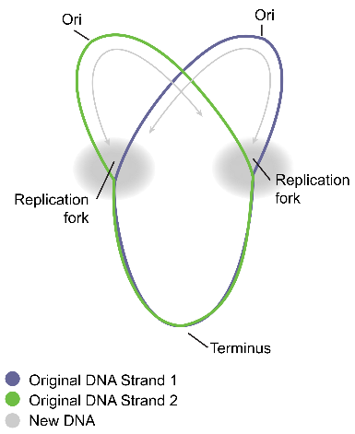
Prokaryotic DNA replication
Remember that prokaryotes have 1 circular chromosome
Have 1 origin of replication

Slide 14
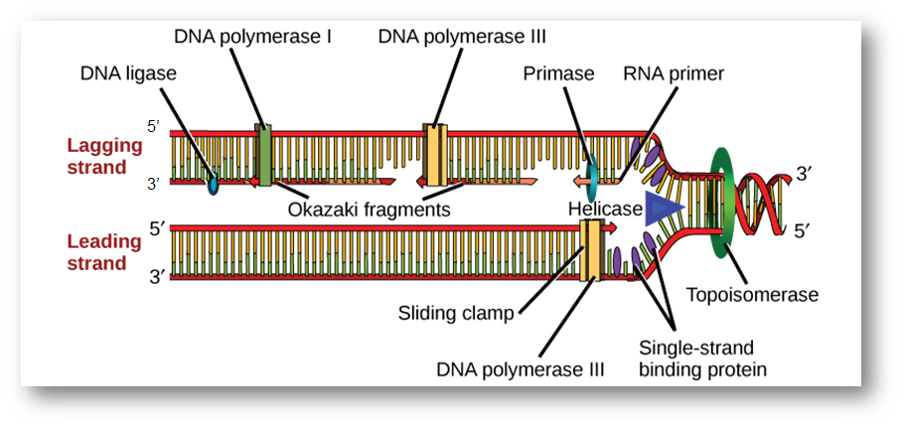
A replication fork is formed when helicase separates the DNA strands at the origin of replication.
Primase synthesizes an RNA primer. So a bit of RNA must be made in order to copy DNA!!
DNA polymerase III uses this primer to synthesize complimentary “new” DNA strands to the original “template” strands.
On the leading strand, DNA is synthesized easily and continuously, whereas on the lagging strand, DNA is synthesized in short stretches called Okazaki fragments.
DNA polymerase I replaces the RNA primer with DNA.
DNA ligase seals the gaps between the Okazaki fragments, joining the fragments into a single DNA molecule.
(credit: modification of work by Mariana Ruiz Villareal)
Download for free at http://cnx.org/contents/185cbf87-c72e-48f5-b51e-f14f21b5eabd@10.61

Slide 15
Eukaryotic DNA Replication
Remember that eukaryotes have multiple linear chromsomes
Have multiple origins of replication
Enzymes (DNA polymerases) differ slightly from prokaryotes
Since DNA polymerase has to add to an already existing strand (primer), this causes a problem on the lagging strand of a linear chromosome…….

Slide 16
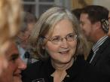
The ends of linear chromosomes are maintained by the action of the telomerase enzyme. Cells that divide a lot have a functioning telomerase enzyme. Cells that do not have telomerase have a finite number of times they can divide – adds to the aging process.
Watch this video: https://www.youtube.com/watch?v=AJNoTmWsE0s
Elizabeth Blackburn, 2009 Nobel Laureate, is the scientist who discovered how telomerase works.
(credit: US Embassy Sweden)
Download for free at http://cnx.org/contents/185cbf87-c72e-48f5-b51e-f14f21b5eabd@10.61

