Slide 1
Chapter 10 Cell Division
Biology for Health Sciences
BSC 1020
Dr. Capers
Download for free at http://cnx.org/contents/185cbf87-c72e-48f5-b51e-f14f21b5eabd@10.61
OpenStax Biology - https://openstax.org/details/books/biology,
PowerPoint made by Dr. Capers - www.jcapers-irsc.weebly.com

Slide 2
Cell division
The cell is a basic unit of life.
All living organisms are composed of one of more cells.
Cells comes from pre-existing cells.
Cell division in unicellular organisms is for reproduction.
Cell division in multicellular organisms is for growth, development, regeneration, and repair.

Slide 3
Watch this video:
https://www.youtube.com/watch?v=xsrH050wnIA

Slide 4
Cell division
A sea urchin begins life as a single cell that
divides to form two cells, visible by scanning electron microscopy
After divisions, there are 16 cells, as seen in this SEM image
After many rounds of cell division, the individual develops into a complex, multicellular organism, as seen in this mature sea urchin.
Download for free at http://cnx.org/contents/185cbf87-c72e-48f5-b51e-f14f21b5eabd@10.61

Slide 5
Before division can happen, the cell must get the proper signal and the DNA has to replicate to make a replicate chromosome

Slide 6
Prokaryotic chromosome
Prokaryotes, including bacteria and archaea, have a single (1), circular chromosome located in a central region called the nucleoid.
Download for free at http://cnx.org/contents/185cbf87-c72e-48f5-b51e-f14f21b5eabd@10.61

Slide 7
Bacterial Binary Fission – since bacteria only have 1 circular chromosome, their division is less complicated than ours
Caption: Binary Fission (c) Ecoddington14, Public domain

Slide 8
Eukaryotic cells have linear chromosomes
Depending on the species, the number can range from a couple to hundreds
Humans have 46 chromosomes
Therefore, division is more complicated – have to keep track of the chromosomes so they end up in the right place
2 types of division with eukaryotes we will talk about:
Mitosis – growth and repair
Meiosis – to make gametes for sexual reproduction

Slide 9
Human chromosomes
Humans have 46 chromosomes in 23 nearly identical pairs
Every species has a different number of chromosomes
Download for free at http://cnx.org/contents/185cbf87-c72e-48f5-b51e-f14f21b5eabd@10.61

Slide 10
Human chromosomes
Particular array of chromosomes in an individual organism is called karyotype.
Humans are diploid (2n)
2 complete sets of chromosomes
46 total chromosomes (all of our cells have 46 chromosomes)
Except gametes (egg and sperm)
Haploid (n): 1 set of chromosomes
Pairs of chromosomes are homologous
Have the same genes, just might have different versions (alleles) of that gene
Example: the two chromosome #3’s are homologous, or the two chromosome #18’s are homologous

Slide 11
Chromosomes Composition
Over 2 meters of DNA inside just one human nucleus.
When the cell is being a cell, the DNA is not condensed
When the cell is getting ready to divide, it will condense (making chromosomes visible under the light microscope)
Chromosomes are composed of chromatin – complex of DNA and protein
One typical human chromosome 140 million nucleotides long

Slide 12
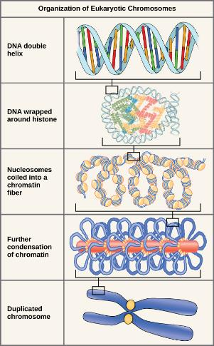
Download for free at http://cnx.org/contents/185cbf87-c72e-48f5-b51e-f14f21b5eabd@10.61

Slide 13
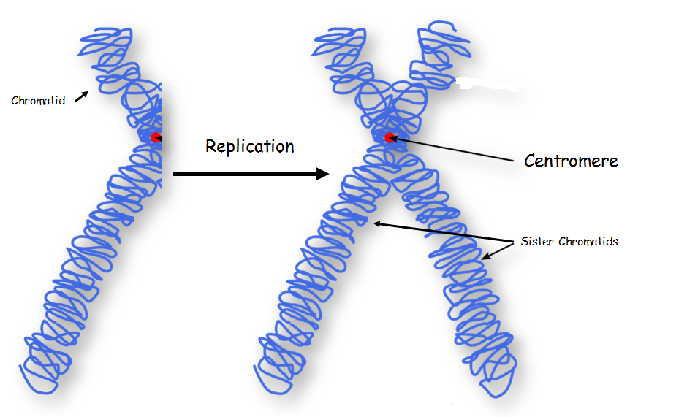
Chromosomes replication
Before replication: each chromosome composed of a single DNA molecule
DNA must make a copy of itself
After replication: each chromosome composed of 2 identical DNA molecules
Held together by cohesin proteins
Visible as 2 strands held together as chromosome becomes more condensed
One chromosome composed of 2 sister chromatids joined at centromere

Slide 14
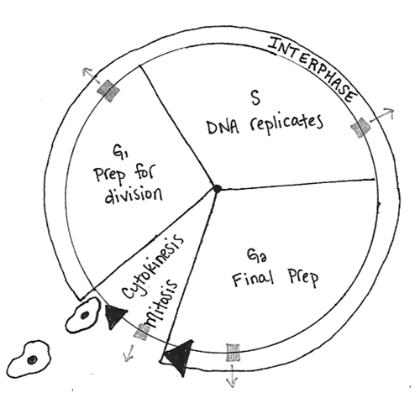
The cell cycle
The cell cycle consists of 2 stages: interphase and the mitotic phase.
During interphase, the cell grows and the nuclear DNA is duplicated.
Interphase is followed by the mitotic phase.
During the mitotic phase, the duplicated chromosomes are segregated and distributed into daughter nuclei.
The cytoplasm is usually divided as well, resulting in two daughter cells.

Slide 15
Eukaryotic Cell Division
The eukaryotic cell cycle has two phases:
Interphase (Between cell divisions)
G₀ phase - Cell is being a cell
Cell nucleus is visible
Cell gets signal to divide – then begins G₁, S and G₂
Cell metabolic functions, including DNA replication, occur
Mitosis/cytokinesis: eukaryotic nuclear division (mitosis) and cell division (cytokinesis)

Slide 16
Eukaryotic Cell Division
G₁ (gap phase 1)
Primary growth phase, longest phase
S (synthesis)
Replication of DNA
G₂ (gap phase 2)
Organelles replicate, microtubules
organize
M (mitosis) – Nuclear division
Subdivided into 4 phases
C (cytokinesis) – Cytoplasmic division
Separation of 2 new cells
Interphase

Slide 17
Duration of Cell Cycle
Most variation in the length of the cell cycle between organisms or cell types occurs in G₁
Cells often pause in G₁ before DNA replication and enter a resting state called G₀
Resting phase G₀ – cells spend more or less time here before resuming cell division.
This is when a cell is being a cell
Can range from hours to decades depending on cell type
Nerve cells remain there permanently – that is why damage to nerve cells is permanent
Liver cells can resume G₁ phase in response to factors released during injury

Slide 18
The Cell Cycle - Mitosis
Mitosis produces genetically-identical daughter nuclei
Mitosis is followed by cytokinesis which splits the two nuclei into two daughter cells
4 main stages:
Prophase
Metaphase
Anaphase
Telophase

Slide 19
The Cell Cycle - Mitosis
Prophase:
Chromosomes condense and become visible
Chromosomes appear as two sister chromatids held together at the centromere
Nuclear envelope breaks down
Mitotic spindle begins to form

Slide 20
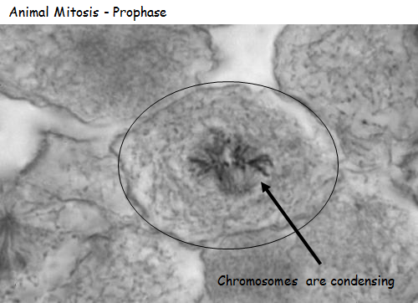
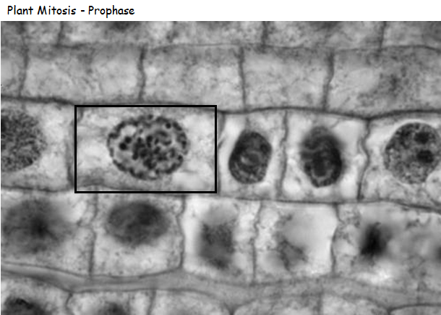

Slide 21
The Cell Cycle - Mitosis
Metaphase:
Alignment of chromosomes along metaphase plate
Not an actual structure
Future axis of cell division

Slide 22
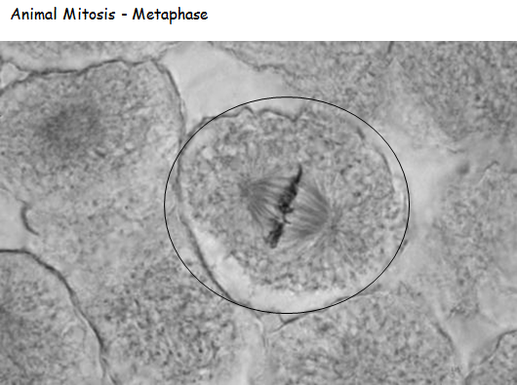
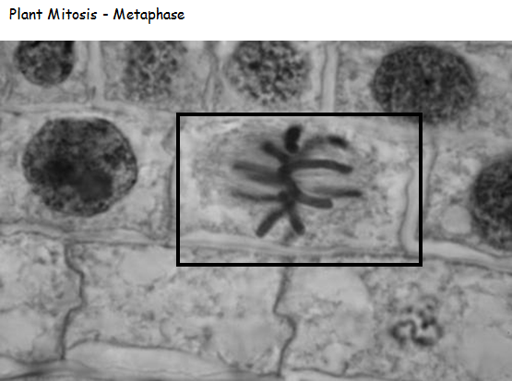

Slide 23
The Cell Cycle - Mitosis
Anaphase:
Begins when centromeres split
Removal of cohesin proteins from all chromosomes
Sister chromatids pulled to opposite poles

Slide 24
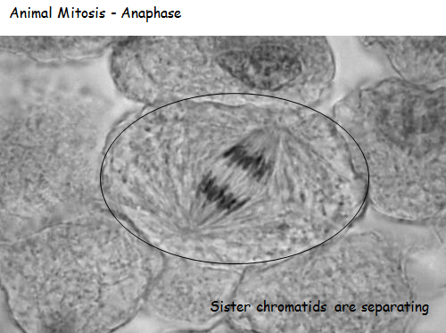
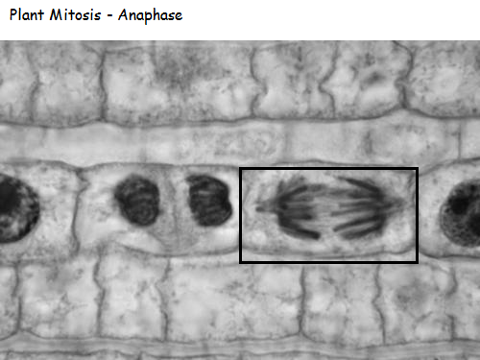

Slide 25
The Cell Cycle - Mitosis
Telophase:
Chromosomes are clustered at opposite poles and decondense
Nuclear envelopes re-forms around chromosomes
Chromosomes begin to uncoil
Golgi complex and ER re-form

Slide 26
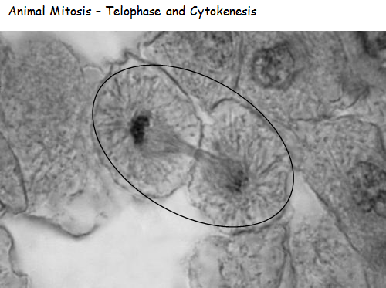
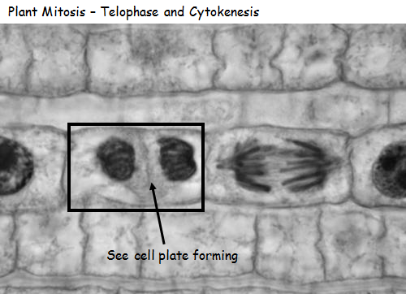

Slide 27
The Cell Cycle - cytokinesis
Cytokinesis is the stage in which two daughter cells are formed from the original one
After cytokinesis, cells re-enter interphase.
Animals:
Proteins pinch the original cell into two new cells

Slide 28
The Cell Cycle - cytokinesis
Cytokinesis in Plants:
Starts with vesicles forming the cell plate.
This results in a new cell wall being formed between the cells forming daughter cells.
The cell wall is made from cellulose

Slide 30
Control of the Cell Cycle
Cell division is a tightly controlled process
Normal cells halt at checkpoints
Proteins survey the condition of the cell
Cell must pass the survey to proceed with cell division
3 checkpoints: G₁,G₂, and metaphase

Slide 31
Control of the Cell Cycle

Slide 32
Control of the Cell Cycle
3 Checkpoints:
G₁/S checkpoint
Cell “decides” whether or not to divide
G₂/M checkpoint
Cell makes a commitment to mitosis
Assesses success of DNA replication
Can stall the cycle if DNA has not been accurately replicated.
Late metaphase (spindle) checkpoint
Cell ensures that all chromosomes are in the right place

Slide 33
Control of the Cell Cycle
There are two groups of intracellular molecules that regulate the cell cycle.
These molecules can either promote progress of the cell to the next phase (positive regulation) or halt the cell cycle (negative regulation.
These molecules can either act individually or in partners with other molecules.
Deficiency or non-functioning of a single regulator may or may not affect the control of cell cycle.

Slide 34
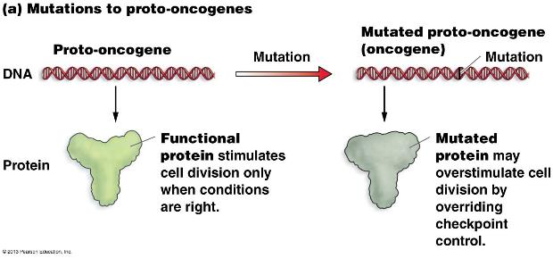
Cancer and the cell cycle
Proto-oncogenes: genes that code for the positive cell cycle control proteins
When proto-oncogenes mutate, they become oncogenes
Their proteins no longer properly regulate cell division
They usually overstimulate cell division even though it is not supposed to.

Slide 35
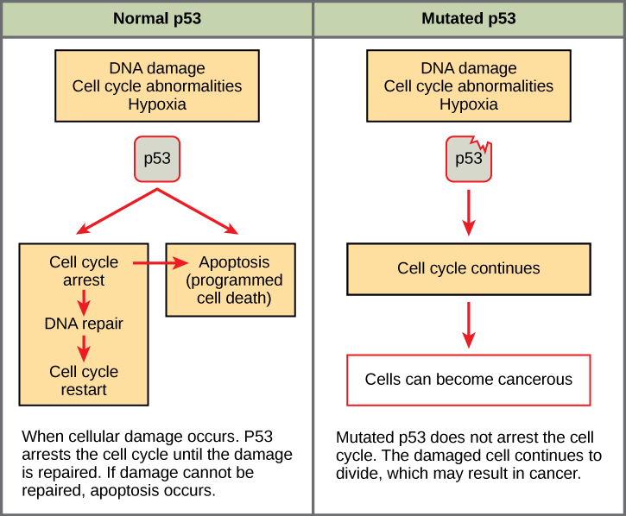
cancer and the cell cycle
Tumor suppressor genes: genes for proteins that stop cell division if conditions are not favorable (negative regulator)
Rb, p53, and p21 are tumor suppressor genes
When mutated, can allow cells to override checkpoints

Slide 36
Remember, cancer is uncontrolled cell growth
Watch this video:
https://www.youtube.com/watch?v=QVCjdNxJreE

Slide 37
Control of the Cell Cycle

