Slide 1
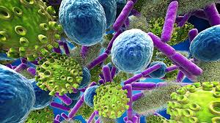
Chapter 21 – 23 Viruses, Bacteria, Protists
Biology for Health Sciences
BSC 1020
Dr. Capers
credit a: USDA ARS
Download for free at http://cnx.org/content/col11448/latest/
OpenStax Biology - https://openstax.org/details/books/biology,
PowerPoint made by Dr. Capers - www.jcapers-irsc.weebly.com

Slide 2
First we will talk about viruses

Slide 3
Viruses are Different from Living Cells, Yet
They Make a Large Impact on Cells
They are “acellular” (not cells).
They have no metabolism and cannot grow.
They depend on host cells to make copies of themselves.
They are the ultimate parasite; cannot replicate unless they are in host cell using that cell’s machinery
Their origin is uncertain.
They seem to have collected pieces of nucleic acid from various sources.
They can infect nearly all lifeforms.
They are not only species specific but tissue specific (as far as what they will infect)

Slide 4
In the 1930s, a new technology made viruses visible by microscopy
Download for free at http://cnx.org/contents/185cbf87-c72e-48f5-b51e-f14f21b5eabd@10.61

Slide 5
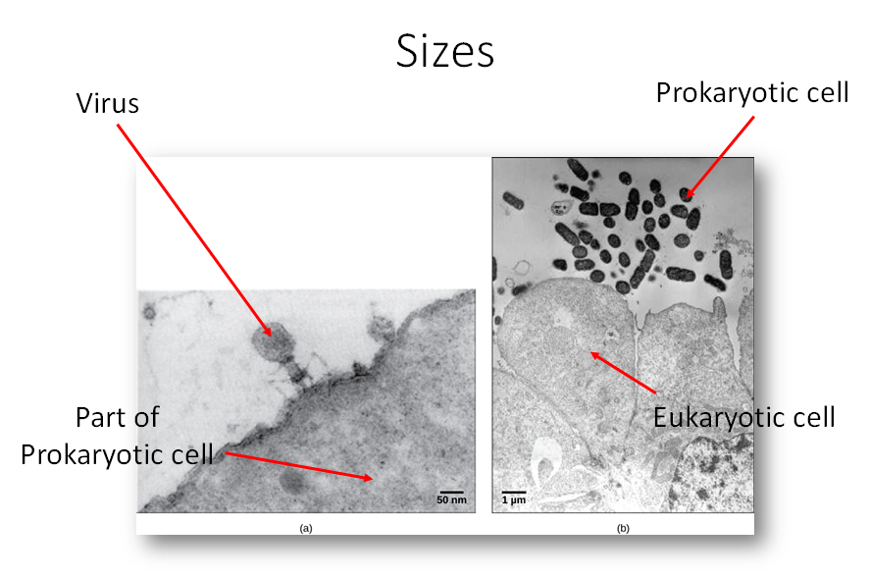

Slide 6
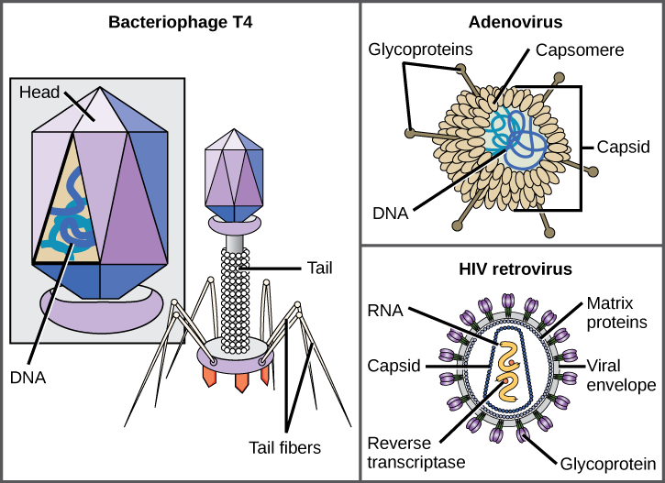
Virus Morphology
Each virion has:
Nucleic acid: might be DNA or RNA, double stranded or single stranded
Protein capsid
Some virions also have an “envelope” that is similar to a cell membrane.
Download for free at http://cnx.org/contents/185cbf87-c72e-48f5-b51e-f14f21b5eabd@10.61

Slide 8
Bacteriophage T4
Bacteriophages infect bacteria
Infects the bacterium, Escherichia coli
Has a DNA genome
Has been studied extensively
Download for free at http://cnx.org/contents/185cbf87-c72e-48f5-b51e-f14f21b5eabd@10.61

Slide 9
Adenovirus
Infects the human respiratory tract
Is non-enveloped
Other non-enveloped viruses include poliovirus, human papillomavirus, and hepatitis A virus.
Download for free at http://cnx.org/contents/185cbf87-c72e-48f5-b51e-f14f21b5eabd@10.61

Slide 10
HIV Retrovirus
Causes AIDS (acquired immunodeficiency syndrome)
Is enveloped
Is a retrovirus (can reverse transcribe its RNA genome into DNA form.
Download for free at http://cnx.org/contents/185cbf87-c72e-48f5-b51e-f14f21b5eabd@10.61

Slide 11
Viruses Have Genomes
The virus core contains nucleic acid.
either DNA or RNA (but not both)
may be single-stranded or double-stranded
may be circular or linear
The genome is much smaller than a cell’s genome.
DNA directs the host cell to make new virus copies.
RNA may be directly transcribed, or replicated first.

Slide 12
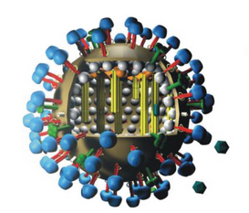
Flu Attack! How a Virus Invades Your Body
Video Link
Download for free at http://cnx.org/contents/185cbf87-c72e-48f5-b51e-f14f21b5eabd@10.61

Slide 13
Cytopathic Effects
These cell damaging changes can occur when a virus replicates in a host cell:
lysis (the cell ruptures or bursts open)*
apoptosis (programmed self-destruction)
widespread symptoms due to the body’s immune response
*In some cases, replicated viruses can leave the cell by “budding”, which does not immediately kill the cell.

Slide 14
Steps of Virus Infections
Attachment – remember viruses are cell specific, will only attach to specific cell
Entry
Replication and Assembly
Egress (Release)

Slide 15
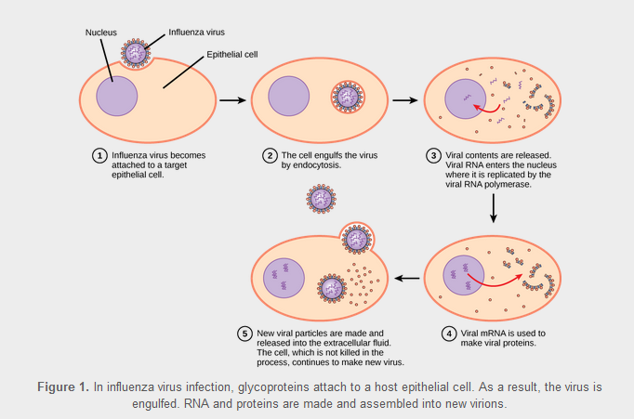
Download for free at http://cnx.org/contents/185cbf87-c72e-48f5-b51e-f14f21b5eabd@10.61

Slide 16
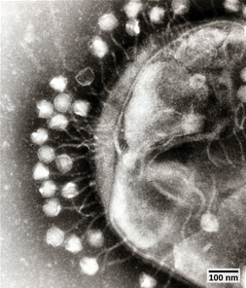
Bacteriophages
Viruses that infect bacteria
Download for free at http://cnx.org/contents/185cbf87-c72e-48f5-b51e-f14f21b5eabd@10.61

Slide 17
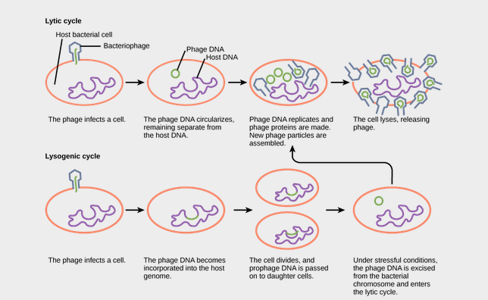
prophage
Download for free at http://cnx.org/contents/185cbf87-c72e-48f5-b51e-f14f21b5eabd@10.61

Slide 18
Animal Viruses
May cause:
Acute disease (colds, influenza)
Chronic infection (hepatitis C)
Latency and intermittent symptoms (herpes simplex)
remains in nerve tissue for life
reactivation causes active replication and cell lysis
Asymptomatic infection (other human herpesviruses)
Oncogenesis (hepatitis B and C, human papillomavirus [HPV])

Slide 19
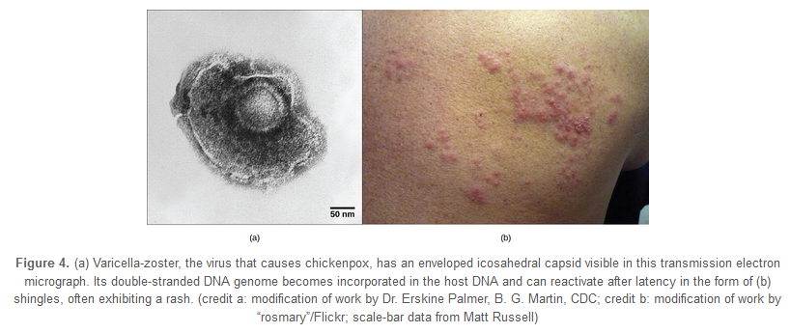
Varicella-zoster (chickenpox virus)
Childhood chickenpox → viral latency → possible reactivation in later life results in shingles
Download for free at http://cnx.org/contents/185cbf87-c72e-48f5-b51e-f14f21b5eabd@10.61

Slide 20
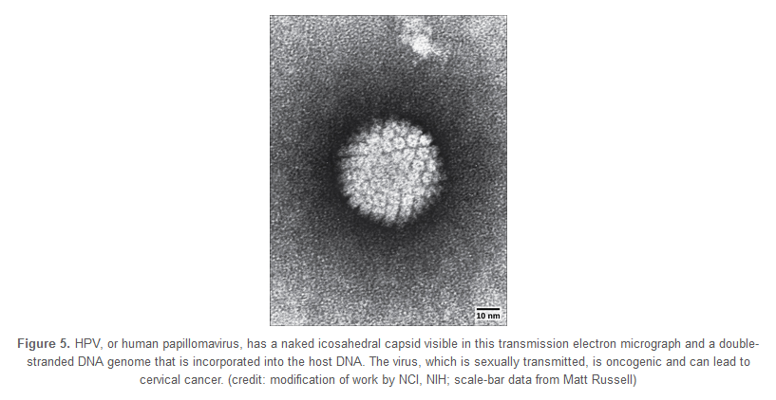
HPV
Download for free at http://cnx.org/contents/185cbf87-c72e-48f5-b51e-f14f21b5eabd@10.61

Slide 21
Plant Viruses
Horizontal transmission
virus typically enters by way of damaged plant tissue
may come from pollen, another plant, or vectors such as insect bites
Vertical transmission
virus is transmitted from the parent plant
May cause hypoplasia (decreased growth and vigor)
May cause necrosis of the plant or plant tissue

Slide 22
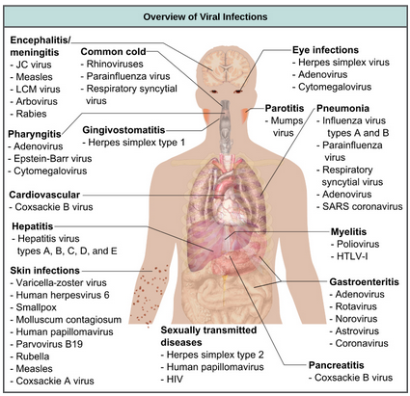

Slide 23
Antibiotics designed to kill bacteria will not eliminate viruses. However, there are some antiviral drugs that are for controlling, but not curing, diseases.

Slide 24
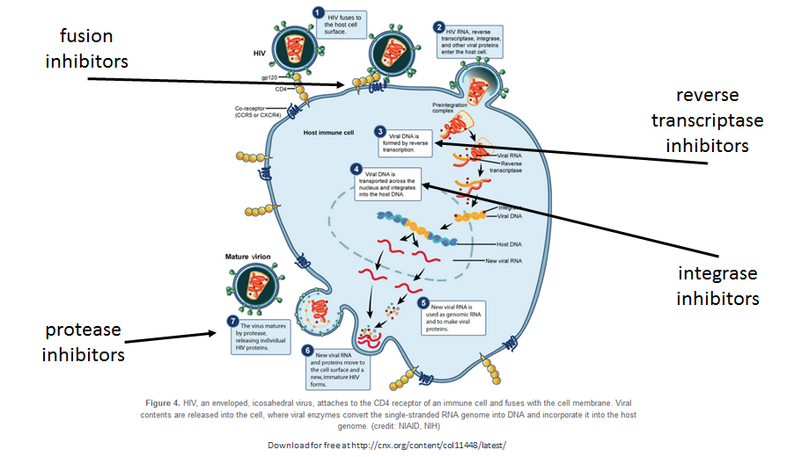

Slide 25
Temperate viruses can remain dormant for a very long time
Similar to the lysogenic cycle in bacteriophages

Slide 26
Prions: Proteinaceous Infectious Particles
Very small
Contain no nucleic acid
Cause fatal neurodegenerative diseases
Mad cow disease (BSE, bovine spongiform encephalopathy)
(v)Creutzfeldt-Jakob disease (in humans)
Kuru (in humans, spread by cannibalism)
Scrapie (in sheep)
Chronic wasting disease (in deer, moose, elk)
Prions are not destroyed by cooking.

Slide 27
Now we will talk about Bacteria

Slide 28
Prokaryotic Diversity
Oldest, structurally simplest, and most abundant forms of life.
Abundant for over a billion years before eukaryotes.
90 to 99% unknown and undescribed
Less than 1% cause disease
Fall into 2 domains
Domain Bacteria – the ones that cause disease are in this Domain
Domain Archaea – include the extremophile bacteria

Slide 29
The features of a typical prokaryotic cell are shown.
Download for free at http://cnx.org/contents/185cbf87-c72e-48f5-b51e-f14f21b5eabd@10.61

Slide 30
Basic bacterial shapes
Prokaryotes have 3 basic shapes:
(a) cocci, or spherical
(b) bacilli, or rod-shaped
(c) spirilli, or spiral-shaped.
Download for free at http://cnx.org/contents/185cbf87-c72e-48f5-b51e-f14f21b5eabd@10.61

Slide 31
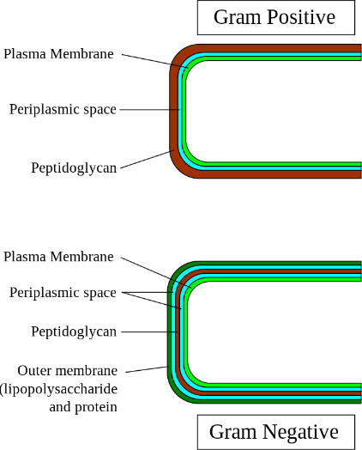
Generally, most species of bacteria are divided into two major groups: Gram positive and Gram negative.
Both groups have a cell wall composed of peptidoglycan: in Gram-positive bacteria, the wall is thick, whereas in Gram-negative bacteria, the wall is thin.
Caption: Gram-cell-wall (c) Graevemoore , Public domain

Slide 32
Cell wall
Peptidoglycan forms a rigid network
Maintains shape
Withstands hypotonic environments
Archaea have a similar molecule
Gram stain
Gram-positive bacteria have a thicker peptidoglycan wall and stain a purple color
Gram-negative bacteria contain less peptidoglycan and do not retain the purple-colored dye – retain counterstain and look pink

Slide 33
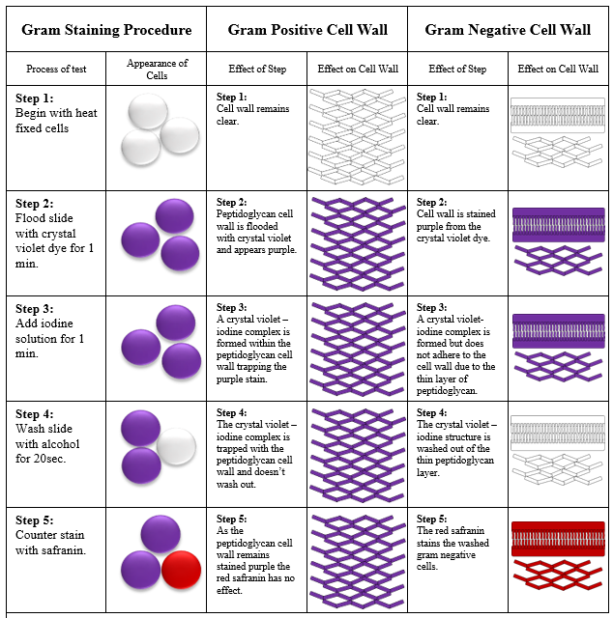
The Gram
Stain Procedure
Caption: Gram Stain Procedure (c)Michigan State University, Public domain

Slide 34
S-layer
Rigid paracrystalline layer found in some bacteria and Archaea
Outside of peptidoglycan or outer membrane layers in gram-negative and gram-positive bacteria
Diverse functions – often involves adhesion
Capsule
Gelatinous layer found in some bacteria
Aids in attachment
Protects from the immune system

Slide 35
Flagella
Slender, rigid, helical structures
Composed of the protein flagellin
Involved in locomotion – spins like propeller
Pili
Short, hairlike structures
Found in gram-negative bacteria
Aid in attachment and conjugation

Slide 36
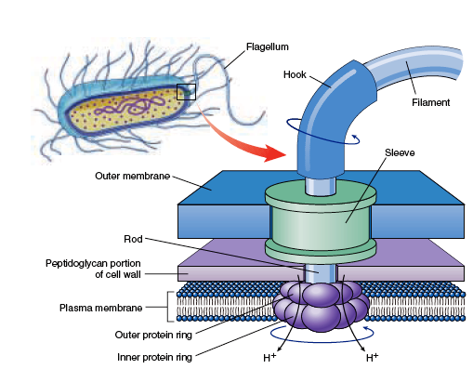
Rotary motion propels the cell
Caption: Flagellum-Beating (c)L. Kohidai, Public domain
Basal body
Caption: Bacterial Flagella (c)biologyexams4u.blogspot.in, Public domain

Slide 37
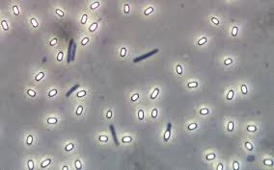
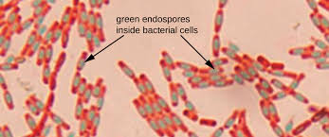
Endospores
Develop a thick wall around their genome and a small portion of the cytoplasm
When exposed to environmental stress
Highly resistant to environmental stress
Especially heat
When conditions improve can germinate and return to normal cell division
Bacteria causing tetanus, botulism, and anthrax
Caption: OSC Microbio 02 04 Endospores (c)CNX OpenStax, Public domain
Caption: Endospore Bazillus (c)Geoman3, Public domain

Slide 38
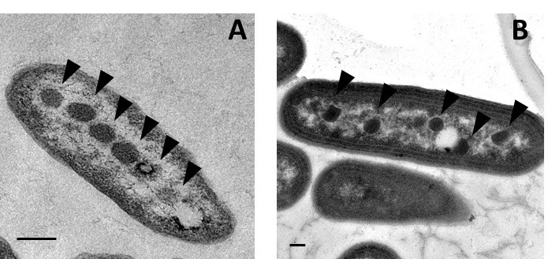
Caption: Electron micrograph of (A) alpha-carboxysomes in Halothiobacillus neapolitanus and (B) beta-carboxysomes in Synechococcus elongatus PCC 7942 (c)Raul Gonzalez and Cheryl Kerfeld, Public domain
Prokaryotic cells often have complex internal membranes
Invaginated regions of plasma membrane
Function in respiration or photosynthesis

Slide 39
Nucleoid region
Contains the single, circular chromosome
May also contain plasmids
Ribosomes
Smaller than those of eukaryotes
Differ in protein and RNA content
Targeted by some antibiotics

Slide 40
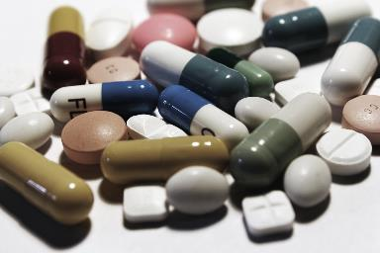
Human Bacterial Disease
In the early 20th century, infectious diseases killed 20% of children before the age of five
Sanitation and antibiotics considerably improved the situation
In recent years, however, many bacterial diseases have appeared and reappeared
Bacterial resistant to antibiotics
Caption: Pills 1 (c)e-Magine Art, Public domain
Caption: Antibiotic Resistance Test
(c)Graham Beards, Public domain

Slide 41
Beneficial Prokaryotes
Only a small percentage of bacteria are pathogenic
Bacteria are vital to the environment
Decomposers release a dead organism’s atoms to the environment
Bacteria can be used as “biofactories”
Bacteria can be used for bioremediation

Slide 42
Now we will touch base on the Protists – in Domain Eukarya

Slide 43
Let’s review Earth formed about 4.5 billion years ago
Prokayotes arose ~3.7-3.5 billion years ago
First prokaryotes used anaerobic respiration, fermentation
~3.5 billion years ago, some prokaryotes began to photosynthesize
Remember that a by-product of photosynthesis is O₂
This allowed the evolution of aerobic respiration, which was able to generate much higher levels of ATP (which is needed if you are a complex eukaryote)
Eukaryotes arose ~2 – 2.1 billion years ago

Slide 44
Protist Diversity
Protists are very diverse
“Protozoa” – heterotrophic protists
Some cause disease
“Algae” – autotrophic protists
Unicellular – phytoplankton
Multicellular – seaweed (not plants!)
Variety of habitats
Most are aquatic (freshwater and marine)
Damp soil
Some are parasites that infect animals or plants
A few are decomposers

Slide 45
Characteristics of Protists
Metabolism
Some protists are autotrophs – photosynthesize
Some are heterotrophic
Some are mixotrophs – can be autotrophic or heterotrophic
What is an autotroph? – organism that photosynthesizes
What is a heterotroph? – organism that gains carbon and energy from another organism

Slide 46
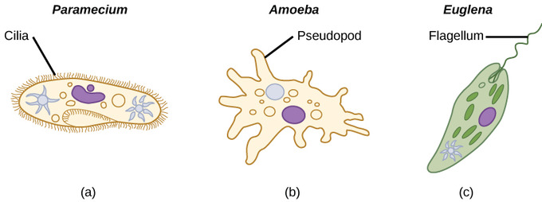
Characteristics of Protists
Motility
Majority of protists have motility
Download for free at http://cnx.org/contents/185cbf87-c72e-48f5-b51e-f14f21b5eabd@10.61

Slide 47
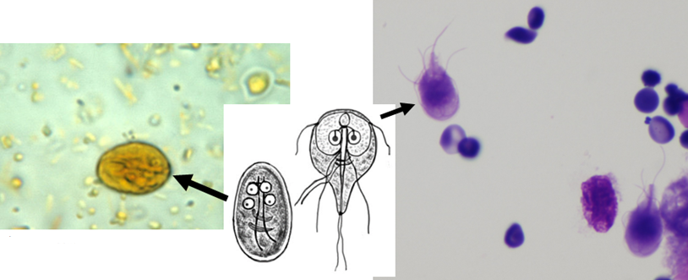
Giardia lamblia
First picture: Caption: Giardia lamblia cyst. Iodine stain (c)CDC, Public domain
Second picture: Caption: Giardia lamblia (G. intestinalis) imago and cystis (c) CDC/Alexander J. da Silva, PhD/Melanie Moser, Public domain
Third picture: Caption: Giardia lamblia seen in a cytologic preparation (cytospin of formalin from small bowel biopsy of a patient with giardia)
(c) Jerad M Gardner, MD, CC BY-SA 3.0

Slide 48
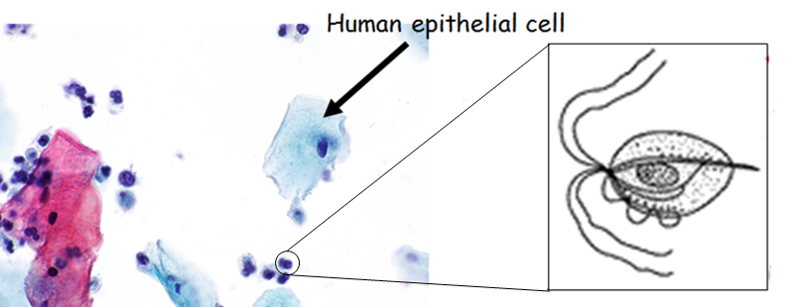
Trichomonas vaginalis
First picture: Caption: Micrograph showing trichomonas on a Pap test (c)Nephron, CC BY-SA 3.0
Second picture: Caption: Trichomoniasis: life cycle of Trichomonas vaginalis (c)CDC, Public domain

Slide 49
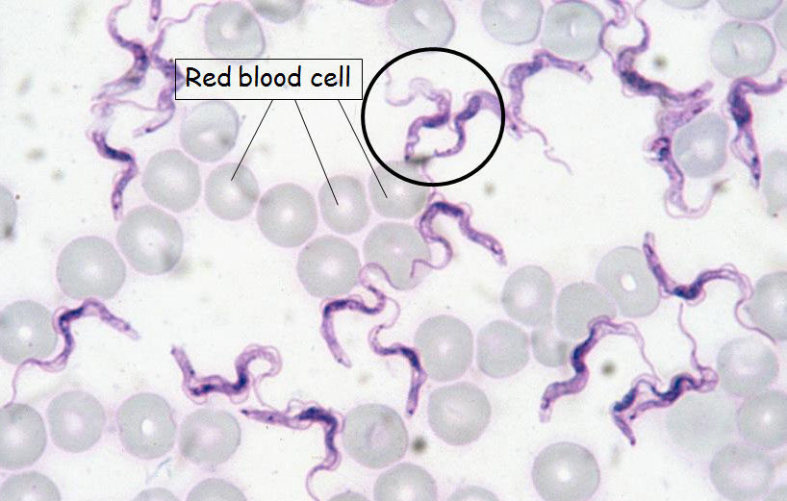
Euglena
Mixotroph, have primitive ocular organ called an eyespot guides them towards light sources
Trypanosoma
Parasite- transmitted by insects
Blood borne disease (causes diseased such as African Sleeping Sickness)
First picture: Caption: Euglena sp., a diagrammatic drawing (c) Alexei Kouprianov, CC BY-SA 3.0
Second picture: Caption: Trypanosoma evansi protozoa (c)Alan R. Walker, CC BY-SA 3.0

Slide 50
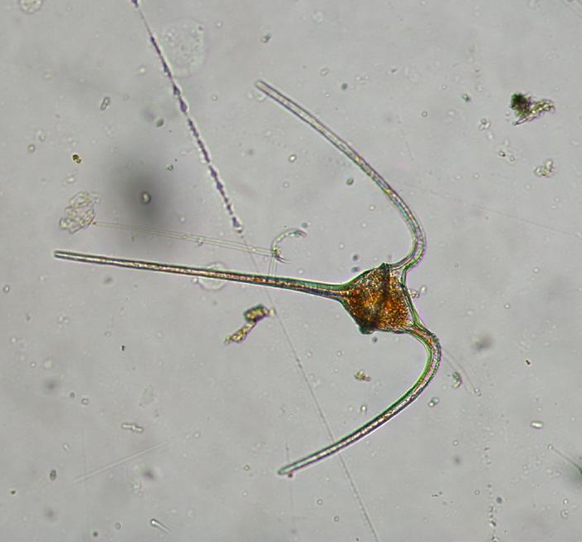
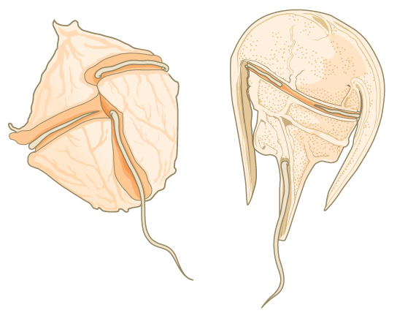
Ceratium
First picture: Download for free at http://cnx.org/contents/185cbf87-c72e-48f5-b51e-f14f21b5eabd@10.61
Second picture: caption: Ceratium sp. (Dinophyta) (c) Keisotyo, CC BY-SA 3.0

Slide 51
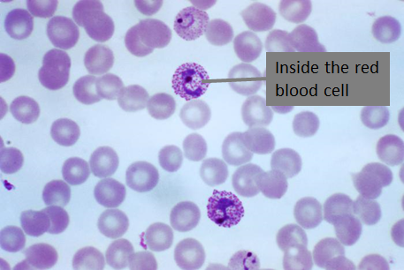
Plasmodium (causes malaria)
Complex life cycle in the mosquito and human
caption: Immature and mature trophozoites of the Plasmodium vivax parasite PHIL 2720 lores (c) CDC/ Dr. Mae Melvin, Public domain

Slide 52
Vaccines are still needed against many diseases
Vaccines that are available need to be administered
There are people that are choosing not to vaccinate……could potentially create scary scenario in future

Slide 53
Misconceptions about Vaccines
“Diseases had already begun to disappear before vaccines were introduced, because of better hygiene and sanitation.”
“The majority of people who get the disease have been vaccinated.”
“Vaccines cause harmful side effects, illnesses, and even death – not to mention possible long-term effects we don’t even know about.”
“Vaccine-preventable diseases have been virtually eliminated from my country, so there is no need for my child to be vaccinated.”
“Giving a child multiple vaccinations for different disease at the same time increases the risk of harmful side effects and can overload the immune system.”
“Vaccines introduce foreign DNA into our cells therefore changing us.”
Many of these misconceptions arise due to various reasons:
Lack of knowledge of how the immune system works
Lack of knowledge that every living thing (including things we eat) have DNA
Lack of knowledge of how vaccines are made
Lack of knowledge of the ingredients (i.e. assuming all mercury is the same)
Lack of knowing anyone in their family who has died of one of these diseases
Thanks to vaccinating!!!!!!!!!!!!!!!!!!!!

Slide 55
Smallpox
Variola virus
Highly contagious, causes rash and flur like symptoms
Kills about 30% of people infected
Leaves scars, can cause blindness
Polio
Poliovirus
Highly contagious, Fever, flu like symptoms, vomiting
Can cause paralysis, muscle weakness in those that survive
10% of children who are infected could die due to respiratory muscle weakness
Measles
Measles virus
Highly contagious, Fever, rash, cough, runny nose
Can lead to pneumonia, infertility
1 out of 1000 cases in children can lead to encephalitis, death rates higher in adults
Whooping cough
Caused by bacteria, Bordetella pertussis
Highly contagious, Fever, cough
Diptheria
Caused by bacteria, Corynebacterium diptheriae
Highly contagious, Difficulty breathing, heart failure, paralysis
Even if you don’t have symptoms, you are contagious
20% death rate in children, 10% in adults

