Slide 1
Annelids,
Molluscs
BSC 2011L

Slide 2
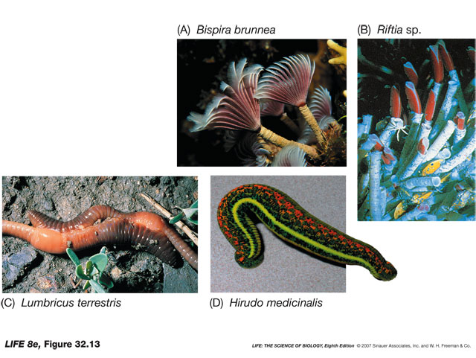
Phylum Annelida
Segmented worms
Circular and longitudinal muscles work against fluid filled coelom to produce changes in width and length
Digestion – complete
Circluation – closed (5 lateral hearts)

Slide 3
Phylum Annelida
Class Oligiochaeta
  Earthworms
  Found in soil
  Can reach 3 meters!

Slide 4
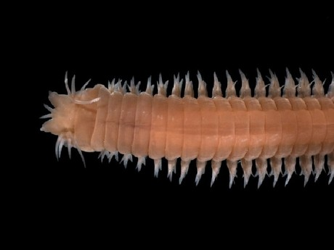
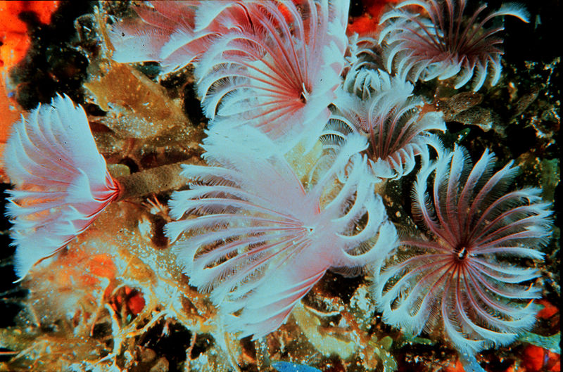
Phylum Annelida
Class Polychaeta
  Sand worms, feather dusters
  Almost all marine
  Live in substrate

Slide 5
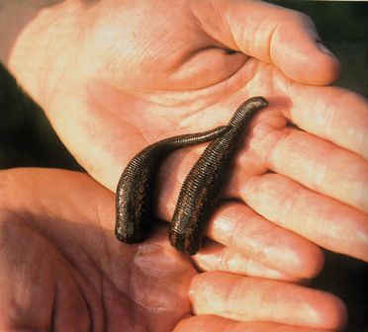
Phylum Annelida
Class Hirudinea
  Leeches
  “bloodsuckers”

Slide 6
Phylum Annelida
Class Oligiochaeta
Animal: Earthworm
Symmetry: Bilateral
Body cavity: coelomate – protostome
Digestion: complete – mouth, esophagus, crop, gizzard, etc
Circulation: closed, 5 hearts
Segmentation: yes
Appendages: none
Nervous: dorsal brain, ventral nerve cord
Habitat: moist soils
Respiration: diffusion through body surface
Excretion: 2 lateral tubes
Locomotion: circular and longitudinal muscles, setae
Support: hydrostatic skeleton

Slide 7
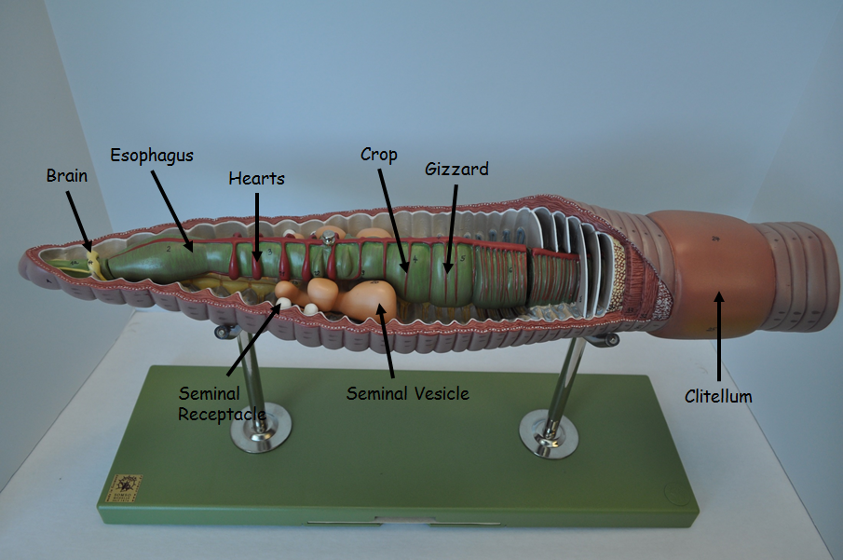
Earthworm model

Slide 8
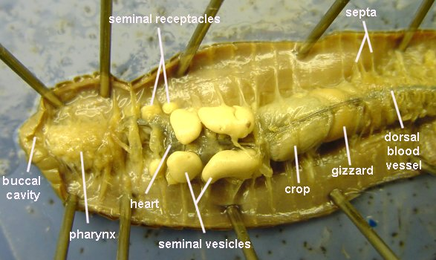
Earthworm Dissection

Slide 9
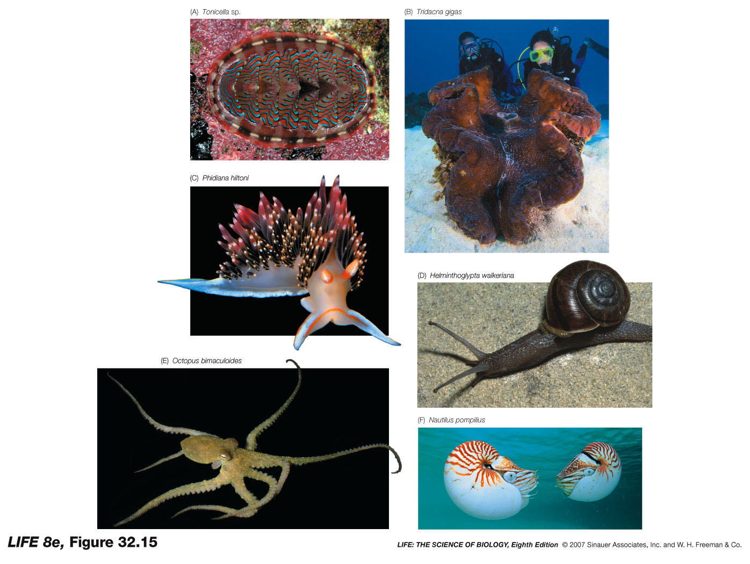
Phylum Mollusca
Mostly marine but some are freshwater and terrestrial
3 part body
  Muscular foot – locomotion
  Visceral mass – internal organs
  Mantle – encloses visceral mass and may secrete shell
Digestion – complete
Circulation – open (except for cephalopods that are closed)

Slide 10
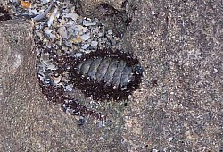
Phylum Mollusca
Class Polyplacophora
  “many plated”
  Chitins

Slide 11
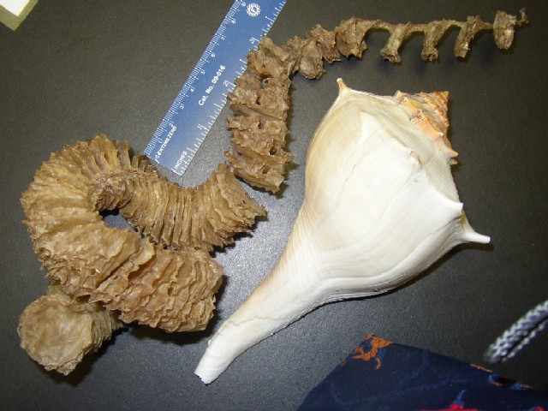
Phylum Mollusca
Class Gastropoda
  “stomach foot:

Slide 12
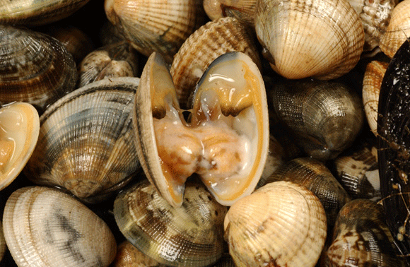
Phylum Mollusca
Class Bivalvia

Slide 13
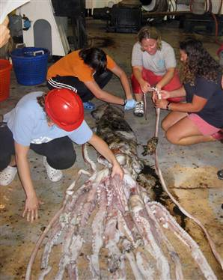
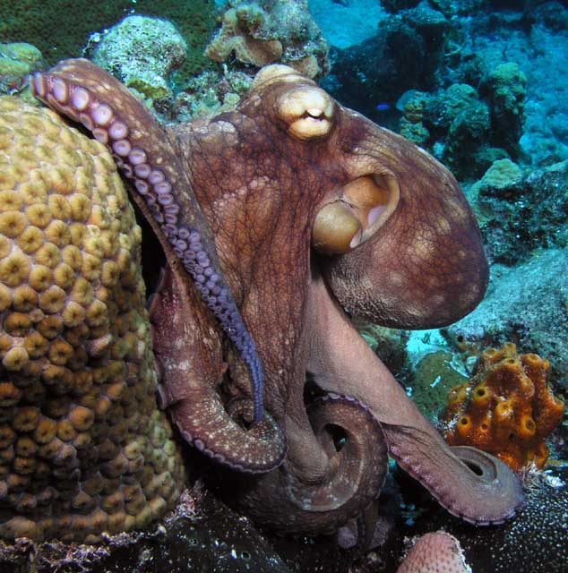
Phylum Mollusca
Class Cephalopoda
  “Head-foot”

Slide 14
Phylum Mollusca
Class Bivalvia
Animal: Clam
Symmetry: bilateral
Body cavity: coelomate – protostome
Digestion: complete, filter feeders
Circulation: open, blue blood, heart, blood vessels
Segmentation: none
Appendages: none
Nervous: 3 ganglia connected by nerves
Habitat: aquatic
Respiration: gills
Excretion: nephridia in kidney
Locomotion: muscular foot
Support: shell

Slide 15
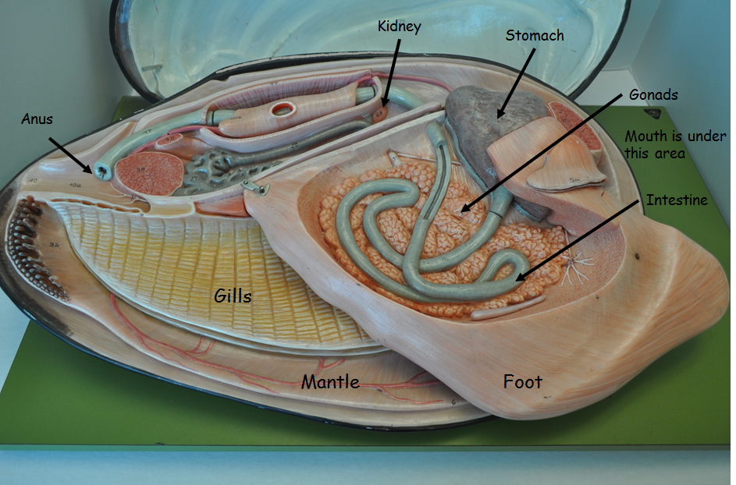
Clam model

Slide 16
Phylum Mollusca
Class Cephalopoda
Animal: squid
Symmetry: bilateral
Body cavity: coelomate – protostome
Digestion: complete, beak jaws
Circulation: closed, 3 hearts
Segmentation: none
Appendages: 8 arms, 2 tentacles
Nervous: brain of 3 fused ganglia, eye
Habitat: aquatic
Respiration: gills
Excretion: nephridia in kidney
Locomotion: muscular mantle, jet propulsion
Support: shell reduced to pen

Slide 18
